Slide 1

Spatial and Temporal Variation of the Anthropogenic Radionuclides
Cs-137 and Cs-134 in Ground-Level Air Samples by IMS Stations
Located on the African Continent
Ms. Dorice Rashid Seif¹ and Mr. Martin Kalinowski²
¹ Ministry of Education, Science and Technology
² CTBTO
P2.4-307

Slide 2
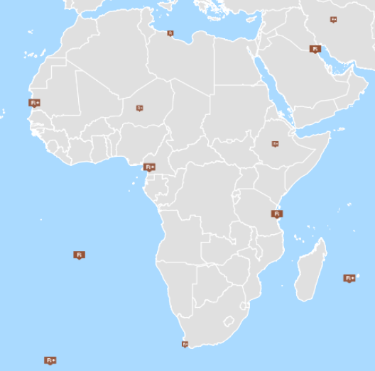
Spatial and Temporal Variation of the Anthropogenic Radionuclides Cs-137 and Cs-134 in Ground-Level Air Samples by IMS Stations Located on the African Continent
Ms. Dorice Rashid Seif, Ministry of Education, Science and Technology; United Republic of Tanzania, doricers85@gmail.com
Mr. Martin Kalinowski, CTBTO
P2.4-307
Anthropogenic radionuclides of fission and activation products are frequently detected by most IMS stations located on the African continent with varying concentrations. This study assesses the spatial and temporal variation of Cs-134 and Cs-137 in ground-level air at IMS stations located in Tanzania (6.8 S, 39.2 E), Mauritania (18.1 N, 15.9 W), Cameroon (3.8 N, 10.2 E) and Niger (17.04 N, 8.04 E) from 2011 to 2020. Spatial and temporal base analysis was performed to discern various patterns of these radionuclides. The regression analysis for Cs-134 and Cs-137 activity concentrations together with number of meteorological parameters revealed that the relative humidity, rainfall, air temperature, and wind speed, significantly affect radionuclides activity concentrations in ground level air samples.
43
48
ABSTRACT
13
64

Slide 3
Spatial and Temporal Variation of the Anthropogenic Radionuclides Cs-137 and Cs-134 in Ground-Level Air Samples by IMS Stations Located on the African Continent
Ms. Dorice Rashid Seif, Ministry of Education, Science and Technology; United Republic of Tanzania, doricers85@gmail.com
Mr. Martin Kalinowski, CTBTO
P2.4-307
The International Monitoring System (IMS) developed by the Comprehensive Nuclear-Test-Ban Treaty Organization (CTBTO) is a global system of monitoring stations, using four complementary technologies: The International Monitoring System (IMS) developed by Comprehensive Nuclear Test Ba seismic, hydroacoustic, infrasound and radionuclide The radionuclide network comprises 80 stations, of which more than 60 are certified. The aim of radionuclide stations is a global monitoring of radioactive aerosols and radioactive noble gases. Stations monitor various radioactive aerosols but Cs134 and Cs137 are two anthropogenic radionuclides which are detected by IMS Stations located in African Continent including Tanzania (6.8 S, 39.2 E), Mauritania (18.1 N, 15.9 W), Cameroon (3.8 N, 10.2 E) and Niger (17.04N, 8.04 E) for the past 10 years (2011 - 2020).
Anthropogenic radionuclides have been injected into the atmosphere by nuclear weapon tests (NWT) in the fifties, sixties and seventies, the burn-up of the SNAP-9A satellite as well as accidents from nuclear power plants such as Chernobyl (1986) and Fukushima (2011).
Radioactive debris became rapidly attached to ambient aerosol particles, which determined the mechanisms governing their atmospheric transport. In the troposphere, dry and wet deposition removes most contaminants within a few weeks to months. In the stratosphere, mean residence time for radioactive debris is longer due to the thermal stratification and separation from the troposphere by the tropopause and the smaller size distribution of the aerosols (Martell, E. A 1966). This study assesses Cs-134 and Cs-137 10-year temporal variation
in ground-level air at IMS stations widely spread over the African Continent.
The study provides insight into the connection of anthropogenic radionuclide concentration levels in ground-level air with meteorological phenomena over the areas under investigations. It also discusses the results in view of the very few possible sources of anthropogenic radioactivity located in Africa, because for effective nuclear explosion monitoring it is important to understand the observed background. The African continent is rarely studied for this purpose and this presentation intends to fill that gap. For effective nuclear explosion monitoring it is important to understand the observed background of CTBT-relevant radionuclides.
INTRODUCTION

Slide 4
Spatial and Temporal Variation of the Anthropogenic Radionuclides Cs-137 and Cs-134 in Ground-Level Air Samples by IMS Stations Located on the African Continent
Ms. Dorice Rashid Seif, Ministry of Education, Science and Technology; United Republic of Tanzania, doricers85@gmail.com
Mr. Martin Kalinowski, CTBTO
P2.4-307
DATA COLLECTION
The data series for activity concentration of ¹³⁴Cs and ¹³⁷Cs for all IMS Radionuclide Stations located in African Continent from 2011 to 2020 were retrieved from the CTBTO Concentration Reporting Tool (CRTool) and analyzed in combination with meteorological parameters.
Daily precipitation/Rainfall data from the Climate Hazards Group InfraRed Precipitation with Stations (CHIRPS) at high-resolution (4km) were used in the analysis at grid resolution of 0.05 degree from the European Centre for Medium - Range Weather Forecasts (ECMWF).
Re-Analysis data fifth generation (ERA5) covering the duration from 2011 to 2020 for air temperature, relative humidity, the zonal and meridional wind components were used in the analysis.
STATISTICAL DATA ANALYSIS
Time series analysis for ¹³⁴Cs and ¹³⁷Cs activity concentration were plotted and changes in their values were analyzed in terms of their meteorological parameters.
Linear regression analysis was employed to examine the influence of air temperature, relative humidity, rainfall and wind speed on variability of ¹³⁴Cs and ¹³⁷Cs by using the R-programing tool, which provides a language and environment for statistical computing (R Core Team 2021) .
The coefficient of correlation (r) between the variables in Linear Regression was examined using critical probability (p) value with significance
level (α) = 0.05 such that for p < 0.05 the statistic modal was significant and for p > 0.05 the modal was not significant
METHODS

Slide 5
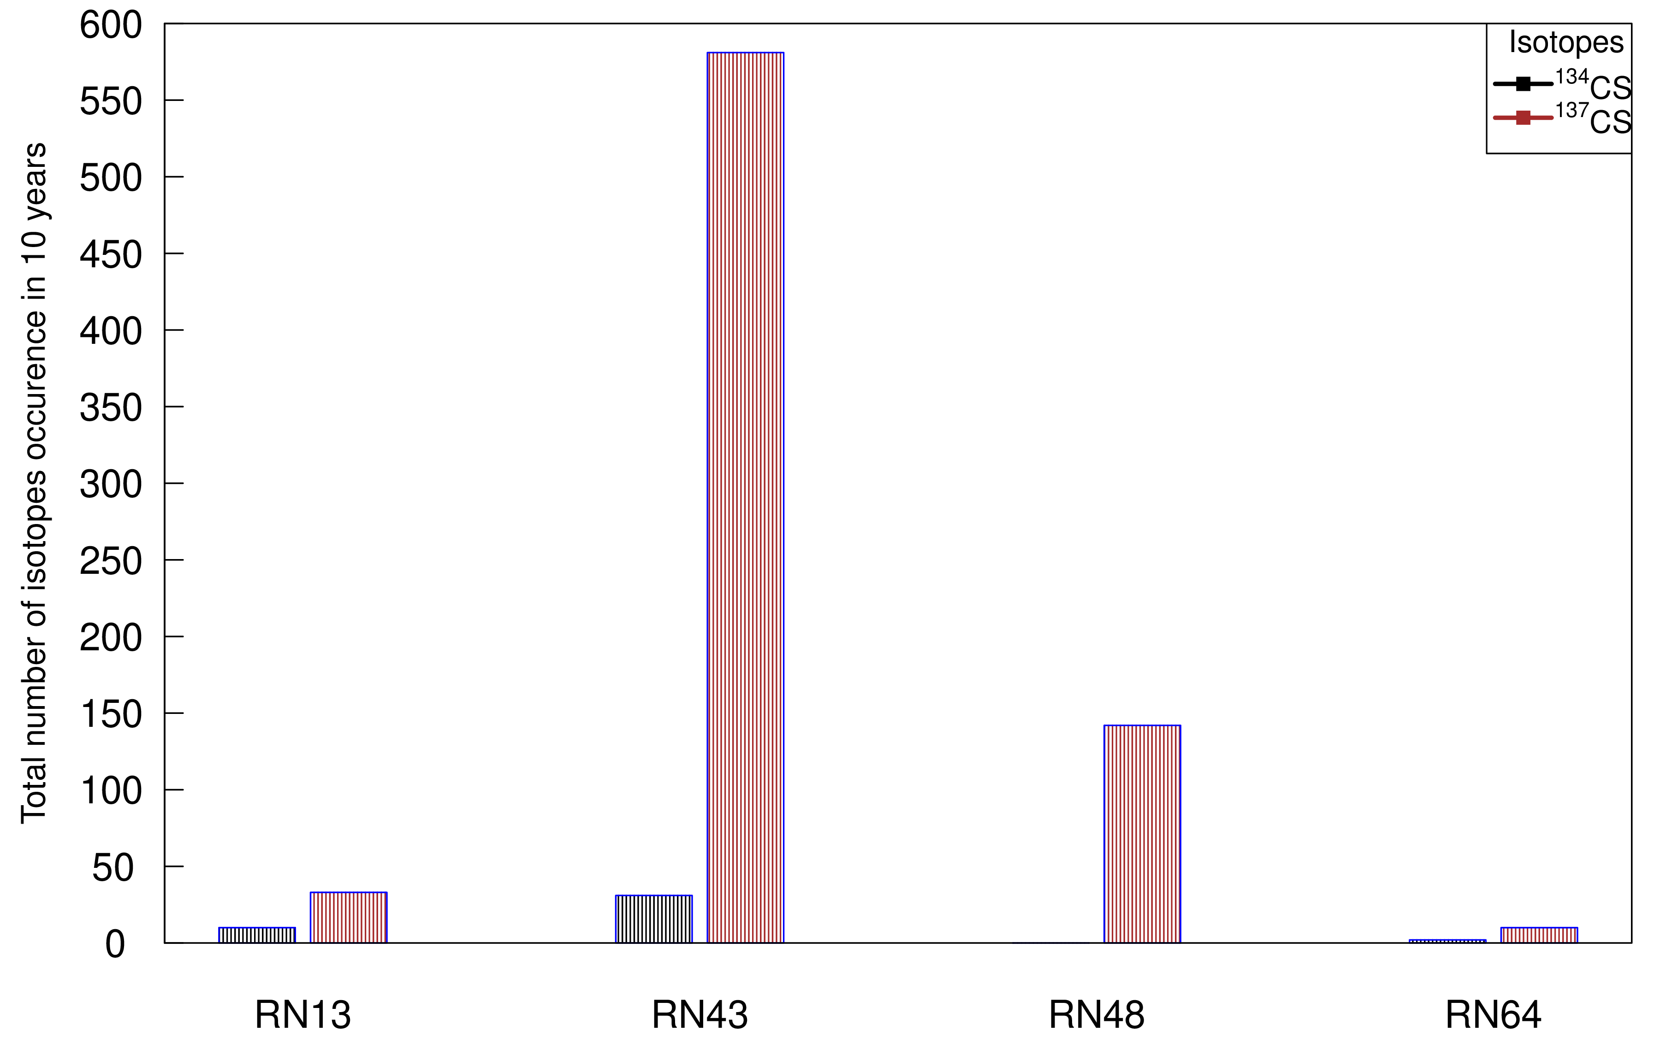
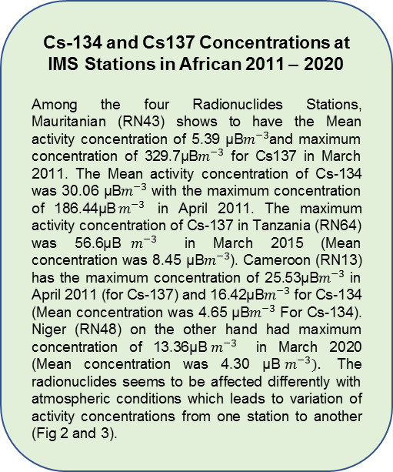
Spatial and Temporal Variation of the Anthropogenic Radionuclides Cs-137 and Cs-134 in Ground-Level Air Samples by IMS Stations Located on the African Continent
Ms. Dorice Rashid Seif, Ministry of Education, Science and Technology; United Republic of Tanzania, doricers85@gmail.com
Mr. Martin Kalinowski, CTBTO
P2.4-307
Regional distribution of the number of detections of Cs-134 and Cs137 at IMS Stations located in African Continent from 2011 - 2020
Fig. 1 shows the different occurrence frequencies of Cs134 and Cs137 at the four IMS stations located in African Continent for the past 10 years. The only station on the Southern Hemisphere has the lowest frequency of detections.
Fig. 1. Total number of occurrence of Cs 134 and Cs 137 (2011 – 2020)
Cs-134 and Cs137 Concentrations at IMS Stations in African 2011 – 2020
Among the four Radionuclides Stations, Mauritanian (RN43) shows to have the Mean activity concentration of 5.39 µB$m^{−3}$and maximum concentration of 329.7µB$m^{−3}$ for Cs137 in March 2011. The Mean activity concentration of Cs-134 was 30.06 µB$m^{−3}$ with the maximum concentration of 186.44µB$m^{−3}$ in April 2011. The maximum activity concentration of Cs-137 in Tanzania (RN64) was 56.6µB$m^{−3}$ in March 2015 (Mean concentration was 8.45 µB$m^{−3}$). Cameroon (RN13) has the maximum concentration of 25.53µB$m^{−3}$ in April 2011 (for Cs-137) and 16.42µB$m^{−3}$ for Cs-134 (Mean concentration was 4.65 µB$m^{−3}$ For Cs-134). Niger (RN48) on the other hand had maximum concentration of 13.36µB$m^{−3}$ in March 2020 (Mean concentration was 4.30 µB$m^{−3}).$ The radionuclides seems to be affected differently with atmospheric conditions which leads to variation of activity concentrations from one station to another (Fig 2 and 3).
RESULTS

Slide 6
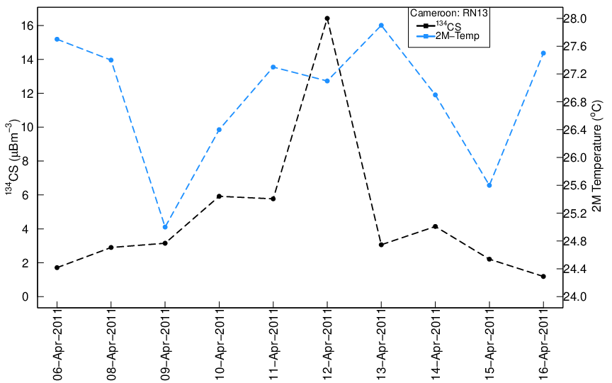
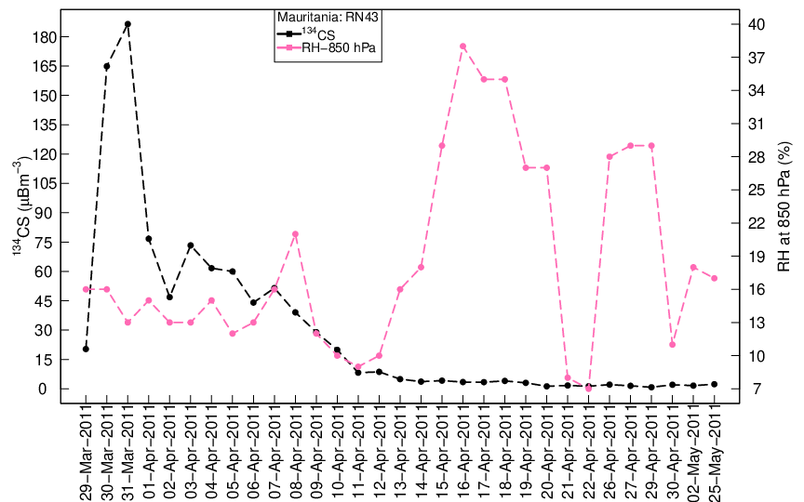
Spatial and Temporal Variation of the Anthropogenic Radionuclides Cs-137 and Cs-134 in Ground-Level Air Samples by IMS Stations Located on the African Continent
Ms. Dorice Rashid Seif, Ministry of Education, Science and Technology; United Republic of Tanzania, doricers85@gmail.com
Mr. Martin Kalinowski, CTBTO
P2.4-307
Trend of Cs134
It has been observed that particulate born radioactivity from Fukushima lasted for about 3 months. For that case, it is evident that the detected Cs134 in most IMS stations from March to June 2011 can be regarded as the period with influence from Fukushima as it is illustrated in Fig.2.
RESULTS
Fig 2. Trend of Cs 134 with Meteorological Parameters for RN13 and RN43

Slide 7
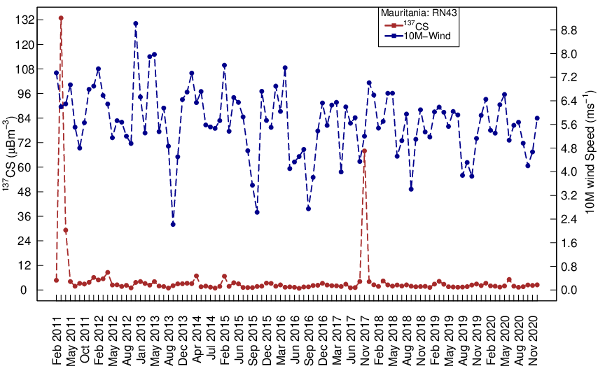
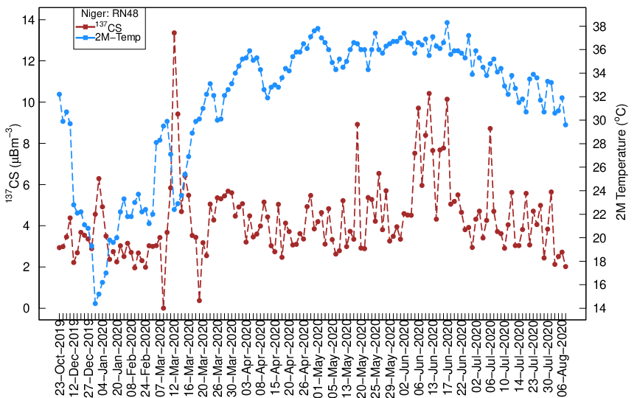
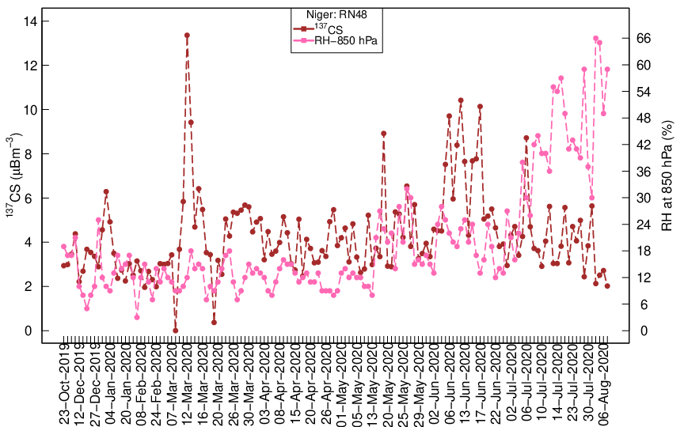
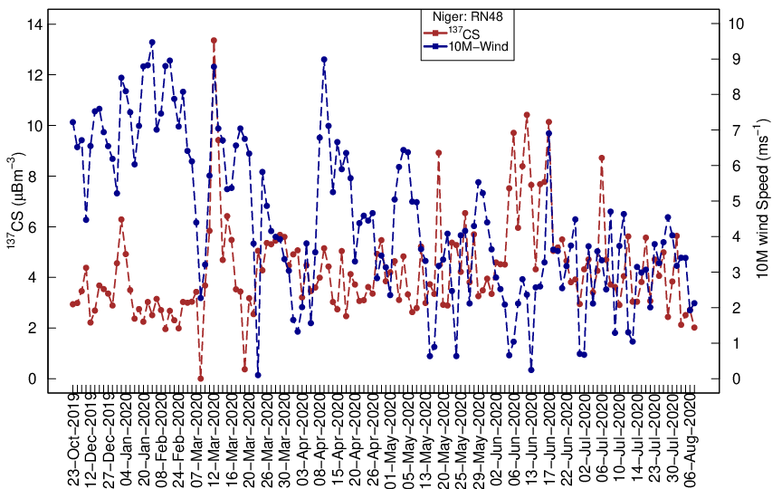
Spatial and Temporal Variation of the Anthropogenic Radionuclides Cs-137 and Cs-134 in Ground-Level Air Samples by IMS Stations Located on the African Continent
Ms. Dorice Rashid Seif, Ministry of Education, Science and Technology; United Republic of Tanzania, doricers85@gmail.com
Mr. Martin Kalinowski, CTBTO
P2.4-307
Variation of Cs-137 with Meteorological Parameters
Radioactive particles were transported by wind from the area with high background of Cs134 and Cs-137 to the respective stations. Though other factors like humidity, air temperature may influence its variations. Fig 3 shows clearly that the increase or decrease of Cs 137 is due to variation of meteorological parameters in a respective station.
RESULTS
Fig 3. Variation of Cs 137 with Meteorological Parameters

Slide 8
Spatial and Temporal Variation of the Anthropogenic Radionuclides Cs-137 and Cs-134 in Ground-Level Air Samples by IMS Stations Located on the African Continent
Ms. Dorice Rashid Seif, Ministry of Education, Science and Technology; United Republic of Tanzania
Mr. Martin Kalinowski, CTBTO; Vienna, Austria
P2.4-307
Correlation between Cs-134 and Cs-137 with Meteorological Parameters.
The relationship between air temperature, relative humidity, wind speed and rainfall with activity concentrations of Cs-134 and Cs-137 activity for 10 years
(2011 –2020) were investigated. Due mismatching of data, Cs-134 and Cs-137 was not correlated (i.e. the occurrence of Cs-134 was independent to that of Cs-137 in all station) From Fig 4, the activity concentration of Cs-137 tends to decrease with the increase in wind speed (RN13: r_{xy}=-0.41; p <0.05, RN48: r_{xy}=-0.18; p<0.05) and increases with the increase in air temperature (RN48: r_{xy}=0.2; p<0.05) while the activity concentration of Cs134 increases with the increase in temperature (RN43: r_{xy}=0.41; p<0.05). Rainfall affects both radionuclides in surface air due to low pressure system that brings rain coming from the wind direction that dominates when radiocesium is detected (Fig 5).
Wind seems to be a dominant parameter affecting radionuclides concentration in surface air (Fig.5). The correlation with wind speed indicates that the source is unlikely to be resuspension of deposit in the region where the station is. Instead, the detected Cs-137 is mainly from remote sources; mainly from nuclear tests and possibly also from Chernobyl.
RESULTS

Slide 9
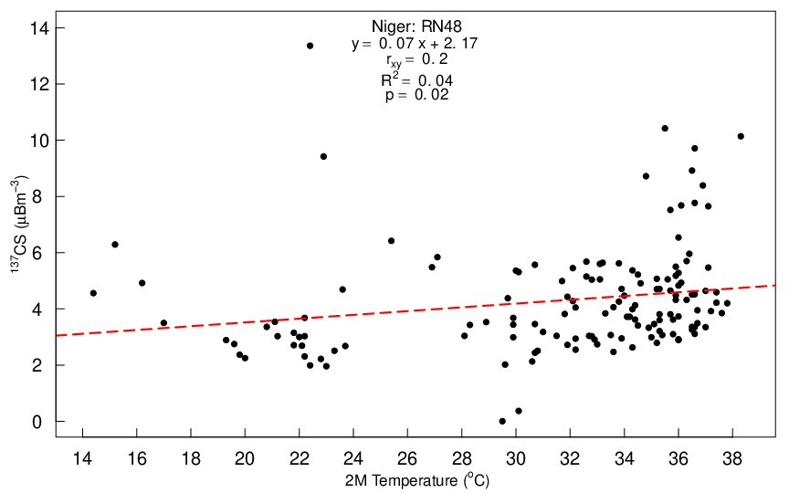
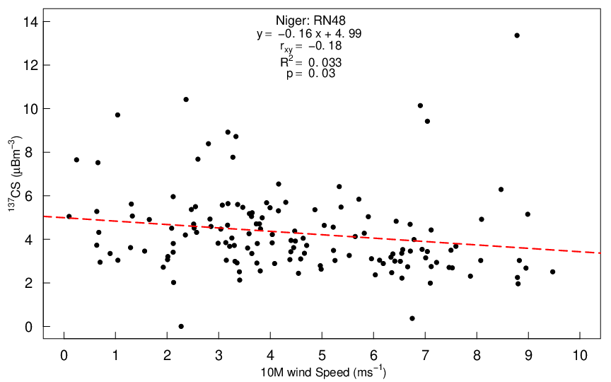
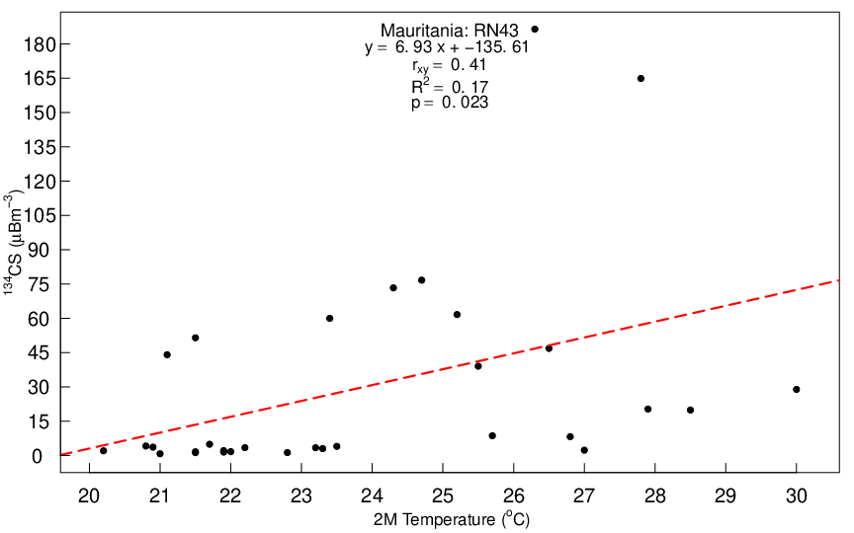
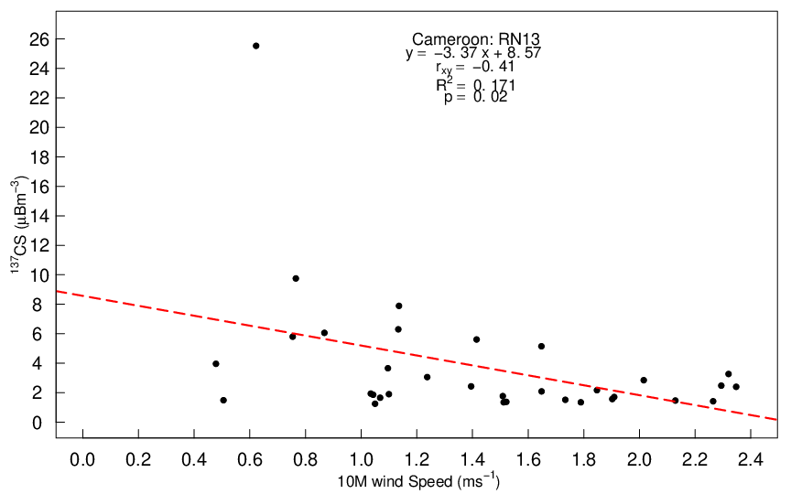
Spatial and Temporal Variation of the Anthropogenic Radionuclides Cs-137 and Cs-134 in Ground-Level Air Samples by IMS Stations Located on the African Continent
Ms. Dorice Rashid Seif, Ministry of Education, Science and Technology; United Republic of Tanzania
Mr. Martin Kalinowski, CTBTO; Vienna, Austria
P2.4-307
RN43 experienced dominant wind blowing from North to East with the average speed of 2.99 m/s (For Cs-134) and 5.30 m/s for Cs-137 whose dominant wind blows in South East and North East. RN13 on the other hand experienced dominant wind blowing from North to East with the average speed of 0.7 m/s (For Cs-134) and 1.5 m/s for
Cs-137.
RESULTS
Fig 4. Correlation between Cs-137 and Cs-134 with Meteorological Parameters

Slide 10
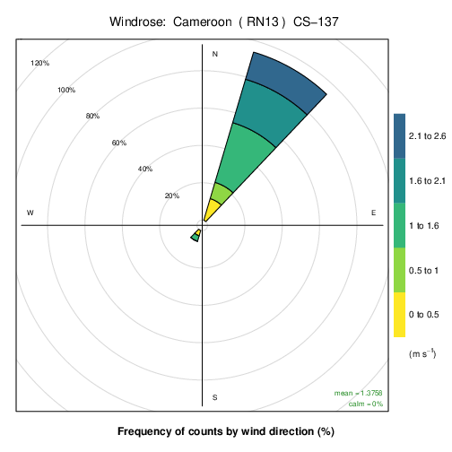
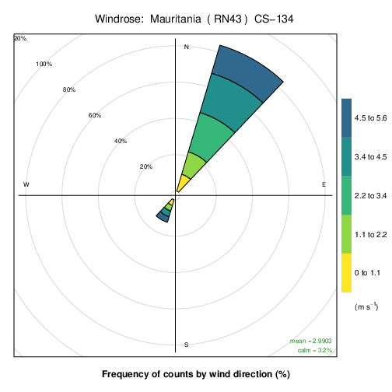
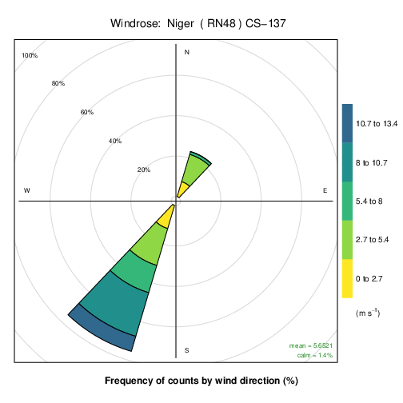

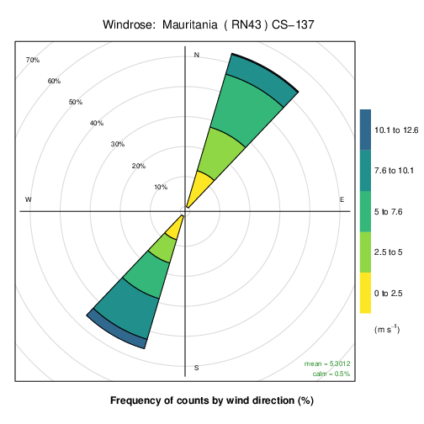
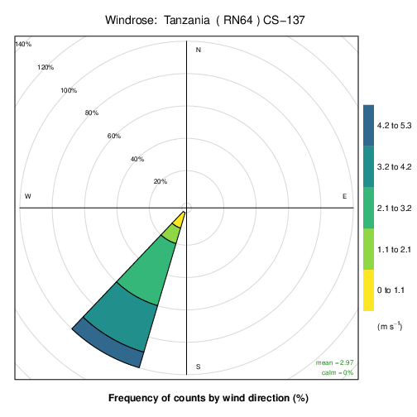
Spatial and Temporal Variation of the Anthropogenic Radionuclides Cs-137 and Cs-134 in Ground-Level Air Samples by IMS Stations Located on the African Continent
Ms. Dorice Rashid Seif, Ministry of Education, Science and Technology; United Republic of Tanzania, doricers85@gmail.com
Mr. Martin Kalinowski, CTBTO; Vienna, Austria
P2.4-307
RESULTS
Fig 5. Wind Trends

Slide 11
Spatial and Temporal Variation of the Anthropogenic Radionuclides Cs-137 and Cs-134 in Ground-Level Air Samples by IMS Stations Located on the African Continent
Ms. Dorice Rashid Seif, Ministry of Education, Science and Technology; United Republic of Tanzania, doricers85@gmail.com
Mr. Martin Kalinowski, CTBTO; Vienna, Austria
P2.4-307
Based on the very narrow wind rose related to radiocesium observations, it can be assumed that the anthropogenic radionuclides are not originating the vicinity of the stations. Instead, they were transported by wind from remote sources; most likely from the nuclear tests conducted in Northern Africa and maybe also from Chernobyl as a result of high activity concentration of
Cs-137 in RN43 when compared to other stations
It is also clear that any Cs (especially the Cs-134) from March to June 2011 (maybe until end of 2011) timeframe was due to the Fukushima release.
RN48 experienced dominant wind blowing from South to West with the average speed of 5.65 m/s (For Cs-137).
RN64 experienced dominant wind blowing from South to West with the average speed of 2.97 m/s (For Cs-137).
RESULTS

Slide 12
Spatial and Temporal Variation of the Anthropogenic Radionuclides Cs-137 and Cs-134 in Ground-Level Air Samples by IMS Stations Located on the African Continent
Ms. Dorice Rashid Seif, Ministry of Education, Science and Technology; United Republic of Tanzania, doricers85@gmail.com
Mr. Martin Kalinowski, CTBTO; Vienna, Austria
]
  P2.4-307
For effective nuclear explosion monitoring it is important to understand the observed background of CTBT relevant radionuclides. This study assesses the spatial and temporal variation of anthropogenic radionuclides Cs-134 and Cs-137 in ground level air samples by IMS Stations located in African Continent. Radionuclide data together with meteorological data were used to investigate the mechanism that govern radionuclides concentration level in surface air. Results revealed that the detected Cs-137 was most likely not originating from the vicinity of the stations but instead it was transported by wind from remote sources, most likely from nuclear tests in North Africa and maybe also from Chernobyl. Obviously, the detected Cs-134 in most IMS stations from March to June 2011 can be regarded as the period with influence from Fukushima.
REFERENCES
"R Core Team (2021) R. A language and environment for statistical computing. R Foundation for Statistical Computing, Vienna, Austria. URL https://www.R-project.org/."
Martell, E. A (1966).The size distribution and interaction of radioactive and natural aerosols in the stratosphere. Tellus XVIII, 486–498
CONCLUSIONS

