Slide 1

Producing High Quality Digitizations from Historical Analog
Seismograms of Nuclear Explosions
Kaitlynn Burkhard, Daniel Burk, Kevin Mackey
P2.5-443
Department of Earth and Environmental Sciences, Michigan State University, East Lansing, MI, USA

Slide 2
Producing High Quality Digitizations from Historical Analog
Seismograms of Nuclear Explosions
Kaitlynn Burkhard, Daniel Burk, Kevin Mackey
Department of Earth and Environmental Sciences, Michigan State University, East Lansing, MI, USA
P2.5-443
The recovery and digitization of legacy seismogram waveforms is critical for research of historical events in nuclear monitoring. We are improving the digitization process by applying an interpolation algorithm and examining the frequency recovery of the potential records. The implementation of a Piecewise Cubic Hermite Interpolating Polynomial (PCHIP) interpolation algorithm improves the quality of the digitization and minimizes the amount of distortion. We quantify the effectiveness of scan density by the ease of digitization and waveform accuracy. Low scan resolutions adversely affect waveform accuracy and ultimately the frequency recovery. This is demonstrated in a synthetic ‘white noise’ seismogram that emulates an analog record. The synthetic signal is converted to numerous scan resolutions then digitized. After digitization, the digital seismograms are compared back to the original synthetic seismogram. Preliminary results indicate that a 200 DPI image can recover signals up to about 3 Hz whereas a 600 DPI image can recover up to about 8 Hz, assuming an original recording speed of 60 mm/minute and a short period sensor. Additional analog seismogram parameters such as line width, signal contrast, and signal amplitude all factor into the overall quality and waveform accuracy of digitized data.
ABSTRACT

Slide 3
Producing High Quality Digitizations from Historical Analog
Seismograms of Nuclear Explosions
Kaitlynn Burkhard, Daniel Burk, Kevin Mackey
Department of Earth and Environmental Sciences, Michigan State University, East Lansing, MI, USA
P2.5-443
Digitization of legacy seismograms are becoming more important because they are at high risk for loss. Data from these seismograms contain vital information of worldwide nuclear tests and important large earthquakes.
Numerous projects within the seismological community have started to preserve, scan, and digitize analog seismograms. Successful digital recovery and usage of these signals is based on the accurate and complete recovery of information from the analog seismogram. Unfortunately, there are no standards or recommendations of how to achieve accurate digitizations. For example, if we wanted to recover a 2 Hz signal on a 60mm/minute recording seismometer, what is the image resolution we need to capture the most accurate translation?
This study starts the investigation for proposed standards of analog seismogram digitization. This poster initially addresses the frequency recovery and scan resolution.
INTRODUCTION

Slide 4
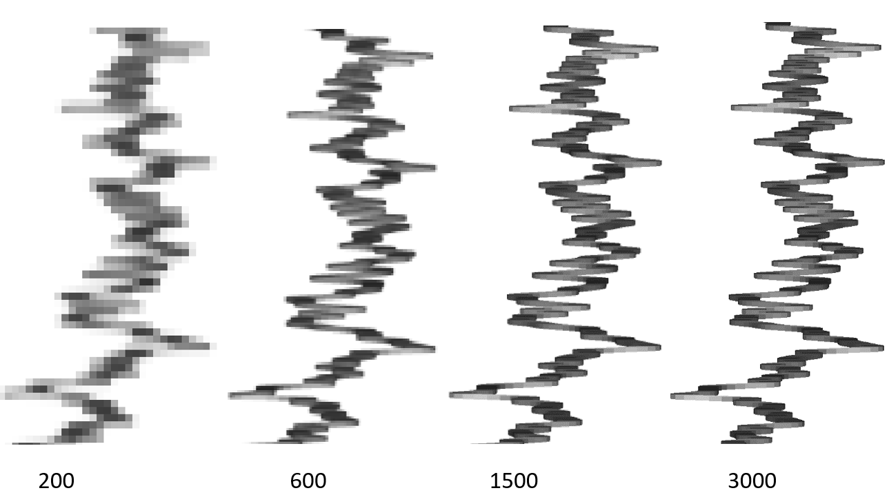
Producing High Quality Digitizations from Historical Analog
Seismograms of Nuclear Explosions
Kaitlynn Burkhard, Daniel Burk, Kevin Mackey
Department of Earth and Environmental Sciences, Michigan State University, East Lansing, MI, USA
P2.5-443
Scan Resolution (DPI, Pixels per Inch)
  Higher DPI → Higher pixel density
  Lower DPI → Lower pixel density
  As DPI decreases, pixels become larger and coarser. This raises the uncertainty for selecting inflection points in the digitization process.
  If DPI is too low, it can cause distortions in the
  General shape
  Seismogram timing
  Frequency recovery
Scanned seismogram at different DPIs
INTRODUCTION
Level of uncertainty grows as DPI decreases
x axis = amplitude y axis = time

Slide 5

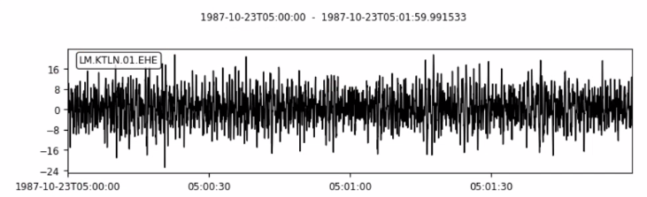
Producing High Quality Digitizations from Historical Analog
Seismograms of Nuclear Explosions
Kaitlynn Burkhard, Daniel Burk, Kevin Mackey
Department of Earth and Environmental Sciences, Michigan State University, East Lansing, MI, USA
P2.5-443
Seismic Data
Synthetic seismograms were used to emulate analog records in the displacement and velocity domains
Signals were generated with specified frequencies and factors such as amplitude and signal thickness can be quantified
Generated waveforms could be saved as a Miniseed file and can be drawn as an overlay trace on a 3000 DPI scan of a paper seismogram
METHODS
Synthetic seismogram with a frequency of 1-12 Hz.
Portion of an overlaid trace on a scanned 3000 DPI paper seismogram.

Slide 6
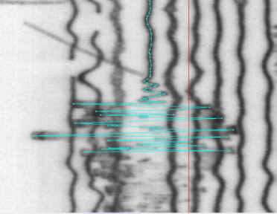
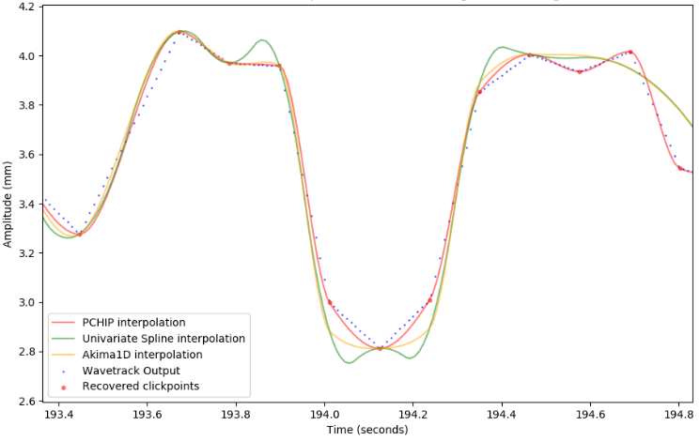
Producing High Quality Digitizations from Historical Analog
Seismograms of Nuclear Explosions
Kaitlynn Burkhard, Daniel Burk, Kevin Mackey
Department of Earth and Environmental Sciences, Michigan State University, East Lansing, MI, USA
P2.5-443
Digitization Method
Digitized seismograms in a manual program called Wavetrack (see P2.5-594 Malovichko et al. for details on the digitization process)
Post processing interpolation of Piecewise Cubic Hermite Interpolating Polynomial (PCHIP) gave the best signal estimation after testing multiple interpolation methods
We used a blind digitization method where multiple technicians digitized waveforms and were unaware of the goal of this study.
METHODS
Left: Analog seismogram in Wavetrack. Blue trace is digitized waveform.
Right: Testing of multiple interpolation methods.

Slide 7




Producing High Quality Digitizations from Historical Analog
Seismograms of Nuclear Explosions
Kaitlynn Burkhard, Daniel Burk, Kevin Mackey
Department of Earth and Environmental Sciences, Michigan State University, East Lansing, MI, USA
P2.5-443
To demonstrate how scan resolution affects frequency recovery, we generated 2 Hz sine waves displayed at different scan resolutions to understand how the scan resolutions affect frequency recovery and waveform distortion. From the figures below, low DPI values force the digitization procedures to select ‘off peak’ locations, distorting the resulting waveform. The same concept illustrates poor frequency recovery from seismograms scanned at low resolution.
RESULTS
150 DPI
600 DPI
DPI can cause variations in the peak to peak spacing. The ambiguity in the true peak location results in asymmetric waveforms.
Wider
Narrower

Slide 8
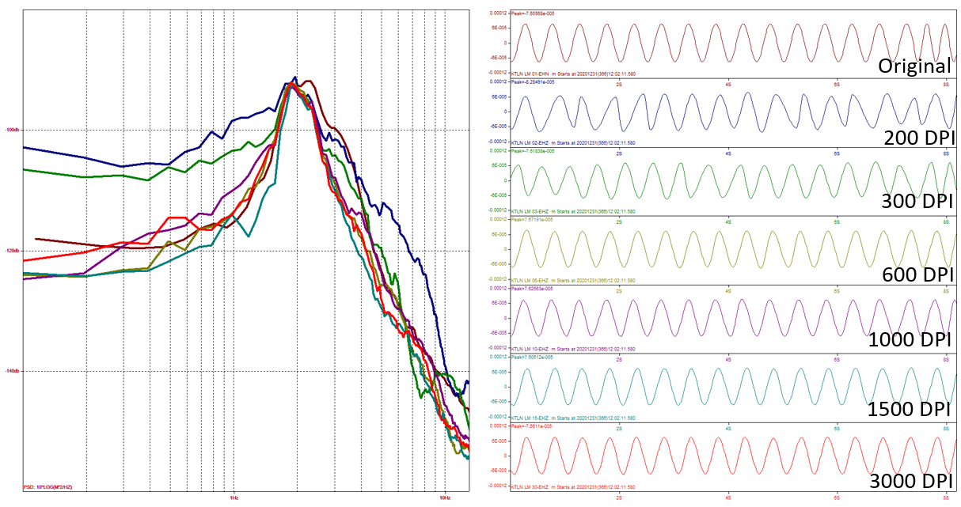
Producing High Quality Digitizations from Historical Analog
Seismograms of Nuclear Explosions
Kaitlynn Burkhard, Daniel Burk, Kevin Mackey
Department of Earth and Environmental Sciences, Michigan State University, East Lansing, MI, USA
P2.5-443
We generated 2 Hz sine waves at different DPIs. An ideal 2 Hz signal would have a sharp peak at the 2 Hz line on the Power Spectral Density (PSD) graph. Our digitizations were compared to this ideal peak and the lower DPIs (200 and 300) have a broader peak at 2 Hz. This is added noise that was introduced by asymmetric waves in the digitization (Ex. yellow areas on the right).
A recommendation for recovering at least 2 Hz is to use a minimum of 600 DPI.
Degradation of 2 Hz sine wave at various DPIs
200 DPI
RESULTS
300 DPI
2 Hz
x axis = frequency y axis = decibels

Slide 9
Producing High Quality Digitizations from Historical Analog
Seismograms of Nuclear Explosions
Kaitlynn Burkhard, Daniel Burk, Kevin Mackey
Department of Earth and Environmental Sciences, Michigan State University, East Lansing, MI, USA
P2.5-443
  With a given DPI, and the assumption of a 60mm/minute recording speed, what is the frequency we should recover in the digitization process?
RESULTS
  Green- Recoverable
  Yellow – Recoverable but distorted
  Red – Not recoverable
*Note: Digitization matrix not finalized yet

Slide 10
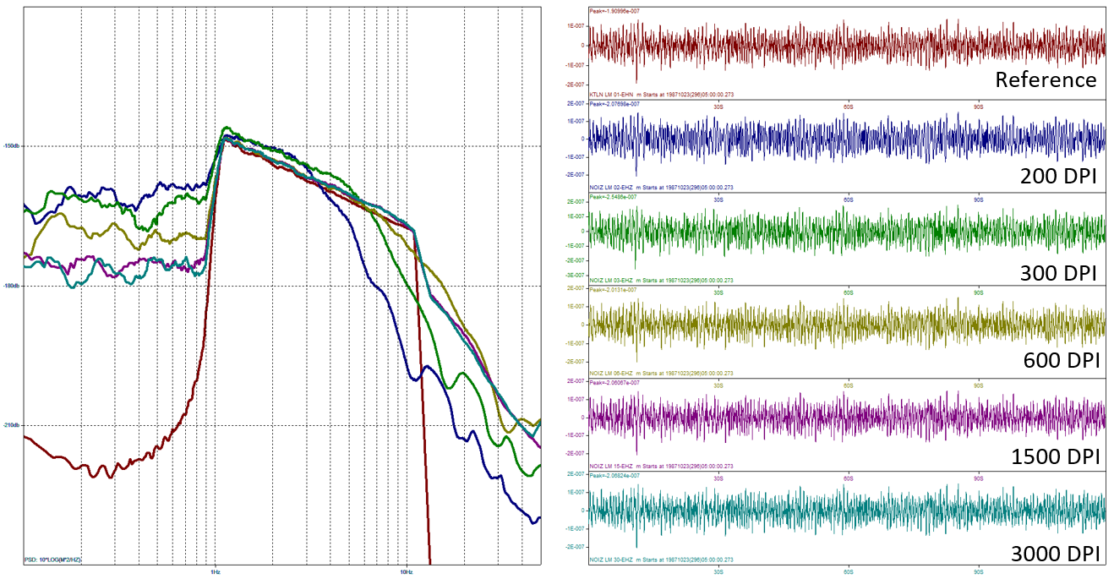
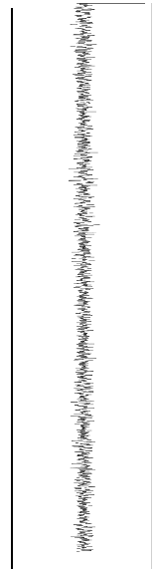
Producing High Quality Digitizations from Historical Analog
Seismograms of Nuclear Explosions
Kaitlynn Burkhard, Daniel Burk, Kevin Mackey
Department of Earth and Environmental Sciences, Michigan State University, East Lansing, MI, USA
P2.5-443
Testing recoverable frequencies in a 1 – 12 Hz signal. A reference signal was made and converted to different DPI resolutions. The PSD graph on the right highlights the maximum frequency that was recovered in each DPI digitization. Frequency is deemed unrecoverable once a sharp decline in the signal is observed. Note: user experience can result in higher recoverability rates.
1 – 12 Hz
200 DPI
300 DPI
600 DPI
Reference
3000 DPI
1500 DPI
DPI | Color | Maximum Recoverable Frequency
- | Red | Reference
200 | Blue | 3 – 4 Hz
300 | Green | 5 – 6 Hz
600 | Gold | 7 – 10 Hz
1500 | Purple | Up to 12 Hz
3000 | Aqua | Up to 12 Hz
RESULTS
Below: Example of 1 – 12 Hz synthetic seismogram
x axis = frequency y axis = decibels
*Note: Assumption of a 60mm/minute recording speed

Slide 11
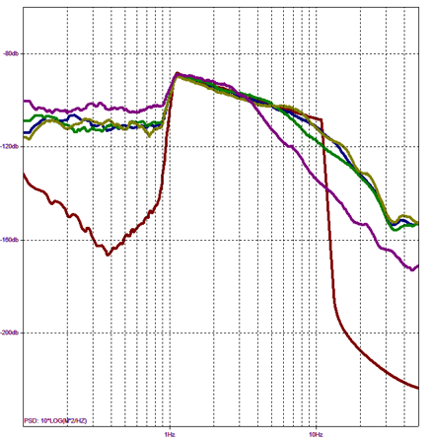
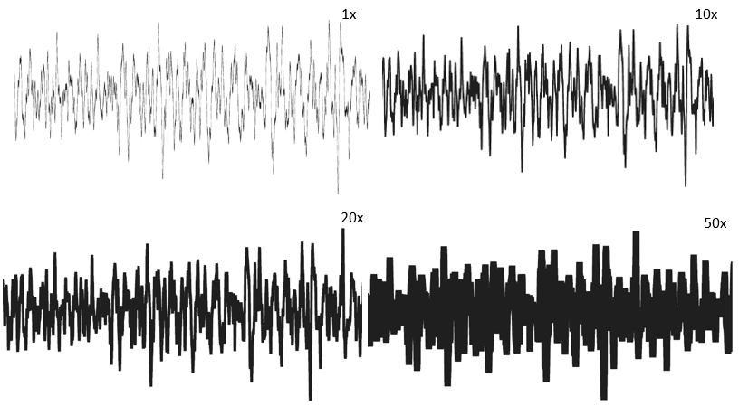
Producing High Quality Digitizations from Historical Analog
Seismograms of Nuclear Explosions
Kaitlynn Burkhard, Daniel Burk, Kevin Mackey
Department of Earth and Environmental Sciences, Michigan State University, East Lansing, MI, USA
P2.5-443
The Effect of Trace Thickness and Frequency Recovery
1 – 12 Hz
Trace thickness of the waveform affects the recoverable frequency in a digitization. A waveform with a frequency of 1 – 12 Hz was created at 600 DPI. The beam thickness was modified at four different widths. At wider beam thicknesses, some frequencies are simply not recoverable due to trace overlap and hidden signal. Note: user experience can result in higher recoverability rates.
Widest (50x)
5x
Thinnest (1x)
20x
Reference
RESULTS
x axis = frequency y axis = decibels
Beam Thickness | Color | Maximum Recoverable Frequency
- | Red | Reference
Thinnest 1x | Blue | 6 – 7 Hz
5x | Green | 5 Hz
20x | Gold | 7 – 10 Hz
Widest 50x | Purple | 3.5 Hz
Below: Example of 1 – 12 Hz synthetic seismograms at various beam thickness.
Recovered higher frequency due to more attention and care while digitizing.
*Note: Assumption of a 60mm/minute recording speed

Slide 12
Producing High Quality Digitizations from Historical Analog
Seismograms of Nuclear Explosions
Kaitlynn Burkhard, Daniel Burk, Kevin Mackey
Department of Earth and Environmental Sciences, Michigan State University, East Lansing, MI, USA
P2.5-443
Higher DPI images produce better quality digitizations. They retain better signal shape and recover more of the signal frequency. For example, a 2 Hz signal will require at least a 600 DPI image to fully recover that frequency. As frequency increases, the DPI will also need to increase to improve confidence in the results.
As trace thickness become wider, less frequencies will be recovered due to trace overlap and hidden signals. A user’s digitization experience can produce a higher frequency recovery.
Digitization is more complex than just analyzing image resolution. Such things are line (beam) thickness, trace velocity, and user experience all factor into making a quality digitization.
For validation of our digitization process, see T2.5-397 Burk and Mackey.
CONCLUSIONS
This effort is continued on several other posters:
T2.5 – 594 by Malovichko et al. for discussion on digitizing Soviet PNEs.
T2.5 – 397 by Burk and Mackey for discussion on the recovery of station responses.
T2.5 – 499 by Martinetti et al. for preliminary research results using digitized PNE waveforms.
Acknowledgements: Thank you to the individuals who helped digitize several waveforms in this study. Also, a thank you to our funding agencies: US Department of State under contract 19AQMM19P0582 and the US Air Force Research Laboratory under contract FA9453-19-C-0066.

