Slide 1


The second generation of precision small-sized temperature sensors: measurement and take in account the internal temperature of seismic
instruments
Valentin GRAVIROV ¹, Konstantin KISLOV ² and Dmitry LIKHODEEV ¹
P3.1-393
1 - Schmidt Institute of Physics of the Earth, Russian Academy of Sciences
2 - Institute of Earthquake Prediction Theory and Mathematical Geophysics, Russian Academy of Sciences

Slide 2
The second generation of precision small-sized temperature sensors: measurement and take in account the internal temperature of seismic instruments
Valentin GRAVIROV, Konstantin KISLOV and Dmitry LIKHODEEV
P3.1-393
P3.1-393
One of the main noise-causing factors in precise long-period seismometry is temperature fluctuations of mechanical elements of devices and sensitive sensors, as well as temperature oscillations in their interior space. To reduce such noise level it is possible to apply adaptive filtering of seismic signal based on elements temperature acquisition. However, to date, this way it was not possible to achieve significant results since there were no small systems capable of recording temperature changes with sufficient accuracy. The developed precision small-sized temperature sensors are capable of simultaneously monitoring the temperature at several of the most important points of many seismic device with an accuracy of at least about 0.001 Celsius degrees.
ABSTRACT

Slide 3
The second generation of precision small-sized temperature sensors: measurement and take in account the internal temperature of seismic instruments
Valentin GRAVIROV, Konstantin KISLOV and Dmitry LIKHODEEV
P3.1-393
The fluctuations of temperature are one of the main noise generation factor at any seismic observations. Whatever physical principles are used in seismic instruments, it is not possible to eliminate this problem completely. There are many ways of penetrating the temperature noise to the recording. Seven such ways have been identified for traditional pendulum systems:
1) Changes in linear dimensions of the device elements, recorded by a seismometer as the oscillations of the Earth or actions on the pendulum as an additional force (changes in the forces’ arms, the deformation of the springy elements, etc.).
2) Changes in the elastic characteristics of the crossed leaf rotary flexural system and spring of the vertical pendulum.
3) The flexure of device basement (plate) due to difference of temperature coefficients of linear extension the device metal plate and concrete pier.
4) The self-noise of the electronic displacement transducer, thermal noise in electronic circuits of the device, the thermal fluctuations in power attenuation.
5) The noise arising from the uneven distribution of the temperature in different parts (elements) of the device, including convective heat currents.
6) Changes in transfer function of the device due to changes of the size structural elements and characteristics of seismometer electronic components.
Thermal noise associated with a change of pressure in the enclosed volume of the device.
INTRODUCTION

Slide 4
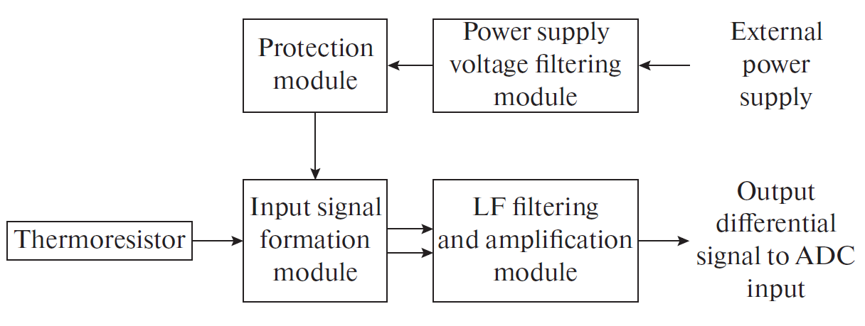
The second generation of precision small-sized temperature sensors: measurement and take in account the internal temperature of seismic instruments
Valentin GRAVIROV, Konstantin KISLOV and Dmitry LIKHODEEV
P3.1-393
METHODS

Slide 5
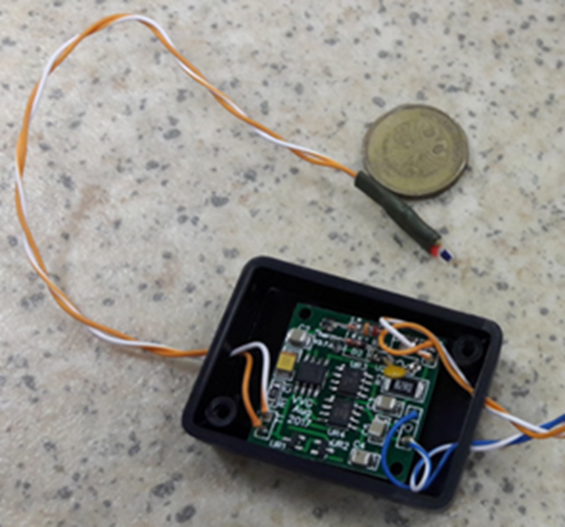
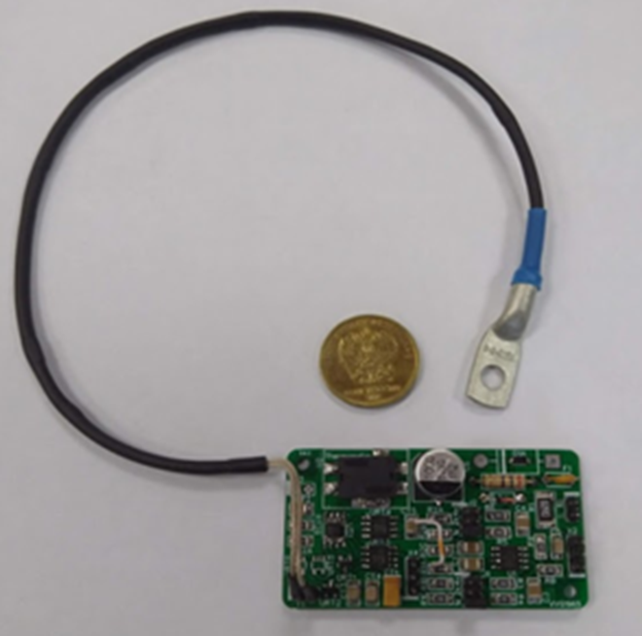
The second generation of precision small-sized temperature sensors: measurement and take in account the internal temperature of seismic instruments
Valentin GRAVIROV, Konstantin KISLOV and Dmitry LIKHODEEV
P3.1-393
General view of thermosensors
METHODS
1-st version (2018)
2-nd version (2019)

Slide 6
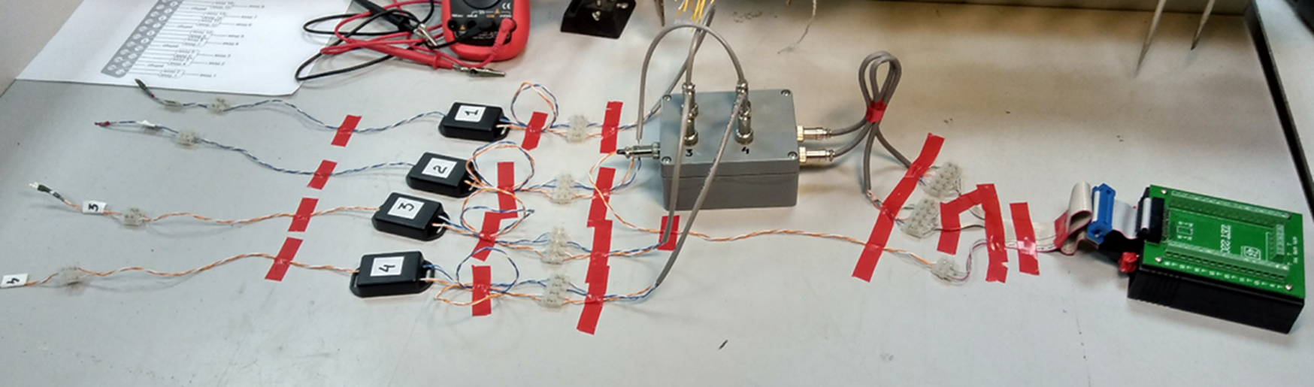
The second generation of precision small-sized temperature sensors: measurement and take in account the internal temperature of seismic instruments
Valentin GRAVIROV, Konstantin KISLOV and Dmitry LIKHODEEV
P3.1-393
METHODS
Test layout of a 4-channel monitoring and temperature control system prototype

Slide 7
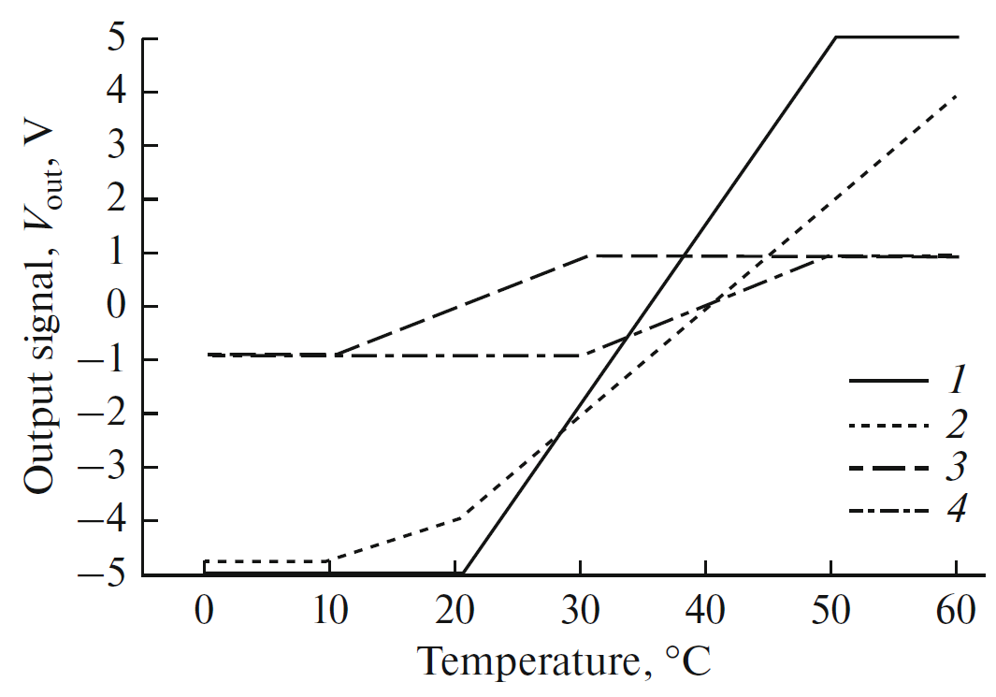
The second generation of precision small-sized temperature sensors: measurement and take in account the internal temperature of seismic instruments
Valentin GRAVIROV, Konstantin KISLOV and Dmitry LIKHODEEV
P3.1-393
Dependence of output
signal for various
versions of
thermometers on temperature:
V.1, (2) V.2,
(3) V.3, (4) V.4.
METHODS

Slide 8
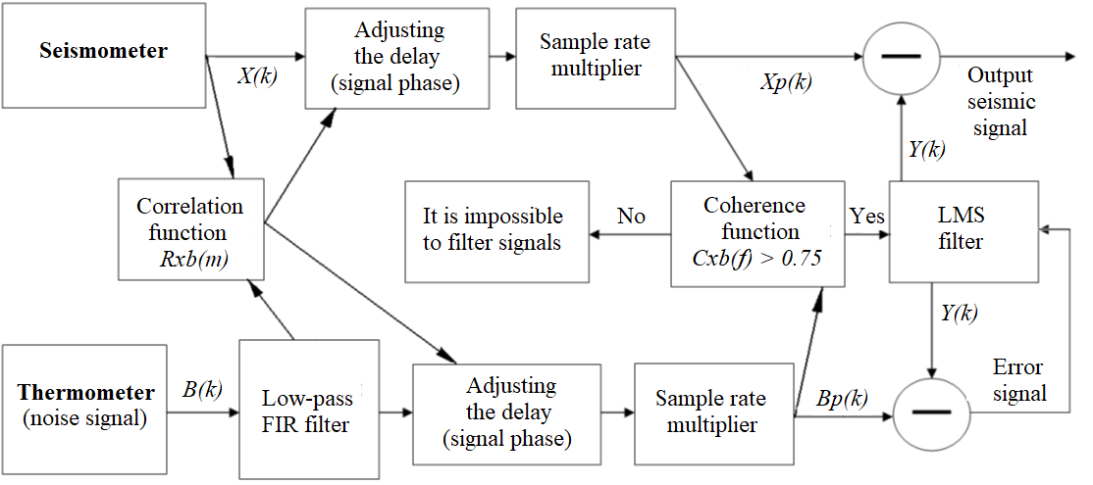
The second generation of precision small-sized temperature sensors: measurement and take in account the internal temperature of seismic instruments
Valentin GRAVIROV, Konstantin KISLOV and Dmitry LIKHODEEV
P3.1-393
METHODS
Test layout of a 4-channel monitoring and temperature control system prototype
Block diagram of the thermal noise correction system

Slide 9
The second generation of precision small-sized temperature sensors: measurement and take in account the internal temperature of seismic instruments
Valentin GRAVIROV, Konstantin KISLOV and Dmitry LIKHODEEV
P3.1-393
One of the most effective tool for reduction of temperature influence is the optimal filtering. At the same time, there might be occasions where the external temperature does not play a role, but relative temperature some components of the device is very important. Recall that not the absolute value of the temperature is important, but accurately measured amplitude of its fluctuations. In a more complex case, it may be necessary to measure the temperature in several points of the device or their relative changes with greater accuracy.
Summarizing the results obtained, it can be argued that the developed system for precise recording the internal temperature of seismic instruments is capable of taking into account the key features of the spectral composition of seismic and temperature signals. It is able to form the transfer functions of the filters that provide the selection of "useful seismic" signal frequencies from any spectrum ranges, with maximum suppression of the noise presented in the second reference input temperature signal.
Thank you for attention!
CONCLUSIONS

