Slide 1


The second generation of precision small-sized temperature sensors: investigation of thermal fields near the Elbrus volcano on the basis of the North
Caucasus Geophysical Observatory
Valentin GRAVIROV ¹, Konstantin KISLOV ² and Dmitry LIKHODEEV ¹
P3.1-394
1 - Schmidt Institute of Physics of the Earth, Russian Academy of Sciences
2 - Institute of Earthquake Prediction Theory and Mathematical Geophysics, Russian Academy of Sciences

Slide 2

P3.1-394
P3.1-393
The Baksan Neutrino Observatory of the Institute for Nuclear Research of the Russian Academy of Sciences is a unique engineering facility, which is a system of underground mine workings in the Andyrchi mountain massif (at a depth of 2 km from the surface and 4 km from mine enter) located twenty kilometers from the Elbrus volcano down the Baksan gorge in the Neutrino village. The unique location of the laboratory allows for a comprehensive analysis of various geophysical fields recorded in an almost complete absence of interference. Precision temperature measurement provides quantitative information about the heat flow from the interior of the Earth, which is fundamental for a deeper understanding of the relationship between fluid-magmatic and geodynamic processes. It allows obtaining unique data on the structure and dynamics of the thermal field of the Elbrus volcano. This study is a particularly important task from the point of view of obtaining new fundamental knowledge about the structure of magmatic structures, and from the point of view of assessing the volcanic hazard caused by the presence of liquid magmatic melt in the interior of the volcano, which in turn will provide new data on the potential hazard of the Elbrus volcanic center.
ABSTRACT

Slide 3
The second generation of precision small-sized temperature sensors: investigation of thermal fields near the Elbrus volcano on the basis of the North
Caucasus Geophysical Observatory
Valentin GRAVIROV, Konstantin KISLOV and Dmitry LIKHODEEV
P3.1-394
Studies of the fine structure of temperature fields in rock strata requires precision measurements of temperature variations, related to the slow propagation rate of temperature disturbances and the long-term high temperature stability of rock massifs. Such high precision measurements of temperature variations will make it possible to estimate the dynamics of temperature fields in rock strata even for small observation intervals.
Temperature measurements carried out at Baksan Neutrino Observatory with different types of sensors) have yielded preliminary, rough estimate of temperature fields in the vicinity of the observatory. Based on earlier measurement results, it was concluded that the temperature in the laboratory adit is highly stable, and the local temperature gradient was estimated as ∼160°C/km.
INTRODUCTION

Slide 4
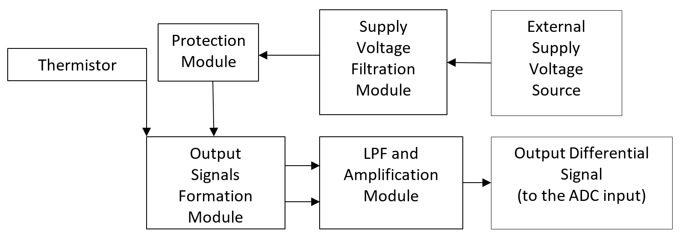
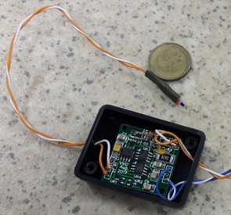
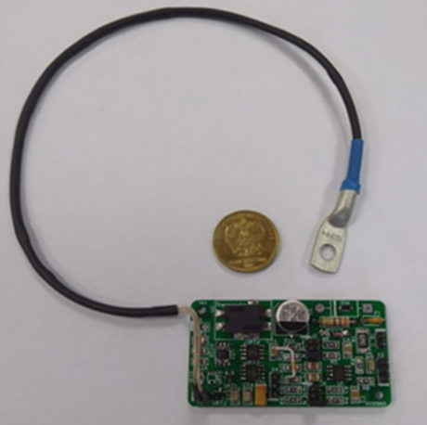
The second generation of precision small-sized temperature sensors: investigation of thermal fields near the Elbrus volcano on the basis of the North
Caucasus Geophysical Observatory
Valentin GRAVIROV, Konstantin KISLOV and Dmitry LIKHODEEV
P3.1-394
METHODS
Basic block diagram of electronic thermometers.
General view of thermometers.
Prototype 2018 (left) and 2019 (right).

Slide 5
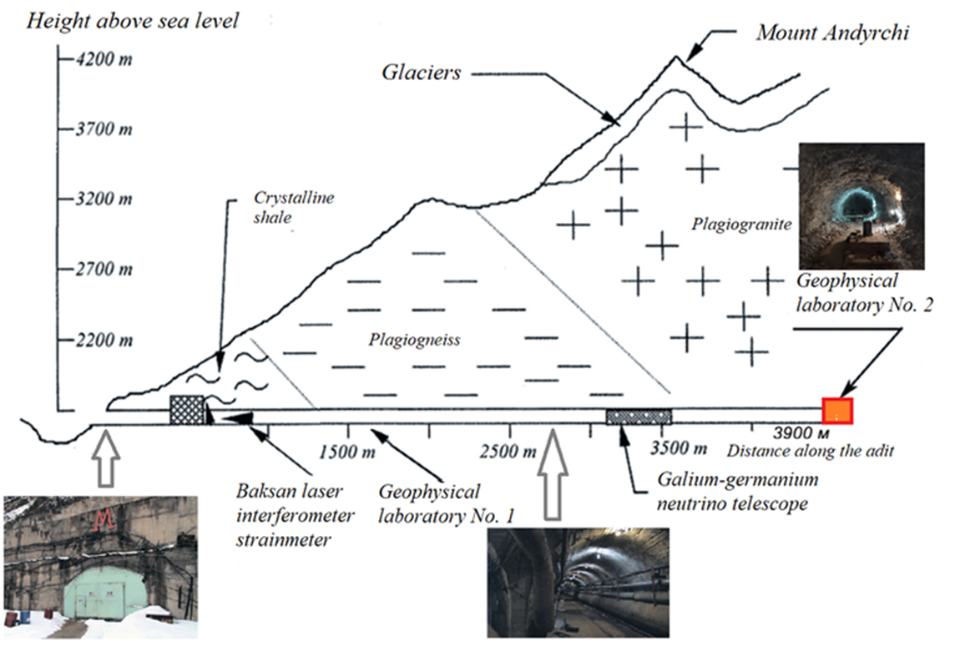
The second generation of precision small-sized temperature sensors: investigation of thermal fields near the Elbrus volcano on the basis of the North
Caucasus Geophysical Observatory
Valentin GRAVIROV, Konstantin KISLOV and Dmitry LIKHODEEV
P3.1-394
Scheme of the Baksan Neutrino Observatory. The red rectangle shows the place of installation of temperature sensors.
METHODS

Slide 6
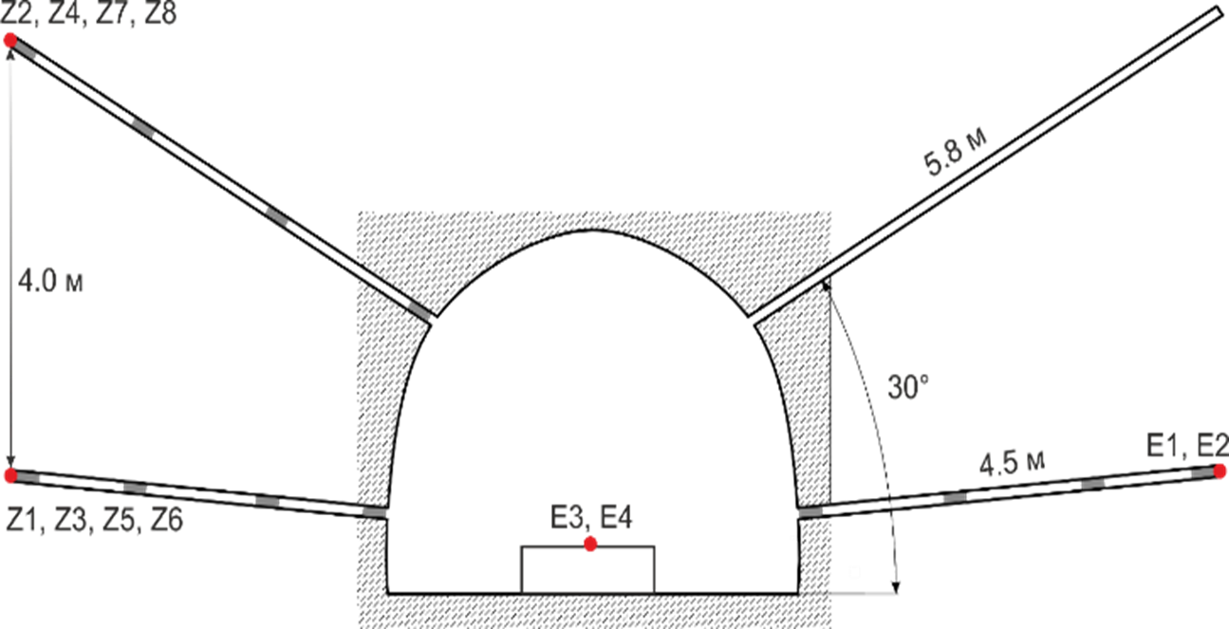
The second generation of precision small-sized temperature sensors: investigation of thermal fields near the Elbrus volcano on the basis of the North
Caucasus Geophysical Observatory
Valentin GRAVIROV, Konstantin KISLOV and Dmitry LIKHODEEV
P3.1-394
Diagram of holes drilled in the adit. The arrangement of temperature sensors (red points) is shown: Z1, Z2,… Z8 - sensors connected to the ZETLAB-220 ADC; E1, E2, E3, E4 - sensors connected to the E-24 ADC. Sensors E3, E4 installed on basement constructed in the adit. Gray rectangles - plugs to exclude convection.
METHODS

Slide 7
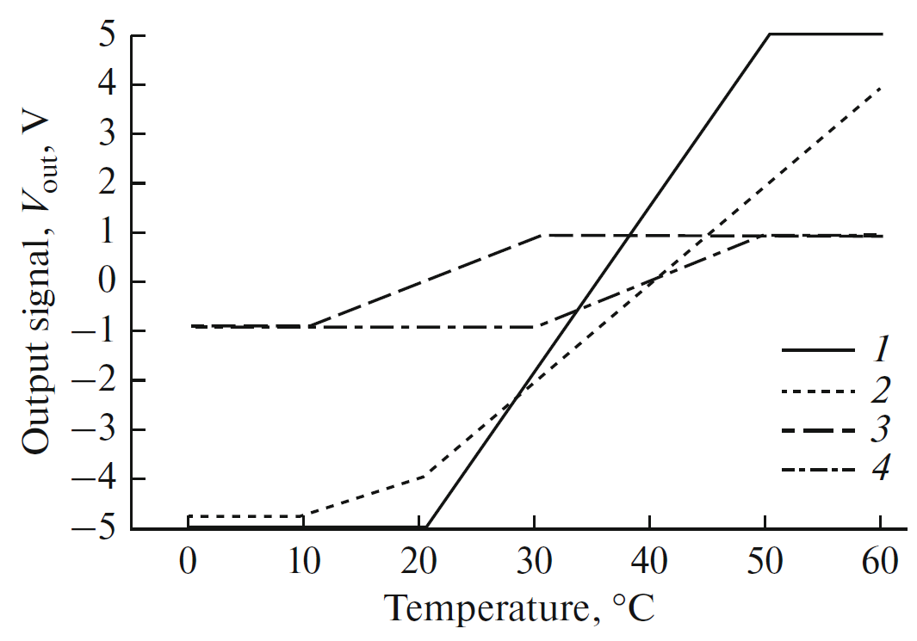
The second generation of precision small-sized temperature sensors: investigation of thermal fields near the Elbrus volcano on the basis of the North
Caucasus Geophysical Observatory
Valentin GRAVIROV, Konstantin KISLOV and Dmitry LIKHODEEV
P3.1-394
Dependence of output
signal for various
versions of
thermometers on temperature:
V.1, (2) V.2,
(3) V.3, (4) V.4.
METHODS

Slide 8
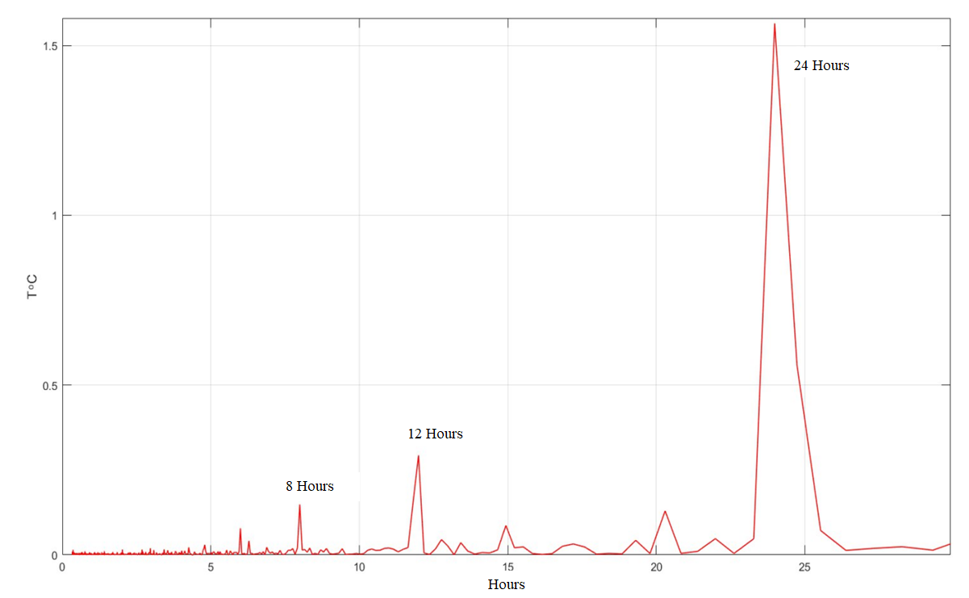
The second generation of precision small-sized temperature sensors: investigation of thermal fields near the Elbrus volcano on the basis of the North
Caucasus Geophysical Observatory
Valentin GRAVIROV, Konstantin KISLOV and Dmitry LIKHODEEV
P3.1-394
Spectra estimation of temperature data for one month period from May 2019 to June 2019
RESULTS

Slide 9
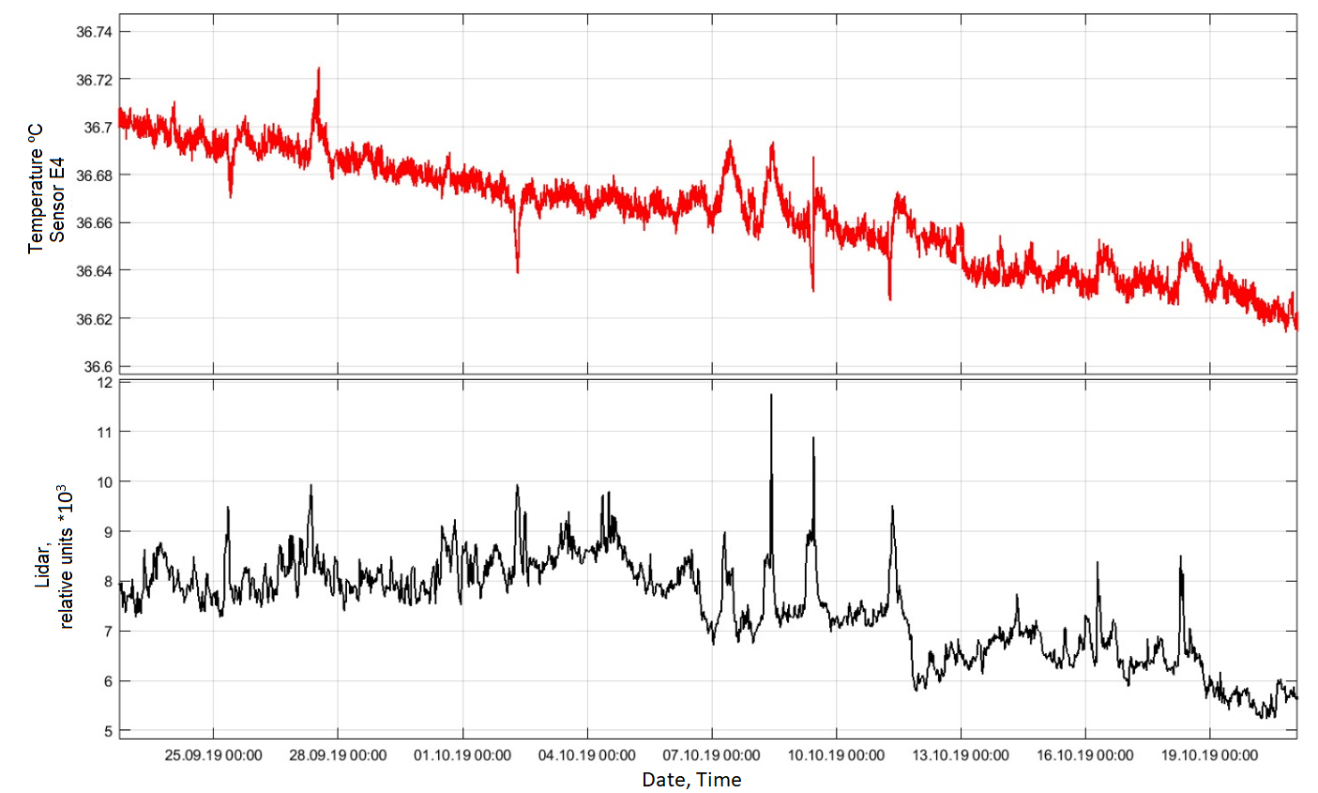
The second generation of precision small-sized temperature sensors: investigation of thermal fields near the Elbrus volcano on the basis of the North
Caucasus Geophysical Observatory
Valentin GRAVIROV, Konstantin KISLOV and Dmitry LIKHODEEV
P3.1-394
Comparison of the temperature change on the basement (Sensor E4 – red) with the change in the aerosol density (black) in the adit.
RESULTS

Slide 10
The second generation of precision small-sized temperature sensors: investigation of thermal fields near the Elbrus volcano on the basis of the North
Caucasus Geophysical Observatory
Valentin GRAVIROV, Konstantin KISLOV and Dmitry LIKHODEEV
P3.1-394
Constant temperature monitoring in the Baksan Neutrino Observatory adit with the developed precision small-sized temperature sensors will aid in obtaining high precision data on the temperature field dynamics in the vicinity of Elbrus volcano and will make a significant contribution to ongoing comprehensive studies of the Elbrus’ volcanic center. Studies of the volcanic activity of Elbrus’ magma structures to reveal possible signs of volcanic hazard is particular important owing to the intensively developed tourist infrastructure both in the Baksan gorge and in the entire near-Elbrus region.
Thank you for attention!
CONCLUSIONS

