Slide 1


Past and future developments of noble gas detection systems at CEA/DAM
S. Topin, P. Gross, A. Cagniant, O. Delaune, T. Philippe, J.-C. Piwowarczyk, J.-P. Fontaine, G. Douysset, G. Le Petit
CEA/DAM Ile de France
P3.1-512

Slide 2
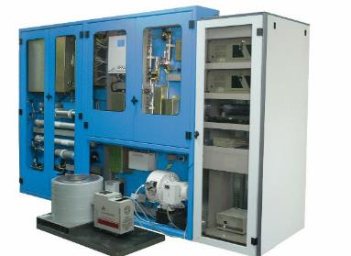
Past and future developments of noble gas detection systems at CEA/DAM
S. Topin, P. Gross, A. Cagniant, O. Delaune, T. Philippe, J.-C. Piwowarczyk, J.-P. Fontaine, G. Douysset, G. Le Petit
P3.1-512
1996 – 2002 development / 2018 end of production: SPALAX-1
Pre-purification: membranes
Purification: Carbon adsorbants
Detection: High resolution γ spectrometry HPGe
Sensitivity (24h sampling & measurement): ≈ 0.2 mBq m⁻³ Xe-133, ≈ 0.1 mBq m⁻³ Xe-135; ≈ 3 mBq m⁻³ Xe-133m and ≈ 7 mBq m⁻³ Xe-131m
SPALAX-1 (until 2018)
Prélèvement gaz xénon (SPALAX)

Slide 3
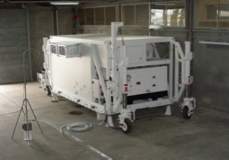
Past and future developments of noble gas detection systems at CEA/DAM
S. Topin, P. Gross, A. Cagniant, O. Delaune, T. Philippe, J.-C. Piwowarczyk, J.-P. Fontaine, G. Douysset, G. Le Petit
P3.1-512
2007 – 2009 development / 2018 end of production : SPALAX-DR
Mobil and Integrated SPALAX-1 (In Shelter)
Energy: Power generator
Air conditioning: Integrated
SPALAX-DR (until 2018)

Slide 4
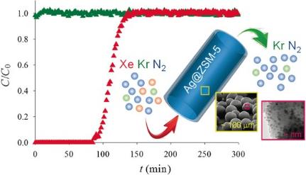
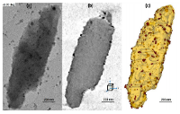
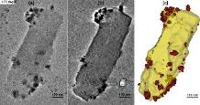
Past and future developments of noble gas detection systems at CEA/DAM
S. Topin, P. Gross, A. Cagniant, O. Delaune, T. Philippe, J.-C. Piwowarczyk, J.-P. Fontaine, G. Douysset, G. Le Petit
P3.1-512
2009 – In progress: Adsorbant developments (see O3.1-316)
Silver exchanged zeolite Ag@ZSM5 for xenon extraction
Capacity of Xe sampling: x 100 versus Charcoals
Deactivation phenomena at high temperature
Ab initio calculations for screening of more performant and stable metals and zeolites
Silver particles growth under high temperature (> 300°C)
L. Deliere et al., Chem. Eu. J 2016, 22, 28, 9660
A. Monpezat et al., Ind. Eng. Chem. Res. 2019, 58, 11, 4560–4571

Slide 5
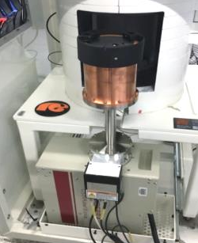
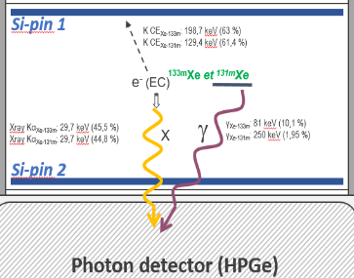
Past and future developments of noble gas detection systems at CEA/DAM
S. Topin, P. Gross, A. Cagniant, O. Delaune, T. Philippe, J.-C. Piwowarczyk, J.-P. Fontaine, G. Douysset, G. Le Petit
P3.1-512
HPGe
2011 - 2015: e⁻ / photon coincident detector development
(HPGe – PIPSBox™)
e⁻ / photon coincident detector development
e⁻ → Double sided Si-PIN detector including the sample: PIPSBox on the top of a HPGe
PIPSBox: ≈ 13 cm³ (1 bar) Xe/N₂ sample
Coincidence: β-γ or CE-X_{ray}
Sensitivity improvement: ≈ x 100 on Xe-131m and 133m
PIPSBox™ detector
CEA-MTC development
G. Le Petit et al., App. Rad. Iso. 103 (2015) 102

Slide 6
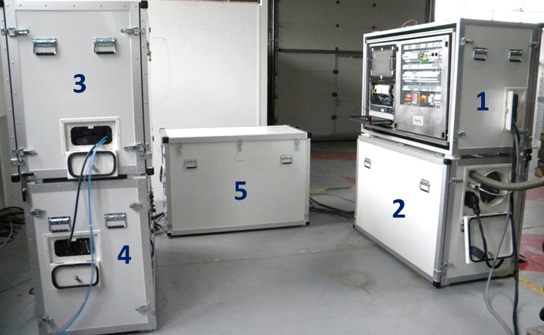
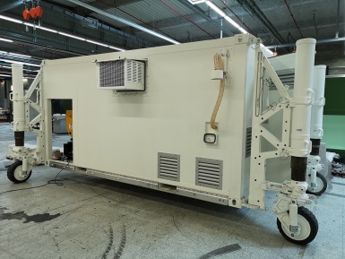
Past and future developments of noble gas detection systems at CEA/DAM
S. Topin, P. Gross, A. Cagniant, O. Delaune, T. Philippe, J.-C. Piwowarczyk, J.-P. Fontaine, G. Douysset, G. Le Petit
P3.1-512
2012 – 2017 development / in production since 2018: SPALAX-NG (see O2.4-510)
Modular or In shelter
Pre-purification: membranes / Purification : Charcoals + Ag@ZSM-5
Detection: High resolution e⁻ / photon spec (HPGe-PIPSBox)
Data treatment: RNELPh in operation at CEA/DAM, AUTOSTRADA in operation at IDC, New development in progress at CEA/DAM for high and low resolution βγ treatment (see P3.5 – 300)
For 8 hours cycle | Isotopes | SPALAX-1 | SPALAX-NG
Vol. Xe |  | 1,3 cm³ | 4 cm³
Minimum Detectable Concentration (mBq/m³) | Xe-133 | 1 | 0,2
 | Xe-135 | 1 | 0,2
 | Xe-131m | 20 | 0,2
 | Xe-133m | 6 | 0,2
S. Topin et al., J. Env. Rad. 225 (2020) 106442

Slide 7
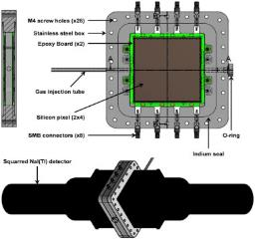
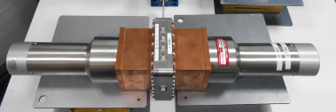
Past and future developments of noble gas detection systems at CEA/DAM
S. Topin, P. Gross, A. Cagniant, O. Delaune, T. Philippe, J.-C. Piwowarczyk, J.-P. Fontaine, G. Douysset, G. Le Petit
P3.1-512
2016 – In progress: NaI – PIXELBox (see P3.1-362)
e⁻ / photon coincident detector development
e⁻ : 8 Si-PIN detectors (faces) including the sample (PIPSBox) surrounded by 2 NaI detectors
PIXELBox : ≈ 50 cm³
Coincidence: β-γ or CE-X_{ray}
Sensitivity gain: × 2-4 vs the PIPSBox
Electronic: Specific development in progress for multi-channel treatment (up to 10 detectors!)
MARGOT (NaI + PIXELBox)
V. Thomas et al., Appl. Rad. Isot. 153 (2019) 108820

