Slide 1
A new damping system for seismic sensors based on the eddy currents
Shamseddin Esmaeili
P3.1-101
Razi university of Kermanshah, Kermanshah, Iran

Slide 2
A new damping system for seismic sensors based on the eddy currents
Shamseddin Esmaeili, s.esmaeili@razi.ac.ir, Razi university of Kermanshah, Kermanshah, Iran
P3.1-101

Slide 3
A new damping system for seismic sensors based on the eddy currents
Shamseddin Esmaeili, s.esmaeili@razi.ac.ir, Razi university of Kermanshah, Kermanshah, Iran
P3.1-101
This study describes a new damping system for optical seismic sensors that, is based on eddy currents. Nowadays, scientists have been considered optical approaches for readout systems of seismic sensors.
The use of reliable and well performance damping systems in this category of seismometers is very important. This has led us to build a damping system based on the eddy currents for a spring-suspended mass whose position is monitored by the moiré technique.
To demonstrate this approach, a conventional oscillation system has been used. Also, the proposed damping system consists of a neodymium magnet which is fixed to the suspended mass, and a conductive plate which is fixed to the frame of the oscillator. The magnet and the conductive plate are facing each other with a distance of 0.5 mm. By relative motion between the magnet and the nearby conductive plate, eddy currents have been produced in a way that opposes its creator.
Experiments to test this approach have been performed, and the evaluations of the results show that the proposed damping system for optical sensors is quite reliable.
ABSTRACT

Slide 4
A new damping system for seismic sensors based on the eddy currents
Shamseddin Esmaeili, s.esmaeili@razi.ac.ir, Razi university of Kermanshah, Kermanshah, Iran
P3.1-101
A seismometer is a very sensitive instrument that can detect movements of the Earth's surface. The problem of measuring vibrations is a very important topic that encompasses different areas of science and technology. Vibration can be measured and characterized in terms of displacement, velocity, or acceleration. All seismometer are based on damped oscillation systems, the inertial mass suspended on a spring or an inertial-pendulum remains the mainstay of seismometer design. The frame of the sensor is fixed to the ground. During ground shaking the movement of the mass is delayed relative to the movement of the frame. A damping mechanism restores the mass to its equilibrium position after a small transient perturbation. Also, seismometers have a readout system to converts the suspended mass motions to a time series. During the last decades different kinds of methods have been widely used for readout system, which are conventionally based on electromechanical, capacitive, or piezoelectric principles, and a force-feedback design which largely improves the linearity of the sensor.
Nowadays, optical methods are considered by scientists to used as a readout system in seismometry. Optical approaches have some advantages with respect to the other techniques such as higher signal to noise ratio, sensitivity and precision. Also, determine the displacements by these method is very important in seismometry.
As we know, the damping system is a very important in quality of data in optical approaches. This research has been motivated by a desire to develop a new damping system for optical seismic sensors. Toward this goal, a readout system based on the moiré technique has been chosen.
INTRODUCTION

Slide 5
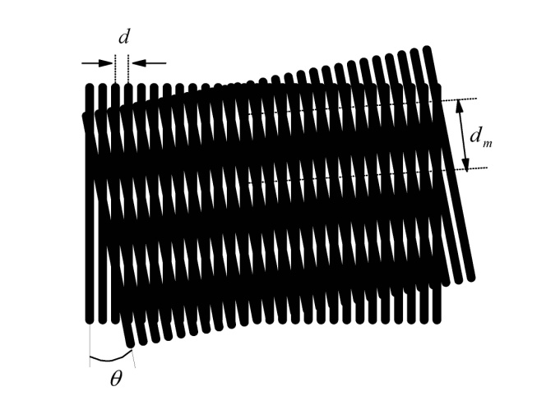

A new damping system for seismic sensors based on the eddy currents
Shamseddin Esmaeili, s.esmaeili@razi.ac.ir, Razi university of Kermanshah, Kermanshah, Iran
P3.1-101
The moiré technique is based on the interference obtained when two transparent plates such as two gratings are superimposed with equal periods. If one of the plates is held over the other, they can be aligned so that no light or only a fraction of it will pass through. Now, if one of the plates is placed over the other and their lines have a small angle together, a new periodic structure appears which called a moiré pattern. The dark and bright regions are called fringes. If the angle between the two gratings is increased, the separation between the light and dark fringes and the sensitivity decreases. By choosing a small angle, the sensitivity and fringe separability increases. In this case, the period of moiré pattern d_{m} is larger than the period of grating d. When one of the gratings moves (such as d) perpendicular to the direction of the grating lines, the moiré pattern moves by d_{m} and can be calculated as:
Where θ is the angle of the gratings lines.
INTRODUCTION
$$d_{m}=\frac{d}{2\sin\left(\frac{θ}{2}\right)} .$$

Slide 6
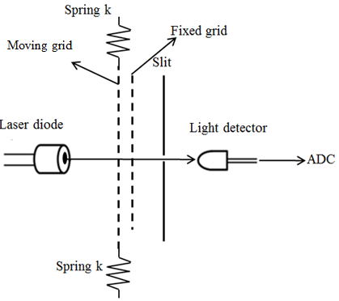
A new damping system for seismic sensors based on the eddy currents
Shamseddin Esmaeili, s.esmaeili@razi.ac.ir, Razi university of Kermanshah, Kermanshah, Iran
P3.1-101
Our optical approach has been used to make a vertical seismic sensor. The oscillation system of the sensor is a spring-suspended mass whose position is monitored by moiré technique. The mass is suspended by two identical springs placed in top and bottom of the mass and fixed into a frame. In this work, the springs of a commercial geophone (SE-10, made by Sunfull Company) have been used to build sensors oscillation system. The suspended mass has 12 gr and has held vertically. The natural frequency of the oscillation system is 10 Hz.
METHODS
To form moiré pattern, two similar Ronchi gratings with 20 lines per millimeter have been used. One of them attached to a frame that are as the suspended mass and the other one is attached to a frame that fixed to the sensor’s frame. The gratings were held close to each other without physical contact and the angle between the lines of superimposed gratings chosen is 6°. When the angle between the lines of superimposed gratings is less than 6°, the d_{m}/d ratio is larger than 10 which will result in a corresponding improvement in the measurement precision. So, d_{m} is 0.48 mm. Gratings can move freely so the angle of their lines remains constant.

Slide 7
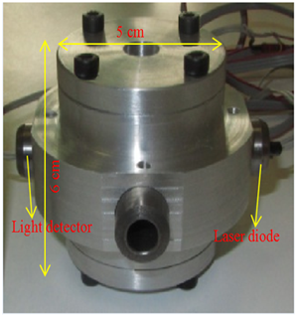
A new damping system for seismic sensors based on the eddy currents
Shamseddin Esmaeili, s.esmaeili@razi.ac.ir, Razi university of Kermanshah, Kermanshah, Iran
P3.1-101
To detect and convert the movement of suspended mass to an output voltage, a laser diode (module size 8 mm×13 mm, wavelength 650 nm, input voltage 3 V, power 1 mW) was placed in front of the gratings and a light-detector (silicon photodiode VTP1188s) faced the laser source from the opposite side. A narrow vertical slit that is parallel to moiré fringes was placed in front of the detector to narrow the light beam. The initial position of the slit is halfway between two adjacent dark and bright moiré fringes. The diode, the detector and the slit were fixed to the instrument frame. The laser beam passes through the moiré pattern and the slit before hitting on the light detector. The distance between the laser diode and the detector is 3 cm.
As we know, damping is an important factor for seismic sensors.
Our damping system is based in the eddy currents principle.
When a conductive material is subjected to a time-varying magnetic flux, eddy currents are generated in the conductor. These eddy currents circulate inside the conductor generating a magnetic field of opposite polarity as the applied magnetic field. The interaction of the two magnetic fields causes a force that resists the change in magnetic flux. However, due to the internal resistance of the conductive material, the eddy currents will be dissipated into heat and the force will die out. As the eddy currents are dissipated, energy is removed from the system, thus producing a damping effect.
METHODS

Slide 8
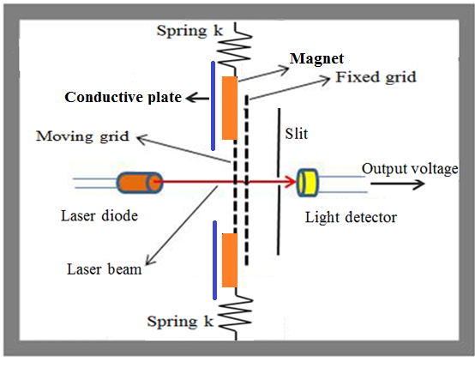
A new damping system for seismic sensors based on the eddy currents
Shamseddin Esmaeili, s.esmaeili@razi.ac.ir, Razi university of Kermanshah, Kermanshah, Iran
P3.1-101
Damping for our sensor is provided by viscous oil, which is placed at the bottom of the sensor. Fig. 3 shows our instrument.
METHODS

Slide 9
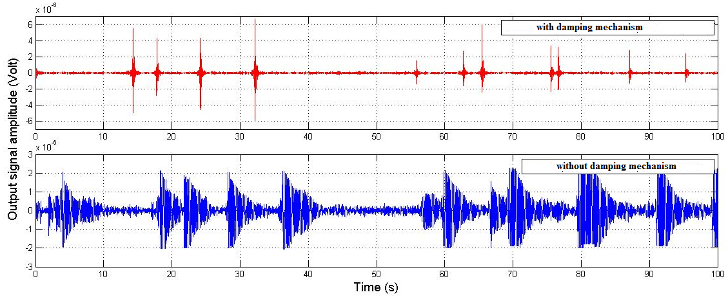
A new damping system for seismic sensors based on the eddy currents
Shamseddin Esmaeili, s.esmaeili@razi.ac.ir, Razi university of Kermanshah, Kermanshah, Iran
P3.1-101
To investigate the performance of our damping system, we have recorded output signals before and after of mounting the damping mechanism. A 12 bit ADC has been used with sampling rate of 60 sps. As we can see the performance of the eddy damping system is quite reliable and very effective.
Damping constant ~ 0.6
RESULTS
Damping constant less that 0.05

Slide 10
A new damping system for seismic sensors based on the eddy currents
Shamseddin Esmaeili, s.esmaeili@razi.ac.ir, Razi university of Kermanshah, Kermanshah, Iran
P3.1-101
In this research a new damping system based on the eddy currents have described. This research has been motivated by a desire to develop a new damping system for optical seismic sensors. The optical readout system has been chosen which is based on the moiré technique.
Our optical approach has been used to make a vertical seismic sensor. The oscillation system of the sensor is a spring-suspended mass whose position is monitored by moiré technique. Our damping mechanism consist of two aluminum (alloy 7075- T6 ) plates and two permanent magnets (Neodymium). The aluminum plates fixed to the sensor body and the magnets attached to the moving frame and faced the aluminum plates with 0.5 mm distance.
To evaluate the performance of our method, output signals before and after installing the damping system, have been recorded.
The results show the good performance of the eddy damping system. Also, this approach is quite practicable and effective.
Also it is easy to install, and we can vary the damping constant by the vary in the distance of the magnet and conductive plate.
CONCLUSIONS

