Slide 1
An approach for determination of suspended mass displacements in seismometry
Shamseddin Esmaeili, Anooshiravan Ansari
P3.1-102
Razi university of Kermanshah, Kermanshah, Iran
International Institute of Earthquake Engineering and Seismology

Slide 2
An approach for determination of suspended mass displacements in seismometry
Shamseddin Esmaeili, Anooshiravan Ansari, s.esmaeili@razi.ac.ir, a.ansari@iiees.ac.ir
P3.1-102

Slide 3
An approach for determination of suspended mass displacements in seismometry
Shamseddin Esmaeili, Anooshiravan Ansari, s.esmaeili@razi.ac.ir, a.ansari@iiees.ac.ir
P3.1-102
In this research, a new approach based on the moiré technique is presented to calculate the displacement of the suspended mass in seismometers. The oscillating system consists of a spring-suspended mass whose position is monitored using the moiré technique. To form the moiré pattern, two similar Ronchi grating are used so that they are facing each other without physical contact. One of the gratings is fixed to the oscillating mass and the other to the body of the oscillating system. An arrangement consisting of a laser diode, a narrow slit, and a photodiode was also used to detect and record the signal from the displacement of the moiré fringes due to the oscillation of the suspended mass. Also, an algorithm for calculations and conversion of the electrical signal into the displacement signal is presented. To validate the equations and the proposed algorithm, simulated and real data were evaluated and the results were compared. The results show the high capability and accuracy of the moiré technique and proposed algorithm in determining the oscillating mass displacement.
ABSTRACT

Slide 4
An approach for determination of suspended mass displacements in seismometry
Shamseddin Esmaeili, Anooshiravan Ansari, s.esmaeili@razi.ac.ir, a.ansari@iiees.ac.ir
P3.1-102
Seismometers are instruments that record ground vibration during the propagation of elastic waves in the earth. Ground displacements during the earth shaking include useful data about the structure of the Earth. Scientists desire these displacements (or time derivatives thereof) relative to an approximation of inertial space namely a mass suspended from a spring in a reference frame. All sensors are based on damped oscillation systems, the inertial mass suspended on a spring or an inertial-pendulum remains the mainstay of seismometer design. Seismometers have a readout system to converts the suspended mass motions to usable data. In most seismometers the readout system consists of a moving coil-transducer that converts the motion of the mass to savable data that is voltage signal. So, scientists have to calculate the displacement signals by integration of velocity signals, but since they are faced with an indefinite integral, there is always an unknown constant to achieve accurate displacement of the suspended mass. So, achieving the displacement signal has always been of great importance to seismologists. In the last two decades, scientists have been looking at using optical methods to get the determination of the suspended mass position. Recently, scientists used Michelson interferometry as a readout system in seismometry. However, due to the number of parts required in this method, these sensors have a high complexity.
In this paper, a new optical approach based on the moiré’ technique is presented for accurate measurement of oscillating mass displacement in seismometers, which is technically simple and has a high capability in detecting small vibrations.
INTRODUCTION

Slide 5
An approach for determination of suspended mass displacements in seismometry
Shamseddin Esmaeili, Anooshiravan Ansari, s.esmaeili@razi.ac.ir, a.ansari@iiees.ac.ir
P3.1-102
In this study, in order to investigate the possibility of determining the displacement by the proposed method, a common oscillating system (mass and spring) used in seismometry has been used. This research has been done on the vertical component. The vibration set up is a mass suspended by two springs placed in top and bottom of the mass and fixed into a frame. We used the springs of a commercial geophone (SE-10) to build our oscillating system. We used two similar Ronchi gratings with 20 Line per millimeter to form the moiré pattern. One of them is attached to the suspended mass and the other one to the frame of the set up. If the angle between the lines of superimposed gratings is less than 6°, the dm/d ratio is larger than 10, which will result in a corresponding improvement in the measurement precision. The gratings are installed close to each other without physical contact. A laser diode (module size 8 mm×13 mm, wavelength 650 nm, input voltage 3 V, power 1 mW) was placed in front of the gratings, and a light-detector (silicon photodiode VTP1188s) faced the laser source from the opposite side. A narrow vertical slit (50 mm) was placed in front of the light-detector, and parallel to moiré fringes to narrow the light beam. The laser beam passes through the moiré pattern and narrow slit, before hitting on the light detector. Due to the suspended mass motion, one of the gratings moves respect to the other one, and as a result the moiré fringes pass through the laser beam and the intensity of the light varies as a result. So, the light-detector records these variations as a time series. The output of the light-detector is electrical signal with amplitude which is proportional to the amplitude of suspended mass motion.
The displacement of the moiré fringes is much larger than the displacement of the suspended mass. Therefore, by measuring the displacement of the moiré fringes, the displacement of the suspended mass and the displacement of the ground are determined with high accuracy. To record the displacement of the friezes, a laser diode and a photodiode were placed on opposite sides of the nets, respectively. A narrow slit was installed to dim the light before the detector.
METHODS

Slide 6
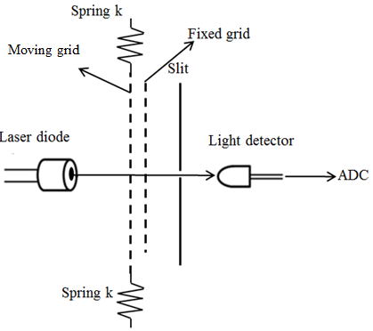
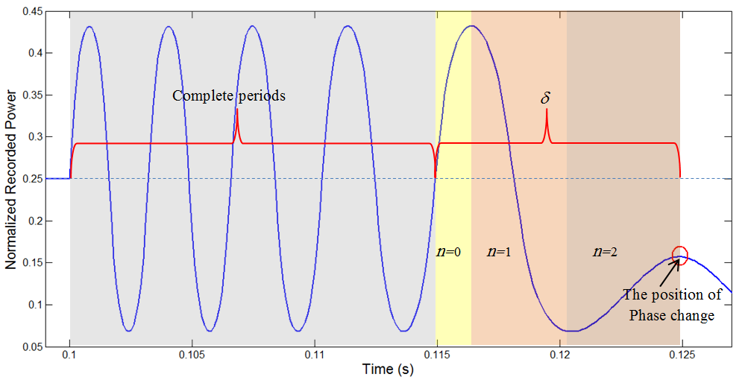
An approach for determination of suspended mass displacements in seismometry
Shamseddin Esmaeili, Anooshiravan Ansari, s.esmaeili@razi.ac.ir, a.ansari@iiees.ac.ir
P3.1-102
The output signal is digitized by a 16-bit analog to digital converter and then recorded by a computer program. Also, we used an electronic circuit to adjust the laser light intensity and the sensitivity of the light detector.
Due to the suspended mass motion because of an external stress, the moiré fringes pass through the laser light, and the power of light varies on the light-detector. The light power varies between two maximum and minimum values as a result of passing bright and dark moiré fringes through the laser beam. The amplitude of the suspended-mass motions is equal to the value of displacement of one of the gratings with respect to the other one. Also, the direction of fringes movements is proportional to the direction of oscillating mass displacements. Due to the oscillation phase changing, the direction of the suspended mass movement reverses, and as a result, the direction of the moiré fringes movement reverses which makes a phase changing in the output signal. Accordingly, the phase changing in output signals shows the oscillating phase changing. So, the value of the suspended mass displacement can derive by equation:
METHODS
Where d is the period of moiré gratings (0.05mm), N is the number of complete period, and δ is the fraction of complete period before the first or between the two consecutive phase changes in the output time series. We can derive δ by equation:
Where n is the number of maxima and minima in δ (which can be 0, 1 and 2), V_{m} is the value of maximum amplitude of output voltage due to passing the moiré fringes in front of the light detector, and V is the value of the output voltage when the phase changing occurred. Accordingly, we can determine the suspended mass displacements. In the following, a practical method for converting the output signal to the displacement time series has been presented.

Slide 7
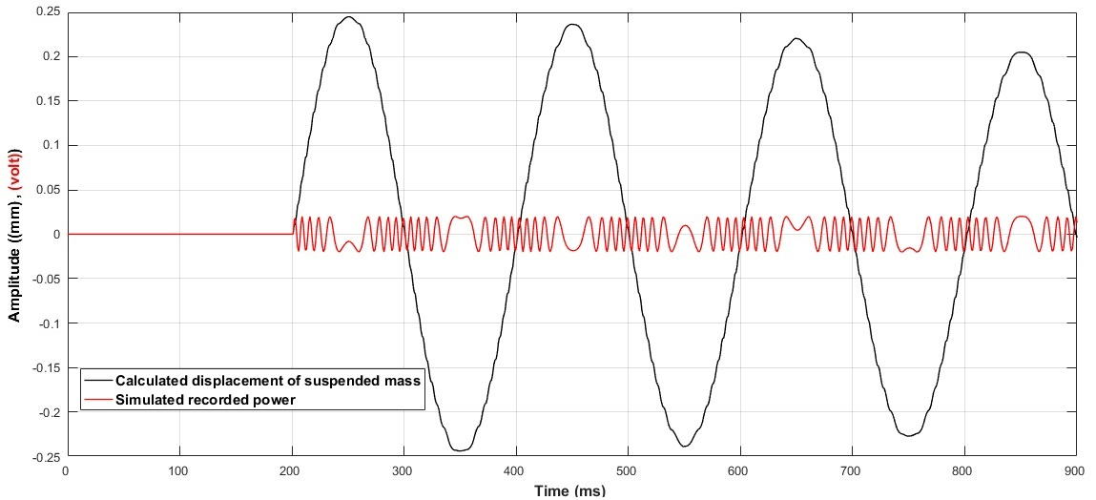
An approach for determination of suspended mass displacements in seismometry
Shamseddin Esmaeili, Anooshiravan Ansari, s.esmaeili@razi.ac.ir, a.ansari@iiees.ac.ir
P3.1-102
In order to validate the performance of the proposed method, we first examine a sample of simulated data. In this case, we consider a simulated time series that occurs for a 5-step grid displacement because both the number of complete rotations and the fraction of a rotation obtained at the power output Is included and thus the ability of the program to identify and calculate the displacement is tested. It should be noted that the damping in this simulation is considered low (0.01) to see more details and to evaluate the program's ability to oscillate with high amplitude. As can be seen, the conversion of the simulated signal into a displacement is achieved with very high accuracy. In the following, the performance of this program is evaluated on real data.
RESULTS

Slide 8
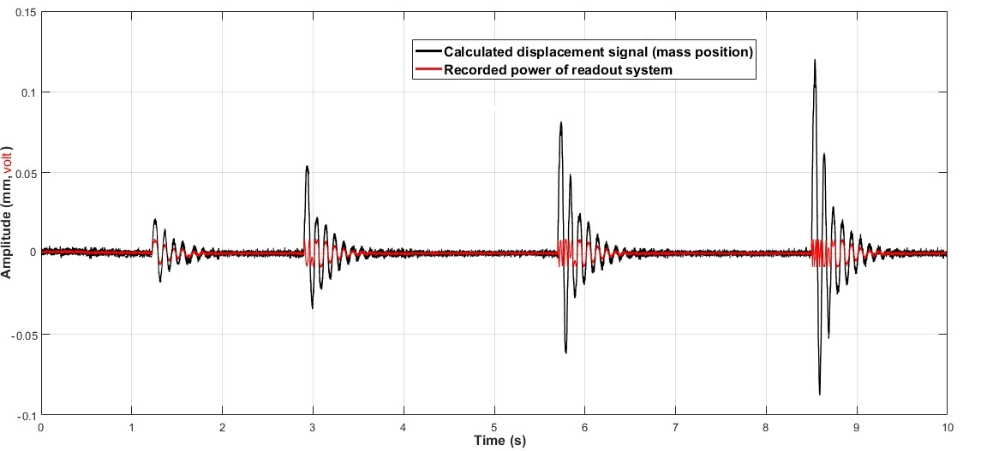
An approach for determination of suspended mass displacements in seismometry
Shamseddin Esmaeili, Anooshiravan Ansari, s.esmaeili@razi.ac.ir, a.ansari@iiees.ac.ir
P3.1-102
In order to evaluate the performance of the proposed method for determining the amplitude of oscillating mass displacement in the real state, calculations were performed on the obtained power signal with different amplitudes, the result of which is presented below. As can be seen in Figure, four seismic pulses with different amplitudes of less than and more than one mesh step (0.05 mm) are applied to the oscillating system, which is signaled by the snake stabilization system. The converted power is shown in red in the figure. The proposed algorithm also well calculates the oscillating mass displacement signal, which is shown in black in the figure. It should be noted that the damping of the oscillating system is 0.1.
RESULTS

Slide 9
An approach for determination of suspended mass displacements in seismometry
Shamseddin Esmaeili, Anooshiravan Ansari, s.esmaeili@razi.ac.ir, a.ansari@iiees.ac.ir
P3.1-102
In this paper, a new method for calculating the exact displacement of the oscillating mass in seismometry based on the snake technique is presented. In this method, two similar rank nets are used to form the snake design, one of which is fixed to the body of the oscillator system and the other is connected to the oscillator mass. Accordingly, the nets have the ability to move relative to each other without physical contact and due to seismic effects. To detect the motion of the freezers displaced by the motion of the grids relative to each other, an arrangement consisting of a laser diode and an optical detector was proposed, which detects the displacement of the oscillating mass. Necessary relations for calculating the displacement signal of the electrical signal obtained are presented in this paper. An algorithm is also proposed to perform the necessary analyzes to calculate the displacement of the obtained electrical signal. In order to validate the calculations and the proposed algorithm, first the simulated data and then the real data were evaluated. The results show the high efficiency and accuracy of the snake optical method and the proposed algorithm for calculating the oscillating mass displacement.
CONCLUSIONS

