Slide 1
CalxPy: a software for the calibration of geophysical systems
against a reference
Benoît Doury¹, Ichrak Ketata²
Poster P3.1-243
¹ CTBTO Preparatory Commission, Vienna, Austria
² Zühlke Engineering GmbH

Slide 2
CalxPy: a software for the calibration of geophysical systems against a reference
Benoît Doury, IMS division, benoit.doury@ctbto.org
Ichrak Ketata, Zuehlke Engineering GmbH, ichrak.ketata@zuehlke.com
P3.1-243
The IMS Operational Manuals for waveform stations require that IMS stations be calibrated regularly. Since 2012, the PTS had relied mostly on electrical calibration to meet that requirement.
However electrical calibration comes with some challenges (no traceability, integration and sustainment issues, high operating costs…).
A part of the geophysical community, including Station Operators, has started performing regular calibrations by comparison against a co-located reference. This method allows a more systematic and centralized approach to calibration. Over the past few years it has been gradually more used at IMS stations, particularly infrasound. In this context, the PTS is developing tools to support this alternative approach.
ABSTRACT
Here we present CalxPy, a web-application developed at the PTS for the calibration of geophysical systems by comparison. With CalxPy, one can calculate, store and display the response of a system for a given period, or track the evolution of the response against time or environmental variables. CalxPy also allows the refinement and evaluation of the measured response against a baseline, and the reporting of IMS2.0 calibration results.
CalxPy supports the Initial calibration and On-site yearly calibration processes, as well as Data Quality Control.
CalxPy can be deployed in the IDC pipeline and in NDC-in-a-box.

Slide 3

CalxPy: a software for the calibration of geophysical systems against a reference
Benoît Doury, IMS division, benoit.doury@ctbto.org
Ichrak Ketata, Zuehlke Engineering GmbH, ichrak.ketata@zuehlke.com
P3.1-243
Extensive testing of a new device model against IMS and manufacturer model specifications
  Testing (full frequency response + self-noise) of a new system in operational conditions against IMS specifications
  Yearly measurements of full frequency response of operational system and comparison against initial calibration results
Testing of an individual device against manufacturer model specifications
INTRODUCTION
Type Approval
Acceptance Testing
Initial Calibration
On-site Calibration
when equipment change
S/N S000x
S/N D000x
S/N W000x
CTBT/WGB/TL-11,17/17/Rev.5

Slide 4
CalxPy: a software for the calibration of geophysical systems against a reference
Benoît Doury, IMS division, benoit.doury@ctbto.org
Ichrak Ketata, Zuehlke Engineering GmbH, ichrak.ketata@zuehlke.com
P3.1-243
History
2014: passive calibration method using side-by-side comparison validated for infrasound technology¹
2015: development and tuning of a prototype in Matlab²
2016: prototype ported to Python scripts and streamlined
validation against initial Matlab prototype (results accuracy)
performance optimized
INTRODUCTION
2017-2018: integration into IDC environment
Integration into internal technology web portal for results representation
Automate runs (monthly and every other day)
2019-2021: Python scripts integrated into a full software solution: CalxPy
Closer match with IMS processes
Adapt software to new non-functional requirements
Develop an interactive frontend to visualize raw data
¹ Gabrielson, 2014
² Charbit, 2015

Slide 5
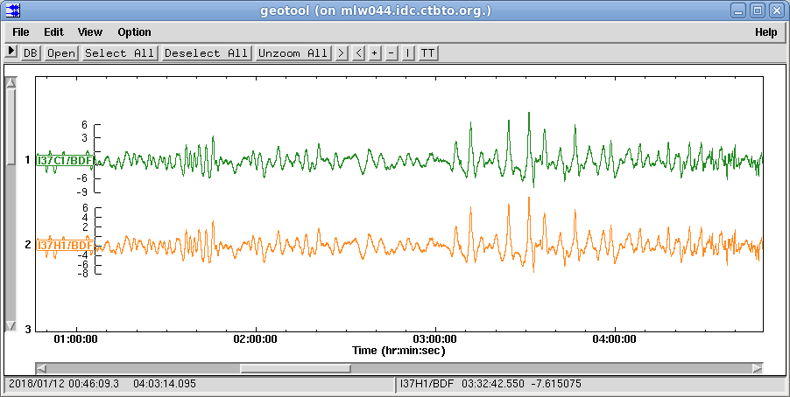

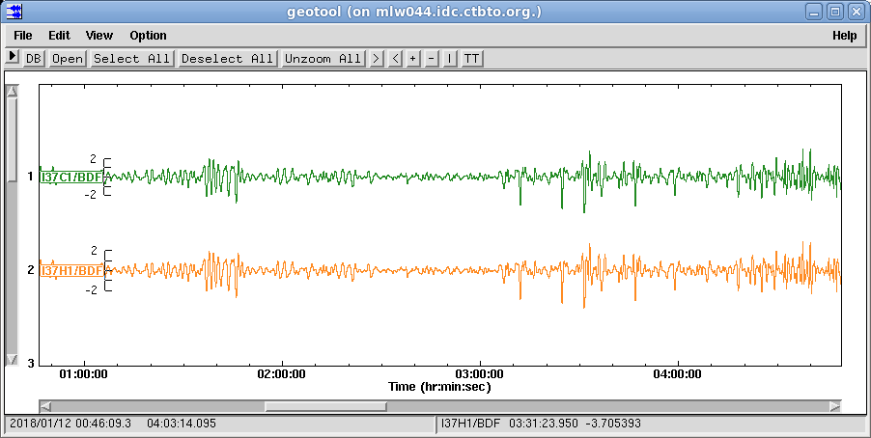
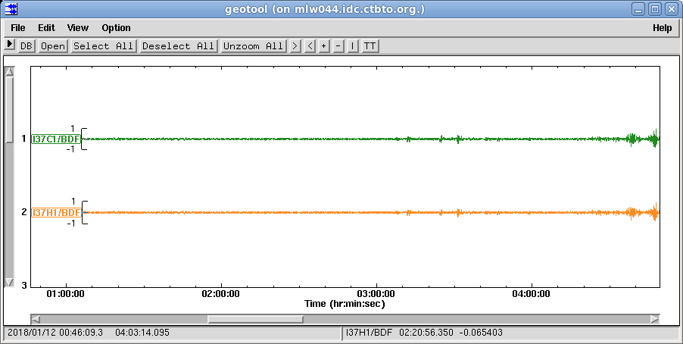

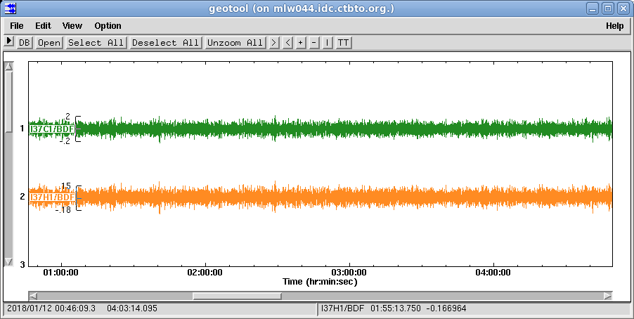
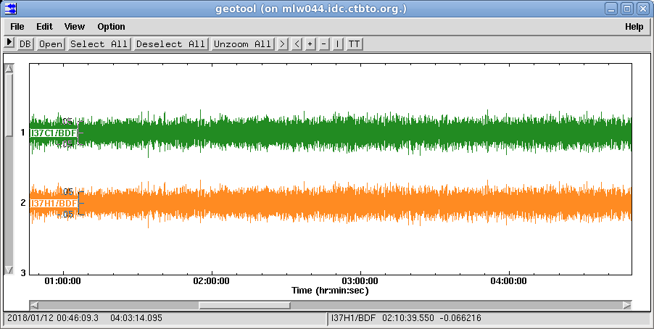
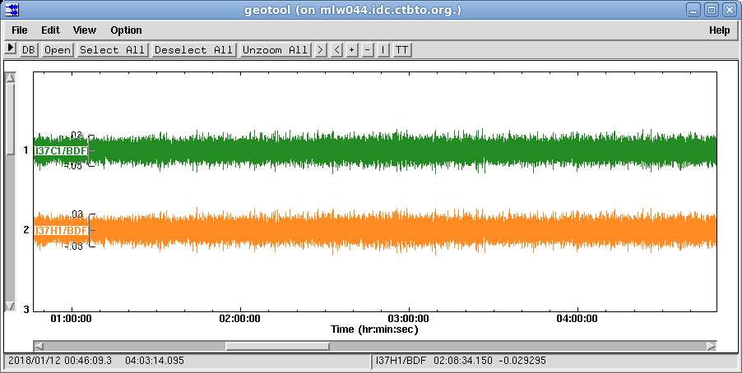
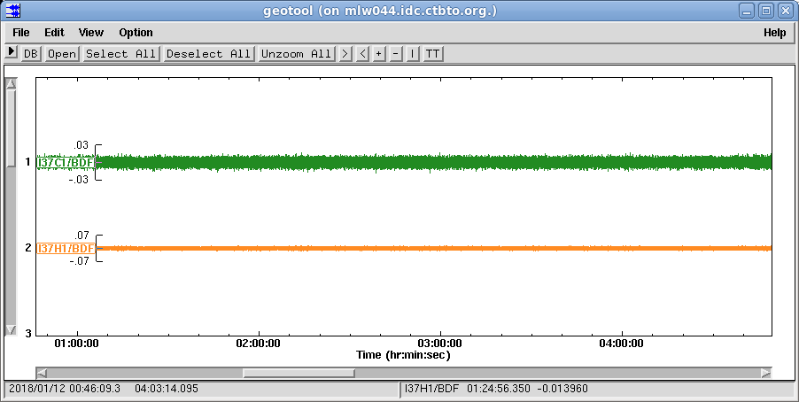
CalxPy: a software for the calibration of geophysical systems against a reference
Benoît Doury, IMS division, benoit.doury@ctbto.org
Ichrak Ketata, Zuehlke Engineering GmbH, ichrak.ketata@zuehlke.com
P3.1-243
Loop on (k,i)
Raw processing overview
C1
x_{H,k,i}(t)
x_{C,k,i}(t)
IDC
H1
50% overlap
1
x_{H,1,1}(t)
PSD
CPSD
PSD
[0.01-0.06 Hz]
1000 s
x_{C,1,1}(t)
2
x_{H,1,2}(t)
METHODS
[0.05-0.15 Hz]
700 s
x_{C,1,2}(t)
ᴕ_{HH,k,i}(f)
ᴕ_{HC,k,i}(f)
ᴕ_{CC,k,i}(f)
3
x_{H,1,3}(t)
[0.14-0.35 Hz]
250 s
x_{C,1,3}(t)
Apply filter k
select time intervals i_{k}
x_{H,1,4}(t)
4
150 s
Response
equation
Coherence
equation
[0.32-0.7 Hz]
x_{C,1,4}(t)
5
x_{H,1,5}(t)
[0.6-1.5 Hz]
30 s
x_{C,1,5}(t)
G_{H,k,i}(f)
MSC_{HC,k,i}(f)
6
20 s
x_{H,1,6}(t)
Frequency Response
Coherence
[1.5-6Hz]
x_{C,1,6}(t)
Raw results

Slide 6
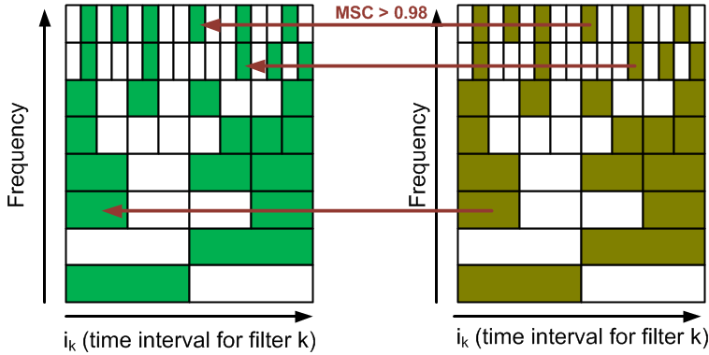
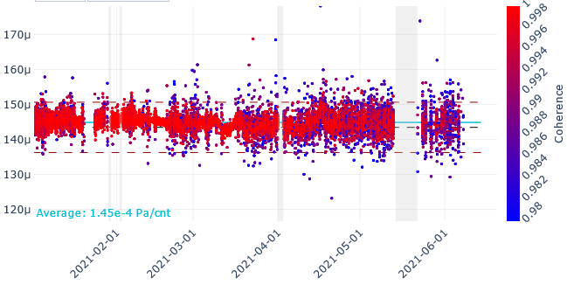
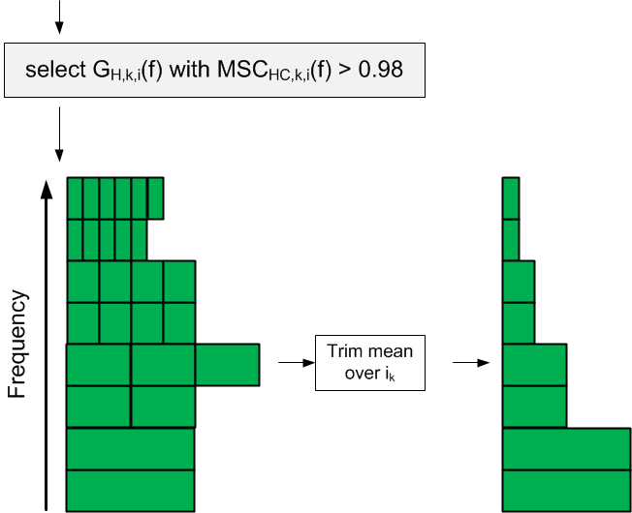
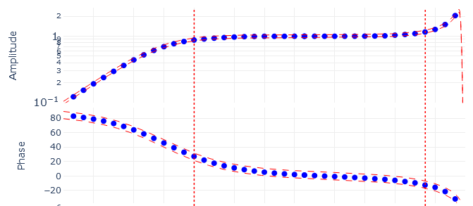
CalxPy: a software for the calibration of geophysical systems against a reference
Benoît Doury, IMS division, benoit.doury@ctbto.org
Ichrak Ketata, Zuehlke Engineering GmbH, ichrak.ketata@zuehlke.com
P3.1-243
Composite Processing overview
ᴕ_{HH,k,i}(f)
ᴕ_{HC,k,i}(f)
Raw
results
ᴕ_{CC,k,i}(f)
Amplitude (Pa/cnt)
@0.25Hz
1
METHODS
Masking Criteria
I37H0 - 2021
Amplitude
Composite results
Phase
2

Slide 7


CalxPy: a software for the calibration of geophysical systems against a reference
Benoît Doury, IMS division, benoit.doury@ctbto.org
Ichrak Ketata, Zuehlke Engineering GmbH, ichrak.ketata@zuehlke.com
P3.1-243
Initial and Scheduled Calibration
Quality Control
IMS Operational Manuals
IMS2.0 Formats and Protocol
Quality Assurance documents
Raw Results exploration
Continuous tracking
Detect configuration changes
Identify trends, seasonal patterns
Sensitivity to environment
Alerts
CALIB / NCALIB
Full frequency response
Evaluation
METHODS
IN_SPEC YES / NO
IMS2.0
Functional Requirements

Slide 8






CalxPy: a software for the calibration of geophysical systems against a reference
Benoît Doury, IMS division, benoit.doury@ctbto.org
Ichrak Ketata, Zuehlke Engineering GmbH, ichrak.ketata@zuehlke.com
P3.1-243
Scalable
Can run in distributed IDC environment (300+ site pairs), but also on a field laptop (NDC in a box)
Non-Functional Requirements
Versatile
Can be used with other waveform technologies Support CSS and MiniSEED
Integrated
Provides a standard interface to other IDC software (for the scheduling, evaluation and publication of results)
METHODS
Smooth
Exploration and Interactive visualization of Raw and Composite results is smooth for the end user
Reproducible
Processing parameters used to obtain results are enough documented to allow reproducibility and re-use on new data sets
Tested and Testable
Core of the algorithm is fully tested and testable
Trustworthy
Guaranties integrity of published results (authentication, safe transactions with VDMS, …)

Slide 9


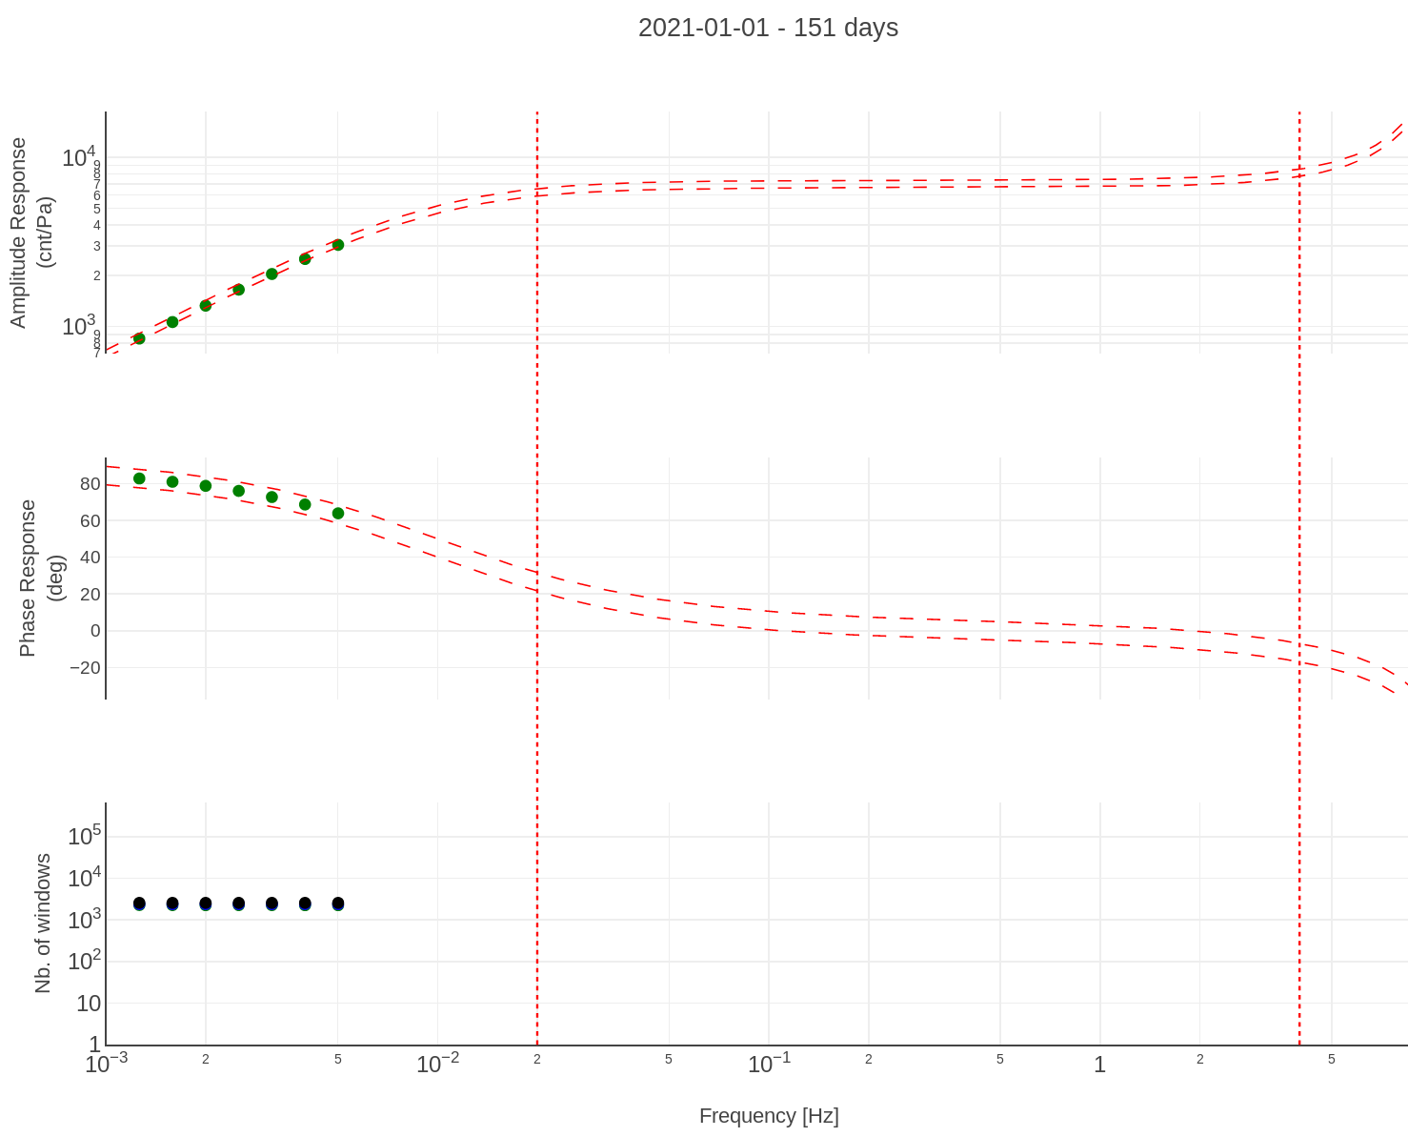



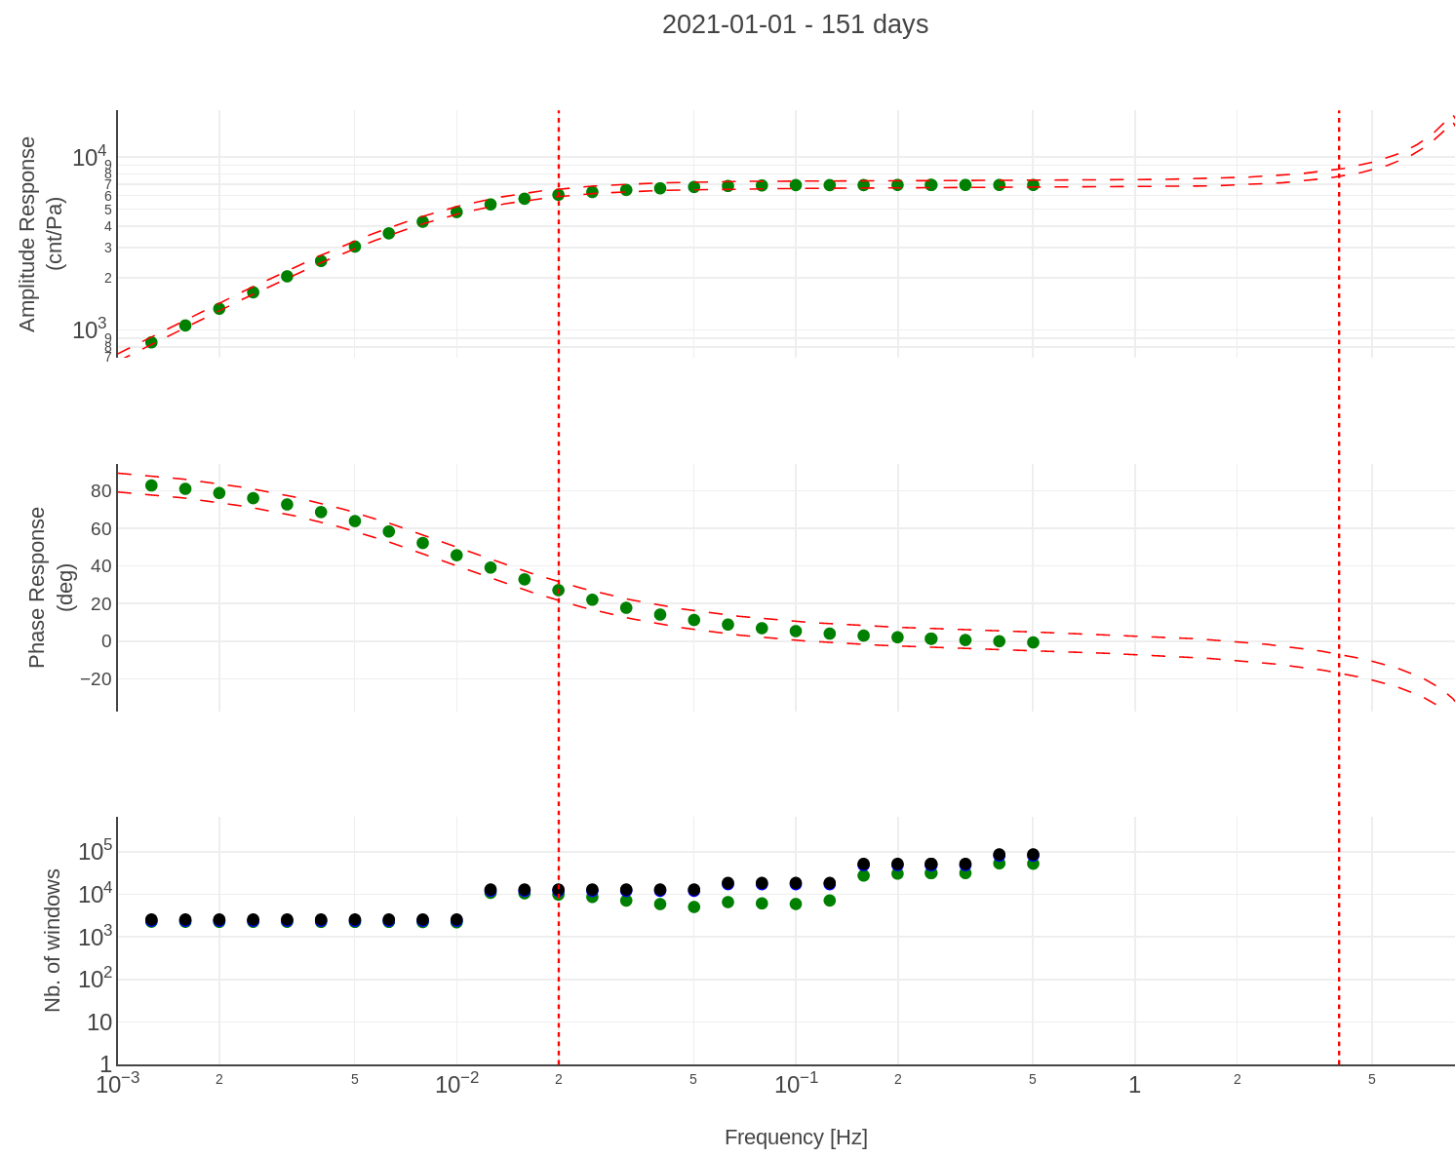
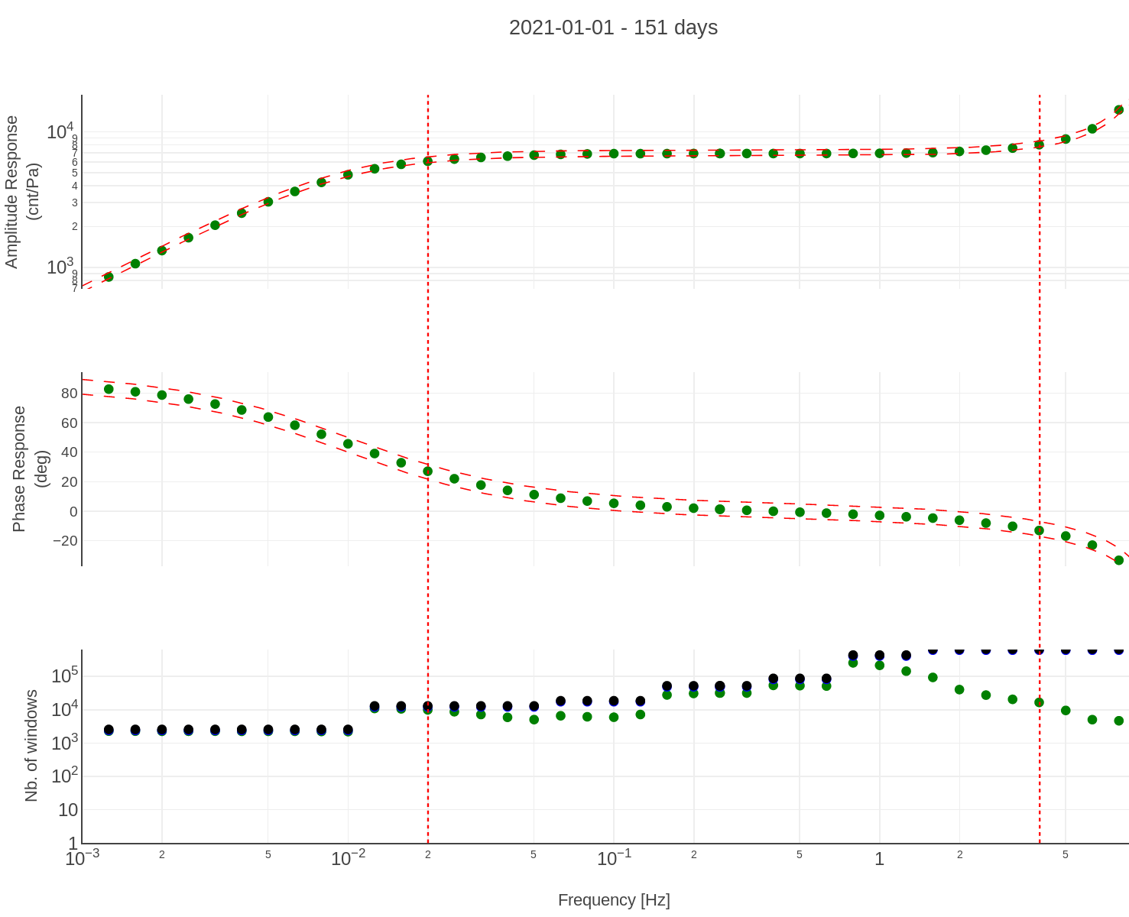



CalxPy: a software for the calibration of geophysical systems against a reference
Benoît Doury, IMS division, benoit.doury@ctbto.org
Ichrak Ketata, Zuehlke Engineering GmbH, ichrak.ketata@zuehlke.com
P3.1-243
Requirements
The user can start multiple computations in parallel
The user can continue navigating during computation
Software engineering
Example of challenge: Computing composite responses “on-the-fly”
Frontend
Start Task
Backend Server
RabbitMQ
Add to queue
Challenges
The computation includes big amounts of data (up to 1.6 millions records for 1 year of data)
The computation can take several minutes
Task ID
Queue
Get latest from Result Store
Task Progress / Computed Values
Get Task Status by ID
Get Task to be executed
METHODS
Solution: Asynchronous Computation
Celery Worker
The user starts new computation from the web interface
A task ID is generated and sent back to the frontend
The task is added to the queue of the message broker RabbitMQ
Save Status
Save Results
(Authorization)
The Celery worker consumes this task and starts the computation
The status of computation is saved to the file system
Result Store
PostgreSQL DB
The frontend application checks the status of execution periodically and updates the plot

Slide 10
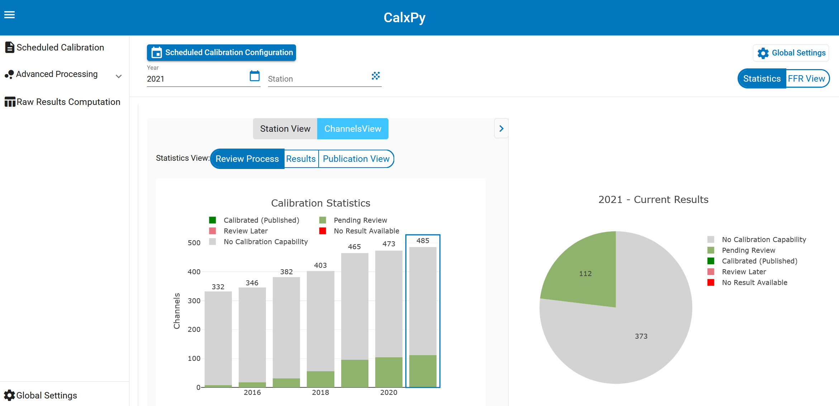
CalxPy: a software for the calibration of geophysical systems against a reference
Benoît Doury, IMS division, benoit.doury@ctbto.org
Ichrak Ketata, Zuehlke Engineering GmbH, ichrak.ketata@zuehlke.com
P3.1-243
Scheduled Calibration
Statistics
Historical statistics
Station / Channel Views
Process, Results
and Publication statistics
Select a year for review
RESULTS

Slide 11
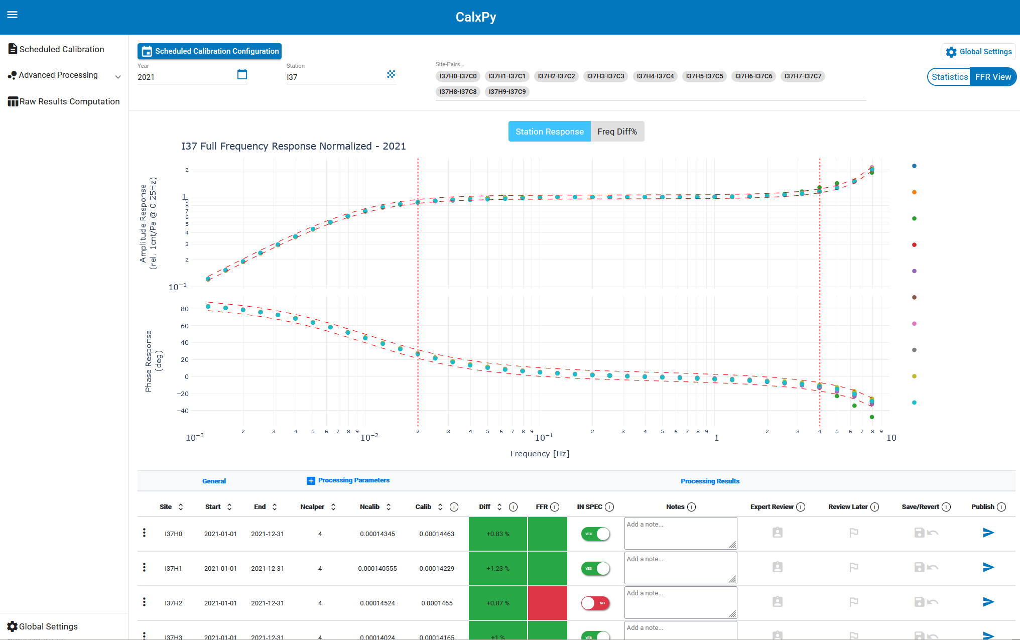


CalxPy: a software for the calibration of geophysical systems against a reference
Benoît Doury, IMS division, benoit.doury@ctbto.org
Ichrak Ketata, Zuehlke Engineering GmbH, ichrak.ketata@zuehlke.com
P3.1-243
Scheduled Calibration
Station view
1.
I37H0/BDF
I37H1/BDF
Quick overview of station calibration
I37H2/BDF
Expand (see next slide)
I37H3/BDF
RESULTS
I37H4/BDF
I37H5/BDF
Auto-evaluation
I37H6/BDF
I37H7/BDF
Reviewer makes his evaluation
I37H8/BDF
I37H9/BDF
Mark for expert review?
Publish result (IMS2.0 or JSON)
3.
2.
4.
5.
6.

Slide 12
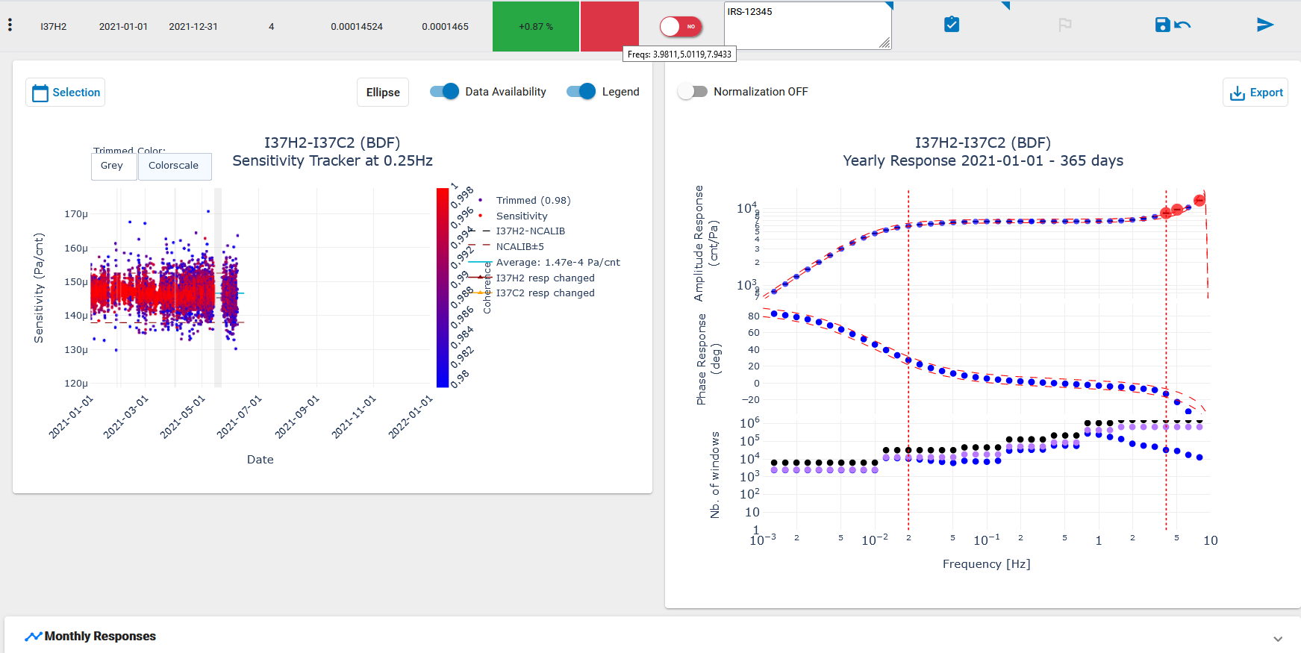
CalxPy: a software for the calibration of geophysical systems against a reference
Benoît Doury, IMS division, benoit.doury@ctbto.org
Ichrak Ketata, Zuehlke Engineering GmbH, ichrak.ketata@zuehlke.com
P3.1-243
Scheduled Calibration
Expand a site
5.
6.
3.
4.
Display points out of +/-5% tolerance
2.
Visualize missing data
RESULTS
Change dates selection
Recompute
Mark for expert review
Publish result (IMS2.0 or JSON)

Slide 13
CalxPy: a software for the calibration of geophysical systems against a reference
Benoît Doury, IMS division, benoit.doury@ctbto.org
Ichrak Ketata, Zuehlke Engineering GmbH, ichrak.ketata@zuehlke.com
P3.1-243
The geophysical community, including Station Operators, is performing regular calibrations by comparison against a co-located reference
The PTS is developing the CalxPy software to support this approach
CalxPy closely supports PTS processes for Quality Assurance (Device Acceptance, Initial Calibration, Scheduled Calibration) and Quality Control
CalxPy is a web application designed to allow for a smooth and interactive user experience even when running against very large datasets (300+ site pairs over 10 years)
Results in CalxPy can be exported in a way (JSON) that allows reproducibility of results
CalxPy can be deployed in the IDC pipeline (distributed) and in NDC-in-a-box (standalone)
CONCLUSIONS

