Slide 1
Novel IDC software applications for Radionuclide data analysis
Abdelhakim Gheddou
Abdelhakim.Gheddou@ctbto.org
O3.5-573

Slide 2
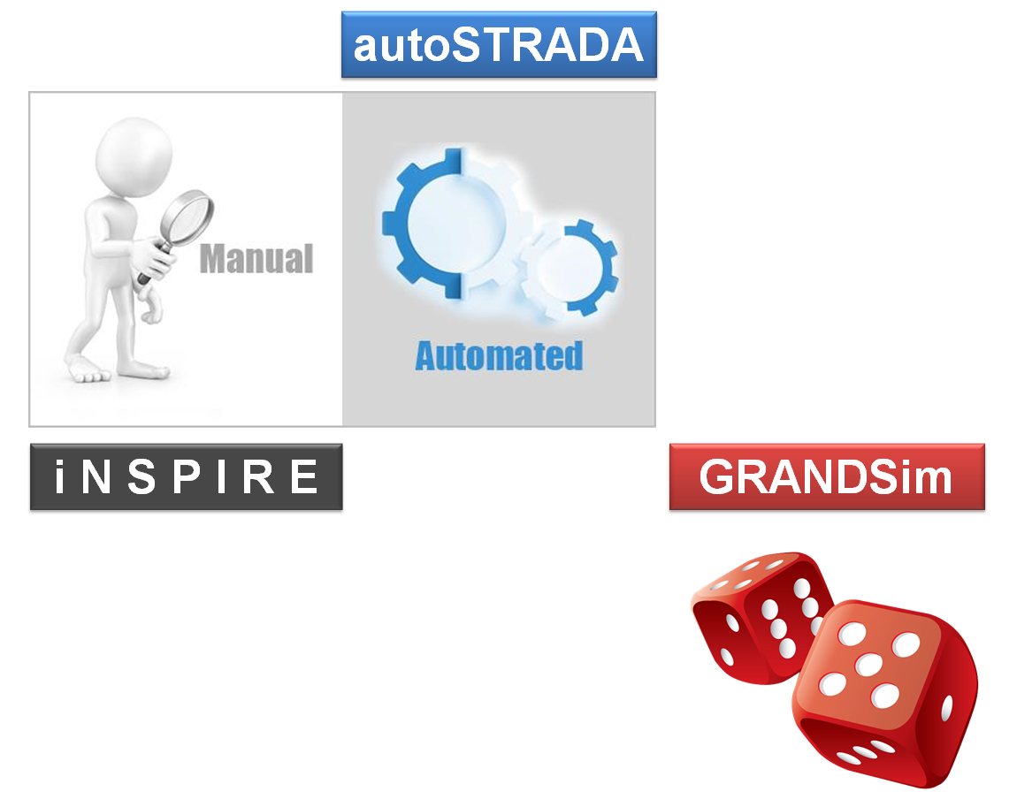

Outline
Hakim Gheddou, International Data Centre
Abdelhakim.gheddou@ctbto.org
O3.5-573
The CTBTO International Data Centre (IDC) is developing novel software applications for modernizing automatic processing and interactive analysis of radionuclide data from the International Monitoring System (IMS).
The projects aim at completing the migration to open source license free software, unifying the processing tools for particulates and noble gas, integrating new technologies and analysis methods as well as enhancing the IDC products and dissemination tools for National Data Centers (NDCs).
The presentation will provide updated status and future plans on ongoing projects:
iNtegrated Software Platform for Interactive Radionuclide rEview (iNSPIRE),
automatic Software Tool for RAdionuclide Data Analysis (autoSTRADA),
Geant4 based RAdioNuclide Detector Simulation (GRANDSim)
The new web based application (RNToolkit).
RNToolkit

Slide 3
O3.5-573
iNSPIRE
for interactive analysis

Slide 4
iNSPIRE
for interactive analysis (1/3)
O3.5-573
iNSPIRE is intended for the interactive review of automatic processing results as generated by automatic software applications of the Radionuclide pipeline.
iNSPIRE provides relevant features and dedicated functionalities to Analysts for checking the data
quality, performing the standard interactive review and introducing necessary corrections to automatic processing results as appropriate.
In addition to sample spectra analysis, the GUI is also used to interactively check all auxiliary spectral data (gas and detector backgrounds, Quality Control and spike spectra).
iNSPIRE software allows assignment of spectra to individual users with required roles and permissions as configured in the database. Interactive changes are only allowed when the spectrum is assigned to the current user.
iNSPIRE is a python language/ Qt framework as a widget toolkit based license-free application.
It runs on Linux Operating System under the standard configuration IDC environment (file system structure and database schema of the Radionuclide pipeline).
In routine analysis mode, iNSPIRE runs in RMSMAN schema for releasing RRR (Reviewed Radionuclide Report).
iNSPIRE also handles additional use cases in the context of special studies and expert technical analysis. It runs then in the new database schema RMSExpert for creating the new IDC product URR (Updated Radionuclide Report).

Slide 5
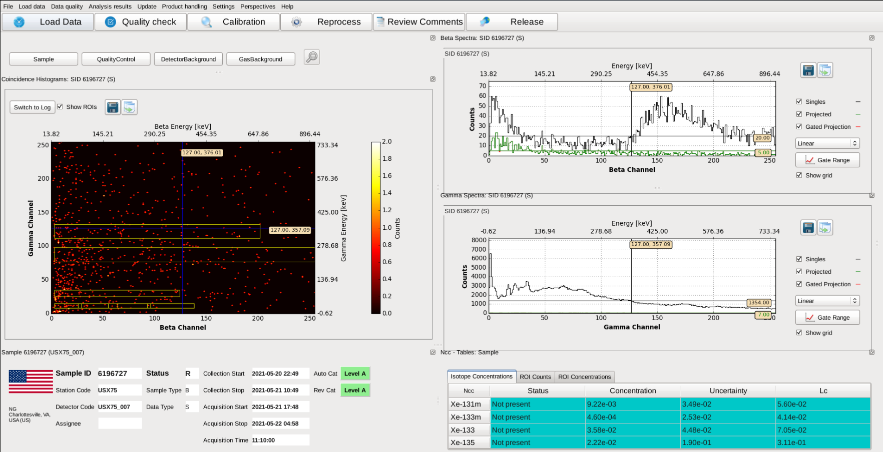
iNSPIRE
for interactive analysis (2/3)
O3.5-573
The first release of iNSPIRE is used in IDC Operations since late May 2021.
This covers the functionalities for beta–gamma noble gas data analysis.
The new version was also delivered to NDCs in November 2020
(Centos 7, Virtual Machine + rpm packages)
The integrated set of iNSPIRE functionalities will further boost the quality of the IDC reviewed products.
In addition to handling currently operated noble gas systems,
iNSPIRE will also process next generation-noble gas technologies.

Slide 6
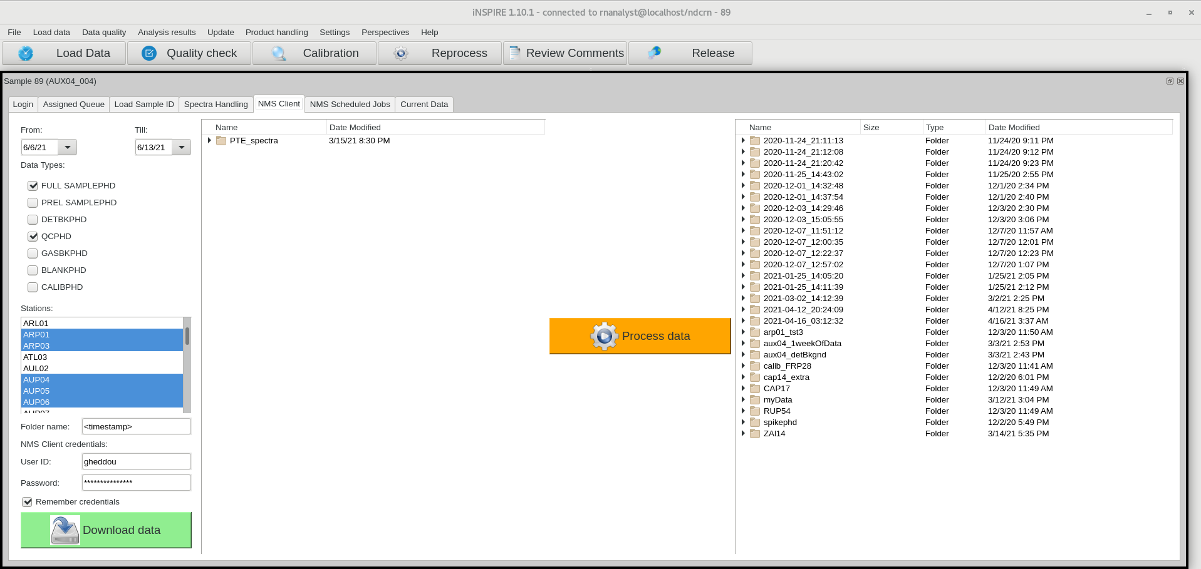
iNSPIRE
for interactive analysis (3/3)
O3.5-573
The version of iNSPIRE in NDC-in-a-Box offers features for downloading IMS data and performing the automatic processing from within iNSPIRE GUI

Slide 7
O3.5-573
autoSTRADA
for automatic processing

Slide 8
autoSTRADA
for automatic processing (1/3)
O3.5-573
In order to ensure smooth integration of next generation noble gas systems, the CTBTO IDC developed a new software tool dubbed autoSTRADA (automatic Software Tool for RAdionuclide Data Analysis).
Both currently operated SAUNA II systems and next generation technologies (SPALAX NG, Xenon International, MIKS and SAUNA III) will be handled by autoSTRADA. The implementation allows data from all systems to be automatically processed using the same software tool, taking into account their inherent specificities.
In addition to the already implemented Net Count Calculation (NCC) method, autoSTRADA modular design will also support new analysis methods of the four CTBT relevant radioxenon isotopes (Xe-131m, Xe-133, Xe-133m and Xe-135) in IMS spectral data of noble gas systems.
The software runs completely automatically without human intervention. The user will control the software through command line parameters.
The software will be used for automatic processing when connected to the RMSAUTO database and as part of the interactive analysis when connected to the RMSMAN database. It also supports the new database schema RMSEXPERT for the new IDC product URR (Updated Radionuclide Report).
autoSTRADA code uses open source license free modern software development framework technology and shares libraries with iNSPIRE.

Slide 9
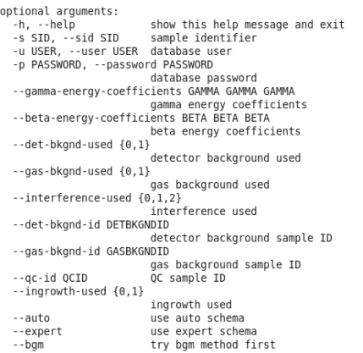
autoSTRADA
for automatic processing (2/3)
O3.5-573
autoSTRADA status
  Compared with CEA software for SPALAX NG.
  Compared with PNNL software for Xenon International.
  Tested with one year of data from SAUNA; benchmarked with bg_analyze.
  Integrated BGM module (FOI software delivered within SAUNA III acceptance testing).
  autoSTRADA supports now both standard NCC and BGM analysis algorithms.
  Under final pre-release testing on IDC testbed.
  Will be promoted to IDC operations for replacing bg_analyze.
  Will be integrated in upcoming release of NDC-in-a-Box.

Slide 10
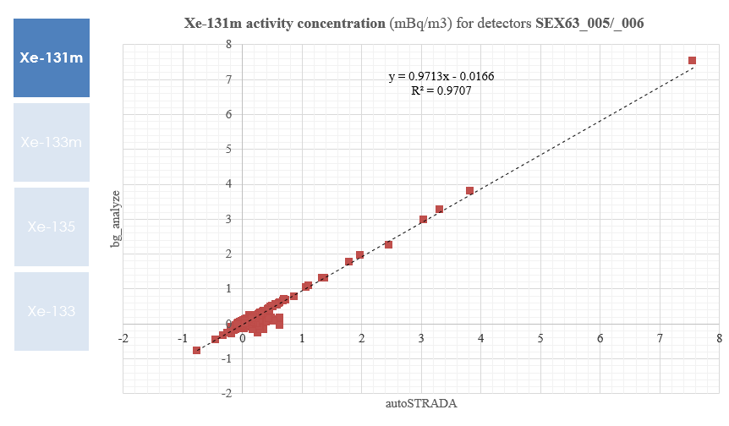
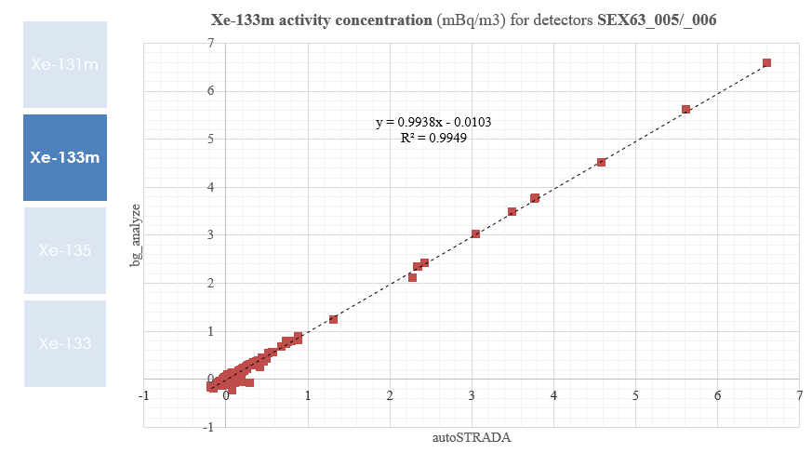
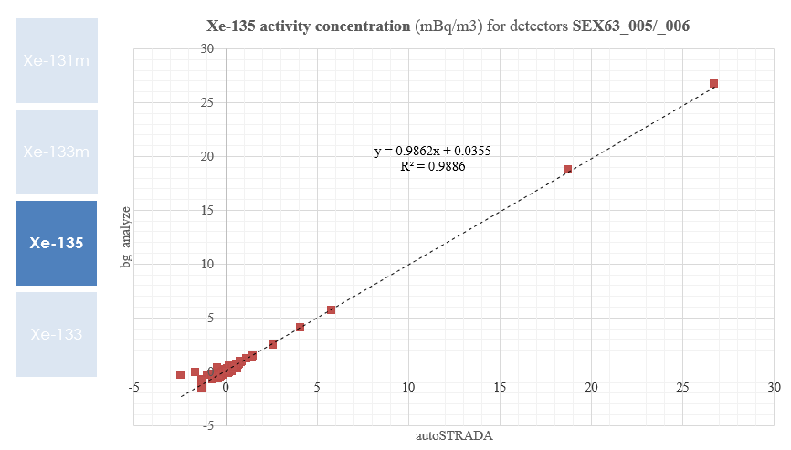
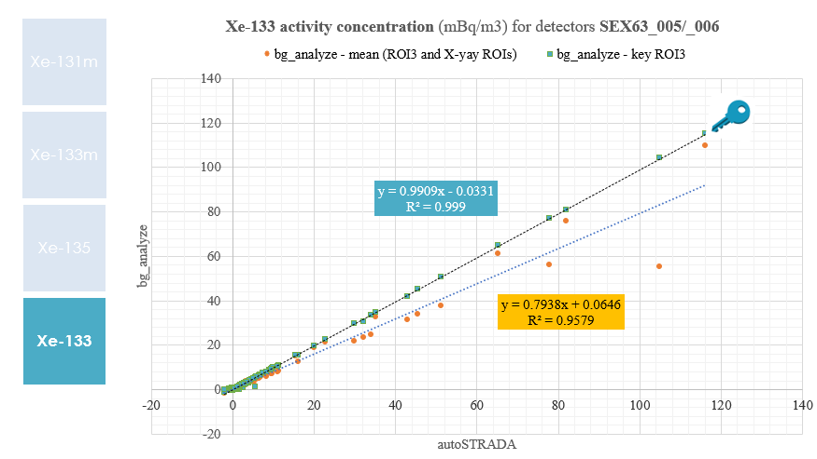
autoSTRADA
for automatic processing (3/3)
O3.5-573
Xe-131m, Xe-133m and Xe-135: excellent agreement
Xe-133: bg_analyze key ROI 3 in excellent agreement with autoSTRADA (ROI 3 based)

Slide 11
O3.5-573
GRANDSim
for Monte Carlo simulation

Slide 12
GRANDSim
for Monte Carlo simulation (1/5)
O3.5-573
Monte Carlo simulation (MC) produces output parameters which allow:
Improving the efficiency calibration data quality (by including coincidence summing corrections);
Enhancing nuclide identification results (by including summation peaks) which reduces the Analysts workload in interactive mode;
Ensuring reliable activity concentration results by including required coincidence summing corrections when applicable.
The IDC was operating a MC simulation tool limited to HPGe gamma detector systems in use at IMS particulate stations.
The tool called VGSL (Virtual Gamma Spectroscopy Laboratory) uses MCNP license dependent code.
Therefore the IDC could not distribute VGSL as part of the NDC-in-a-Box software package.
GRANDSim is a Geant 4 based simulation software for radionuclide detectors in use at IMS.
  Status:
  - Oct 2020: alpha version provided to NDCs + Webinar
  - Apr – Jun 2021: pre-release testing by IDC Analysts

Slide 13
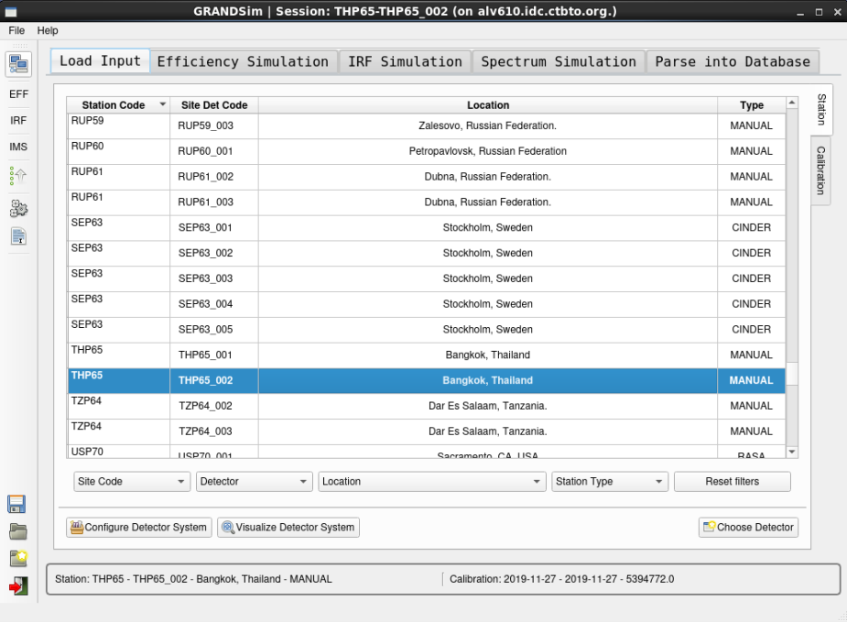

GRANDSim
for Monte Carlo simulation (2/5)
O3.5-573
(a) Database mode:
  Input setup parameters (detector, sample, shielding) from DOTS (Database Of the Technical Secretariat) database.
  Experimental calibration from GARDS (Global Atmospheric Radionuclide Detection System) database.
  Simulation output (Efficiency, IRF and CSC) will be parsed into GARDS database.
(b) Standalone mode:
  Input will be read from local configuration.
  Can also be provided from the GUI.
  Output (ascii files) into filesystem.

Slide 14
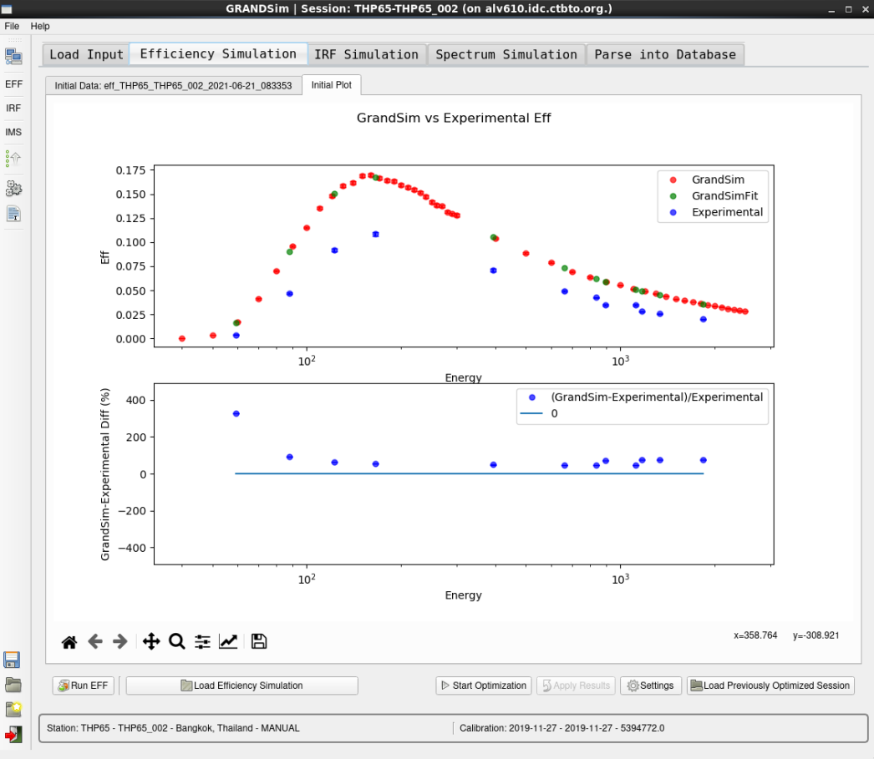

GRANDSim
for Monte Carlo simulation (3/5)
O3.5-573
Model optimization
GRANDSim performs consistency check between simulation and experimental efficiency.
The physical model is automatically optimized by constraining simulation results against experimental calibration for non-summing energies.
Optimized parameters
- Manual and Cindrella stations:
  thickness of detector top dead layer
  distance crystal to end-cap
- RASA stations:
  thickness of side dead layer
  sample holder diameter

Slide 15
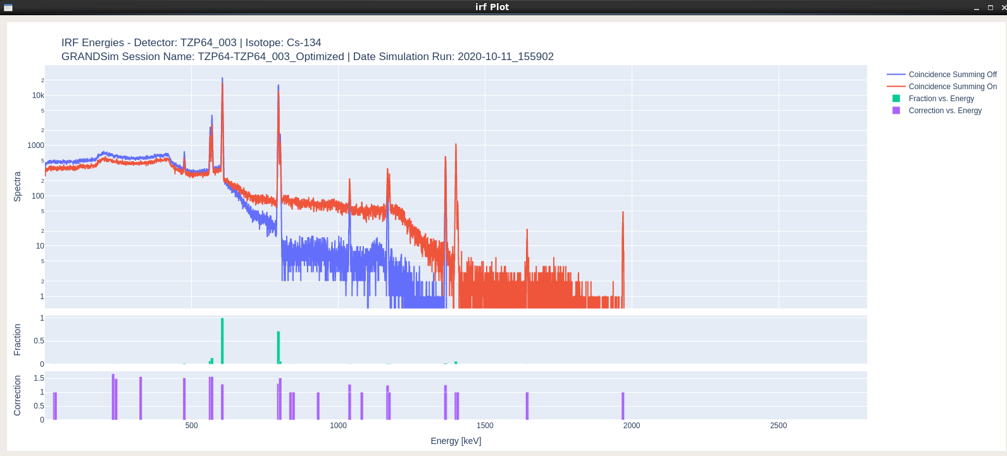
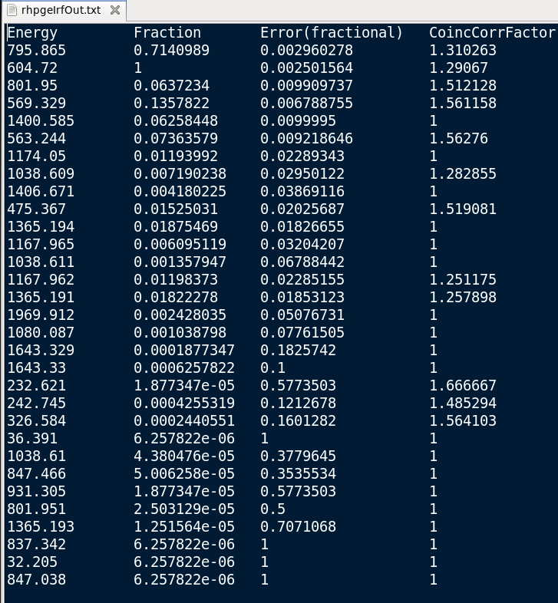
GRANDSim
for Monte Carlo simulation (4/5)
O3.5-573
Isotope Response Function (IRF) and Cascade Summing Corrections (CSC)

Slide 16
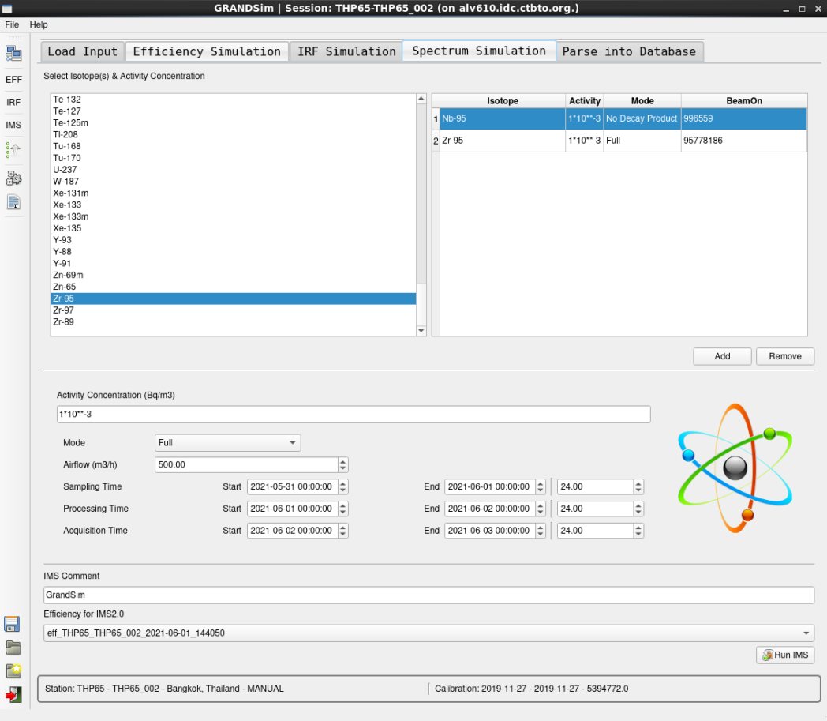
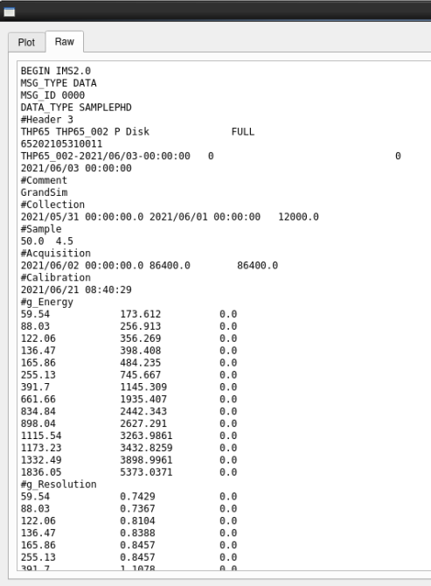
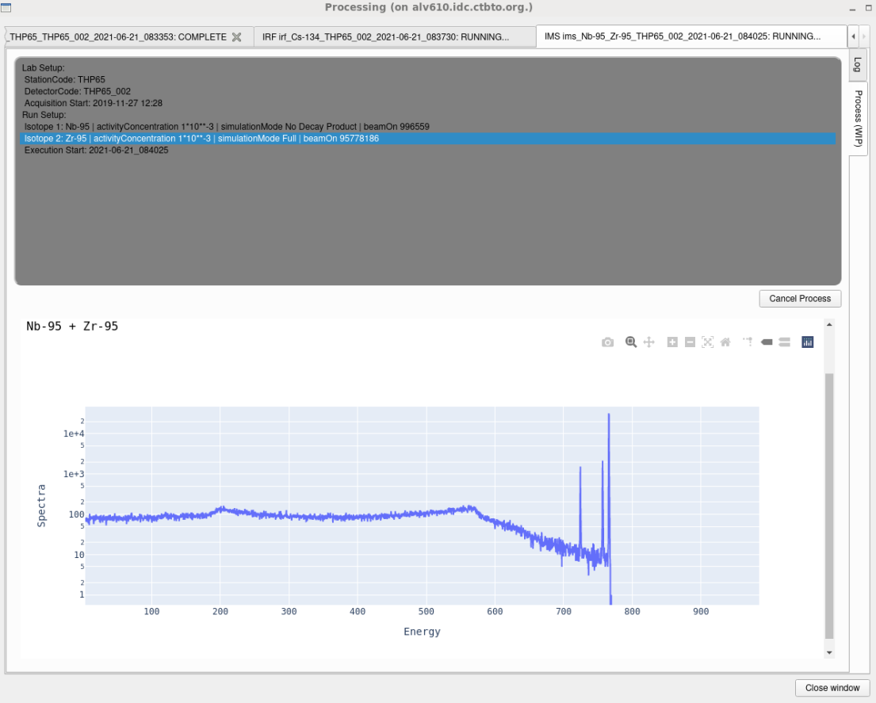
GRANDSim
for Monte Carlo simulation (5/5)
O3.5-573
Simulation of sample spectra for any source term. Output in IMS2.0 format

Slide 17
O3.5-573
RNToolkit
web-based application

Slide 18
RNToolkit
web-based application (1/4)
O3.5-573
With the aim of further empowering National Data Centres (CND), the IDC developed a novel web-based application, dubbed RNToolkit.
RNToolkit offers several options that the user can customize for accommodating specific needs, for in-depth spatial-temporal analysis of anthropogenic activity concentrations that might be released into the air by a nuclear test.
Main functionalities include time development of detected nuclides, activity concentration, categorization parameters and isotopic ratios. It also provides contextual access to IDC products for any sample.
Among the key features, detections at different stations can be compared for any CTBT radionuclide.
Furthermore, RNToolkit allows tracking of detections on IMS map for targeted days and in animated mode for a time frame of interest.
In addition to CTBT verification related activities as a main application domain, RNToolkit also constitutes a powerful resource for the purposes of radiological impact assessment studies, namely in the case of a major nuclear accident.
Current status:
- Delivered to NDCs in March 2021
- Accessible with SSO credentials on https://rntoolkit.ctbto.org/

Slide 19
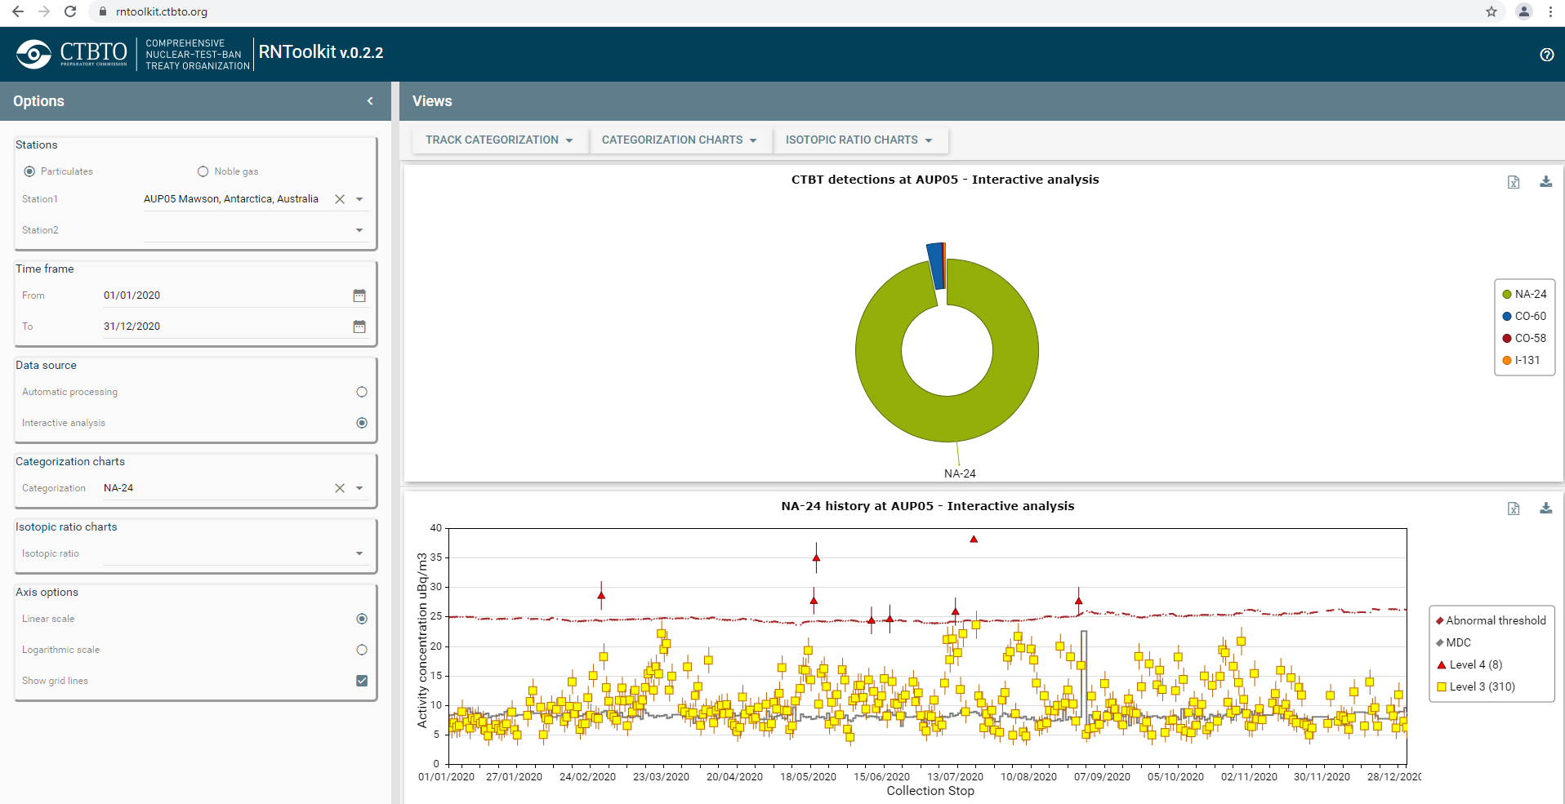
RNToolkit
web-based application (2/4)
O3.5-573
Time development of detected nuclides, activity concentration, categorization parameters

Slide 20
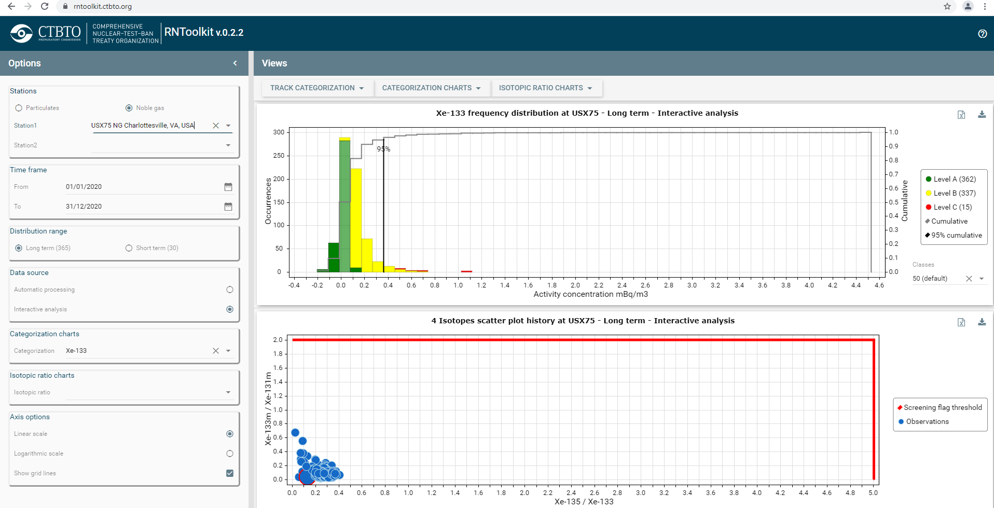
RNToolkit
web-based application (3/4)
O3.5-573
Frequency distribution plot of sample category results.
Radioxenon isotope ratios plots with screening flag threshold lines.

Slide 21
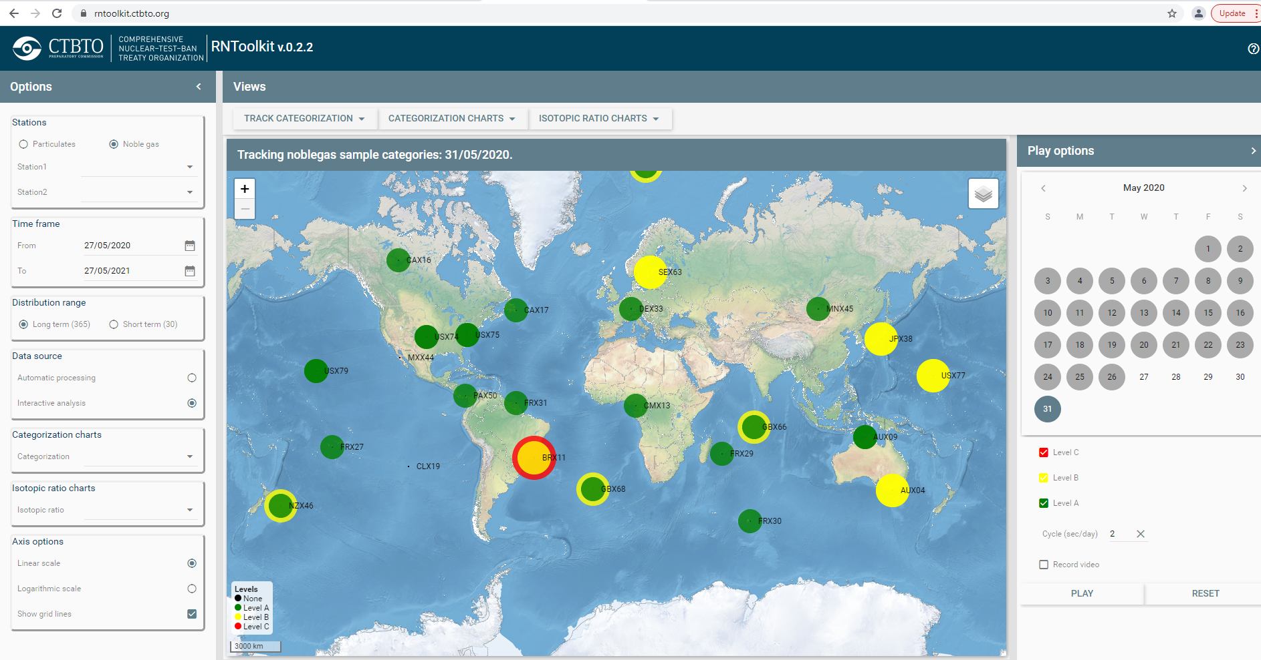
RNToolkit
web-based application (4/4)
O3.5-573
Tacking of detections on IMS map for targeted days and in animated mode for a time frame of interest.

Slide 22
O3.5-573
Summary

Slide 23
Summary
O3.5-573
iNSPIRE (interactive analysis):
  Deployed in IDC the production
  Handles both current and next generation noble gas systems
autoSTRADA (automatic processing):
  Supports two analysis algorithms (NCC and BGM)
  Under final pre-release testing
  Will handle both current and next generation noble gas systems
GRANDSim (Monte Carlo simulation):
  Full functionality for particulates
  Under final pre-release testing
RNToolkit (radionuclide web-based “browser”):
  Particulates and noble gas
  Delivered to NDCs

Slide 24
Thank you!

