Slide 1
On the requirements for validation data sets in potential future scientific projects for enhancing and developing methods to highlight possible nuclear explosion signatures in radionuclide monitoring
Martin Kalinowski, Jolanta Kusmierczyk-Michulec, Boxue Liu, Anne Tipka
IDC/CTBTO, Vienna, Austria
P3.5-610

Slide 2
Abstract
P3.5-610
The discrimination between the highly variable radioxenon background caused by normal operations of nuclear facilities and CTBT-relevant events is a challenging but crucial task. For this reason, the radioxenon background at IMS noble gas systems must be sufficiently characterized and understood. The scientific methods and software tools to do this can still be significantly enhanced. This presentation summarizes relevant scientific project line-outs that would serve this purpose and make use of atmospheric transport modelling (ATM). These include methods for associating multiple samples to the same release event, provision of higher source location estimates, developing of the screening flag “ATM backtracking to known sources”, corrections to ATM in case of systematic discrepancies between observed and simulated concentrations from a known source due to complex terrain, land sea breeze, and mountains, as well as the use of isotopic ratio measurements for screening. For each of these possible projects, the atmospheric radioxenon measurement data required for developing and validating the methods and tools is described. These build on IMS noble gas measurements possibly supplemented by data from temporary experiments with transportable noble gas measurement systems.
ABSTRACT

Slide 3
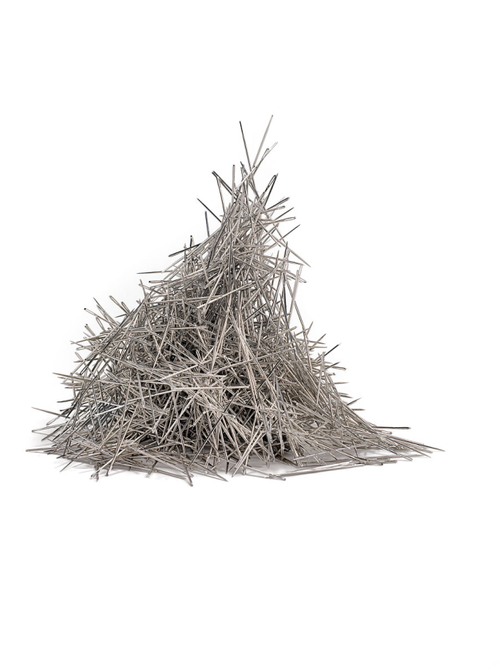
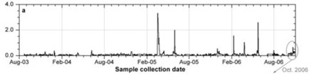
What are the problems
that we are trying to solve?
P3.5-610
“Needle in a needle stack”: Xe-133 from nuclear explosion same as from civil facilities.
Level C every day but still insufficient: every Level B (10,000 per year!) might indicate a nuclear explosion and may still be above 1 mBq/m³ = network design requirement.
INTRODUCTION
Blinding effect: Small signal from a nuclear explosion may be covered up by large background from civilian sources.
Multiple sources on the continent
Hard to relate to a relevant SHI event: Association with close-by source often inconclusive due to further downwind civil sources.
IMS station
Regional source

Slide 4
How to address these problems
with IDC analysis methods:
P3.5-610
“Needle in a needle stack”: Xe-133 from nuclear explosion is the same as from civil facilities.
Level C every day but still insufficient: every Level B may be caused by a nuclear explosion (10,000 per year!) and may still be above 1 mBq/m³ = network design requirement.
Blinding effect: Small signal from a nuclear explosion may be covered up by large background from civilian sources.
Hard to relate to a relevant SHI event: Association with close-by source often inconclusive due to further downwind civil sources.
Categorization scheme (Levels A, B, C) and screening flags.
SSREB*: Multi-sample association and Possible Source Region (PSR).
Long time series analysis.
Flag “ATM backtracking to known sources”.
PSR and known sources combined.
* SSREB = Standard Screened Radionuclide Event Bulletin
INTRODUCTION

Slide 5
How validation data sets
could help develop IDC analysis methods:
P3.5-610
Get higher number of experimental cases with multiple detections than achievable with sparse network needed to validate PSR.
Validate ATM models with NG observations in the vicinity of the IMS station.
Learn to distinguish close from far sources at IMS station by observations in the vicinity.
Validate quantitative PSR method.
SSREB: Multi-sample association and Possible Source Region (PSR).
Long time series analysis.
Flag “ATM backtracking to known sources”.
PSR and known sources combined.
INTRODUCTION

Slide 6
Overview
P3.5-610
Proposal: Method for associating samples to the same release event
Proposal: Provide more accurate estimates of the possible location of the source of an event and test the different PSR options
Proposal: Developing the screening flag "ATM backtracking to known sources" for ARR and RRR
Proposal a: Complex terrain - Mountains
Proposal b: Complex terrain – Land-sea Breeze
Proposal: Use of isotopic ratio measurements for screening
PROPOSALS

Slide 7
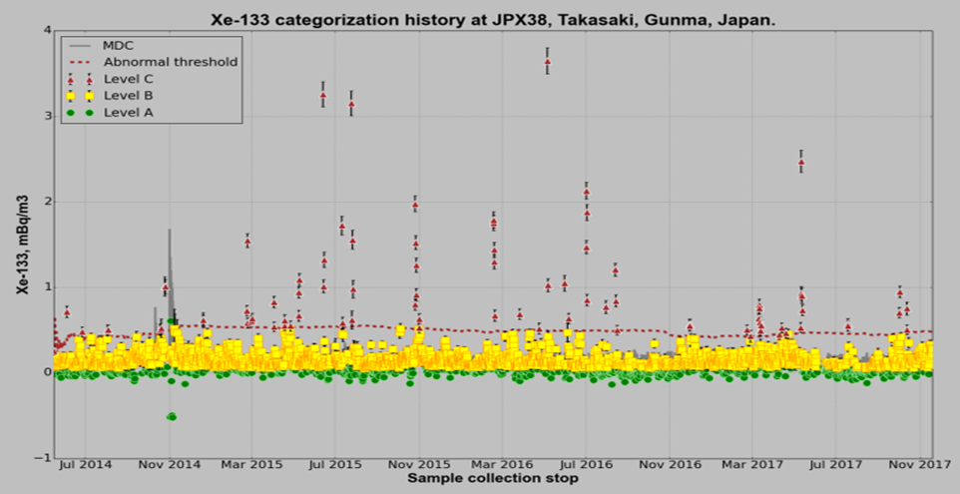
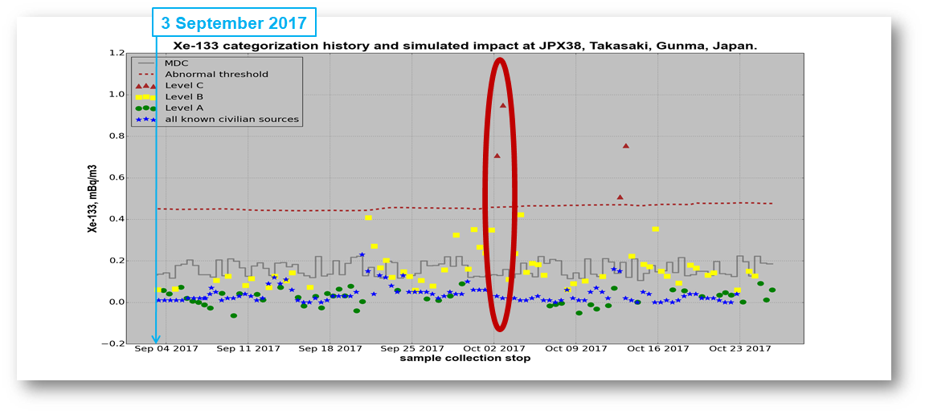
Proposal 1:
Method for associating samples
to the same release event
P3.5-610
1. What is the problem to be solved?
  The possible source region (PSR) is still missing in the SSREB.
  PSR for Expert Technical Simulations is based on subjective decisions.
  One trigger condition for sending samples to CTBT radionuclide lab to be automated.
2. Which method is to be applied to address the problem?
  Alternative mathematical algorithms will be developed and compared to identify the best one.
3. What is the expected outcome?
  A validated method for associating samples. Implementation in the SSREB.
4. What kind of data is required?
  Need multiple detections at different sites from one dominating source. Can best be achieved with a transportable system in the vicinity of an IMS system.
5. Host region requirements for transportable system (if applicable)
  In vicinity of an IMS noble gas system.
  Downwind from a major emitter (MIPF).
PROPOSALS

Slide 8
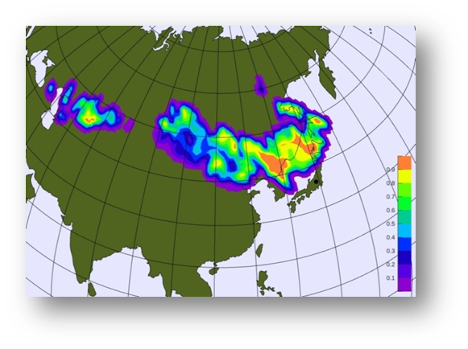
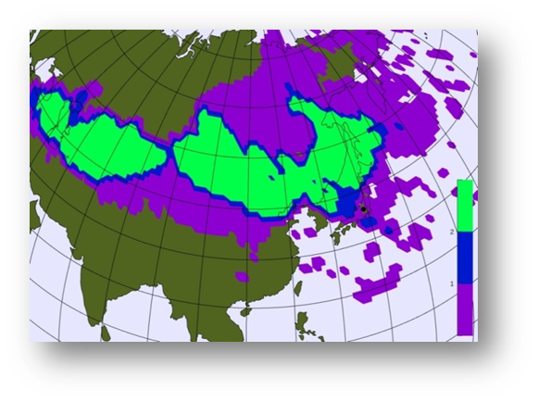
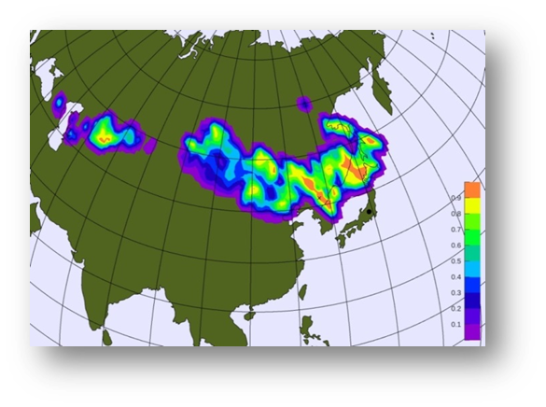
Proposal 2:
Provide more accurate estimates of the possible location of the source of an event and test the different PSR options
P3.5-610
1. What is the problem to be solved?
  The possible source region (PSR) is based on subjective decisions
  Different PSR options require testing
2. Which method is to be applied to address the problem?
  Alternative mathematical algorithms will be developed and compared to identify the best one.
  Optimized ATM parametrization will result in more accurate SRS fields.
3. What is the expected outcome?
  More accurate estimation of the possible location of the source of an event
  Different PSR options
4. What kind of data is required?
Additional experimental data collected in different topographical conditions, preferably by two collocated sampling systems operating e.g. at different heights, in a valley versus in a mountain, along a coast versus inland etc
ATM simulations to understand detections
5. Host region requirements for transportable system (if applicable)
  In vicinity of an IMS noble gas system.
  Downwind from major emitters, preferably with well-defined emissions.
  In areas representing different topographical conditions
PROPOSALS

Slide 9
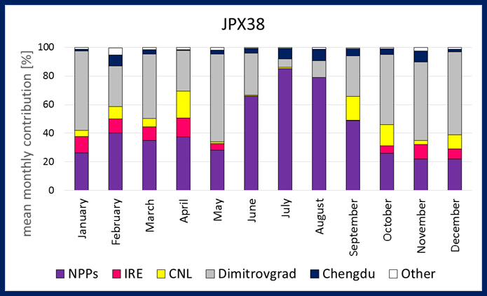
Proposal 3:
Developing the screening flag
"ATM backtracking to known sources" for ARR and RRR
P3.5-610
1. What is the problem to be solved?
  More accurate estimation of the source term parameters (localisation, temporal release profile, total amount of radioactivity released) in case of a nuclear test.
2. Which method is to be applied to address the problem?
  Different mathematical techniques applied to data set consisting of detections from the IMS and transportable NG systems and SRS fields.
3. What is the expected outcome?
  Estimation of the radioxenon contribution from known sources to every sample collected by noble gas systems at IMS stations
  The screening flag "ATM backtracking to known sources" for ARR and RRR
4. What kind of data is required?
Additional experimental data collected in different topographical conditions (different heights, in a valley versus in a mountain, along a coast versus inland etc)
ATM simulations to understand detections
5. Host region requirements for transportable system (if applicable)
  In vicinity of an IMS noble gas system.
  Downwind from major emitters ( e.g. MIPFs, NPPs), preferably in areas heavily influenced by emissions from non-treaty activities.
  In areas representing different topographical conditions
PROPOSALS
Mean monthly contribution of Xe-133 emissions from individual sources as observed at IMS stations. The results are based on operationally produced ATM results (backward modelling) using meteorological data from ECMWF.

Slide 10
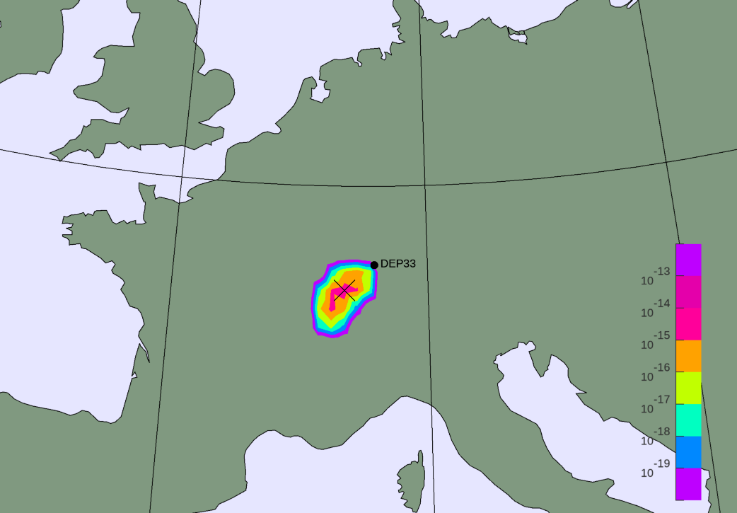
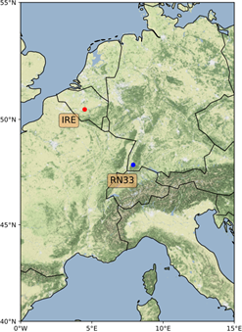
Proposal 4a:
Complex terrain - Mountains
P3.5-610
1. What is the problem to be solved?
  Understand the effects of turbulence around mountainy IMS stations to be able to interpret ATM results.
  Verify the representativity of the IMS locations in mountainy locations.
2. Which method is to be applied to address the problem?
  Applying a sensitivity study of input and output parameters with ATM and comparing the results with measurements (spatial variability).
  Fine tuning of ATM.
3. What is the expected outcome?
  Observed and modelled concentrations should show a similar frequency distribution.
  Improvement of final ATM products, specifically in ETA. Depending on results, might also influence RRR and ARR.
4. What kind of data is required?
  Multiple sources in a close range of the IMS station and at varying heights at significant locations of the complex region.
5. Host region requirements for transportable system (if applicable)
  Region with an IMS station in a mountainy region where emissions from nearby sources are frequently detected. Additional stations should be located around IMS station at various heights, preferably in more open areas, at mountain slopes and a mountain face.
PROPOSALS

Slide 11
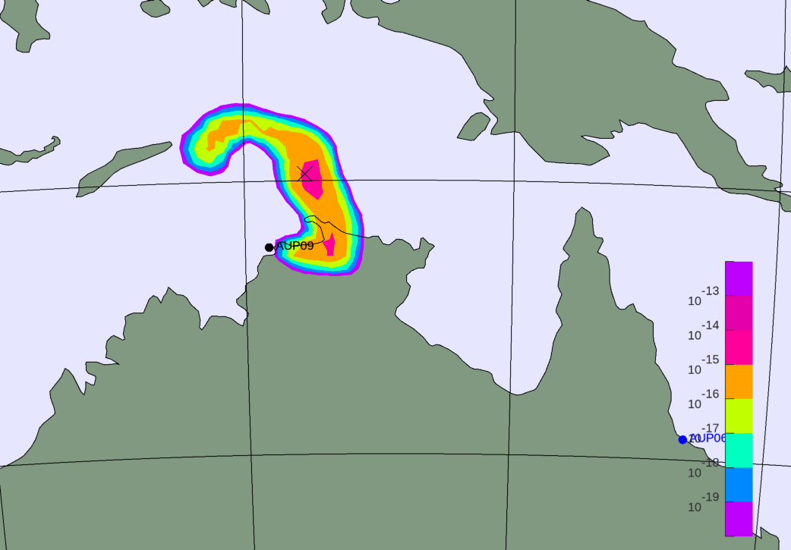
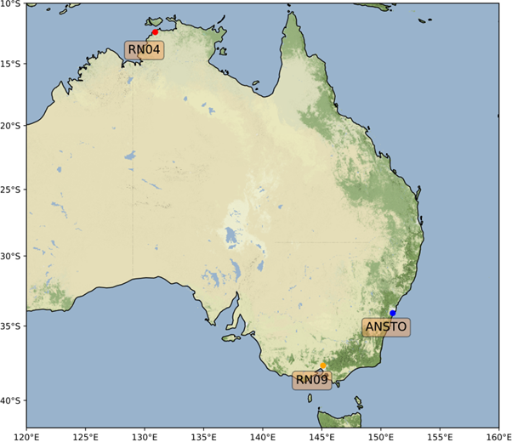
Proposal 4b:
Complex terrain – Land-sea breeze
P3.5-610
1. What is the problem to be solved?
  Understand the effects of turbulence and influences of land-sea breeze on measurements of IMS stations to be able to interpret ATM results.
  Verify the representativity of the IMS locations at the coast.
2. Which method is to be applied to address the problem?
  Applying a sensitivity study of input and output parameters with ATM and comparing the results with measurements (spatial variability).
  Fine tuning of ATM.
3. What is the expected outcome?
  Observed and modelled concentrations should show a similar frequency distribution.
  Improvement of final ATM products, specifically in ETA. Depending on results, might also influence RRR and ARR.
4. What kind of data is required?
  Multiple measurements in a close range of the IMS station and at varying distances and significant locations from the coast.
  Campaign should last at least for a year to capture all seasons.
5. Host region requirements for transportable system (if applicable)
  Region with IMS station close to the coast and experiencing land-sea breeze, preferably a location with complex terrain and a nearby source (e.g. MIPF).
  Possibility to add transportable systems scattered around IMS station and at varying distances to the coast. Maybe also in different terrains.
PROPOSALS

Slide 12
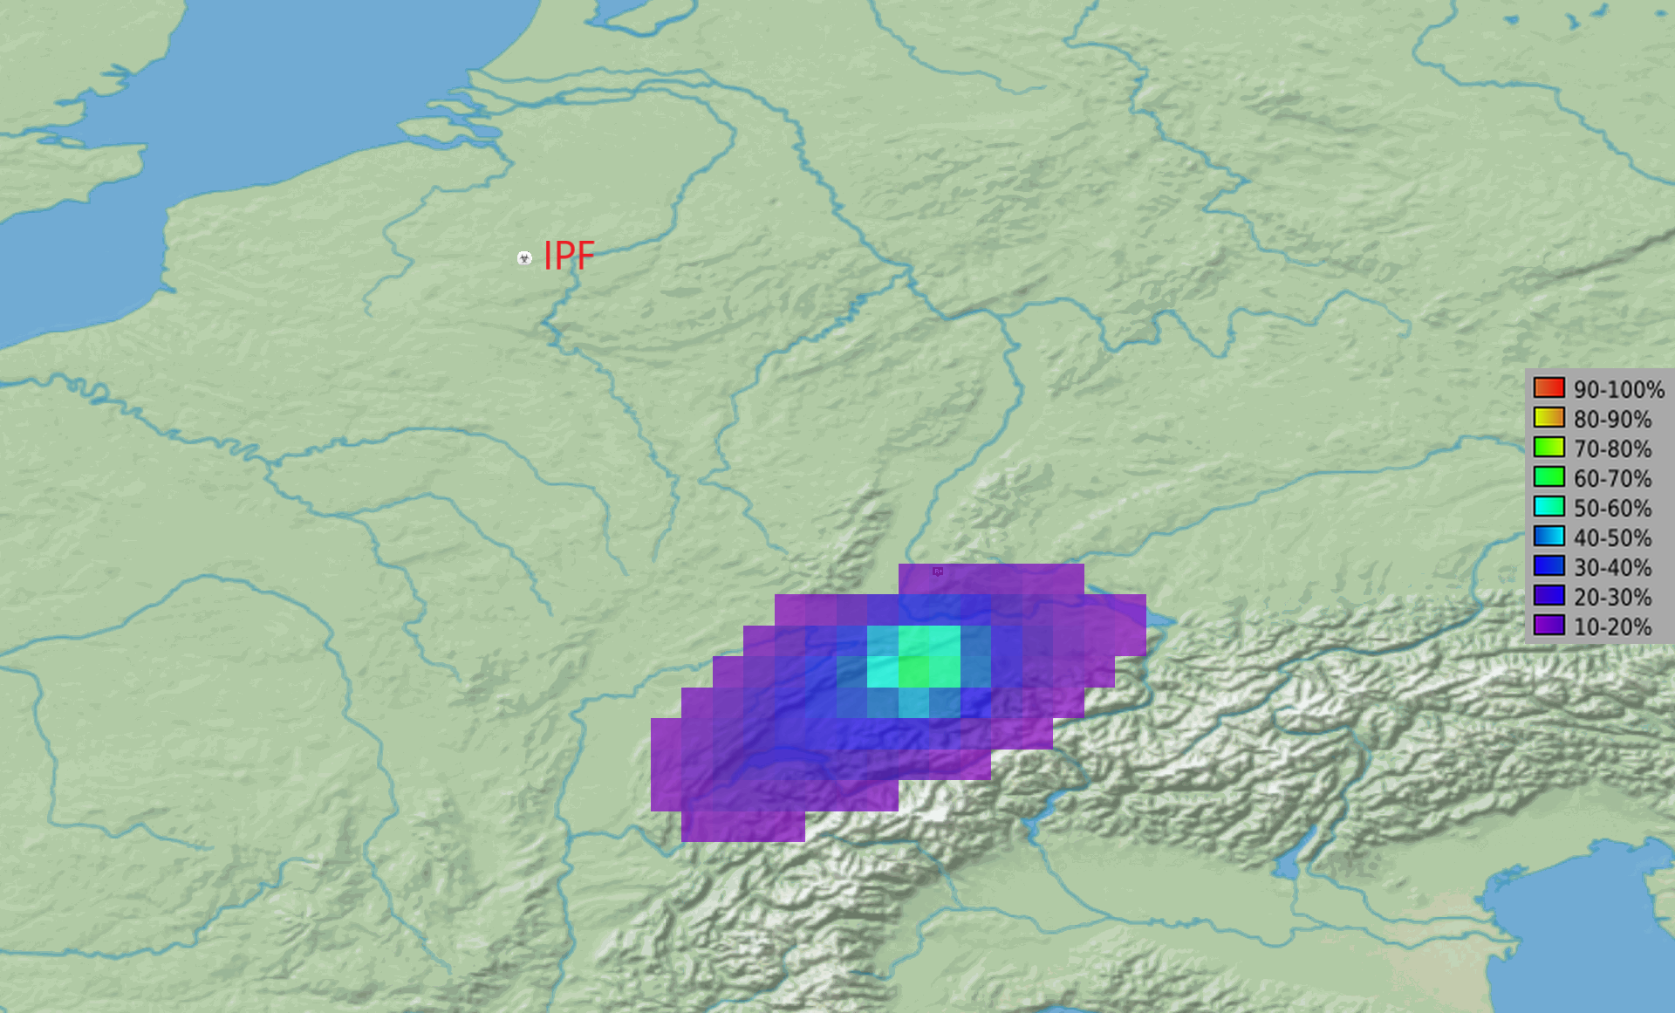
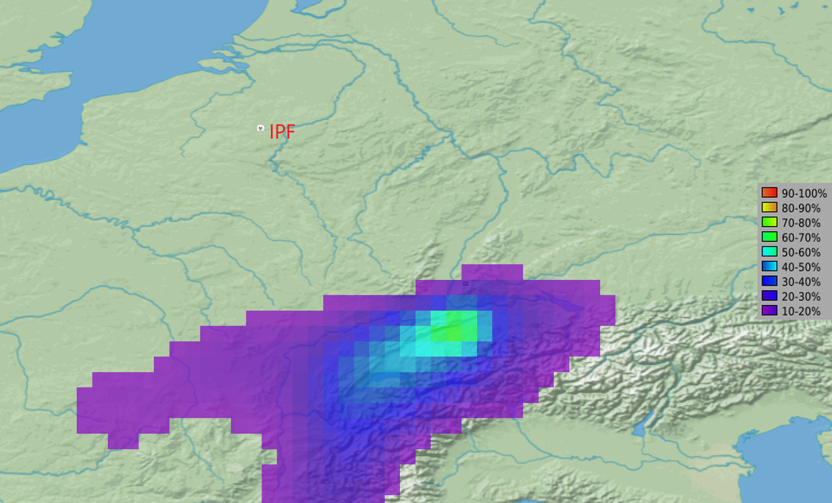
Proposal 5:
Use of isotopic ratio measurements for screening
P3.5-610
1. What is the problem to be solved?
  Even though multiple radioxenon isotopes are often observed at IMS stations, the methods of using isotopic ratios for discriminating between known sources and possible signals from nuclear tests are insufficient.
2. Which method is to be applied to address the problem?
  Kernel density estimates of probability distributions for radioxenon concentrations at IMS stations from known sources.
3. What is the expected outcome?
  Derive probability distributions of isotopic ratios at IMS stations from known sources to adjust and validate analysis methods of isotopic ratios for event screening flags, expert technical analysis and special studies.
4. What kind of data is required?
  Statistically relevant large data set of radioxenon observations caused by known sources are missing. Due to short half-live of Xe-135, ratios with this isotope are rarely observed at IMS NG systems (see figures).
5. Host region requirements for transportable system (if applicable)
  Locations where well-defined emissions can be observed, such as IRE and ANSTO.
PROPOSALS
Examples of the Network Coverage for DEX33 in winter 2020. Upper Panel: Xe-135; Bottom Panel: Xe133. The red sign indicates IPF in Fleurus (IRE) . The color-coded percentage indicates the area monitored by DEX33 with sufficient sensitivity to trigger detection.

Slide 13
Summary
P3.5-610
This presentation describes possible scientific projects to develop and enhance IDC analysis methods for radioxenon samples with different objectives:
Closing gaps in standard IDC products, including
      Screening flag “ATM backtracking to known sources” in Automatic/Reviewed Radionuclide Reports
      and associating multiple samples to the same radionuclide release event as foreseen in the SSREB (Standard Screened Radionuclide Event Bulletin).
Enhancing ATM output
      Identifying the most precise method for the Possible Source Region
      Correcting for errors due to complex terrain (mountains, land-sea breeze)
Sufficiently characterize the radioxenon background at IMS noble gas system
      Among others by optimizing the use of isotopic activity ratios.
Appropriate validation data sets will make sure that scientific methods and software tools for radioxenon monitoring can be significantly enhanced.
among others methods for, for. It describes what radioxenon measurement data are required to validate the results.
CONCLUSIONS

