Slide 1

ARMD — a suite of Analysis system for CTBT Radionuclide Monitoring Data
Zhang Xin-jun, Wang Shi-Lian, Li Qi, Fan Yuan-qing, Jia Huai-Mao, Zhao Yun-Gang
P3.5-345

Slide 2
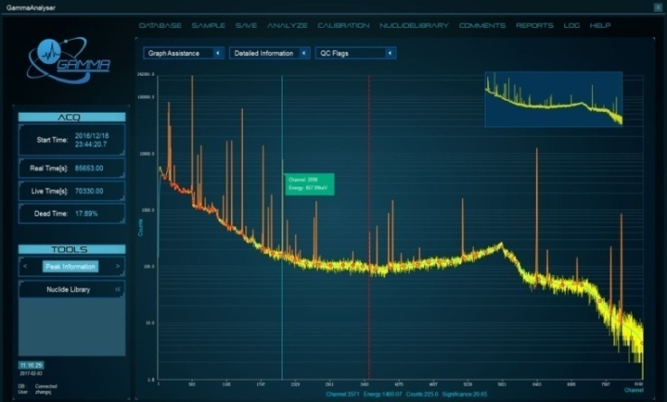
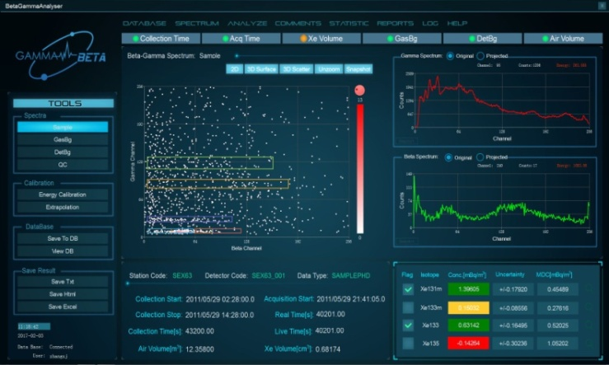
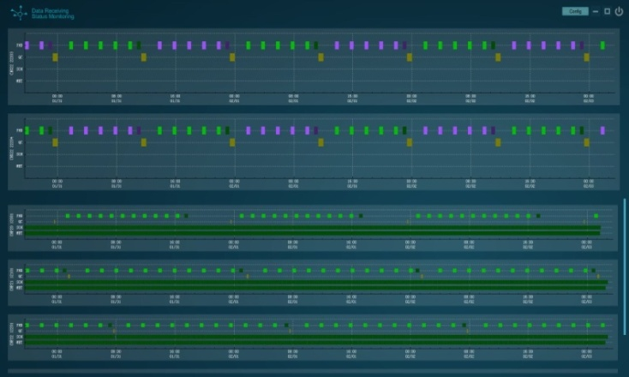
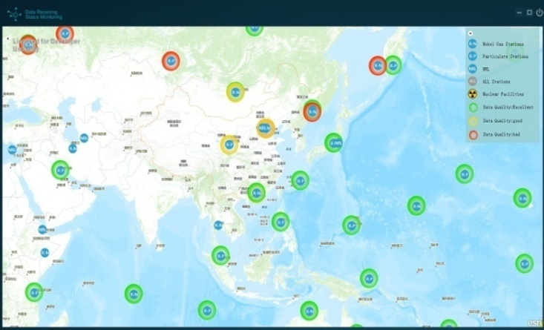
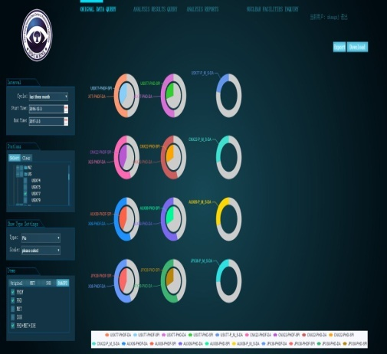
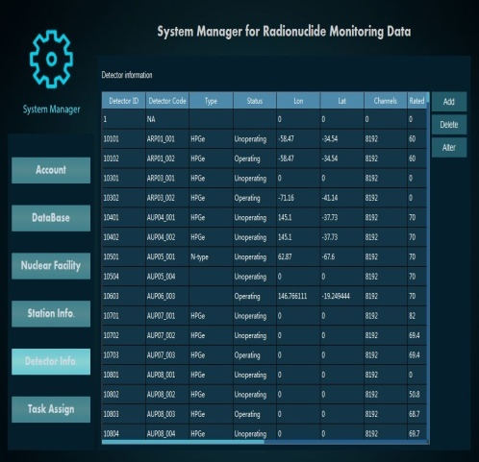
ARMD — a suite of Analysis system for CTBT Radionuclide Monitoring Data
Zhang Xin-Jun, CTBT Beijing National Data Centre and Beijing Radionuclide Laboratory, xinjun.zhang@nrl.org.cn
P3.5-345
An analysis system for CTBT radionuclide monitoring data was developed by CNNDC. The system achieved the functions of automatic acquisition, database storage, automatic processing, interactive analysis and statistical query of IMS radionuclide monitoring data.
ABSTRACT

Slide 3

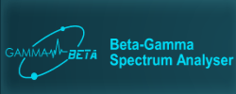
ARMD — a suite of Analysis system for CTBT Radionuclide Monitoring Data
Zhang Xin-Jun, CTBT Beijing National Data Centre and Beijing Radionuclide Laboratory, xinjun.zhang@nrl.org.cn
P3.5-345
Functionalities:
Automatically receive and process radionuclide monitoring data from IMS
PHD MET ALERT SOH
Interactive review of automatic processing results
GammaAnalyser for γ spectra of particulates and SPALAX
BetaGammaAnalyser for β-γ coincidence spectra of SAUNA and ARIX
Statistics query
data statistics query based on web.
Database storage
ORACLE MySQL
Environment:
C++ and Qt
MySQL or ORACLE
Java、GIS
Windows or Linux
INTRODUCTION

Slide 4
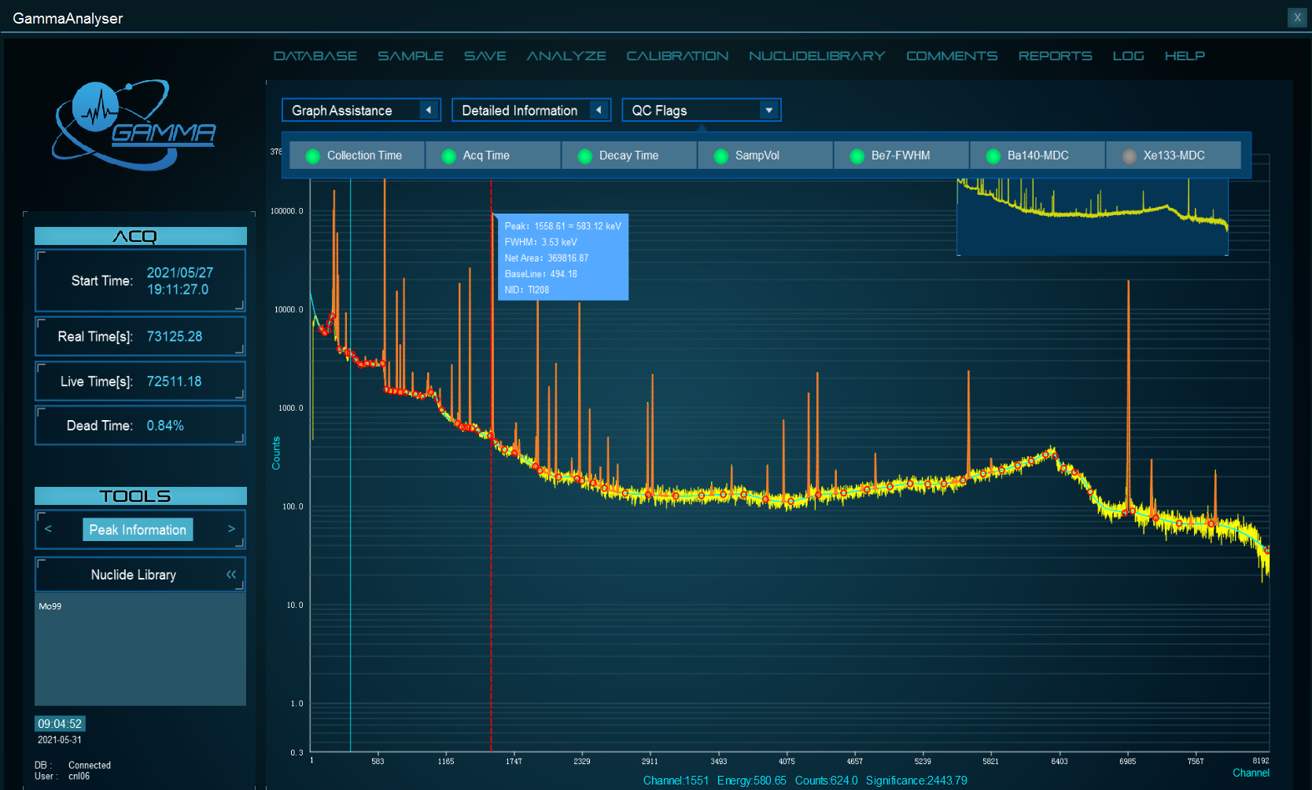
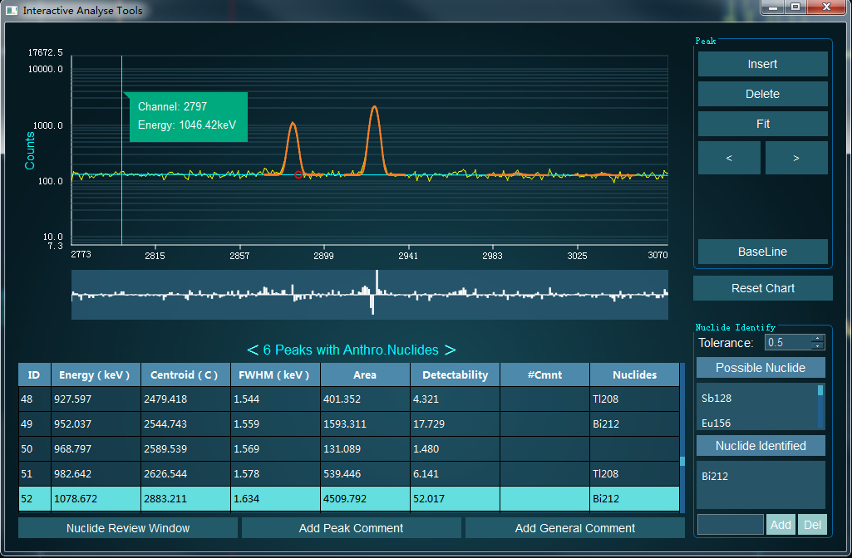
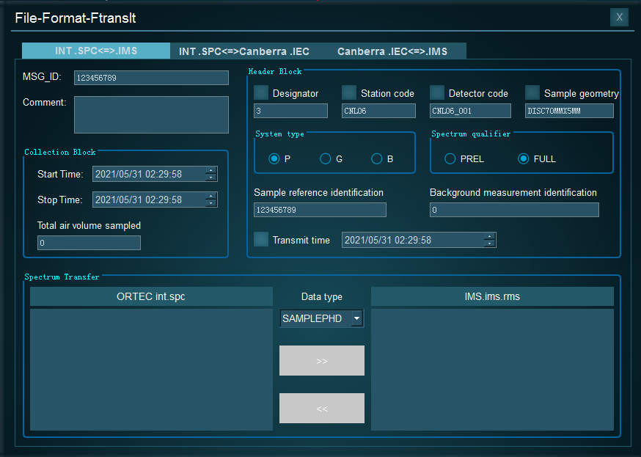
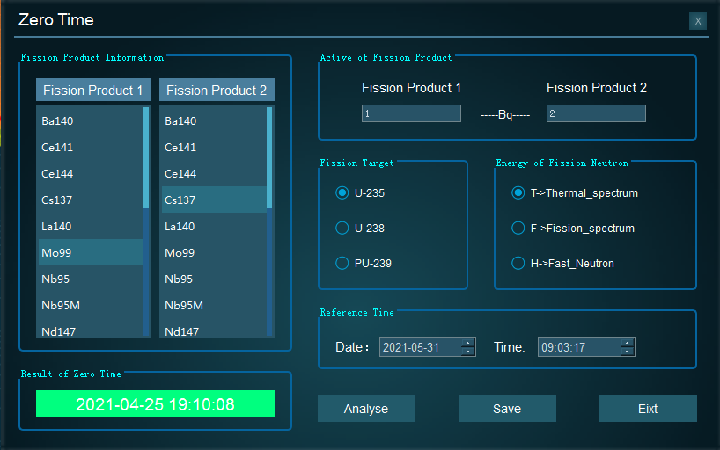
ARMD — a suite of Analysis system for CTBT Radionuclide Monitoring Data
Zhang Xin-Jun, CTBT Beijing National Data Centre and Beijing Radionuclide Laboratory, xinjun.zhang@nrl.org.cn
P3.5-345
GammaAnalyser is a GUI application for interactive review of automatic processing results of HPGe γ spectra.
Main functionalities:
Automatic energy calibration correction based on γ rays of natural radionuclide
Interactive reprocessing with user-defined parameters
Loading spectra data from file system and database
Batch processing of spectra
Data quality check
Zero time calculation tool
Data format transformation tool
INTRODUCTION

Slide 5
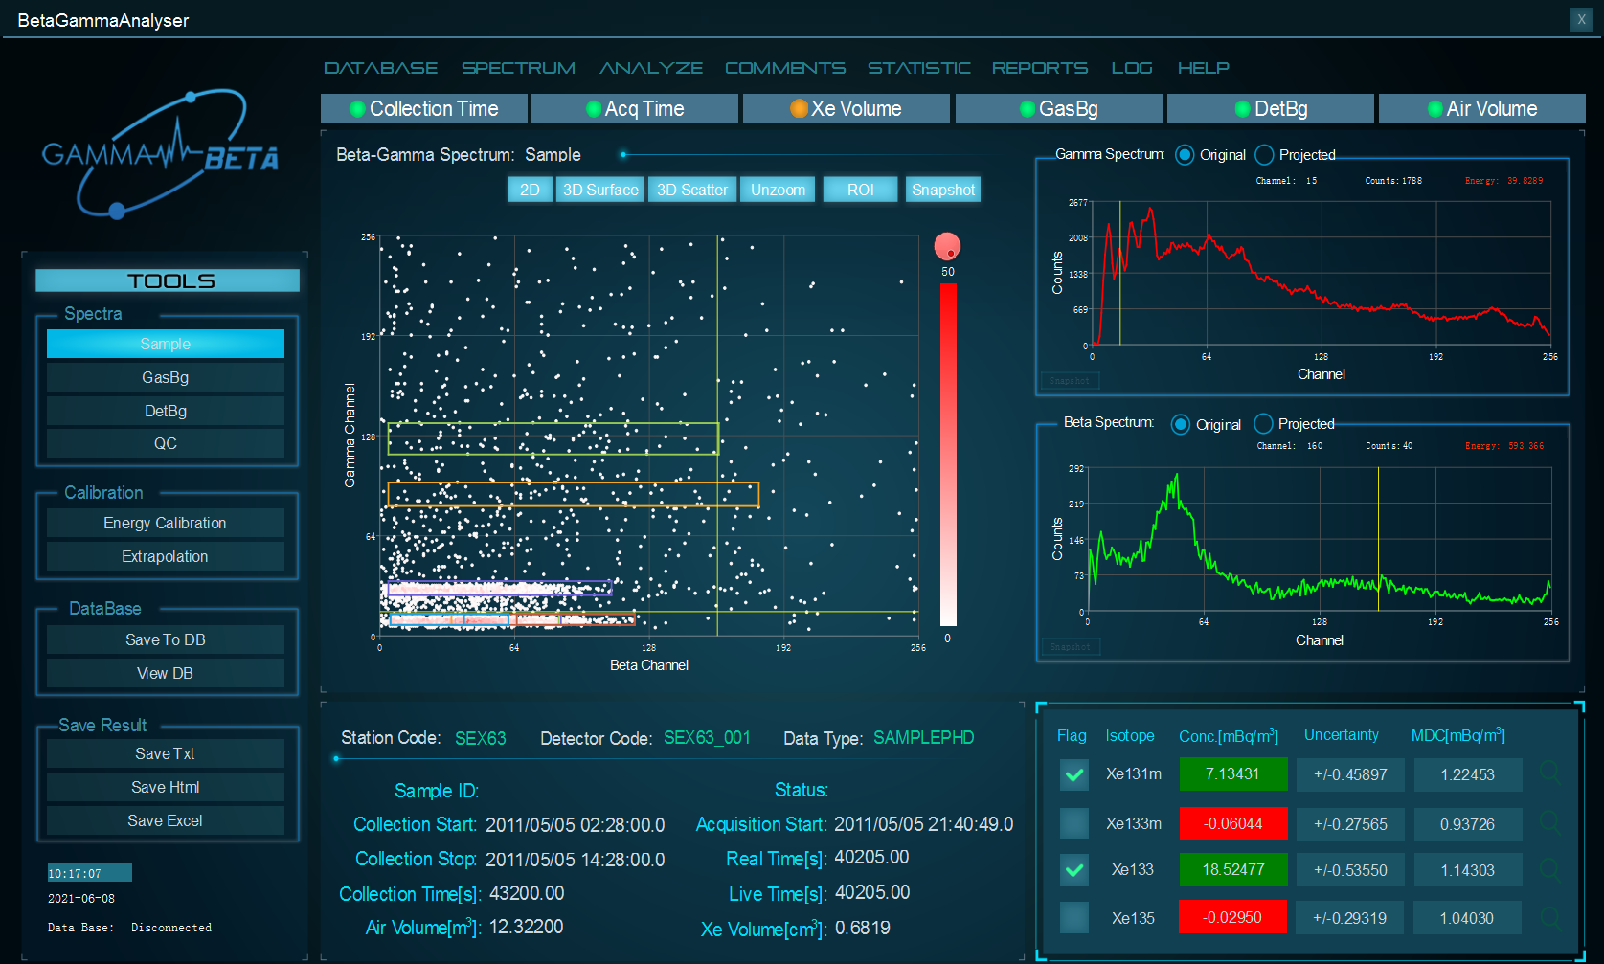
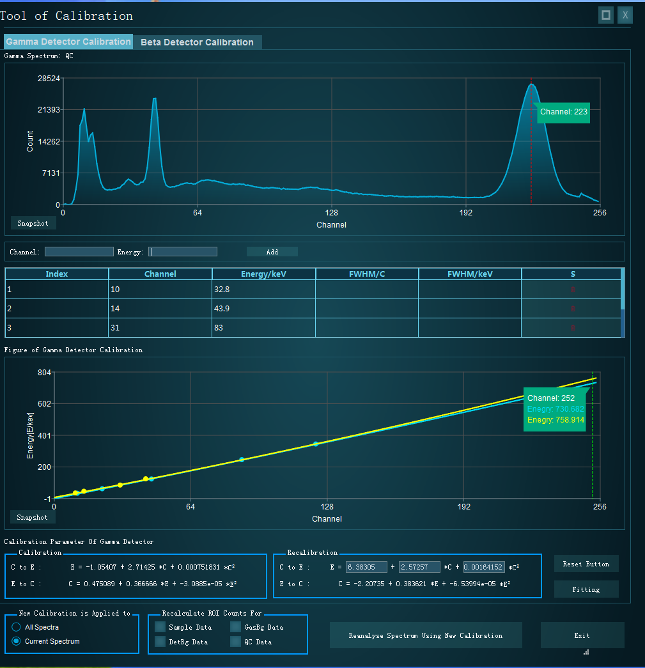
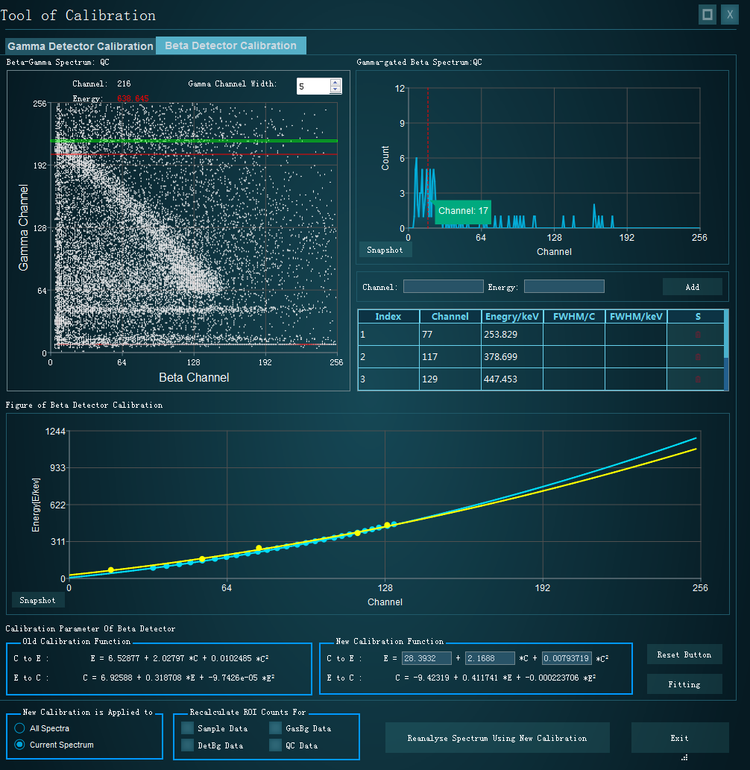
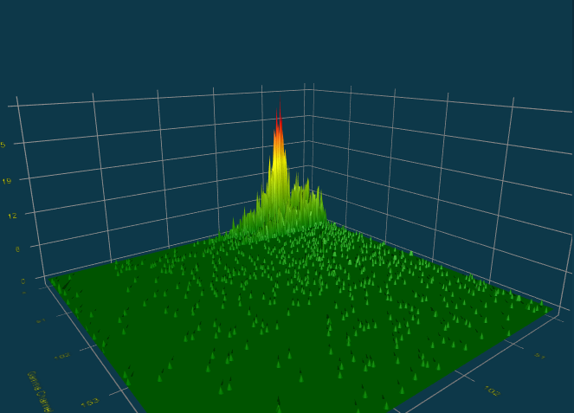
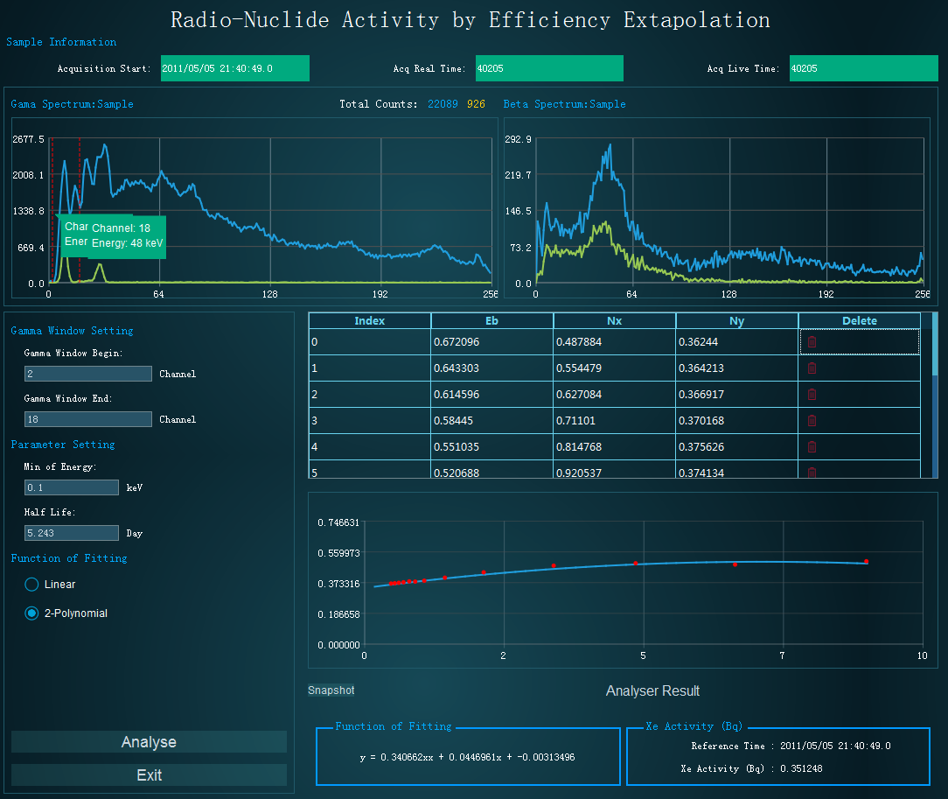
ARMD — a suite of Analysis system for CTBT Radionuclide Monitoring Data
Zhang Xin-Jun, CTBT Beijing National Data Centre and Beijing Radionuclide Laboratory, xinjun.zhang@nrl.org.cn
P3.5-345
BetaGammaAnalyser is a GUI application for interactive review of automatic processing results of β-γ coincidence spectra.
Main functionalities:
Net Count Calculation method
2D and 3D display of spectra
Interactive reprocessing with user-defined parameters
Loading spectra data from file system and database
Batch processing of spectra
Data quality check
Energy shift correction tools based on QC spectra
Radionuclide activity calculation tool based on efficiency extrapolation method
INTRODUCTION

Slide 6

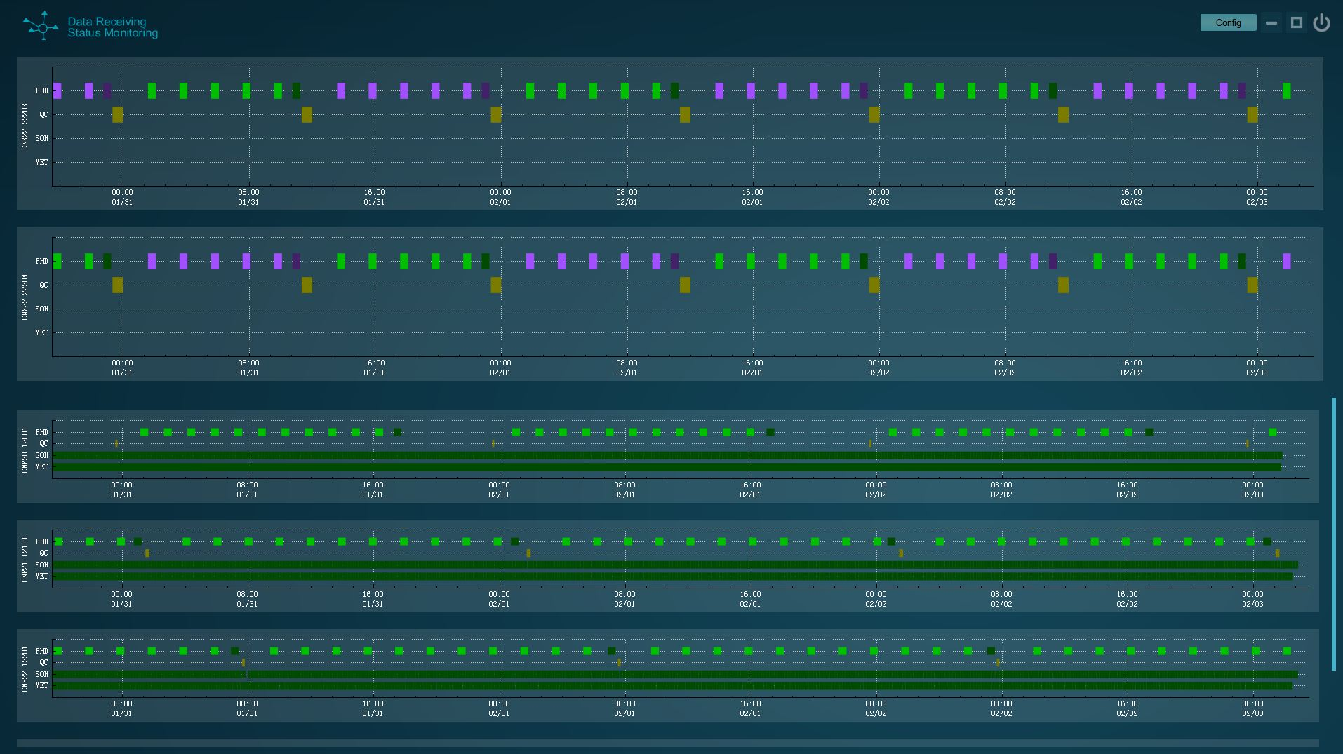

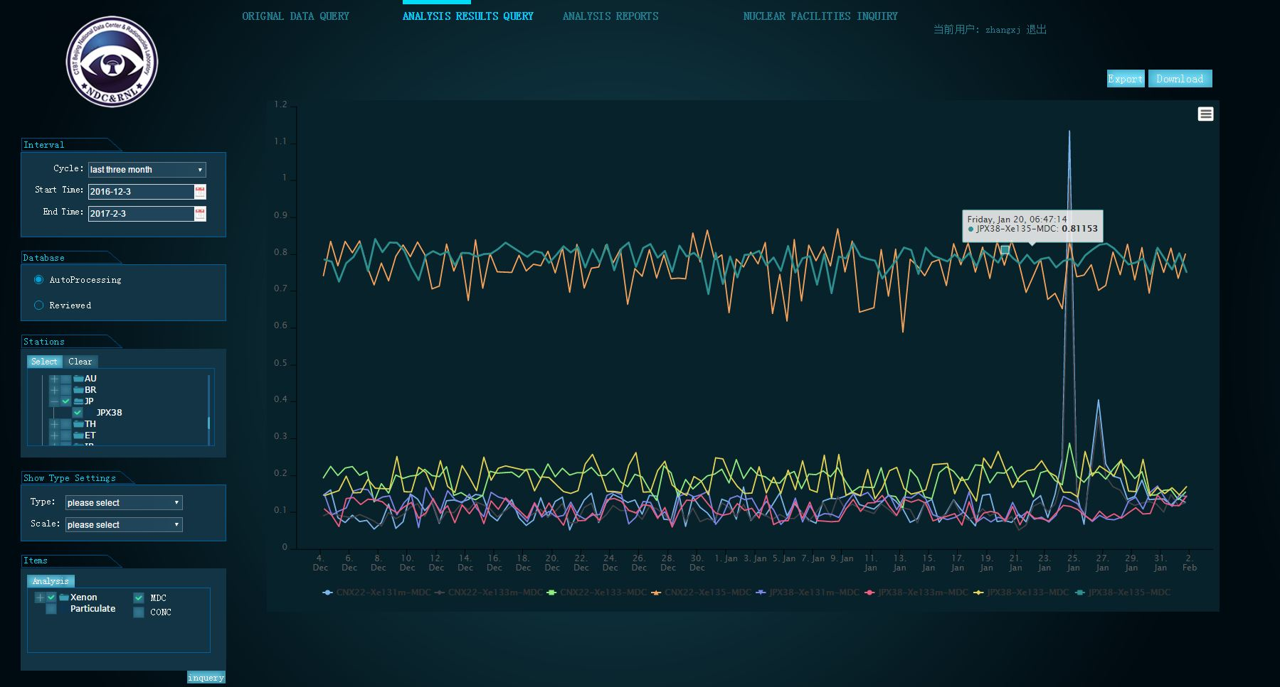
ARMD — a suite of Analysis system for CTBT Radionuclide Monitoring Data
Zhang Xin-Jun, CTBT Beijing National Data Centre and Beijing Radionuclide Laboratory, xinjun.zhang@nrl.org.cn
P3.5-345
Data receiving status monitoring tool
Displaying data receiving status
Displaying IMS radionuclide stations and nuclear facilities on GIS map
Statistics of data availability of IMS radionuclide stations
System management tool
Station information
Detector information
Database management
Account management
Nuclear facilities information
Analysis task assignment
Data query tool based on Web
Historical data query
Analysis report
INTRODUCTION

