Slide 1

Recent algorithm developments on methods for the analysis of radioxenon beta/gamma coincidence spectrum
A. CAGNIANT, O. DELAUNE, J. DEVAUX, P. GROSS, S. TOPIN
CEA/DAM Ile de France
T3.5 300

Slide 2
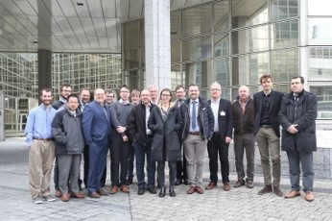
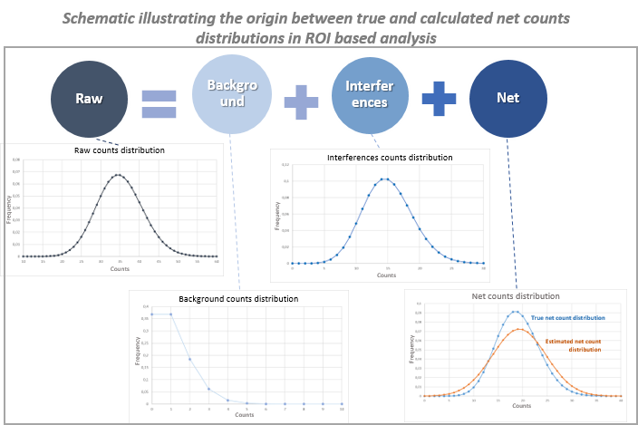
Recent algorithm developments on methods for the analysis of radioxenon beta/gamma coincidence spectrum
A. CAGNIANT, O. DELAUNE, J. DEVAUX, P. GROSS, S. TOPIN
T3.5-300
The evolution of the SPALAX systems, now equipped with a high resolution beta/gamma detection equipment (HPGe/PIPSBox), led CEA/DAM to develop dedicated spectrum analysis algorithms.
The first developments were presented to the CTBTO noble gas experts during the “Paris equation” meeting in March 2018.
Group picture, “Paris equation” expert meeting. March 8th, 2018.
ABSTRACT
Lately, CEA/DAM conducted a computer-based study to evaluate those algorithms. A large low count rate spectra database was generated by Monte-Carlo simulations for several detector configurations. It allowed the production of counts statistical distributions and the proper evaluation of associated uncertainties, critical and detection limits.
The discrepancies between algorithms and detector configurations are presented. It is shown that new algorithm implementation can reduce the false detection rate, especially in the case of increasing radon activity in the sample. The study is been continued.

Slide 3
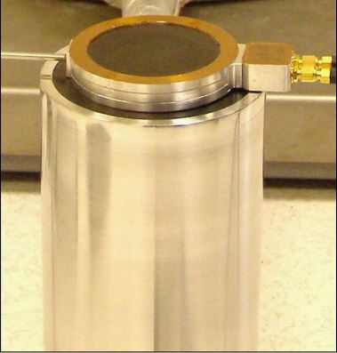
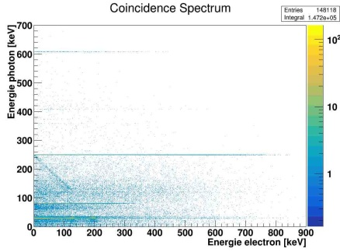
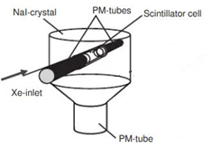
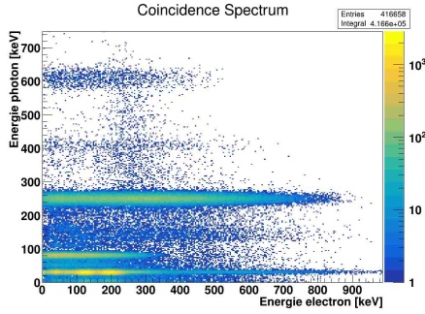

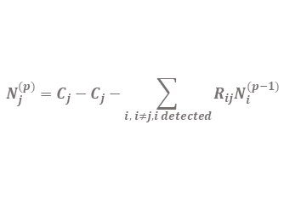
Recent algorithm developments on methods for the analysis of radioxenon beta/gamma coincidence spectrum
A. CAGNIANT, O. DELAUNE, J. DEVAUX, P. GROSS, S. TOPIN
T3.5-300
HPGe / PIPSBox⁽¹⁾ | NaI(Tl)/BC404⁽²⁾
High photon and electron energy resolution Low detection efficiency | Low photon and electron energy resolution High detection efficiency
Detectors
HPHe detector
INTRODUCTION
2D spectrum analysis based on Region Of Interest (ROI) counts calculations: Net = Gross – Background – Interferences Results in radionuclide: Net count (N_{i}), Net count uncertainty (u_{Ni}), critical limit (L_{C,i}) and detection limit (L_{D,i}).
RTGA | RTGA - Operationnal | Iterative-Analysis
- Linear algebra resolution of equation via matrix inversion | Same as RTGA, with arbitral lower threshold of L_{C} (@ 3,3 counts) and L_{D} (@ 9,3 counts) Algorithm successfully tested on SPALAX NG stations; | Corrects interferences from a particular radionuclide only if it is detected, otherwise its contribution is considered in u_{N}, L_{C} and L_{D} only. And:
Algorithms⁽³⁾
$$N=C−B−R×N$$
Matrix of interference ratio
$$N_{j}^{(0)}=C_{j}−C_{j}$$
Vector of net, gross and background counts
$$N_{j}^{(p)}=C_{j}−C_{j}−\sum_{i, i≠j, i detected}{{R_{ij}N}_{i}^{(p−1)}}$$

Slide 4
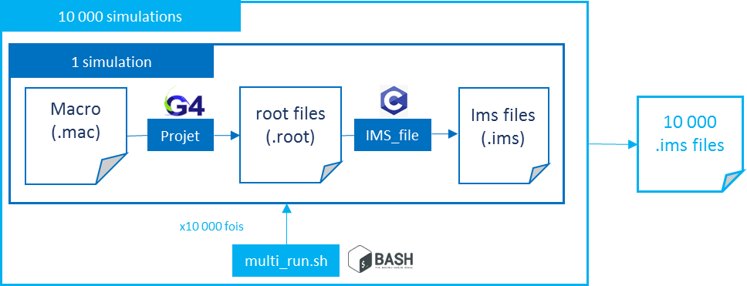
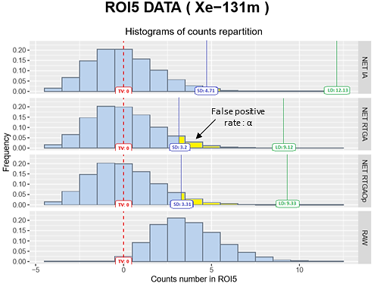
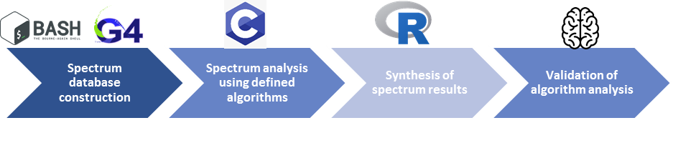
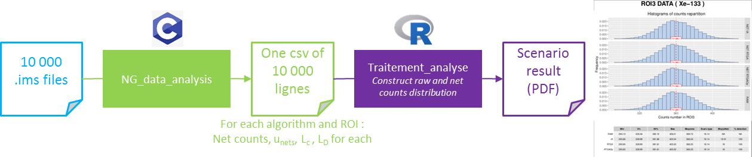
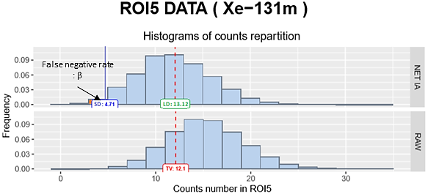


Recent algorithm developments on methods for the analysis of radioxenon beta/gamma coincidence spectrum
A. CAGNIANT, O. DELAUNE, J. DEVAUX, P. GROSS, S. TOPIN
T3.5-300
Coherence between results:
Target Value (TV) ⬄ net count distribution average
α and β < 5% (for SD = L_{C} and L_{D})
L_{C} check. Example : ^{131m}Xe counts distribution in a sample of pure ¹³³Xe (9500 nucleus), HPGe/PIPSBox detector :
$σnet≥$ $σbrut$
$$\overline{u}net≥ σnet$$
$$σnet$$
METHODS
$$σbrut$$
L_{D}check. Example : ^{131m}Xe counts distribution in a mixture of ¹³³Xe (9500 nucleus) and ^{131m}Xe (317 nucleus), HPGe/PIPSBox detector :

Slide 5
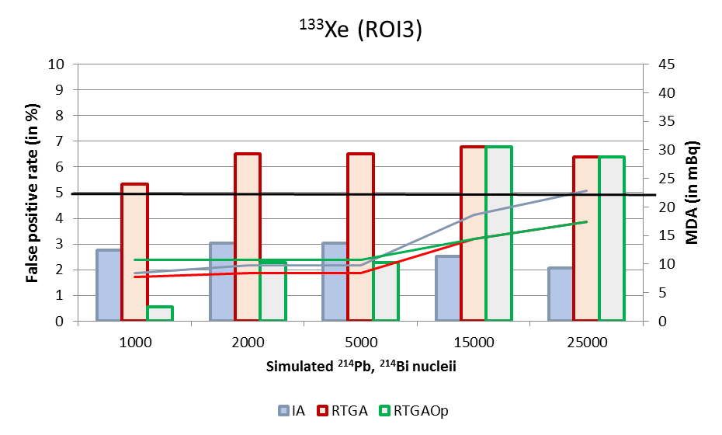
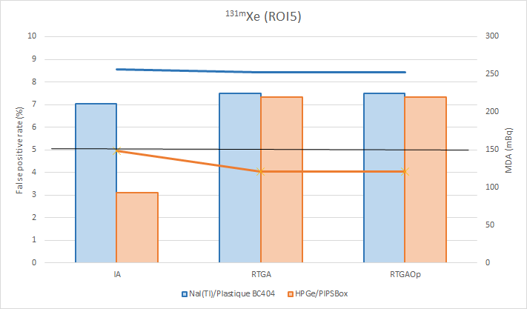
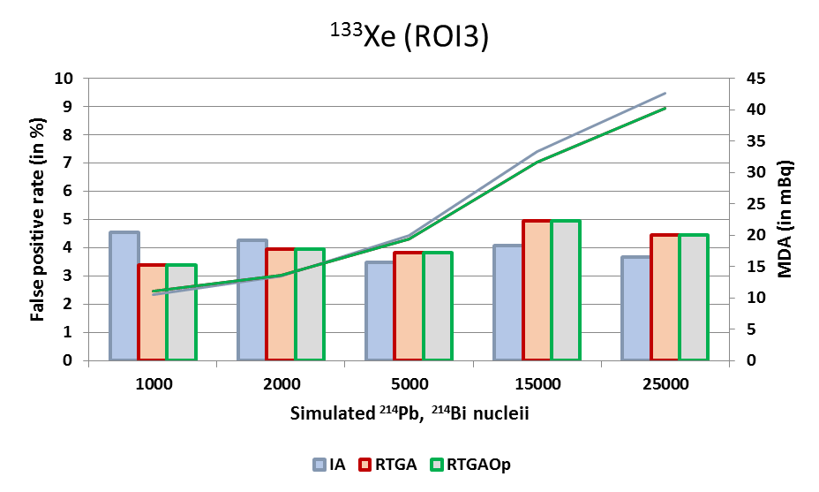
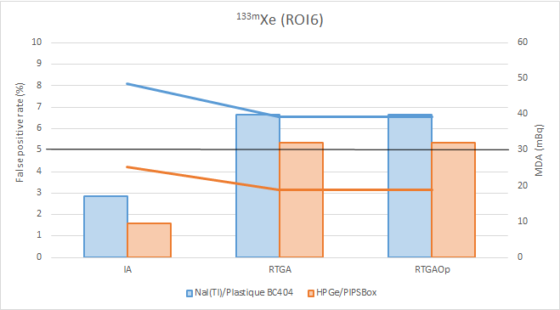
Recent algorithm developments on methods for the analysis of radioxenon beta/gamma coincidence spectrum
A. CAGNIANT, O. DELAUNE, J. DEVAUX, P. GROSS, S. TOPIN
T3.5-300
1. Radon effect: increasing concentration in ²¹⁴Pb et ²¹⁴Bi
HPGe / PIPSBox
NaI(Tl) / BC404
2. Active radioxenon mixtures
« Fukushima-like sample » ¹³⁵Xe: 0.5 mBq/m³ ¹³³Xe: 2240 mBq/m³ ^{133m}Xe: 6 mBq/m³ ^{131m}Xe: 0.
« QC sample » ¹³⁵Xe: 0.1 mBq/m³ ¹³³Xe: 106 mBq/m³ ^{131m}Xe: 6 mBq/m³ ^{133m}Xe: 0.
RESULTS

Slide 6
Recent algorithm developments on methods for the analysis of radioxenon beta/gamma coincidence spectrum
A. CAGNIANT, O. DELAUNE, J. DEVAUX, P. GROSS, S. TOPIN
T3.5-300
 | IA | RTGA | RTGA-Op
Generalities | This study is based on simulated data. The following effects are not taken into account: calibration shift during measurement, equilibrium between radon progenies, memory effect, blank measurements. Electron detectors energy resolution were considered flat.
 | This algorithm is written to be conservative regarding interferences. Therefore, it exhibits relatively low false positive rates at the cost of higher MDAs. | This algorithm is straightforward, and considers interferences between ROI in all case. Provided MDAs are lower than the ones from IA, but in extreme cases false detection rates are two high. | Because manipulated thresholds around low number of counts [0; 5] can be tricky, this algorithm is artificially bridled at a low level of L_{C} at 3.3 counts. MDAs are artificially increased.
HPGe/PIPSBox | For both effect of radon progenies in ROI3 or ^{133,135}Xe in ROI5 or 6, this algorithm keeps a stable false detection rate around 2.5 % or lower. | Increasing false detection rate as the number of radon progenies nuclei goes from 1000 to 25 000. False detection rate remains lower than 6%. | Prevents from false positive rate above 5% up to 15000 simulated nuclei of radon progenies. The L_{c} thresholds helps to keep a way lower than 5% false detection rate in most common measurement configuration, at the cost of increased MDAs.
NaI(Tl)/Plastic | Effect of radon progenies on ROI3 is stable and a little lower than 5%, witch is good. The only case where it exhibits false detection rate higher than 5% is for the highly active “Fukushima-like” sample. | Stable and efficiently corrects interferences. | RTGA-OP exhibits results very close to RTGA for this detector. The use of low level threshold at 3.3 counts for L_{C} is not helping as calculated L_{C} is always higher.
CONCLUSIONS
Ongoing study:
Test other detection setup (such as the NaI/PIXELBox⁽⁴⁾, see O. Delaune poster ID 3.1 361)
Test other algorithms such as : linear resolution, spectral unmixing, multimodal analysis (correction using gamma spectra)
References:
S. Topin et al. 2020. J. Environ. Radioact 225. 6 months of radioxenon detection in western Europe with the SPALAX-New generation system-Part 1: Metrological capabilities
A Ringbom et al. 2003. Nuclear Inst. and Meth. in Phys. Res. Section A. 508. SAUNA - a system for automatic sampling, processing, and analysis of radioactive xenon
A. Cagniant et al. 2018. CEA/DIF/DASE/SRCE/134/2018/DO Methods for multimodal analysis applied to environmental radioxenon measurements.
V. Thomas 2019. PhD thesis . http://www.theses.fr/2019SACLS454

