Slide 1
Method for assessing ³⁷Ar emissions from nuclear reactors
Martin Kalinowski¹, Pouneh Tayyebi²
P3.5-483
1 CTBTO, IDC
2 Nuclear science and technology research institute (NSTRI), Tehran, Iran

Slide 2
Method for assessing ³⁷Ar emissions from nuclear reactors
Martin Kalinowski, Pouneh Tayyebi
P3.5-483
³⁷Ar is an indicator of an underground nuclear explosion. This radioisotope is produced via ⁴⁰Ca (n, α) ³⁷Ar reaction through neutron activation of ⁴⁰Ca included in the rocks near to the nuclear explosion location. The relatively long half-life of 35 days compared to CTBT-relevant radioxenon isotopes results into ³⁷Ar activity becoming stronger than radioxenon activity approximately 50 days after detonation. Normal operational releases of ³⁷Ar from nuclear facilities contributes to the atmospheric background. It can be produced via neutron activation of air or of gas dissolved in water. The emissions of this isotope are not regularly measured and very few release data are available. Therefore, the two-step method presented here is more complex than the method the authors had applied previously for assessing ³⁷Ar releases from nuclear research reactors. As the first step, simulations with ORIGEN determine isotopic ratios of ³⁷Ar and an appropriate proxy like ⁴¹Ar for which stack release data are available. These ratios are depending on the duration of the irradiation and the intensity of the neutron flux. As second step, the retention time is used to account for the decay between escaping the neutron flux and getting released through the stack.
ABSTRACT

Slide 3
Method for assessing ³⁷Ar emissions from nuclear reactors
Martin Kalinowski, Pouneh Tayyebi
P3.5-483
Klingberg et al. (2013) showed that radioxenon, including non-traditional radioxenon isotopes, resulting from activation in the HFIR research reactor could be observed at IMS stations.
Kirchner et al. (2020) identified the process resulting in the largest possible releases of ³⁷Ar from NPPs being activation of ³⁶Ar dissolved in the primary coolant. Under certain conditions it could be detected beyond 100 km from the emitting plant.
Such studies raise the question to what extend and under what conditions radioxenon resulting from activation could be observed at IMS stations.
The method suggested here for estimating ³⁷Ar releases can be extended to radioxenon.
INTRODUCTION

Slide 4
Simple method used previously
P3.5-483
Kalinowski/Tayyebi (2019) estimated the release of ³⁷Ar of research reactors based on a scaling factor, SF, from the logarithmic mean of ³⁷Ar release rates reported for a few NRRs:
SF = 111 Bq/kWh
The estimated annual emission from each nuclear research reactor is calculated with the following equation:
R = SF × CF × P × 365 × 24
Where
                R (Bq/y): release rate
                SF (Bq/kWh): Scaling factor
                CF: capacity factor
                P (kW): power
                365×24: converting factor for h/y
METHODS

Slide 5
Two step method
P3.5-483
More robust method:
Here, we show a method for estimating the release of ³⁷Ar using ⁴¹Ar as proxy because for this isotope stack release data are often available.
This works for all situations where activation in air or water is the main production path.
As first step, ORIGEN simulations were done to determine the activity ratio of ³⁷Ar to ⁴¹Ar . We studied how these ratios are depending on the duration of the irradiation and the intensity of the neutron flux.
As second step, the retention time is used to account for the decay between escaping the neutron flux and getting released through the stack.
Resulting solution:
With the ORIGEN results of activity ratios at the end of irradiation and the decay correction using the retention time, the ³⁷Ar release can be determined from ⁴¹Ar release reports.
METHODS

Slide 6


Method to determine irradiation and retention time
P3.5-483
Differential equation for the activity of isotope i in the reactor:
A - Activity release rate
B - Birth rate from activation
      λ – Radioactive decay constant
      z – Effective retention time
In case of equilibrium, the ratio of birth rate and the release rates leads to this equation:
METHODS

Slide 7

Method to determine irradiation and retention time
P3.5-483
Since both isotopes are the same gas (argon), we can assume z₁=z₂. The simplified equation can be solved for z and get possible retention times depending on the birth rate ratio calculated with ORIGEN, if reported releases are available:
This leaves still the question open what irradiation time can be assumed.
The idea is to find a match between irradiation time and retention time using additional information confining the technically reasonable ranges of these times.
Further confirmation of these times to reflect the reality well may come from results for other pairs of radioactive noble gas isotopes.
METHODS

Slide 8
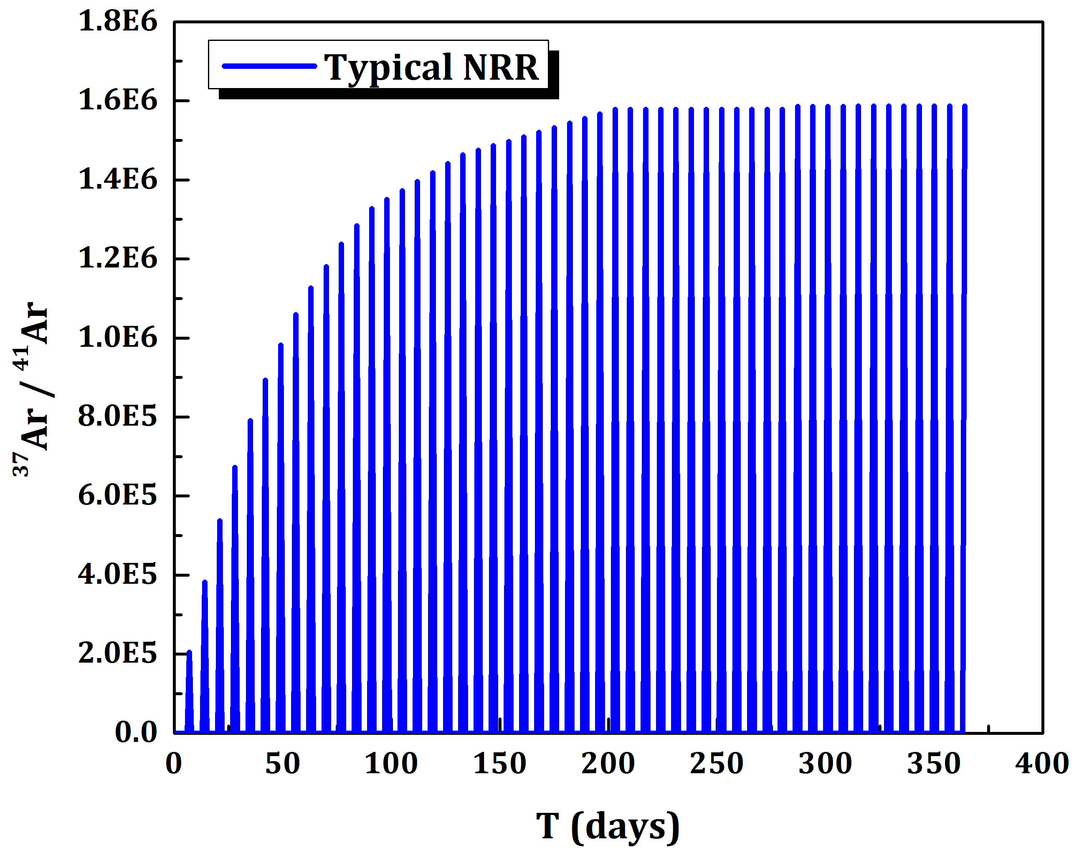
Saturation level of ³⁷Ar / ⁴¹Ar
P3.5-483
ORIGEN simulations were done for a typical NRR for a full year with a periodic cycle of 5 days irradiation and several 2 days cooling time.
The figure shows: the activity ratio of ³⁷Ar to ⁴¹Ar reaches saturation after about 200 days.
The high variability results from the short half-life of ⁴¹Ar .
RESULTS
Radioisotope | Half life
³⁷Ar | 35.04 d
⁴¹Ar | 109.34 m

Slide 9
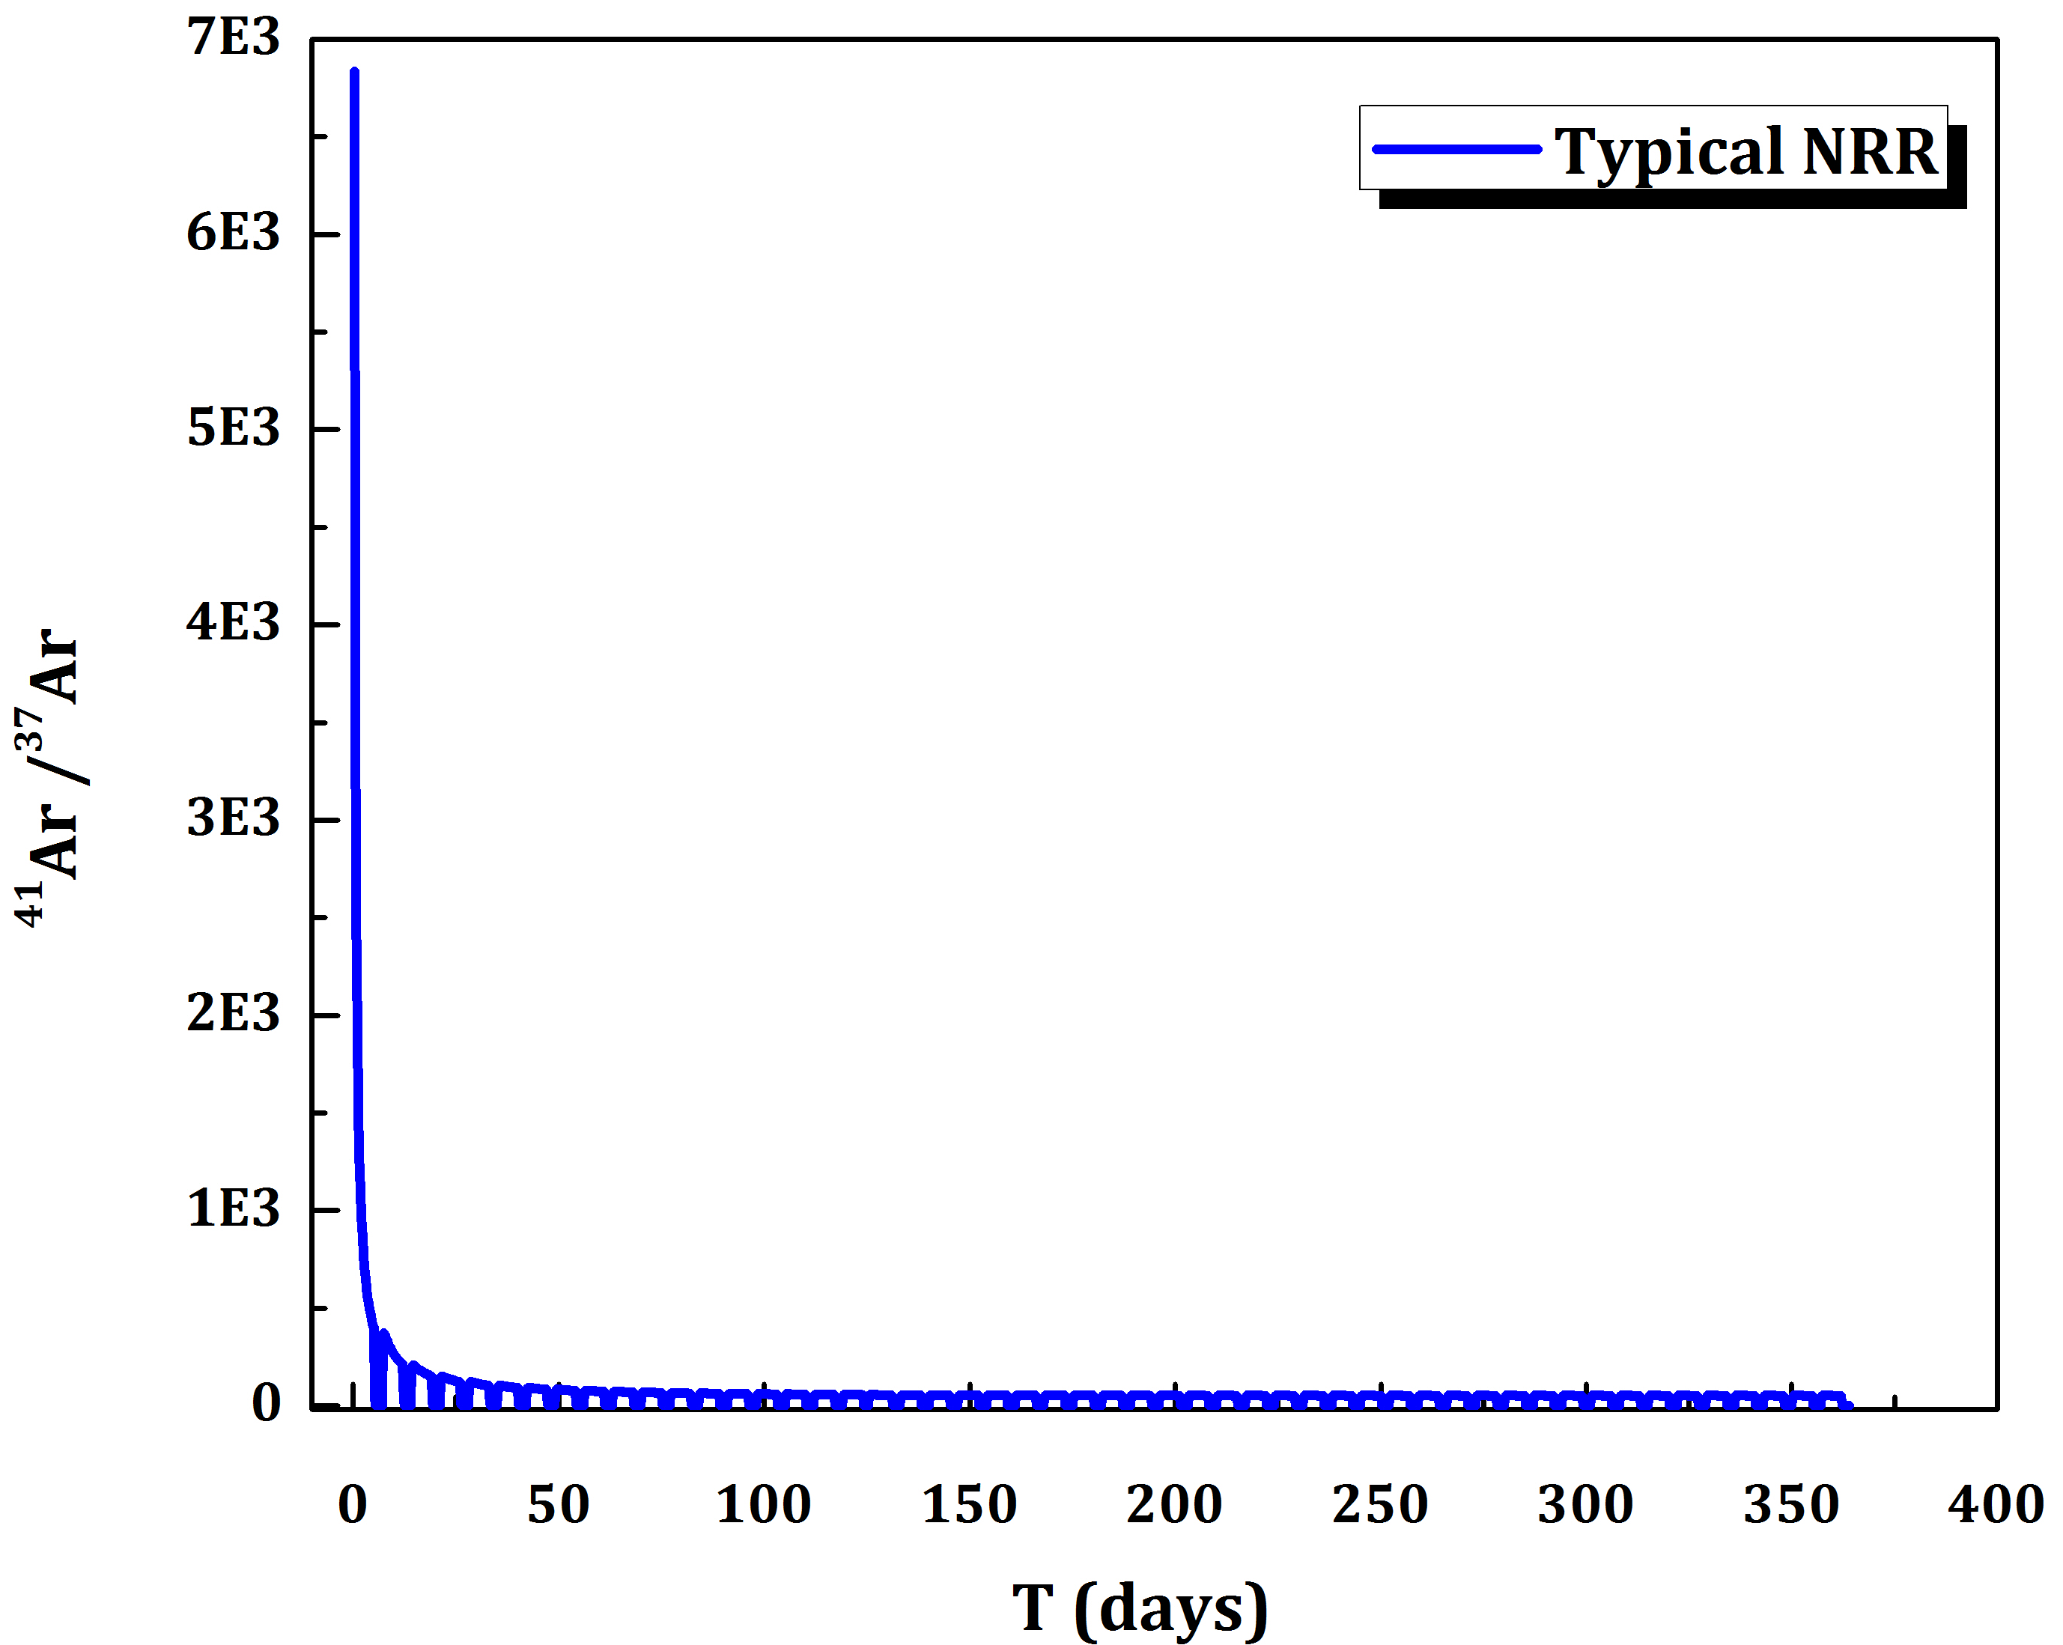
Saturation level of ³⁷Ar / ⁴¹Ar
P3.5-483
The figure shows the activity ratio of ⁴¹Ar to ³⁷Ar initially starts at very high levels that depend on the irradiation time.
This result is consistent with the ratio of 8430 as measured by Johnson et al. (2017) at the argon purge stack of the Texas TRIGA reactor.
Conclusion: Two parameters need to be known to use ⁴¹Ar as proxy for ³⁷Ar :
      Irradiation time
      Retention time
RESULTS

Slide 10
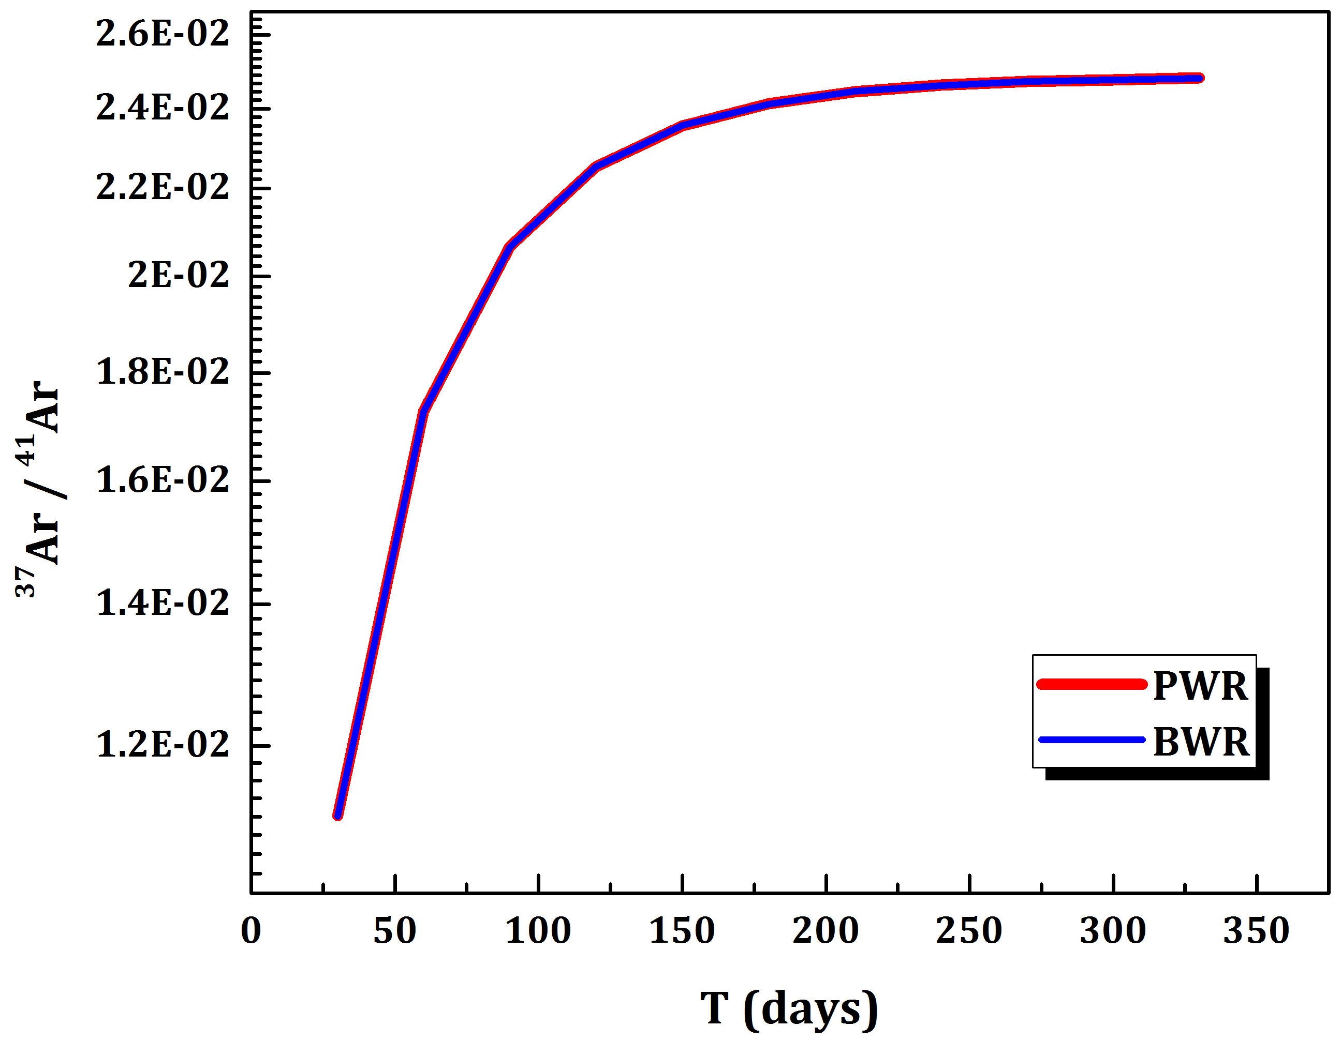
Saturation level of ³⁷Ar / ⁴¹Ar
P3.5-483
ORIGEN simulations were done for 2 types of NPP (BWR and PWR) for a full year of constant power.
The figure shows the activity ratio of ³⁷Ar to ⁴¹Ar reaches saturation after about 200 days, irrespective of NPP type.
RESULTS

Slide 11
Irradiation and retention time
P3.5-483
Additional information to confine the possible range for the retention time: Kirchner et al. (2020) finds for ³⁷Ar an exhaust air retention time of less than 24 hours.
The ORIGEN simulations show that the results are more critically dependent on the irradiation time. Therefore, we fix the retention time e.g. to 12 hours and find the matching irradiation time.
RESULTS
 | ORIGEN2.1 |  |  | Johnson et al. (2017)
Z (h) | irradiation time (m) | estimated release ratio of ⁴¹Ar / ³⁷Ar | estimated release ³⁷Ar (mBq/m³) | release ratio of ⁴¹Ar / ³⁷Ar | released ⁴¹Ar (mBq/m³) | released ³⁷Ar (mBq/m³)
1 | 146 | 8.51E+03 | 1.20E+04 | 8.43E+03 | 1.02E+08 | 1.21E+04
2 | 65 | 8.37E+03 | 1.22E+04
3 | 5 | 8.27E+03 | 1.23E+04

Slide 12
Method for assessing 37Ar emissions from nuclear reactors
Martin Kalinowski, Pouneh Tayyebi
P3.5-483
Results of this work
³⁷Ar is important as indicator of an underground nuclear explosion.
Reactor (NPP, NRR) emissions contribute to the ambient background and need to be assessed.
This presentation describes a method how to achieve this.
Outlook
The method needs to be validated against data. Initial checks are giving confidence.
Next, the method will be extended to predict radioxenon releases from activation.
The first application using a graphical trial and error approach is very promising.
See Tayyebi/Kalinowski at SnT2021, O3.5-456
CONCLUSIONS

Slide 13
Method for assessing 37Ar emissions from nuclear reactors
Martin Kalinowski, Pouneh Tayyebi
P3.5-483
Fay (2014), Characterization of Sources of Radioargon in a Research Reactor, The University of Texas at Austin.
Fay et al. (2013) Contributions to the ³⁷Ar background by research reactor Operations, J Radioanal Nucl Chem, 296:273–277.
Johnson et al. (2017) Production and release rate of ³⁷Ar from the UT TRIGA Mark-II research reactor, Journal of Environmental Radioactivity 167, 249-253.
Kalinowski/Tayyebi (2019) Investigation of emission of ³⁷Ar from all nuclear research reactors worldwide. INGE2019 in Freiburg, Germany.
Kirchner et al. (2020). Will ³⁷Ar emissions from light water power reactors become an obstacle to its use for nuclear explosion monitoring Journal of Environmental Radioactivity, 223, 106392.
Klingberg et al. (2013). Radioxenon signatures from activation of environmental xenon, Journal of Radioanalytical and Nuclear Chemistry, 296(1), 117-123.
References

