Slide 1
Identification of Repeating Seismic Events using Non-Linear Dimensionality Reduction
Yuri Bregman¹, Itay Niv², Yochai Ben-Horin¹, Neta Rabin²
Pres. No. O3.6-148
¹ Israeli NDC, Soreq Nuclear Research Center, Yavne, Israel
² Dept. of Engineering, Tel-Aviv University, Israel

Slide 2
Identification of Repeating Seismic Events using Non-Linear Dimensionality Reduction
Yuri Bregman, Itay Niv, Yochai Ben-Horin, Neta Rabin
O3.6-148
Outline
Introduction
Diffusion maps: a non-linear dimension reduction method
Case Studies
  Aftershock identification at local distances (I).
  Aftershock identification at regional distances (II).
  Identification arrivals caused by mine explosions (III).
Summary

Slide 3
Identification of Repeating Seismic Events using Non-Linear Dimensionality Reduction
Yuri Bregman, Itay Niv, Yochai Ben-Horin, Neta Rabin
O3.6-148
Introduction
Motivation
Repeating seismic events such as aftershock sequence or mine explosions make up a significant part of seismicity.
Automatic identification of repeating event may lighten the analysts’ burden and to allow for timely production of reviewed bulletins.
Moreover, small aftershocks and local mine explosions may reduce the quality of IDC automatic bulletins by creating fake events.
Therefore, it is desirable to identify and remove the arrivals of such small events prior to the IDC association process.
Goal
Automatic identification of repeating seismic events at a single seismic station.

Slide 4
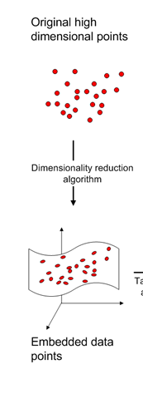

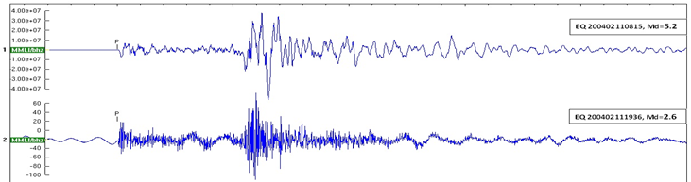

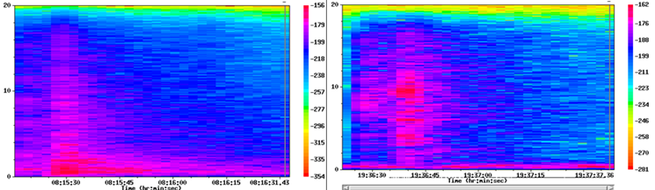
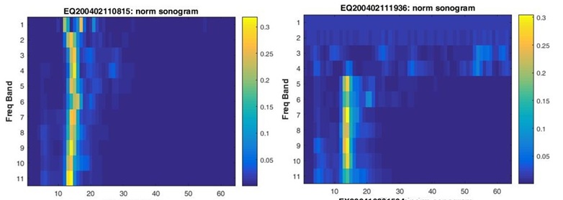
Identification of Repeating Seismic Events using Non-Linear Dimensionality Reduction
Yuri Bregman, Itay Niv, Yochai Ben-Horin, Neta Rabin
O3.6-148
Basic Processing Framework
1. Pre-processing: normalized sonograms
Top: EQ, md=5.2, Bottom: EQ, md=2.6
seismogram
Pre-processing
Compute the spectrograms
Normalized sonogram
Normalized sonograms: logarithmically scaled frequency bands & the sum of the energy in every frequency band is normalized to 1.

Slide 5
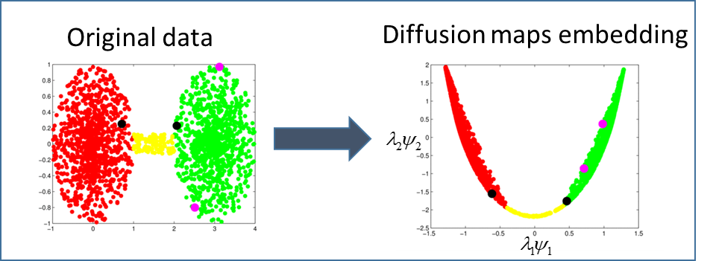
Identification of Repeating Seismic Events using Non-Linear Dimensionality Reduction
Yuri Bregman, Itay Niv, Yochai Ben-Horin, Neta Rabin
O3.6-148
Basic Processing Framework (cont.)
2. Nonlinear dimension reduction: Diffusion Maps
An unsupervised technique, does not use the data labels.
Constructs a global description of the dataset from local similarities.
Uses the eigenfunctions of a Markov matrix.
Preserves the distances of the original data by defining a diffusion metric.

Slide 6
Identification of Repeating Seismic Events using Non-Linear Dimensionality Reduction
Yuri Bregman, Itay Niv, Yochai Ben-Horin, Neta Rabin
O3.6-148
Diffusion maps – A Schematic Description
Spectral decomposition and dimensionality reduction
Graph-structured data
Kernel matrix

Slide 7
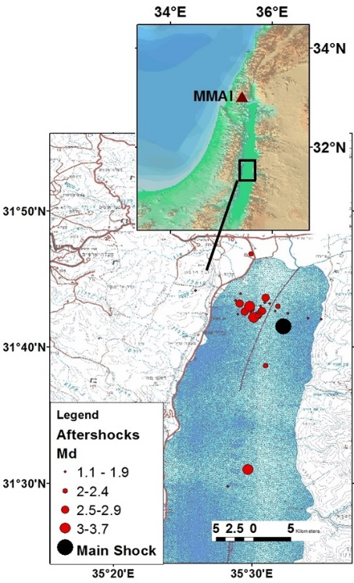
Identification of Repeating Seismic Events using Non-Linear Dimensionality Reduction
Yuri Bregman, Itay Niv, Yochai Ben-Horin, Neta Rabin
O3.6-148
Case Study I: Aftershocks of 2004 Dead Sea EQ
Dataset:
Feb 11-17, 2004 waveforms of vertical channel MMA0 of IMS seismic array MMAI.
Only the mainshock was identified in advance.
Detector:
Butterworth filter [1,5] Hz followed by STA/LTA detector with STA=1s, LTA=25s and threshold=3.5.
Detections:
98 time stamps were extracted by the detector.
The associated waveforms were cut and aligned according to arrival times.

Slide 8
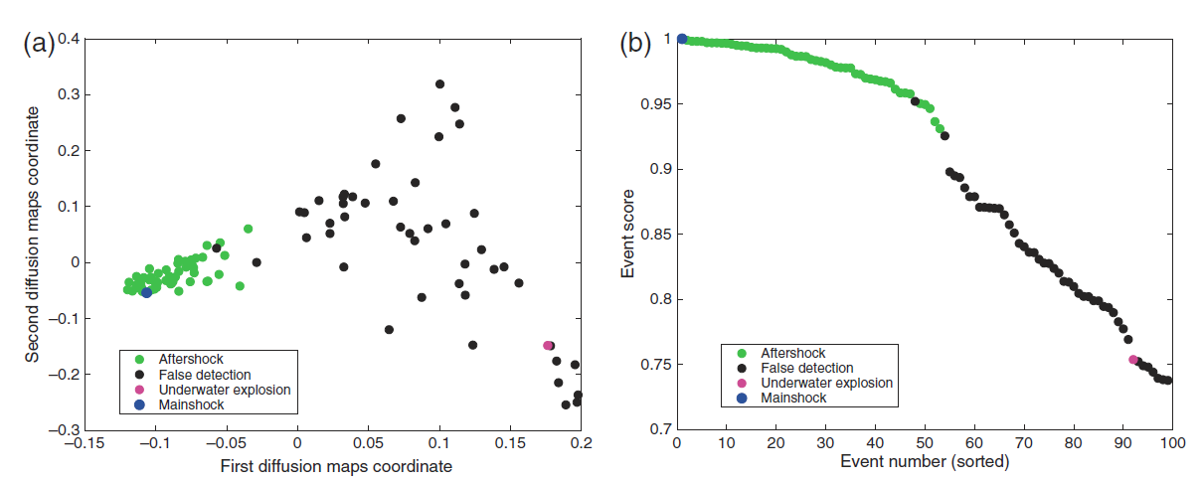

Identification of Repeating Seismic Events using Non-Linear Dimensionality Reduction
Yuri Bregman, Itay Niv, Yochai Ben-Horin, Neta Rabin
O3.6-148
Case Study I: diffusion maps embedding
51 aftershocks, 18 new (the points are colored by the result of our manual analysis)
Underwater explosion:
6 km from the epicenter of mainshock
Diffusion maps embedding of inspected events. (b) Calculated event scores:
The two detections that are embedded near the aftershock cluster belong to earthquakes that originate at similar distances from the MMAI array as the inspected mainshock, but with different azimuths.

Slide 9
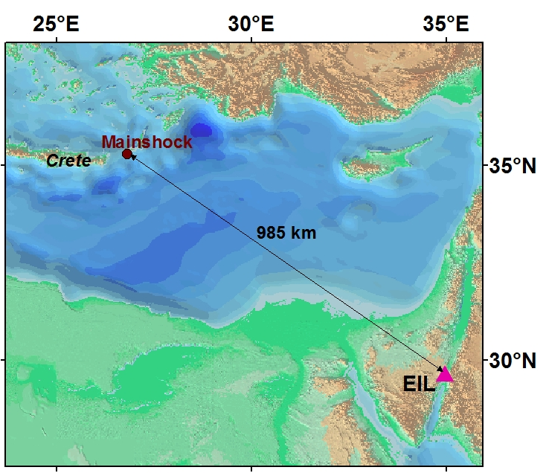
Identification of Repeating Seismic Events using Non-Linear Dimensionality Reduction
Yuri Bregman, Itay Niv, Yochai Ben-Horin, Neta Rabin
O3.6-148
Case Study II: Aftershocks of Crete Earthquake on 16.4.2015 with mb=5.6
Dataset:
Vertical waveforms of IMS station Eilat (EIL) on Apr 16-17, 2015.
Arrivals:
216 automatic arrivals of International Data Center (IDC).
Method:
The seismogram of the main shock is used as a single template for identification of related aftershocks.
A score based on the Diffusion maps embedding was calculated for each detected arrival.

Slide 10
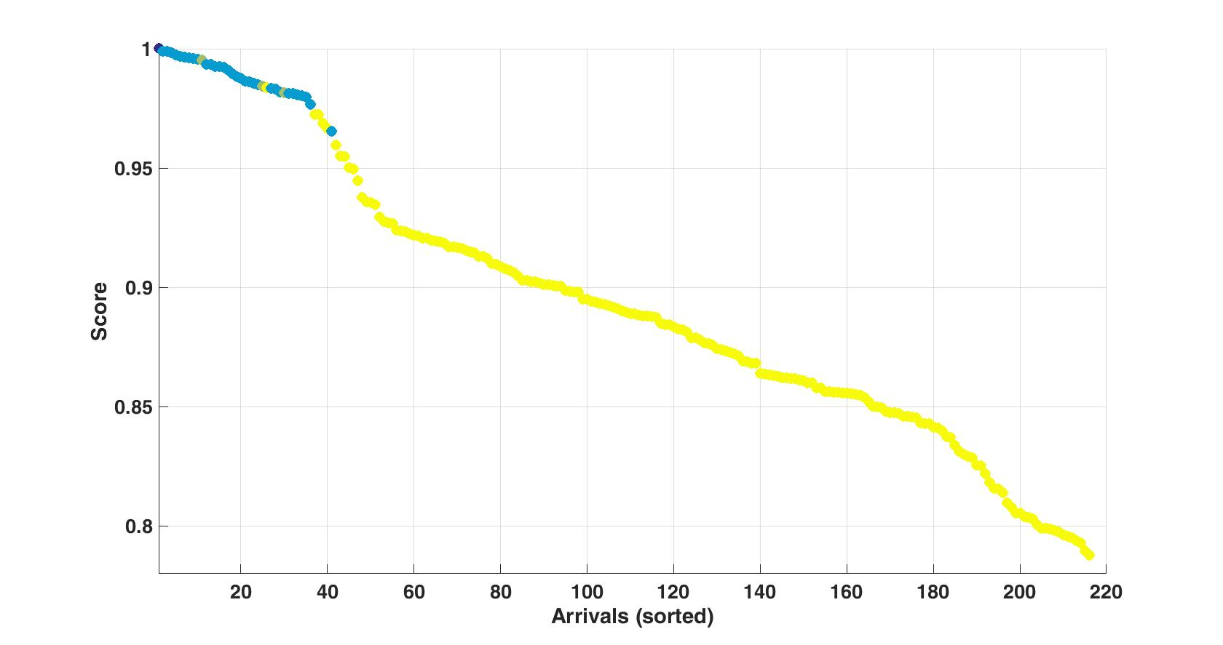
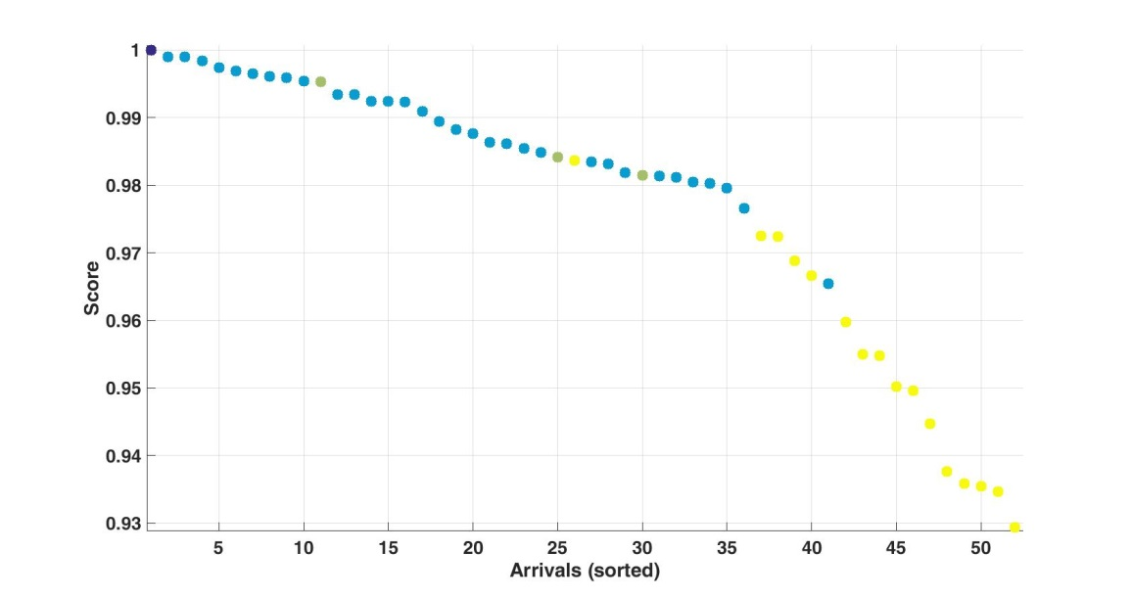
Identification of Repeating Seismic Events using Non-Linear Dimensionality Reduction
Yuri Bregman, Itay Niv, Yochai Ben-Horin, Neta Rabin
O3.6-148
Case Study II: results
Zoom in
False automatic IDC aftershock
Mainshock (dark blue)
IDC aftershocks (blue)
Catalog aftershocks (green)
Other detections (yellow)

Slide 11
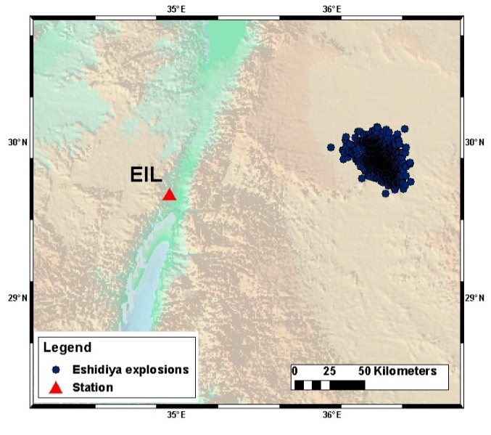
Identification of Repeating Seismic Events using Non-Linear Dimensionality Reduction
Yuri Bregman, Itay Niv, Yochai Ben-Horin, Neta Rabin
O3.6-148
Case Study III: Identification of Arrivals from a Specific Mine
Goal:
Identification of arrivals at the IMS station EIL caused by the explosions at the Eshidiya mine, Jordan.
Training set:
1196 historic explosions.
Waveforms of Mar 1-8, 2011 together with 190 IDC automatic arrivals.
Test set:
Waveforms of Mar 9-31, 2011 together with 845 IDC automatic arrivals

Slide 12

Identification of Repeating Seismic Events using Non-Linear Dimensionality Reduction
Yuri Bregman, Itay Niv, Yochai Ben-Horin, Neta Rabin
O3.6-148
Case Study III (cont.)
Diffusion maps embedding of train set
Train set embedding: Diffusion maps from 3 channels of EIL station.
Historic mine explosions are colored in green.
Waveforms of Mar 1-8, 2011 that do not belong to the mine are colored black.
Waveforms of Mar 1-8, 2011 that belong to the mine are colored red.

Slide 13
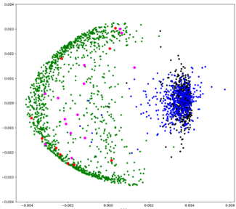
Identification of Repeating Seismic Events using Non-Linear Dimensionality Reduction
Yuri Bregman, Itay Niv, Yochai Ben-Horin, Neta Rabin
O3.6-148
Case Study III (cont.)
Test set & Identification Results
Test set: waveforms of Mar 9-31, 2011 together with 845 IDC automatic arrivals.
The test set is embedded to the constructed embedding.
Test points that do not belong to the mine are colored blue.
Test points that belong to the mine are colored pink.
Accuracy: 99% out of 845 test IDC arrivals.
Out-of-sample embedding of the test set

Slide 14
Identification of Repeating Seismic Events using Non-Linear Dimensionality Reduction
Yuri Bregman, Itay Niv, Yochai Ben-Horin, Neta Rabin
O3.6-148
Summary
Diffusion maps modeling is a robust method for automatic identification of repeating seismic event.
The method was successfully applied to identification of aftershocks and mine explosions.
Future goal will be to develop a program that can be integrated into the IDC automatic processing for identification of repeating events.

