Slide 1




On using self-sustained events for stochastic waveform modelling
with deep neural networks
Xavier Cassagnou¹, Christophe Millet^{1,2}, Mathilde Mougeot^{1,3}
Cyril Nefzaoui Blanchard¹
[P.3.6-615]
¹ Centre Borelli, ENS Paris-Saclay, F-91190 Gif-sur-Yvette, France
² CEA, DAM, DIF, F-91297 Arpajon, France
³ ENSIIE, F-91000 Évry, France

Slide 2
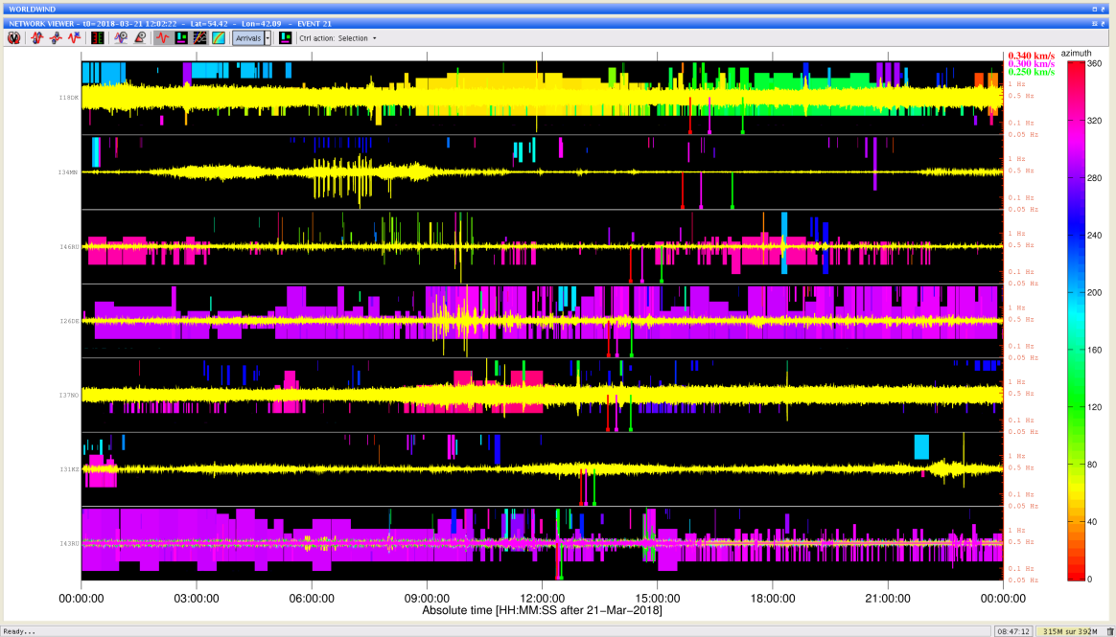
On using self-sustained events for stochastic waveform modelling with deep neural networks
Xavier Cassagnou¹, Christophe Millet^{1,2}, Mathilde Mougeot^{1,3}, Cyril Nefzaoui Blanchard^{1,2}
      ¹Centre Borelli, ENS Paris-Saclay, F-91190 Gif-sur-Yvette, France, ²CEA, DAM, DIF, 91297 Arpajon, France,
      ³ENSIIE, F-91000 Évry, France
      Corresponding authors : xavier.cassagnou@ens-paris-saclay.fr, christophe.millet@cea.fr
P3.6-615
The performance of the IMS is known to be related to atmospheric properties, but the usual approach at the IDC still relies on simple models to incorporate the environmental knowledge.
We develop a deep neural network (NN) that takes advantage of fundamental properties of dynamical systems to learn a model for the stochastic component involved in wave propagation, and predict some statistics of the recorded time series.
The NN model is suitable for training on data emanating from individual stations of the IMS, using far-field self-sustained natural events such as microbaroms and high-fidelity simulation data.
ABSTRACT
Example of signals exhibiting self-sustained events during 24 hours for 9 infrasound stations of the IMS. No reliable information about these events (localizations, sources, etc.) is available on a daily basis.

Slide 3
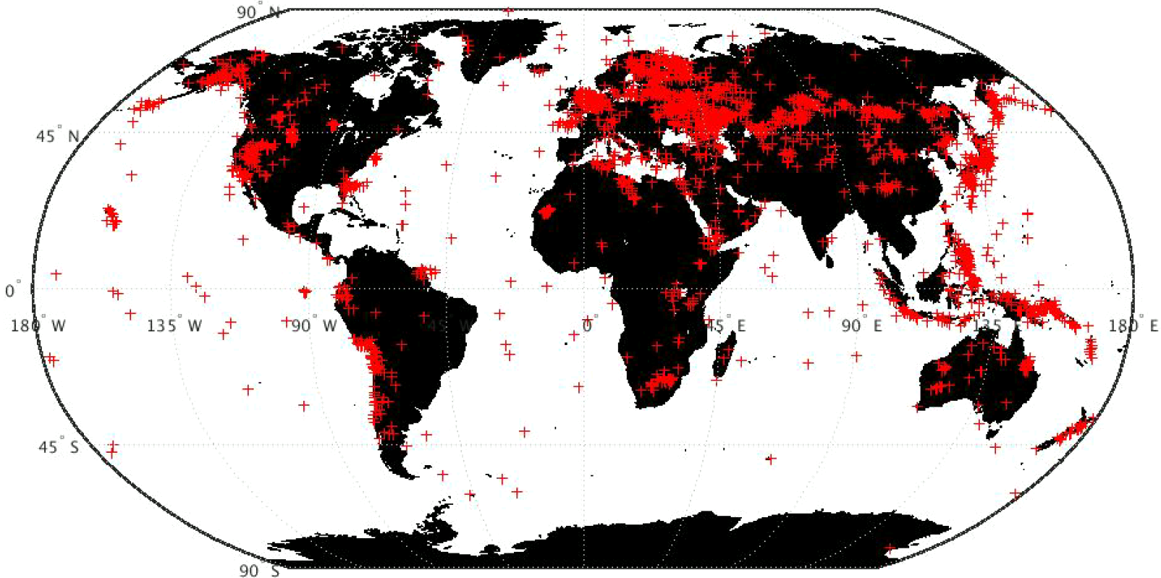
On using self-sustained events for stochastic waveform modelling with deep neural networks
Xavier Cassagnou¹, Christophe Millet^{1,2}, Mathilde Mougeot^{1,3}, Cyril Nefzaoui Blanchard^{1,2}
      ¹Centre Borelli, ENS Paris-Saclay, F-91190 Gif-sur-Yvette, France, ²CEA, DAM, DIF, 91297 Arpajon, France,
      ³ENSIIE, F-91000 Évry, France
      Corresponding authors : xavier.cassagnou@ens-paris-saclay.fr, christophe.millet@cea.fr
P3.6-615
Context
Waveform sensor stations of the International Monitoring System (IMS).
Self sustained perturbators are “mixed” with the events of interest. Such perturbators are known to cause false alarms.
Need to produce automated data-driven processes to reduce the false alarms rate.
Usual approach
Global Association, NET-VISA, ...
Case-by-case study that relies on expert judgments, propagation models and prior on the distribution of perturbators.
How can we train ML algorithms from past data to better describe the effect of self-sustained perturbators in the recorded signals?
INTRODUCTION
Localization of events in the database REB that have generated infrasound detections during the period 2011-2019.

Slide 4
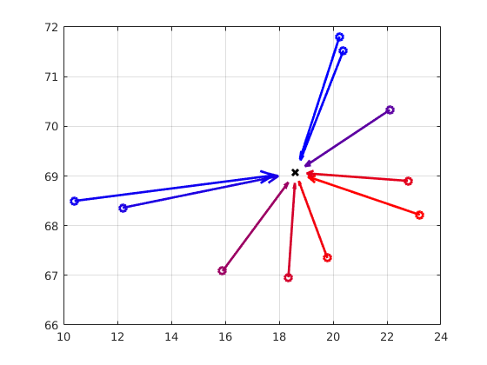
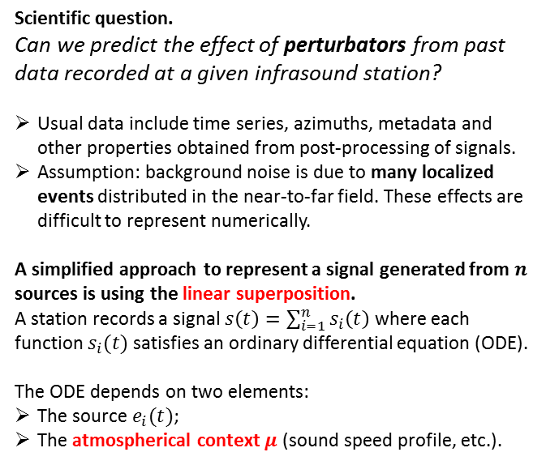

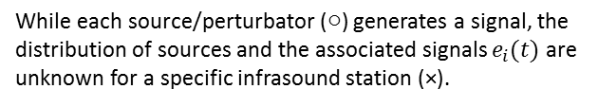

On using self-sustained events for stochastic waveform modelling with deep neural networks
Xavier Cassagnou¹, Christophe Millet^{1,2}, Mathilde Mougeot^{1,3}, Cyril Nefzaoui Blanchard^{1,2}
      ¹Centre Borelli, ENS Paris-Saclay, F-91190 Gif-sur-Yvette, France, ²CEA, DAM, DIF, 91297 Arpajon, France,
      ³ENSIIE, F-91000 Évry, France
      Corresponding authors : xavier.cassagnou@ens-paris-saclay.fr, christophe.millet@cea.fr
P3.6-615
Scientific question.
Can we predict the effect of perturbators from past data recorded at a given infrasound station?
Usual data include time series, azimuths, metadata and other properties obtained from post-processing of signals.
Assumption: background noise is due to many localized events distributed in the near-to-far field. These effects are difficult to represent numerically.
A simplified approach to represent a signal generated from $n$ sources is using the linear superposition.
A station records a signal $s\left(t\right)=\sum_{i=1}^{n}{s_{i}\left(t\right)}$ where each function $s_{i}(t)$ satisfies an ordinary differential equation (ODE).
The ODE depends on two elements:
The source $e_{i}(t)$;
The atmospherical context $μ$ (sound speed profile, etc.).
$$e_{i}\left(t\right)$$
Color = $μ$
Latitude
INTRODUCTION
Longitude
While each source/perturbator ($○$) generates a signal, the distribution of sources and the associated signals $e_{i}(t)$ are unknown for a specific infrasound station (×).

Slide 5
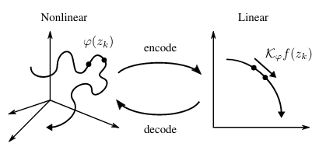
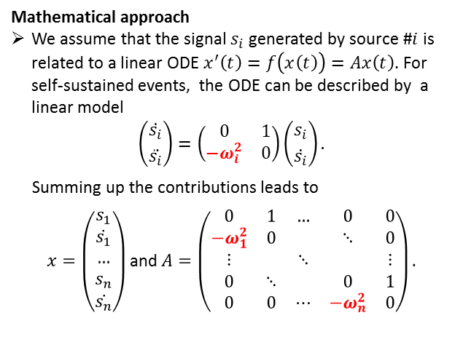

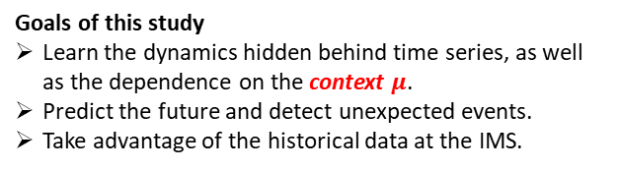

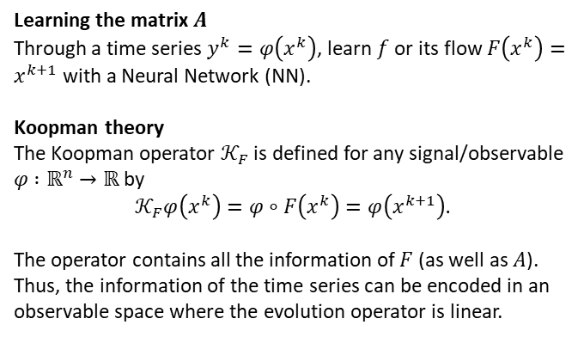
On using self-sustained events for stochastic waveform modelling with deep neural networks
Xavier Cassagnou¹, Christophe Millet^{1,2}, Mathilde Mougeot^{1,3}, Cyril Nefzaoui Blanchard^{1,2}
      ¹Centre Borelli, ENS Paris-Saclay, F-91190 Gif-sur-Yvette, France, ²CEA, DAM, DIF, 91297 Arpajon, France,
      ³ENSIIE, F-91000 Évry, France
      Corresponding authors : xavier.cassagnou@ens-paris-saclay.fr, christophe.millet@cea.fr
P3.6-615
Goals of this study
Learn the dynamics hidden behind time series, as well as the dependence on the context $μ$.
Predict the future and detect unexpected events.
Take advantage of the historical data at the IMS.
Learning the matrix $A$
Through a time series $y^{k}=φ\left(x^{k}\right)$, learn $f$ or its flow $F\left(x^{k}\right)=x^{k+1}$ with a Neural Network (NN).
Koopman theory
The Koopman operator $𝒦_{F}$ is defined for any signal/observable $φ$ $:ℝ^{n}→ℝ$ by
$$𝒦_{F}φ\left(x^{k}\right)=φ∘F\left(x^{k}\right)=φ\left(x^{k+1}\right).$$
The operator contains all the information of $F$ (as well as $A$). Thus, the information of the time series can be encoded in an observable space where the evolution operator is linear.
Mathematical approach
We assume that the signal $s_{i}$ generated by source #$i$ is related to a linear ODE $x^{′}\left(t\right)=f\left(x\left(t\right)\right)=Ax\left(t\right)$. For self-sustained events, the ODE can be described by a linear model
$$\left({\dot{s_{i}} \atop \ddot{s_{i}}}\right)=\left(\begin{matrix}0 & 1 \\ −ω_{i}^{2} & 0\end{matrix}\right)\left({s_{i} \atop \dot{s_{i}}}\right).$$
Summing up the contributions leads to
$x=\left(\begin{matrix}s_{1} \\ \dot{s_{1}} \\ … \\ s_{n} \\ \dot{s_{n}}\end{matrix}\right)$ and $A=\left(\begin{matrix}0 & 1 & … & 0 & 0 \\ −ω_{1}^{2} & 0 & & ⋱ & 0 \\ ⋮ & & ⋱ & & ⋮ \\ 0 & ⋱ & & 0 & 1 \\ 0 & 0 & ⋯ & −ω_{n}^{2} & 0\end{matrix}\right).$
INTRODUCTION
$$φ\left(x^{k}\right)$$
$$𝒦_{F}φ\left(x^{k}\right)$$

Slide 6
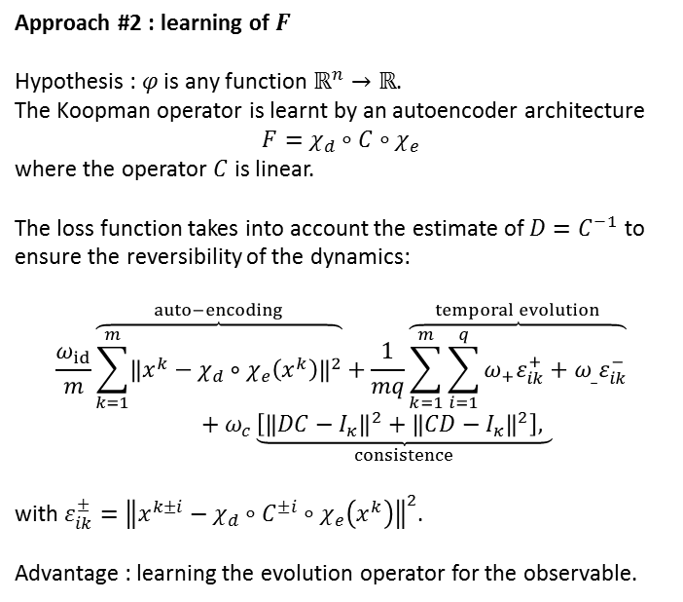
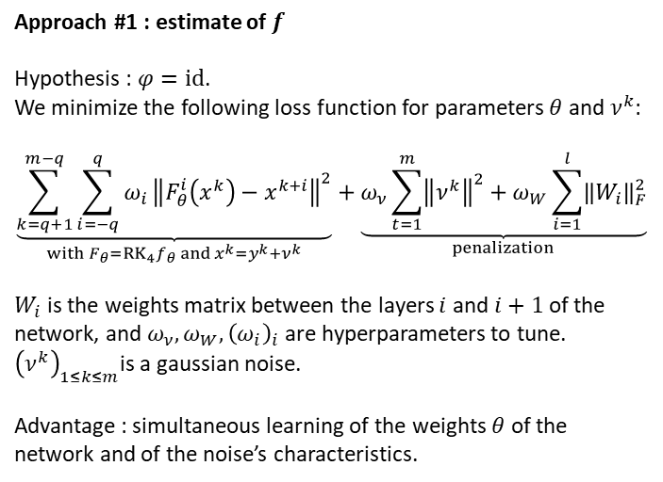
On using self-sustained events for stochastic waveform modelling with deep neural networks
Xavier Cassagnou¹, Christophe Millet^{1,2}, Mathilde Mougeot^{1,3}, Cyril Nefzaoui Blanchard^{1,2}
      ¹Centre Borelli, ENS Paris-Saclay, F-91190 Gif-sur-Yvette, France, ²CEA, DAM, DIF, 91297 Arpajon, France,
      ³ENSIIE, F-91000 Évry, France
      Corresponding authors : xavier.cassagnou@ens-paris-saclay.fr, christophe.millet@cea.fr
P3.6-615
Approach #1 : estimate of $f$
Hypothesis : $φ=id$.
We minimize the following loss function for parameters $θ$ and $ν^{k}$:
$$\underset{with F_{θ}=RK_{4}f_{θ} and x^{k}=y^{k}+ν^{k}}{\underbrace{\sum_{k=q+1}^{m−q}{\sum_{i=−q}^{q}{ω_{i}}{\left\|F_{θ}^{i}\left(x^{k}\right)−x^{k+i}\right\|}^{2}}}}+\underset{penalization}{\underbrace{ω_{ν}\sum_{t=1}^{m}{{\left\|ν^{k}\right\|}^{2}}+ω_{W}\sum_{i=1}^{l}{{\left\|W_{i}\right\|}_{F}^{2}}}}$$
$W_{i}$ is the weights matrix between the layers $i$ and $i+1$ of the network, and $ω_{ν}, ω_{W}, {\left(ω_{i}\right)}_{i}$ are hyperparameters to tune.
${\left(ν^{k}\right)}_{1≤k≤m}$is a gaussian noise.
Advantage : simultaneous learning of the weights $θ$ of the network and of the noise’s characteristics.
Approach #2 : learning of $F$
Hypothesis : $φ$ is any function $ℝ^{n}→ℝ$.
The Koopman operator is learnt by an autoencoder architecture
$$F=χ_{d}∘C∘χ_{e}$$
where the operator $C$ is linear.
The loss function takes into account the estimate of $D=C^{−1}$ to ensure the reversibility of the dynamics:
$$\frac{ω_{id}}{m}\overset{auto−encoding}{\overbrace{\sum_{k=1}^{m}{{\left\|x^{k}−χ_{d}∘χ_{e}\left(x^{k}\right)\right\|}^{2}}}}+\frac{1}{mq}\overset{temporal evolution}{\overbrace{\sum_{k=1}^{m}{\sum_{i=1}^{q}{ω_{+}ε_{ik}^{+}}+ω_{_}ε_{ik}^{−}}}}+ω_{c}\underset{consistence}{\underbrace{\left[{\left\|DC−I_{κ}\right\|}^{2}+{\left\|CD−I_{κ}\right\|}^{2}\right], }}$$
with $ε_{ik}^{±}={\left\|x^{k±i}−χ_{d}∘C^{±i}∘χ_{e}\left(x^{k}\right)\right\|}^{2}$.
Advantage : learning the evolution operator for the observable.
METHODS

Slide 7
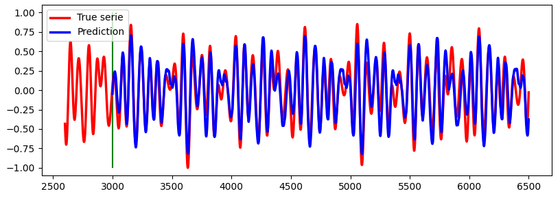
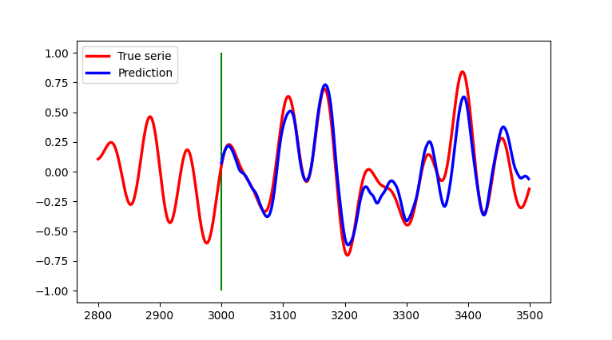
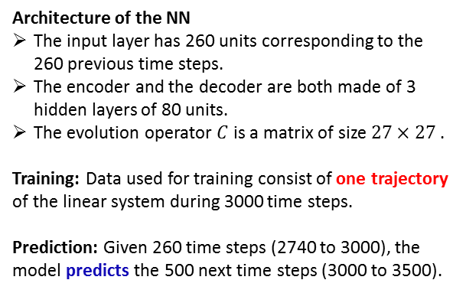
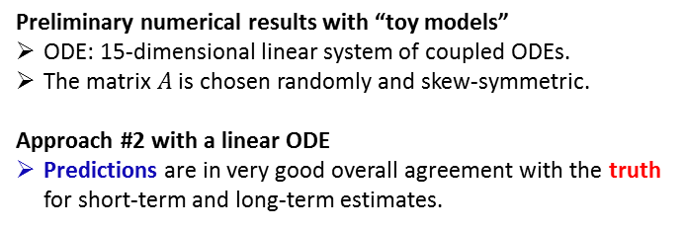
On using self-sustained events for stochastic waveform modelling with deep neural networks
Xavier Cassagnou¹, Christophe Millet^{1,2}, Mathilde Mougeot^{1,3}, Cyril Nefzaoui Blanchard^{1,2}
      ¹Centre Borelli, ENS Paris-Saclay, F-91190 Gif-sur-Yvette, France, ²CEA, DAM, DIF, 91297 Arpajon, France,
      ³ENSIIE, F-91000 Évry, France
      Corresponding authors : xavier.cassagnou@ens-paris-saclay.fr, christophe.millet@cea.fr
P3.6-615
Preliminary numerical results with “toy models”
ODE: 15-dimensional linear system of coupled ODEs.
The matrix $A$ is chosen randomly and skew-symmetric.
Approach #2 with a linear ODE
Predictions are in very good overall agreement with the truth for short-term and long-term estimates.
RESULTS
Architecture of the NN
The input layer has 260 units corresponding to the 260 previous time steps.
The encoder and the decoder are both made of 3 hidden layers of 80 units.
The evolution operator $C$ is a matrix of size $27×27$.
Training: Data used for training consist of one trajectory of the linear system during 3000 time steps.
Prediction: Given 260 time steps (2740 to 3000), the model predicts the 500 next time steps (3000 to 3500).
Time steps

Slide 8
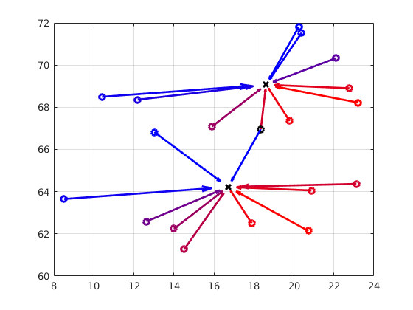
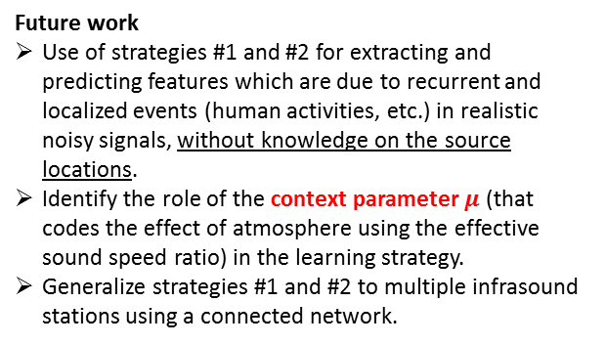


On using self-sustained events for stochastic waveform modelling with deep neural networks
Xavier Cassagnou¹, Christophe Millet^{1,2}, Mathilde Mougeot^{1,3}, Cyril Nefzaoui Blanchard^{1,2}
      ¹Centre Borelli, ENS Paris-Saclay, F-91190 Gif-sur-Yvette, France, ²CEA, DAM, DIF, 91297 Arpajon, France,
      ³ENSIIE, F-91000 Évry, France
      Corresponding authors : xavier.cassagnou@ens-paris-saclay.fr, christophe.millet@cea.fr
P3.6-615
Future work
Use of strategies #1 and #2 for extracting and predicting features which are due to recurrent and localized events (human activities, etc.) in realistic noisy signals, without knowledge on the source locations.
Identify the role of the context parameter $μ$ (that codes the effect of atmosphere using the effective sound speed ratio) in the learning strategy.
Generalize strategies #1 and #2 to multiple infrasound stations using a connected network.
Color = $μ$
Latitude
CONCLUSIONS
Sketch of connected stations ($×$) and multiple events ($∘$)
Longitude
References
[1] Rudy, S. H., Kutz, J. N., and Brunton, S. L. (2019). Deep learning of dynamics and signal-noise decomposition with time-stepping constraints. Journal of Computational Physics, 396:483–506.
[2] Lusch, B., Kutz, J. N., and Brunton, S. (2018). Deep learning for universal linear embeddings of nonlinear dynamics. Nature Communications, 9.
[3] Azencot, O., Erichson, N., Lin, V., and Mahoney, M. W. (2020). Forecasting Sequential Data using Consistent Koopman Autoencoders. International Conference on Machine Learning (ICML).

