Slide 1

A neural network architecture for detecting repeating events using seismic arrays
S. Maeland, A. Köhler, B. Dando
{steffen.maeland,andreas.kohler,benjamin.dando}@norsar.no
P3.6-326
NORSAR, Gunnar Randers Vei, Kjeller, Norway

Slide 2
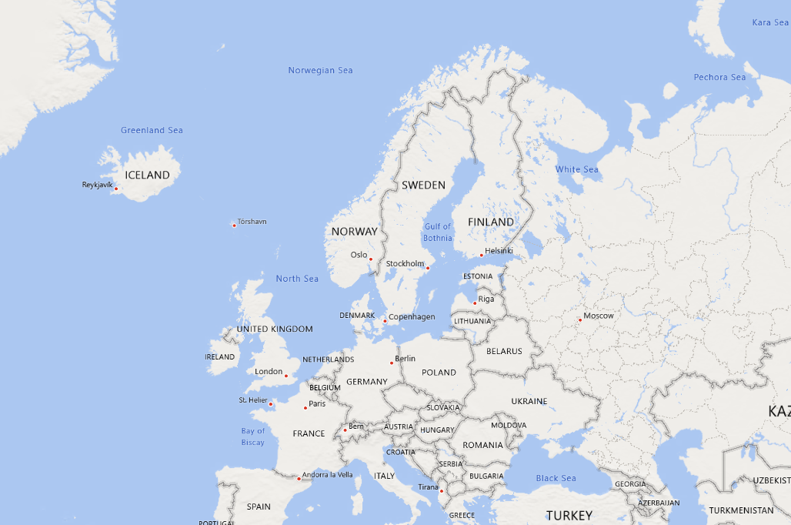
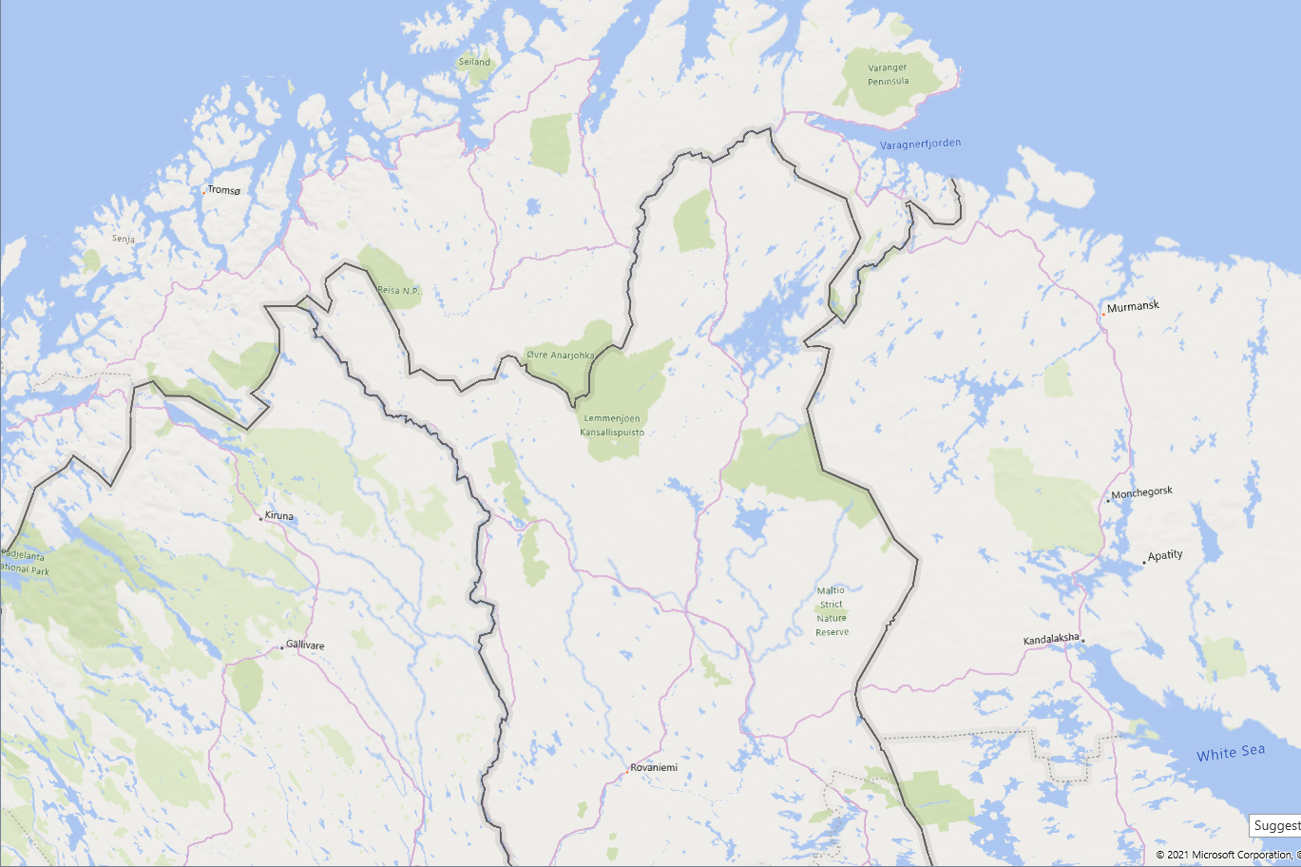

A neural network architecture for detecting repeating events using seismic arrays
S. Maeland, A. Köhler, B. Dando (NORSAR)
P3.6-326
Recent advances in convolutional neural networks (CNNs) have brought impressive detection capabilities to one- and three-component seismic stations
Still, the highest sensitivity to repeating events is obtained by beamforming signals over a seismic array
We propose a new neural network architecture that combines the two, by introducing a two-dimensional convolutional layer that encodes the propagation time delays between array stations.
Waveforms
Activations
2D image of activations
Classification
ARCES
ABSTRACT
1D convolution block
Concatenation
2D convolution block
The result is a purely empirical model, which does not rely on the plane-wave approximation of traditional beamforming
We demonstrate the model by detecting and classifying repeating blasts from multiple mining sites in northern Fennoscandia
Notes:
Hello, my name is Steffen Mæland, and I work as a researcher at NORSAR. I will present a proposed neural network architecture for detecting repeating events using seismic arrays,
which is work done together with my colleagues Andreas Köhler, and Ben Dando.
- Over the last couple of years there has been a strong focus on machine learning methods within seismology, and we have seen impressive detection capabilities by the use of convolutional neural networks, or CNNs.
- Most of there studies are, however, limited to using one- or three-component data. NORSAR is operating several large seismic arrays, and this motivates the development of a method that is applicable to these.
- A straight-forward multi-channel CNN would lose the timing information between array stations, so the idea is to reformat the data into a two-dimensional shape, and introduce two-dimensional convolutional layers. These can recognise the differences in propagation times that form the signature of events from a given location.
- Before the reformatting one can have a potentially advanced structure of convolutional layers operating on single- or three-component data, which allows for integrating recent models specific to that into this method.
- A benefit of this method is that it is purely empirical, and has no assumptions on theoretical wave propagation.
- While this is still work in progress, we demonstrate the method on mining blasts from five different mines around the ARCES array in northern Norway, from which the results can be seen the remaining slides of this poster.

Slide 3
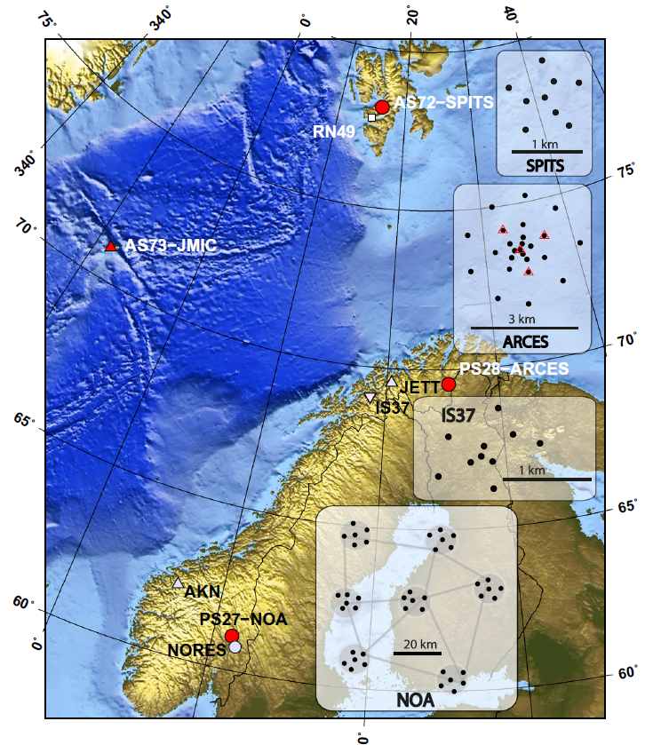
A neural network architecture for detecting repeating events using seismic arrays
S. Maeland, A. Köhler, B. Dando (NORSAR)
P3.6-326
Several recent papers demonstrate the exceptional earthquake detection performance of convolutional neural networks (CNNs) (see [1, 2] for reviews)
Progress in image recognition have pioneered network architectures – arrangements of the network’s layers – that have proven extremely effective also for seismic data
  Deep architectures like ResNet [3], Inception [4] and others, are based on repeated convolutional layers
However, recent works have been applied to three-component data only
  NORSAR operates six seismic arrays
  Want a network architecture that can process on the data from these, with a minimal amount of preprocessing
  The network should encode the propagation time delays between array stations, resulting in a purely empirical model without prior assumptions on wave propagation
INTRODUCTION
[1] Bergen, K. J., Johnson, P. A., de Hoop, M. V. & Beroza, G. C. Machine learning for data-driven discovery in solid Earth geoscience. Science 363, (2019)
[2] Kong, Q. et al. Machine Learning in Seismology: Turning Data into Insights. Seismological Research Letters 90, 3–14 (2019)
[3] He, K., Zhang, X., Ren, S., & Sun, J. Deep residual learning for image recognition. Proceedings of the IEEE conference on computer vision and pattern recognition (2016)
[4] Szegedy, C., Vanhoucke, V., Ioffe, S., Shlens, J., & Wojna, Z. Rethinking the inception architecture for computer vision. In Proceedings of the IEEE conference on computer vision and pattern recognition (2016)

Slide 4
A neural network architecture for detecting repeating events using seismic arrays
S. Maeland, A. Köhler, B. Dando (NORSAR)
P3.6-326
The standard practice for computing convolutions over multiple channels, is constructing
one or several filters, and summing or averaging their output
  This summing destroys the time/location info of the array elements
Our approach is to treat the sorted list of 1D waveforms as a 2D image
  Apply 2D convolution layers, sliding only along the time axis
  Move-out time differences between array elements are preserved, and learnt during training
  Obtain a signature of each site of repeating events
Filter 1
Filter 2
METHODS
Conv 1D
Conv 1D
Concatenate
Conv 2D
Classify
Conv 1D
Conv 1D
Waveforms
1D convolution block
Activations
2D image of activations
2D convolution block

Slide 5
A neural network architecture for detecting repeating events using seismic arrays
S. Maeland, A. Köhler, B. Dando (NORSAR)
P3.6-326
To reduce the total number of free parameters, hence lower the amount of data required to fit them, we propose to first apply the same 1D convolutional block to all array elements
  This block operates on 3-component data
  Any complex architecture (ResNet etc) can be used here – our model allows for seamless integration with recent seismic detection models
Conv 1D
Conv 1D
Conv 1D
Conv 1D
METHODS
We evaluate the performance on data from mining blasts at five different sites in Fennoscandia, recorded at the 25-element ARCES array
As a baseline for comparison, we set up crosscorrelation detectors for each site
  Crosscorrelation done on all array channels
ARCES

Slide 6
A neural network architecture for detecting repeating events using seismic arrays
S. Maeland, A. Köhler, B. Dando (NORSAR)
P3.6-326
Optimisation of hyperparameters (kernel sizes, number of layers, etc) involves a huge search space and is computationally very expensive
Here we present preliminary results with a simple network, which are subject to improvement
  Use three convolutional layers in the 1D block, with 10 filters each and increasing kernel length (5-8-12)
  Similarly for the 2D block: Three convolutional layers with 10 filters each, increasing kernel length (5-10-15)
  Output of the last convolution layer is passed to a global average pooling layer, classification done by a single feed-forward layer with softmax activation
Model trained on 9000 mining events
Performance comparable to correlation detectors with similarity threshold adjusted down to 0.05, when testing on mining events
Expect correlation detector at this threshold to suffer from false detections; work ongoing
RESULTS
Results on unseen test data:
 | 2D CNN | Crosscorrelation (thr. = 0.05) | Crosscorrelation (thr. = 0.2)
Accuracy | 0.965 | 0.950 | 0.190
Precision (weighted mean) | 0.966 | 0.975 | 0.995
Recall (weighted mean) | 0.964 | 0.950 | 0.190

Slide 7
A neural network architecture for detecting repeating events using seismic arrays
S. Maeland, A. Köhler, B. Dando (NORSAR)
P3.6-326
We have presented a novel neural network architecture for detecting repeating seismic events using array stations
Can take advantage of recent progress on single-station detection capabilities
The method does not rely on any assumptions on wave propagation, but rather recognises the arrival time differences between array elements for a given source
  Conceptually similar to empirical matched-field processing (EMFP) [5]
The method is superior to crosscorrelation detectors in terms of accuracy and in manual work required to set up
Tuning and additional testing still ongoing
CONCLUSIONS
[5] Harris, D. B. & Kvaerna, T. Superresolution with seismic arrays using empirical matched field processing: Superresolution with matched field processing. Geophysical Journal International 182, 1455–1477 (2010).

