Slide 1
Simulation of operational results of NET-VISA on a three-month historical data set
Ronan Le Bras, Noriyuki Kushida, Pavel Strachota, Nimar Arora, Geeta Arora
P3.6-651
Designated area for External Participants to insert their Logo and/or Affiliation
Please remove this text and the dashed outline after placing your Logo

Slide 2
Simulation of operational results of NET-VISA on a three-month historical data set
Ronan Le Bras, Noriyuki Kushida, Pavel Strachota, Nimar Arora, Geeta Arora
P3.6-651
NET-VISA has benefitted tremendously from the interaction between its developers and CTBT State Signatories experts. One way that this interaction has taken place is through the delivery of data sets processed with successively enhanced versions of the software, with feedback from the experts. We present the results of a full simulation of operational results conducted offline with a recent version of NET-VISA (December 2020). The processing includes the complete three-pipeline configuration. The data set covers August-October 2016, includes an announced nuclear test, and is intended to be delivered to the State Signatories experts. The analysis will cover the essential comparison criteria of overlap and inconsistency between the automatic results and reviewed results, but will also go deeper into the comparison of the NET-VISA results with the SEL3 automatic bulletin for that period, taking into account location accuracy and completeness of the automatic events.
ABSTRACT

Slide 3
Simulation of operational results of NET-VISA on a three-month historical data set
Ronan Le Bras, Noriyuki Kushida, Pavel Strachota, Nimar Arora, Geeta Arora
P3.6-651
NET-VISA uses a Bayesian approach in the Network Processing step of SHI data. It has been used operationally since January 2018 in complement to Global Association (GA) which has been in use since the inception of the IDC.
The results of NET-VISA version 2.4.2 processing were obtained using a full-pipeline mode and generated SEL1/2/3 automatic bulletins similarly to the Global Association (GA) software, including retrieval of auxiliary seismic stations segments based on SEL1 and SEL2 events.
The testing was performed on the set of arrivals obtained through the automated station processing from 1 August to 31 October 2016, which includes one of the DPRK announced nuclear tests.
INTRODUCTION

Slide 4
Simulation of operational results of NET-VISA on a three-month historical data set
Ronan Le Bras, Noriyuki Kushida, Pavel Strachota, Nimar Arora, Geeta Arora
P3.6-651
The following criteria are used to compare the results of the three-month dataset with the standard results obtained with GA:
    Total number of events in the three automatic bulletins
    Comparison with the Ground-Truth (GT) events from the ISC for that time period
    Overlap and Inconsistency comparison with the REB bulletin
    Split and joint comparison with the REB bulletin
    Number of defining associations in each bulletin
    Comparison of the automatically obtained DPRK test of 9 September 2016
    Comparison of the two maps (NET-VISA and GA) of automatic events
METHODS

Slide 5
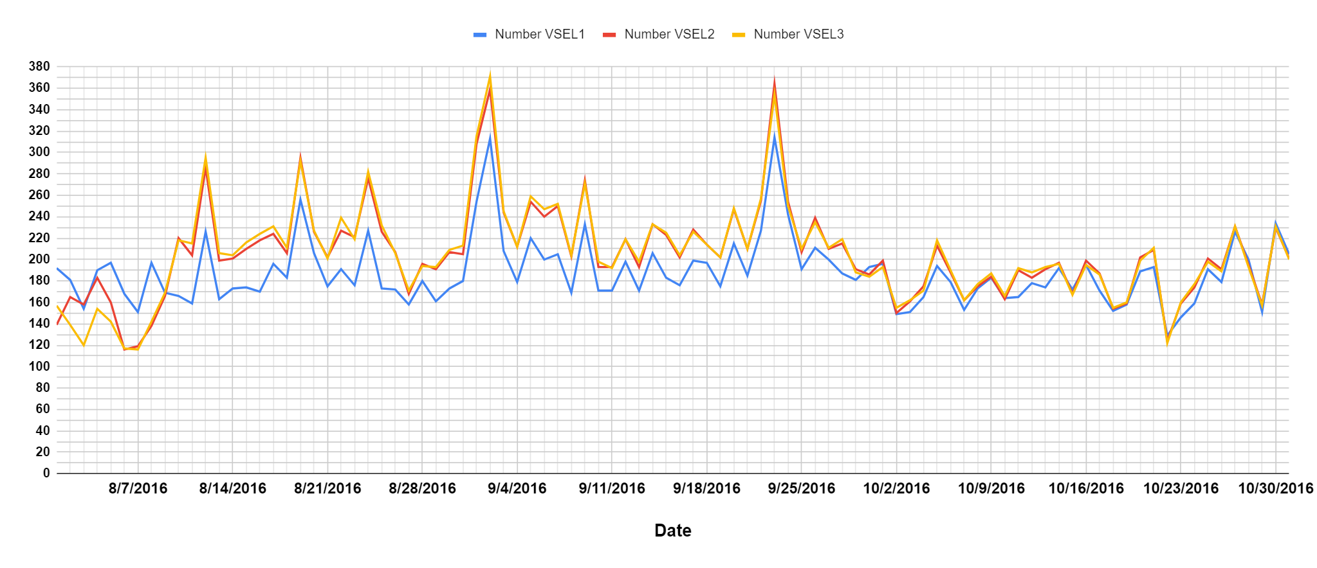
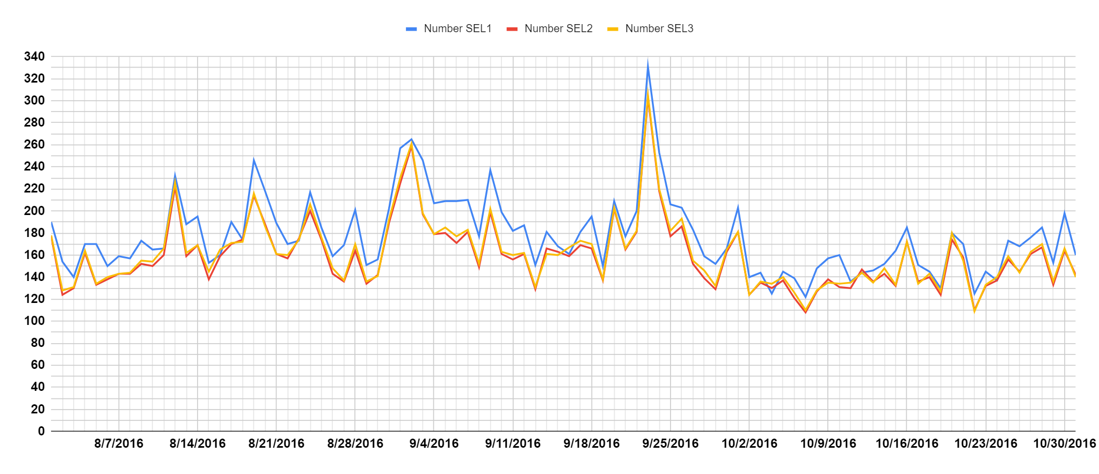
Simulation of operational results of NET-VISA on a three-month historical data set
Ronan Le Bras, Noriyuki Kushida, Pavel Strachota, Nimar Arora, Geeta Arora
P3.6-651
Number of events per day
VSEL1/VSEL2/VSEL3
(NET-VISA)
Same overall pattern with time, with several maxima on the same days.
VSEL1 numbers are smaller than VSEL2 and VSEL3, contrary to SEL1 which has higher numbers than SEL2 and SEL3.
RESULTS
Number of events per day
SEL1/SEL2/SEL3
(GA)

Slide 6
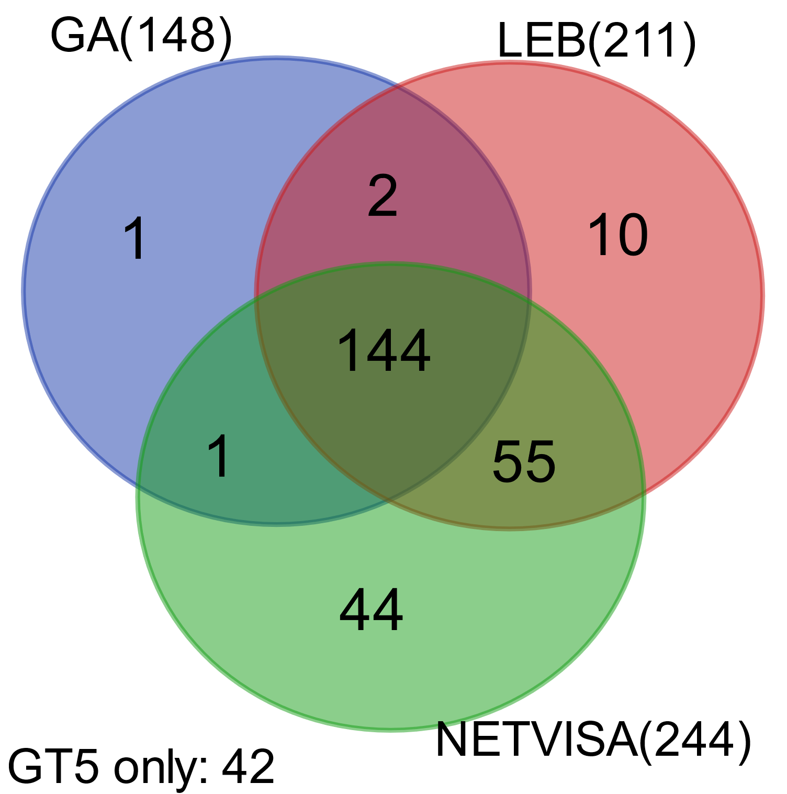
Simulation of operational results of NET-VISA on a three-month historical data set
Ronan Le Bras, Noriyuki Kushida, Pavel Strachota, Nimar Arora, Geeta Arora
P3.6-651
Data set: Aug - Oct 2016
  DPRK test on September
299 ISC-GT5 events in the same time period
Matching criteria to GT5 events:
  Distance: < 5 deg. & Time: < 120 sec.
NET-VISA surpasses both GA and LEB in terms of matched events
RESULTS
Bulletin | LEB | GA | NET-VISA | NONE
Number Matched (rank) | 211 | 148 | 244 | 42
Percentage Matched | 70.6 | 49.5 | 81.6 | 14.0
Average distance (km) | 24.0 | 87.6 | 82.1 | N/A
Average distance of 144 events in common (km) | 19.2 | 82.7 | 52.5 | N/A
Median distance of 144 events in common (km) | 15.3 | 36.4 | 29.3 | N/A

Slide 7
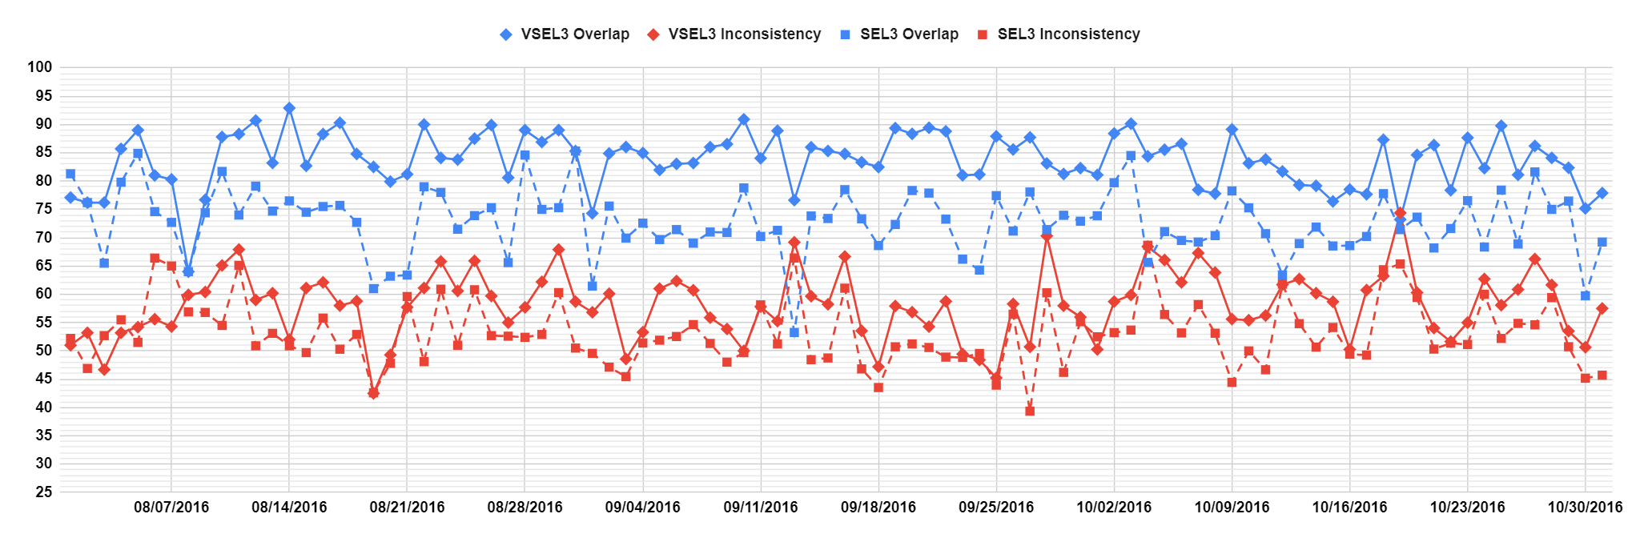
Simulation of operational results of NET-VISA on a three-month historical data set
Ronan Le Bras, Noriyuki Kushida, Pavel Strachota, Nimar Arora, Geeta Arora
P3.6-651
Historical Data Set processed with NET-VISA
Aug-Oct 2016 – Overlap Inconsistency
Comparison with REB
Overlap |  | Inconsistency
NET-VISA | SEL3 | NET-VISA | SEL3
83.7% | 72.8% | 58.0% | 53.1%
RESULTS

Slide 8
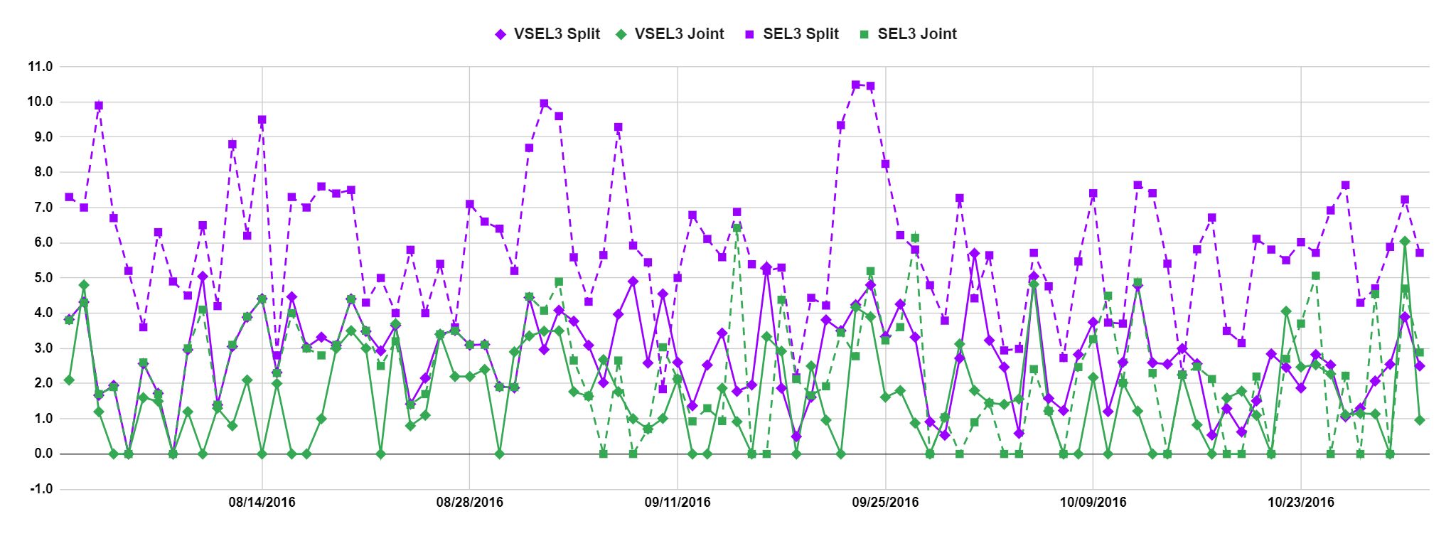
Simulation of operational results of NET-VISA on a three-month historical data set
Ronan Le Bras, Noriyuki Kushida, Pavel Strachota, Nimar Arora, Geeta Arora
P3.6-651
Historical Data Set processed with NET-VISA
Aug-Oct 2016 – Split - Joint
Comparison with REB
Split |  | Joint
NET-VISA | SEL3 | NET-VISA | SEL3
2.8 | 5.9 | 1.6 | 2.4
RESULTS

Slide 9
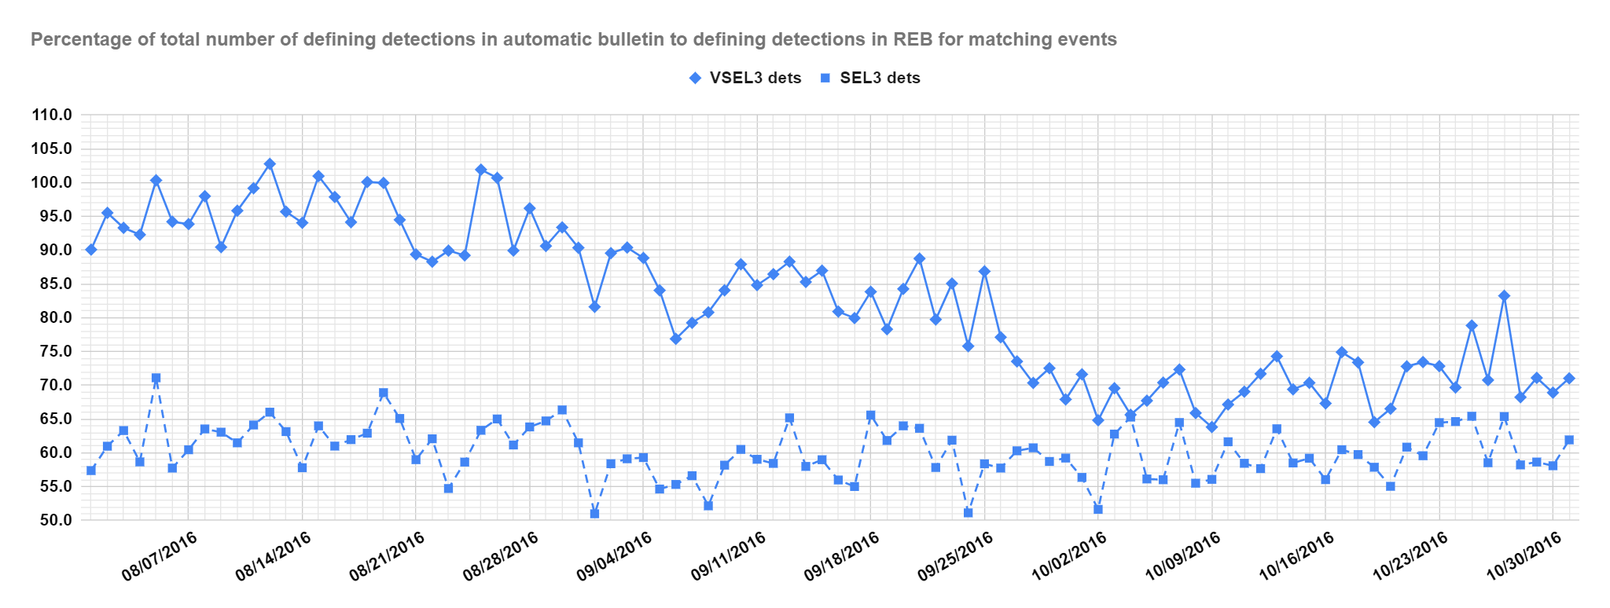
Simulation of operational results of NET-VISA on a three-month historical data set
Ronan Le Bras, Noriyuki Kushida, Pavel Strachota, Nimar Arora, Geeta Arora
P3.6-651
Historical Data Set processed with NET-VISA
Aug-Oct 2016 – Percentage of defining associations. Comparison with REB
RESULTS

Slide 10
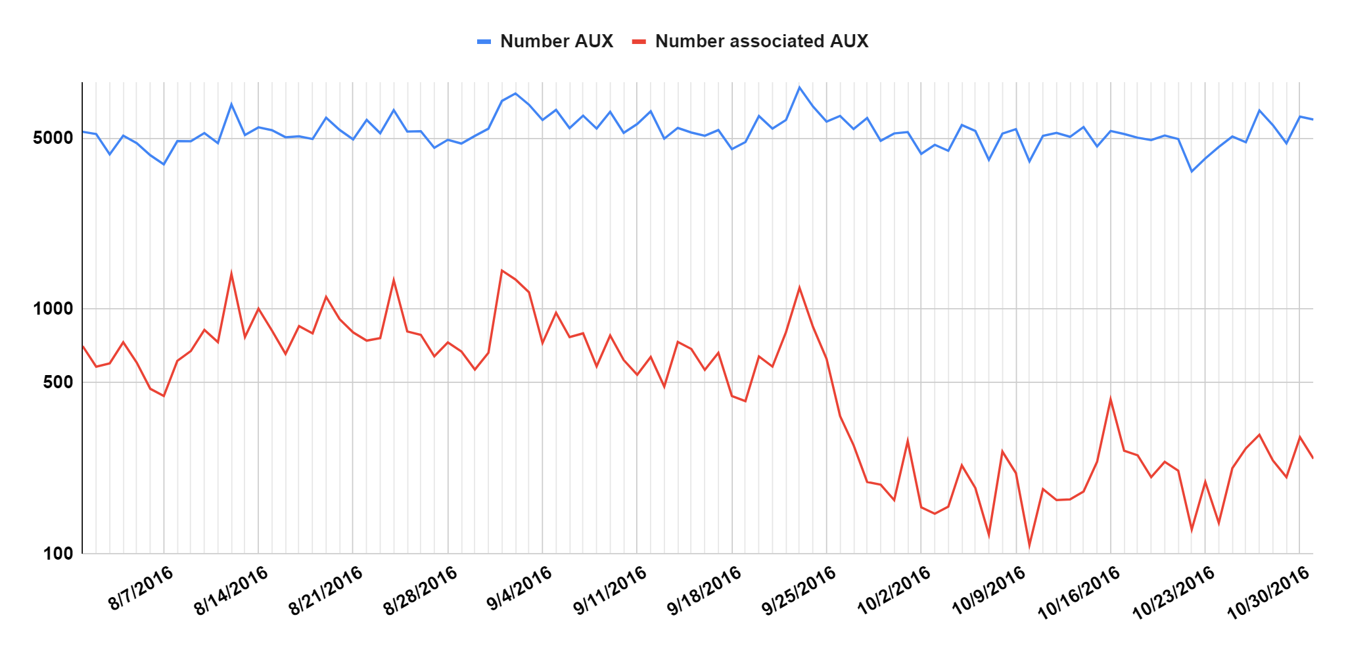
Simulation of operational results of NET-VISA on a three-month historical data set
Ronan Le Bras, Noriyuki Kushida, Pavel Strachota, Nimar Arora, Geeta Arora
P3.6-651
Number of auxiliary seismic station detections per day – LOG SCALE
RESULTS

Slide 11
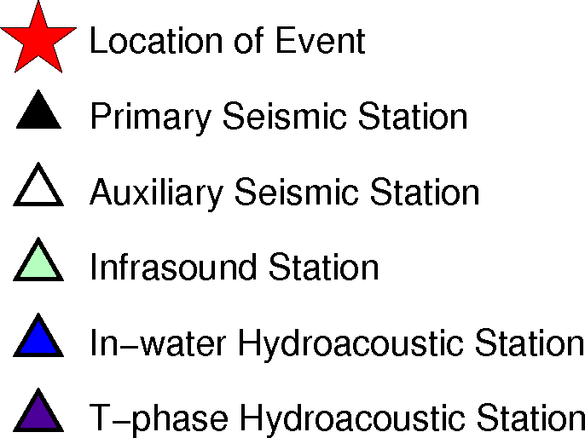
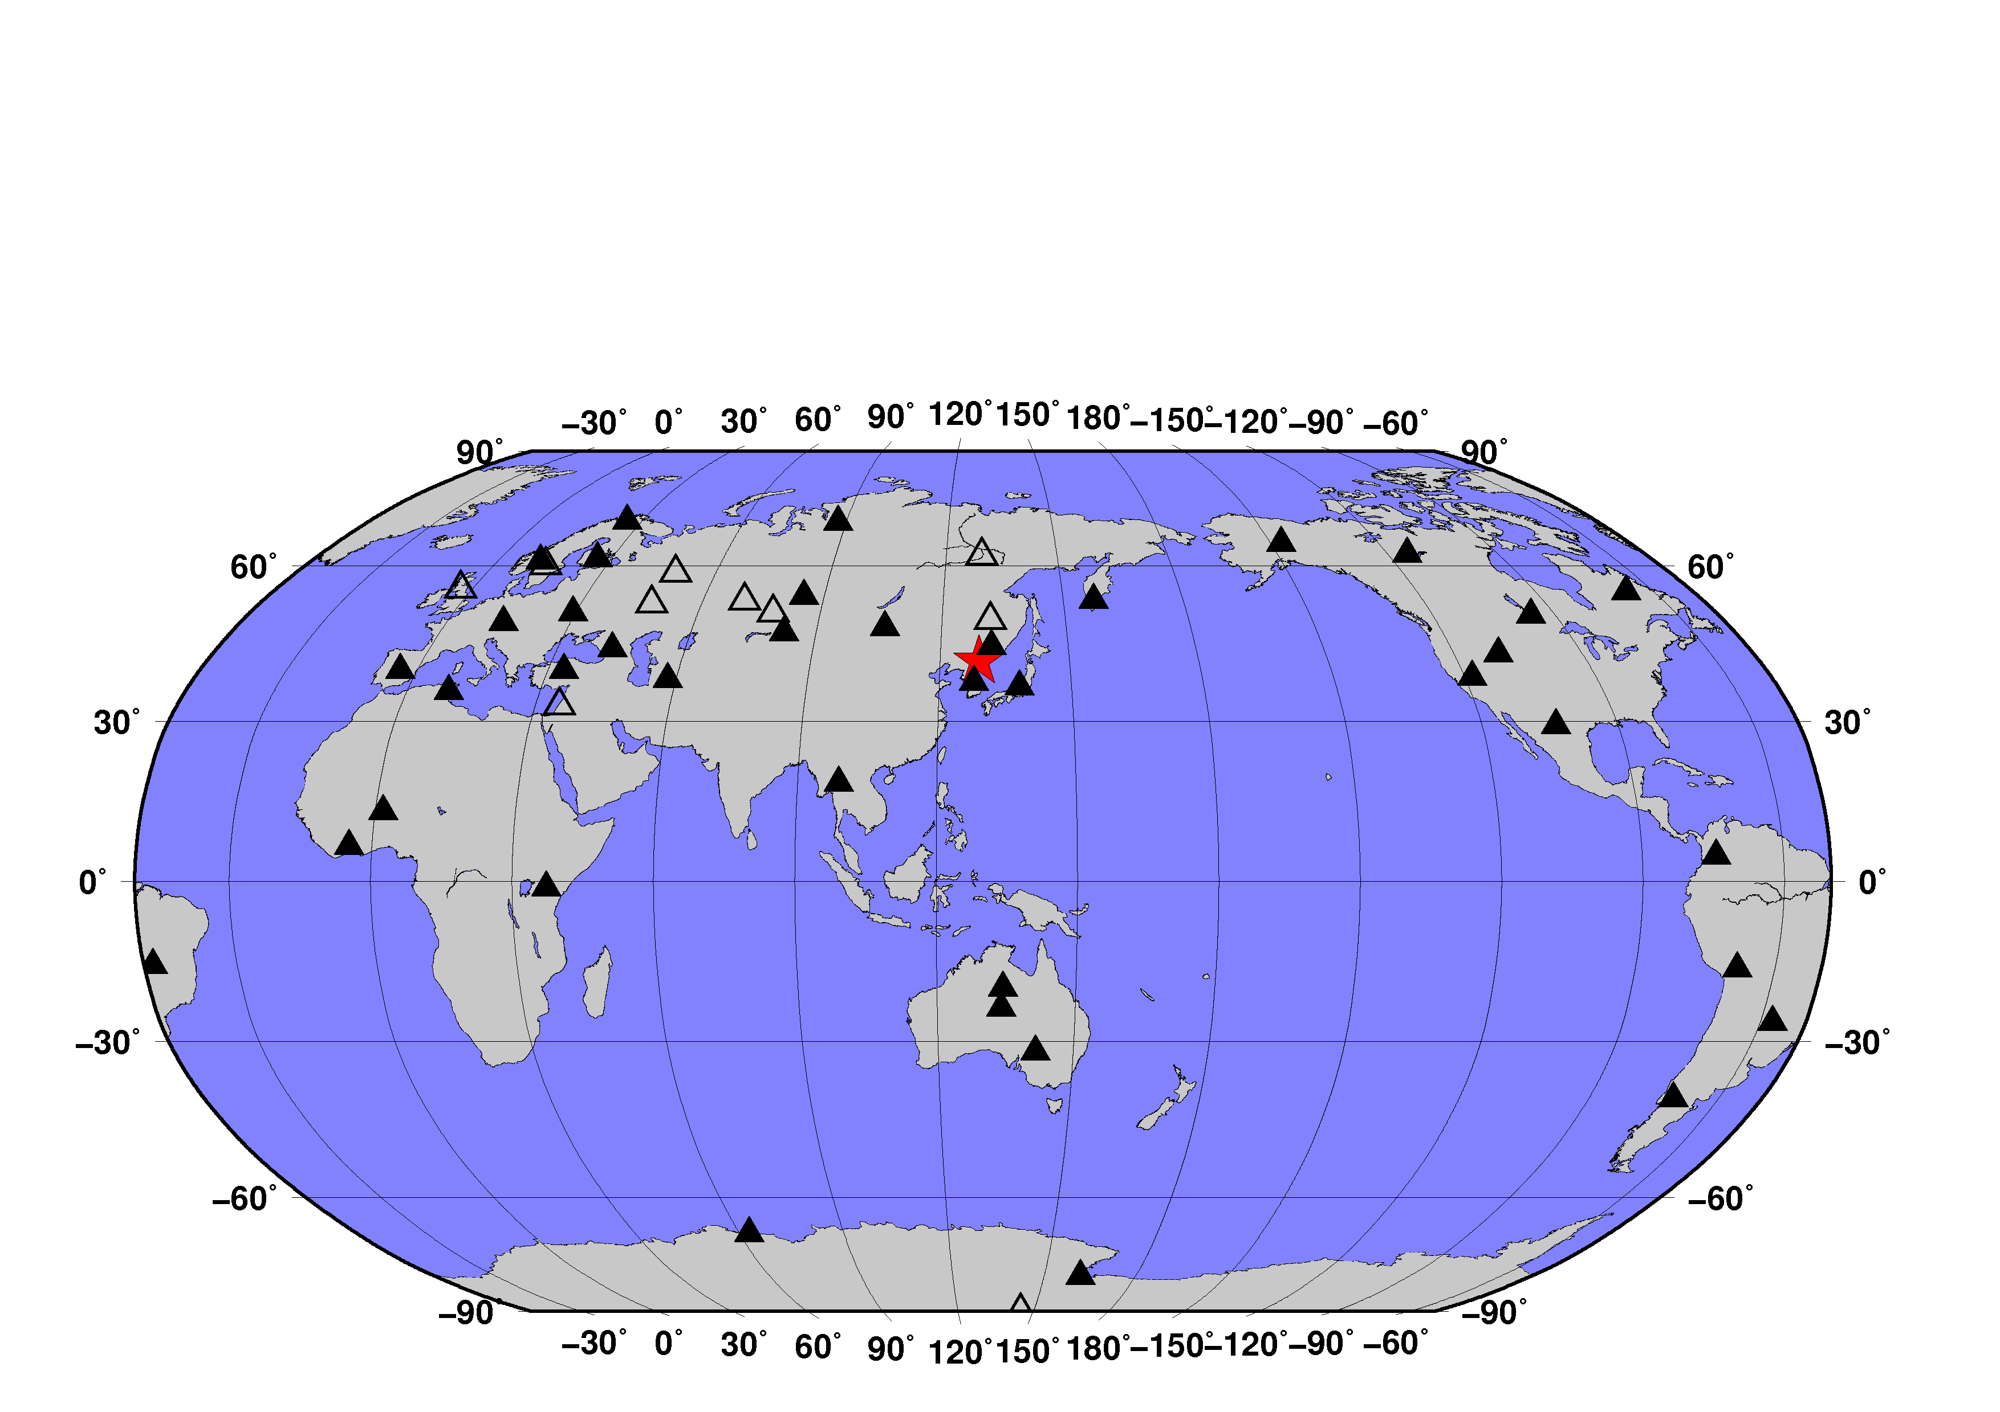

Simulation of operational results of NET-VISA on a three-month historical data set
Ronan Le Bras, Noriyuki Kushida, Pavel Strachota, Nimar Arora, Geeta Arora
P3.6-651
NET-VISA
SEL3 (GA)
RESULTS
Stations detecting
DPRK5 announced test 9 Sep 2016
NET-VISA 39 Primary 10 Auxiliary Seismic
SEL3 29 Primary 7 Auxiliary Seismic

Slide 12
Simulation of operational results of NET-VISA on a three-month historical data set
Ronan Le Bras, Noriyuki Kushida, Pavel Strachota, Nimar Arora, Geeta Arora
P3.6-651
Depth D in km
D < 40
40 < D < 100
100 < D < 300
300 < D
RESULTS

Slide 13
Simulation of operational results of NET-VISA on a three-month historical data set
Ronan Le Bras, Noriyuki Kushida, Pavel Strachota, Nimar Arora, Geeta Arora
P3.6-651
The full simulation of an operational context, including the request of auxiliary data by NET-VISA events in SEL1 and SEL2 shows that the software is ready for operations.
The previously estimated improvement (> 10%) in overlap is confirmed and slightly better than for previous off-line tests and the version used in operations as of June 2021.
A comparison with Ground-Truth data, independent of the REB, shows excellent results for NET-VISA version 2.4.2, with improvement in the accuracy of the location
NET-VISA overall associates more defining associations and will simplify the work of the analysts
CONCLUSIONS

