Slide 1




Global Scale Discrimination of Explosions and Earthquakes with Deep Learning
Rayna Arora, Nimar Arora, Ronan Le Bras
P3.6-703

Slide 2
Global Scale Discrimination of Explosions and Earthquakes
with Deep Learning
Rayna Arora / CTBTO Youth Group Nimar Arora / Bayesian Logic Inc. Ronan Le Bras / CTBTO
P3.6-703
Discriminating between explosions and earthquakes is necessary for treaty monitoring so that natural events can be screened out by the IDC, and NDCs can forge their own opinions.
It can also be useful for building seismic hazard maps.
Current research on this topic using waveforms or spectrograms is limited to detections of within 400 km.
This isn’t applicable in countries with a sparse network of seismic sensors
Research Question: Is it possible to use Deep Learning to discriminate between earthquakes and explosions from seismic waveforms detected at over 20 degrees (2000 km) away?
INTRODUCTION

Slide 3
Global Scale Discrimination of Explosions and Earthquakes
with Deep Learning
Rayna Arora / CTBTO Youth Group Nimar Arora / Bayesian Logic Inc. Ronan Le Bras / CTBTO
P3.6-703
Developed new Deep Learning architecture for seismic classification from 1D waveforms
For comparison purposes, extended existing Deep Learning architectures based on 2D spectrograms to work at over 20 degrees even though they were not designed for these distances.
Demonstrated generalization capacity on a novel class of explosion-like events (rock bursts)
CONTRIBUTIONS

Slide 4
Global Scale Discrimination of Explosions and Earthquakes
with Deep Learning
Rayna Arora / CTBTO Youth Group Nimar Arora / Bayesian Logic Inc. Ronan Le Bras / CTBTO
P3.6-703
Data from 1978-2018 was gathered from the ISC Event and Arrival Bulletins^{[1]} and the IRIS waveform repository^{[2]}
The dataset consists of 7608 waveform samples
Data included equal number of earthquakes and explosions in each distance bucket of 10 degrees from 20 to 180 degrees
This dataset is publicly available for future research: https://github.com/RaynaArora/TeleseismicDiscrimination/tree/main/snt2021
^{[1]}Storchak, D.A., Harris, J., Brown, L., Lieser, K., Shumba, B., Verney, R., Di Giacomo, D., Korger, E. I. M. (2017). Rebuild of the Bulletin of the International Seismological Centre (ISC), part 1: 1964–1979. Geosci. Lett. (2017) 4: 32. doi: 10.1186/s40562-017-0098-z
Storchak, D.A., Harris, J., Brown, L., Lieser, K., Shumba, B., Di Giacomo, D. (2020) Rebuild of the Bulletin of the International Seismological Centre (ISC)—part 2: 1980–2010. Geosci. Lett. 7: 18, https://doi.org/10.1186/s40562-020-00164-6
^{[2]}The facilities of IRIS Data Services, and specifically the IRIS Data Management Center, were used for access to waveforms, related metadata, and/or derived products used in this study. IRIS Data Services are funded through the Seismological Facilities for the Advancement of Geoscience (SAGE) Award of the National Science Foundation under Cooperative Support Agreement EAR-1851048.
All seismic data were downloaded through the IRIS Wilber 3 system (https://ds.iris.edu/wilber3/) or IRIS Web Services (https://service.iris.edu/), including the following seismic networks: (1) the AZ (ANZA; UC San Diego, 1982); (2) the TA (Transportable Array; IRIS, 2003); (3) the US (USNSN, Albuquerque, 1990); (4) the IU (GSN; Albuquerque, 1988).
DATA

Slide 5
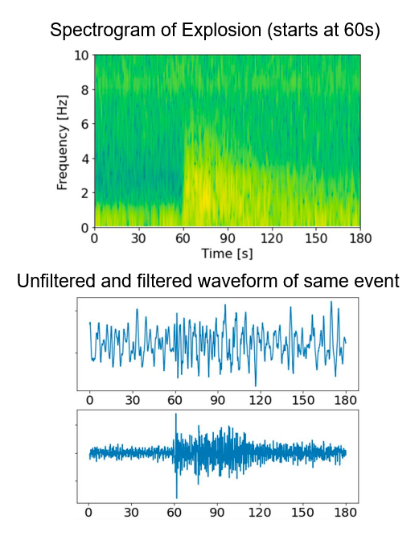
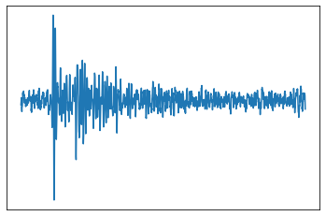
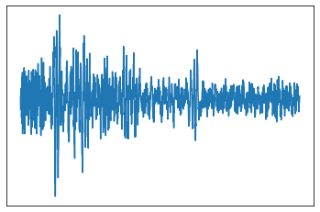
Global Scale Discrimination of Explosions and Earthquakes
with Deep Learning
Rayna Arora / CTBTO Youth Group Nimar Arora / Bayesian Logic Inc. Ronan Le Bras / CTBTO
P3.6-703
Waveforms from 10 seconds before to 80 seconds after first P arrival
Highpass filter performed at 1 Hz
Downsampled to 20 Hz
Eliminated data without STA/LTA value of at least 2 within 10 seconds of recorded arrival time
Waveforms de-trended and normalized
METHODS
Explosion (76 degrees, 5.1 mb)
Earthquake (61 degrees, 5.5 mb)

Slide 6
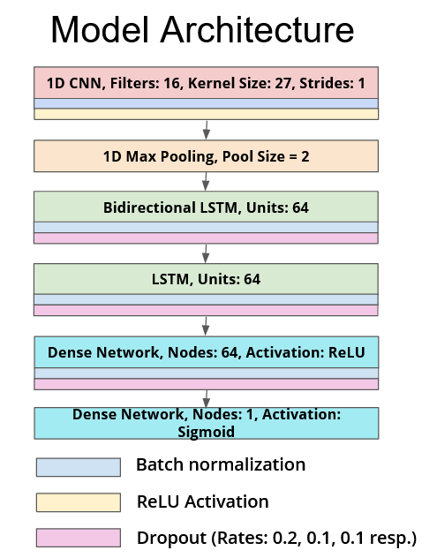
Global Scale Discrimination of Explosions and Earthquakes
with Deep Learning
Rayna Arora / CTBTO Youth Group Nimar Arora / Bayesian Logic Inc. Ronan Le Bras / CTBTO
P3.6-703
Feature Extraction
Sequential Pattern
Recognition
METHODS
Produce final prediction

Slide 7
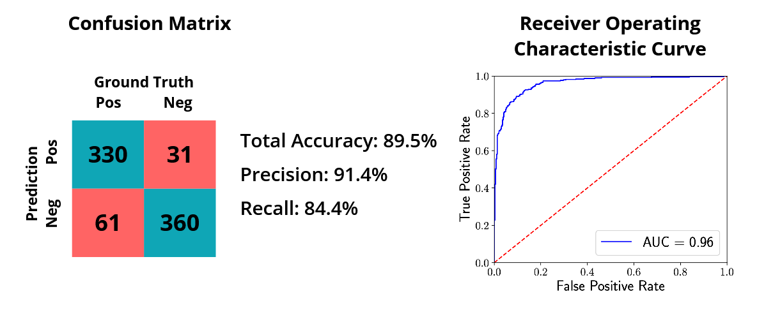
Global Scale Discrimination of Explosions and Earthquakes
with Deep Learning
Rayna Arora / CTBTO Youth Group Nimar Arora / Bayesian Logic Inc. Ronan Le Bras / CTBTO
P3.6-703
fffff
RESULTS

Slide 8
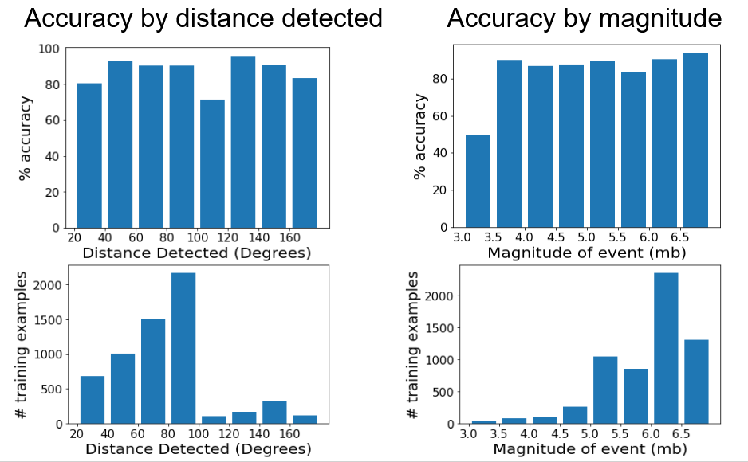
Global Scale Discrimination of Explosions and Earthquakes
with Deep Learning
Rayna Arora / CTBTO Youth Group Nimar Arora / Bayesian Logic Inc. Ronan Le Bras / CTBTO
P3.6-703
RESULTS

Slide 9
Global Scale Discrimination of Explosions and Earthquakes
with Deep Learning
Rayna Arora / CTBTO Youth Group Nimar Arora / Bayesian Logic Inc. Ronan Le Bras / CTBTO
P3.6-703
Mousavi, S.M., Zhu, W., Sheng, Y. et al. CRED: A Deep Residual Network of Convolutional and Recurrent Units for Earthquake Signal Detection. Sci Rep 9, 10267 (2019). https://doi.org/10.1038/s41598-019-45748-1
      This research uses a Deep Learning network on spectrograms for P phase detection
      Results only available for detections within 50 km
Linville, L., Pankow, K., Draelos, T. Deep Learning Models Augment Analyst Decisions for Event Discrimination. AGU Geophysical Research Letters (2019). https://agupubs.onlinelibrary.wiley.com/doi/full/10.1029/2018GL081119
      This research tests a Convolutional Neural Network(CNN) and Recurrent Neural Network(RNN) on spectrograms for discrimination between earthquakes and quarry blasts.
      Results only available for detections within 400 km.
Both methods require many more parameters because they process 2D spectrograms rather than 1D waveforms.
RELATED WORK

Slide 10
Global Scale Discrimination of Explosions and Earthquakes
with Deep Learning
Rayna Arora / CTBTO Youth Group Nimar Arora / Bayesian Logic Inc. Ronan Le Bras / CTBTO
P3.6-703
Models from related work were reproduced and trained and tested on the corresponding spectrograms for the dataset of our proposed method.
Model | Best Accuracy | AUC | Parameters
Proposed Method | 89.5% | 0.962 | 96,641
Mousavi et al. (CRED) | 89.7% | 0.957 | 208,273
Linville et al. CNN | 83.9% | 0.896 | 456,237
Linville et al. RNN | 80.9% | 0.894 | 375,425
RELATED WORK

Slide 11
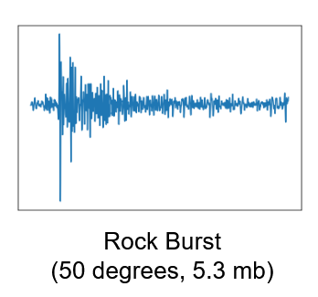
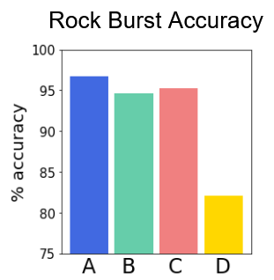
Global Scale Discrimination of Explosions and Earthquakes
with Deep Learning
Rayna Arora / CTBTO Youth Group Nimar Arora / Bayesian Logic Inc. Ronan Le Bras / CTBTO
P3.6-703
  Rock Burst Results
Rock bursts are spontaneous explosive ejections of rocks in mines caused by high stress.
      Our model was not trained on rock burst data, but a separate test was performed to assess how well the model generalizes
      Rock bursts were treated as explosions
      Our model obtained 96.7% accuracy on over 2000 rock burst waveform samples
RELATED WORK
A | Proposed Method
B | CRED
C | Linville et al. CNN
D | Linville et al. RNN

Slide 12
Global Scale Discrimination of Explosions and Earthquakes
with Deep Learning
Rayna Arora / CTBTO Youth Group Nimar Arora / Bayesian Logic Inc. Ronan Le Bras / CTBTO
P3.6-703
Deep Learning methods work well for discriminating between earthquakes and explosions on waveforms detected at teleseismic distances (over 20 degrees / 2000 km), yielding ~90% accuracy despite limited data
Using seismic waveforms rather than spectrograms as model inputs, it was possible to train a model with far fewer parameters that generalizes better for unseen inputs such as rock bursts
Future Work:
      Test on CTBT data
      Apply to Phase identification
      Apply to detection
CONCLUSIONS

