Slide 1




On filtering turbulent noise with interpretable neural networks
Cyril Nefzaoui Blanchard^{1,2}, Christophe Millet^{1,2}, Mathilde Mougeot^{1,3}
Xavier Cassagnou^{1,2}
P3.6-622
¹ Centre Borelli, ENS Paris-Saclay, F-91190 Gif-sur-Yvette, France
² CEA, DAM, DIF, F-91297 Arpajon, France
³ ENSIIE, F-91000 Évry, France

Slide 2
On filtering turbulent noise with interpretable neural networks
Cyril Nefzaoui Blanchard¹ , Christophe Millet^{1,2}, Mathilde Mougeot^{1,3}, Xavier Cassagnou¹
      ¹Centre Borelli, ENS Paris-Saclay, F-91190 Gif-sur-Yvette, France
      ²CEA, DAM, DIF, 91297 Arpajon, France
      ³ENSIIE, F-91000 Évry, France
      corresponding authors : cyril.nefzaouiblanchard@ensta-paris.fr , christophe.millet@cea.fr
P3.6-622
The environment of infrasound stations is characterized by mesoscale wind speed and temperature fluctuations that affect the temporal variability of the Atmospheric Boundary Layer (ABL). While the statistical characteristics of turbulence are poorly constrained, modeling such statistics appears to be crucial since each sensor of infrasound stations is subject to this local noise that may mask true signals and cause false detections. In this work, we propose to improve the station processing by characterizing the noise due to turbulence in the ABL using neural networks. Assuming that the turbulence is governed by a parametric nonlinear dynamical system which involves known dimensionless numbers, a neural network architecture is proposed to infer the turbulent noise in the data.
For this task, we design a custom deep autoencoder network to obtain a coordinate transformation into a reduced space where the dynamics of the ABL can be sparsely represented. The resulting modeling framework combines the strengths of deep neural networks for flexible representation and sparse identification of nonlinear dynamics for parsimonious models. The performance of our approach is assessed using real-world signals recorded at several infrasound stations of the International Monitoring System, over days and nights, and for different seasons.
ABSTRACT

Slide 3
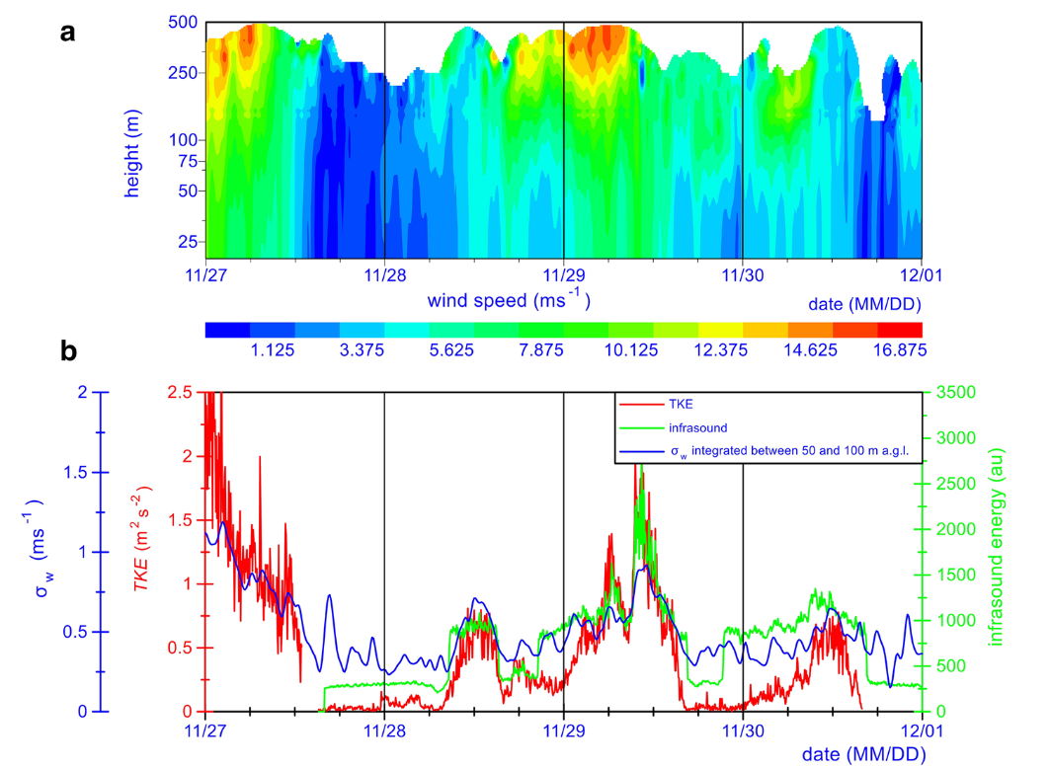
On filtering turbulent noise with interpretable neural networks
Cyril Nefzaoui Blanchard¹ , Christophe Millet^{1,2}, Mathilde Mougeot^{1,3}, Xavier Cassagnou¹
      ¹Centre Borelli, ENS Paris-Saclay, F-91190 Gif-sur-Yvette, France
      ²CEA, DAM, DIF, 91297 Arpajon, France
      ³ENSIIE, F-91000 Évry, France
      corresponding authors : cyril.nefzaouiblanchard@ensta-paris.fr , christophe.millet@cea.fr
P3.6-622
Context
Infrasound measurements are used to detect acoustic waves and a large effort is devoted to eliminate the turbulence-related infrasound signal to prevent false detections.
Infrasound can also provide information on turbulence in the Atmospheric Boundary Layer (ABL).
Detection methods would be greatly enhanced if analysts had access to reliable and interpretable predictions of time series of interest like pressure, turbulent kinetic energy (TKE) or all other time series recorded in a station.
Some difficulties
The prediction problem is hard to solve with traditional forecasts (such as WRF) because they ignore the specificities of a station environment and the grid resolution is always limited.
Turbulence in ABL is a complex phenomenon involving deterministic and stochastic components.
How can we filter out the deterministic component using machine learning?
INTRODUCTION
Examples of sodar wind profile in the lower atmosphere (a) and time series of TKE from a sonic anemometer in the surface layer (b) [3].
(b) Acoustic energy in the infrasound range and standard deviation of the vertical velocity as estimated by the sodar integrated between 50 and 100 m.

Slide 4
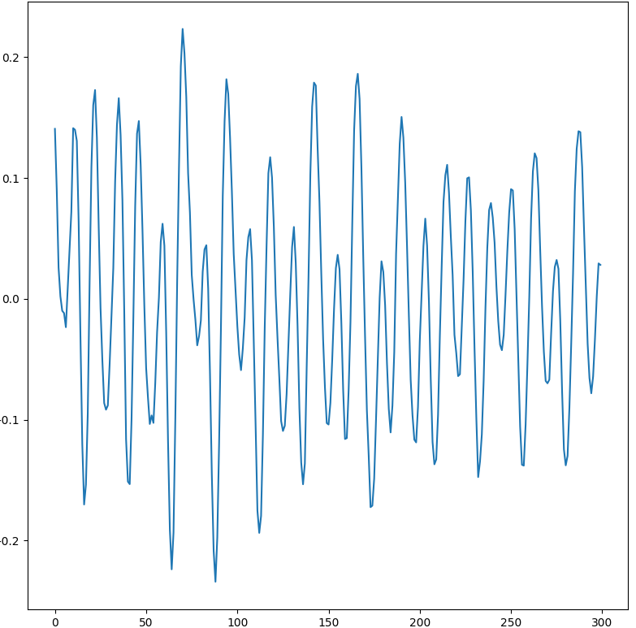
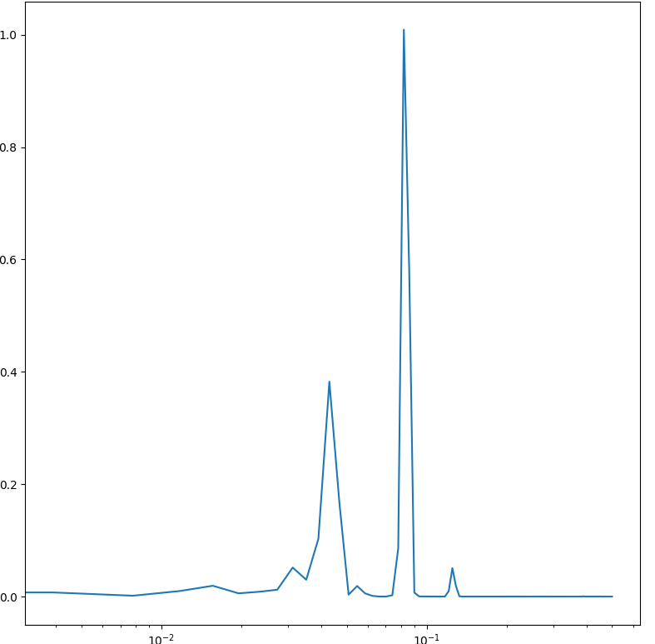
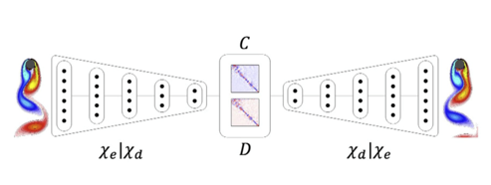
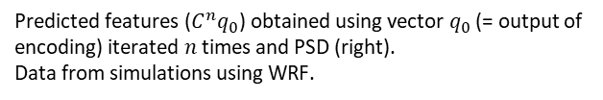
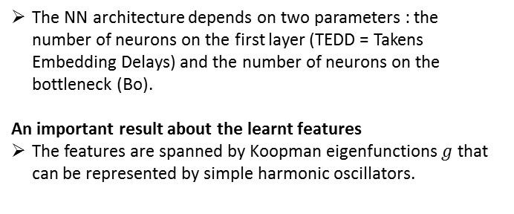
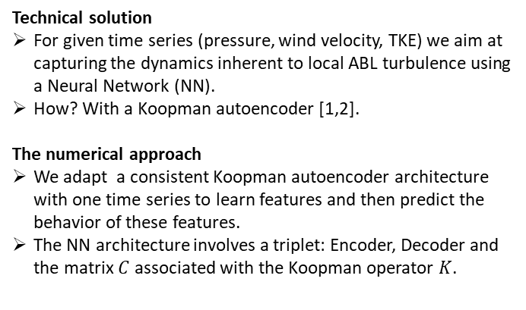

On filtering turbulent noise with interpretable neural networks
Cyril Nefzaoui Blanchard¹ , Christophe Millet^{1,2}, Mathilde Mougeot^{1,3}, Xavier Cassagnou¹
      ¹Centre Borelli, ENS Paris-Saclay, F-91190 Gif-sur-Yvette, France
      ²CEA, DAM, DIF, 91297 Arpajon, France
      ³ENSIIE, F-91000 Évry, France
      corresponding authors : cyril.nefzaouiblanchard@ensta-paris.fr , christophe.millet@cea.fr
P3.6-622
Technical solution
For given time series (pressure, wind velocity, TKE) we aim at capturing the dynamics inherent to local ABL turbulence using a Neural Network (NN).
How? With a Koopman autoencoder [1,2].
The numerical approach
We adapt a consistent Koopman autoencoder architecture with one time series to learn features and then predict the behavior of these features.
The NN architecture involves a triplet: Encoder, Decoder and the matrix $C$ associated with the Koopman operator $K$.
The NN architecture depends on two parameters : the number of neurons on the first layer (TEDD = Takens Embedding Delays) and the number of neurons on the bottleneck (Bo).
An important result about the learnt features
The features are spanned by Koopman eigenfunctions $g$ that can be represented by simple harmonic oscillators.
METHODS
Time of prediction $n$
Predicted features ($C^{n}q_{0}$) obtained using vector $q_{0}$ (= output of encoding) iterated $n$ times and PSD (right).
Data from simulations using WRF.

Slide 5
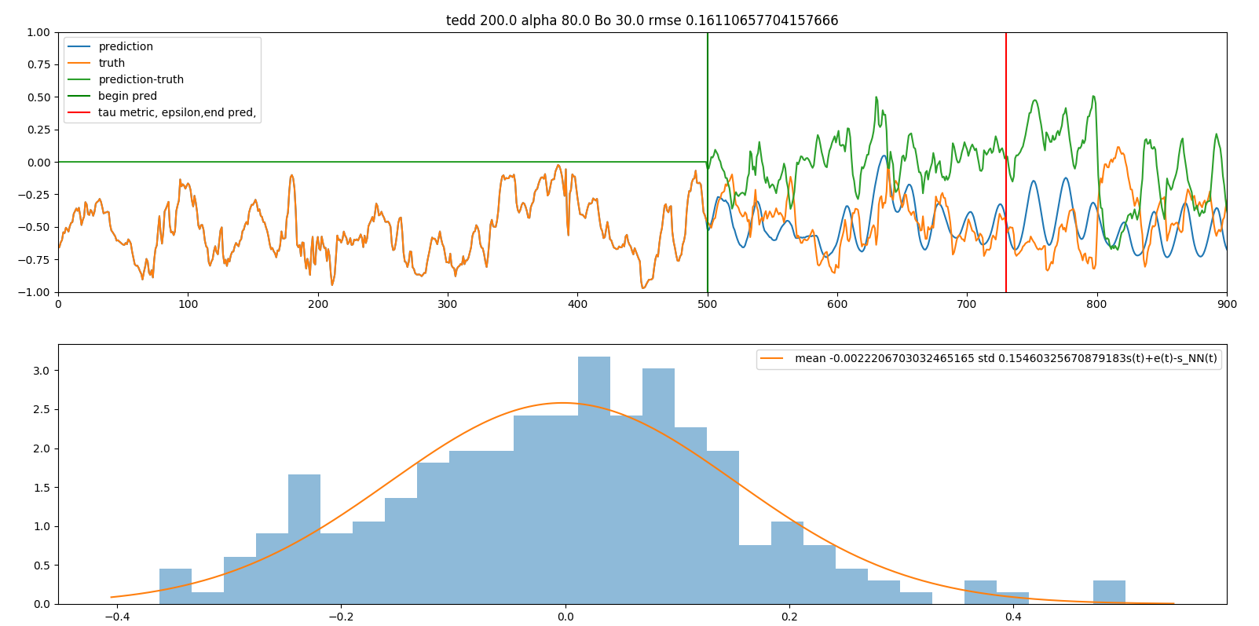
On filtering turbulent noise with interpretable neural networks
Cyril Nefzaoui Blanchard¹ , Christophe Millet^{1,2}, Mathilde Mougeot^{1,3}, Xavier Cassagnou¹
      ¹Centre Borelli, ENS Paris-Saclay, F-91190 Gif-sur-Yvette, France
      ²CEA, DAM, DIF, 91297 Arpajon, France
      ³ENSIIE, F-91000 Évry, France
      corresponding authors : cyril.nefzaouiblanchard@ensta-paris.fr , christophe.millet@cea.fr
P3.6-622
Predictions and biases
The prediction obtained for the wind speed using the NN is in good agreement with the measurements (WRF simulation).
No bias was observed between predictions and WRF simulations which suggests the possibility of some form of filtering using NN predictions.
The predicted signal simply relies on linear regression on the learnt features, which emphasizes the interpretability of the resulting NN.
CTBTO related applications
Real-time filtering of infrasound signals from past time series of several 1D-data (e.g., pressure and wind measured at the IMS station).
Characterizing and predicting site effects (such as ABL turbulence through TKE) in the vicinity of IMS stations.
RESULTS
Results obtained for the wind speed. The signal obtained with WRF is given in red and the predicted signal with the NN is given in blue (TEDD=200, Bo=30 with a training of 3000 time steps).
    The signal is extracted from WRF simulation at a fixed localization (43.7696° latitude and -75.5897° longitude).
WRF data are produced on a high-performance computing cluster using Weather Research Forecasting (WRF*) model initialized by ERA5.
Data are available anywhere in the world from 10 years ago to the present.
* https://www.mmm.ucar.edu

Slide 6
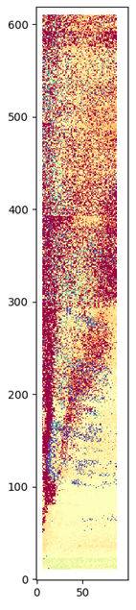
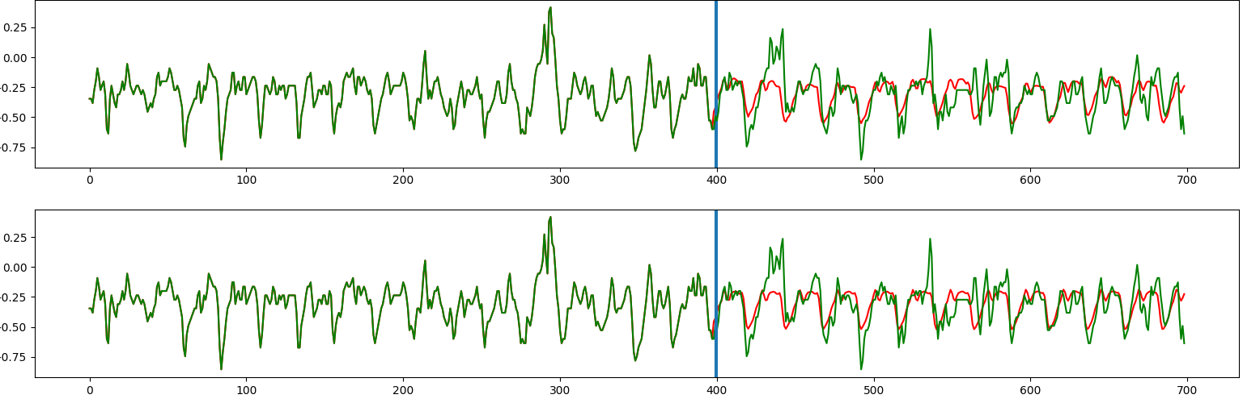
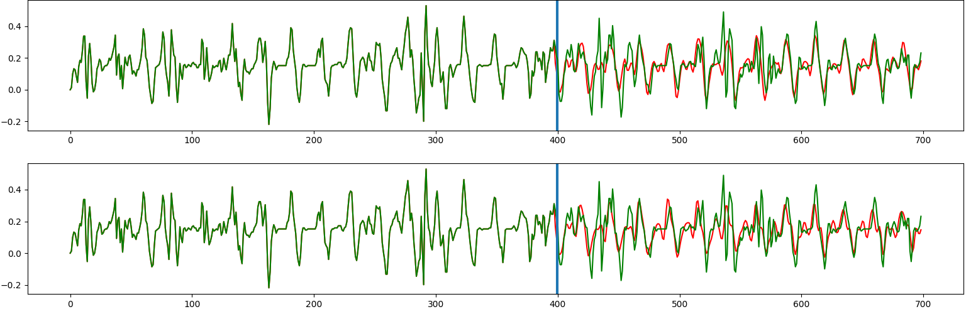
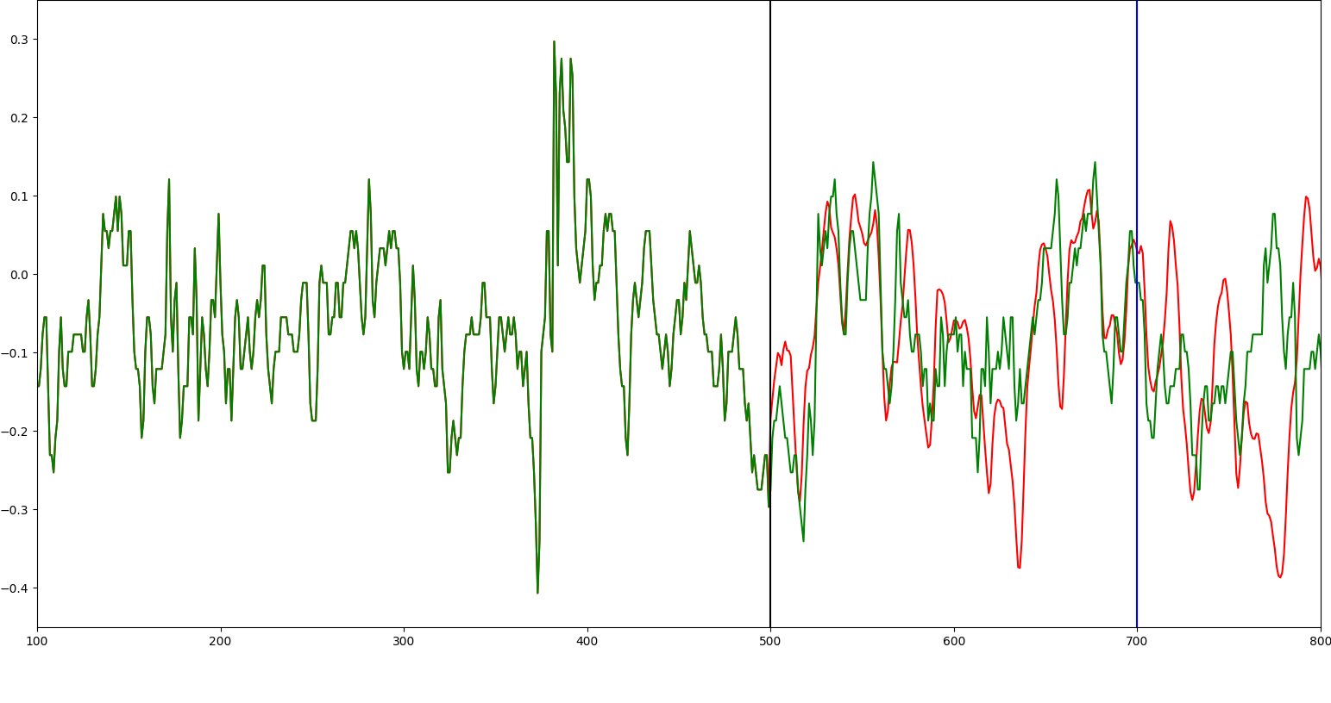





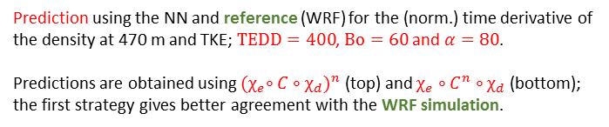

On filtering turbulent noise with interpretable neural networks
Cyril Nefzaoui Blanchard¹ , Christophe Millet^{1,2}, Mathilde Mougeot^{1,3}, Xavier Cassagnou¹
      ¹Centre Borelli, ENS Paris-Saclay, F-91190 Gif-sur-Yvette, France
      ²CEA, DAM, DIF, 91297 Arpajon, France
      ³ENSIIE, F-91000 Évry, France
      corresponding authors : cyril.nefzaouiblanchard@ensta-paris.fr , christophe.millet@cea.fr
P3.6-622
Dynamics and transfer learning
A common NN architecture captures the same dynamics for different observables: pressure, wind speed, TKE, horizontal radiance (not shown here).
Better predictions are achieved with the derivatives of physical quantities (see figures →).
The best NN architecture is not necessarily the “deepest” (i.e. obtained for large TEDD).
$$ρ(470 m)$$
TKE
TEDD
RESULTS
WRF
Prediction using the NN and reference (WRF) for the (norm.) time derivative of the density at 470 m and TKE; $TEDD=400$, $Bo=60$ and $α=80$.
Predictions are obtained using ${{(χ}_{e}∘C∘χ_{d})}^{n}$ (top) and $χ_{e}∘C^{n}∘χ_{d}$ (bottom); the first strategy gives better agreement with the WRF simulation.
$$ρ(470 m)$$
300 h
Prediction for the pressure derivative using $TEDD=603$, $Bo=33$ and $α=80$.
$$100$$
Bo
TKE
$$10$$
Prediction time for Tol.<20%

Slide 7
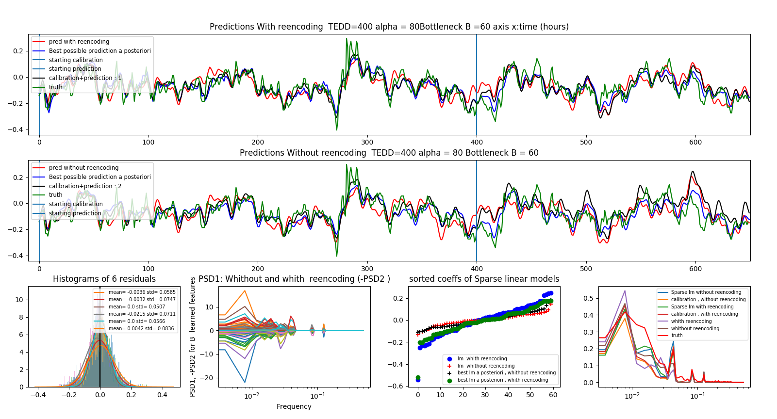


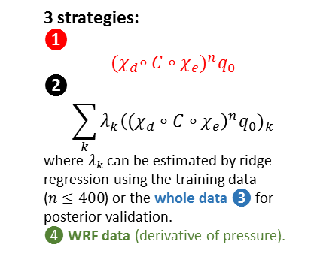
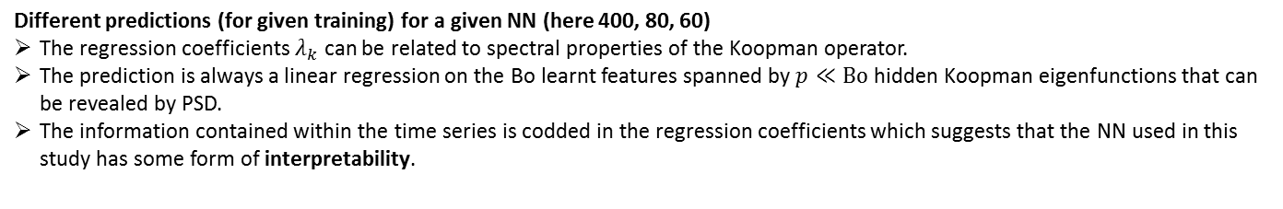
On filtering turbulent noise with interpretable neural networks
Cyril Nefzaoui Blanchard¹ , Christophe Millet^{1,2}, Mathilde Mougeot^{1,3}, Xavier Cassagnou¹
      ¹Centre Borelli, ENS Paris-Saclay, F-91190 Gif-sur-Yvette, France
      ²CEA, DAM, DIF, 91297 Arpajon, France
      ³ENSIIE, F-91000 Évry, France
      corresponding authors : cyril.nefzaouiblanchard@ensta-paris.fr , christophe.millet@cea.fr
P3.6-622
3 strategies:
❶
$${(χ}_{d}∘C∘χ_{e})^{n}q_{0}$$
❷
$$\sum_{k}{λ_{k}{\left((χ_{d}∘C∘χ_{e}\right)}^{n}q_{0})_{k}}$$
where $λ_{k}$ can be estimated by ridge regression using the training data ($n≤400$) or the whole data ❸ for posterior validation.
❹ WRF data (derivative of pressure).
(a)
(b)
RESULTS
With reencoding (i.e. with ${(χ}_{d}∘C∘χ_{e})^{n}$).
Without reencoding ($χ_{d}∘C^{n}∘χ_{e}$).
Different predictions (for given training) for a given NN (here 400, 80, 60)
The regression coefficients $λ_{k}$ can be related to spectral properties of the Koopman operator.
The prediction is always a linear regression on the Bo learnt features spanned by $p≪Bo$ hidden Koopman eigenfunctions that can be revealed by PSD.
The information contained within the time series is codded in the regression coefficients which suggests that the NN used in this study has some form of interpretability.

Slide 8
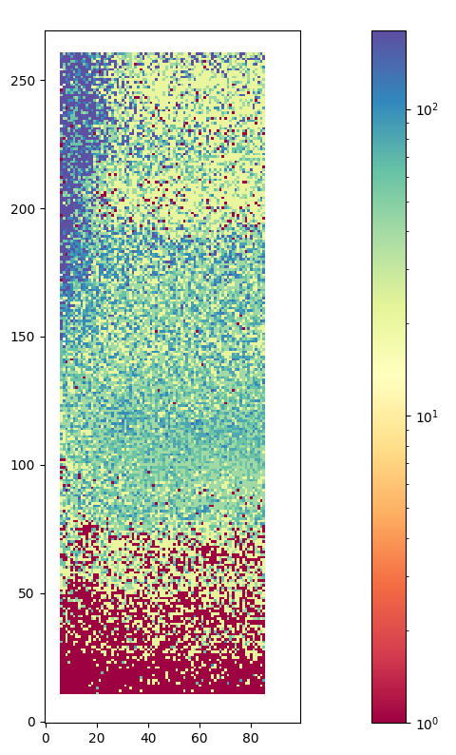
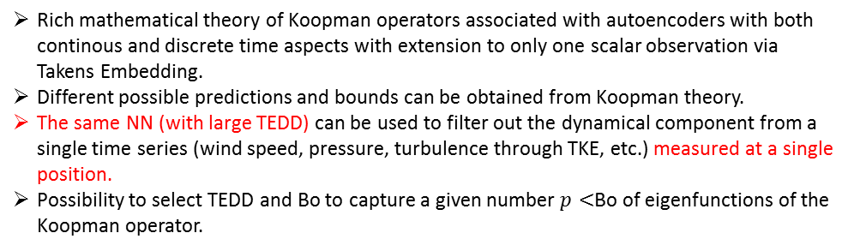
On filtering turbulent noise with interpretable neural networks
Cyril Nefzaoui Blanchard¹ , Christophe Millet^{1,2}, Mathilde Mougeot^{1,3}, Xavier Cassagnou¹
      ¹Centre Borelli, ENS Paris-Saclay, F-91190 Gif-sur-Yvette, France
      ²CEA, DAM, DIF, 91297 Arpajon, France
      ³ENSIIE, F-91000 Évry, France
      corresponding authors : cyril.nefzaouiblanchard@ensta-paris.fr , christophe.millet@cea.fr
P3.6-622
Rich mathematical theory of Koopman operators associated with autoencoders with both continous and discrete time aspects with extension to only one scalar observation via Takens Embedding.
Different possible predictions and bounds can be obtained from Koopman theory.
The same NN (with large TEDD) can be used to filter out the dynamical component from a single time series (wind speed, pressure, turbulence through TKE, etc.) measured at a single position.
Possibility to select TEDD and Bo to capture a given number $p<$Bo of eigenfunctions of the Koopman operator.
CONCLUSIONS
How can we choose the best architecture (i.e. TEDD and Bo)? Need to specify a metric (here we use rms) and a tolerance (Tol.)
Time prediction as a function of TEDD and Bo for Tol.<20%
Linear model (Antisymmetric 15x15 with random coefficients).
[1] O. Azencot, N. B. Erichson, V. Lin, M. W. Mahoney (2020). Forecasting sequential data using consistent Koopman autoencoders, https://arxiv.org/abs/2003.02236
[2] D. Giannakis (2019). Data-driven spectral decomposition and forecasting of ergodidc dynamical systems, Applied and Computational Harmonic Analysis, 47, 338-396.
[3] J. Cuxart, D. Tatrai, T. Weidinger, A. Kircsi, J. Józsa, M. Kiss (2015). Infrasound as a detector of local and remote turbulence. Boundary-Layer Meteorology, 159, 185-192.

