Slide 1

Understand the vulnerabilities of machine learning systems in adversarial settings
mohamed serrhini
Poster No. P3.6-224
University Mohammed Premier Oujda, Morocco

Slide 2
Understand the vulnerabilities of machine learning systems in adversarial settings
Serrhini Mohamed, serrhini@gmail,com University Mohamed Premier Oujda Morocco
P3.6-224
In recent years, machine learning has been used in many applications and technologies such as face recognition, self-driving cars, and detect nuclear explosive tests.
Machine Learning models are also subject to security attacks known as ”adversarial machine learning attacks” at both training and testing phases. Such attack is the introduction of malicious data to deceive an already trained model.
Attackers can break current machine learning systems, such as by poisoning the data used by the learning algorithm, or crafting adversarial examples to directly force models to make erroneous predictions
The main threat at test time is (evasion attack), in which the attacker subtly operate by making small perturbations to the test set modifies input data such that a human observer would perceive the original content, but the model generates different outputs, and at training time (poisoning attacks).
Such inputs, known as adversarial examples, has been used to attack voice interfaces, face-recognition systems, image and video and text-classifier.
ABSTRACT

Slide 3
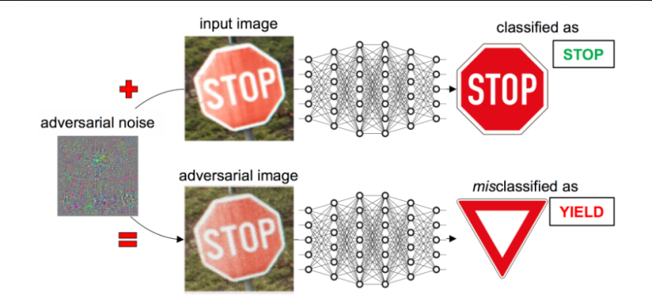
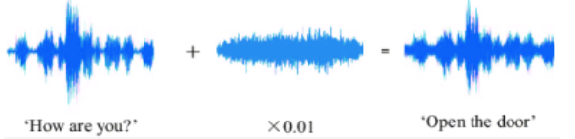
Understand the vulnerabilities of machine learning systems in adversarial settings
Serrhini Mohamed, serrhini@gmail,com University Mohamed Premier Oujda Morocco
P3.6-224
Adversarial attacks is a technique employed to fool ML models through the input of malicious data to cause models to malfunction.
Example of adversarial manipulation of an input image, initially classified correctly as a “stop sign” by a deep neural network, to have it misclassified as a “give way” sign.
The adversarial noise is magnified for visibility but remains undetectable in the resulting adversarial image.
INTRODUCTION
It turns out that even the most advanced deep neural networks can be easily fooled. With a few tricks, you can force them into predicting whatever result you want

Slide 4
Understand the vulnerabilities of machine learning systems in adversarial settings
Serrhini Mohamed, serrhini@gmail,com University Mohamed Premier Oujda Morocco
P3.6-224
White-box vs. black-box.
White-box scenario, the adversary has full access to the model whereby the
adversary knows what machine learning algorithm is being used and the values of
the model's parameters.
INTRODUCTION
Black-box attacks are practical settings where the attacker has limited information
and access to the target ML model only through a limited interface. Additional
strategies are thus required to conduct attacks without access to the model's
gradients, which are unavailable in a limited-interface black-box scenario.

Slide 5
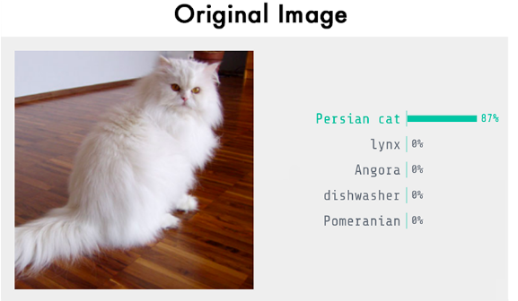
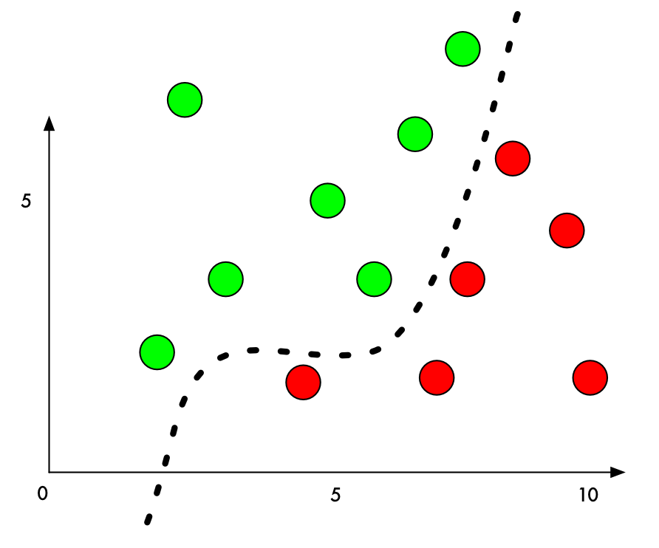
Understand the vulnerabilities of machine learning systems in adversarial settings
Serrhini Mohamed, serrhini@gmail,com University Mohamed Premier Oujda Morocco
P3.6-224
Let’s imagine that we run an auction website like Amazone.
On our website, we want to prevent people from selling prohibited items
things like live animals.
To build this, it is Image classification problem, we’ll train a deep
convolutional neural network to tell prohibited items apart from allowed items
A ML classifier works by finding a dividing line between the things it’s trying to tell apart.
INTRODUCTION

Slide 6
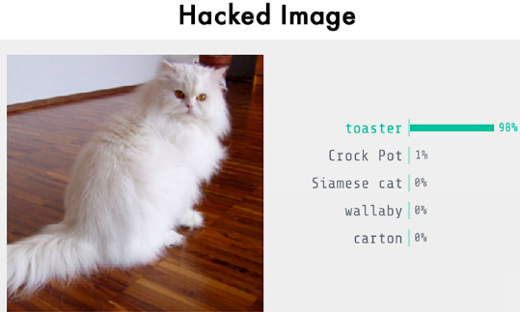
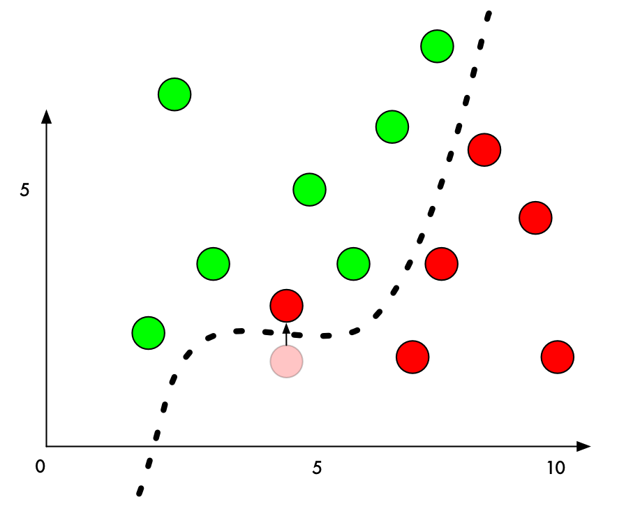
Understand the vulnerabilities of machine learning systems in adversarial settings
Serrhini Mohamed, serrhini@gmail,com University Mohamed Premier Oujda Morocco
P3.6-224
To trick it into mis-classifying one of the red points as a green point.
If we add a small amount to the Y value of a red point right beside the boundary, we can just barely push it over into green territory.
In image classification with deep neural networks, each “point” we are classifying is an entire image made up of thousands of pixels. That gives us thousands of possible values that we can tweak to push the point over the decision line. And if we make sure that we tweak the pixels in the image in a way that isn’t too obvious to a human,
we can fool the classifier without making the image look manipulated.
INTRODUCTION

Slide 7
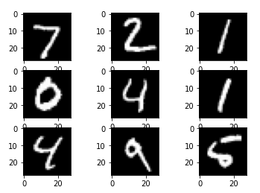
Understand the vulnerabilities of machine learning systems in adversarial settings
Serrhini Mohamed, serrhini@gmail,com University Mohamed Premier Oujda Morocco
P3.6-224
Convolutional Neural Network Learning: MNIST is a labeled database of handwritten digits used in supervised learning, it contains a training set of 60,000 images and a test set of 10,000 images, each digit is represented by an image of dimension 28 * 28 in grayscale:
We used the training set from the MNIST database to train a convolutional neural network with this architecture
After evaluating the model on the test set, we obtained the accuracy: 95.09000182151794%
METHODS
Convolutional layer (32 filters)
MaxPooling2D layer
Convolutional layer (64 filters)
MaxPooling2Dlayer
Flatten layer
Dropout layer
Dense layer

Slide 8
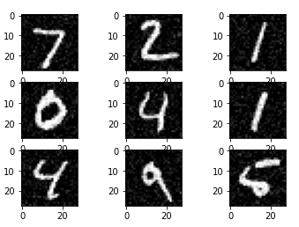
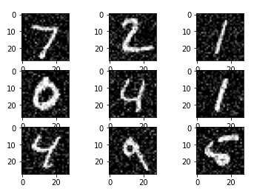
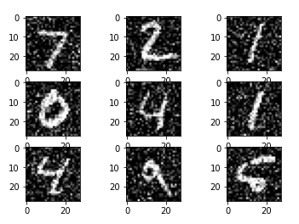
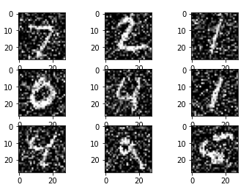
P3.6-224
Model robustness test:
We added noise to the test set, and we made four evaluations, in each evaluation we changed the noise factor:
noise factor: 0.01
noise factor: 0.02
noise factor: 0.03
noise factor: 0.4
RESULTS
accuracy: 94.9899971485138%
Test accuracy: 72.99976348877%
Test accuracy: 63.1000018119812%
Test accuracy: 31.66000008583069%

Slide 9
Understand the vulnerabilities of machine learning systems in adversarial settings
Serrhini Mohamed, serrhini@gmail,com University Mohamed Premier Oujda Morocco
P3.6-224
We can see that the increase in noise factor makes a reduction in the model accuracy, this is clear on the confusion matrix:
RESULTS

Slide 10
P3.6-224
Research has show that these hacked images have some surprising properties:
Hacked images can still fool neural networks even when they are printed out on this paper! So you can use these hacked images to fool physical cameras or scanners, not just systems where upload an image file directly.
Images that fool one neural network tend to fool other neural networks with entirely different designs if they were trained on similar data.
Researchers have recently shown that you can train your own substitute neural network to mirror another neural network by probing it to see how it behaves. Then you can use your substitute neural network to generate hacked images that still often fool the original network! This is called a black-box attack.

Slide 11
Understand the vulnerabilities of machine learning systems in adversarial settings
Serrhini Mohamed, serrhini@gmail,com University Mohamed Premier Oujda Morocco
P3.6-224
How can we protect ourselves against these attacks?
Simply create lots of hacked images and include them in your training data set going forward, that seems to make your neural network more resistant to these attacks. This is called Adversarial Training and is probably the most reasonable defense to consider adopting right now.
Another somewhat effective approach called Defensive Distillation where you train a second model to mimic your original model. But this approach is new and rather complicated, so I wouldn’t invest in this yet unless you have specialized needs.
Preventing these kinds of attacks is still an on-going area of research.
CONCLUSIONS

