Slide 1
Machine learning based earthquakes-explosion discrimination
for Sea of Galilee seismic events of July 2018
Yuri Bregman ¹¹, Yael Radzyner¹, Yochai Ben-Horin¹, Neta Rabin²
Poster No. P3.6-111
¹ Israeli NDC, Soreq Nuclear Research Center, Yavne, Israel
² Dept. of Engineering, Tel-Aviv University, Israel

Slide 2
P3.6-111
Earthquakes-explosions discrimination methods currently used by the IDC are often ineffective for regional events, particularly in Israel’s region.
For instance, five seismic events whose epicenters lie near the Sea of Galilee were reported by the IDC in July of 2018; Three of these were not screened out as natural events, though they were a part of a swarm of earthquakes.
In this work, the diffusion maps-based discrimination method is adapted and applied for discrimination of the July 2018 Sea of Galilee seismic events.
ABSTRACT

Slide 3
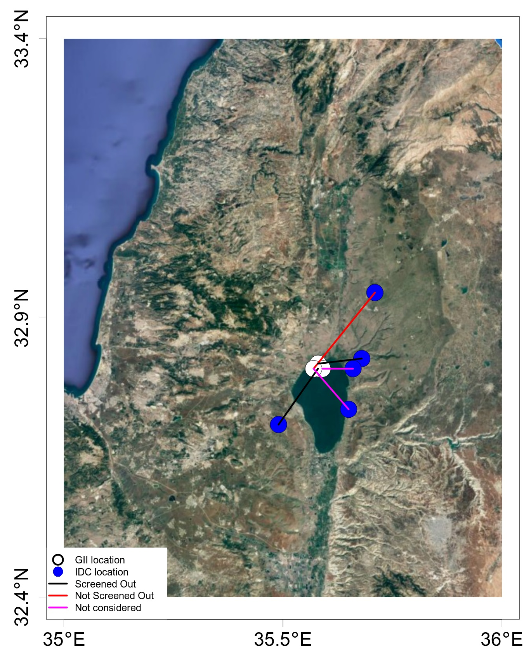

P3.6-111
Sea of Galilee July 2018 REB events
Date | Time | Lat | Lon | mb | SSEB* | Dist**
2018/07/04 | 01:50:06 | 32.74 | 35.49 | 3.8 | SO | 15
2018/07/04 | 03:52:00 | 33.00 | 35.71 | 3.6 | NS | 21
2018/07/04 | 19:45:30 | 32.87 | 35.68 | 4.1 | SO | 9
2018/07/08 | 13:30:47 | 32.85 | 35.66 | 3.5 | NC | 7
2018/07/22 | 06:41:24 | 32.77 | 35.65 | 3.2 | NC | 12
BACKGROUND
*SSEB screening category: NS - not screened out, NC - not considered, SO - screened out.
** Distance between REB and Israel National Catalog locations (in km).

Slide 4

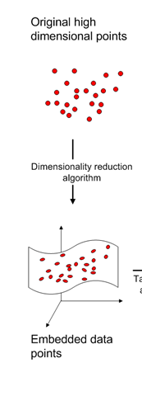


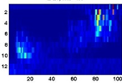
P3.6-111
Basic processing framework*
Pre-processing
Main processing
Post-processing
METHODS
1-nearest neighbors classifier
Seismograms
Normalized sonograms
*Rabin N. et.al., Earthquake-Explosion Discrimination Using Diffusion Maps, Geophysical Journal International, 2016, 207, 1484–1492.
Diffusion Maps

Slide 5
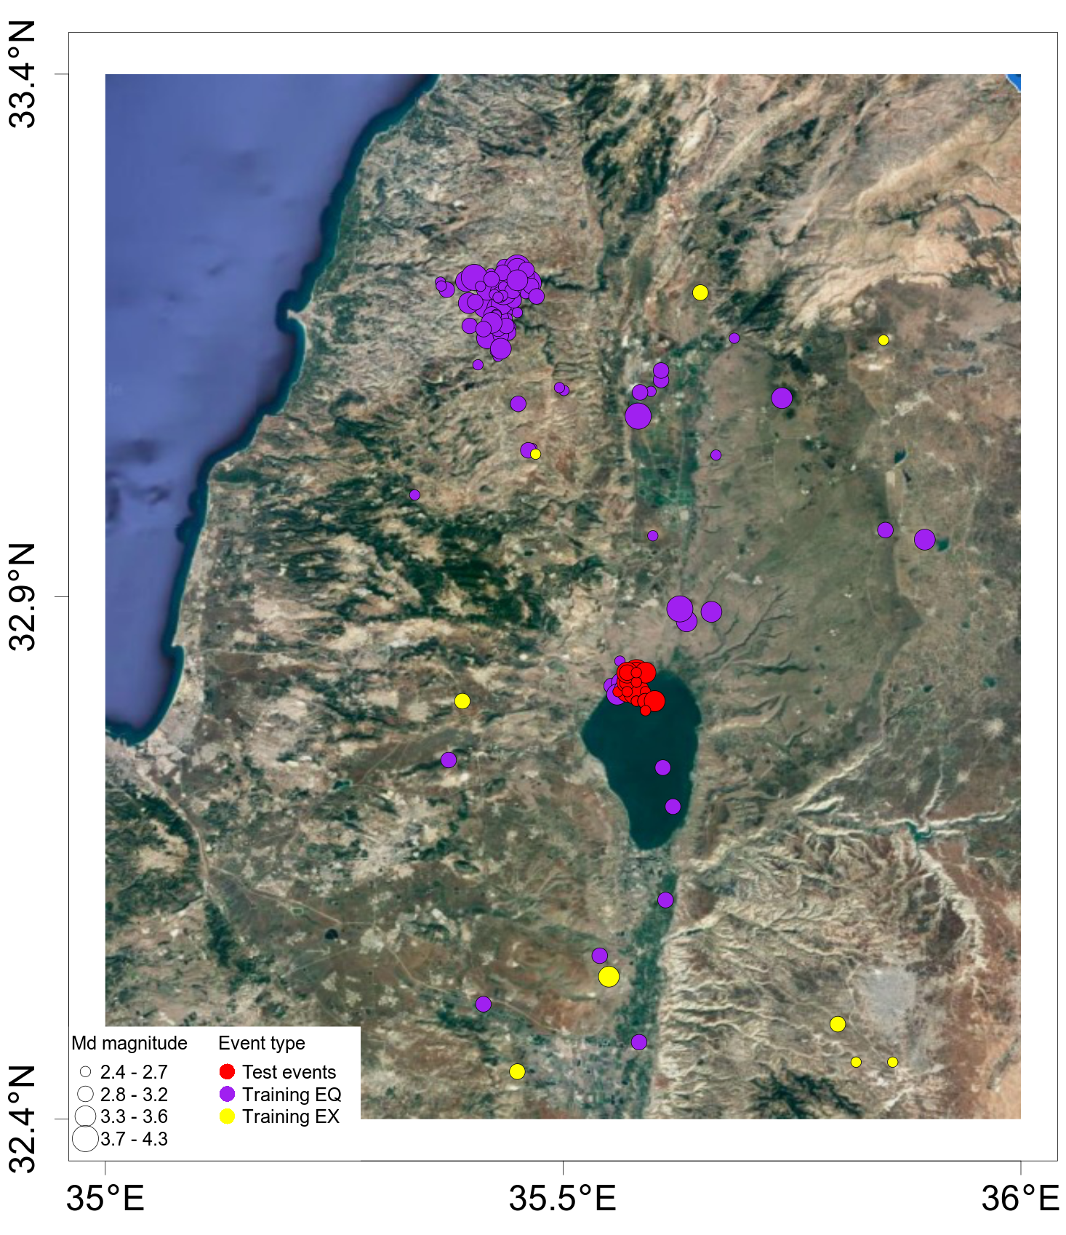
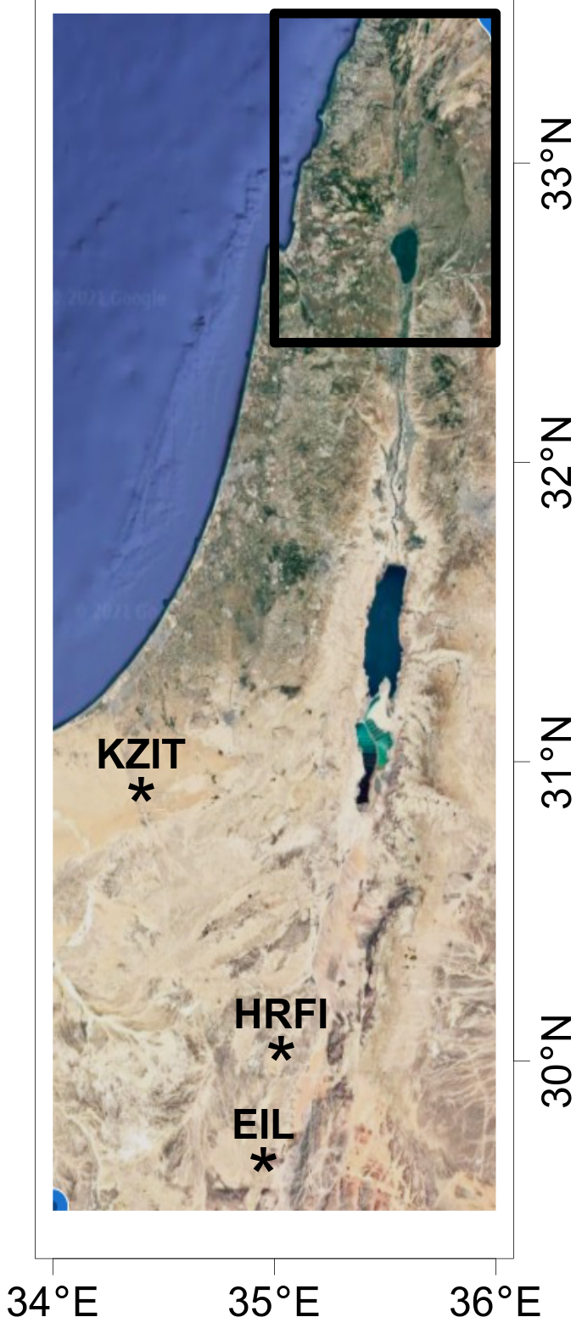
P3.6-111
Test set
39 events included in the Israel National Seismic Bulletin with durational magnitude Md>2.3.
Training set
136 earthquakes + 12 explosions (2004-2018)
Stations
3-component IMS station EIL and Israel Cooperating National Facility stations KZIT & HRFI.
METHODS

Slide 6
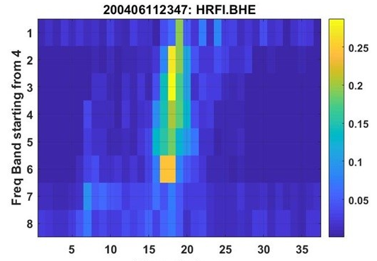
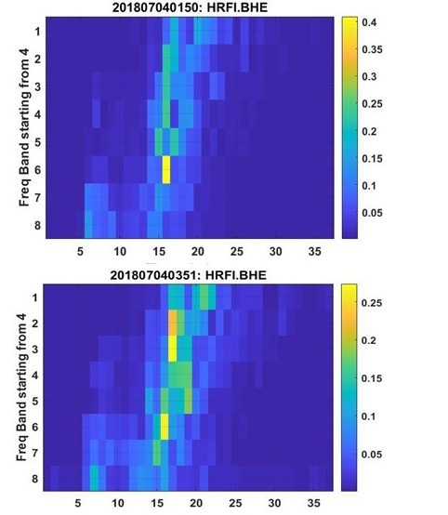
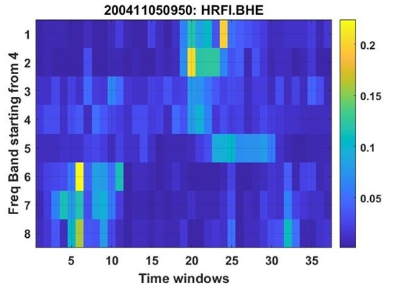
P3.6-111
Earthquake (Md = 2.7)
REB event (Md = 4.1)
Examples of normalized sonograms for:
A historic earthquake with durational magnitude Md= 2.7 (top left),
A historic explosion with Md=2.5 (bottom left),
Two REB events with Md= 4.1 and Md=3.9 (top and bottom right, respectively).
The normalized sonograms of REB events show resemblance and they are similar to the normalized sonogram of the historical earthquake.
The REB event with Md=3.9 was not screened out.
RESULTS
Explosion (Md = 2.5)
REB event (Md = 3.9)
Not Screened Out

Slide 7
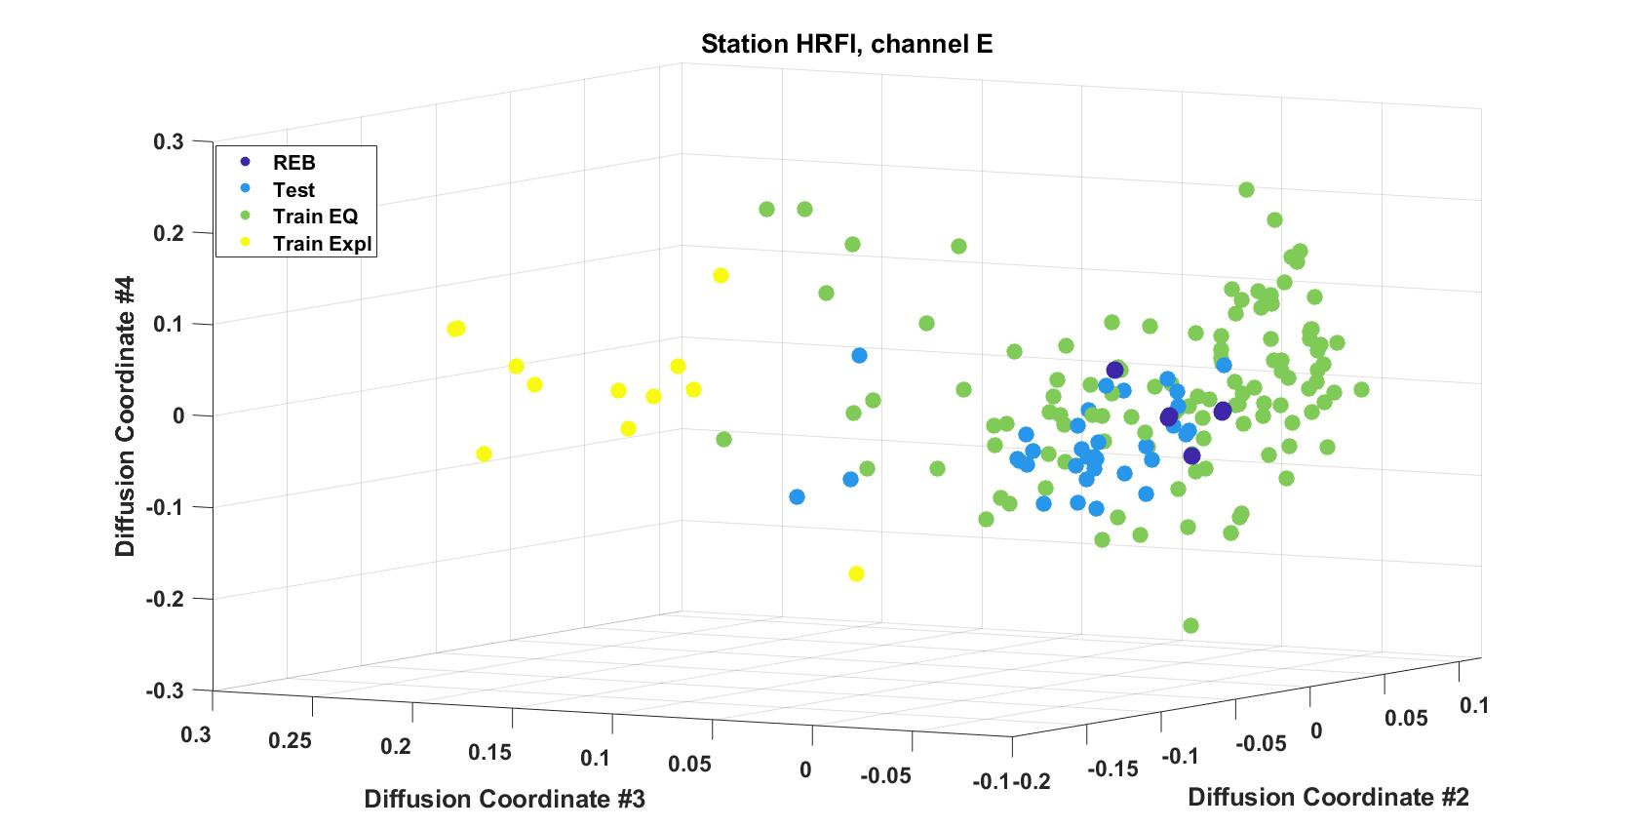
P3.6-111
We compute distance to every historical event in a 3D diffusion space.
For each channel, the label (earthquake or explosion) of every test event is defined as a label of the nearest historical event.
For each station, the discrimination label is determined using a majority vote over labels of all channels for each test event.
Final earthquake-explosion discrimination label is determined using a majority vote over labels of all 3 stations.
This procedure results in that all July 2018 Sea of Galilee seismic events are classified as earthquakes.
Note that all REB events are found inside the population of earthquakes for all channels of all 3 stations (see example in the figure).
RESULTS
Leading diffusion coordinates for channel E of station HRFI

Slide 8
P3.6-111
In this work, diffusion maps-based discrimination is adapted and applied for discrimination of the July 2018 Sea of Galilee seismic events.
The method correctly classifies all of the July 2018 Sea of Galilee seismic events with durational magnitude Md > 2.3 as earthquakes.
All 5 REB events were classified as earthquakes with their diffusion coordinates located deep within the population of earthquakes, even though three of those were not screened out by the IDC.
The method can be used during Expert Technical Analysis in order to help the State Party concerned to identify the source of specific events.
CONCLUSIONS

