Slide 1


Participation of the Austrian NDC in the NPE2019-Exercise
Ulrike Mitterbauer, Maria-Theresia Apoloner, Christian Maurer
(Central Institution for Meteorology and Geodynamics (ZAMG), Vienna, Austria),
Johannes H. Sterba (Technische Universität (TU), Vienna, Austria)
P4.1-365

Slide 2
Abstract
P4.1-365
Following the statement of the state of RAETIA regarding an accident at a TRIGA reactor facility, the Austrian NDC started investigating a possible violation of the Test-Ban Treaty. Based on a list of IMS radionuclide detections a forward run was performed and Possible Source Regions were determined. However, the detections could not be traced back unambiguously to the location of the reactor. Especially, the forward simulation supported the hypothesis that radioxenon measurements from IMS station Schauinsland were not related to the TRIGA reactor. In agreement with atmospheric transport modeling (ATM) results radionuclide analysis revealed the possibility of two overlapping incidents. Possibly, a second event took place around three days before the announced reactor release.
Additional data was released over a three months period. The second release contained radionuclide records from the national station in Vienna. ATM in combination with radionuclide analysis supported the hypothesis of a second event.
The last data released, was seismic data from local non-IMS-networks. With the data and public available bulletins, analysis of the waveforms was started. Finally, a suspicious source, an explosion,was localized and identified.However, it was not possible to relate this event to the radionuclide measurements at Schauinsland and at Vienna via ATM.
ABSTRACT

Slide 3
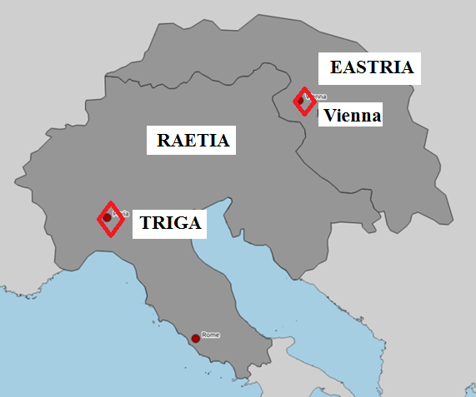
Scenario
P4.1-365
TRIGA Reactor accident in RAETIA 30.7.2019
Disclosure of data in four steps:
RN detection within IMS: Ba-140, La-140, Cs-134, Cs-137, and X-133, Xe-133m, Xe-135
RN detection in Vienna: I-131, Xe-131m (published by EASTRIA)
Publication of ETA (requested by EASTRIA)
Local seismic data (published by EASTRIA)
Timeline:
Observation of RN: 1.8.-11.8.2019
Announcement of data from Vienna: 10.12.2019 at station VIP01/VIX01
Disclosure of seismic data from stations in the north of RAETIA: 14.2.2020
INTRODUCTION

Slide 4
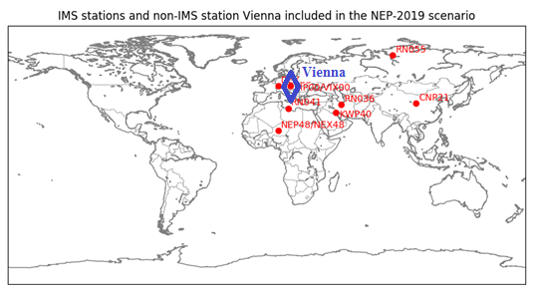
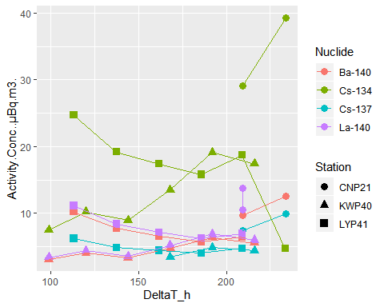
Radionuclide Analysis
P4.1-365
Particulates:
Strong increase at station KWP40 for Isotop Cs-134 – indication of a possible second event
METHODS
Ba-140, La-140, Cs-134, Cs-137:
typical fission and activation products for U-235
and X-133, Xe-133m, Xe-135
Noble Gas:
Kalinowski Plots (Kalinowski et al., 2010)
-> ambiguous result depending on 3 or 4
isotopes used
Result:
Dating the event Cs-134 / Ba-140
Two possible events 30.7.2019, 27.7.2019

Slide 5
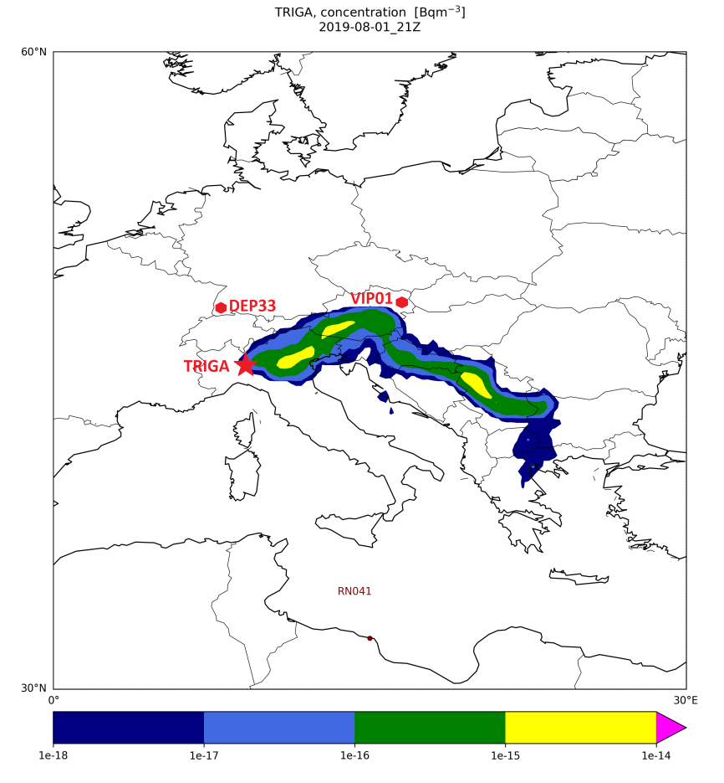
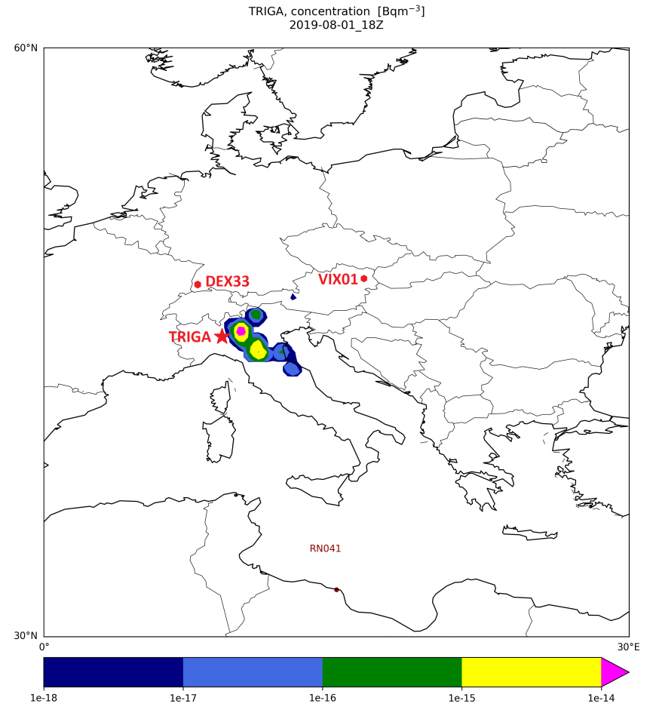
ATM
P4.1-365
Forward Simulation with a source in Pavia 30.7.2019 using ECMWF and NCEP
Source Term: 1E13Bq Cs-134, 1E15 Bq Xe-133
Result:
High values of Cs-134 and Xe-133 at VIP01 / VIX01 cannot be reproduced,
measurements are not consistent with TRIGA, but consistent with IMS-stations
-> two possible events
METHODS
ECMWF – Cs-134
NCEP – Xe-133

Slide 6
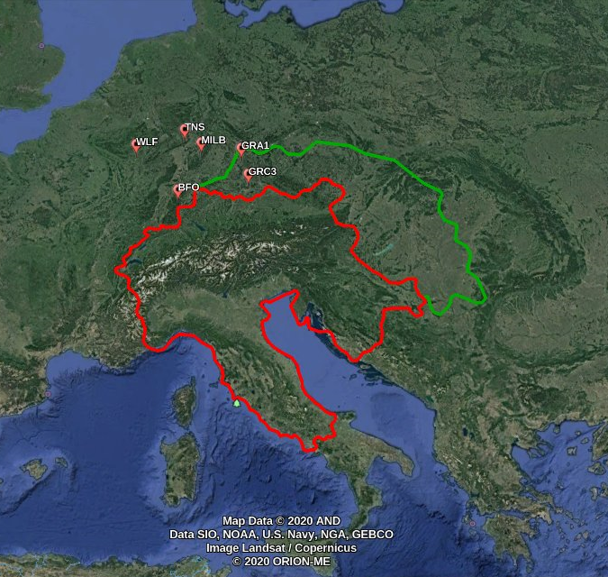
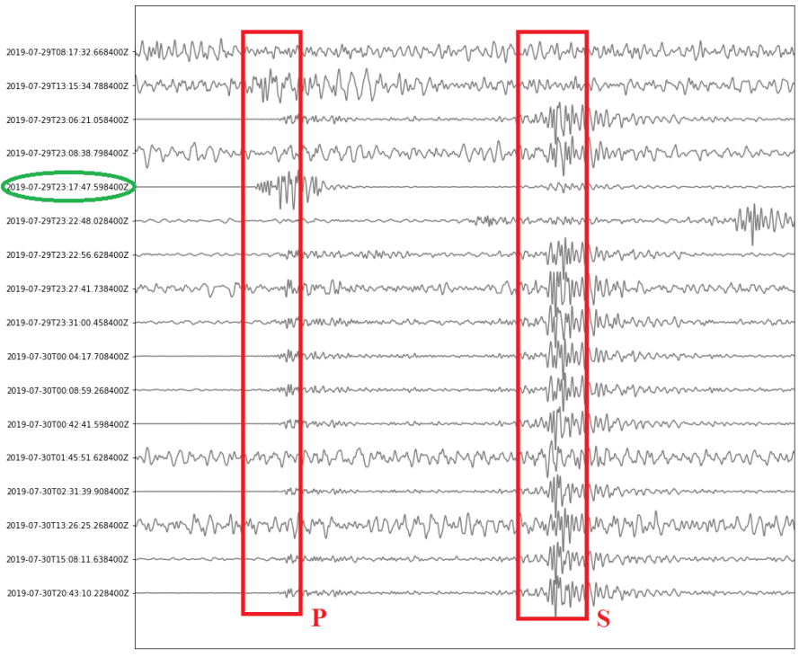
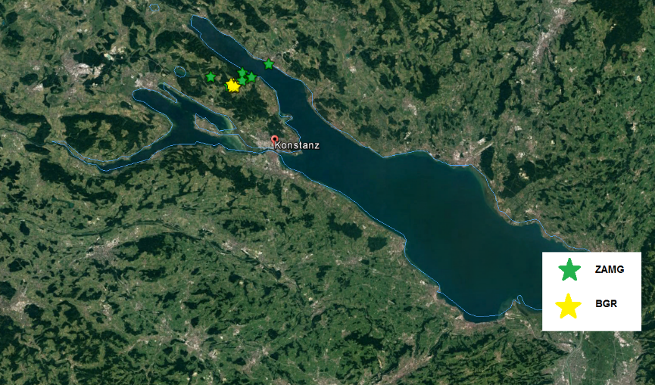
Seismic Data
P4.1-365
Searching REB and LEB between 29. and 31.7.2019:
REB 0
LEB 4: two Infrasound, two seismic events were identified
Request of local bulletins: ZAMG 38, BGR 8
both catalougues indicate a series of earthquakes in the area of Konstanz / Swiss
Release of seismic data by EASTRIA: 29.-30.7.2019
earthquake series Konstanz / Swiss
-> Waveform Correlation: detection of 17 earthquakes
METHODS
Event of Interest:
29.7.2019 23:17:48

Slide 7
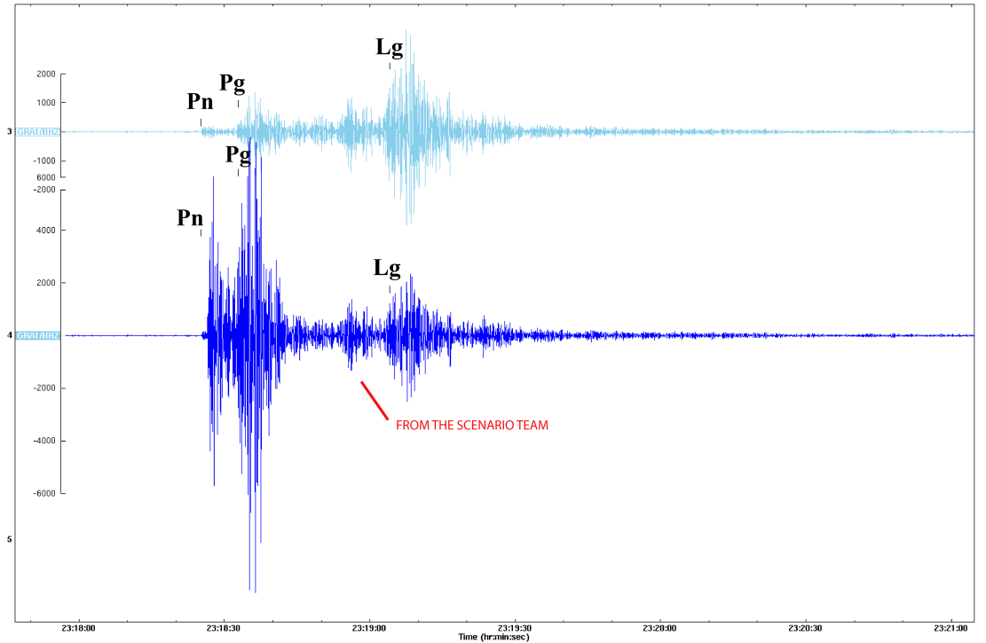
Forensic Studies
P4.1-365
Comparison with GRA1 /GEOFON
METHODS
Scenario team:
amplification of P-wave to simulate of an explosion

Slide 8
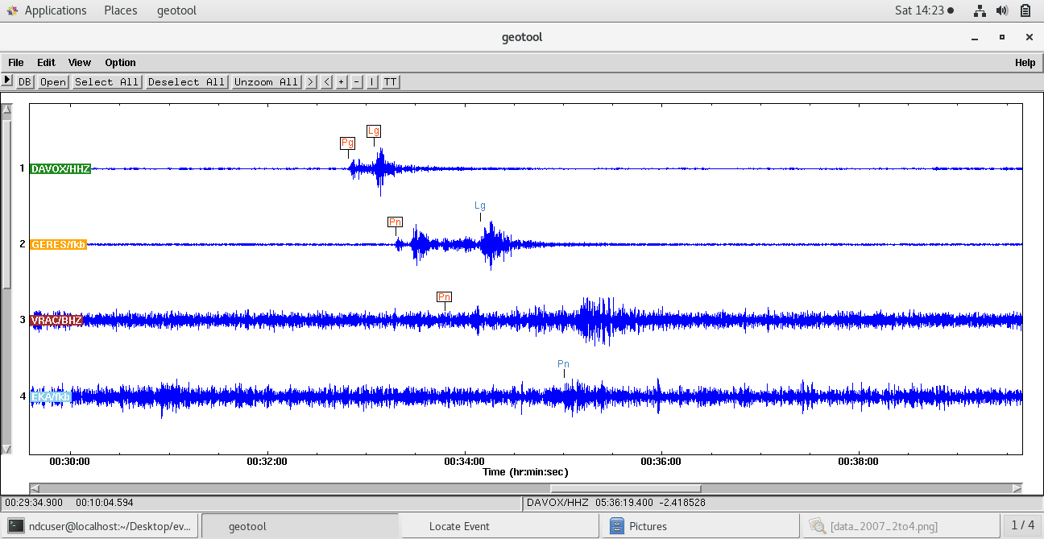
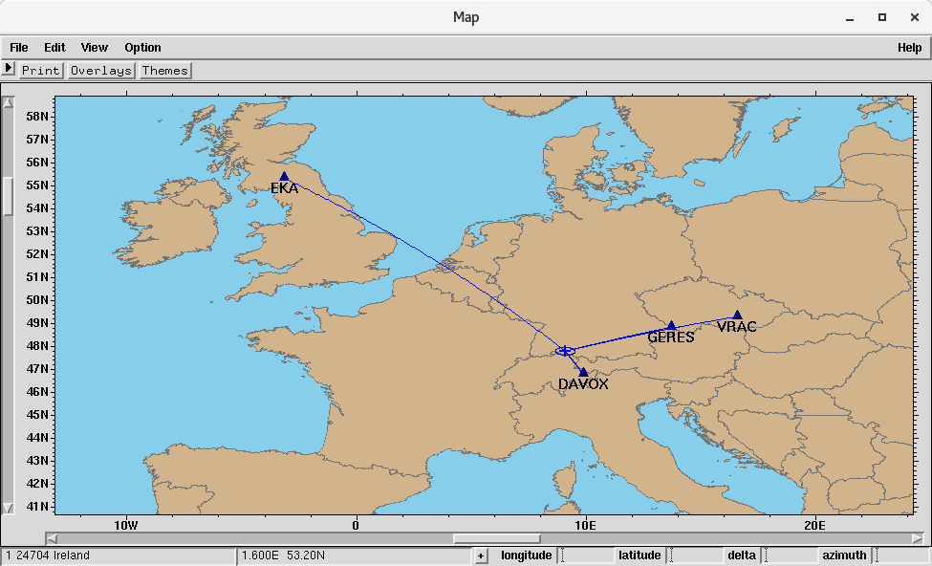
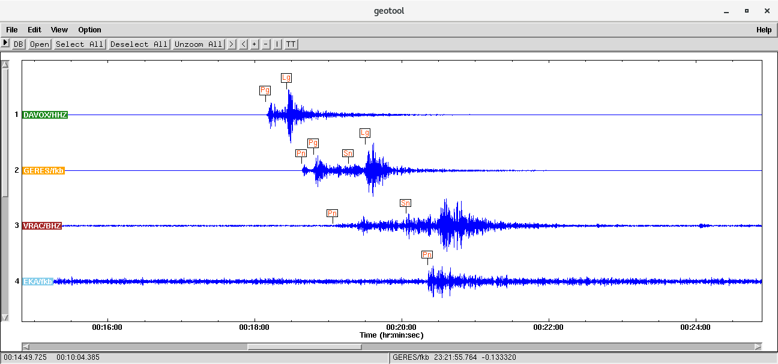
Seismic Analysis
P4.1-365
Comparison with ZAMG Bulletin (7 events) and BGR (8 events):
29.7.2019 - 31.7.2019 earthquake series / mb 2.1 to 3.7
Geotool (DAVOX, GERES, VRAC, EKA)
29.7.2019, 23:17:48 UTC
47.78 / 9.11
depth: 13.55
METHODS
31.7.2019; ml 2.8
29.7.2019; ml 3.3

Slide 9

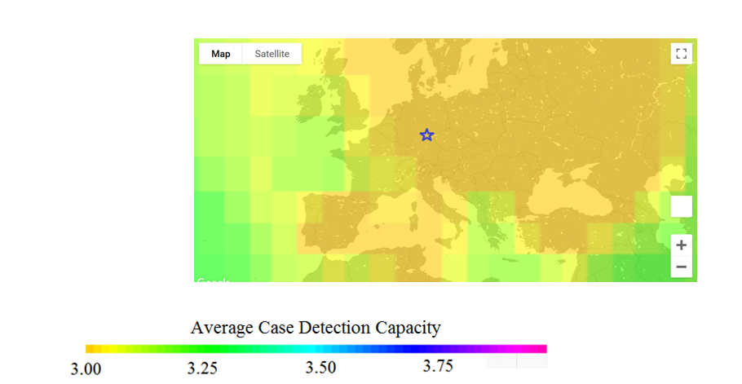
CTBTO-Bulletins
P4.1-365
Why doesn´t the event appear in LEB?
31.7.2019 – ml 2.8 (Geotool) – published in LEB
29.7.2019 – ml 3.3 (Geotool) – not published in LEB … strongest event of the series
METHODS
31.7.2019
29.7.2019

Slide 10
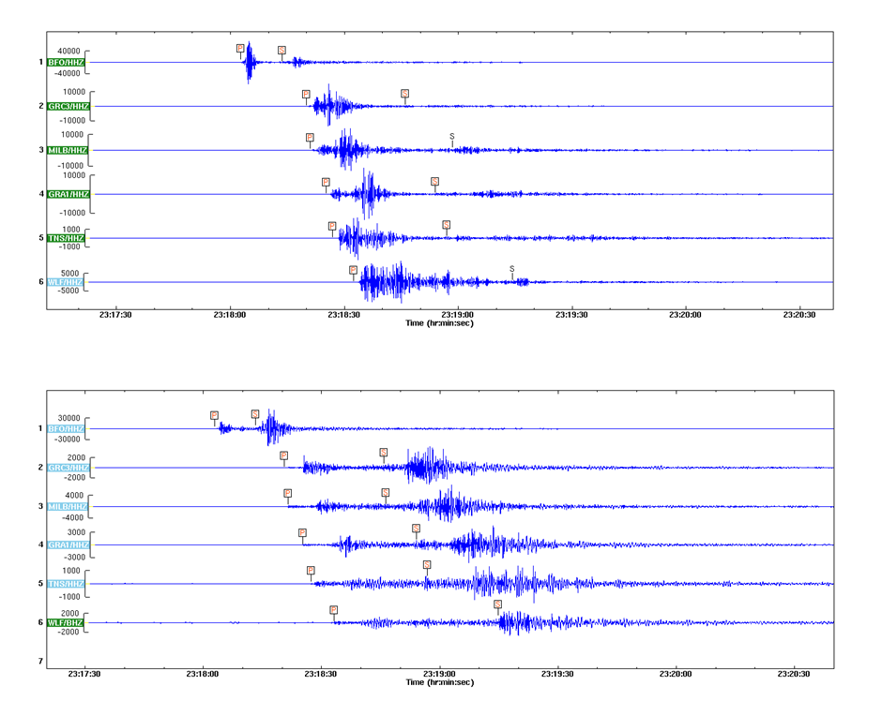
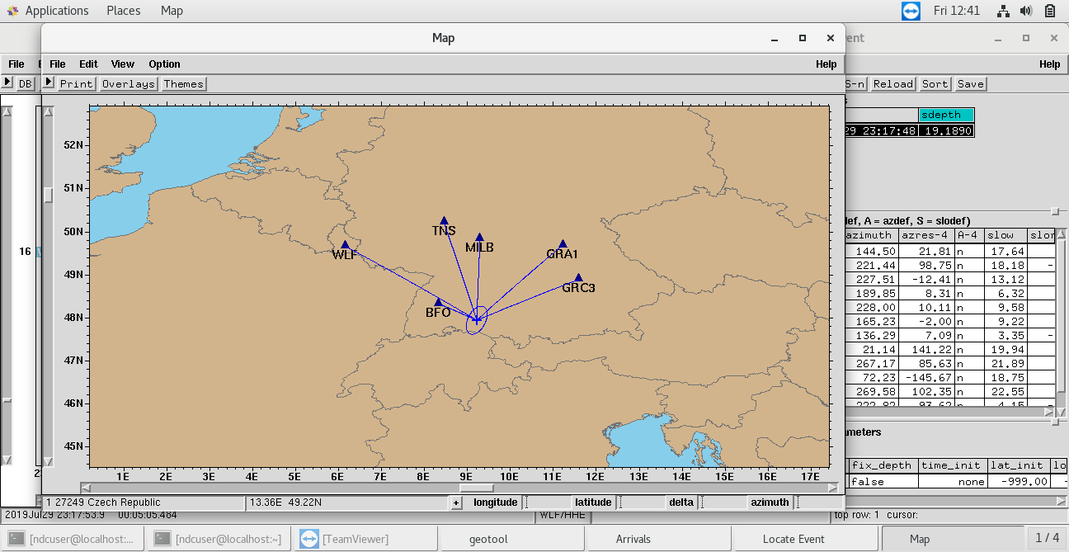
Final Location
P4.1-365
EASTRIA dataset
METHODS
Location
dataset published by EASTRIA
29.7.2019, 23:17:48 UTC
47.92 / 9.21
depth 8.1 km
mb 6.1
ml 5.2
ORFEUS dataset

Slide 11
Summary
P4.1-365
Radionuclide Scenario: indicates a second earlier event
ATM confirms second event
Reseach of local bulletins (ZAMG, BGR)
earthquake serie between 29. and 31.7.2019 around Konstanz
Waveform correlation using dataset published by EASTRIA
Result 29.7.20219 23:17:48
Request of data from GEOFON shows that the data was simulated
RESULTS

Slide 12
Conclusion
P4.1-365
NPE2019 was a useful exercise testing different technologies of the IMS
Interdisciplinary work at the NDC-AT
ATM: Missing information about MDCs in RRR
Open question: Why was the event not listed in the LEB?
Geotool as an advanced software:
working with data from external networks works well
strong support from capacity section on Geotool
CONCLUSIONS

