Slide 1

Australian NDC testing of the NET-VISA application integrated with SeisComP3
Svetlana Nikolova and Spiro Spiliopoulos

Slide 2
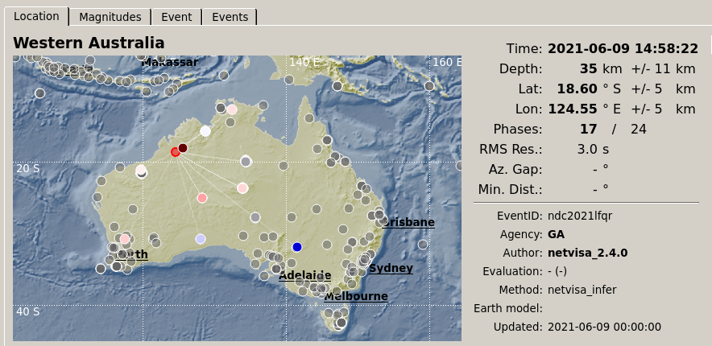
Abstract
The results of testing, at the Australian NDC, of the NDC-in-a-Box (NIAB) release containing the NET-VISA associator integrated with SeisComp3 (SC3) are presented. The aim of this work was twofold: First to test how well the NIAB release was able to reproduce the reviewed and automatic bulletins produced by the International Data Centre (IDC) using data from the IMS network of stations. Second, to use an updated version of the NET-VISA software that allowed integration of non-IMS stations within NIAB, to examine how performance improved in areas of interest to the NDC. In both cases the IDC DFX detector was used to produce detections.

Slide 3
Introduction
The NET-VISA module is a Bayesian seismic monitoring system that builds a bulletin of events given detections from a network of monitoring stations. For a technical description of NET-VISA see Arora et al. (2013).
The PTS has been developing and testing NET-VISA for some time with operational testing beginning in 2017. Further integration of the NET-VISA software into operations is continuing with NET-VISA now contributing approximately 10% of REB events in the current workflow (ECS/WGB-56/PTS/1).
To assist NDCs in their verification roles, recent NIAB releases include the NET-VISA associator with SeisComP3. An NDC testing group was established and has been using NIAB with NET-VISA and providing feedback and recommendations. More recently the functionality of NET-VISA was extended to allow use of non-IMS stations. This functionality was tested as part of the work presented here.

Slide 4
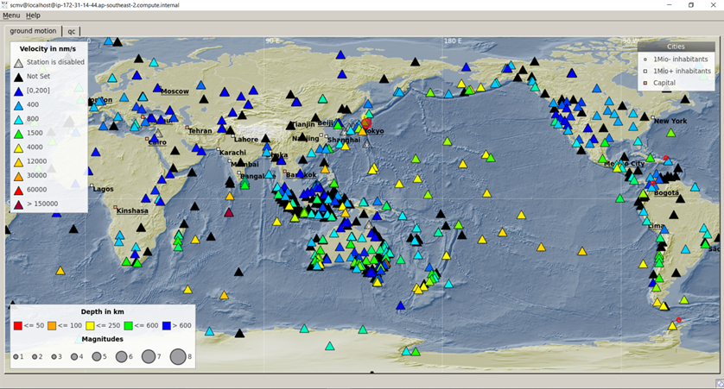
Methods:
Setup:
SeisComP3 Jakarta 2018.327.p16 with NET-VISA 2.4.0 was installed on an AWS virtual machine (specifications: c5.xlarge CentOS 7, 4 virtual CPUs, 8 Gb memory and 500 Gb disk space).
Data Acquisition:
Data is acquired from a number of networks including the IMS network and other
global and national
networks. Seedlink or
CD protocols used for
data acquisition.
Approx: 860 channels were
being acquired.

Slide 5
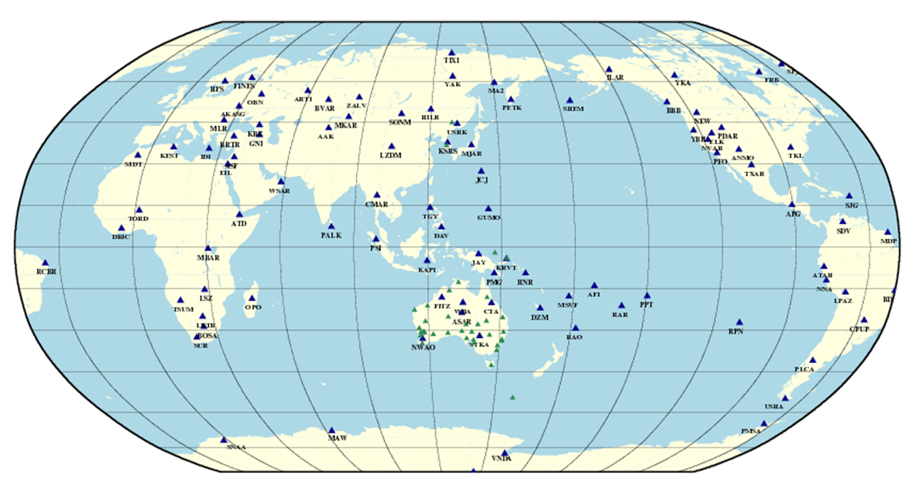
Methods:
Processing Workflow:
Detections were made on a subset of all acquired stations using the IDC DFX detector (implemented as module scdfx). For non-IMS stations included in the detection process parameter files were. The remaining stations can be used interactively to analyse events.
Detections were copied from the IDC database (module nms2proc.py).
Both the NET-VISA and SC3 associator were used but for the purpose of this testing we look at only the output of the NET-VISA associator.
Station priors, required by NET-VISA, for non-IMS stations are taken from the closest IMS station as it is not yet possible to run learning applications for these stations.
Stations with detector scdfx.

Slide 6
Results – Global Monitoring:
The first test was to determine how well the NIAB could reproduce IDC bulletins. In this test only detections from seismic IMS stations copied from the IDC were used within NET_VISA to produce the NIAB bulletin. The workflow was to copy detections from the IDC 90 minutes after real time and run NET_VISA in 30 minute sliding windows with an overlap of 5 minutes. The NIAB bulletin was then compared to the global IDC bulletins over a 3 day period by checking if the location and origin time matched within 500km and 60 seconds. The results are in Table 1. In comparing results it should be noted the workflow implemented here differs from the IDC workflow and the event comparison test is simplistic. Event comparison should be made in terms of arrivals in common. The numbers in Table 1 are likely an underestimate of performance. Nevertheless agreement was reasonable.
IDC Bulletin | Recall | Precision
vSEL3 | 0.86 | 0.58
LEB | 0.84 | 0.47
REB | 0.83 | 0.36
When non-IMS station detections were added and compared to REB the recall increased to 0.86 while the precision decreased to 0.23.

Slide 7
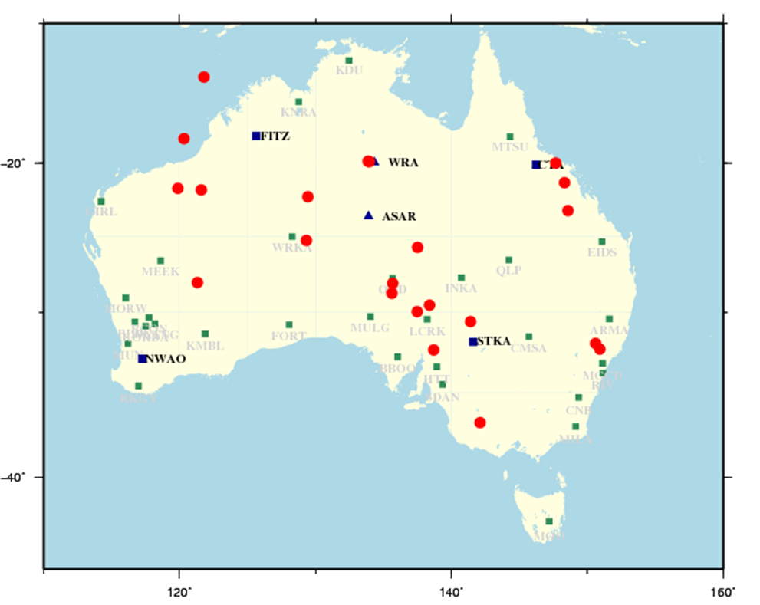
Results - Region of Interest 1:
The IMS stations were augmented with stations from the Australian national network and the NIAB bulletin was compared to the IDC products. The period studied was 01/01/2021 to 01/05/2021. The stations used and the region of interest are shown in Figure 3.The results are summarised in the table.
The REB contained 22 events located in the region. One of these was an infrasound only event. The automatic NIAB bulletin matched 17 of seismic events compared to the SEL3 and VSEL3 bulletins which matched 14 and 13 respectively. Of the seismic REB events, 14 derived from SEL3, 1 from VSEL3 and 6 were manually added. The 4 REB events missed by NIAB were in SEL3.
REB | NIAB | SEL3 | vSEL3
 | Matched | Matched | Matched
22 | 17 | 14 | 13
Comparing Australian regional events in the NIAB bulletin with the REB, SEL3 and vSEL3.The number of matched events are shown in the table.
Map shows REB events (red) and stations used. IMS station in blue and non-IMS in green.

Slide 8
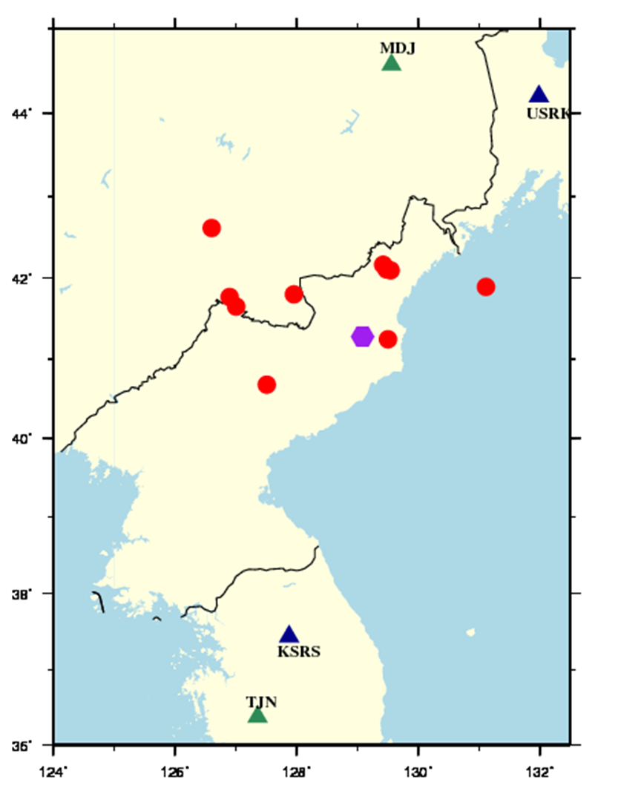
Results - Region of Interest 2:
For this study two non-IMS stations (MDJ and TJN) were acquired and used in the automatic NIAB processing. For the period 01/01/2021 to 1/5/2021 and the region shown in Figure 3 the NIAB bulletin was compared to IDC products (Table 3).
The automatic NIAB bulletin contained 6 of the 10 REB events. Of the 4 events missed by the NIAB two were manually added by analysts and 2 came from the SEL3, although with incorrectly associated stations
REB | NIAB | SEL3 | vSEL3
 | Matched | Matched | Matched
10 | 6 | 8 | 2
Comparing events in the NIAB bulletin with the REB, SEL3 and vSEL3 in the region shown in the adjacent map. Map shows stations used and REB events.
Non-IMS stations in green.

Slide 9
Results - Detailed Analysis:
A detailed analysis of one day (13/05/2021) of the NIAB bulletin was made. This bulletin was formed using IMS stations and the stations used in the regional studies. Each event in the NIAB bulletin was examined, using the waveforms, both to determine: if the event was valid; and if it appeared in the IDC LEB. Events were matched by comparing arrivals unlike the previous use of a distance and time threshold.
For this day the LEB totalled 105 events and the NIAB matched 90 of these events. Five of the missed events were infrasound only events and six were added by analysts. The remaining 4 came from the SEL3 but did also appear in the vSEL3. The high recall rate confirms that earlier comparisons underestimated matched events.
This analysis was able to find a number of NIAB events that were considered to be potential new LEB events. Additionally a number of single station events were identified.
The NIAB using IMS and non-IMS stations reproduced most of the LEB events. However a number of additional false events were produced with many of the false events being split events.

Slide 10
Conclusions:
The Australian NDC successfully installed the NDC-in-a-Box (NIAB) recent release containing the NET-VISA associator integrated with SeisComp3 (SC3) and ran it using a range of seismic stations from global and national networks.
NIAB with NET-VISA using only IMS stations compared well to the IDC vSEL3 bulletin.
Integration of non-IMS stations into the NIAB with NET-VISA was successful. Non-IMS stations were used in two regions of interest to test performance.
In the Australian region the use of non-IMS stations improved performance compared to the IDC bulletins. In the region of Nth Korea performance improved slightly.
A detailed one-day analysis that included waveform analysis and arrival comparison using the IMS network augmented with non-IMS stations showed very good performance compared to the LEB.

Slide 11
Conclusions and Comments:
The current version of NIAB is proving useful for our NDC monitoring use. Following testing of NIAB with NET-VISA the alpha testing group made recommendations to improve usability. We would urge the PTS to continue to work on these recommendations. These include exploring options to display waveforms from array stations (beams).
Our NDC will continue tuning and testing to improve performance including reducing false alarms.
We are happy to share our knowledge and experience with NDCs who may be interested in setting up this software.

Slide 12
References
ECS/WGB-56/PTS/1 25 February 2021, Testing, Provisional Operations and Performance Assessment, Application Software for Waveform and Radionuclide Analysis
Arora, N. S., S. Russell, E. Sudderth (2013). NET-VISA: Network Processing Vertically Integrated Seismic Analysis, Bull. Seismol. Soc. Am. 103, pp.709-729.

