Slide 1





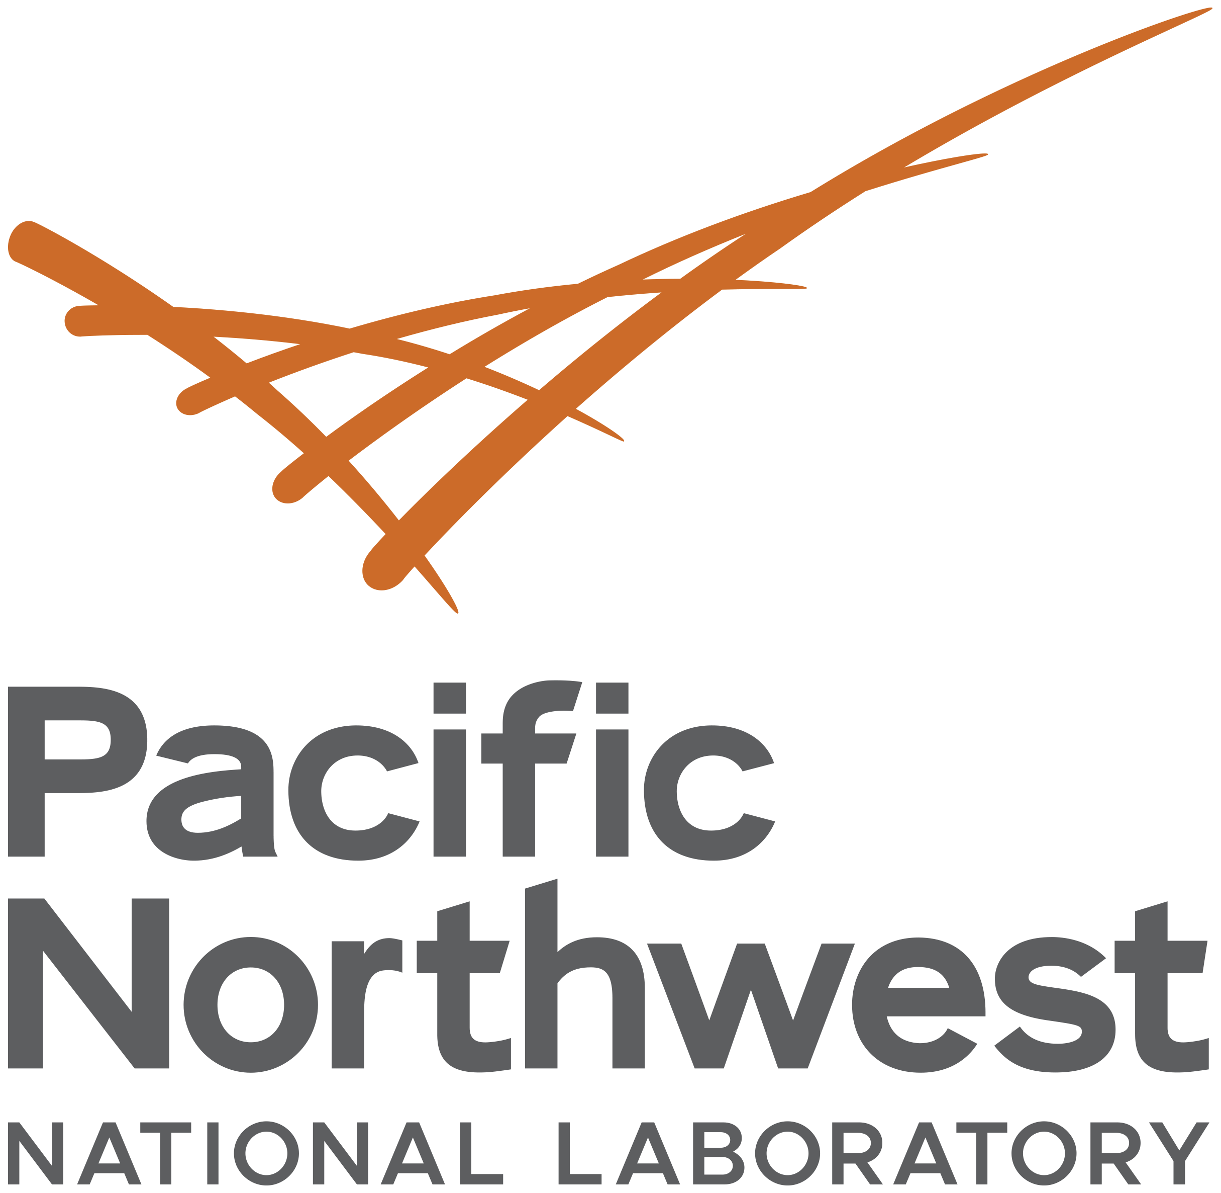
T4.3: Seismic-Hydroacoustic-Infrasound (SHI) in the Sky: benefits and pitfalls of
NDC-in-a-box in the Cloud
Gordon MacLeod¹, Jonathan MacCarthy¹, Omar Marcillo², Christopher Young³, Stephen Myers⁴, and Jonathan Burnett⁵
¹Los Alamos National Laboratory, ²Oak Ridge National Laboratory, ³Sandia National Laboratories, ⁴Lawrence Livermore National Laboratory, ⁵Pacific Northwest National Laboratory
O4.3-167
The views expressed here do not necessarily reflect the views of the United States Government, the United States Department of Energy, the National Nuclear Security Administration, or the Los Alamos National Laboratory. LA-UR-21-24628

Slide 2
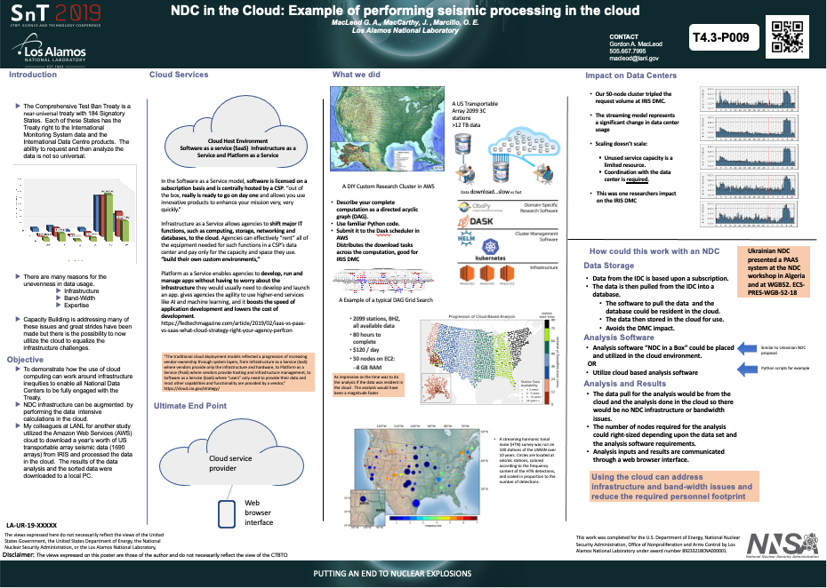
T4.3: Seismic-Hydroacoustic-Infrasound (SHI) in the Sky: benefits and pitfalls of NDC-in-a-box in the Cloud
O4.3-167
Motivation
Omar Marcillo, ONRL and Jonathan MacCarthy, LANL have been executing research on cloud computing. This research inspired the SnT19 poster T4.3 P9 NDC in the Cloud.
Gordon MacLeod, LANL is a former PTS OSI PPO Chief and PM of the IFE14 who was first introduced to NDC in the Box at a NDC meeting in Asunción, Paraguay and OSI RN Laboratory during the IFE14.
This work moves forward on all of their interests to study if the cloud will allow expanded functionality and capability without impacting infrastructure or bandwidth at minimal costs.
We set out to demonstrate what was possible

Slide 3
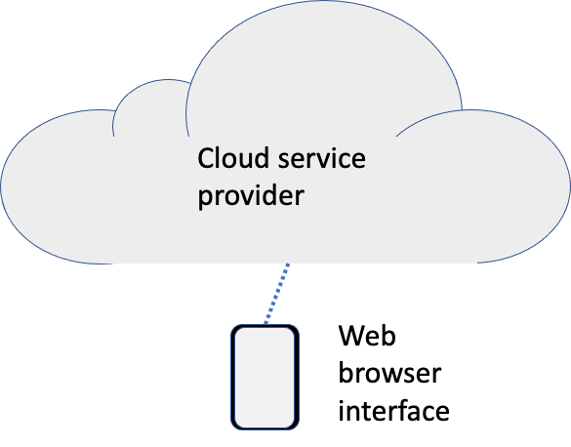
T4.3: Seismic-Hydroacoustic-Infrasound (SHI) in the Sky: benefits and pitfalls of NDC-in-a-box in the Cloud
O4.3-167
Initial Study Goals
Conduct a study that would demonstrate feasibility and evaluate the operational capabilities of “NDC-in-a-Box” in cloud environments using virtualized hardware and standardized software.
Demonstrate how a standardized software suite (NIAB) can be deployed using the software delivery platforms available in the cloud.
Explore using both IMS and other data.
Document the cost and the logistical burden of providing NIAC computing hardware by using virtualized computing services in the cloud.
Standardize and increase the computing resources available by using virtualized computing services in the cloud.

Slide 4
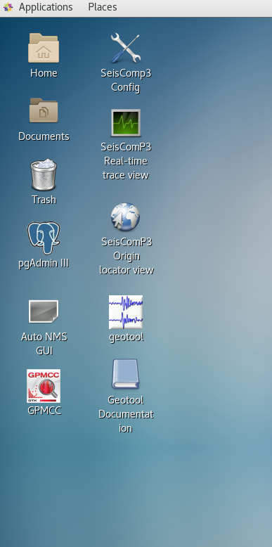
T4.3: Seismic-Hydroacoustic-Infrasound (SHI) in the Sky: benefits and pitfalls of NDC-in-a-box in the Cloud
O4.3-167
Bottom Line Upfront
We successfully loaded the virtual machine images from SHI NIAB.
We loaded the RN NIAB within the SHI VM
We were using a virtual 8 CPU, 32GB Ram and 50GB drive
We have found no noticeable lag while running the software from a variety of bandwidth environments

Slide 5
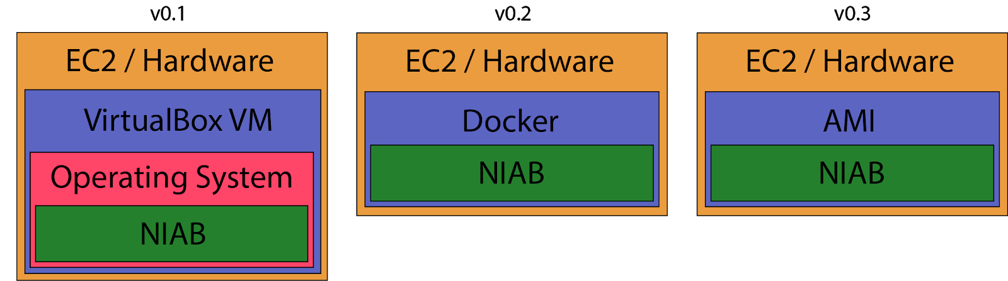
Placing NIAB in the Cloud (NIAC)
O4.3-167
Initial Set Up
A cloud-based infrastructure to host NIAB can be built in multiple ways, employing several different technology paths. A primary objective of this project is to evaluate multiple paths so that a cost-efficient and performant solution can be recommended.
We evaluated:
  running the NIAB Virtual Machine (VM) using VirtualBox software in the cloud
  building a Docker image from scratch that installs all NIAB software and running the container in the cloud
  converting the NIAB VM to an Amazon Machine Image (AMI) and running the AMI in the cloud

Slide 6
Placing NIAB in the Cloud (NIAC)
O4.3-167
NIAC v0.1 Virtual Box
NIAB has is currently distributed using a VirtualBox VM, which virtualizes an entire operating system and its software.
NIAC v0.1 is the most one-to-one translation of the existing NIAB distribution into a cloud-backed infrastructure.
To create NIAC v.0.1, we launched an Amazon Elastic Compute Cloud (EC2) instance, selected CentOS Linux operating system, connected to it with a terminal, and installed VirtualBox and its prerequisites and dependencies using the standard “yum” package manager.
The NIAB .ova file was uploaded to the instance
Imported and configured in VirtualBox following instructions from NIAB release.

Slide 7
Placing NIAB in the Cloud (NIAC)
O4.3-167
NIAC v0.1
Pros
  NIAC v0.1 offers the scalability of EC2 as the host system and the familiarity of the existing NIAB distribution.
Cons
  NIAC v0.1 has an extra layer of virtualization.
    host systems like EC2 are themselves virtualized
    there is no advantage to virtualization software like VirtualBox when the host system (EC2) can be customized on a per-application basis.
  Additional steps must be taken to configure the VM to have a graphical desktop interface
Findings
  The additional configuration required for obtaining a remote desktop environment dissuaded us from pursuing this technical path any further.

Slide 8
Placing NIAB in the Cloud (NIAC)
O4.3-167
NIAC v0.2 Docker Image
Docker is a versatile and lightweight virtualization software, similar in spirit to VirtualBox VMs.
  Different in implementation
  Uses far fewer host system resources
Docker is used to build self-contained images of an operating system and installed NIAB software that can be run on any host system with Docker software installed.
An image is built using a “recipe” called a Dockerfile, in which one specifies a base operating system and a series of commands that copy files and install software into the image.
Using Docker for NIAC v0.2 would allow the NIAB software to run on EC2 hardware using an array of cloud services, each with different cost and performance profiles. It addresses the high system resource usage of v0.1.

Slide 9
Placing NIAB in the Cloud (NIAC)
O4.3-167
NIAC v0.2
Pros
  Docker uses fewer system resources compared to the VirtualBox
  virtualization software, as it shares tasks with the host operating
  system
Cons
  Docker does not support the systemctl commands necessary to run the desktop virtualization software
    Graphical NIAB software must use a slower virtual desktop system, or send graphical windows to the user's local computer
Findings
  The graphical interface solutions were found to be too slow and inconvenient
  Docker is an option for non-graphical elements of the NIAB software suite

Slide 10
Placing NIAB in the Cloud (NIAC)
O4.3-167
NIAC v0.3 AMI
Amazon Machine Image (AMI) to virtualize the operating system.
  AMIs are more resource-intensive than Docker images, but less than VirtualBox VMs
  They are optimized to run on the AWS hardware virtualization platform.
  AMIs address both the high system resource use of VirtualBox and the difficulty running desktop virtualization software using Docker.
We use AWS’s VM Import functionality to import the existing SHI NIAB version 5 VirtualBox VM .ova file and convert the image into an AMI.
  NIAC v0.3 uses NIAB version 5, and we install the desktop virtualization software NICE DCV into it.

Slide 11
Placing NIAB in the Cloud (NIAC)
O4.3-167
NIAC v0.3 AMI
Pros
  As this solution uses the existing NIAB VirtualBox VM as its basis, it requires no extra configuration by the IDC in order to support it.
  Virtual desktop software is easily installed into an AMI and works as expected with graphical interfaces.
Cons
  AMIs are AWS-specific (and region-specific), and cannot be moved to other cloud providers.
  NIAB updates would require starting at the beginning to install.
  Data and results could also be ephemeral
Findings
  This was our most successful installation and the remainder of the talk is focused on our findings.

Slide 12
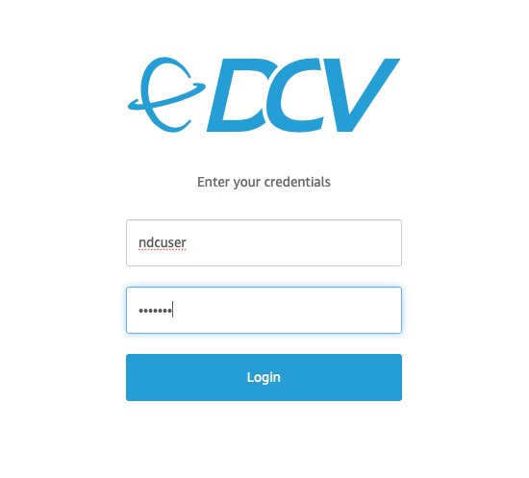
Placing NIAB in the Cloud (NIAC)
O4.3-167
Multi-User NIAC v0.3 AMI
The Multi-User NIAC workflow requires three elements: 1) a base NIAB installation in an AMI, 2) virtual desktop software, and 3) a way to update and distribute the AMI to users.
We used the AWS VM import service to convert the existing VirtualBox VM into an AWS AMI, which is stored in our AWS account.
We ran the AMI on an Amazon Elastic Compute Cloud (EC2) instance to install the high-performance remote display software, NICE DCV,
  Allows access to remote EC2 instances via several local desktop clients or a web browser.
The updated AMI was again saved to the AWS account, resulting in a reusable NIAB software installation that can be “launched” onto virtual computers in AWS EC2 of various sizes.

Slide 13
Placing NIAB in the Cloud (NIAC)
O4.3-167
Multi-User NIAC v0.3 AMI
To evaluate the AMI-based NIAB-in-the-cloud (NIAC) SHI installation:
  We launched the AMI onto six AWS EC2 instances, each with 8 virtual CPUs, 32 GB RAM, and 50 GB storage in the “us-west-2” (Oregon).
  This allowed evaluators at Los Alamos, Sandia, Lawrence Livermore, Oak Ridge and Pacific Northwest National Laboratories to remotely log into their respective virtual desktops for testing.
Evaluators were asked to use the software, tutorials, and documentation from the original SHI NIAB v5.0 VirtualBox image, and offer feedback on the desktop performance, software functionality, and overall user experience.
  We later added the RN NIAB software.

Slide 14
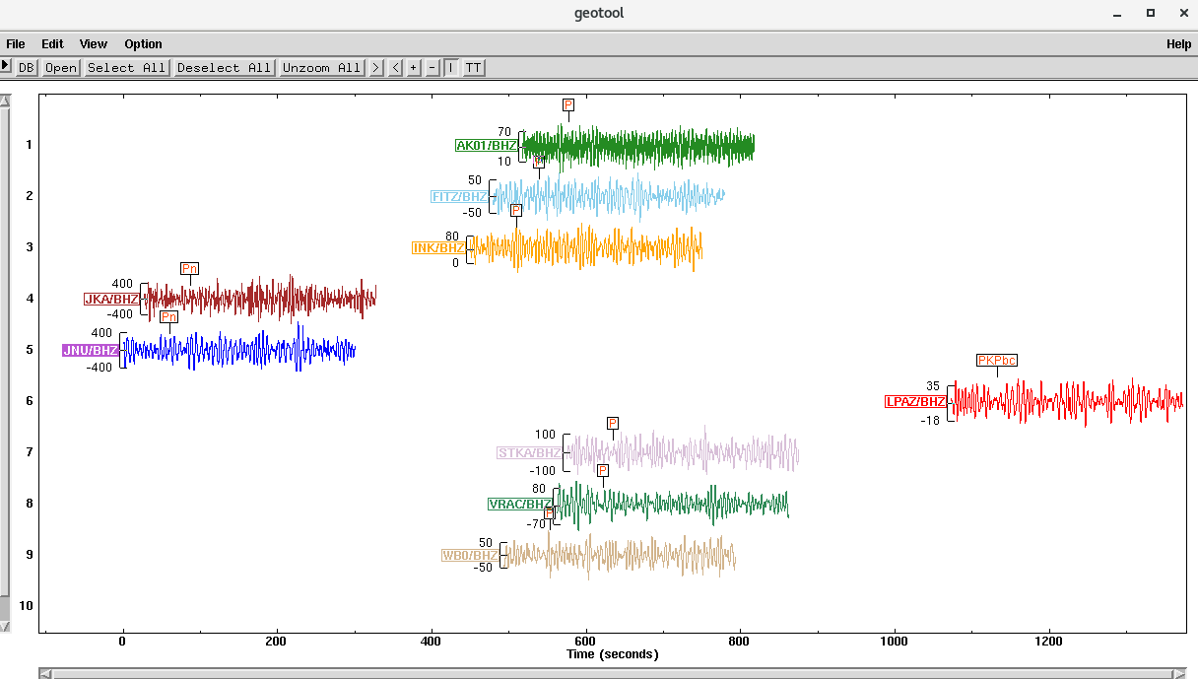
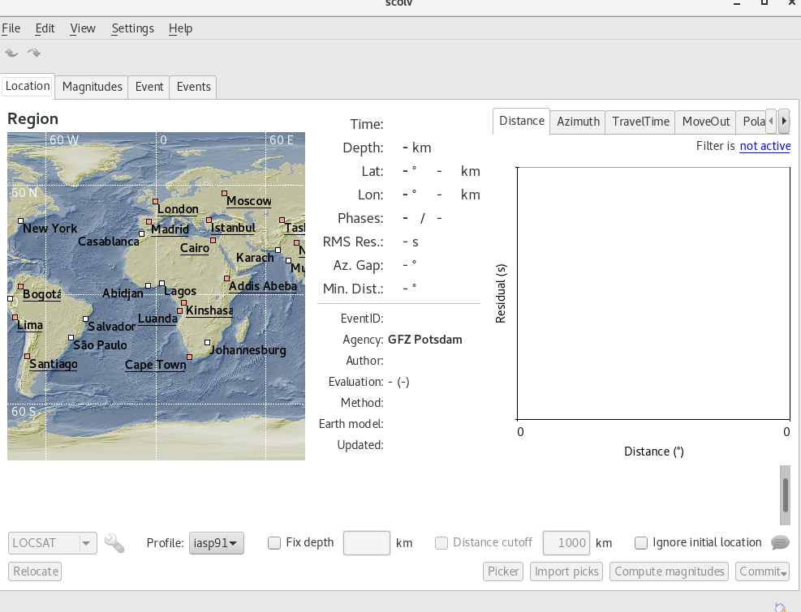
Evaluating NIAC
O4.3-167
NIAB SHI
GeoTool was the first tool tested using the training data - worked well.
SeisComP3 has been a challenge to set up properly
  Principal User vs Regular User issues
  Initially used IRIS data vs IDC
  Still have issues with the Postgres database integration
GMPCC was recently used as the PI became available
  Initially used IRIS data vs IDC

Slide 15
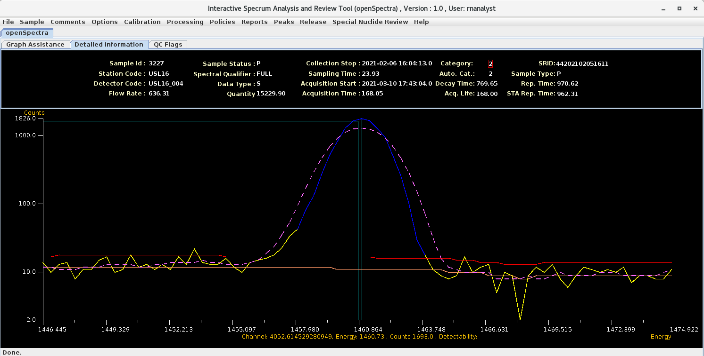
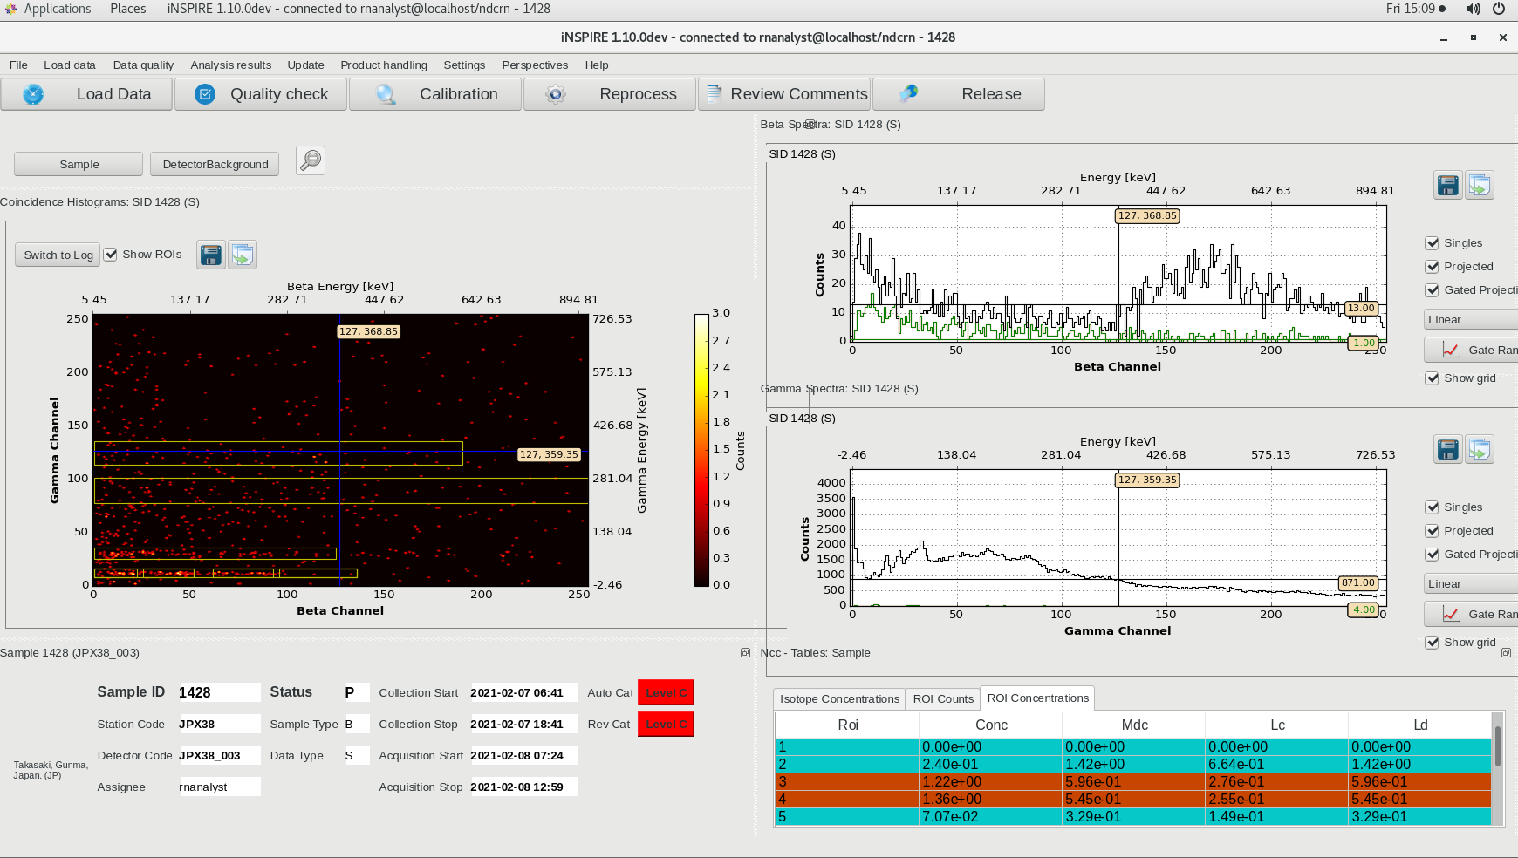
RN NIAB loaded into the SHI VM
O4.3-167
RN NIAB
Loaded NIAB RN into the SHI instance
Yum installation method from the SWP
Running the RN NIAB software using the terminals
NMS Client Principal User was exercised - worked well
iNSPIRE - worked well
Open Spectre - worked well

Slide 16
Placing NIAB in the Cloud (NIAC)
O4.3-167
Multi-User NIAC v0.3 AMI
Costs for NIAC v0.3 is approximately $14 per instance per day, due entirely to EC2 usage, resulting in an estimated annual cost of $5110 per instance.
  This initial estimate is not at all optimized, however, and will be revised significantly downward following expected improvements in EC2 uptime and persistent disk storage.
  The EC2 instance initially chosen is oversized (32 GB RAM, 8 CPUs, 50 GB disk space) for its software requirements, and is running continuously.
  Right-sizing the EC2 instance and reducing its uptime will significantly reduce costs, bringing them into ranges that will better reflect long-term usage patterns.

Slide 17
T4.3: Seismic-Hydroacoustic-Infrasound (SHI) in the Sky: benefits and pitfalls of NDC-in-a-box in the Cloud
O4.3-167
Initial Conclusions
For AWS the NIAC installation using EC2 and AMI worked well and created a stable platform for NIAB.
  Set up of the software and access to the data are identical
  Troubleshooting has the added unanticipated benefit of being able to access the NIAC from anywhere including Vienna
    You can email support your instance
We are still investigating the need to set up multiple AMIs to match the VMs
  SHI was initially loaded. Loaded the RN NIAB via Yum.
  GrandSim and WebGrape VMs have not yet been loaded.
Need to investigate the capabilities with other cloud providers

