Slide 1
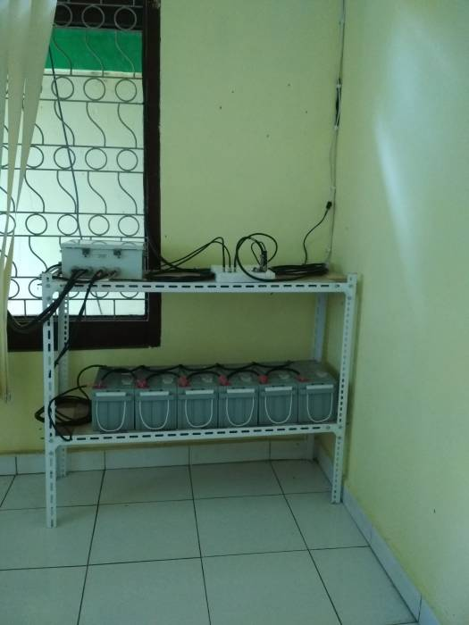
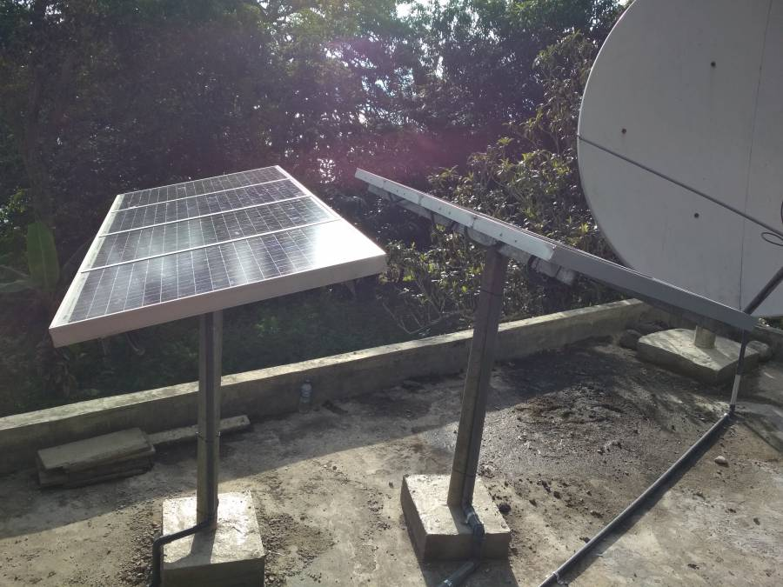
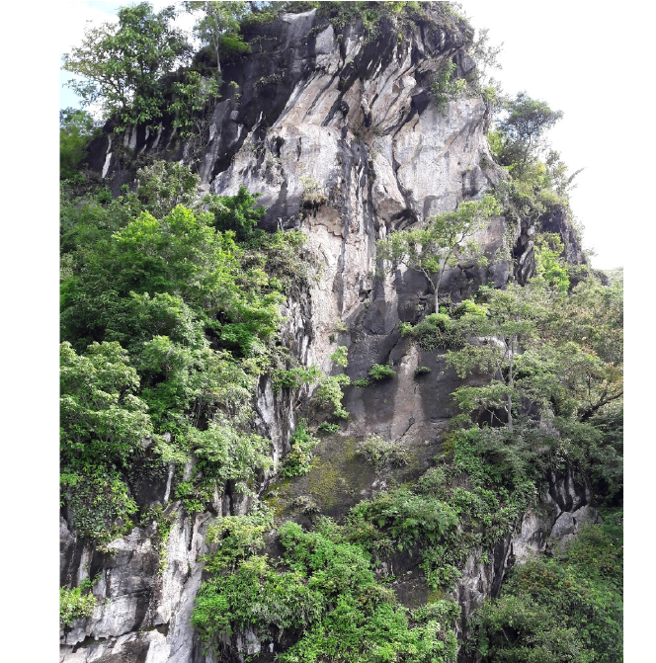
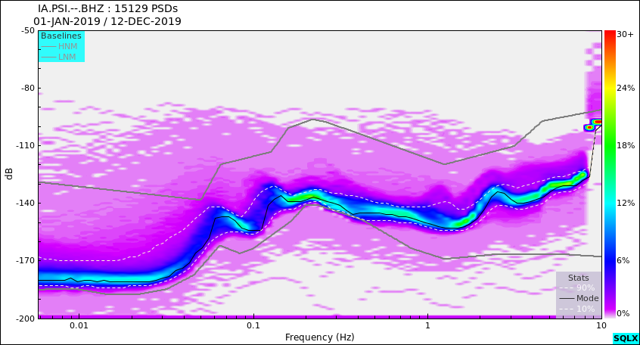
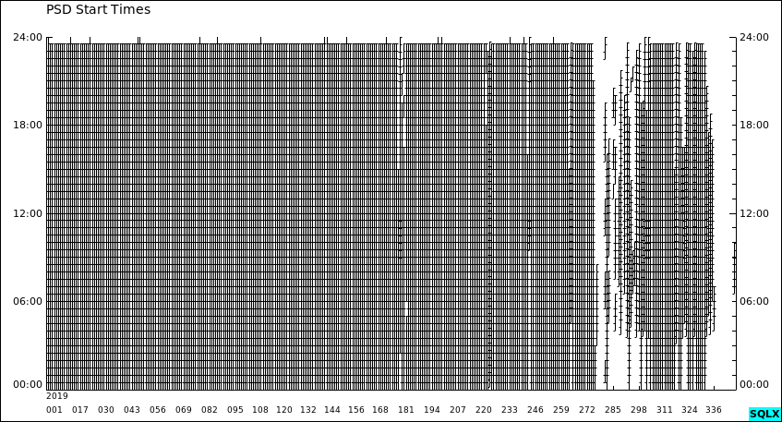
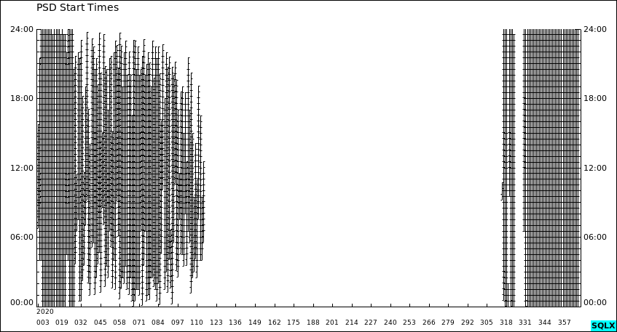
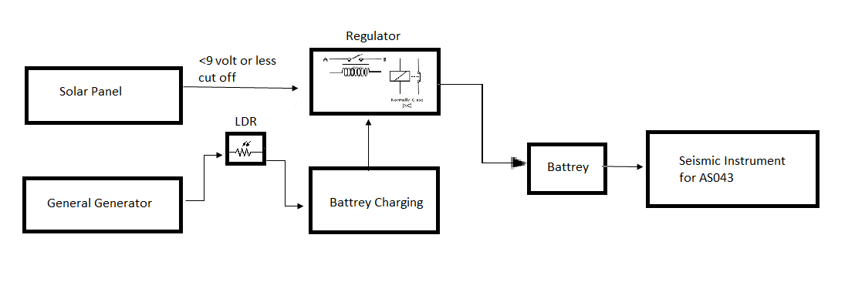
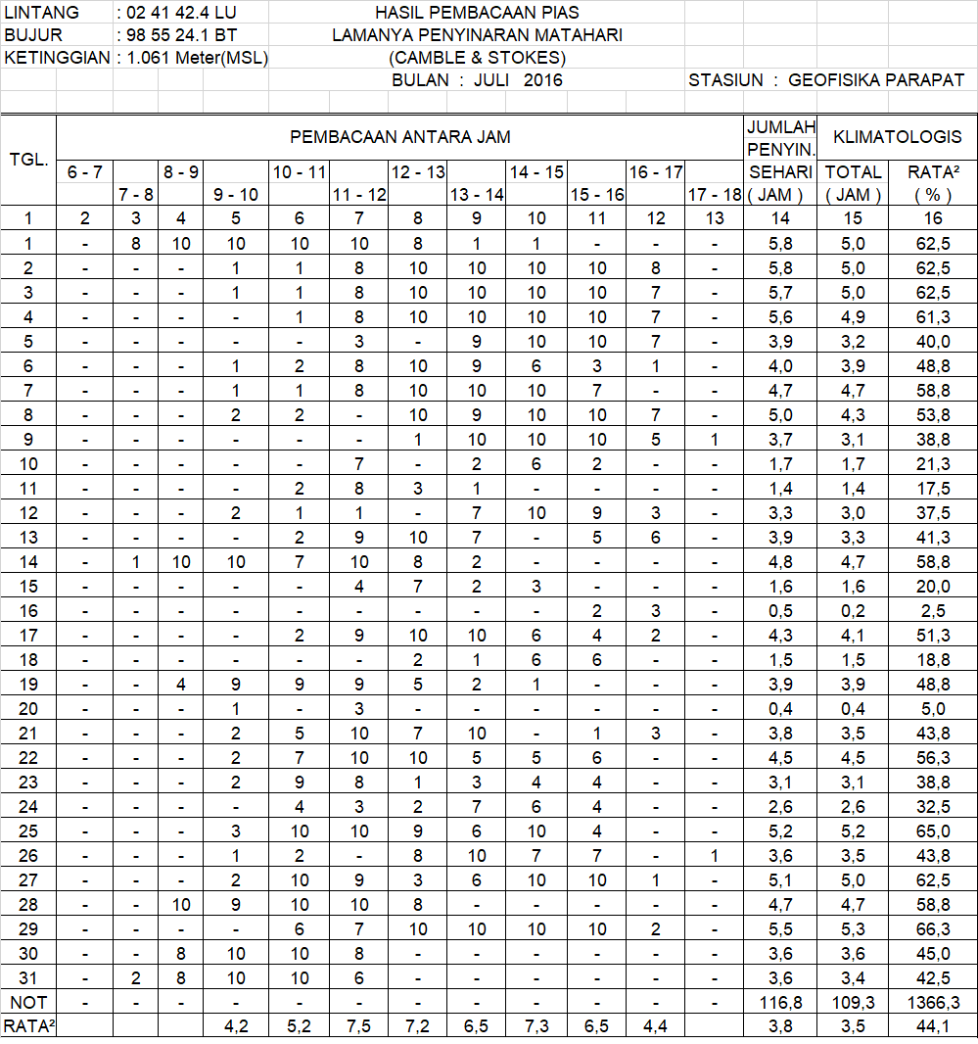
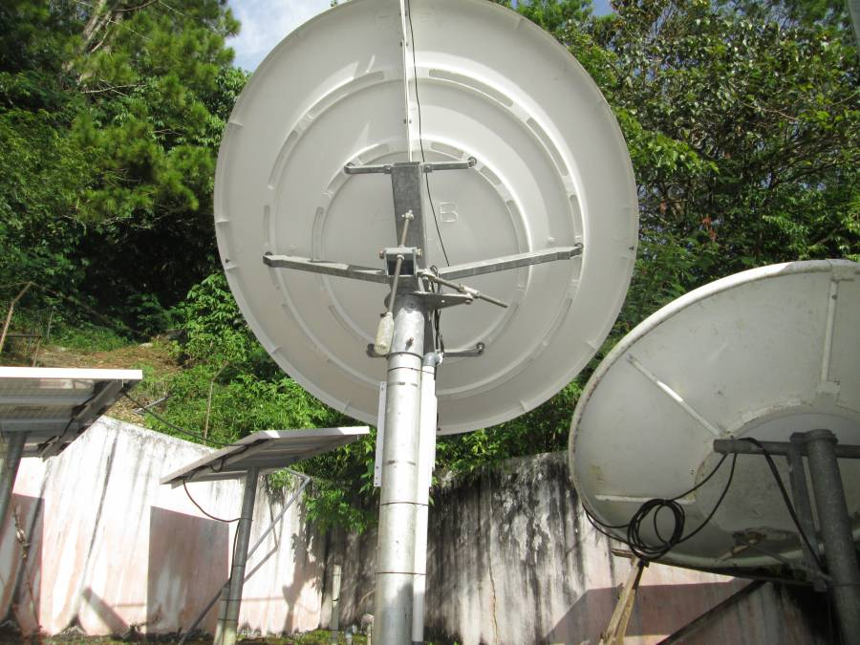
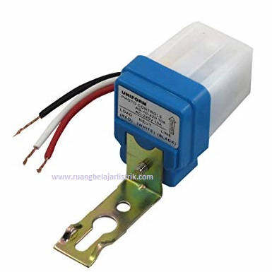
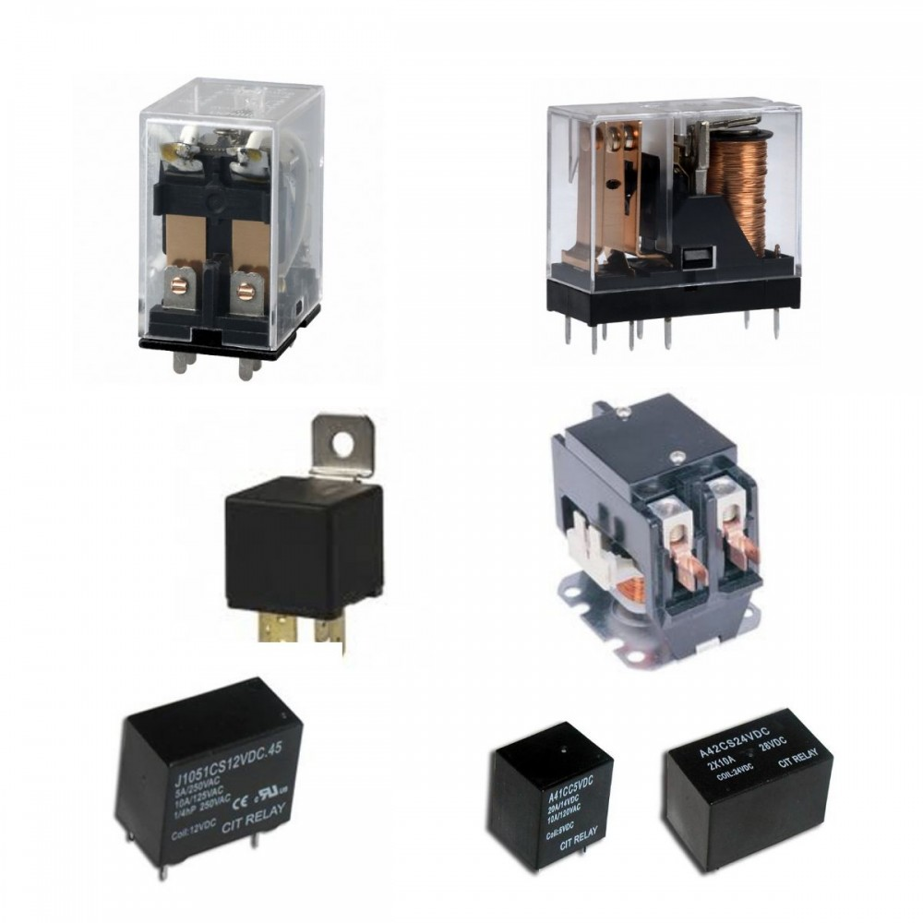
A solution for the continuous power supply of the AS043 station
Abstract
A CTBTO site station in Parapat AS043), North Sumatra since 2020 has always lost data. This results in the loss of important data for analysis. Data analysis from SQLX, seismometer in good condition and noise spectrum still within HNM / LNM limits. The site station has used the electrical system by building solar panels, but that's not enough. Solar panel energy cannot supply battery power effectively. The solar panels work for about 4 hours. Due to the Parapat climate it is almost cloudy every day. LDR (lightning detector relay) is designed to regulate the supply of power sources from the consumption of solar power and the main generator. This way, the battery can always be fully charged. Therefore, data can be sent continuously. The LDR is intended for automatic switching between the generator and solar panels coupled with a contactor type relay. This is not a new technology, just a simple solution to ensure continuous data availability without interruption. Noise studies have not been carried out, but the converter can be located outside the seismograph area. The generator power supply is used because only that device may be available in the vicinity of the site.
Intruduction
Power Supply Availabilty
Parapat AS043 CTBTO Station is located at the foot of the Bukit Barisan, North Sumatra. It has solid rock that is able to record seismic well. From the existing records, even have seismic records with magnifications up to 450K. Clean seismic data with minimal environmental noise. However, it is very unfortunate when the data cannot be utilized because the seismic data is interrupted due to a discontinuous power supply.
The current availability of power supplies only uses solar panels to charge the battery.
Metode
Data Availability
The addition of backup energy that is able to supply the battery in addition to the solar panel will be able to increase the battery life. So that it can meet the needs of the power supply of the tool. The availability of an existing backup power supply, namely electric power from the Parapat station office network.
Through SQLX data in 2019 the data records generated were 80 percent. The worst year 2020 is only 20 percent. This is due to battery performance that cannot last due to minimal charging supply, so it only lasts 1 year. Solar Panels, which are the main energy suppliers, are not able to meet the needs of power tools.
Work Principle
Through the switching method using LDR as an indicator of energy sufficiency from the solar panel and relay as a breaker and connection between the 12V inverter and the solar panel. So that the power on the battery will always be full and it is possible to increase battery life and ensure the availability of data on the device.
Climat of Data
The location of the site is blocked by the Bukit Barisan which causes only 3-4 hours of incoming sunlight on average per day. Coupled with the climatic conditions of Parapat Station which are often cloudy and rainy.
By. Hendro Subekti
Meteorology, Climatology and Geophysics Agency Calibration Technician
Supporting by. Dr. Dwinanto Msi
Lecturer of Physics at Indonesian State Islamic University

