Slide 1

Operation and Maintenance of the Botswana Seismological Network (BSN)
Stations including Lessons Learned from the COVID-19 Pandemic Crisis
MARITINKOLE, Joseph (Botswana Geoscience Institute, Lobatse, Botswana);
KWADIBA, Motsamai Tarzan (Botswana Geoscience Institute, Lobatse, Botswana);
NTIBINYANE, Onkgopotse (CTBTO Preparatory Commission, Vienna, Austria);
WETTUM, Arie Van (Utrecht University, The Netherlands)
Poster number: P4.4-686

Slide 2
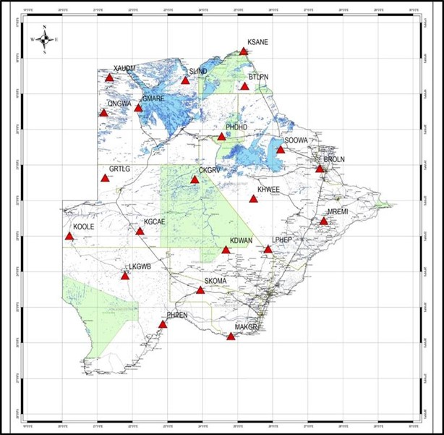
[Operation and Maintenance of the Botswana Seismological Network (BSN) Stations including Lessons Learned from the COVID-19 Pandemic Crisis]
[MARITINKOLE, J., KWADIBA, M.T., NTIBINYANE, O., WETTUM, A. van]
P4.4-686
BOTSWANA SEISMOLOGICAL NETWORK (BSN) STATIONS
The BSN comprises a total to 21
Countrywide seismic stations
18 stations are telemetered
3 are located in areas devoid of
Telecommunication network coverage
ABSTRACT

Slide 3
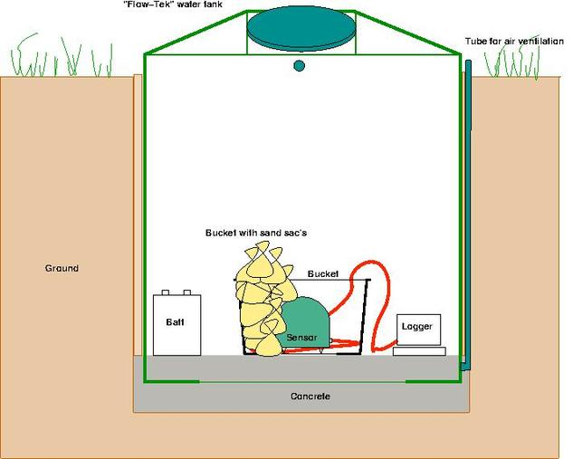
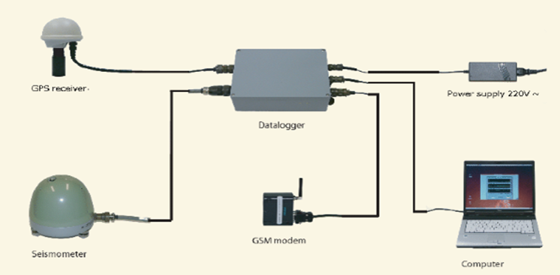
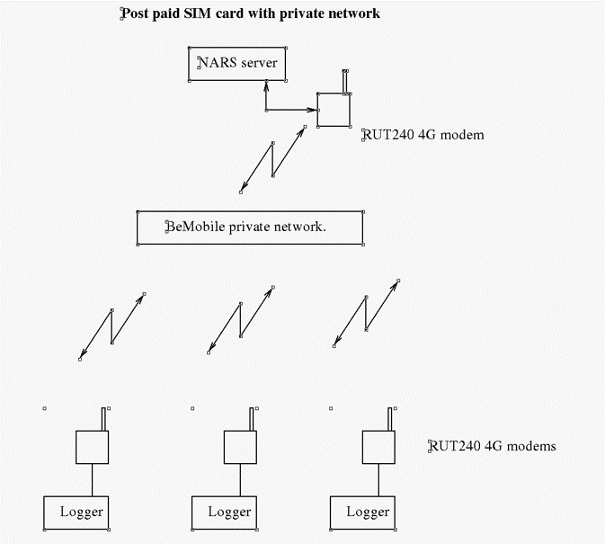
[Operation and Maintenance of the Botswana Seismological Network (BSN) Stations including Lessons Learned from the COVID-19 Pandemic Crisis]
[MARITINKOLE, J., KWADIBA, M.T., NTIBINYANE, O., WETTUM, A. van]
P4.4-686
INSTRUMENTATION AND SETUP
CURRENT STATUS

Slide 4
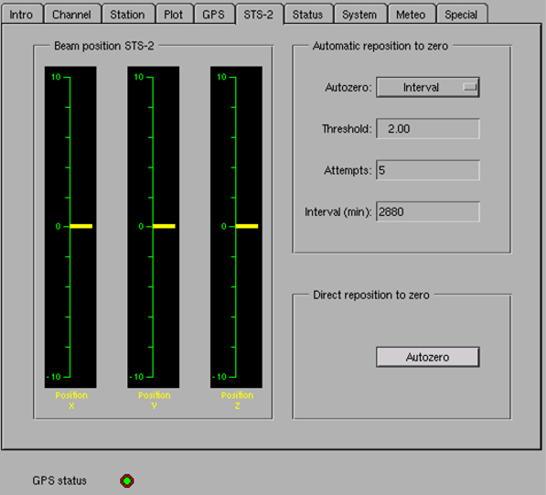
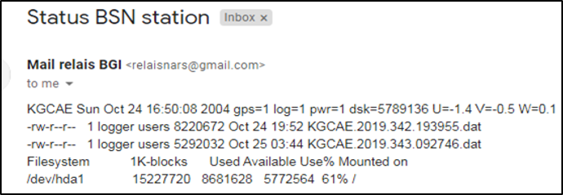
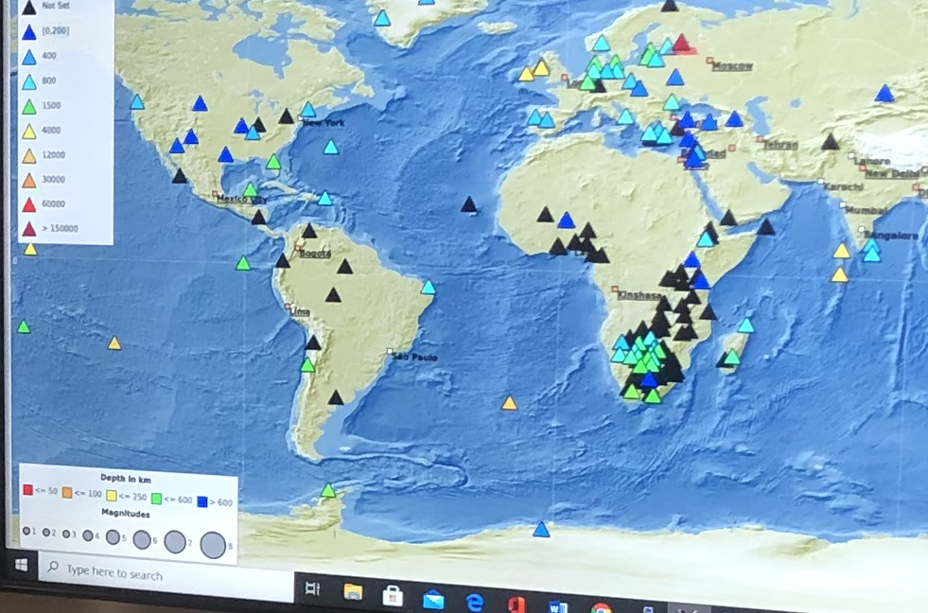
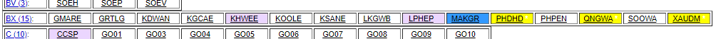
[Operation and Maintenance of the Botswana Seismological Network (BSN) Stations including Lessons Learned from the COVID-19 Pandemic Crisis]
[MARITINKOLE, J., KWADIBA, M.T., NTIBINYANE, O., WETTUM, A. van]
P4.4-686
STATE OF HEALTH (SoH)

Slide 5
[Operation and Maintenance of the Botswana Seismological Network (BSN) Stations including Lessons Learned from the COVID-19 Pandemic Crisis]
[MARITINKOLE, J., KWADIBA, M.T., NTIBINYANE, O., WETTUM, A. van]
P4.4-686
LOCKDOWNS &TRAVEL RESTRICTIONS
POWER ISSUES
COMMUNICATION ISSUES
SYSTEM ISSUES
CHALLENGES

Slide 6
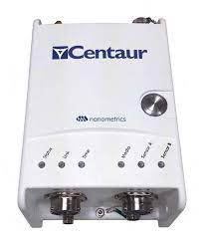
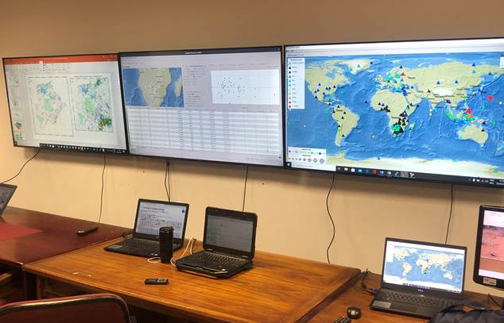
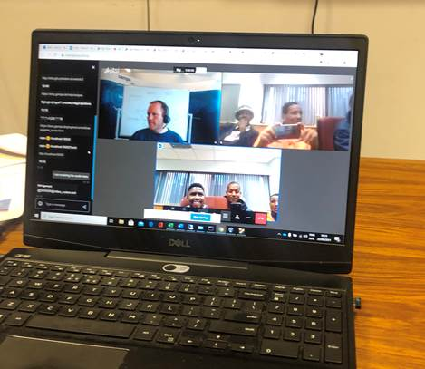
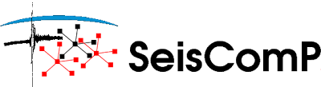
[Operation and Maintenance of the Botswana Seismological Network (BSN) Stations including Lessons Learned from the COVID-19 Pandemic Crisis]
[MARITINKOLE, J., KWADIBA, M.T., NTIBINYANE, O., WETTUM, A. van]
P4.4-686
RECTIFICATION
Ensured that all ups are up and running at all times
Issuance of travel permits for all the seismology unit officers
VSat internet was explored and procured
Use of scripts
Acquired NANOMETRICS digitizers
IMPROVEMENTS
Establishment of a seismological Laboratory
Local capacity building through virtual trainings
Acquired Seiscomp licensed modules for remote and automatic works

Slide 7
[Operation and Maintenance of the Botswana Seismological Network (BSN) Stations including Lessons Learned from the COVID-19 Pandemic Crisis]
[MARITINKOLE, J., KWADIBA, M.T., NTIBINYANE, O., WETTUM, A. van]
P4.4-686
Operation and Maintenance of the Botswana Seismological Network (BSN) Stations was successful despite the covid-19 Pandemic challenges. To this end, we have several accomplishments including
Training and local capacity building
Technical support from nanometrics and Gempa(GmbH)
Seismological Laboratory established
Digitizers acquired
CONCLUSIONS

Slide 8
[Operation and Maintenance of the Botswana Seismological Network (BSN) Stations including Lessons Learned from the COVID-19 Pandemic Crisis]
[MARITINKOLE, J., KWADIBA, M.T., NTIBINYANE, O., WETTUM, A. van]
P4.4-686
Botswana Geoscience Institute is in the process of establishing a national Earthquake Information and Seismological Research Center
The 3 stations located in the remote regions of the country will be telemetered through deployment of VSAT
Expansion of the BSN network to minimize large inter-station distances
Continued collaboration with:
WAY FORWARD
Utrecht University
University of Twente
Gempa GmbH
CTBTO
IRIS

Slide 9
[Operation and Maintenance of the Botswana Seismological Network (BSN) Stations including Lessons Learned from the COVID-19 Pandemic Crisis]
[MARITINKOLE, J., KWADIBA, M.T., NTIBINYANE, O., WETTUM, A. van]
P4.4-686
THANK YOU !!!

