Slide 1
State of Health Monitoring of the IMS Network
Han*, D.; Campus, P.; Cruz, P; Ekimov, P.; Guenther, M.; Hoffmann, T. ; Malephane, H.;
Malakhova, M.; Nava, E.; Nizamska, M.; Parithusta, R.A. ; Villarreal, R.E.
CTBTO Preparatory Commission
P4.5-333

Slide 2
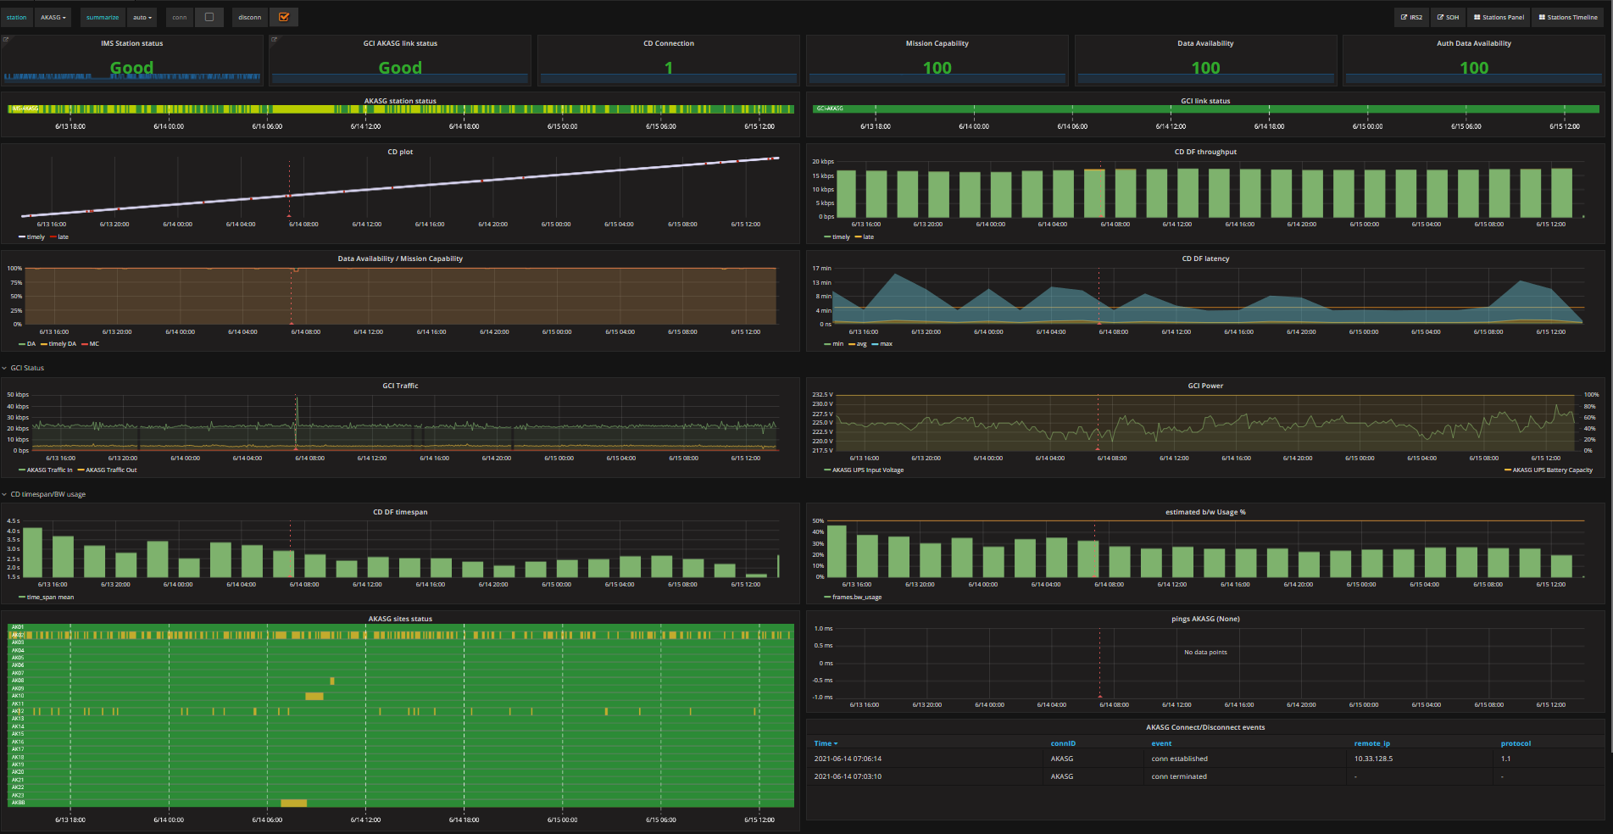
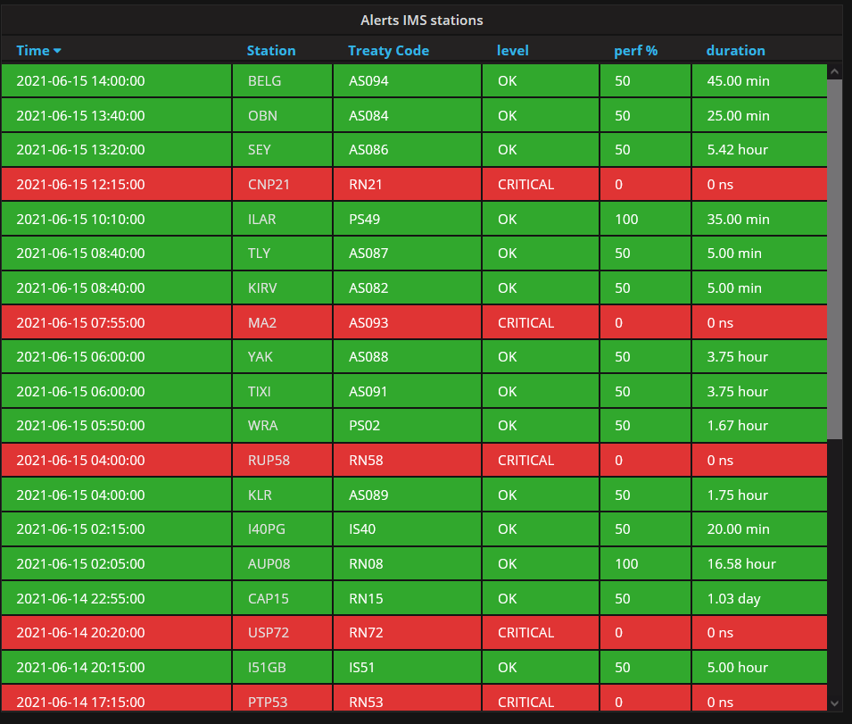
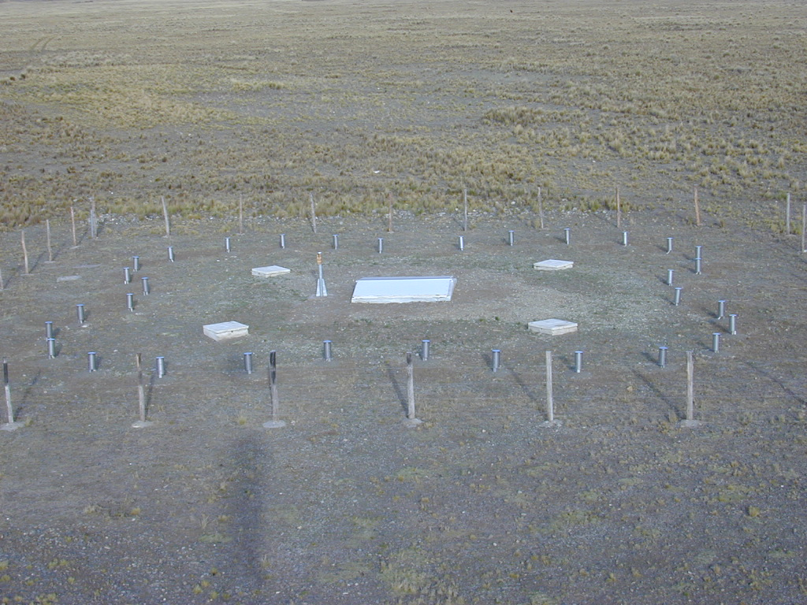
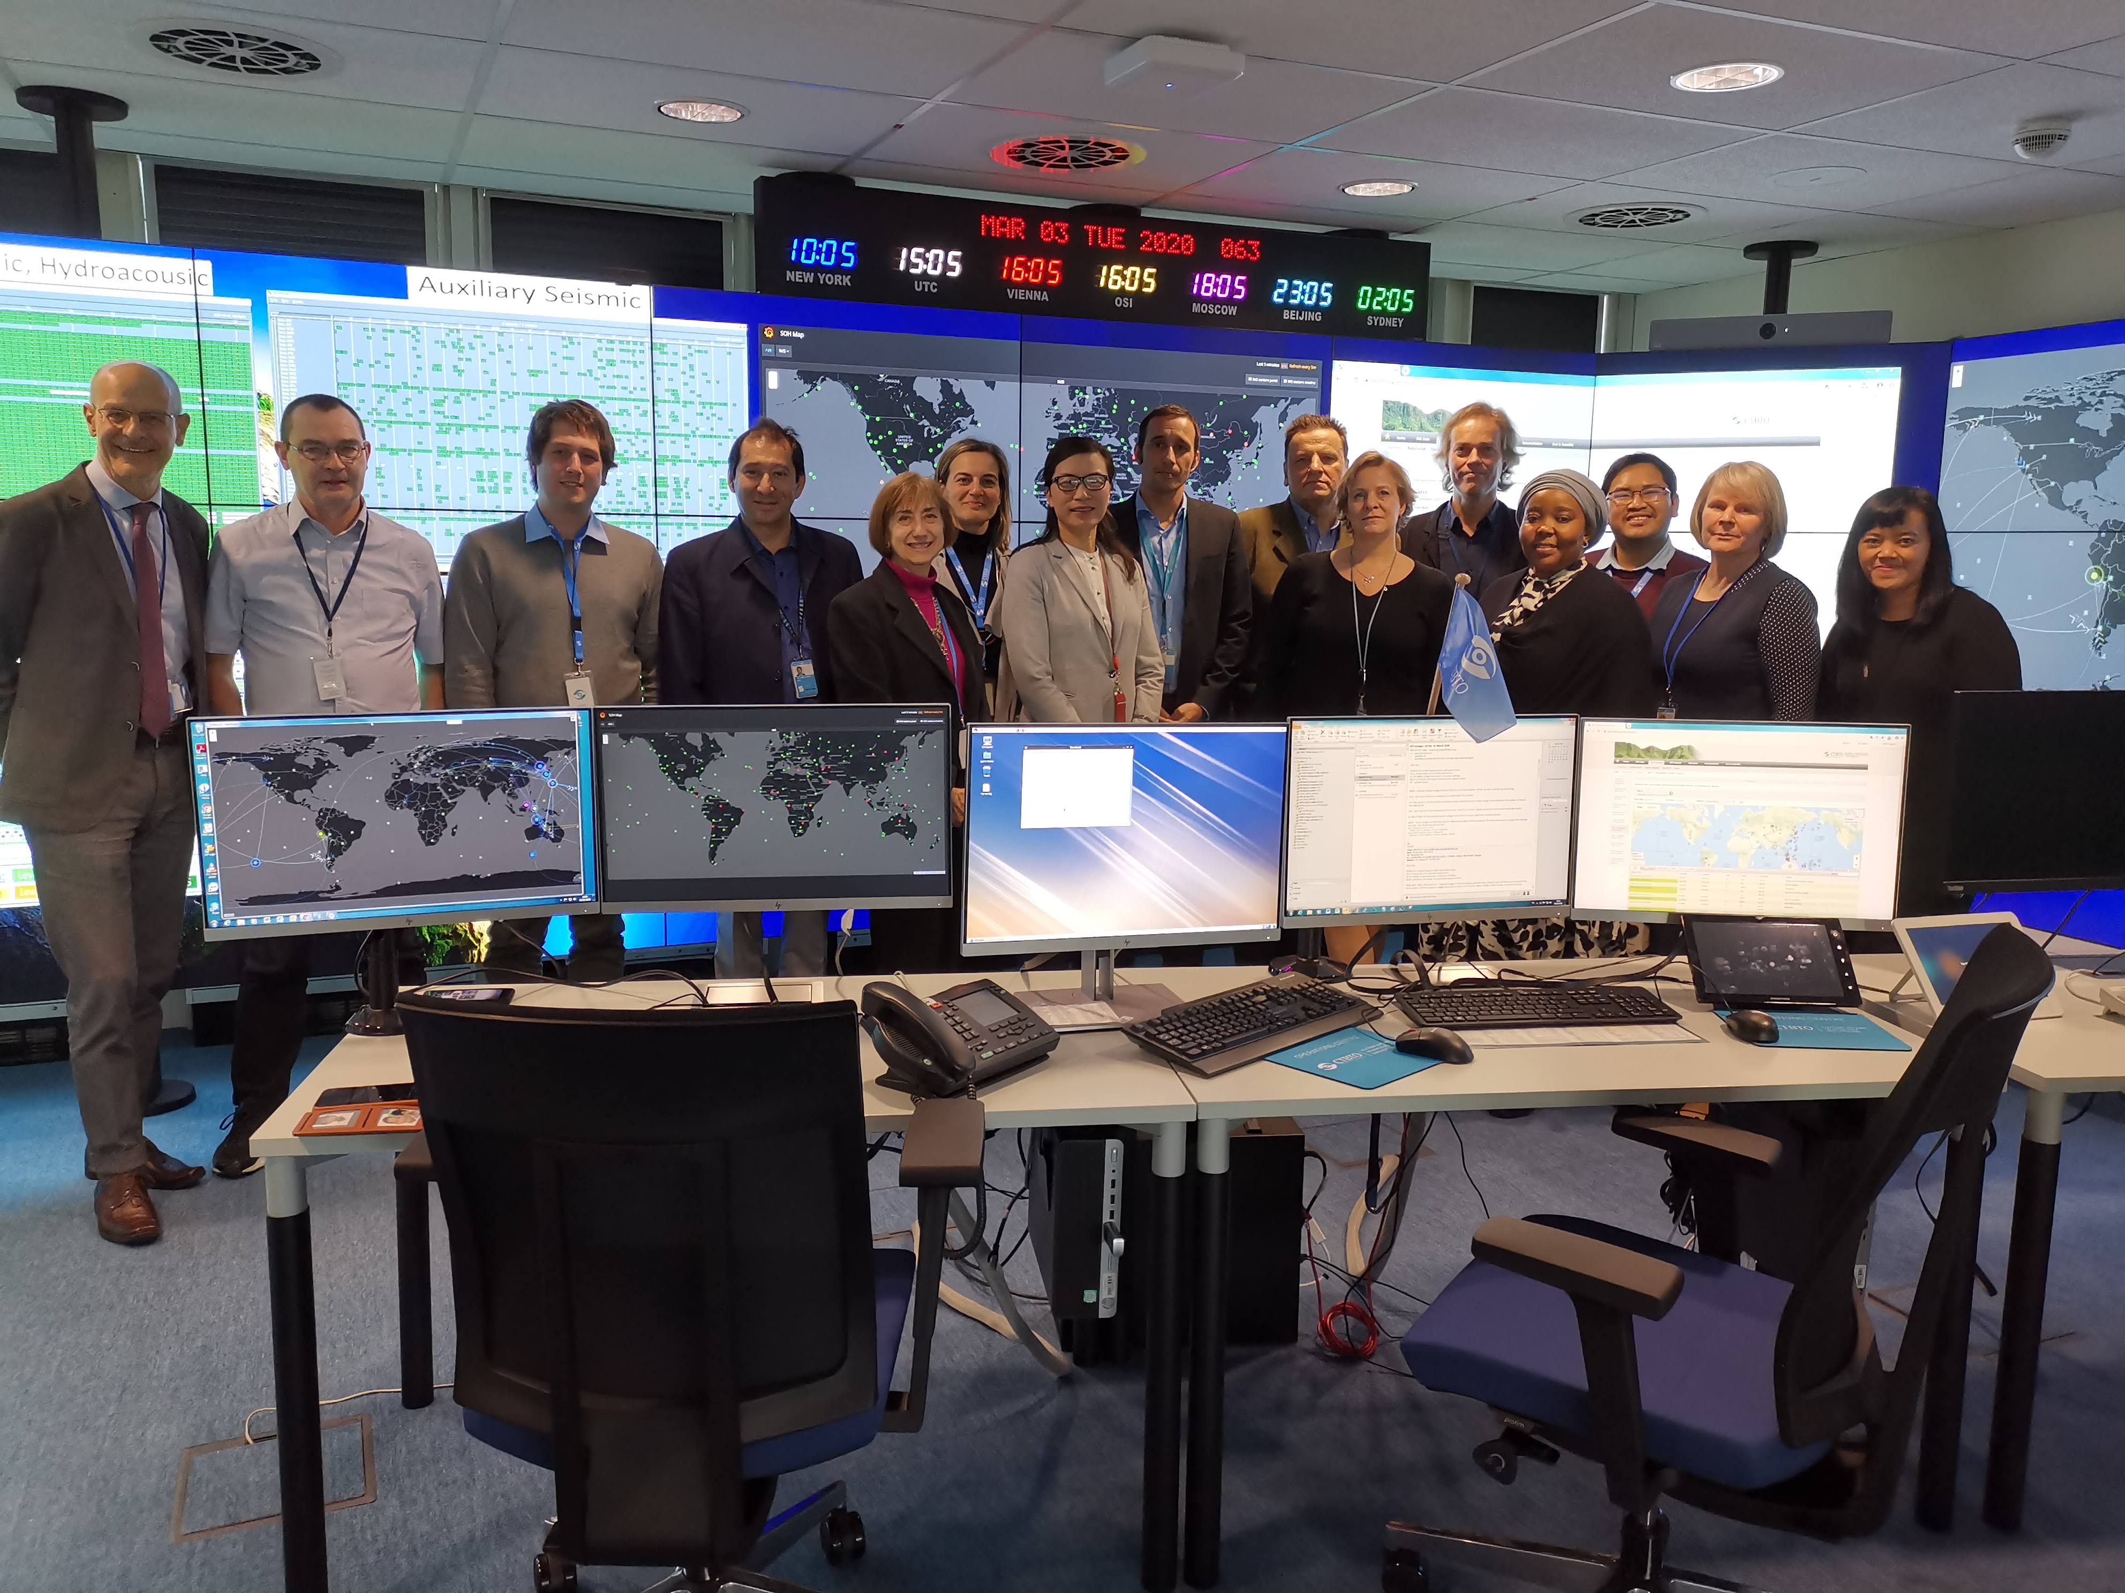
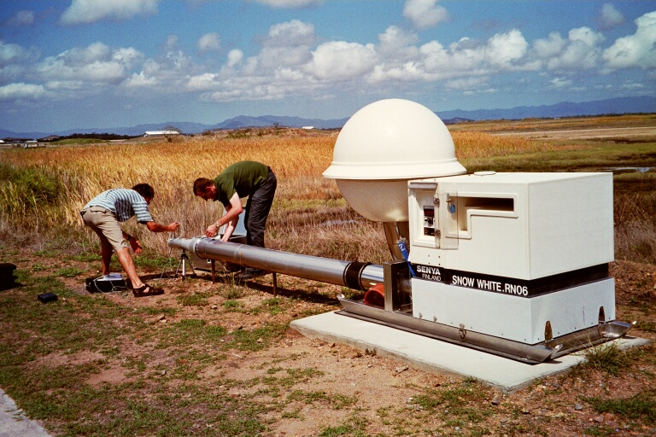
State of Health Monitoring of the IMS Network
Han*, D.; Campus, P.; Cruz, P; Ekimov, P.; Guenther, M.; Hoffmann, T. ; Malephane, H.;
Malakhova, M.; Nava, E.; Nizamska, M.; Parithusta, R.A. ; Villarreal, R.E.
Dongmei.han@ctbto.org
P4.5-333
The IDC Operations Section makes daily use of operation tools to over see and manage the Operation of the IMS network and the communications between the PTS and station operators. Some tools and their features are already available to station operators through Single-Sign-On (SSO). As part of the COVID-19 resilience enhancement, new features and functionalities are under development to facilitate station operators with notifications, monitoring, and troubleshooting of IMS station incidents and communication between PTS and station operators. Different monitoring tools, including the PTS centralized monitoring tools, the monitoring capabilities for station operators with a large number of stations, station operator tools for a single or a small number of stations, and the Station Standard Interface(SSI) at IMS stations, will complement each other. All these tools will make the monitoring of the IMS network more reliable and incident identification and resolution more efficient and thus contribute to achieve as the highest possible overall IMS network data availability, data quality, and data surety.
ABSTRACTS

Slide 3
State of Health Monitoring of the IMS Network
Han*, D.; Campus, P.; Cruz, P; Ekimov, P.; Guenther, M.; Hoffmann, T. ; Malephane, H.;
Malakhova, M.; Nava, E.; Nizamska, M.; Parithusta, R.A. ; Villarreal, R.E.
Dongmei.han@ctbto.org
P4.5-333
PTS: Supervision and Coordination of Network Operations
  Concluding agreements, arrangements, or contracts with SO;
  Coordinating operations through reporting and messaging system;
  Providing assistance as needed;
SO: Operation and Maintenance of Individual IMS Station
To ensure station is operating properly, meeting Data Availability, Data Quality, and Data Surety requirements;
  Filling the proper reports;
  Scheduling Preventive Maintenance;
  Providing timely troubleshooting;
  Conducting timely repair in case of Unscheduled data outage;
  Reporting any unauthorized access to the station facilities;
RESPONSIBILITIES

Slide 4
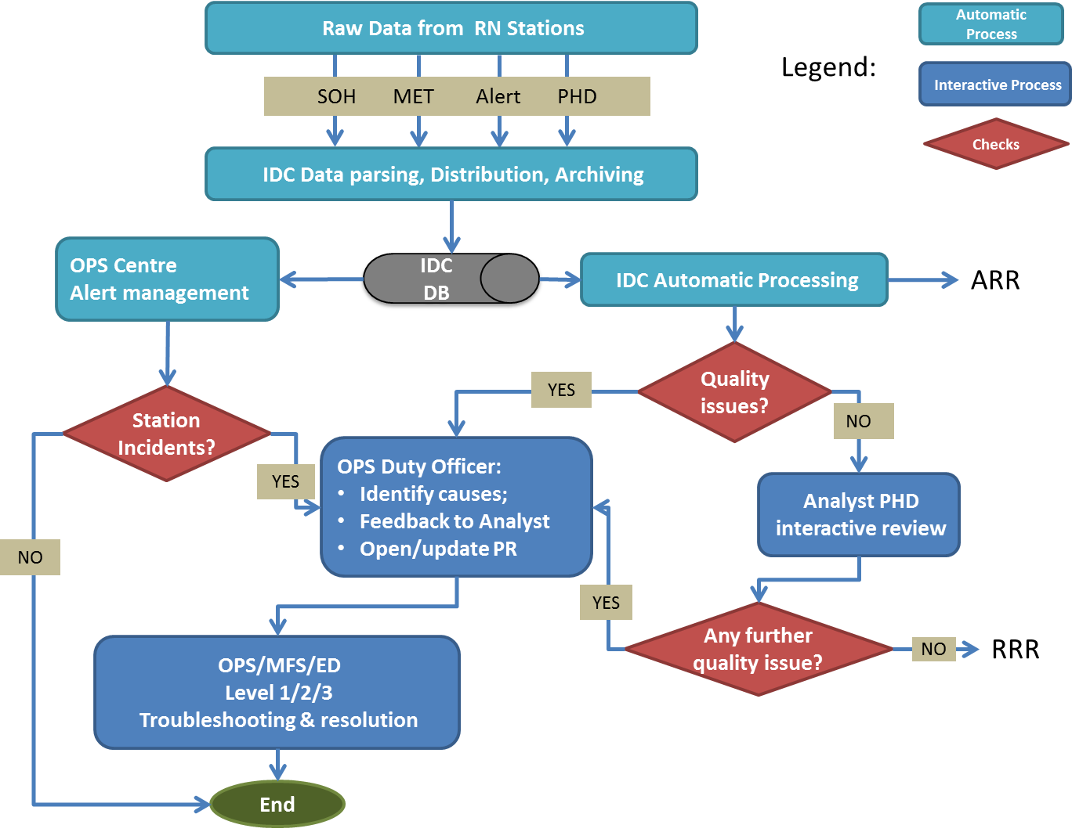
State of Health Monitoring of the IMS Network
Han*, D.; Campus, P.; Cruz, P; Ekimov, P.; Guenther, M.; Hoffmann, T. ; Malephane, H.;
Malakhova, M.; Nava, E.; Nizamska, M.; Parithusta, R.A. ; Villarreal, R.E.
Dongmei.han@ctbto.org
P4.5-333
SO: Monitoring of Individual Station
Interfaces
PTS: Monitoring Process for the RN Network
SOH Tool
IRS
DOTS
PR Tool
SOPET
RN MONITORING

Slide 5
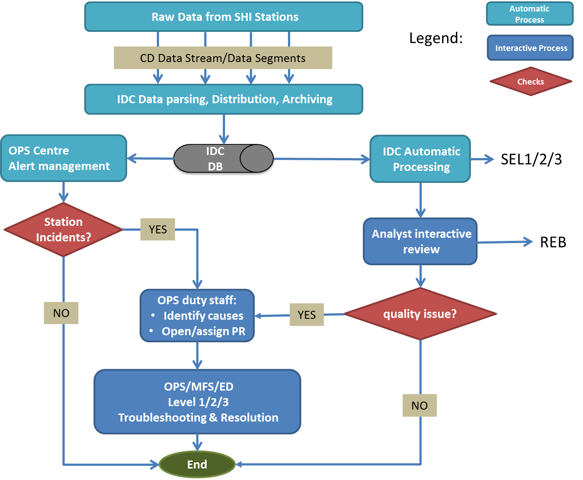
State of Health Monitoring of the IMS Network
Han*, D.; Campus, P.; Cruz, P; Ekimov, P.; Guenther, M.; Hoffmann, T. ; Malephane, H.;
Malakhova, M.; Nava, E.; Nizamska, M.; Parithusta, R.A. ; Villarreal, R.E.
Dongmei.han@ctbto.org
P4.5-333
SO: Monitoring of Individual Station
Interfaces
PTS: Monitoring Process for the SHI Network
SOH Tool
IRS
DOTS
PR Tool
SOPET
SHI MONITORING

Slide 6
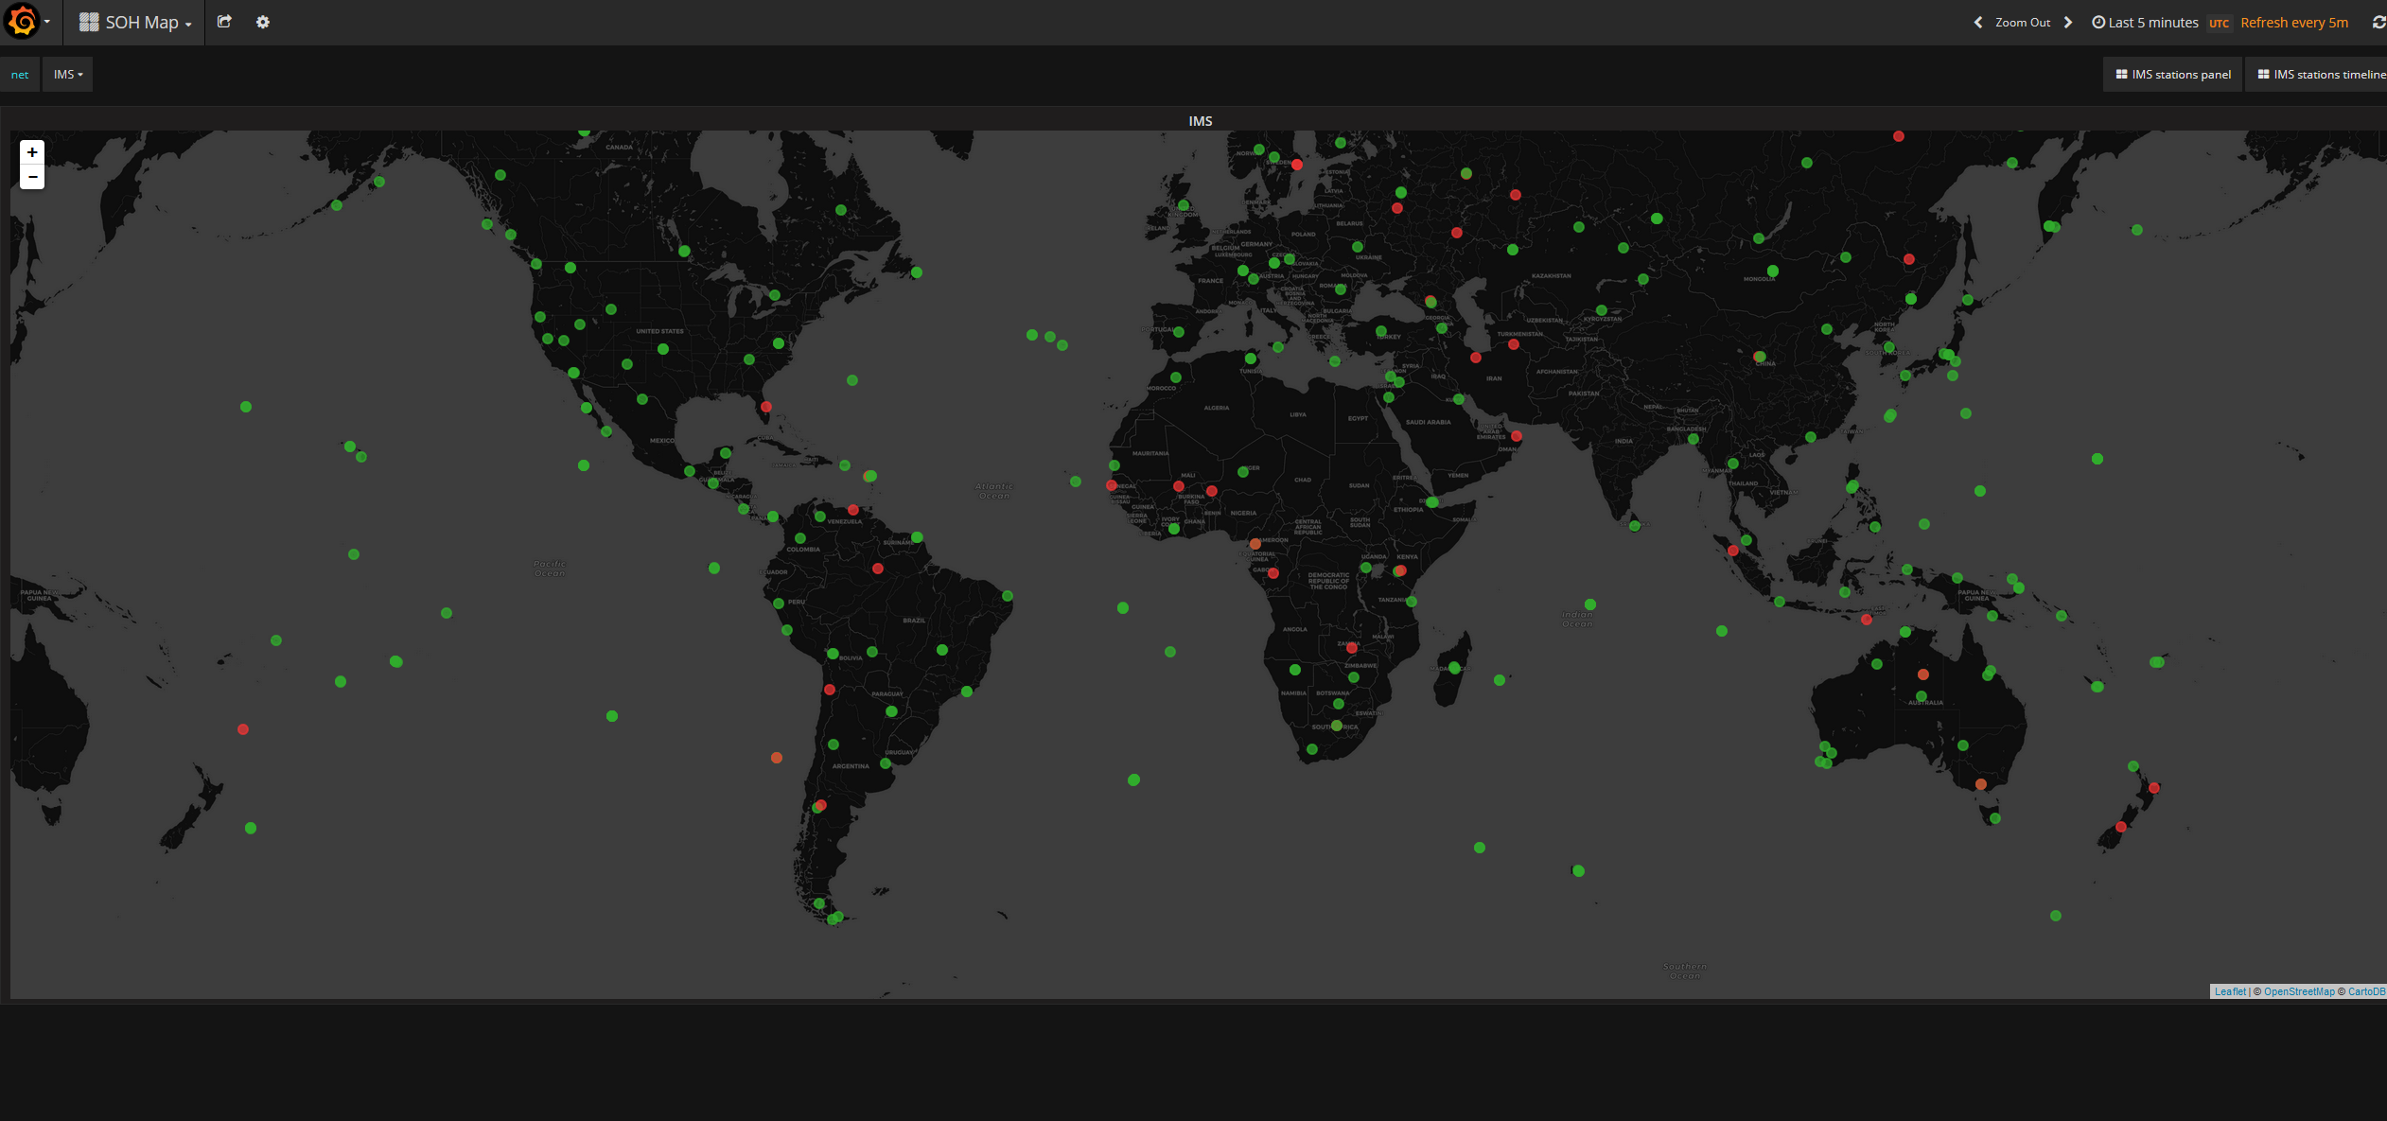
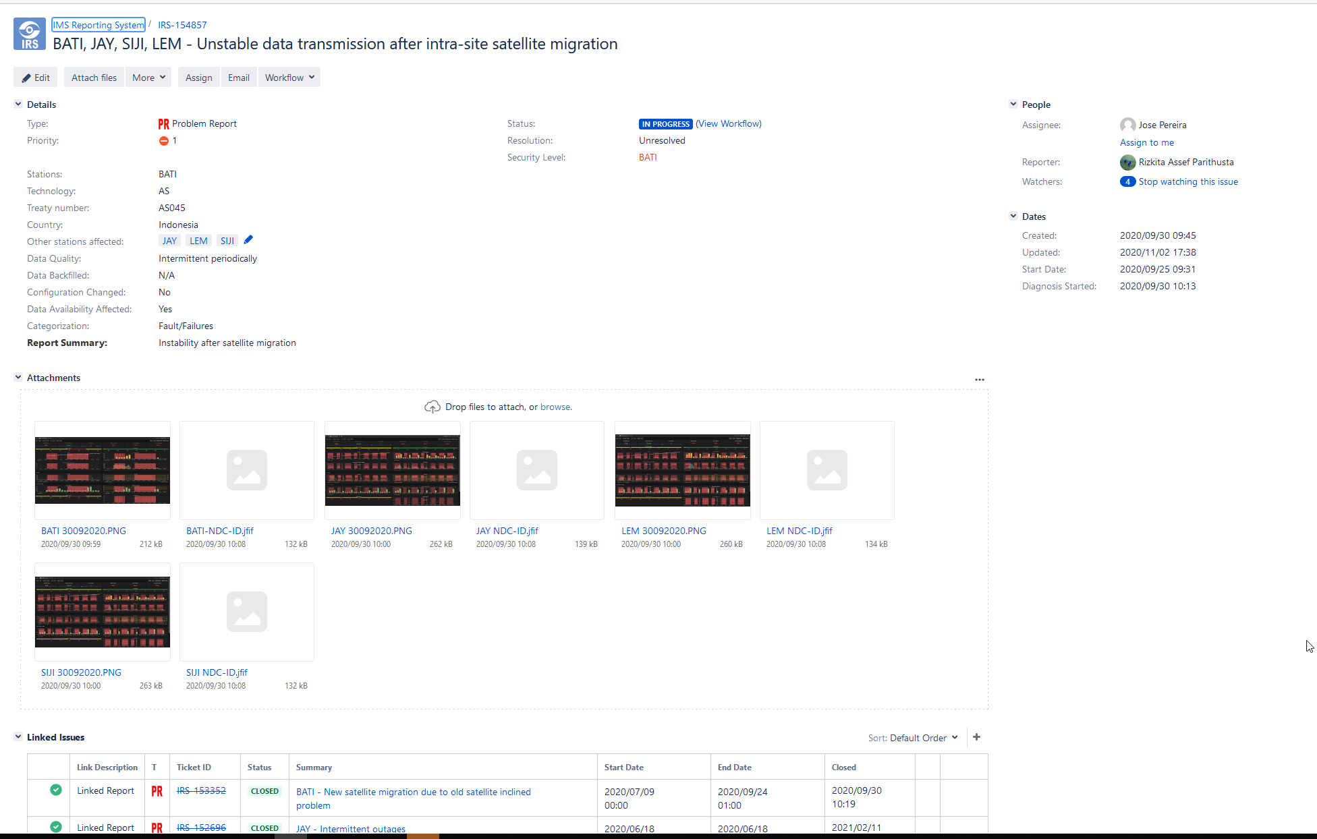
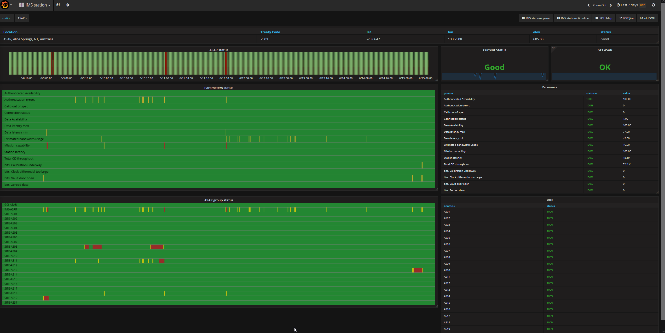
State of Health Monitoring of the IMS Network
Han*, D.; Campus, P.; Cruz, P; Ekimov, P.; Guenther, M.; Hoffmann, T. ; Malephane, H.;
Malakhova, M.; Nava, E.; Nizamska, M.; Parithusta, R.A. ; Villarreal, R.E.
Dongmei.han@ctbto.org
P4.5-333
PTS Monitoring and Communication Tools
State of Health Monitoring (SOH)
This allows the Operations Centre to view the overall state of health of the IMS network and drill-down to individual components of stations.​
IMS Reporting System – IRS
PTS TOOLS

Slide 7
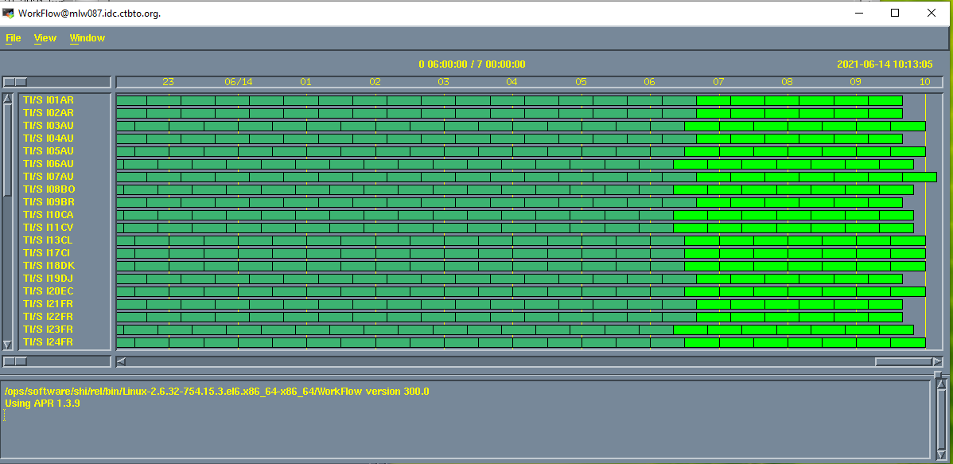
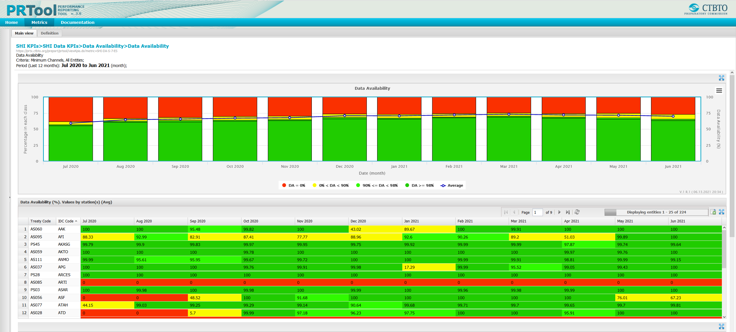
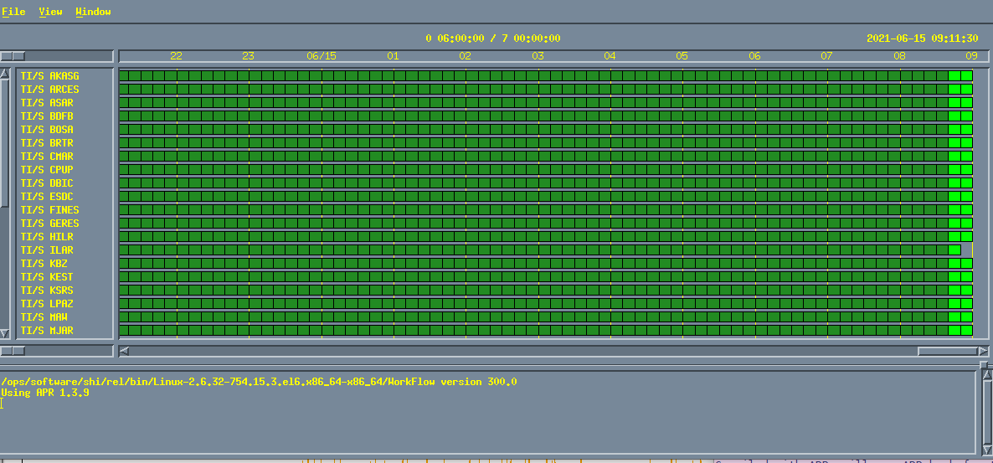
State of Health Monitoring of the IMS Network
Han*, D.; Campus, P.; Cruz, P; Ekimov, P.; Guenther, M.; Hoffmann, T. ; Malephane, H.;
Malakhova, M.; Nava, E.; Nizamska, M.; Parithusta, R.A. ; Villarreal, R.E.
Dongmei.han@ctbto.org
P4.5-333
PTS Monitoring and Communication Tools
PRTools:
The Station performance statistics over a certain time interval for a number of Key Performance Indicators (KPIs): Data Availability (%, Authenticated, Unauthenticated); Data Timeliness (%); Mission Capability (%); and Data Quality (%)(Constant values, Data gaps).
PTS TOOLS

Slide 8
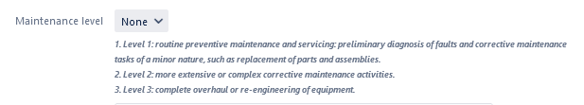
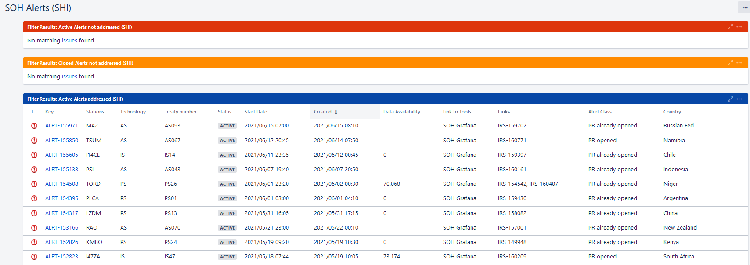
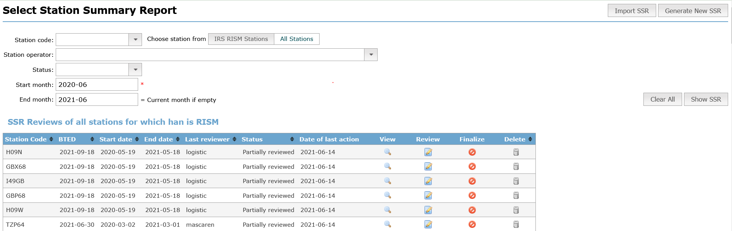
State of Health Monitoring of the IMS Network
Han*, D.; Campus, P.; Cruz, P; Ekimov, P.; Guenther, M.; Hoffmann, T. ; Malephane, H.;
Malakhova, M.; Nava, E.; Nizamska, M.; Parithusta, R.A. ; Villarreal, R.E.
Dongmei.han@ctbto.org
P4.5-333
IRS:
Maintenance Levels are introduced in accordance with IMS manual.
Other improvements made to help cross-monitoring of the overall network status.
SOH:
Alert Manager will be available to SO => facilitate SO to take proactive action
Make other features available to SO = > Allow SO to have more comprehensive overview of station status
SOPET:
Provide access to SOPET through SSO:
SO can create Operation report for all its stations in selected period.
MR: O&M plans to be available to compile MRs to facilitate submission and review of MR.
Create SSR through the interface.
Improvement to IRS
SOH Alert Management
IMPROVEMENTS
SOPET Interface for SSR

Slide 9
State of Health Monitoring of the IMS Network
Han*, D.; Campus, P.; Cruz, P; Ekimov, P.; Guenther, M.; Hoffmann, T. ; Malephane, H.;
Malakhova, M.; Nava, E.; Nizamska, M.; Parithusta, R.A. ; Villarreal, R.E.
Dongmei.han@ctbto.org
P4.5-333
Inputs from station operators are appreciated for their requirements of new features to:
  Facilitate notification, monitoring, troubleshooting of station incidents
  Enhance communication between PTS and station operators
  Create station performance report
Send recommendations to Support@ctbto.org with the subject “Inputs for monitoring tool development”
Test New Features before moving to Product Version
  Selected station operators will be contacted by PTS to test new features before publishing any new product version
  (Thanks to station operators who are willing to support this project)
WAY FORWARD

