Slide 1

Difficulties and obstacles to keeping a radionuclide station in operation in Brazil during 2020
Rócio G. dos Reis
Poster No. P4.5-542

Slide 2
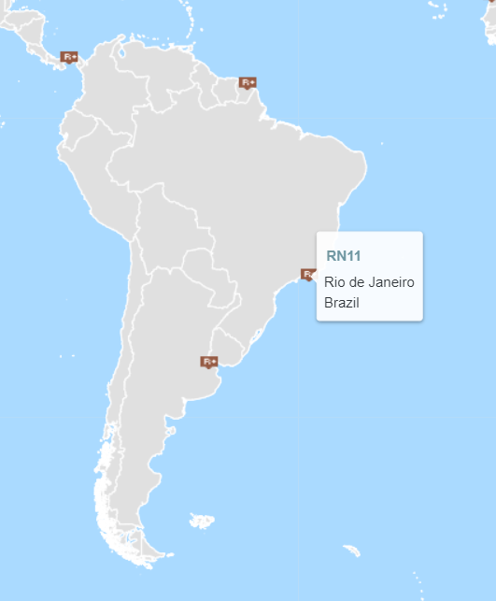
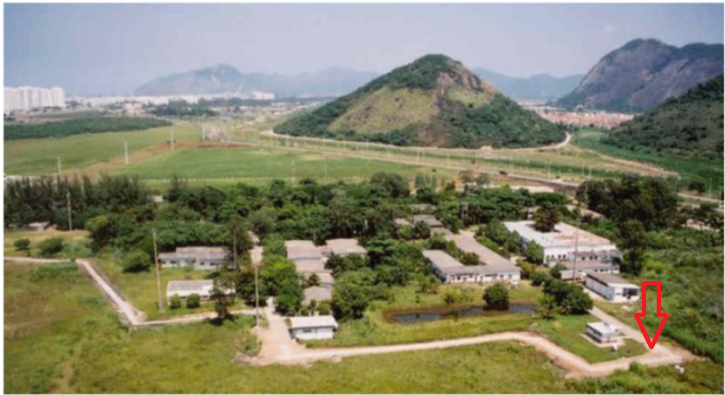
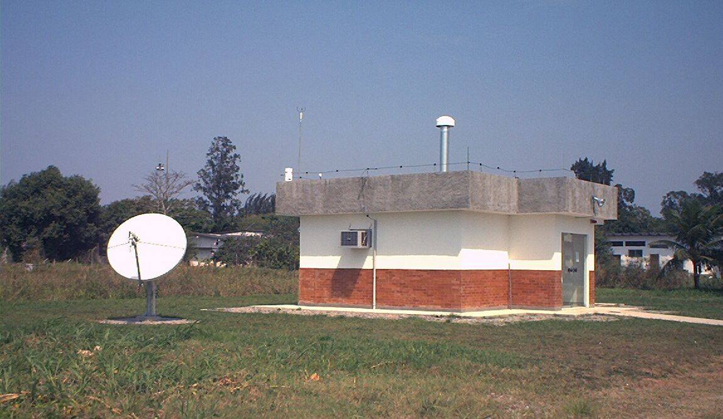
Difficulties and obstacles to keeping a radionuclide station in operation in Brazil during 2020
Rócio G. dos Reis, rocio@ird. gov.br, Institute of Radioprotection and Dosimetry
P4.5-542
Source: CTBTO.
Institute of Radioprotection and Dosimetry
RN11

Slide 3
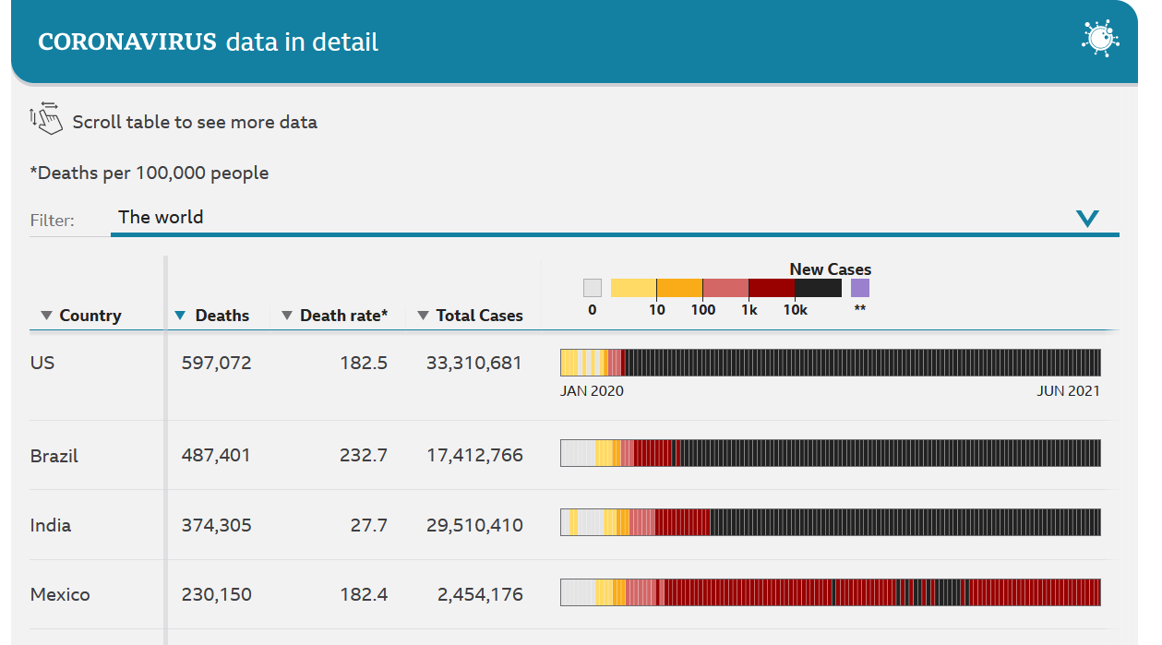
Difficulties and obstacles to keeping a radionuclide station in operation in Brazil during 2020
Rócio G. dos Reis, rocio@ird. gov.br, Institute of Radioprotection and Dosimetry
P4.5-542
The RN11 radionuclide station is located at the Institute of Radioprotection and Dosimetry, in the city of Rio de Janeiro, Brazil. The country has been severely affected by the pandemic, with millions of people infected and more than 400,000 dead. The different spheres of government sought to manage the effects of this tragic event in different ways, such as instituting rules for social engagement, remote work, blockades, among other initiatives. Many of these laws and regulations have had adverse effects on the management and functioning of the RN11 station, such as the difficulty of access of team members to the RN11 station building, or the inability to send or receive shipments and also the cancellation or postponement of technical visits to maintenance of station equipment. On the other hand, as the pandemic evolved, the team had to take measures to protect itself from the danger and at the same time try to keep the RN11 station running. An analysis of these events identifying the positive and negative points and possible opportunities for improvement are presented in this work.
ABSTRACT
Source: BBC.

Slide 4
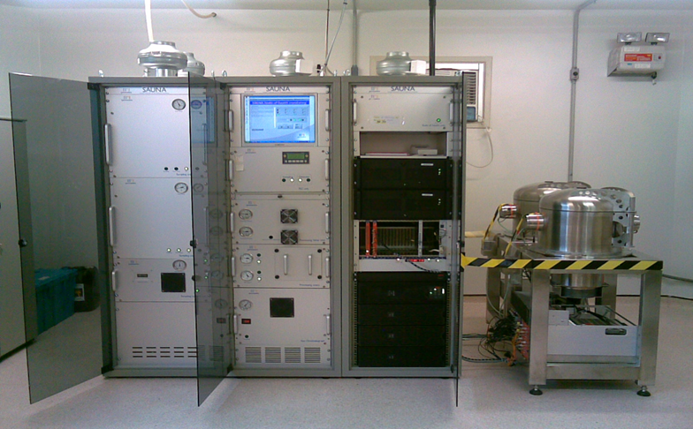
Difficulties and obstacles to keeping a radionuclide station in operation in Brazil during 2020
Rócio G. dos Reis, rocio@ird. gov.br, Institute of Radioprotection and Dosimetry
P4.5-542
The RN11 radionuclide monitoring station has two atmospheric sampling equipment, one being the Radionuclide Aerosol Sampler and Analyzer (RASA) used to detect radioactivity in particulates, the other detection equipment is the Swedish Automatic Unit for Noble Gas Acquisition (SAUNA), used in the detection of radioactive noble gases.
RN11 does not currently have a contract for post-certification activities with the CTBTO. Thus, the local staff maintain routine activities and are supported by the CTBTO. An important support offered by the CTBTO is the annual shipment of equipment and spare parts and the technical visit for preventive and corrective maintenance for RASA and SAUNA.
The pandemic started in Brazil some time after it hit Europe, especially Italy. This disease was little known in the country and in the world, as well as its destructive capacity. There were no defined protocols and procedures to deal with this emergency in public health and decisions were taken in a reactive way, as people learned, more and more, when dealing with the disease. The authorities constituted at the federal, state and municipal levels took several decisions, which could or could not affect the work of the local team and the CTBTO to keep the RN11 monitoring station in permanent operation.
INTRODUCTION
SAUNA

Slide 5
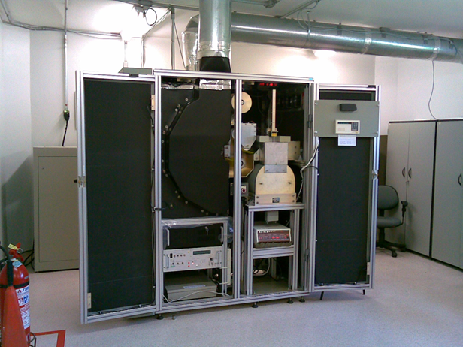
Difficulties and obstacles to keeping a radionuclide station in operation in Brazil during 2020
Rócio G. dos Reis, rocio@ird. gov.br, Institute of Radioprotection and Dosimetry
P4.5-542
As soon as the pandemic started, one of the first measures that the government decreed was that civil servants who had comorbidities or over 60 years old should work at home and other civil servants should only go to the workplace to carry out activities that it was not possible to perform by home. To access the RN11 station, it was necessary for the name to be on the Institute's daily access list. After a short period of time, the station operator was permanently added to the access list by the Institute's board for unrestricted access to the Institute at any time and day.
Another measure to curb the spread of the disease's contamination was the establishment of roadblocks in the city by the city hall. This measure did not prosper for a long time and was mainly limited to the entrances to the city. It was not necessary to get a pass to work at RN11.
Another temporary measure taken by the city to stop the contamination of the disease was to close several commercial establishments or institute different hours for their operation. Although this measure did not affect access to the RN11 station, it had some consequences, such as the closing of the post offices, which made it impossible to send samples to one of the 16 reference laboratories of the CTBTO.
RESULTS
RASA

Slide 6
Difficulties and obstacles to keeping a radionuclide station in operation in Brazil during 2020
Rócio G. dos Reis, rocio@ird. gov.br, Institute of Radioprotection and Dosimetry
P4.5-542
Probably due to the pandemic there was a lack of funds and the solution was to ask the CTBTO to bear the costs of some activities such as:
• Sending samples to the network of 16 reference laboratories;
• Maintenance of the auxiliary generator by exchanging the control unit for a new one.
Other support activities, funded by the CTBTO, that routinely took place, such as the sending of shipments with spare parts and equipment and technical visits by specialists for the maintenance of RASA and SAUNA, did not take place in 2020, due to the pandemic. This implied using the equipment for longer than normal without proper maintenance, which increased the risk of defects and malfunctions, which could lead to a stop in the monitoring carried out by the RN11 station.
On the other hand, help and support provided remotely has become more important than before the pandemic. An example of remote help was a video produced by General Dynamics to help repair an extrusion roller. This maintenance more recently.
RESULTS

Slide 7
Difficulties and obstacles to keeping a radionuclide station in operation in Brazil during 2020
Rócio G. dos Reis, rocio@ird. gov.br, Institute of Radioprotection and Dosimetry
P4.5-542
Fortunately, the RN11 station managed to maintain normal operation during the year 2020 and also in the first months of the year 2021. However, all responses to the challenges posed by the pandemic were reactive. We had no procedure or protocol to deal with the adversities and obstacles that arose. That is, in large part, this resilience to the pandemic was due to chance.
As a suggestion of this work, I believe that a study of the characteristics of the monitoring stations and the attitudes taken by the respective local teams during the pandemic could be studied to see if there were common points among those that were successful and also among those that failed to keep the stations in normal operation.
As a result of this study, we may have a proposal for measures and actions that minimize damage to the global monitoring system due to future pandemics.
CONCLUSIONS

