Slide 1
Ensuring the operation of Russian IMS stations
in the context of a pandemic of COVID-19
Ilya Mishenin
Poster No. P4.5-342
Vienna Institute for CTBT Science and Technology

Slide 2
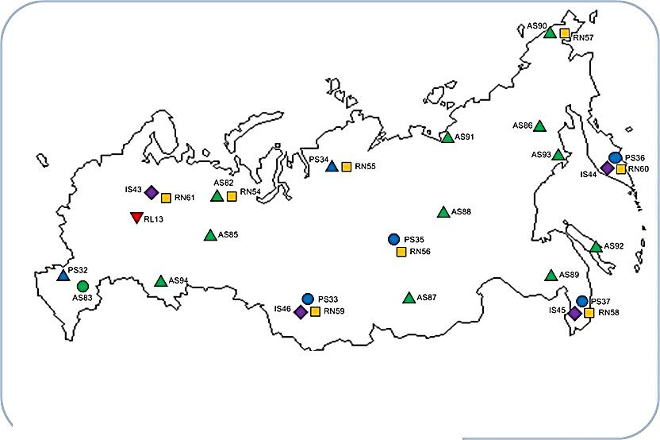
Russian segment of IMS Stations
P4.5-342
The SMS ensures the operation of more than 20 Russian IMS stations.

Slide 3
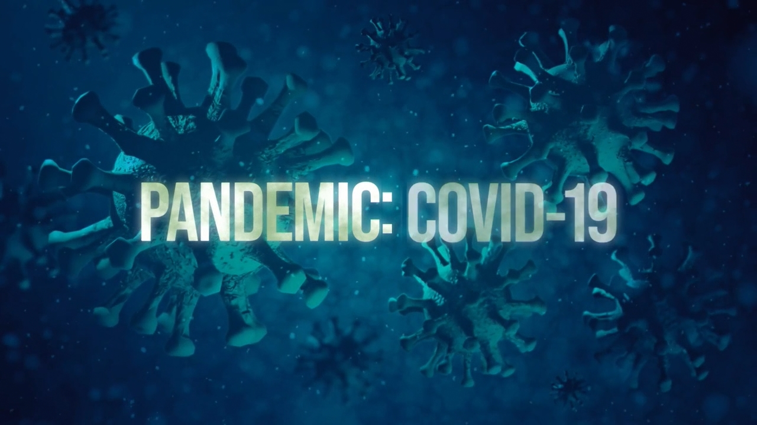
Ensuring the operation of Russian IMS stations
in the context of a pandemic of COVID-19
P4.5-342
For more than a year, the world community has been continuously fighting the new COVID-19 virus. The pandemic affected many people, intervened in all areas of the economy and industries without exception. Despite the widespread changes in global processes, the task of maintaining the verification regime not only does not become less relevant, but on the contrary requires the consolidation of additional forces.
ABSTRACT

Slide 4
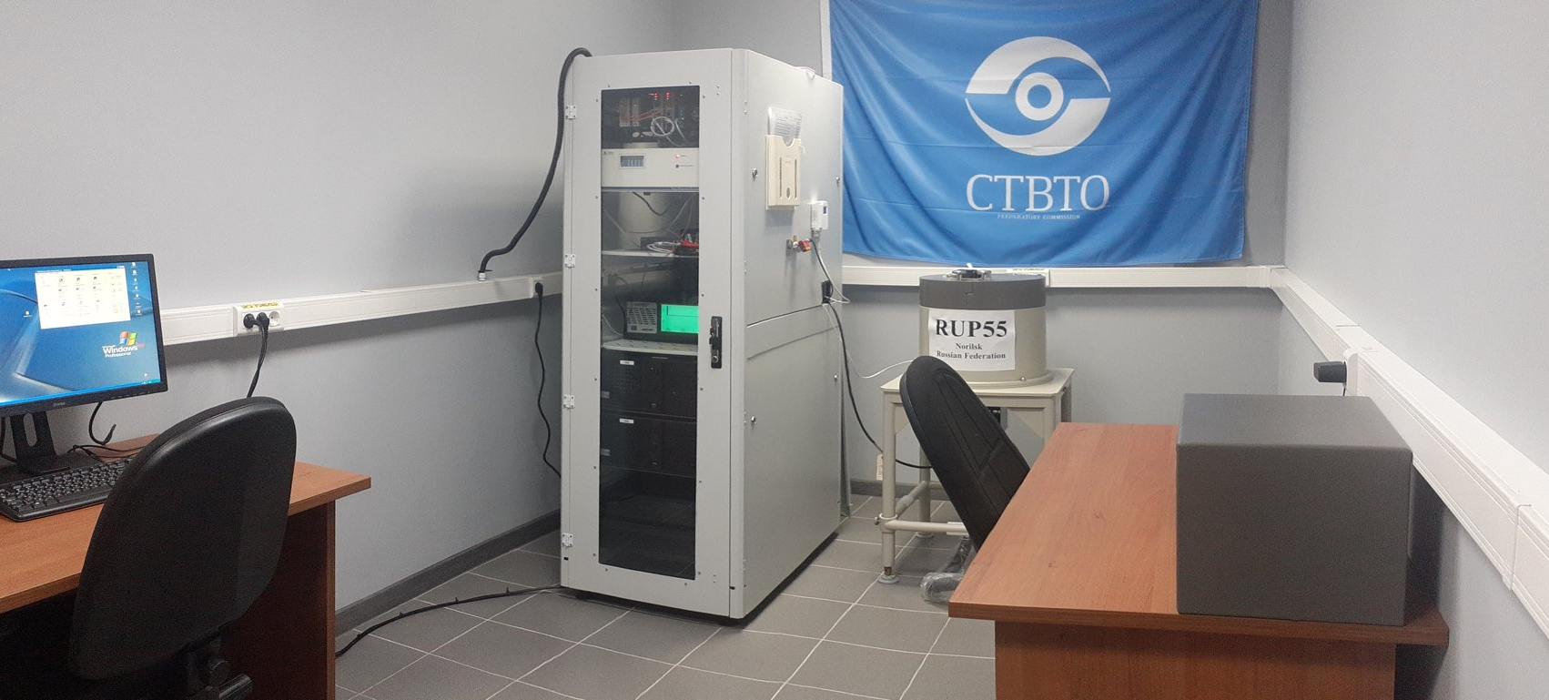
Ensuring the operation of Russian IMS stations
in the context of a pandemic of COVID-19
P4.5-342
1. Ensuring the operation of Russian IMS stations
in the context of a pandemic of COVID-19.
2. Radionuclide monitoring station RN55 (Norilsk) certification.
INTRODUCTION

Slide 5
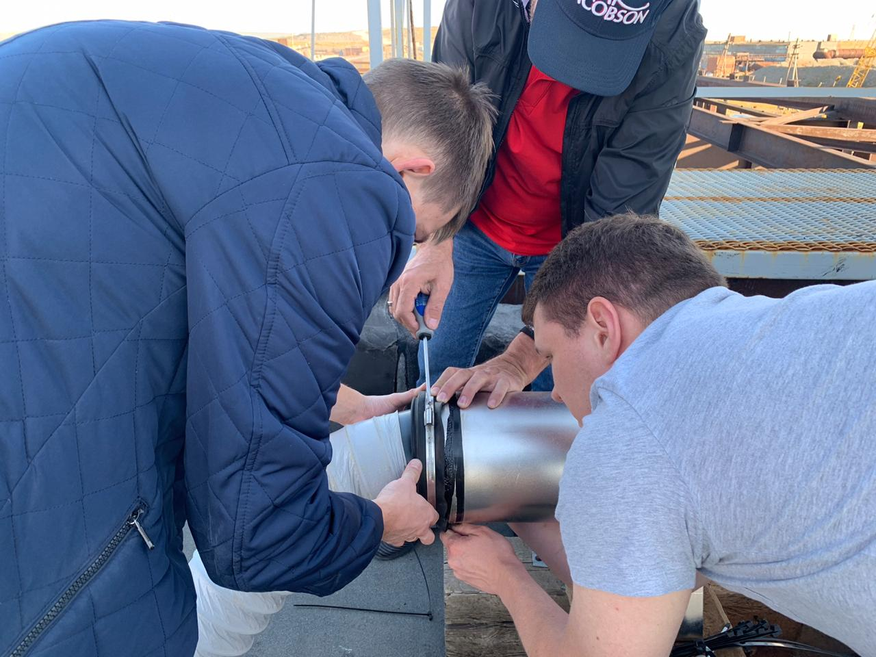
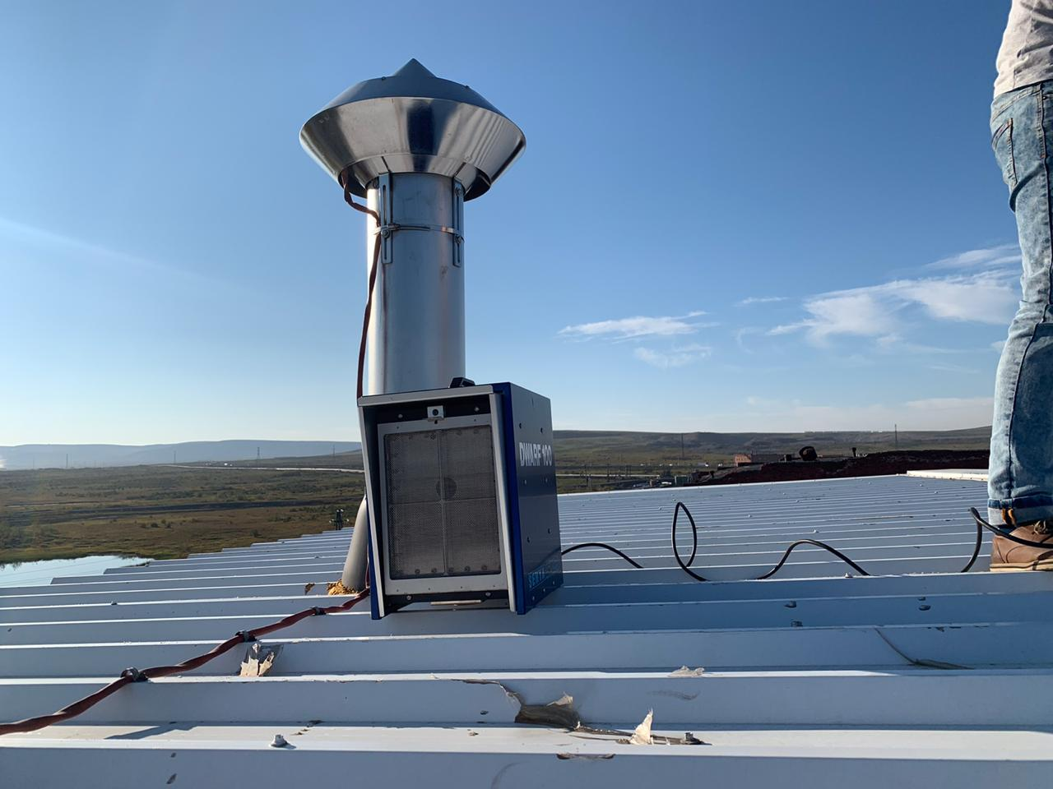
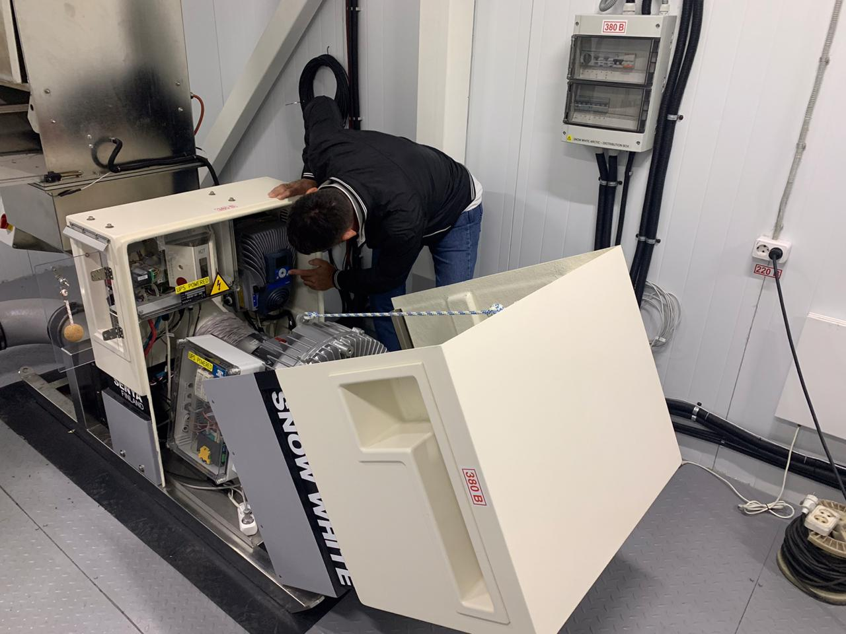
Ensuring the operation of Russian IMS stations
in the context of a pandemic of COVID-19
P4.5-342
Control
Monitoring
Knowledge
METHODS

Slide 6
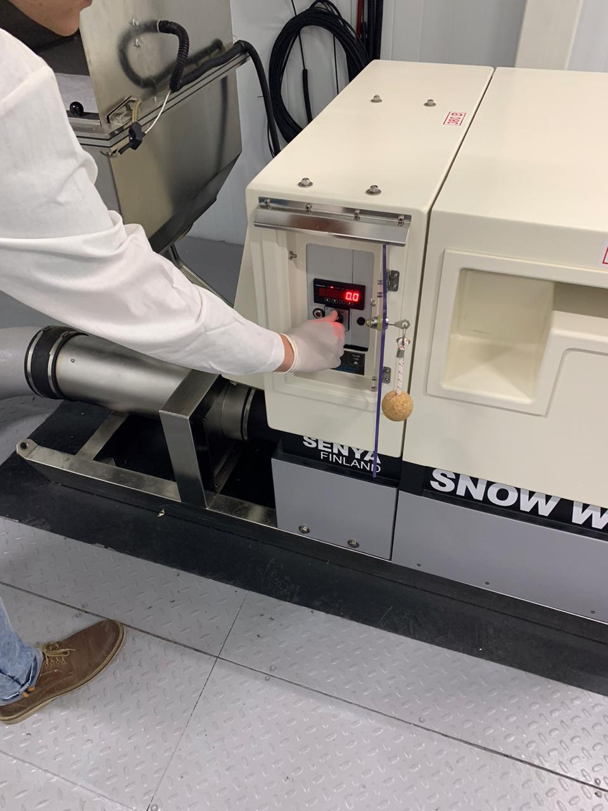
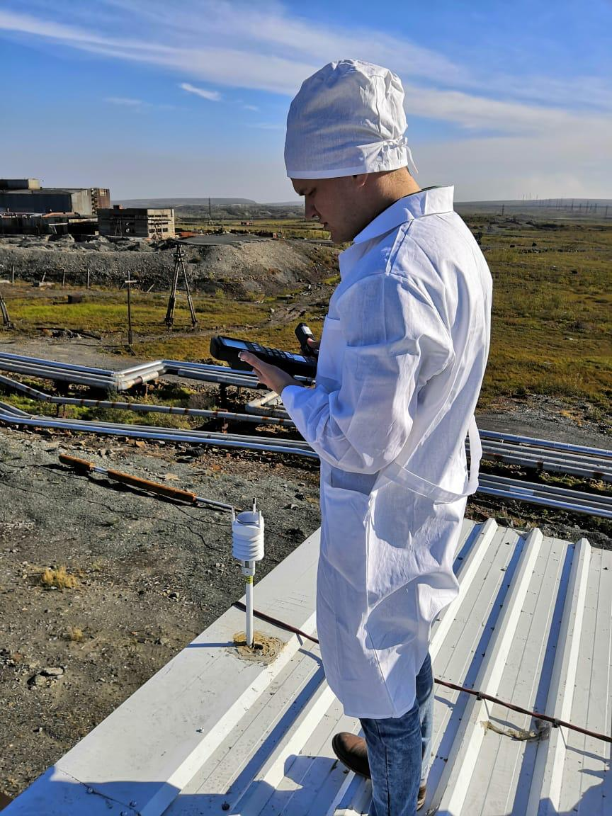
Ensuring the operation of Russian IMS stations
in the context of a pandemic of COVID-19
P4.5-342
1. Data availability from Russian segment of IMS stations was above 97%
2. Radionuclide monitoring station RN55 (Norilsk) was certified on 9 October 2020.
RESULTS

Slide 7
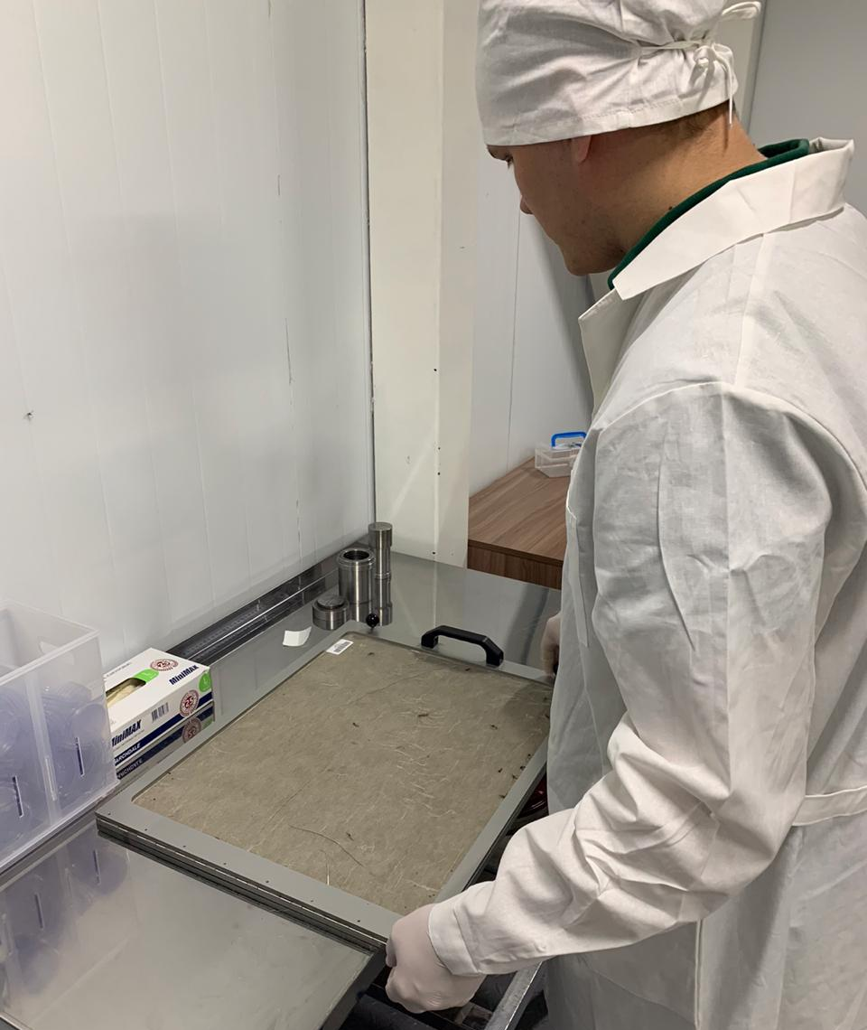
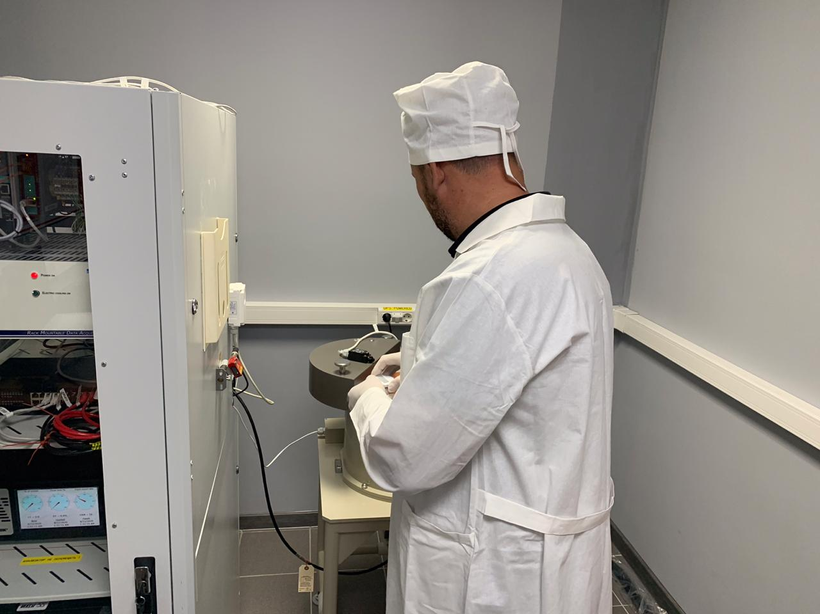
Ensuring the operation of Russian IMS stations
in the context of a pandemic of COVID-19
P4.5-342
The pandemic affected many people, intervened in all areas of the economy and industries, but In 2021 the specialists of the Special monitoring service continue ensuring the operation of an equipment of IMS stations in the context of a pandemic of COVID-19.
CONCLUSIONS

