Slide 1
Operation of seismic, infrasound and hydro-acoustic stations in Australia during the COVID-19 Pandemic.
Craig Bugden and Hugh Glanville

Slide 2
Introduction
Robust station design, good working relationships with local operators, remote monitoring and access to station equipment are key factors that allowed Geoscience Australia (GA) to continue operating CTBTO stations in Australia and Antarctica with minimal downtime during the COVID-19 pandemic.
COVID-19 Impacts
Travel restrictions within Australia due to the pandemic resulted in station maintenance only undertaken for one out of five Australian stations between December 2019 and November 2020. The COVID-19 situation in Australia has settled down a lot in 2021, but we are still experiencing outbreaks, state border closures and quarantine/isolation enforcements.

Slide 3
Australian Travel Restrictions
The Australian travel restrictions include the closure of our international border to all but essential travel and state borders being closed and opened throughout the pandemic. This has had a number of impacts:
CTBTO staff haven’t been able to travel to Australia to work on station upgrades;
the closed international boarder and ongoing uncertainty of state borders has meant more Australians are travelling within Australia and within their home states;
within Australia it has been difficult to book accommodation and hire vehicles to conduct maintenance visits, and
the pandemic has also impacted the movement of cargo to and from Australia, as well as within Australia.
These factors are still impacting our ability to conduct maintenance visits.

Slide 4
Impact to CTBT Stations
Australian CTBT stations have performed very well during the COVID-19 shutdowns and restrictions.
However we did encounter problems with elements at an Infrasound array and an issue at the Hydroacoustic station. Due to the previously mentioned restrictions, we weren’t able to visit the stations to investigate and resolve the issues.
We have had to use the tools available to us to remotely diagnose and find the issues.

Slide 5
Remote Troubleshooting
With the ability to monitor station performance remotely to identify outages and issues, and remotely access station equipment to undertake root cause analysis, in most cases we have been able to resolve critical problems at stations. Tools such as Grafana, Nagios, IRIS Mustang and GA data monitoring web pages, have allowed us to keep track of station performance and operation. The ability to remotely log into equipment, from workstations, communication devices, power systems and digitisers, at stations enabled fault finding and narrowing down of where issues have occurred.
We were able to engage with local operators nearby stations with knowledge of the equipment and systems, who could assist with equipment exchange and perform tests. Having these resources available has been critical to maintaining station operation within travel restrictions.

Slide 6
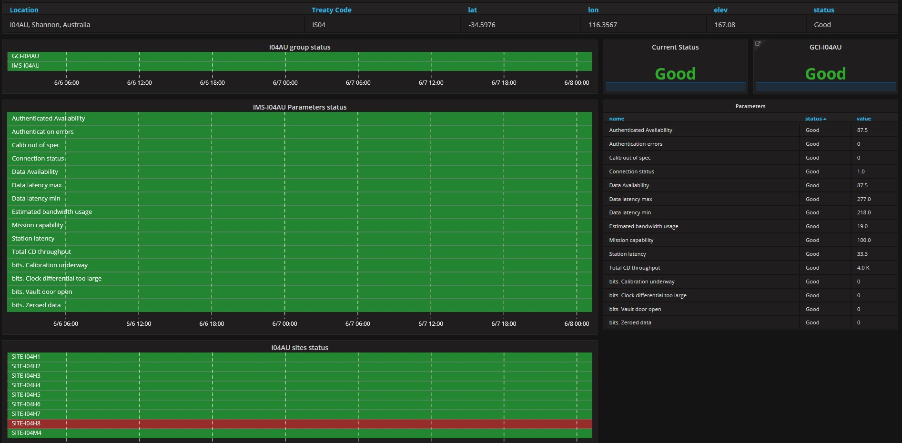
Grafana

Slide 7
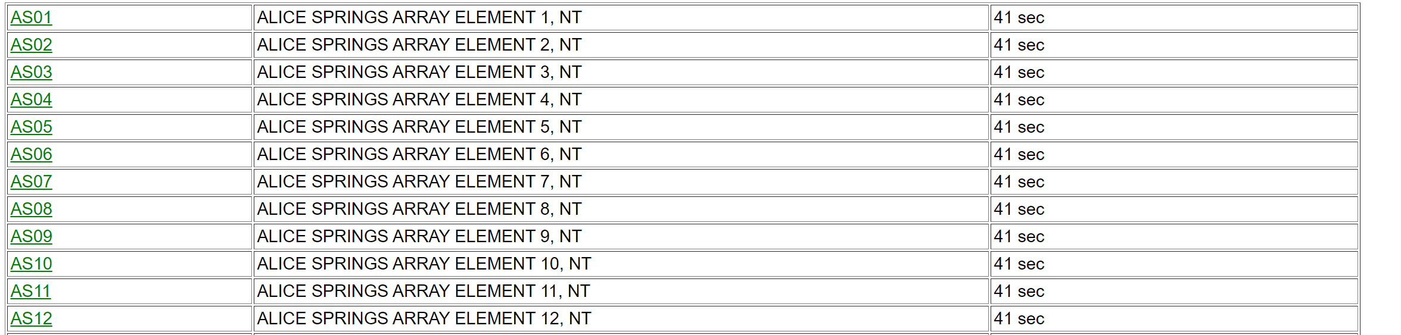
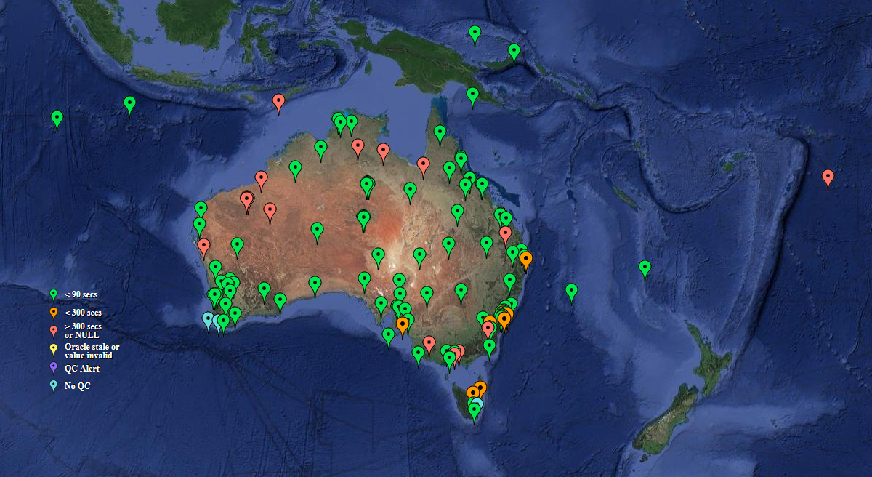
GA monitoring of data sources

Slide 8
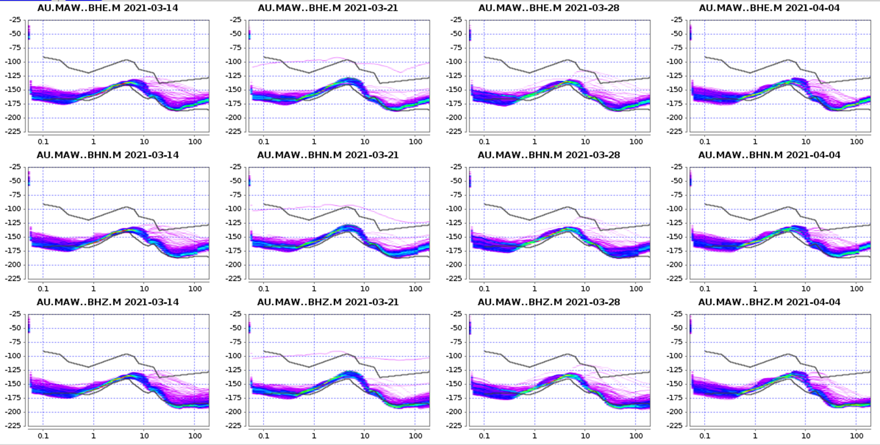
Automated display of IRIS Mustang toolkit Power Spectral Density (PSD) plots to monitor seismic station channel health.

Slide 9
IS06 remote troubleshooting
IS06 suffered from a few issues during the COVID-19 restrictions: a failed power supply at H1 and a failed fibre-optic modem at H7. The element at H1 with the power supply issue required a new power supply, which due to a previous failure we have back in our main office to fix. Using monitoring systems and assistance from the local operator, we were able to identify the outages at H7, troubleshoot and determine the cause and return the element to operation. The troubleshooting involved the local operator going to site a number of times to test various pieces of equipment and take photos. Due to the lack of communications on Cocos Island, the local operator had to the return to his office to send through the information. Through testing power and communication systems at the element and the CF, a faulty fibre-optic modem at the element was found to be the cause of the outage. The local operator replaced the modem with a spare, returning the element to service.

Slide 10
HA01 remote troubleshooting
HA01 also experienced issues with the station DDFI computer, which caused an outage of data from the station. With the Western Australian state border closures making travel from Eastern Australia extremely difficult it was important to work out a way to restore the station without the need for travel. Information and diagnostics was shared between the local operator, GA, CTBTO and L3-Maripro. This enabled L3-Maripro and CTBTO to develop a set of instructions for the local operator to follow. Using over the phone assistance from GA we were able to guide the local operator through the steps of the instructions and restore the data collection and the station to operating status.
Grounds Maintenance
The absence of regular maintenance visits has meant issues like vegetation clearing haven’t been conducted and vegetation is overgrowing some of the infrasound elements. We expect to find other maintenance issues that will need to be addressed as we return to routine maintenance visits.

Slide 11
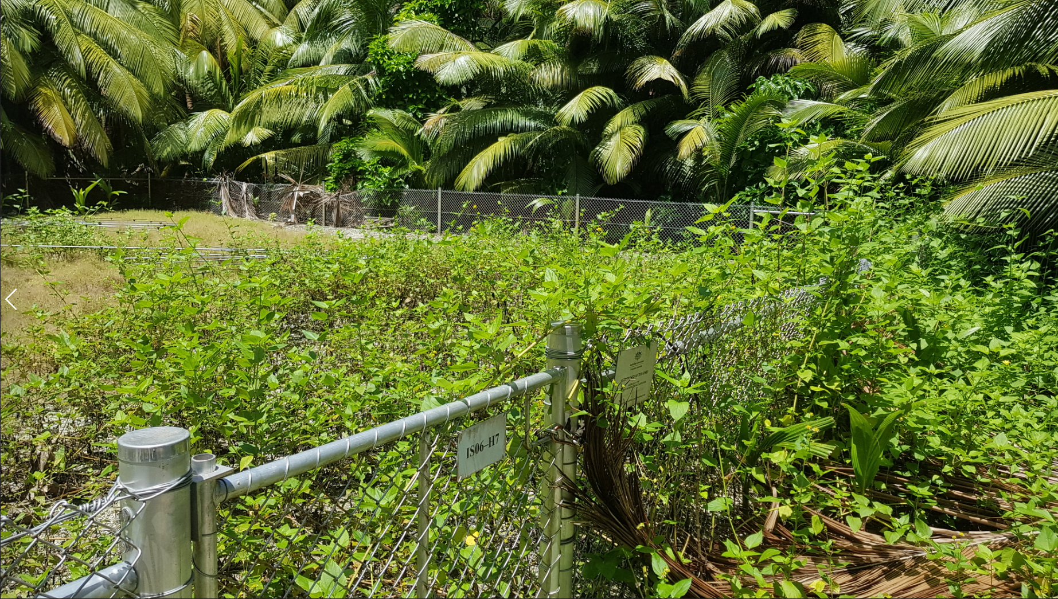
Element H7 at IS06 – overgrowth caused by lack of maintenance visits

Slide 12
Ongoing Efforts
With some travel restrictions lifting in Australia we are now able to reinstate semi-regular maintenance visits of stations, although continuing outbreaks of COVID-19 in the community have ongoing impacts to travel.
The compounding effects of minimal maintenance have created a backlog of maintenance and rectification works. Additionally, efforts in site upgrade and recapitalisation works have been delayed, further adding to a large work program over the coming years.
Understanding, flexibility and support from CTBTO in managing delays to these maintenance visits and works programs has enabled forward planning to adapt to the ever changing conditions.

Slide 13
References
Geoscience Australia’s Network Monitoring: http://www.ga.gov.au/auntie/stn_html.stn_ffp?layerid=COMMS1
Western Australia’s controlled border: https://www.wa.gov.au/organisation/covid-communications/covid-19-coronavirus-controlled-border
CTBTO state of health Grafana page for AU network: https://soh.ctbto.org/soh2/dashboard/db/ims-stations-panel?orgId=2&var-country=AU&var-tech=All&var-station=All
IRIS mustang noise pdf browser: http://services.iris.edu/mustang/noise-pdf-browser/1/gallery?target=AU.MAW.*.BH?.M&interval=week

