Slide 1
Knowledge Transfer Processes: Lessons learned from
an application in the OPCW
Ms GALINDO Marta, Ms CONSTANT Marine, Mr HAKOPOV, Zaven, Mr HASSEN, Imededdine
Knowledge Management Team, OPCW, The Hague
P5.1-460

Slide 2



Knowledge Transfer Processes: Lessons learned from
an application in the OPCW
Ms Marta GALINDO, Ms CONSTANT, Mr HAKOPOV, Zaven, Mr HASSEN, Imededdine
Knowledge Management Team, OPCW , The Hague
P5.1-460
The OPCW Technical Secretariat (TS) is implementing a Continuous Knowledge Management (CKM) strategy to remain the global repository of knowledge and expertise in its core business areas, ensuring continuity of its knowledge base to maintain the OPCW fit for its purpose in the future, as mandated by its Policy Making Organs.
The Knowledge Management Team (KMT) among its activities is running three different processes in the TS to ensure retention of the core knowledge, in particular when professional staff are departing. This poster details the three methodologies:
and presents the results obtained during their implementation, and conclusions for knowledge transfer processes at organizations with high staff mobility.
INTRODUCTION
1. Filling a document called Knowledge Transfer Annex by every staff as defined in an internal Administrative Directive; | 2. Leaving interviews – retention of core knowledge from departing staff | 3. Knowledge Transfer sessions

Slide 3
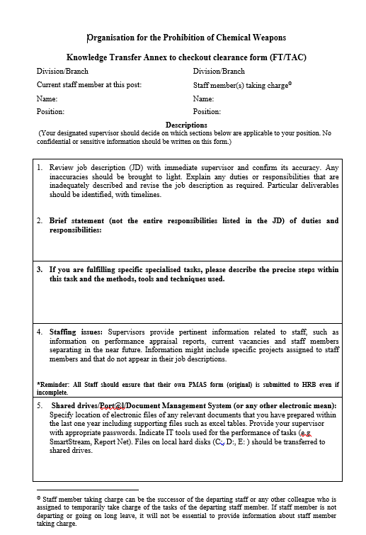
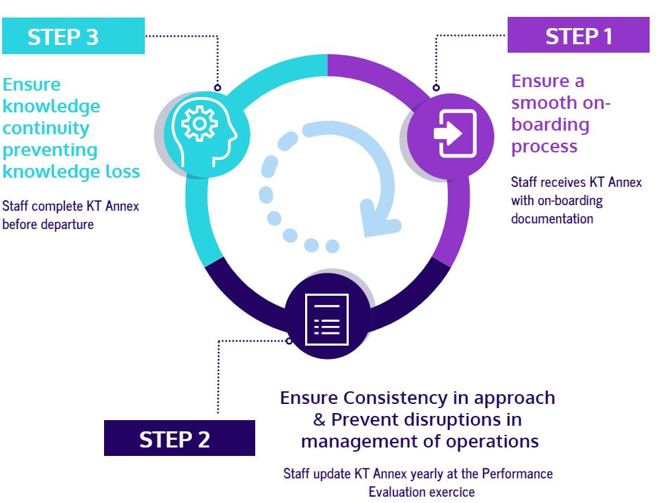
Knowledge Transfer Processes: Lessons learned from
an application in the OPCW
Ms Marta GALINDO, Ms CONSTANT, Mr HAKOPOV, Zaven, Mr HASSEN, Imededdine
Knowledge Management Team, OPCW , The Hague
P5.1-460
1. The Knowledge Transfer Annex Form
AD/ADM/28 Knowledge Transfer Annex
METHODS
  KT Annex knowledge transfer cycle

Slide 4
Knowledge Transfer Processes: Lessons learned from
an application in the OPCW
Ms Marta GALINDO, Ms CONSTANT, Mr HAKOPOV, Zaven, Mr HASSEN, Imededdine
Knowledge Management Team, OPCW , The Hague
P5.1-460
1.1 Knowledge Transfer (KT) Annex of the internal Adminstrative Directive
Evaluation of the KT Annex process in one division of the Technical Secretariat through:
    A review of the KT Annex process during the 2019 Performance Evaluation exercise
    A divisional survey on the use of the KT Annex in May 2020
  Knowledge transfer process using only the KT annex does not fulfil completely objectives such us speeding up the on-boarding learning curve or providing continuity of the tasks.
        Onboarding: not all staff received the KT Annex from their predecessor in the post.
        Continuous knowledge transfer: there are cases where the transfer document is not kept up to date
        Access to the knowledge: while most staff have access to their peers’ KT Annexes, they did not always refer to that information during their work.
  Documentation of the staff unique tasks is identified as the most important area of the KT Annex
        Most of the division staff documented their unique tasks and made them accessible to their alternates but only half of the alternates received the necessary documentation to perform the job.
  KT Annex needs add two new sections;
        Participation in cross divisional groups and mandatory trainings for the post.
RESULTS
*The views expressed in this poster are those of the authors and do not necessarily represent the views of the OPCW

Slide 5
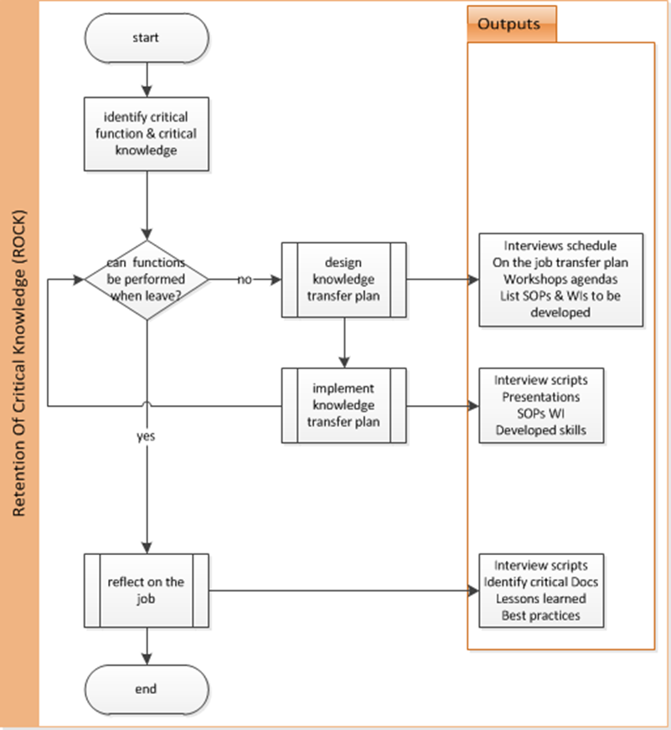
Knowledge Transfer Processes: Lessons learned from
an application in the OPCW
Ms Marta GALINDO, Ms CONSTANT, Mr HAKOPOV, Zaven, Mr HASSEN, Imededdine
Knowledge Management Team, OPCW , The Hague
P5.1-460
  2. Leaving Interviews - Retention of Core Knowledge (ROCK)
Process | Identification of expert core functions | Design knowledge transfer plan | Implement Knowledge transfer plan | Reflect on the job
Inputs | Interview incumbent Interview line manger Job description KT Annex | Mapped incumbent functions Documented SOPs and Wis | Interview scheduled On the job transfer plan New SOPs planned, Presentations scheduled, Workshop schedule | Incumbent expertise
Participants | Incumbent Facilitator, KM Champion Line Manager | Facilitator, KM Champion Incumbent | Incumbent Experts Facilitator, KM Champion | Incumbent Experts Facilitator, KM Champion
Outputs | Mapped incumbent functions | Interview scheduled On the job transfer plan New SOPs, presentations, reports Workshop schedule | Reports, Presentations, SOPs, WIs, Trained staff | LLs BPs
METHODS

Slide 6
Knowledge Transfer Processes: Lessons learned from
an application in the OPCW
Ms Marta GALINDO, Ms CONSTANT, Mr HAKOPOV, Zaven, Mr HASSEN, Imededdine
Knowledge Management Team, OPCW , The Hague
P5.1-460
  2.1. Leaving Interviews - Retention of Core Knowledge (ROCK)
Since the end of 2017 the Technical Secretariat has performed 25+ leaving interview processes; as results new knowledge products were created: SOPs and WIs, workshops, presentations, training, libraries as project repositories, Lessons Learned, Best Practices and areas for improvement identified in reports.
The aim for leaving interviews process is not to gather all separating staff members knowledge, but to identify the core knowledge necessary to perform their functions. This identification is a collaborative exercise between the line manager and the incumbent guided by the facilitator, and essential for the success of the exercise.
Every leaving interviews process is unique and is defined by the separating staff member functions, stakeholders of his/her work, and potentially the process of recruiting for the position.
The results of the exercise are presented to the line manager to identify possible areas for improvement and prioritize their implementation plan as well as include best practices and lessons learned in the operational procedures.
The minimum timeline to perform a knowledge transfer based on this method is six months, whereas operationally there are cases where this timeline had to be compressed.
RESULTS

Slide 7
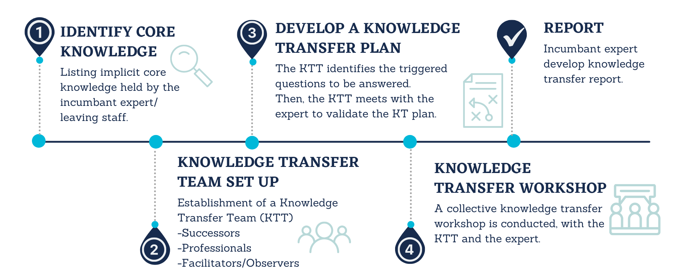
Knowledge Transfer Processes: Lessons learned from
an application in the OPCW
Ms Marta GALINDO, Ms CONSTANT, Mr HAKOPOV, Zaven, Mr HASSEN, Imededdine
Knowledge Management Team, OPCW , The Hague
P5.1-460
3. Knowledge Transfer sessions
METHODS

Slide 8
Knowledge Transfer Processes: Lessons learned from
an application in the OPCW
Ms Marta GALINDO, Ms CONSTANT, Mr HAKOPOV, Zaven, Mr HASSEN, Imededdine
Knowledge Management Team, OPCW , The Hague
P5.1-460
3.1. Knowledge Transfer sessions
This is a new methodology introduced in the TS in 2021. Three different exercises have taken place in this period involving inter and cross divisional teams.
The initial process of defining the trigger questions is a great brain storming exercise to define areas of interest from the experts.
The KT processes have been very well defined, roles identified, sessions well guided which helped to identify Lessons Learned and Best Practice. The experts had very lively discussions and gave the impression that more time was needed for the subjects.
A particular exercise attracted a great community of experts which helped to identify a possible Community of Practice (CoP). When the identified subject of discussion is of the interest of a substantial number of experts, the knowledge transfer exercise could be transformed into a more regular discussions and the identified trigger questions can lead different threads in the Co.
It is a very powerful tool which will discover more applications as we expand its implementation.
RESULTS

Slide 9
Knowledge Transfer Processes: Lessons learned from
an application in the OPCW
Ms Marta GALINDO, Ms CONSTANT, Mr HAKOPOV, Zaven, Mr HASSEN, Imededdine
Knowledge Management Team, OPCW , The Hague
P5.1-460
X
The three knowledge transfer process presented in this poster are complementary. The selection of the method is a function of the nature of the knowledge to be retained and the environment where the knowledge is located but it is fundament that organizations with high staff mobility develop a knowledge transfer programme.
The use of a knowledge transfer form is a very static process and difficult to fully implement. Success in the implementation will be greater using dynamic web based tools.
Business process maturity of the organizational unit will define the level of effort that is necessary for a successful knowledge transfer exercise. Units with developed processes, up-to-date procedures and work instructions will concentrate the process on specific tasks such as cross divisional groups and gathering ideas and areas for improvements from the leaving staff. The aim for a knowledge transfer process is not to gather all separating staff members knowledge, but the core of it that is critical to continuity of the functions.
For successful exercises, the business units need to establish a process to communicate, implement and follow up on lessons learned, good practices and suggestions for improvements and ensure the feedback is introduced in the existing processes.
The knowledge transfer expert workshop is a process that allows to identify areas of interest for group of experts and can be use to set up CoP with identified subjects of interest.
CONCLUSIONS

