Slide 1

Resiliency and the OPCW Scientific Advisory Board: Tales of Providing Scientific Advice During a Pandemic
Peter J Hotchkiss, Ph.D.
P5.1-055

Slide 2
Resiliency and the OPCW Scientific Advisory Board: Tales of Providing Scientific Advice During a Pandemic
Peter J Hotchkiss, Ph.D.; Organisation for the Prohibition of Chemical Weapons; peter.Hotchkiss@opcw.org
P5.1-055
Decision makers serving in policymaking organs of international arms control, disarmament and non-proliferation instruments often consider and review information with significant scientific underpinning. Engagement with scientific communities helps to ensure that an organisation remains abreast of developments in science and technology, and can continue to adapt to emerging challenges and develop capabilities that enhance operational effectiveness. The Organisation for the Prohibition of Chemical Weapons utilizes its Scientific Advisory Board (SAB) to monitor science and technology developments of importance to the Chemical Weapons Convention and States Parties. The SAB has recently, as everyone else, had to adapt to a challenging and changing working environment – one where travel is restricted and communication taxed. We will discuss the SAB’s important role in providing scientific advice to the Director-General and States Parties and how the SAB has continued its work during the recent Covid-19 pandemic. Necessary adaptations, success stories and lessons learned to providing scientific advice during uncertain times will be shared. The current challenge has given us an opportunity to test our fortitude and build resiliency into our processes, guaranteeing the SAB’s efforts and effectiveness moving forward.
ABSTRACT

Slide 3
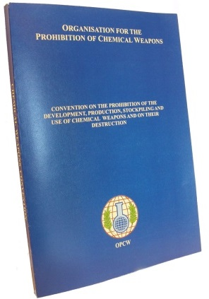
Resiliency and the OPCW Scientific Advisory Board: Tales of Providing Scientific Advice During a Pandemic
Peter J Hotchkiss, Ph.D.; Organisation for the Prohibition of Chemical Weapons; peter.Hotchkiss@opcw.org
P5.1-055
Chemical Weapons Convention (CWC)
Implemented by OPCW
Which consists of
  Conference of the States Parties
  Executive Council
  Technical Secretariat
The Convention aims to eliminate an entire category of weapons of mass destruction by prohibiting the development, production, acquisition, stockpiling, retention, transfer or use of chemical weapons by States Parties.
INTRODUCTION

Slide 4
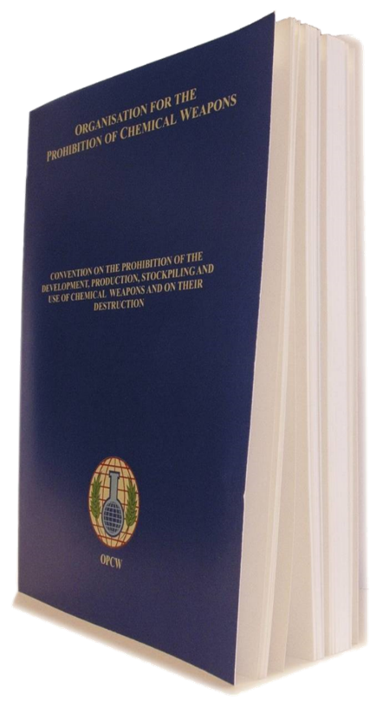
Resiliency and the OPCW Scientific Advisory Board: Tales of Providing Scientific Advice During a Pandemic
Peter J Hotchkiss, Ph.D.; Organisation for the Prohibition of Chemical Weapons; peter.Hotchkiss@opcw.org
P5.1-055
The Conference of States Parties Shall:
  “Review scientific and technological developments that could affect the operation of this Convention and, in this context, direct the Director General to establish a Scientific Advisory Board to enable him, in the performance of his functions, to render specialized advice in areas of science and technology relevant to this Convention, to the Conference, the Executive Council or States Parties.”
  CWC Article VIII, Section B, paragraph 21(h)
INTRODUCTION

Slide 5
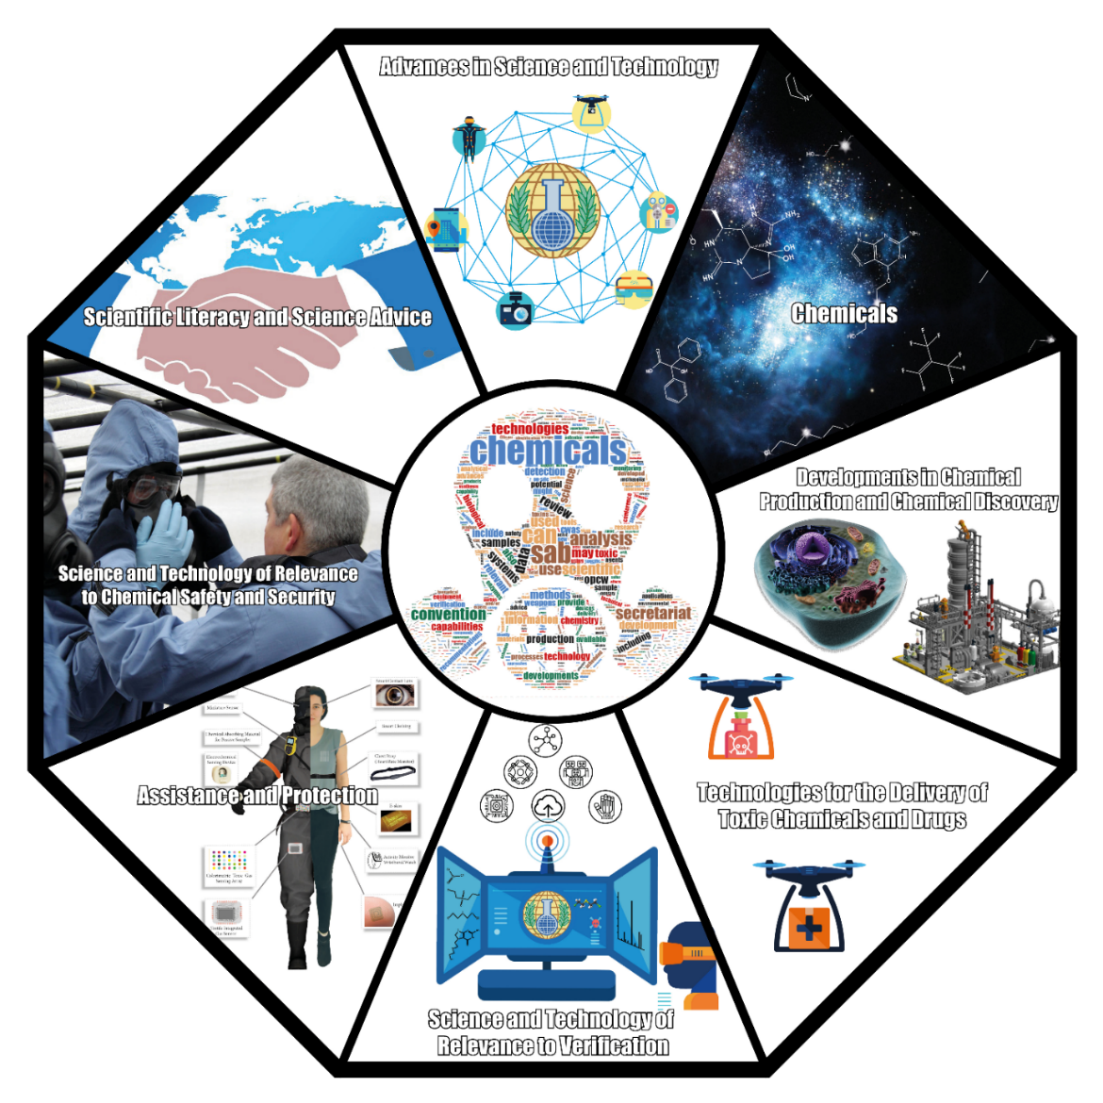
Resiliency and the OPCW Scientific Advisory Board: Tales of Providing Scientific Advice During a Pandemic
Peter J Hotchkiss, Ph.D.; Organisation for the Prohibition of Chemical Weapons; peter.Hotchkiss@opcw.org
P5.1-055
The Scientific Advisory Board (SAB) Undertakes a Continual Review of Science and Technology
METHODS

Slide 6



Resiliency and the OPCW Scientific Advisory Board: Tales of Providing Scientific Advice During a Pandemic
Peter J Hotchkiss, Ph.D.; Organisation for the Prohibition of Chemical Weapons; peter.Hotchkiss@opcw.org
P5.1-055
The SAB pays special attention to certain types of technologies
Emerging technologies
Technical innovations that breach new territory in a particular field
e.g., Artificial Intelligence led Molecular Design
Converging technologies
These develop from the convergence of different systems evolving towards a similar goal
e.g., Chem/Bio Convergence
Disruptive technologies
Innovations that help create new markets and go on to disrupt an existing market, often displacing an earlier technology
e.g., Additive Manufacturing
METHODS

Slide 7
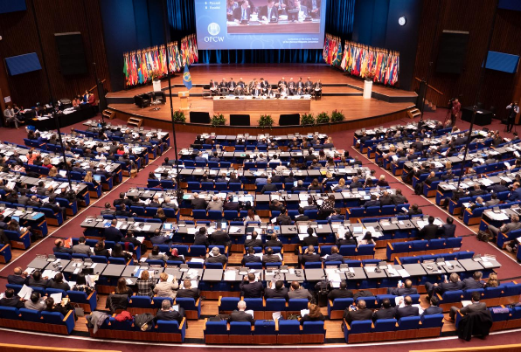


Resiliency and the OPCW Scientific Advisory Board: Tales of Providing Scientific Advice During a Pandemic
Peter J Hotchkiss, Ph.D.; Organisation for the Prohibition of Chemical Weapons; peter.Hotchkiss@opcw.org
P5.1-055
Review Conference Report
States Parties
General Public
CSP Briefings
Scientific Advisory Board
METHODS
Director General

Slide 8
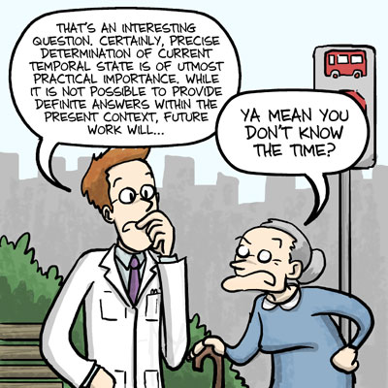
Resiliency and the OPCW Scientific Advisory Board: Tales of Providing Scientific Advice During a Pandemic
Peter J Hotchkiss, Ph.D.; Organisation for the Prohibition of Chemical Weapons; peter.Hotchkiss@opcw.org
P5.1-055
The Importance of Communication
The SAB endeavors to ensure that the important science and technology relevant to the CWC and States Parties can be properly communicated and understood by policymakers
METHODS

Slide 9
Resiliency and the OPCW Scientific Advisory Board: Tales of Providing Scientific Advice During a Pandemic
Peter J Hotchkiss, Ph.D.; Organisation for the Prohibition of Chemical Weapons; peter.Hotchkiss@opcw.org
P5.1-055
As everywhere, the SAB had to reinvent how it worked during the restrictions of the pandemic
Despite the unknowns, SAB members embraced the challenge and previously-planned in-person meetings were changed to virtual formats
The SAB does have some unique attributes making virtual meetings more challenging
        SAB members hail from 25 different countries, currently representing 9 different time-zones across 13 hours
        All SAB Sessions are held with simultaneous interpretation into the 6 official languages of the OPCW
RESULTS

Slide 10
Resiliency and the OPCW Scientific Advisory Board: Tales of Providing Scientific Advice During a Pandemic
Peter J Hotchkiss, Ph.D.; Organisation for the Prohibition of Chemical Weapons; peter.Hotchkiss@opcw.org
P5.1-055
Table showing parameters of SAB Sessions before, during and after the COVID-19 pandemic
 | 2015 – 2019 (pre-pandemic) | 2020 – 2021 (pandemic) | 2022 and beyond (end of / post pandemic)
Session Modality | In-Person | Virtual | Hybrid
Session Location | The Hague, Netherlands | Microsoft Teams | Netherlands and Microsoft Teams
Session Frequency | Once per year (sometimes twice) | 2-3 times per year | 2-3 times per year
Session Length | 4-5 full days | 2-3 half days | Variable as needed
Participation Rate | 88-96% | >95% | Unknown, should be high
RESULTS

Slide 11
Resiliency and the OPCW Scientific Advisory Board: Tales of Providing Scientific Advice During a Pandemic
Peter J Hotchkiss, Ph.D.; Organisation for the Prohibition of Chemical Weapons; peter.Hotchkiss@opcw.org
P5.1-055
There are pros and cons for both in-person and virtual meetings
 | In-Person | Virtual
Pros | Side meetings and building rapport is easier Smoother flow to meeting Able to cover more material | Easier to find and accommodate external speakers Negligible costs Shorter meetings
Cons | Expensive (travel and per diem) Time-consuming for attendees External speakers limited to those with time/inclination | Needing to accommodate for time zones No ‘unstructured’ rapport building Simultaneous language interpretation is harder
RESULTS

Slide 12
Resiliency and the OPCW Scientific Advisory Board: Tales of Providing Scientific Advice During a Pandemic
Peter J Hotchkiss, Ph.D.; Organisation for the Prohibition of Chemical Weapons; peter.Hotchkiss@opcw.org
P5.1-055
Other changes the SAB has made include:
Recording SAB sessions so that members who have internet difficulties can view the recordings later
Setting up and utilizing a Sharepoint site
        Invite-only, password protected
        Allows for the sharing and storing of documents, presentations, publications, session recordings, etc. to facilitate the work of the SAB
RESULTS

Slide 13
Resiliency and the OPCW Scientific Advisory Board: Tales of Providing Scientific Advice During a Pandemic
Peter J Hotchkiss, Ph.D.; Organisation for the Prohibition of Chemical Weapons; peter.Hotchkiss@opcw.org
P5.1-055
The OPCW Scientific Advisory Board is tasked with providing scientific advice to the Director-General and the Technical Secretariat
While the COVID-19 pandemic has forced the SAB to work remotely and virtually, the SAB sessions have been successful
        Attendance is high
        External speakers have still presented
        The business of the SAB has continued productively
This experience will allow the SAB to move forward in a more hybrid meeting model, allowing it to conduct its work and to be flexible and resilient for whatever challenges lay ahead
CONCLUSIONS

