Slide 1

SEISMICITY AND SEISMIC HAZARD ASSESSMENT IN WEST AFRICA
¹Kadiri A. U. and ²Kijko A.
T5.2-033
¹Centre for Geodesy and Geodynamics, PMB 11, Toro, Bauchi State, Nigeria
²Natural Hazard Centre, University of Pretoria, Pretoria, Republic of South Africa

Slide 2
SEISMICITY AND SEISMIC HAZARD ASSESSMENT IN WEST AFRICA
Geodesy and Geodynamics, PMB 11, Toro, Bauchi State, Nigeria. Email: umakad@yahoo.com,
¹Mobile: +2348037122784
]
P5.2-033
No in-depth seismic hazard study for West Africa (WA) has ever been conducted, as the regional earthquake catalogues are incomplete. Such lack of comprehensive seismic hazard study for the region has negatively affected the planning and development of critical infrastructure and disaster risk management. Therefore, this study aims to bridge the knowledge gap by applying modern techniques to updating the existing catalogues and assessing the seismic hazards for the region. We updated the current earthquake catalogue for WA using information from the International Seismological Centre, published information, and data from seismic stations in the region. The seismotectonic setting of WA is considered stable continental crust despite several recorded earthquakes occurring in the region, the largest being the 22 June 1939 earthquake of magnitude M6.8 with epicentre in Ghana. However, WA has also been classified as a region of shallow crustal seismicity. Therefore, we investigated both these research schools of thought and compared their results. For each scenario, three different ground-motion models (GMMs) were applied and combined to produce each hazard map using logic tree formalism with equal weights. The region was divided into five seismic source zones for computation of the earthquake recurrence parameters, with the same parameters computed for the entire WA region. The computed Gutenberg–Richter b-value, activity rates λ, and regional maximum possible magnitudes m_{max} for the five zones ranged from 0.84 to 1.0, 0.3–2.1, and 5.2–7.0, respectively. The calculated b-value, λ, and m_{max} for the entire region were 0.77, 4.1, and 7.2, respectively. The estimated b-value of 0.77 falls within the generally accepted range for tectonic seismicity. The seismic hazard predicted by GMMs for stable continental areas was higher than that predicted for shallow crustal seismicity in the investigated region. Therefore, our results confirmed that WA is characterised by stable continental crust. The highest hazard levels were observed in parts of Ghana, Togo, Guinea-Bissau, Guinea, and the Cameroon Volcanic Line region (CVL), ranging between 0.02 g and 0.03 g.
ABSTRACT

Slide 3
SEISMICITY AND SEISMIC HAZARD ASSESSMENT IN WEST AFRICA
Geodesy and Geodynamics, PMB 11, Toro, Bauchi State, Nigeria. Email: umakad@yahoo.com,
¹Mobile: +2348037122784
P5.2-033
No record of a large-scale probabilistic seismic hazard analysis (PSHA) projects in WA due to dearth of data
Seismotectonic setting of WA is considered stable continental crust (SCC) despite several recorded earthquakes occurring in the region; other school of thoughts classified WA as a region of shallow crustal seismicity (SCS).
So, past seismic hazard studies focused primarily on other parts of Africa, excluding WA. E.g. Shudofsky (1985); Midzi et al. (1999); Poggi et al. (2017); Hartnady (2002) and Mohamed et al. (2012) etc.
Most PSHA in WA concentrated only on the southern part of Ghana (Kumapley, 1996; Anon, 1988; Amponsah et al., 2009; Ahulu et al., 2018; Osei et al., 2018)
INTRODUCTION

Slide 4
SEISMICITY AND SEISMIC HAZARD ASSESSMENT IN WEST AFRICA
Geodesy and Geodynamics, PMB 11, Toro, Bauchi State, Nigeria. Email: umakad@yahoo.com,
¹Mobile: +2348037122784
P5.2-033
Recently, on Nigeria (Afegbua et al., 2019) and other countries such as Cameroun (Orci1 et al., 2016).
Establishing hazard maps for an area is fundamental to mitigating the potential destructive effects on lives and infrastructure posed by seismic risk.
We aimed to update the earthquake catalogue and compute the earthquake hazard parameters for WA to assist in holistic planning for the region.
Further, we applied the updated for WA to assess the seismic hazard for (1) stable continental areas and (2) areas characterised by shallow crustal seismicity.
We therefore compared our results. We computed PGAs for whole WA for the first time
INTRODUCTION

Slide 5
SEISMICITY AND SEISMIC HAZARD ASSESSMENT IN WEST AFRICA
Geodesy and Geodynamics, PMB 11, Toro, Bauchi State, Nigeria. Email: umakad@yahoo.com,
¹Mobile: +2348037122784
P5.2-033
Data Sources
Local seismic stations, ISC, a monograph by Ambraseys and Adams (1986), information from newspapers, and others.
Magnitudes were homogenised Mw as a result of merging of catalogues from different agencies; using procedures described by Scordilis, 2006; Kadiri, 2016; Marshall, 1970).
Initial catalogue (1615-2016) with 2, 019 events was desclustered using the procedure by Bender and Perkins (1987) to remove foreshocks, aftershocks, and earthquake swarms; to obtained a homogenous catalogue comprising 216 events.
Catalogue completeness was established with a unique technique developed by the authors, and implemented using MATLAB computer code (MathWorks, Inc., USA).
METHODS

Slide 6
SEISMICITY AND SEISMIC HAZARD ASSESSMENT IN WEST AFRICA
Geodesy and Geodynamics, PMB 11, Toro, Bauchi State, Nigeria. Email: umakad@yahoo.com,
¹Mobile: +2348037122784
P5.2-033
We applied the maximum likelihood estimate method as implemented in Kijko et al. (2016) to assess the essential seismic hazard parameters (activity rate, λ, the Gutenberg–Richter b-value, and the regional maximum possible magnitude mmax).
We identified five seismic source zones based on the available seismic records and the seismotectonics of WA; each zone with different Level of Completeness (LoC)
We also performed PSHA for the entire WA, using three sub-catalogues (Historical and two Complete parts)
For each of the seismotectonic setting of WA (SCC or SCS), we applied three different ground-motion models (GMMs) and combined to produce each hazard map using logic tree formalism with equal weights, and compared the results.
METHODS

Slide 7
SEISMICITY AND SEISMIC HAZARD ASSESSMENT IN WEST AFRICA
Geodesy and Geodynamics, PMB 11, Toro, Bauchi State, Nigeria. Email: umakad@yahoo.com,
¹Mobile: +2348037122784
P5.2-033
Our area of investigation in WA is large, and the completeness of the available earthquake catalogue is highly inhomogeneous.
Table 1 Estimated recurrence parameters per zone
Zone | Maximum observed magnitude | b-value | Activity rate λ (for magnitude MW=4.0) | m_{max}
1 | 6.1 | 0.84±0.16 | 1.91±1.14 | 6.23±0.28
2 | 6.8 | 0.86±0.12 | 0.15±0.03 | 6.98±0.31
3 | 5.3 | 1.00±0.23 | 0.33±0.14 | 5.74±0.52
4 | 4.9 | 0.90±0.24 | 0.30±0.14 | 5.18±0.31
5 | 5.9 | 0.95±0.10 | 0.03±0.01 | 7.0 (assumed)
RESULTS

Slide 8
SEISMICITY AND SEISMIC HAZARD ASSESSMENT IN WEST AFRICA
Geodesy and Geodynamics, PMB 11, Toro, Bauchi State, Nigeria. Email: umakad@yahoo.com,
¹Mobile: +2348037122784
P5.2-033
Table 2 Mean annual activity rates, return periods, and the probability of exceedances for selected magnitudes in 1, 50, 100, 250, and 1 000 yr in the five source zones. MW =3.5 as threshold magnitude, and MW 5.3, 5.8, and 6.0 were used in the analysis depending on the zone. Zone #3 and Zone #4 truncated at MW 5.8 and MW 5.3, respectively. For space consideration, only magnitudes 4.0 and 6.0 are shown.
Magnitude | Earthquake recurrence parameters | Zone #1 | Zone #2 | Zone #3 | Zone #4 | Zone #5
4.0 | Activity rate (λ) | 0.3 | 0.5 | 0.3 | 0.3 | 0.4
 | Return period (years) | 0.5 | 3 | 3 | 3.3 | 26
6.0 | Activity rate (λ) | 0.02 | 0.02 | 0.0007 | 0.005 | 0.0009
 | Return period (years) | 42 | 48 | 1410 | 185 | 1030
4.0 | Probability of exceedance | 84% in 1 yr | 32% in 1 yr | 2.8% in 1 yr | 26.1% in 1yr | 3.8% in 1 yr
 | Probability of exceedance | 100% in 10 yr | 100% in 50 yr | 99% in 50 yr | 99% in 50yrs | 84% in 50 yr
 | Probability of exceedance | 100% in 25 yr | 100% in 100 yr | 100% in 100 yr | 100% in 100yrs | 97% in 100 yr
 | Probability of exceedance | 100% in 50 yr | 100% in 1 000 yr | 100% in 250 yr | 100% in 250yrs | 99.9% in 250 yr
6.0 | Probability of exceedance | 2% in 1 yr | 2% in 1 yr | 0.071% in 1 yr | 0.54% in 1yr | 0.097% in 1 yr
 | Probability of exceedance | 21% in 10 yr | 63% in 50 yr | 3.5% in 50 yr | 23.6% in 50yrs | 4.7% in 50 yr
 | Probability of exceedance | 45% in 25 yr | 86% in 100 yr | 6.9% in 100 yr | 41.2% in 100yrs | 9.2% in 100 yr
 | Probability of exceedance | 69% in 50 yr | 99% in 1 000 yr | 16.2% in 250 yr | 74% in 250yrs | 21.4% in 250 yr
RESULTS

Slide 9
SEISMICITY AND SEISMIC HAZARD ASSESSMENT IN WEST AFRICA
Geodesy and Geodynamics, PMB 11, Toro, Bauchi State, Nigeria. Email: umakad@yahoo.com,
¹Mobile: +2348037122784
P5.2-033
Table 3. Estimated mean activity rate λ, return periods, and the probability of exceedance of selected values of earthquake magnitudes occurring in West Africa
Magnitude | Activity rate (λ) | Return period | Probability of exceedance in t years
 |  |  | 1 year | 50 years | 100 years | 1 000 years
3.50 | 4.05 | 0.25 | 97.29% | 100.00% | 100.00% | 100.00%
5.00 | 0.32 | 3.12 | 27.18% | 100.00% | 100.00% | 100.00%
6.00 | 0.06 | 17.90 | 5.41% | 92.33% | 99.16% | 100.00%
6.50 | 0.02 | 62.60 | 1.59% | 54.16% | 78.21% | 100.00%
6.60 | 0.01 | 91.50 | 1.09% | 41.56% | 65.24% | 99.98%
6.80 | 0.003 | 370.00 | 0.27% | 12.59% | 23.50% | 91.76%
6.90 | 0.002 | 392.00 | 0.17% | 08.59% | 18.50% | 91.12%
RESULTS

Slide 10
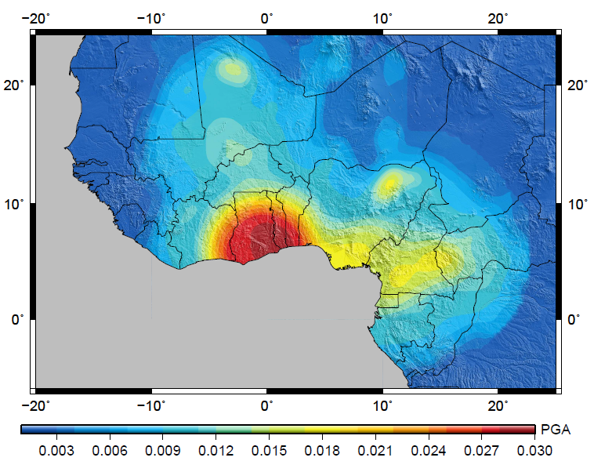
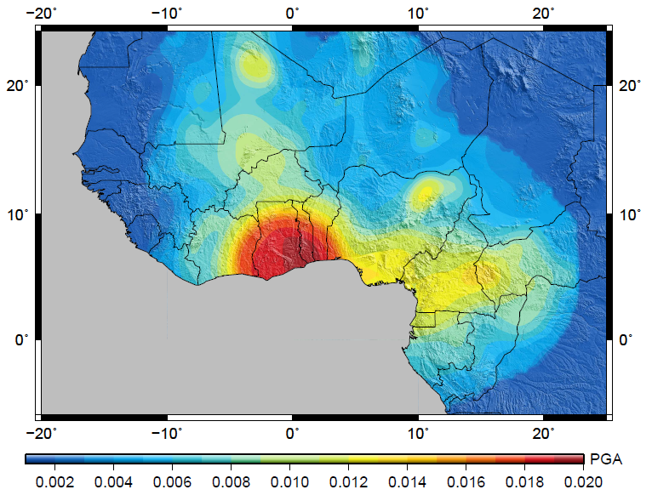
SEISMICITY AND SEISMIC HAZARD ASSESSMENT IN WEST AFRICA
Geodesy and Geodynamics, PMB 11, Toro, Bauchi State, Nigeria. Email: umakad@yahoo.com,
¹Mobile: +2348037122784
P5.2-033
RESULTS
Figure 1. Expected PGA (g) for 10% probability of exceedance at least once in 50 yr for the study area of West Africa under the assumption that (a) the observed seismicity is characteristic for stable continental areas, and (b) seismicity is shallow and crustal.

Slide 11
SEISMICITY AND SEISMIC HAZARD ASSESSMENT IN WEST AFRICA
Geodesy and Geodynamics, PMB 11, Toro, Bauchi State, Nigeria. Email: umakad@yahoo.com,
¹Mobile: +2348037122784
P5.2-033
Table 8. Estimated maximum values of the horizontal component of PGA (10% probability of exceedance at least once in 50 yr), for five investigated seismic zones (SS = shallow crustal seismicity; SCC = stable continental crust)
GMMs | Zone #1 | Zone #2 | Zone #3 | Zone #4 | Zone #5
SS | 0.016 | 0.02 | 0.008 | 0.006 | 0.018
SCC | 0.024 | 0.03 | 0.012 | 0.009 | 0.027
RESULTS
In our study and those of other authors, the differences in the assessment of seismic hazard for WA could be ascribed to several factors: application of different seismic event catalogues and applied GMMs.
However, as more data, the regional GMMs, and seismotectonic information on the area become available, the knowledge on seismic hazard should improve.

Slide 12
SEISMICITY AND SEISMIC HAZARD ASSESSMENT IN WEST AFRICA
Geodesy and Geodynamics, PMB 11, Toro, Bauchi State, Nigeria. Email: umakad@yahoo.com,
¹Mobile: +2348037122784
P5.2-033
Our study addressed the lack of consensus on the type of seismicity experienced by the WA region. We showed that WA is classified as stable continental Crust, with predicted PGA (with 10% probability within 50 years) range 0.005–0.03 g.
Estimated b-value for the five zones ranged from 0.84 to 1.0. The range of activity rates λ and zone-characteristic, maximum possible earthquake magnitudes is significant.
CONCLUSIONS
Comprehensive seismic hazard studies have never been conducted in most countries of WA. The present study is the first based on a comprehensive and updated seismic event catalogue for the entire WA region and provides the latest seismic hazard maps.
Results from this study are expected to serve as baseline data for holistic planning and development, and as a precursor for the development of building codes by the respective countries in West Africa.

