Slide 1
Importance of the National Data Centers (NDC) in the ratification
of the CTBTO treaty.
Didier Birimwiragi Namogo and Arsène Sadiki
Poster No. P5.3-617
Department of Seismology, Goma Volcano Observatory, RDCongo.

Slide 2
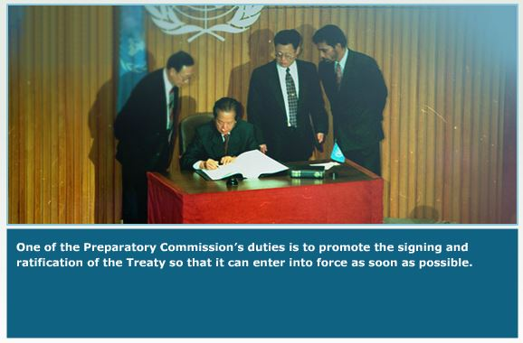
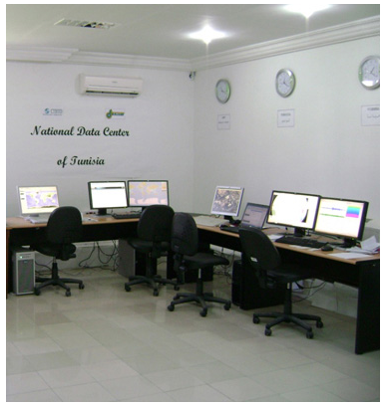
Importance of the National Data Centers (NDC) in the ratification
of the CTBTO treaty.
Didier Birimwiragi Namogo and Arsène Sadiki, Department of Seismology, Goma Volcano Observatory, DRCongo.
P5.3-617
How can NDCs help for the ratification of the Treaty?

Slide 3
Importance of the National Data Centers (NDC) in the ratification
of the CTBTO treaty.
Didier Birimwiragi Namogo and Arsène Sadiki, Department of Seismology, Goma Volcano Observatory, DRCongo.
P5.3-617
The National Data Center is an effective tool in getting some countries that have never ratified the treaty to do so.
Indeed, some countries have signed the CTBT nuclear test ban treaty but are reluctant to ratify it.
This can have several causes:
Either their selfish aspect which can lead them to do not accept a total control by the preparatory commission of CTBTO,
or the diplomatic relations are not very well strengthened between CTBTO and these countries.
We believe that the installation of National Data Centers (NDC) in these countries can be a necessary tool to gradually bring them to the ratification of the treaty.
HOW CAN THIS BE POSSIBLE?
ABSTRACT

Slide 4

Importance of the National Data Centers (NDC) in the ratification
of the CTBTO treaty.
Didier Birimwiragi Namogo and Arsène Sadiki, Department of Seismology, Goma Volcano Observatory, DRCongo.
P5.3-617
Negotiation of signatures for the establishment of the NDC in a country.
INTRODUCTION
Contact between CTBTO staff and decision makers in the country.

Slide 5
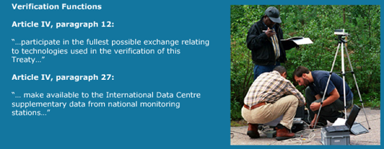
Importance of the National Data Centers (NDC) in the ratification
of the CTBTO treaty.
Didier Birimwiragi Namogo and Arsène Sadiki, Department of Seismology, Goma Volcano Observatory, DRCongo.
P5.3-617
Installation of the NDC in the concerned country.
METHODS
Regular contact between NDC and PTS staff.

Slide 6

Importance of the National Data Centers (NDC) in the ratification
of the CTBTO treaty.
Didier Birimwiragi Namogo and Arsène Sadiki, Department of Seismology, Goma Volcano Observatory, DRCongo.
P5.3-617
Installation of the NDC in the concerned country.
METHODS
Contacts between the authorities of CTBTO and the decision makers of the country.

Slide 7

Importance of the National Data Centers (NDC) in the ratification
of the CTBTO treaty.
Didier Birimwiragi Namogo and Arsène Sadiki, Department of Seismology, Goma Volcano Observatory, DRCongo.
P5.3-617
With the NDC, now a regular relationship is established between CTBTO
and the country hosting the NDC:
(a) Regional trainings
RESULTS

Slide 8

Importance of the National Data Centers (NDC) in the ratification
of the CTBTO treaty.
Didier Birimwiragi Namogo and Arsène Sadiki, Department of Seismology, Goma Volcano Observatory, DRCongo.
P5.3-617
With the NDC, now a regular relationship is established between CTBTO
and the country hosting the NDC. .
RESULTS
(a) Regional trainings

Slide 9
Importance of the National Data Centers (NDC) in the ratification
of the CTBTO treaty.
Didier Birimwiragi Namogo and Arsène Sadiki, Department of Seismology, Goma Volcano Observatory, DRCongo.
P5.3-617
3. With the NDC, now a regular relationship is established between CTBTO
and the country hosting the NDC. .
(b) CTBTO invites the staff of the NDC (diplomatic, scientific and even political delegates) in its various activities such as conferences.
(c) PTS staff are regularly sent to the country to help with technical problems of the NDC and trainings involving the training of NDC staff.
RESULTS

Slide 10
Importance of the National Data Centers (NDC) in the ratification
of the CTBTO treaty.
Didier Birimwiragi Namogo and Arsène Sadiki, Department of Seismology, Goma Volcano Observatory, DRCongo.
P5.3-617
Multiple exchanges ranging from the signing of the agreement for the establishment of the NDC to the organization of local trainings in the country brutalizing the NDC, are:
Scientists,
Diplomatic,
Politics
Techniques.
Such regular exchanges have the consequence of familiarizing and strengthening the relationship between CTBTO and the country's political decision-makers. Such exchanges can therefore lead a country, if it has not yet done so, to ratify the CTBTO Treaty.
CONCLUSIONS

Slide 11
Importance of the National Data Centers (NDC) in the ratification
of the CTBTO treaty.
Didier Birimwiragi Namogo and Arsène Sadiki, Department of Seismology, Goma Volcano Observatory, DRCongo.
P5.3-617
Thank you very much for your attention

