Slide 1
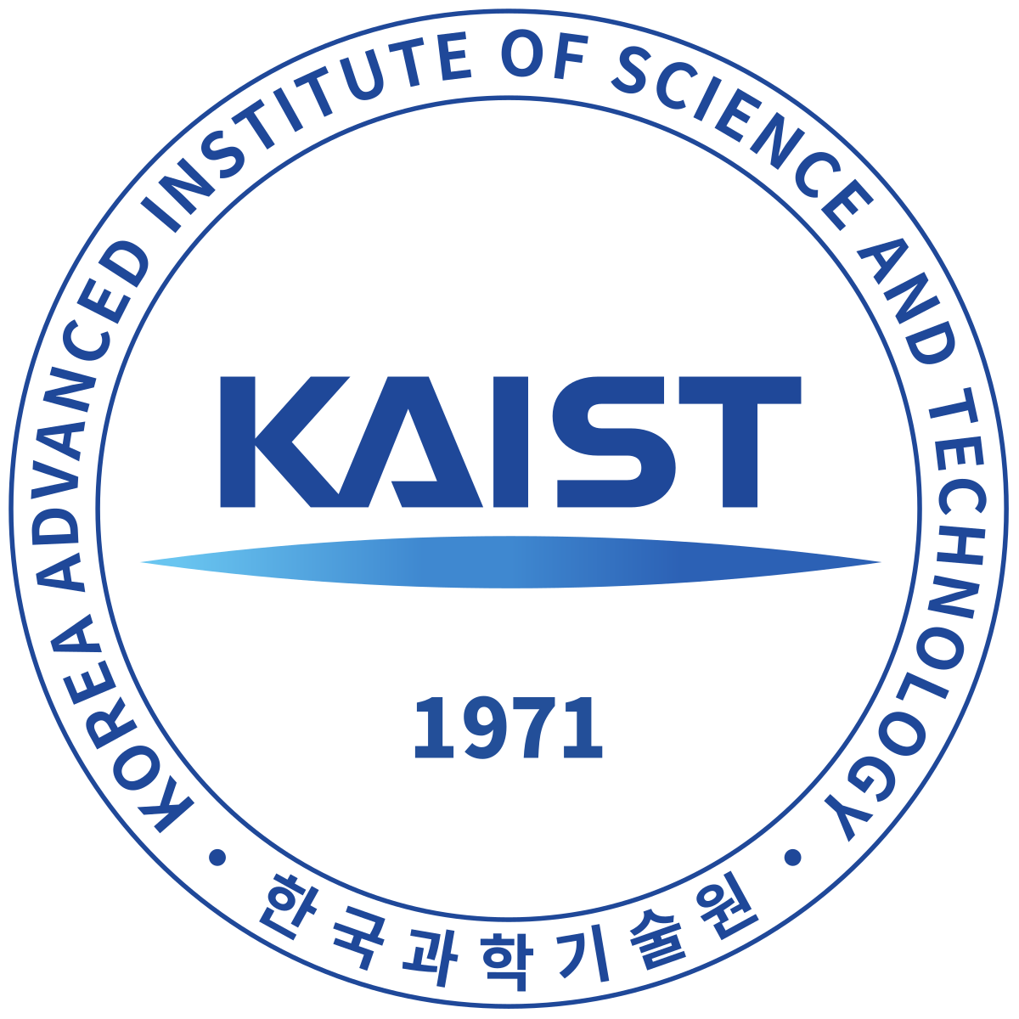

CTBTO Youth Academy of Sciences
Ms. Kseniia Pirnavskaia
Mr. Evgenii Afanasev
Poster No. P5.3-578
Korea Advanced Institute of Science and Technology
Moscow State University

Slide 2
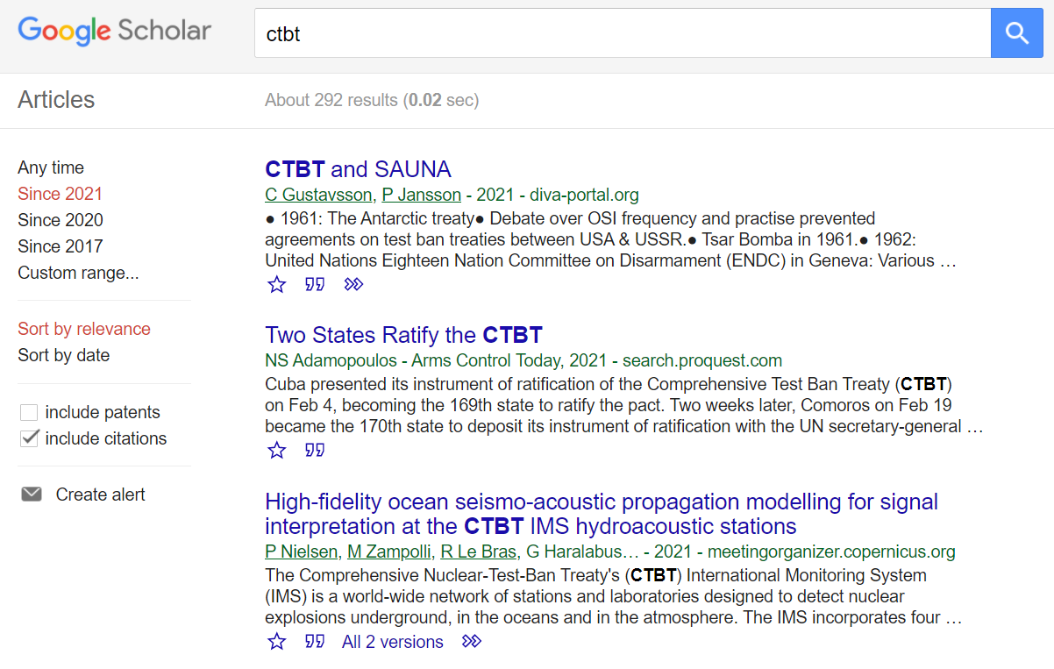
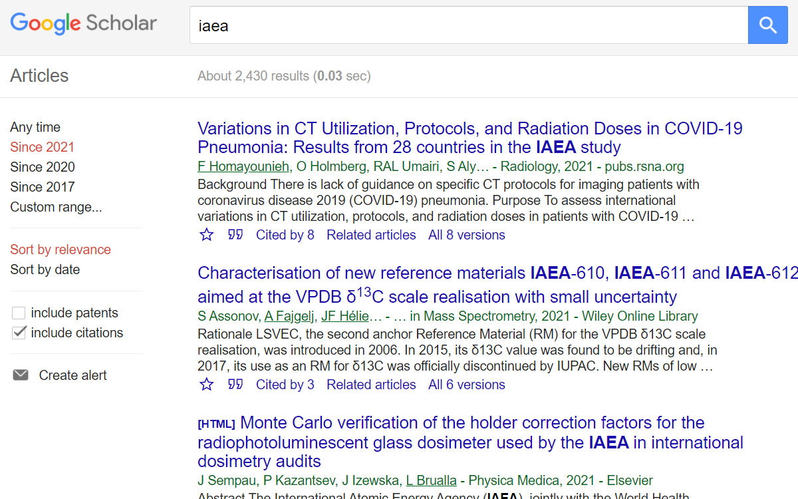
CTBTO Youth Academy of Sciences
Kseniia Pirnavskaia, Master’s Student, Korea Advanced Institute of Science and Technology, pirnavskayakd@gmail.com Evgenii Afanasev, Master’s Student, Moscow State University, asafrc97@gmail.com
P5.3-578
IDEA
What: research and educational project
Who: existing CYG members to involve them in the research related to the CTBTO/CTBT topics
Why:
to extend scholarship generated by youth about the CTBT
to place CTBT on the scientific agenda on relevant platforms,
encourage youth to continue their research for the sake of the CTBT
Where: online, results may be presented during the SnT or SDS
When: 2021-2022
How long: 2-3 months

Slide 3
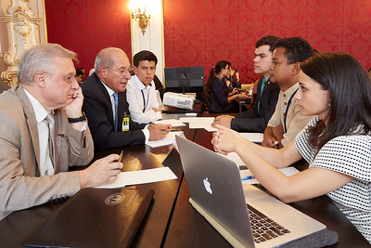
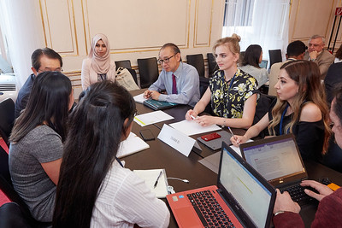
CTBTO Youth Academy of Sciences
Kseniia Pirnavskaia, Master’s Student, Korea Advanced Institute of Science and Technology, pirnavskayakd@gmail.com Evgenii Afanasev, Master’s Student, Moscow State University, asafrc97@gmail.com
P5.3-578
FORMAT
Team-work research: the participants (approx. 30 people) will be divided into groups of 4-5 people to work on the certain research topic.
Topics: Verification Issues, Article 14, CTBTO in the context of the nonproliferation regime, Science Diplomacy in the context of the CTBT, CTBTO and Climate change, other scientific and civil applications of the IMS, CTBTO and SDGs.
Mentoring: each group has a scientific supervisor from the GEM to bridge younger and more experienced generations.
Expected results: 5-6 researches done by CYG members together with their GEM member to be published in the Newsroom magazine, CTBTO web-site, as well as in other respected journals such as the Bulletin of the Atomic Scientists to revitalize the discussion around the CTBT in the scholars community be the voices of young generation.
*The project is intended to be an annual initiative.
SNT 2019, CYG-GEM session

Slide 4
CTBTO Youth Academy of Sciences
Kseniia Pirnavskaia, Master’s Student, Korea Advanced Institute of Science and Technology, pirnavskayakd@gmail.com Evgenii Afanasev, Master’s Student, Moscow State University, asafrc97@gmail.com
P5.3-578
PROGRAM
I
Pre-orientation online lectures on advanced issues related to the CTBT.
II
One-week-long online seminars on the CTBT key challenges, areas of possible research from the GEM members as speakers and future supervisors.
III
2-3 months research work of the research groups and a GEM supervisor.
IV
Publishing of the results. Presentation of the results during the SNT/SDS.

Slide 5
CTBTO Youth Academy of Sciences
Kseniia Pirnavskaia, Master’s Student, Korea Advanced Institute of Science and Technology, pirnavskayakd@gmail.com Evgenii Afanasev, Master’s Student, Moscow State University, asafrc97@gmail.com
P5.3-578
SMART-ANALYSIS
S
M
A
R
T
boosting research related to the CTBT
convenient framework for young researchers
published results = increased motivation
newly developed research beneficial for the CTBTO
around 30 CYG members are involved in the CTBT-research work
5-6 published articles on the respective topics
participants will work collaboratively with at least one supervisor from the GEM.
online conference platform
experts, GEM involvement
2-3 organizers
certificates
publishing opportunity
The youth’s researches demonstrate:
  relevance of the issue
  interest of the young generation towards the CTBT
3 months total

