Slide 1
CTBTO Youth Group as a Prime Model of Track 2 Diplomacy: United in Science
Marzhan Nurzhan
Poster No. P5.3-682

Slide 2

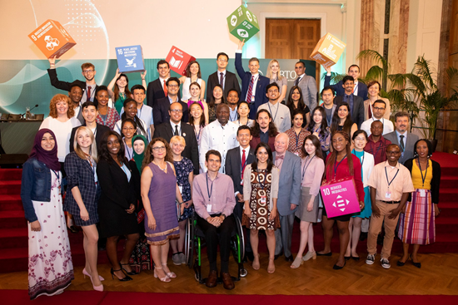
CTBTO Youth Group as a Prime Model of Track 2 Diplomacy: United in Science
Marzhan Nurzhan
P5.3-682
established in 2016 at the symposium "Science and Diplomacy for Peace and Security: the CTBT@20“ – 5 years anniversary in 2021
one of the largest youth initiatives on nuclear disarmament and non-proliferation
1000 + members
100+ countries
almost 50/50 % gender representation
CYG members at the SnT 2019 in Vienna
Notes:
Source: Spectrum, issue 25, July 2020

Slide 3
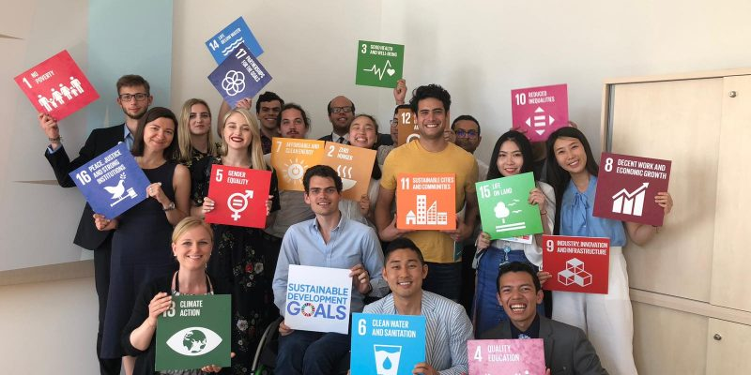
CTBTO Youth Group as a Prime Model of Track 2 Diplomacy: United in Science
Marzhan Nurzhan
P5.3-682
CTBTO Youth Group (CYG) represents a unique platform of connecting science and policy in an interdisciplinary way. The platform provides opportunities through nuclear disarmament and non-proliferation education to involve its members in various track 2 diplomacy channels creating a safe space for active engagement, learning and exchange between peers coming from non- and nuclear weapon/armed states.
ABSTRACT
CYG members at the Ban Ki-moon Centre for Global Citizens, 2019
Notes:
Summary excerpt of the submitted abstract

Slide 4

CTBTO Youth Group as a Prime Model of Track 2 Diplomacy: United in Science
Marzhan Nurzhan
P5.3-682
UN GA resolution (2019) on Youth, Disarmament and Non-proliferation:
recognises the role of young people as key agents for social change and acknowledges the positive contributions of youth engagement to sustainable peace and security;
stresses the importance of realizing the full potential of young people through education and capacity-building, bearing in mind the ongoing efforts and the need to promote the sustainable entry of young people into the field of disarmament and non-proliferation.
Securing Our Common Future: An Agenda for Disarmament (2018)
the role of young people as drivers of change was emphasised, along with the need for sustainability and long-term engagement of youth and further investment in disarmament education.
INTRODUCTION
Notes:
Sources: text of the UN GA resolution https://undocs.org/en/A/C.1/74/L.48
Securing Our Common Future: An Agenda for Disarmament https://www.un.org/disarmament/sg-agenda/en/

Slide 5
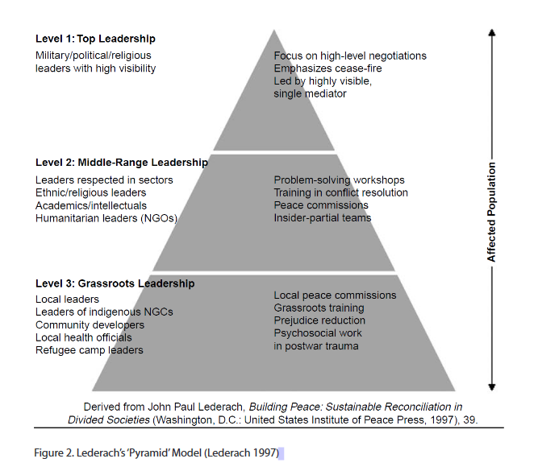
CTBTO Youth Group as a Prime Model of Track 2 Diplomacy: United in Science
Marzhan Nurzhan
P5.3-682
Analytical framework:
Track 2 diplomacy/Citizen diplomacy – unofficial informal interaction between non-state or non-governmental actors (reference to the level 2 in the Lederach´s pyramid).
Concepts and key terms:
Non-state/private actors - Citizen diplomacy:
Youth as citizen diplomats
Youth engagement and intergenerational dialogue
Informal interaction - Science diplomacy:
Conferences, workshops, meetings
Use of information and communication technologies (ICT)
E-learning/ online education
METHODS
Notes:
Sources: Carson, Lisa (2018). Why youth and feminist activism matters: insights from anti-nuclear campaigns in practice. Global Change, Peace & Security, (), 1–9.
https://peacemaker.un.org/sites/peacemaker.un.org/files/TrackOneandaHalfDiplomacy_Mapendere.pdf
Definition of science diplomacy: “Science diplomacy is the use of scientific collaborations among nations to address the common problems facing 21st century humanity and to build constructive international partnerships.” More on various definitions https://www.s4d4c.eu/topic/2-3-1-what-do-we-mean-by-science-diplomacy/

Slide 6
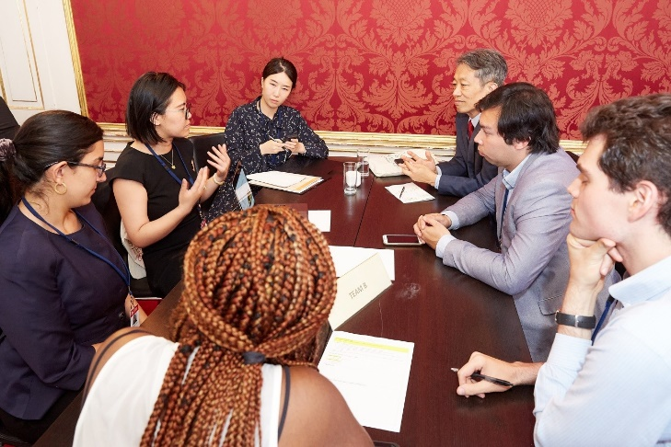
CTBTO Youth Group as a Prime Model of Track 2 Diplomacy: United in Science
Marzhan Nurzhan
P5.3-682
Analyze activities/interactions of the CYG, categorize them, show examples
Identify roles of the CYG members
Conduct of survey in social media channel of the CYG by asking a question and present some answers/testimonies
METHODS

Slide 7
CTBTO Youth Group as a Prime Model of Track 2 Diplomacy: United in Science
Marzhan Nurzhan
P5.3-682
CYG uses various channels and ways for interaction between members:
Virtual space – use of the ICT
the website/platform
online course – CYG introductory curriculum
social media channels - Twitter account and What´sApp (WA) group(s)
mailing list and newsletter
webinars
citizen journalism academy
newsroom project
In person meetings (some of major ones)
CYG conferences (in Russia, 2017 and Kazakhstan, 2018)
Science Diplomacy Symposium (2016, 2018)
Science and Technology Conference (2017, 2019, 2021)
CTBTO side-events at the Nuclear Non-Proliferation Treaty’s Preparatory Committee (2017, 2018 and 2019)
CTBTO Ministerial Meetings (2017, 2019)
Roles of CYG members
Presenters
Invited speakers (incl. to high-level meetings)
Faclitators (during webinars)
Educators/students of the course
Project managers
Bridge builders
Consultants (for the events in the regions or country of origin/residence/study)
Citizen journalists, article contributors
Members of the delegation at the multilateral negotiations meetings
RESULTS
Question asked for the survey in social media (WA groups): How does CYG contribute to peacebuilding?
Notes:
Sources: Spectrum, issue 25, July 2020

Slide 8
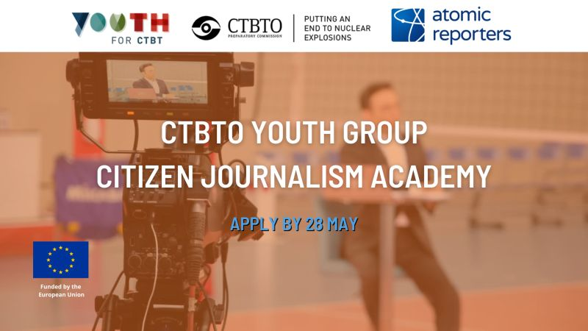
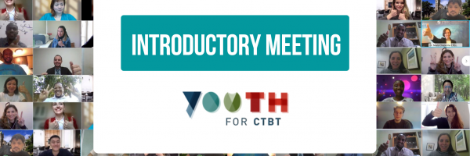

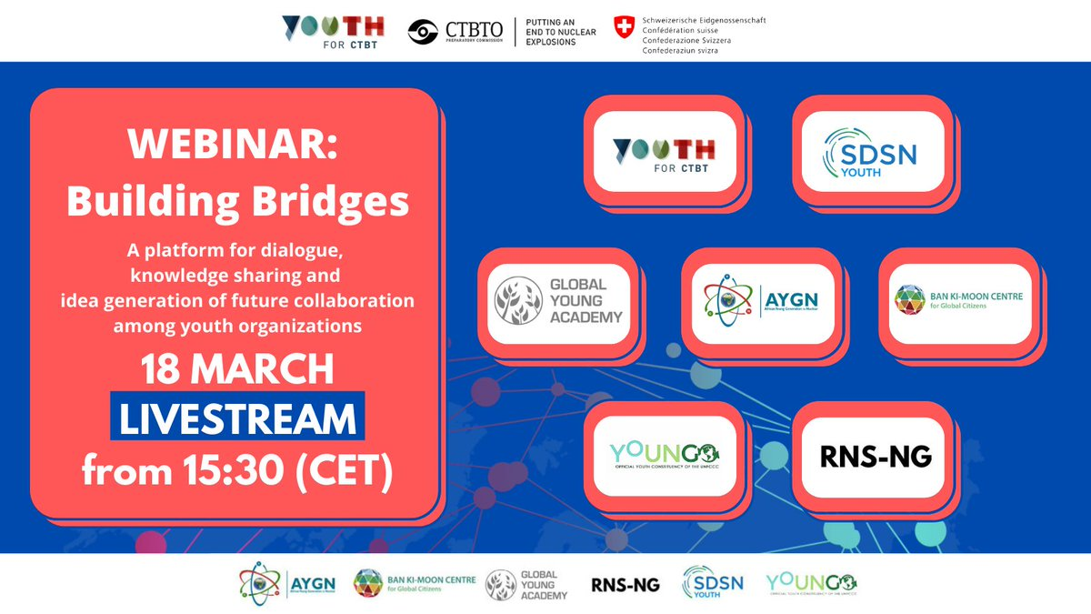
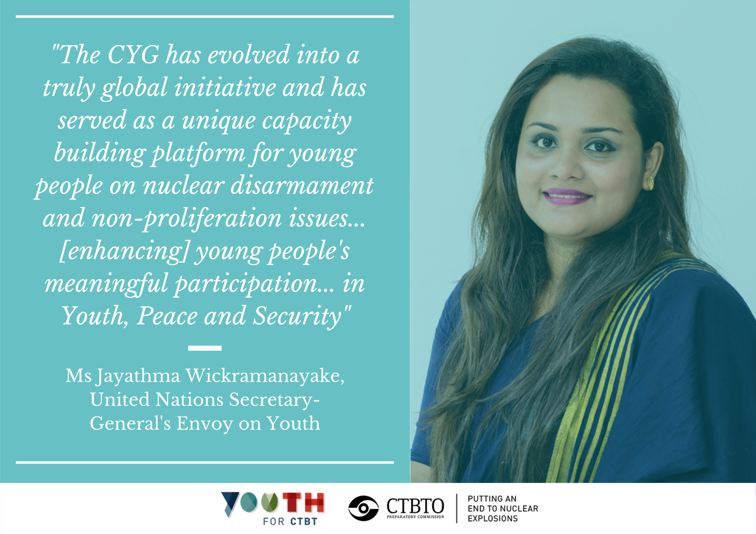
CTBTO Youth Group as a Prime Model of Track 2 Diplomacy: United in Science
Marzhan Nurzhan
P5.3-682
RESULTS

Slide 9
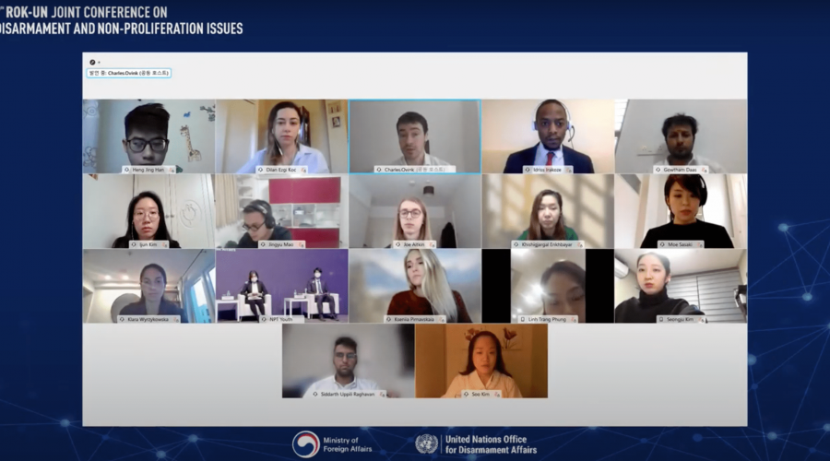
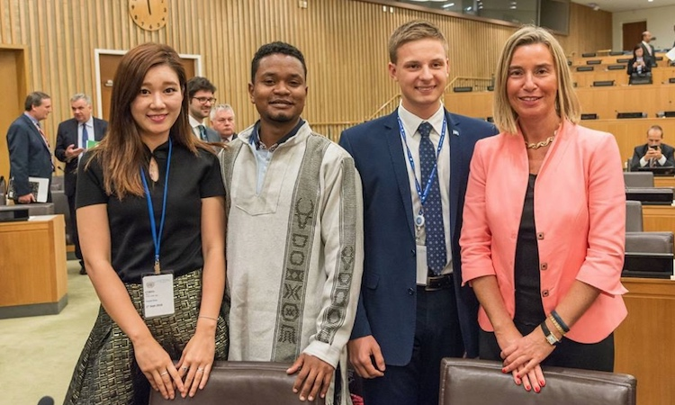
CTBTO Youth Group as a Prime Model of Track 2 Diplomacy: United in Science
Marzhan Nurzhan
P5.3-682
Some of the answers to the question on: How CYG contributes to peacebuilding as a track 2 diplomacy channel?
Idriss: “Technology can build trust through applications like detecting nuclear tests.”
Christopher: "CYG provides exposure to a diversity of individuals that promotes engaging and serious dialogue that results in small but measurable results at both academic and grassroots levels.“
Guillaume: “I would say the value here is in cultural exchange and openness towards foreigners.”
RESULTS
CYG members with then High Representative of the European Union for Foreign Affairs and Security Policy, Federica Mogherini
Notes:
Source: https://www.youth4disarmament.org/spotlight/new-voices-fresh-perspectives-making-space-young-people-participate-disarmament?language_content_entity=en

Slide 10
CTBTO Youth Group as a Prime Model of Track 2 Diplomacy: United in Science
Marzhan Nurzhan
P5.3-682
Network and members engage in the SDGs 4, 16 and 17
Informed and empowered youth participation in nuclear issues as citizen diplomats takes place through the network of CYG
Diversity, geographical and regional representation of the network members are conducive for track 2 diplomacy (especially Annex 2 States)
Members of the CYG contribute to peacebuilding, providing opportunity for inclusive and open interactions, including intergenerational dialogue with GEM (Group of eminent persons)
CYG serves as a prime model for nurturing and building new generation of experts in the field of nuclear disarmament and non-proliferation applying track 2 diplomacy
Technological aspects of the CYG platform include the website with e-learning resources, connection via webinars and social media practicing science diplomacy.
These tools help to expand the network outside of nuclear field through track 2 diplomacy and attract more interest in the importance of banning nuclear testing, demonstrating support using a variety of means and contributing for the entry into force of the CTBT, highlighting its verification regime along with the scientific benefits.
CONCLUSIONS
“Education is, quite simply, peace-building by another name”. Kofi Annan, former Secretary-General of the United Nations

