Slide 1


Integrating realtime CTBTO and local seismic data using SEISAN
Peter H. Voss, Tine B Larsen, Lars Ottemöller & Jens Havskov
Poster No. T5.3-530

Slide 2
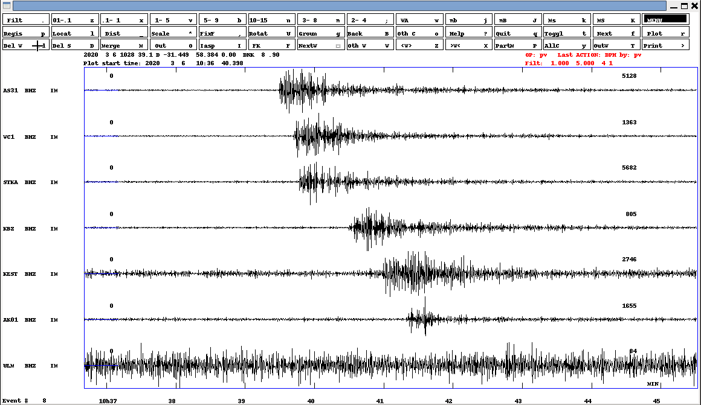
Integrating realtime CTBTO and local seismic data using SEISAN
Peter H. Voss (pv@geus.dk) ¹, Tine B Larsen¹, Lars Ottemöller² & Jens Havskov²
¹Geological Survey of Denmark and Greenland (GEUS), Denmark, ²University of Bergen, Norway
P5.3-530
We present methods to integrate CTBTO seismic realtime data with local data, which will enable NDCs to improve nuclear test monitoring, using the newly developed SeedLink service available on the GCI and IDC bulletins. We use the seismic analysis software package SEISAN.
ABSTRACT

Slide 3
Integrating realtime CTBTO and local seismic data using SEISAN
Peter H. Voss (pv@geus.dk) ¹, Tine B Larsen¹, Lars Ottemöller² & Jens Havskov²
¹Geological Survey of Denmark and Greenland (GEUS), Denmark, ²University of Bergen, Norway
P5.3-530
At new entry at the NDC Forum under the tag SEISAN seven video tutorials and a end user tutorial document is presented.
They focus on the new formats for IDC products recently made available by PTS, with the release of VDMS 3.2.0. The new formats are:
NORDIC format support for bulletins
data-less SEED format support for station configuration information
SEEDLink format for real-time waveform data
INTRODUCTION

Slide 4
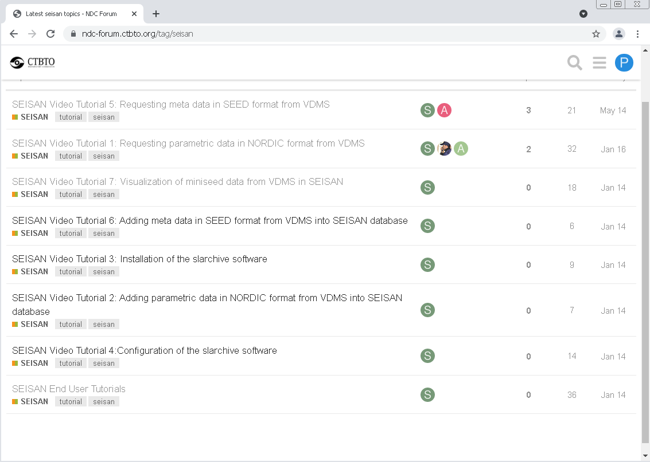
Integrating realtime CTBTO and local seismic data using SEISAN
Peter H. Voss (pv@geus.dk) ¹, Tine B Larsen¹, Lars Ottemöller² & Jens Havskov²
¹Geological Survey of Denmark and Greenland (GEUS), Denmark, ²University of Bergen, Norway
P5.3-530
In this poster we will give an overview of how to use the new formats, more details are found at the NDC Forum at:
https://ndc-forum.ctbto.org/c/other-shi-analysis-software/seisan
INTRODUCTION

Slide 5
Integrating realtime CTBTO and local seismic data using SEISAN
Peter H. Voss (pv@geus.dk) ¹, Tine B Larsen¹, Lars Ottemöller² & Jens Havskov²
¹Geological Survey of Denmark and Greenland (GEUS), Denmark, ²University of Bergen, Norway
P5.3-530
NORDIC format support for bulletins
Via the VDSM email service one can now request IMS bulletins in Nordic format by using the new BULLETIN definition. By
Adding the line
BULLETIN IMS2.0:NORDIC
to the email request, one will receive a bulletin in Nordic format.
Below is an example on a request for a bulletin in Nordic format, from the REB bulletin:
BEGIN IMS2.0
MSG_TYPE REQUEST
MSG_ID reb_bulletin_nordic
TIME 2020/02/18 07:00 to 2020/02/18 09:00
BULL_TYPE REB
BULLETIN IMS2.0:NORDIC
STOP
METHODS

Slide 6
Integrating realtime CTBTO and local seismic data using SEISAN
Peter H. Voss (pv@geus.dk) ¹, Tine B Larsen¹, Lars Ottemöller² & Jens Havskov²
¹Geological Survey of Denmark and Greenland (GEUS), Denmark, ²University of Bergen, Norway
P5.3-530
data-less SEED format support for station configuration information
Via the VDSM email service one can now request station meta data in dataless SEED format using the new STA_INFO definition. By
Adding the line
STA_INFO IMS2.0:DLSEED
to the email request, one will receive a dataless SEED file.
Below is an example on a request for the dataless SEED station meta data from the IMS station SFJD:
BEGIN IMS2.0
MSG_TYPE REQUEST
MSG_ID dlseed-IM_SFJD
TIME 2020/01/01 TO 2020/02/29
STA_LIST SFJD
STA_INFO IMS2.0:DLSEED
STOP
METHODS

Slide 7
Integrating realtime CTBTO and local seismic data using SEISAN
Peter H. Voss (pv@geus.dk) ¹, Tine B Larsen¹, Lars Ottemöller² & Jens Havskov²
¹Geological Survey of Denmark and Greenland (GEUS), Denmark, ²University of Bergen, Norway
P5.3-530
SEEDLink format for real-time waveform data
Via the GCI (The Global Communications Infrastructure) CTBTO is now providing real-time waveform data from the IMS. The data stream is made available using the seedlink protocol.
Software that is able to request data via the seedlink protocol can be ues to request real-time data via the GCI. Request are send to:
Hostname: seedlinktest.ctbto.org
IP address: 193.218.117.120
Port: 18000
Network: IM
METHODS

Slide 8
Integrating realtime CTBTO and local seismic data using SEISAN
Peter H. Voss (pv@geus.dk) ¹, Tine B Larsen¹, Lars Ottemöller² & Jens Havskov²
¹Geological Survey of Denmark and Greenland (GEUS), Denmark, ²University of Bergen, Norway
P5.3-530
SEEDLink format for real-time waveform data
In the example below we use the software programs slinktool and slarchive, to check status and request data, respectively. The softare is available at:
https://github.com/iris-edu/slinktool
https://github.com/iris-edu/slarchive
slinktool has different options for status output, the simple form is:
$ slinktool -I 193.218.117.120:18000
SeedLink server: SeedLink v3.2 (2014.071)
Organization : PTS
Start time : 2019/11/14 09:33:34.2301
Both slinktool and slarchive is executed on the command line on a NDC-in-a-Box linux PC.
METHODS

Slide 9
Integrating realtime CTBTO and local seismic data using SEISAN
Peter H. Voss (pv@geus.dk) ¹, Tine B Larsen¹, Lars Ottemöller² & Jens Havskov²
¹Geological Survey of Denmark and Greenland (GEUS), Denmark, ²University of Bergen, Norway
P5.3-530
SEEDLink format for real-time waveform data
slinktool has different options for status output, the more detailed form is:
$ slinktool -Q 193.218.117.120:18000
…
IM ROSC BHE D 2020/03/07 15:11:28.2250 - 2020/03/09 13:02:53.2250
IM ROSC BHN D 2020/03/07 15:11:37.6500 - 2020/03/09 13:02:59.4500
IM SCHQ BHE D 2020/03/07 16:59:59.3250 - 2020/03/09 11:56:41.7250
IM SONB4 SHZ D 2020/03/04 14:35:21.2200 - 2020/03/09 13:02:44.1200
IM SONB5 SHZ D 2020/03/04 18:05:36.0600 - 2020/03/09 13:02:46.9200
…
Where start and end times of data available in the real-time data stream is given. By using the –tw and –S flags data within this window can be extracted.
METHODS

Slide 10
Integrating realtime CTBTO and local seismic data using SEISAN
Peter H. Voss (pv@geus.dk) ¹, Tine B Larsen¹, Lars Ottemöller² & Jens Havskov²
¹Geological Survey of Denmark and Greenland (GEUS), Denmark, ²University of Bergen, Norway
P5.3-530
SEEDLink format for real-time waveform data
slarchive is used to connect to the seedlink server and dump the real-time data on the local harddisk. Here the command line setting is given, NDC Forum provide information on automated requests:
$ slarchive -k 600 -l IMS.streams -SDS ./SDS 193.218.117.120:18000
here l gives the file specifying the station one wish to request data from and –SDS the local folder where data will be loaded to. The –l file could look like:
$ cat IMS.streams
IM KEST
IM WB10
IM SFJD
IM BORG
METHODS

Slide 11
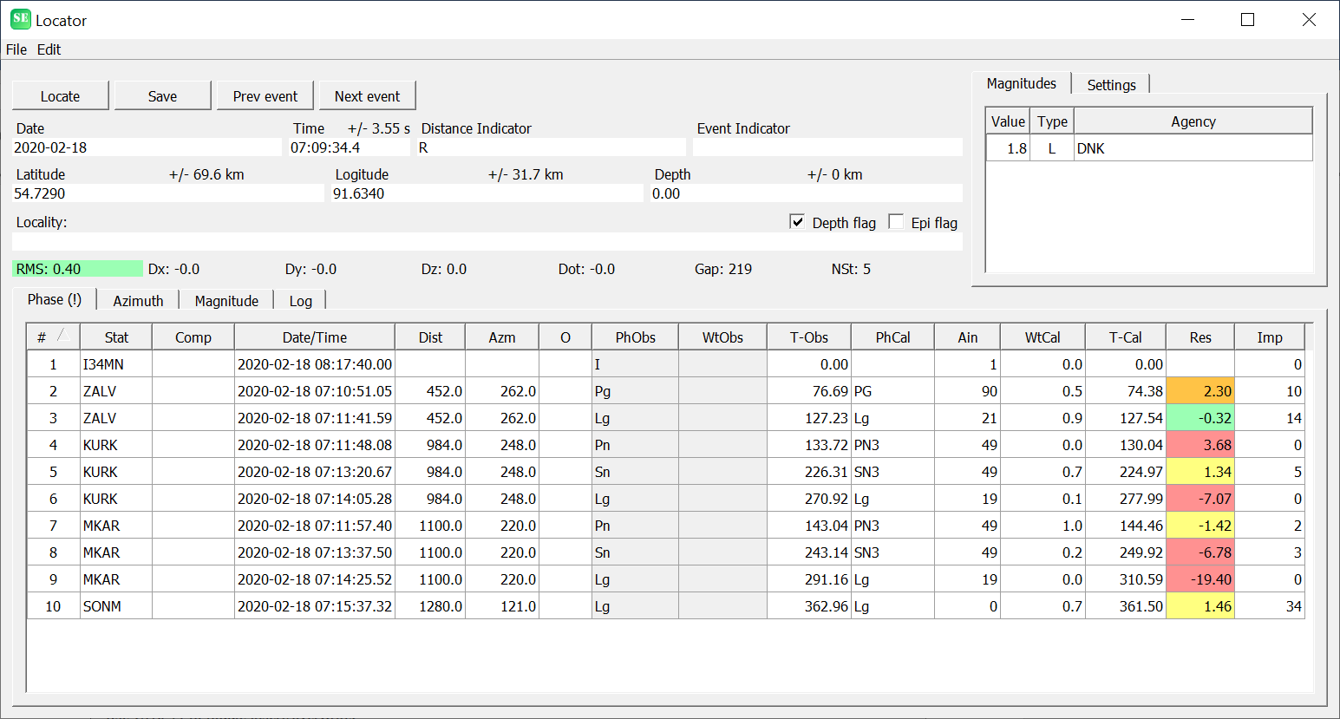
Integrating realtime CTBTO and local seismic data using SEISAN
Peter H. Voss (pv@geus.dk) ¹, Tine B Larsen¹, Lars Ottemöller² & Jens Havskov²
¹Geological Survey of Denmark and Greenland (GEUS), Denmark, ²University of Bergen, Norway
P5.3-530
Data analysis
For a bulletin request the received Nordic format file can be loaded in the SEISAN earthquake analisis software (See http://seisan.info/). SEISAN has different applications for analysing the events in a bulletin, to do a relocation the SEISAN Locater seen here is one option.
RESULTS

Slide 12
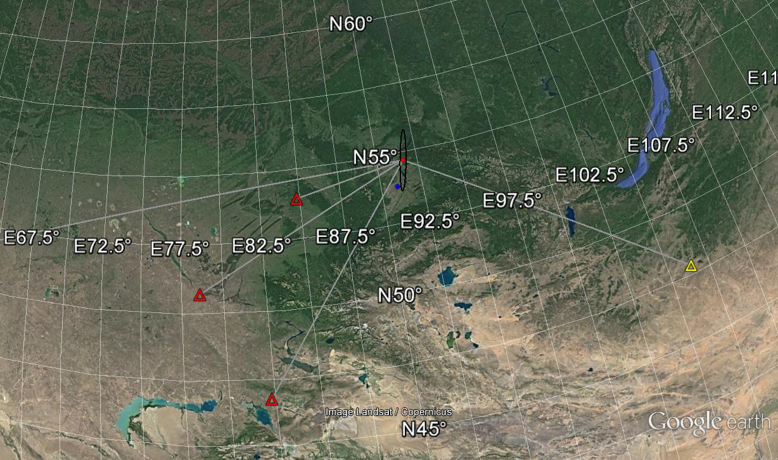
Integrating realtime CTBTO and local seismic data using SEISAN
Peter H. Voss (pv@geus.dk) ¹, Tine B Larsen¹, Lars Ottemöller² & Jens Havskov²
¹Geological Survey of Denmark and Greenland (GEUS), Denmark, ²University of Bergen, Norway
P5.3-530
Data analysis
After the event location SEISAN gives different epicentre mapping options, here we show how the Google Earth plugin phases parametric data in KML format that Google Earth will load using its network functionality. Red circle is new epicentre after relocation and blue is old. Black is error ellipse and triangle are stations with gray paths.
RESULTS

Slide 13
Integrating realtime CTBTO and local seismic data using SEISAN
Peter H. Voss (pv@geus.dk) ¹, Tine B Larsen¹, Lars Ottemöller² & Jens Havskov²
¹Geological Survey of Denmark and Greenland (GEUS), Denmark, ²University of Bergen, Norway
P5.3-530
Signal analysis
The real-time data received via the GCI can be accessed directly by SEISAN. If one already have events defined in SEISAN one can setup the GCI data as a virtual network in SEISAN and associate these to the events one with to analyse.
In the Nordic format one can either specify each data channel, as:
ARC SFJD BHZ IM 2020 2 1 859 0 10000
with start time and duration. Or specify a virtual network, here “_CTBTO” as
ARC _CTBTO 2020 2 1 859 0 10000
with start time and duration.
See the SEISAN manual fro details.
RESULTS

Slide 14
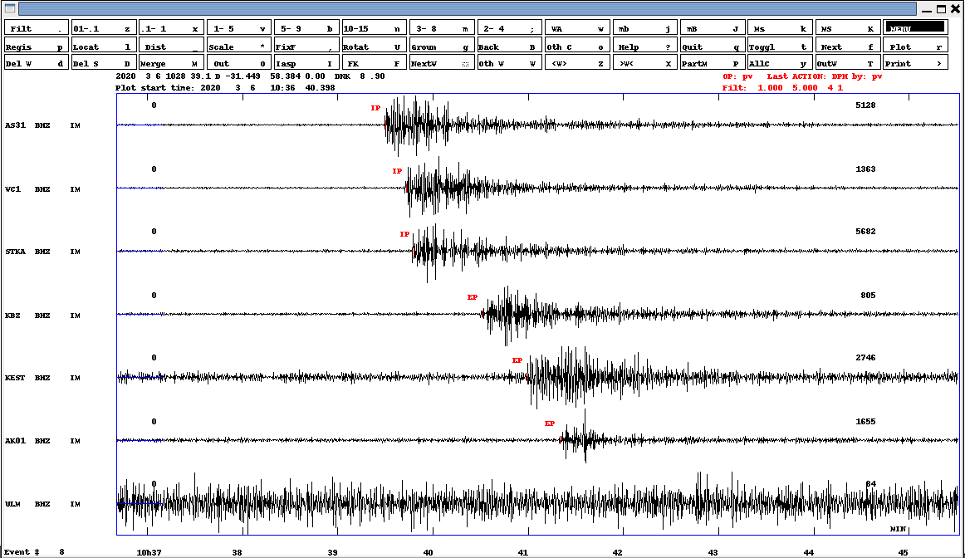
Integrating realtime CTBTO and local seismic data using SEISAN
Peter H. Voss (pv@geus.dk) ¹, Tine B Larsen¹, Lars Ottemöller² & Jens Havskov²
¹Geological Survey of Denmark and Greenland (GEUS), Denmark, ²University of Bergen, Norway
P5.3-530
Signal analysis
To display waveform data in SEISAN one can plot several stations, trace by trace or three component. Here we show several stations. SEISAN has several filters options, that the user can adjust to their need. Here we show picks of IP and EP using a 1 to 5 Hz filter. SEISAN reads station meta data in RESP format (ASCII version of dataless SEED) for reading amplitudes.
RESULTS

Slide 15
Integrating realtime CTBTO and local seismic data using SEISAN
Peter H. Voss (pv@geus.dk) ¹, Tine B Larsen¹, Lars Ottemöller² & Jens Havskov²
¹Geological Survey of Denmark and Greenland (GEUS), Denmark, ²University of Bergen, Norway
P5.3-530
We have presented how the new formats for IDC products recently made available by PTS, can be accessed and used in seismic signal analysis: NORDIC format support for bulletins, data-less SEED format support for station configuration information and SEEDLink format for real-time waveform data.
The new formats will be very useful for the NDC when requesting real-time data and for the many NDC’s using the SEISAN software when processing and analyzing both IMS bulletins and seismic waveform data.
More details are fond at NDC Forum at:
https://ndc-forum.ctbto.org/c/other-shi-analysis-software/seisanQ
CONCLUSIONS

