Slide 1

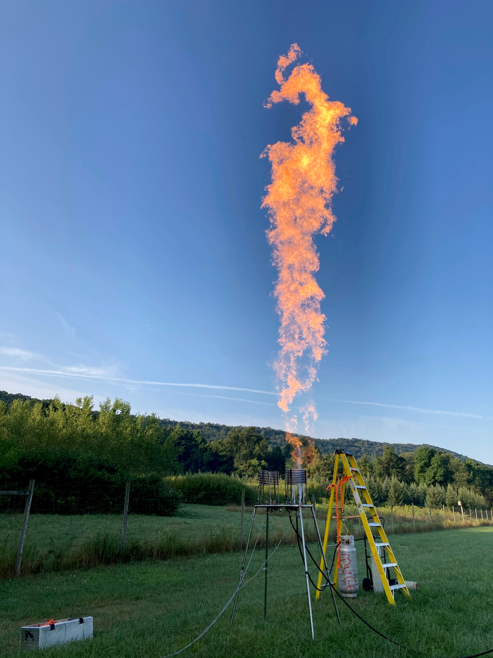
A coherent gas-combustion infrasound source
CTBT Science and Technology 2021
Poster No: P3.1-713
Chad Smith and Tom Gabrielson
Email: chad.smith@psu.edu
This work was supported by the Nuclear Arms Control Technology (NACT) Program at the Defense Threat Reduction Agency (DTRA).
Cleared for Release

Slide 2
Primary goal: Development of a practical coherent (non-explosive, periodic, with controlled duration) infrasound source to aid in IMS verification, calibration, and coherence studies.
Design goals:
Frequency coverage from 0.1 Hz to several Hz
Suitable for coherent processing (helping to increase SNR over wind noise)
Usable signal level at ranges greater than 1 km
Transportable
Reasonably cost efficient
Further information:
Smith, C. M., & Gabrielson, T. B. (2020). Farfield coherent infrasound generation using an air-propane burner. The Journal of the Acoustical Society of America, 148(5), 3181-3194.
Smith, C. M., & Gabrielson, T. B. (2018). Measurements and modelling of a gas-combustion infrasound source. In Proceedings of Meetings on Acoustics 176ASA (Vol. 35, No. 1, p. 045004). Acoustical Society of America.
Smith, C. M., & Gabrielson, T. B. (2018, April). Scaling of a gas-combustion infrasound source. The Journal of the Acoustical Society of America, 143(3), 1808-1808.
Smith, C. M., & Gabrielson, T. B. (2015). Theoretical model and experimental validation of a gas-combustion infrasound source. The Journal of the Acoustical Society of America, 137(4), 2407-2407.

Slide 3
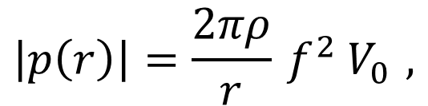
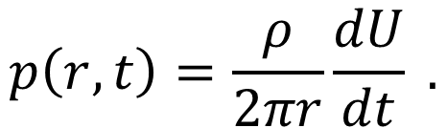




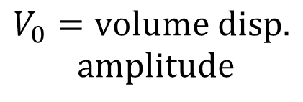
Practical infrasound sources are inefficient
Any practical (transportable) infrasound source will be much smaller wave length in the infrasound regime. However, simple sources are commonly known to be highly inefficient. The pressure from a simple source assumed to be baffled by the earth is described as,
$$U=volume velocity$$
$$p\left(r,t\right)=\frac{ρ}{2πr}\frac{dU}{dt} .$$
$$ρ=air density$$
volume acceleration
$$r=range$$
$$t=time$$
This relationship shows how the time domain pressure for a simple source is proportional to the volume or mass acceleration. Assuming a time harmonic source, examining the amplitude of this relationship in the frequency domain,
$$\left|p\left(r\right)\right|=\frac{2πρ}{r}{ f}^{2}{ V}_{0} ,$$
$$V_{0}=volume disp.$$
$$amplitude$$
it is obvious that (due to a frequency squared relationship) very large amounts of air must be displaced to create sub-hertz signals as useful levels.

Slide 4
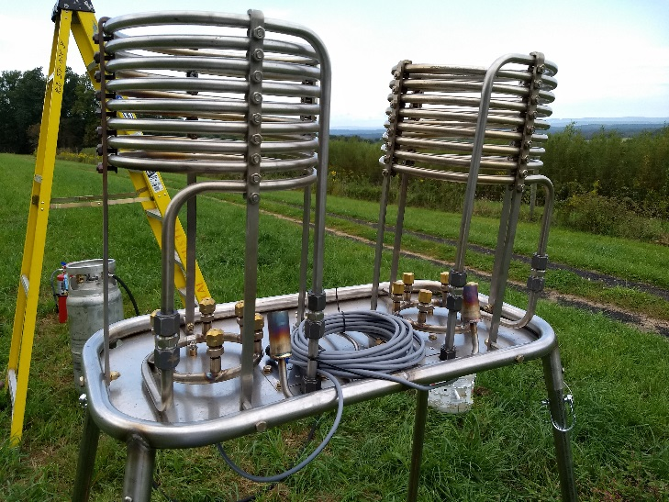
Available energy density
Due to the fundamental inefficiency of simple sources, the authors have proposed an unconventional but practical method of coherent infrasound excitation— using gas combustion to periodically displace large volumes of air within the open atmosphere.
Custom Built 10 MW Infrasound Source
Periodic displacement of gaseous combustion constituents not only allows far greater displacement than a conventional transducer, but also has four orders of magnitude greater energy density than releasing compressed air at common pressure levels.
Potential energy density in air at
150 PSI: 2 MJ/m³
Combustion energy density in propane: 29,000 MJ/m³
While an infrasound source will be inherently inefficient, this source method can increase the useful range of a sub-hertz infrasound source compared with previous work.

Slide 5
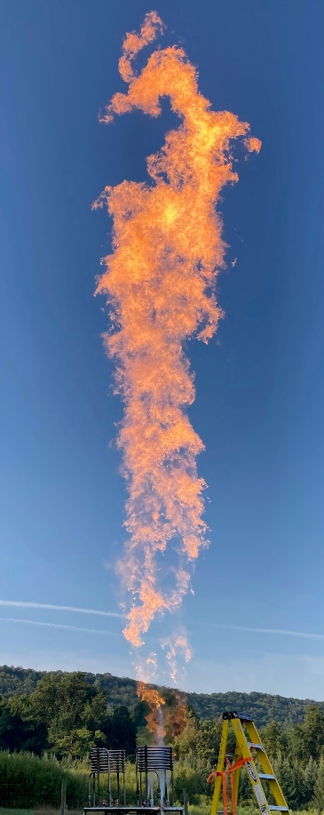

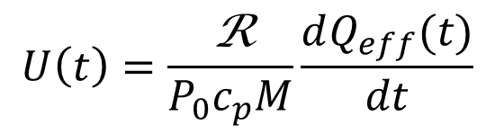

Thermodynamic model
An idealized thermodynamic model has been developed to estimate the volume velocity output of a cycled gas-burner. This model defines a thermodynamic control-mass (CM) encompassing the burner’s gaseous volume injection of highly heated combustion constituents. Assuming stoichiometric combustion, the volume velocity output of the source is directly proportional to the effective heat power of the burner. This relationship displays the scalable nature of this method, e.g., two burners placed near one another would output twice the volume velocity of a single burner. Please see reference at the bottom of this slide for model development.
CM
$$U\left(t\right)=\frac{\text{R}}{P_{0}c_{p}M}\frac{dQ_{eff}(t)}{dt}$$
$U\left(t\right)$ = volume velocity
$\frac{dQ_{eff}}{dt}$ = effective burner heat power
R = universal gas constant
M = molecular weight
P₀ = atmospheric pressure
c_{p} = specific heat at constant pressure for CM
Smith, C. M., & Gabrielson, T. B. (2020). Farfield coherent infrasound generation using an air-propane burner. The Journal of the Acoustical Society of America, 148(5), 3181-3194.

Slide 6
Source design and field testing
The source was designed to maximize heat power output while ensuring safe and automated control. The current prototype is compose of dual liquid propane burners. Liquid propane is periodically injected into the vaporization coils using digitally controlled solenoid valves.
A real-time-capable embedded controller in conjunction with solenoid valve control circuitry allows each burner to be tightly and synchronously controlled. This system also allows the system to be controlled remotely via an Ethernet/SSH connection.
Field testing was done by placing calibrated GRAS infrasound microphones throughout the test site (slide eight) with 3 or 6 meter wind-noise reduction systems. Microphones were placed from
Custom Built 10 MW Infrasound Source
vaporization coils
vapor fuel ports
50 to 1000 meters from the source. The source was operated for five minutes synchronously and the entire five minutes was processed using a single DFT.

Slide 7
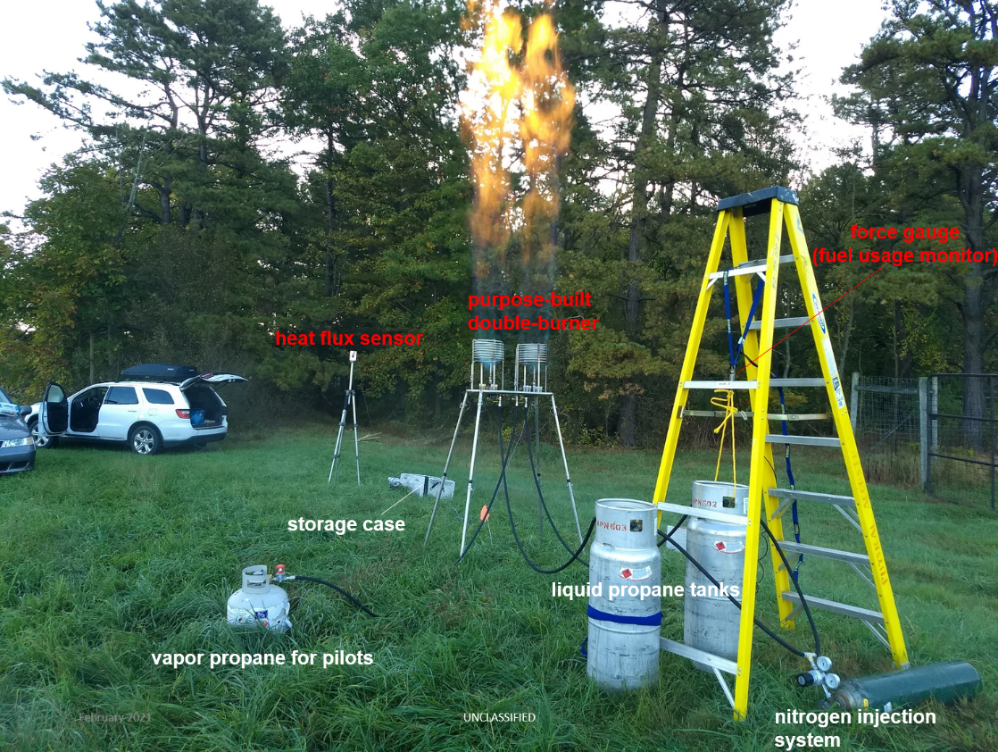
Source operation and measurements
Source operation requires a separate 43 lb liquid propane tank for each burner. These tanks are similar to those commonly used to power forklifts, however, these tanks have been retrofitted with high flow rate valves for liquid propane extraction, and vapor injection valves. The vapor injection valves are used to inject nitrogen
into the top of the tank. While nitrogen is inert and does not combust, this allows careful control of propane fuel delivery pressure. This control decreases the impact of latent heat of vaporization chilling the fuel tanks, increases source output, and reduces variation in source output signal level.
A standard vapor propane tank is used to power each burner’s pilot light. In early tests, a ladder and force gauge where used measure
Field-measurement Configuration
fuel usage, while a heat flux sensor was used to monitor thermal radiation. The ladder, force gauge, and heat flux sensor are not required for source operation.

Slide 8
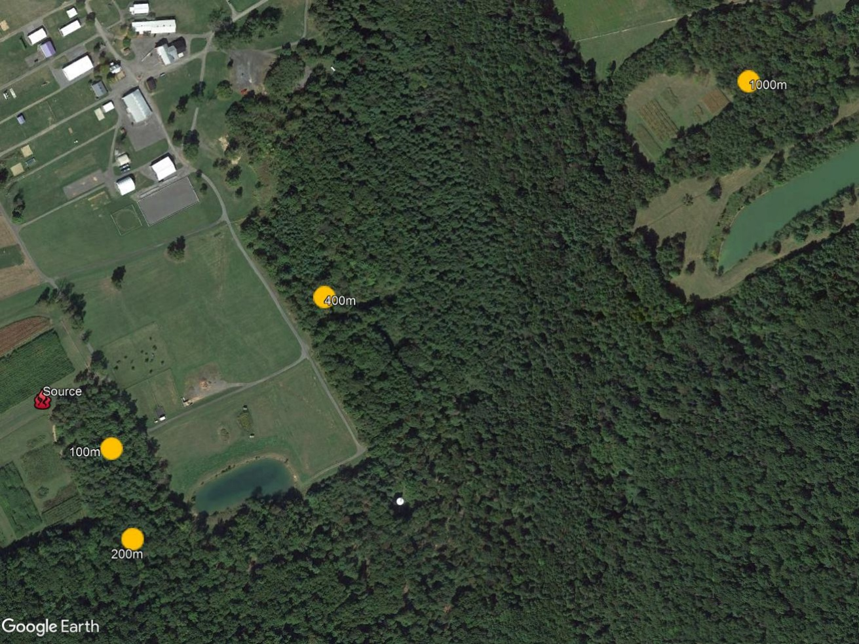
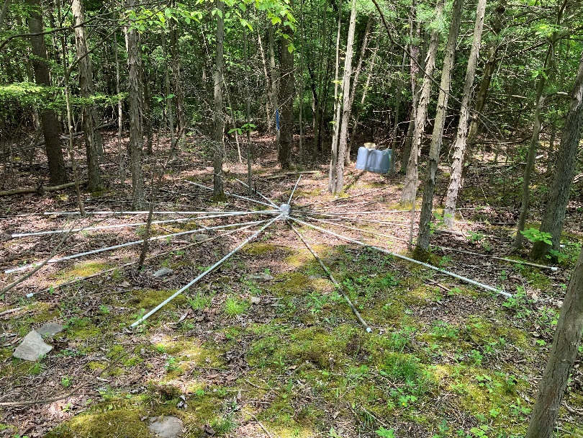
Source/receiver locations
200 m
3-6 m PVC Wind-noise Reduction Systems
receivers at 100, 200, 400, and 1000 meters
Russell E. Larson
Agricultural Research Center
Penn State University

Slide 9
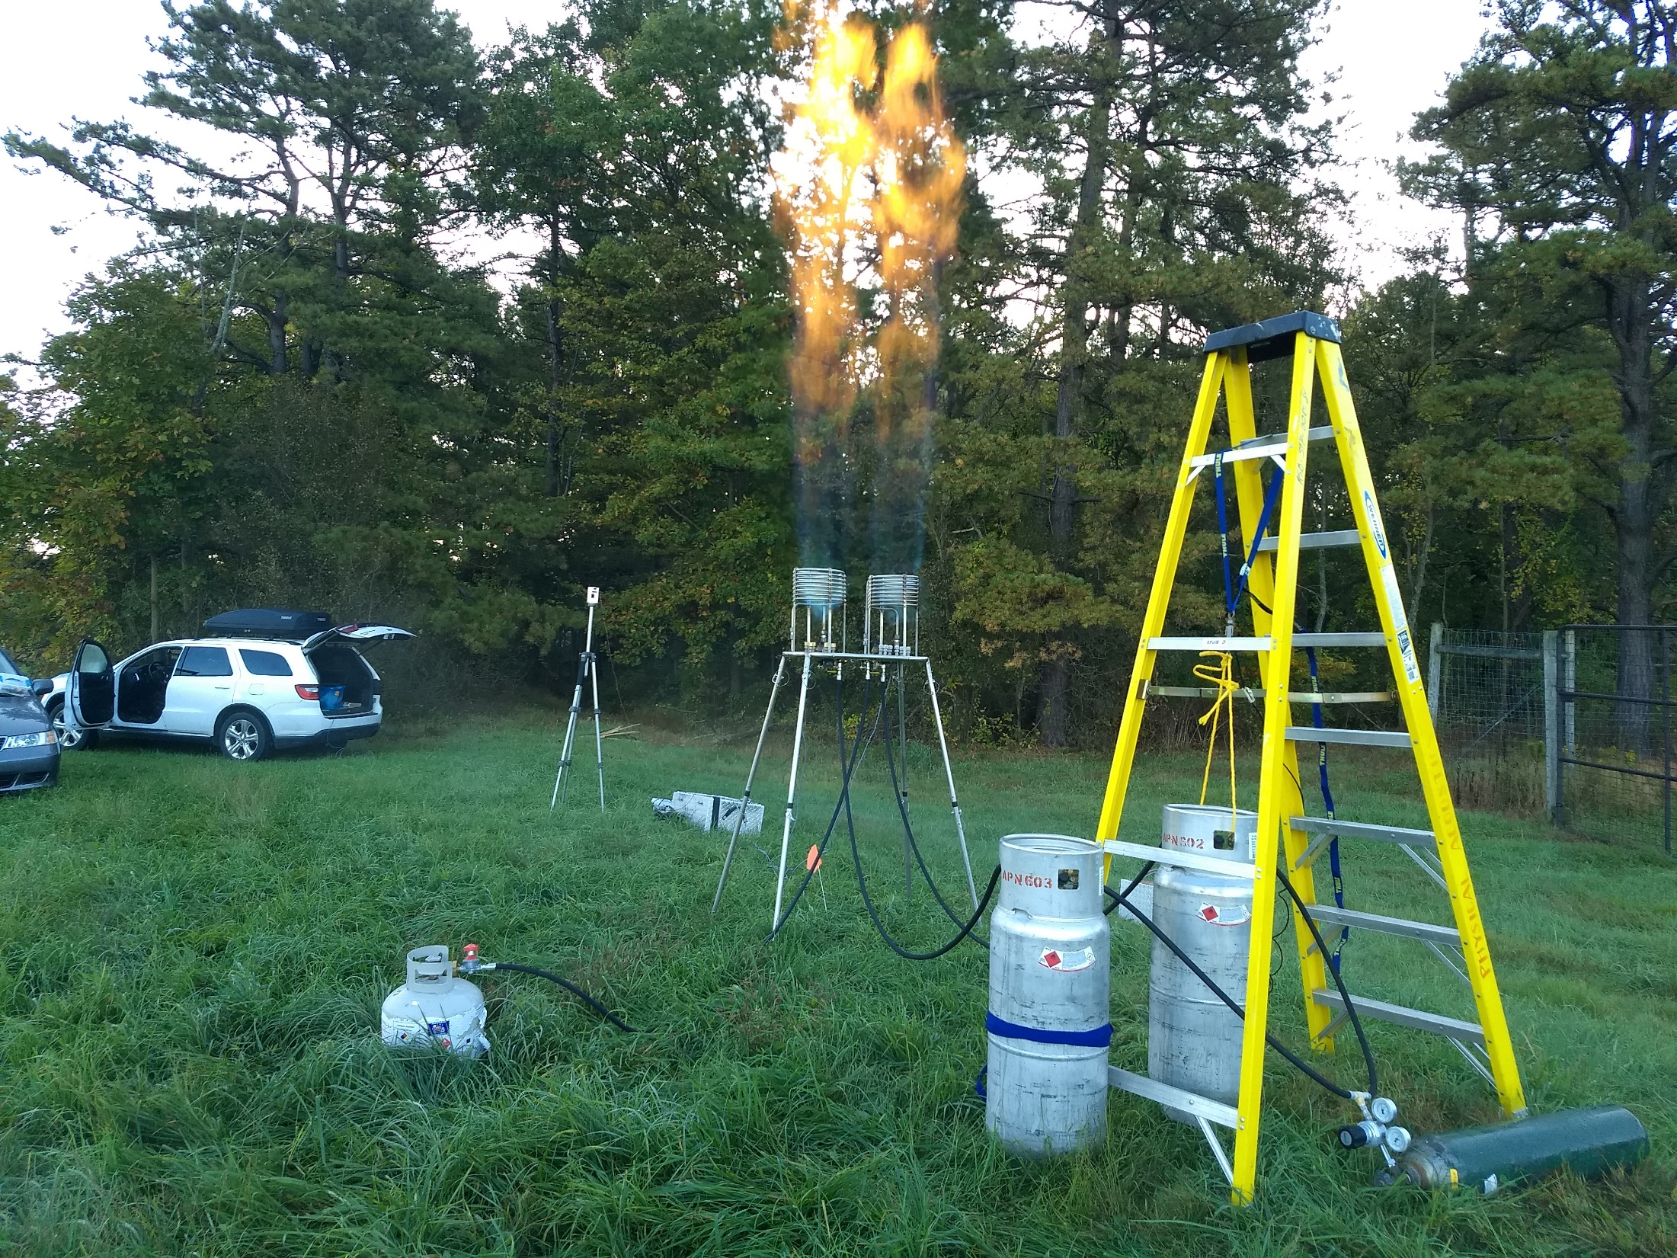
Measurement
Configuration
force gauge
(fuel usage monitor)
purpose-built
double-burner
heat flux sensor
storage case
liquid propane tanks
vapor propane for pilots
nitrogen injection
system

Slide 10
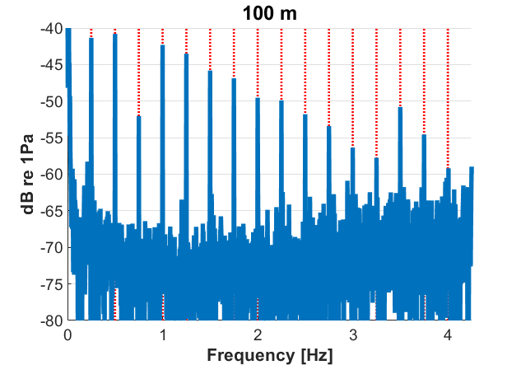
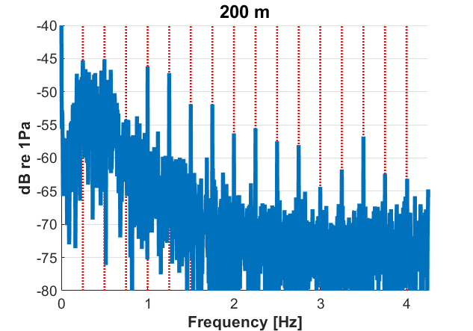
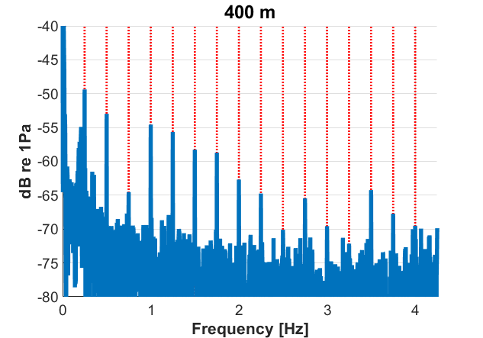
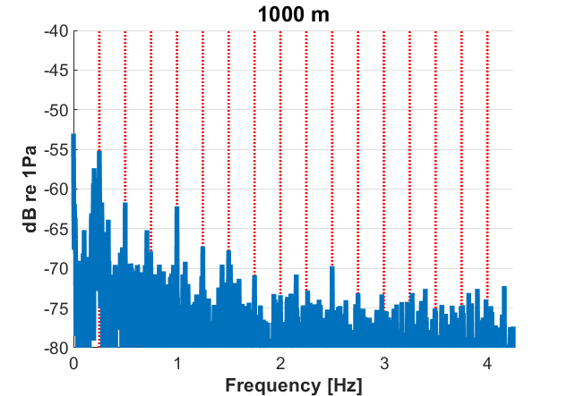
Signal-to-noise vs. Range (0.25 Hz fundamental)
fundamental and many harmonics still above noise floor at 1km

Slide 11
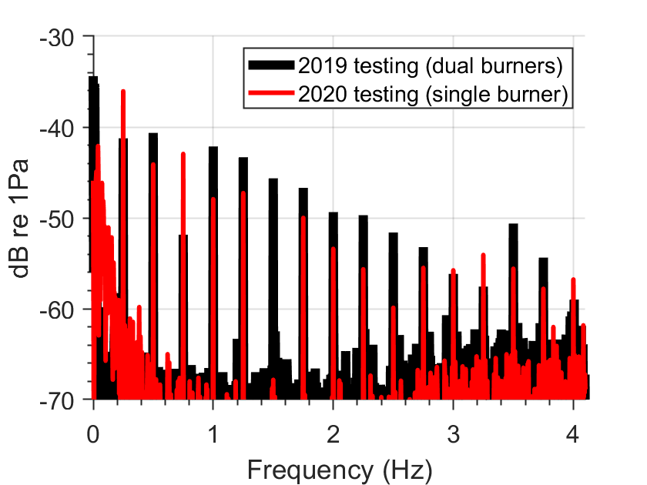
Increasing useful source range
In the 2019 test season, the thermodynamic engineering model and source method were validated. It was experimentally shown that this source method can produce sub-hertz infrasound that propagates into the farfield.
The 2020 test season focused on improving acoustic output through adjusting vapor fuel port dimensions, fuel delivery pressure, and the duty cycle of fuel modulation. While 2020 testing used a single burner and ranges of ≤400 m, acoustic output is believed to have been increased 6-12 dB at the fundamental.
Greatest Source Output (2019 vs. 2020)
5.25 dB
(100 m range)

Slide 12
Results:
A large gas-combustion infrasound source prototype was designed, built, and experimentally verified to create infrasound that propagates into the farfield
This source is easily transported and suitable for phase-coherent processing of signals to help overcome wind noise
Usable signal level was recorded at ranges greater than 1 km in low wind conditions in 2019. More recent work on this topic is believed to have increased signal level 6-12 dB compared with 2019 measurements.
Future work:
Further refinement of source operations and optimization of useful range
Characterization of frequency band capability for the fundamental (testing thus far has been at 0.25 Hz)
On-site testing at an IMS or similar monitoring station

