Slide 1

Operation and maintenance of Japanese RN stations under the COVID-19 related
Yutaka Tomita, Akiko Furuno, Yoichi Yamamoto
CTBT and Nuclear Materials Transport Support Section
Integrated Support Center for Nuclear Nonproliferation and Nuclear Security
Japan Atomic Energy Agency

Slide 2
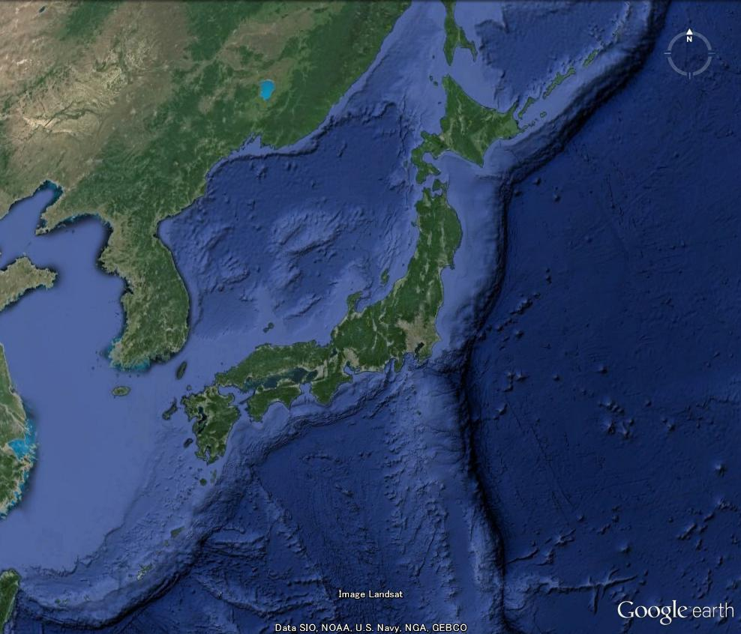
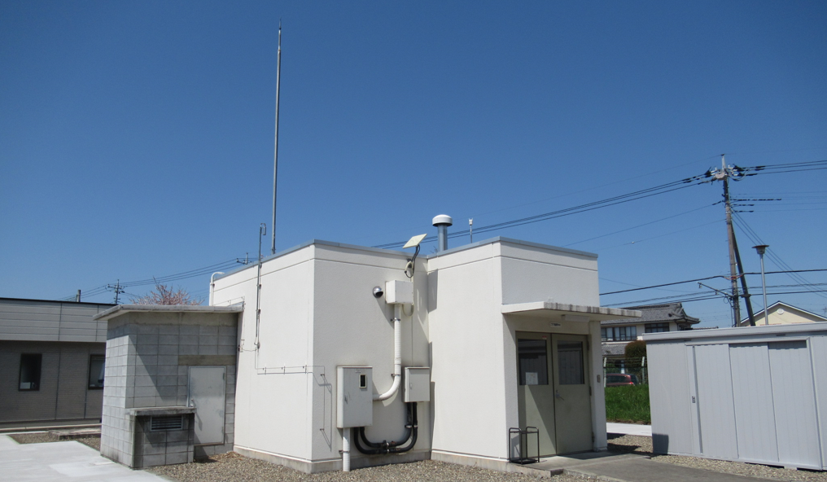
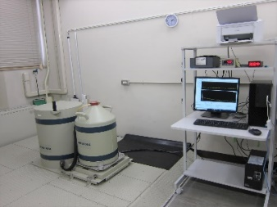
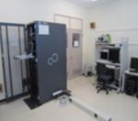
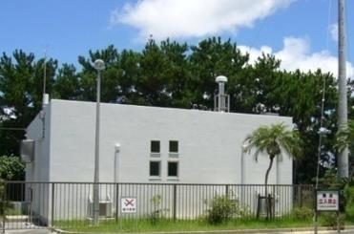
Radionuclide Facilities in Japan
【Radionuclide Stations】
・Okinawa (RN37)
・Takasaki (RN38)
Local operators perform
daily checks and maintenance
works on site
Takasaki Station
（RN38）
・Particle(JPP38)
・Noble gas(JPX38)
Tokai Radionuclide Laboratory（RL11）
NDC-2
(for Radionuclide)
【Radionuclide Laboratory】
・Tokai (RL11)
【National Data Center-2】
・Tokai
Okinawa Station
（RN37）
・ Particle(JPP37)
Station operator & station
manager stay in Tokai

Slide 3
Impact of “State of Emergency” for the station
Japanese government asked for a minimum of reduction in people-to-people contact and performed immigration restrictions of visitors from foreign countries.
JAEA's response to the government's request
・Reduce local operators and JAEA staffs to less than half
・Self-restraint of business trip for maintenance work
・Postponement of maintenance performed by manufacturer
Number of positive with PCR test in Japan
State of emergency
for some areas
(4/23-6/20)
National state of
emergency
(4/16-5/25)
Third wave
State of emergency
for metropolitan area
(1/8-2/21)
Fourth wave
Second wave
First wave

Slide 4
Trouble shooting for RN37 and RN38
Troubles of RN37 and 38 during COVID-19 pandemic
RN37 Okinawa (JPP37)
・Failed a preamplifier of detector
・Failed a System Instrumentation Unit
RN38 Takasaki
1)JPP38
・ Failed a preamplifier of detector
・RASA system down due to barcode
misreading
2)JPX38
・Failed sampling pumps
CTBTO
Technical Advice
Trouble
Shooting
Information
Sharing
Report
Station Manager
Station Operator
Tokai
Manufacturer
・General Dynamics :USA
(JPP37, JPP38)
・Scienta SAUNA systems :Sweden
(JPX38)
Trouble
Shooting
Report
Takasaki,
Okinawa
Local Operator
Flowchart for trouble shooting

Slide 5
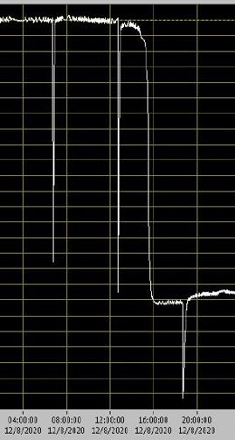
Example-1
Trouble caused by postponement of annual maintenance of SAUNA
※
Normally, an annual maintenance for the SAUNA is carried out as followings with an engineer of the manufacture (Scienta SAUNA system)
Main annual maintenance works
・General system check-up and evaluation of data
・ Replacement of part and equipment
sampling pumps, air inlet filter, check
valves and gas line filters, etc
・ Leak check of the system
・ Recalibrate of the Gas chromatography
・ Check of detector performance
Sampling pumps were failed due to postpone of
the annual maintenance
Sampling pressure drop
※ SAUNA : Swedish Automatic Unit for Noble Gas Acquisition

Slide 6
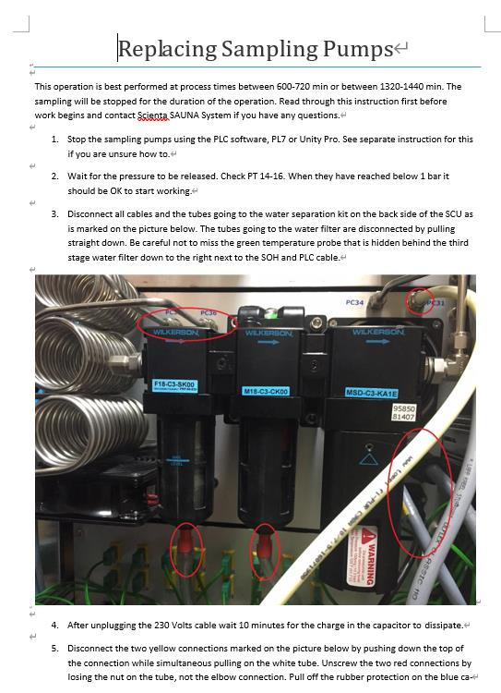
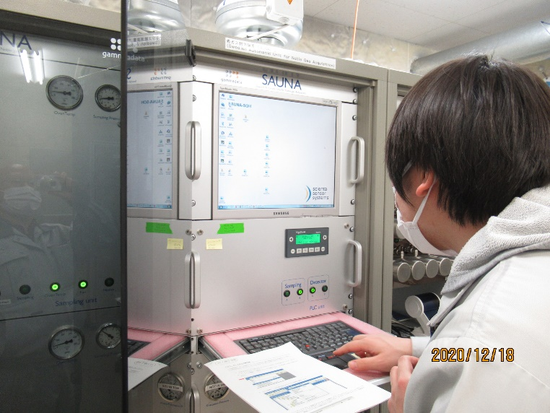
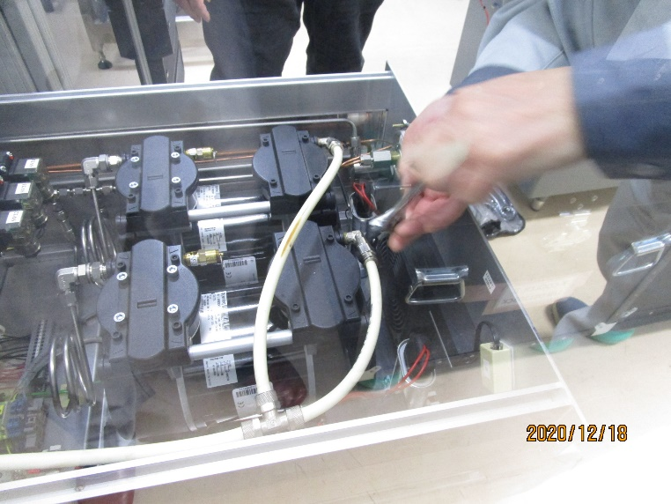
Example-1
Replacement of pumps by local operators
Detailed instruction sent from CTBTO
Replacement of the sampling pumps

Slide 7
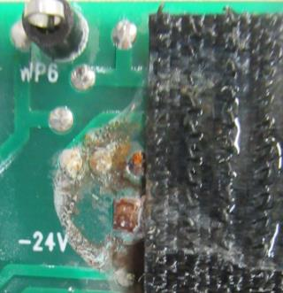
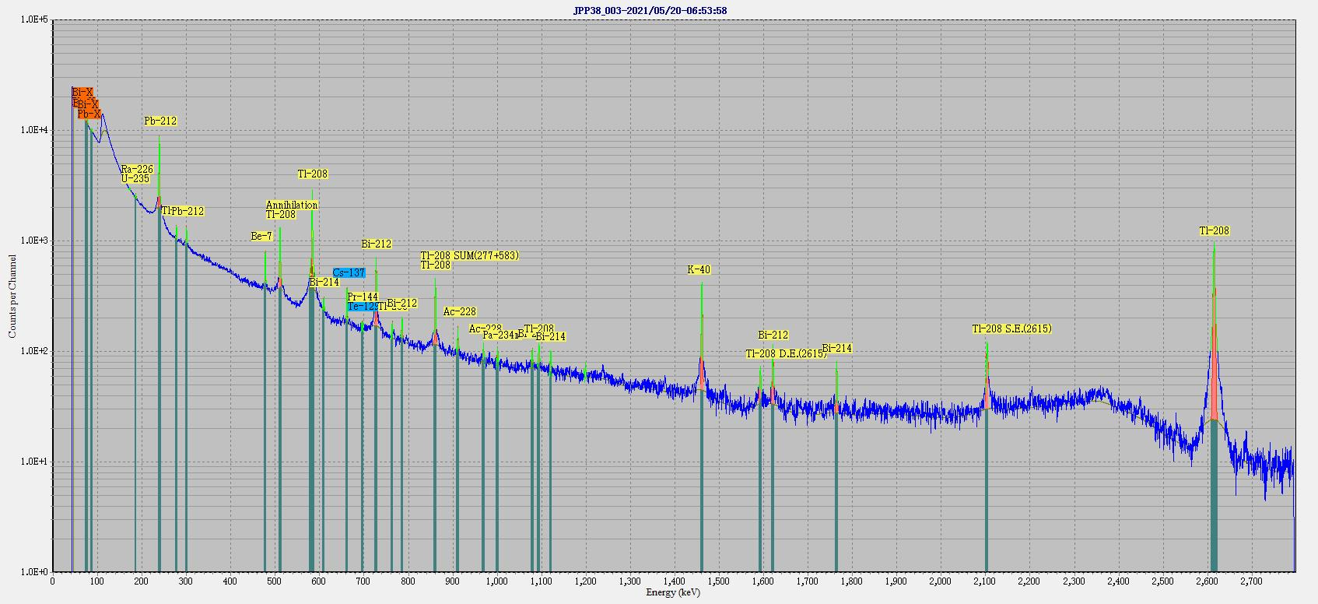
Example-2
Trouble of a detector for RASA
※
・Many noises appeared in the spectrum of RASA
・The cause was corrosion of the preamplifier
in the detector
Noise
※RASA：Radionuclide Aerosol Sampler/Analyzer

Slide 8
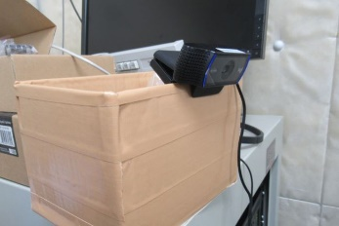
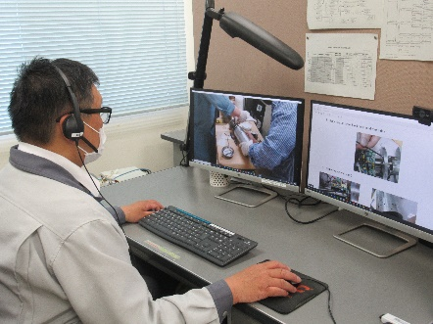
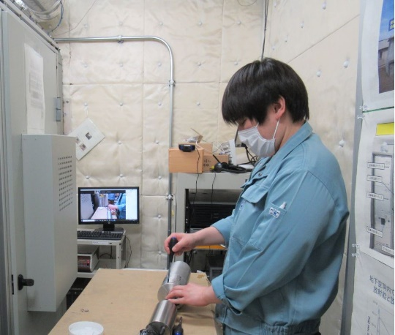
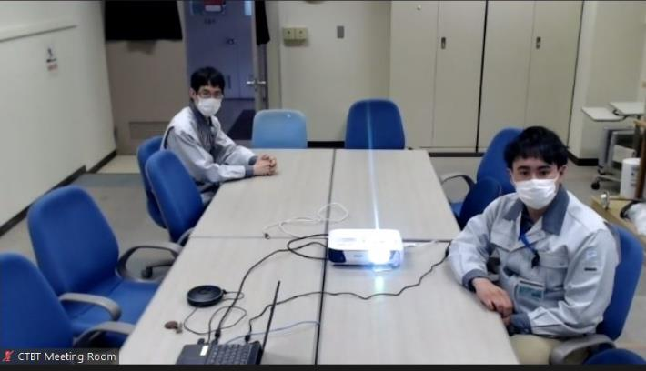
Example-2
Remote support for maintenance work using web conferencing software
Advantages of using the web conferencing software
・Instructions of maintenance work can be given to local operators remotely
・Save time and travel allowance
・Share the maintenance experience with other staffs
・Recording can be used as training material for current and future operators
RN38 Takasaki
Tokai Office
Web camera
Connecting with
Web Conferencing
Software
Monitor

Slide 9
Summary
Equipment failures that occurred during COVID-19 pandemic were addressed through close communication with the stations, CTBTO, and manufacturers.
Instructions sent from CTBTO are very detailed and helpful. Station Operators hope that more and more such instructions will be developed.
It is very effective to use web conferencing software for support of the maintenance work done by local operators.

