Slide 1

SnT2021 Panel
Innovation affecting CTBT: pertinent to IMS monitoring system (sensors)
Distributed Optical Fiber Sensing
Geoffrey Cram
Applied Physics Laboratory, University of Washington

Slide 2
Distributed Optical Fiber Sensing
Geoffrey Cram
Geoffrey Cram
Distributed Optical Fiber Sensing (DOFS) Fundamentals
Interrogator laser injects light pulses, typically at multiple kHz rate into fiber.
Features in fiber scatter incoming pulse, reflect small portion of light back to detector.
Fiber features can be affected by environmental conditions, causing variations in amplitude, phase, polarization of returned light.
Interrogator transforms variations in returned pulses into environmental measurement of interest.
Properly-selected pulse interval allows individual fiber segments (sensors) to be independently addressed → localized measurements at known positions along fiber. Position established from time-of-flight.

Slide 3
Distributed Optical Fiber Sensing and its Potential Application for IMS Hydroacoustic Stations
Cram*, Winebrenner, Williams, Wilcock *cramg@uw.edu
O3.1-384
Rayleigh Backscatter (a.k.a. DAS/DVS/DRS)
Elastic scattering of incident photons.
  Interaction between probe wave and local, fixed refractive index variations in fiber (<100 nm scale).
  Polarization is preserved in the scattered photons.
  Dynamic (down to mHz) with fixed frequency source.
Used for temperature and strain sensing.
  Reported: 0.005 ºC resolution (DTGS); 1 – 20 m spatial resolution; 100s-1000s of Hz; 100 km max range.
Commercial users:
  Power cables (temperature and strain), borehole seismic (onshore/offshore), borehole flow (temperature, acoustic), surface seismic, perimeter surveillance (strain), pipeline monitoring (temperature and strain).
Strengths:
  Very high update rate.
  Extremely sensitive to temperature and strain.
Limitations:
  No commercial static implementations yet.

Slide 4
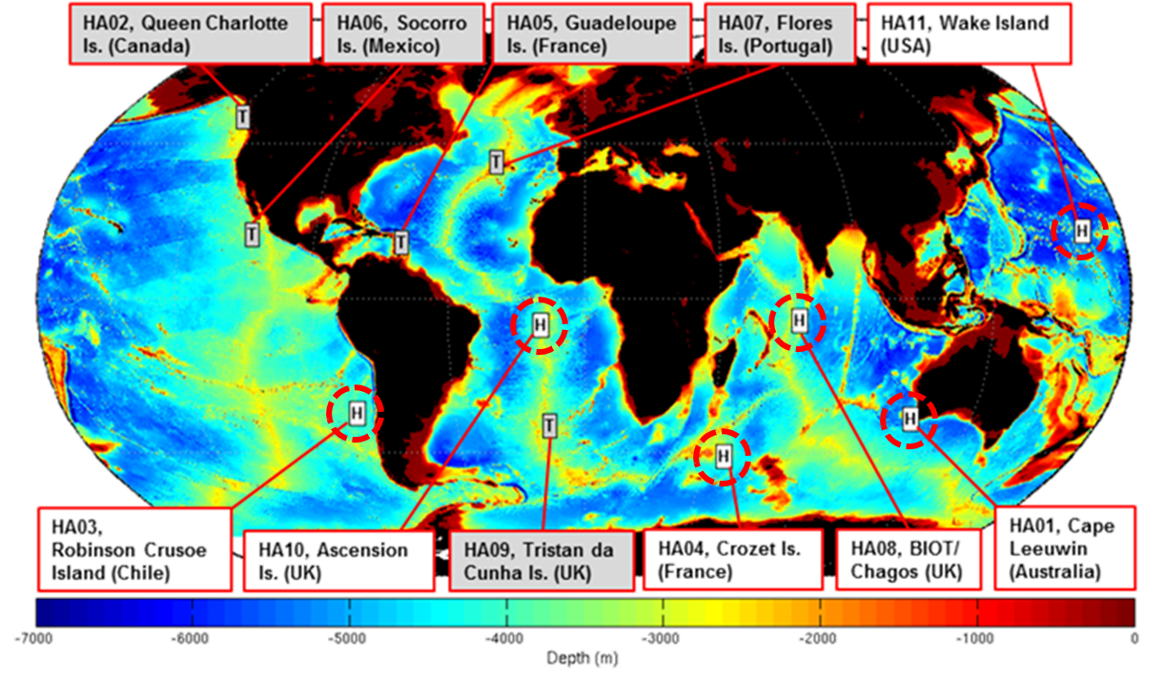
Distributed Optical Fiber Sensing and its Potential Application for IMS Hydroacoustic Stations
Cram*, Winebrenner, Williams, Wilcock *cramg@uw.edu
O3.1-384
The IMS HA Network
White stations labeled ‘H’:
Circled in red. 6 hydroacoustic stations (11 triplets) at which moored hydrophones detect hydroacoustic signals in the water column.
Grey stations labeled ‘T’:
T-phase on-shore seismometers. Not addressed here.

Slide 5
Distributed Optical Fiber Sensing and its Potential Application for IMS Hydroacoustic Stations
Cram*, Winebrenner, Williams, Wilcock *cramg@uw.edu
O3.1-384
Anatomy of a CTBTO Hydroacoustic Triplet

