Slide 1
Use of CTBTO data in regional earthquake monitoring
Xyoli Pérez-Campos
Instituto de Geofísica
Universidad Nacional Autónoma de México
Panel discussion on Civil and scientific applications
SnT2021
2 July 2021

Slide 2
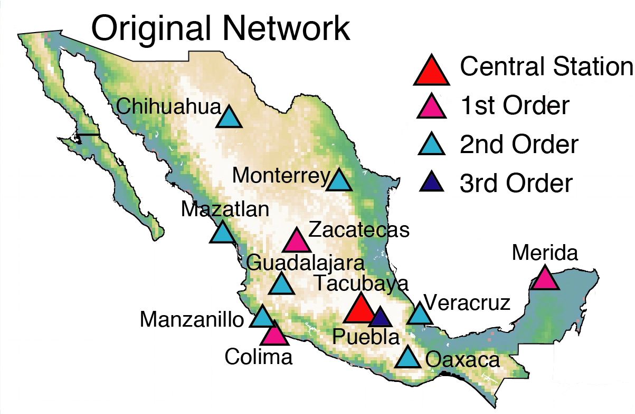
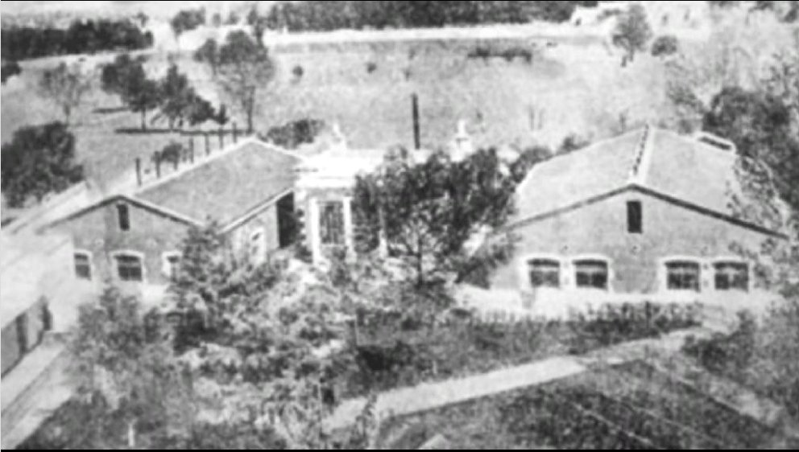


National Seismological Service
Transfer to UNAM in 1929
Geophysics Institute was established in 1948, in 1953 got in charge of the SSN.
Founded in 1910
Pérez-Campos et al. ISC Bulletin [2019]

Slide 3
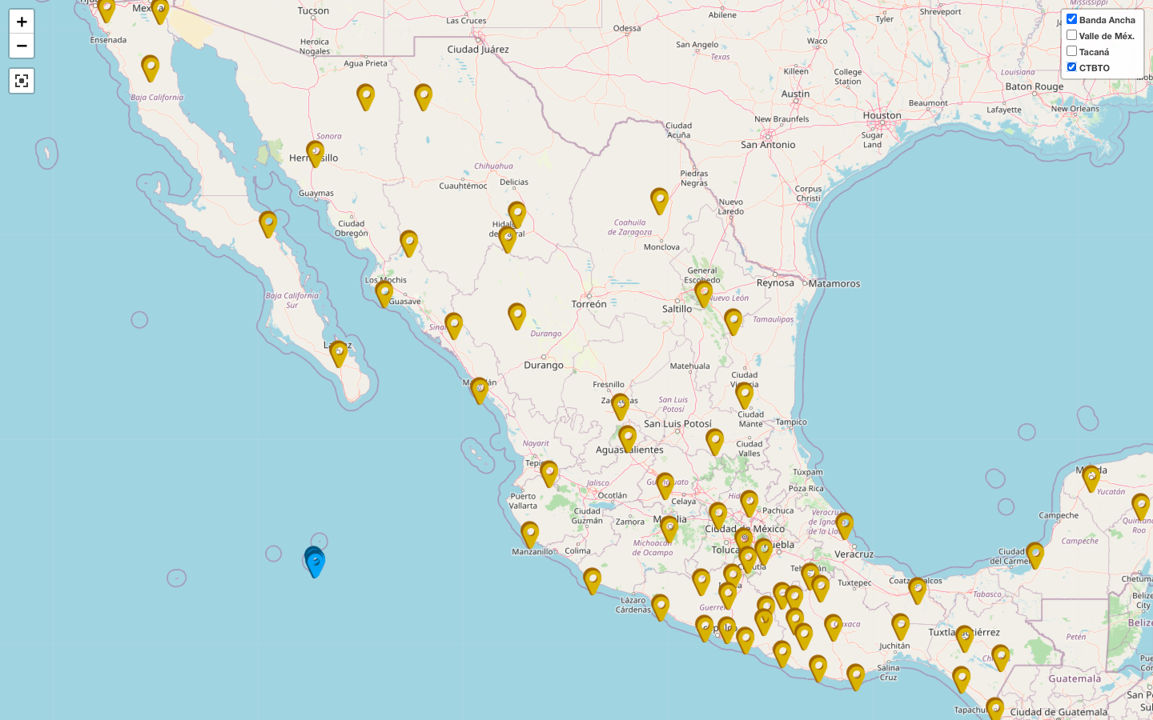
Broadband seismic network
63 stations
HA06

Slide 4
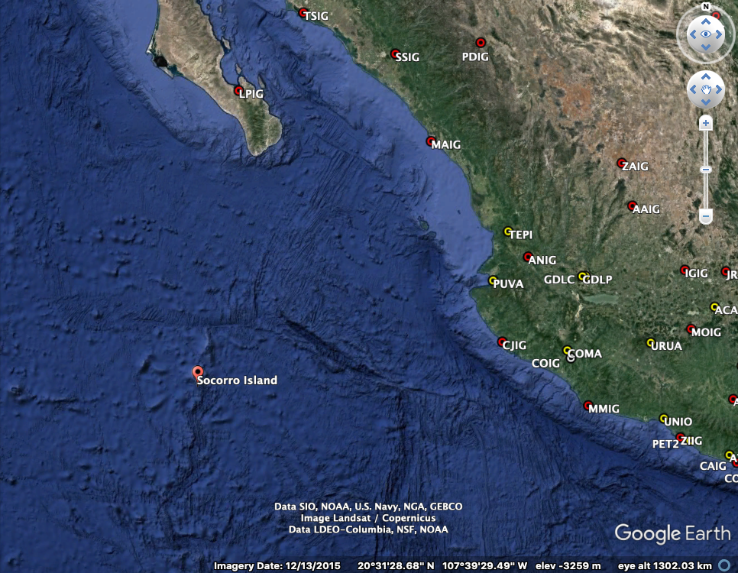
Rivera Fracture Zone

Slide 5
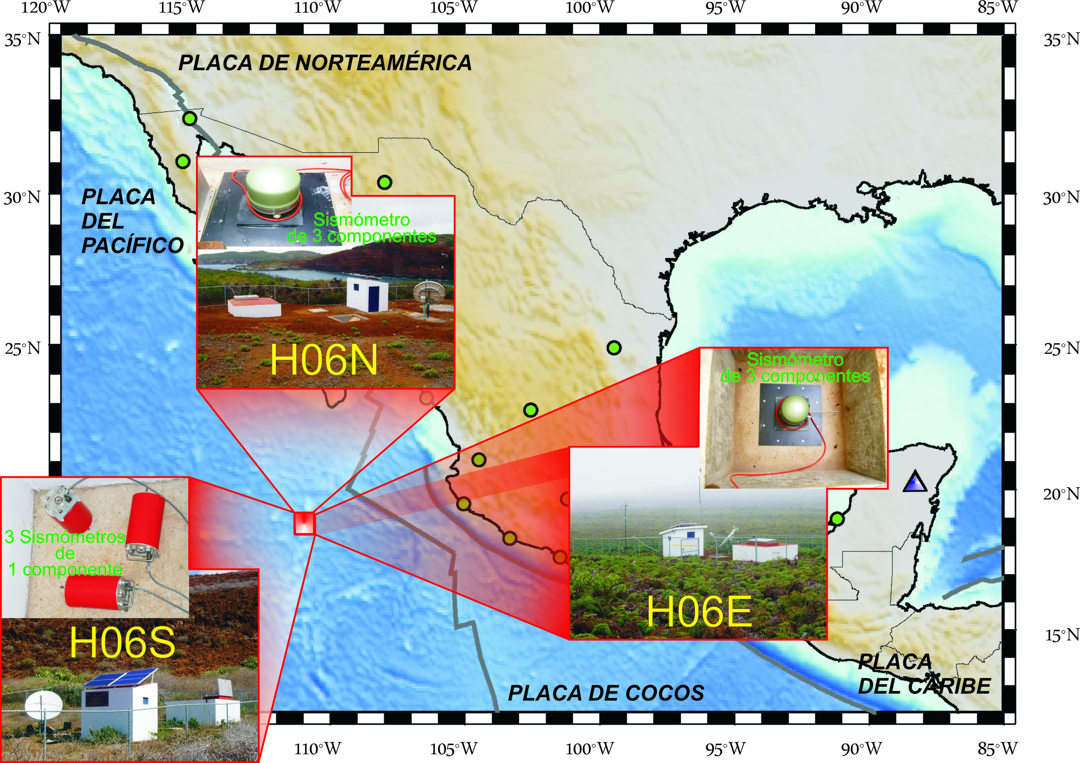
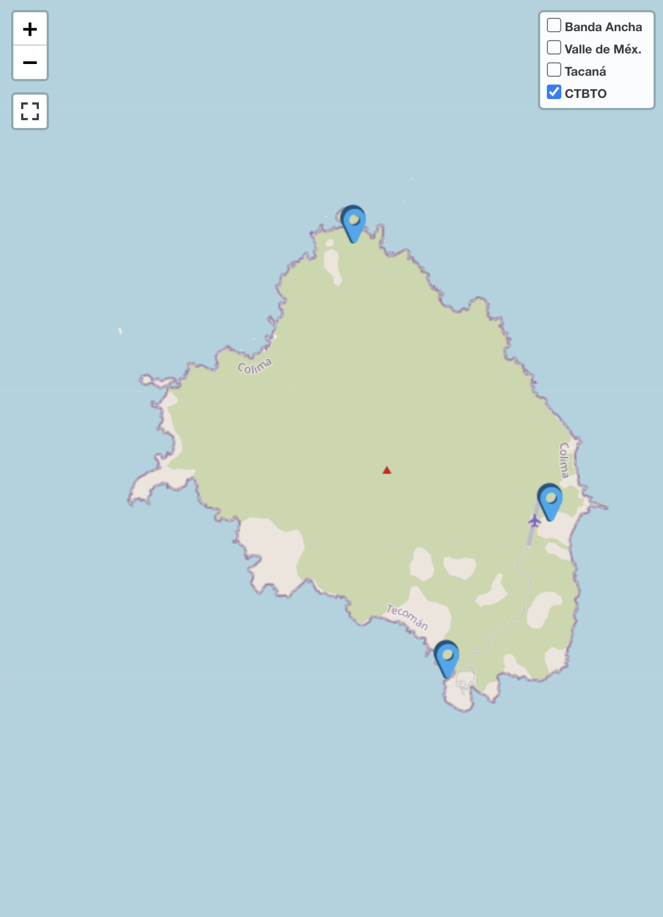
Station HA06

Slide 6
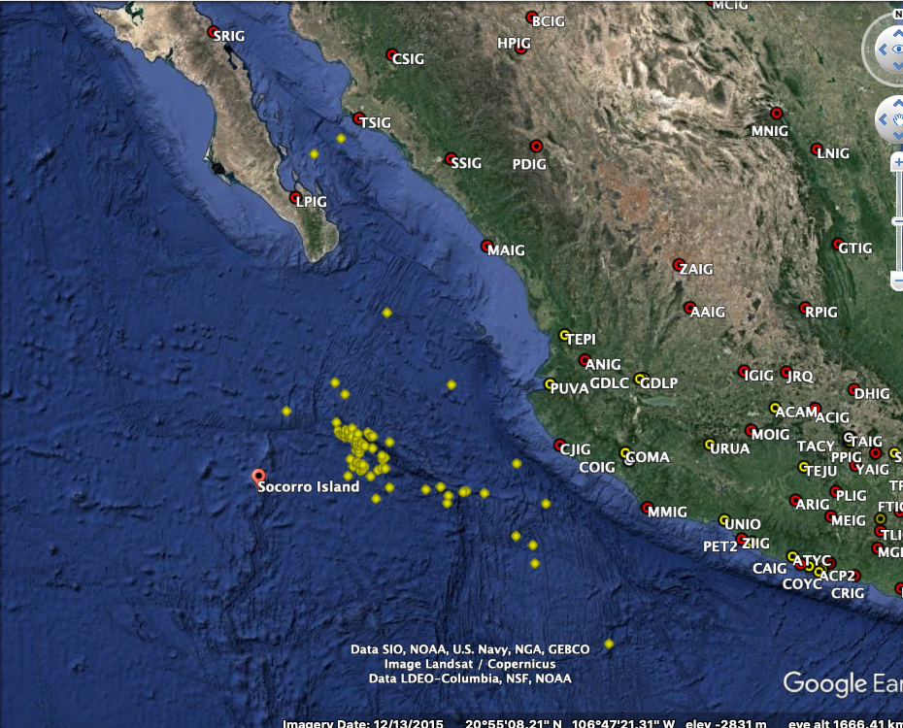
2004 - 2021
93 events
4 ≤ M ≤ 6.4

Slide 7
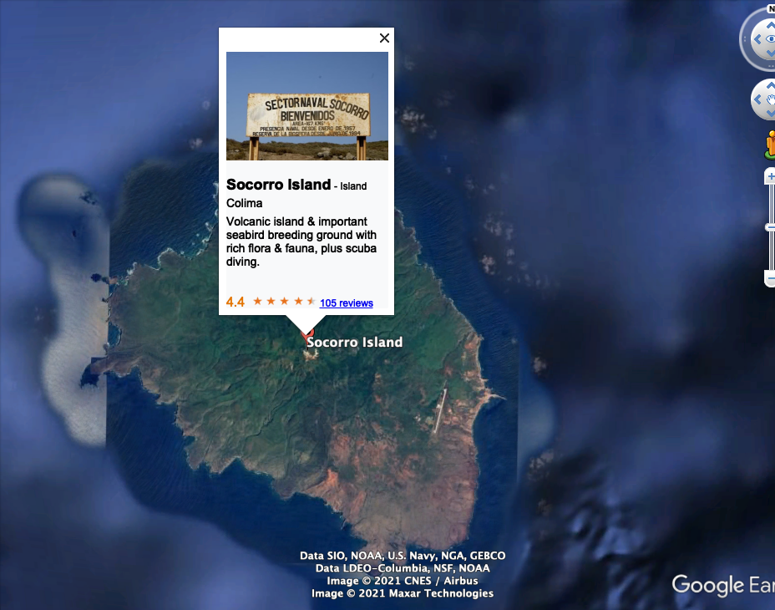

Slide 8

GRACIAS xyoli@igeofisica.unam.mx
@xyolipc

