Slide 1
Understanding Risk & Metrics:
A false sense of security?
Steve MacFeely
Chief Statistician
UNCTAD

Slide 2
Global Health Security Index – Inaugural report 2019
Countries not prepared for a globally catastrophic biological event, nor are they fully prepared for epidemics or pandemics
Collective international preparedness is weak. Many countries do not show evidence of the health security capacities and capabilities needed to prevent, detect, and respond to significant infectious disease outbreaks
Prophetically, they warned: “knowing the risks, however, is not enough. Political will is needed to protect people from the consequences of epidemics, to take action to save lives, and to build a safer and more secure world”.
They also noted that “unfortunately, political will for accelerating health security is caught in a perpetual cycle of panic and neglect”.

Slide 3
Global Health Security Index - configuration
A multidimensional analytical framework or benchmarking index.
A composite comprising six categories:
(1) prevention;
(2) detection and reporting;
(3) rapid response;
(4) health systems;
(5) compliance with international norms; and
(6) risk environment.
Populated with 34 indicators and 85 subindicators.
The overall index for each country is the weighted sum of the category scores, where the weights are agreed by an expert panel

Slide 4
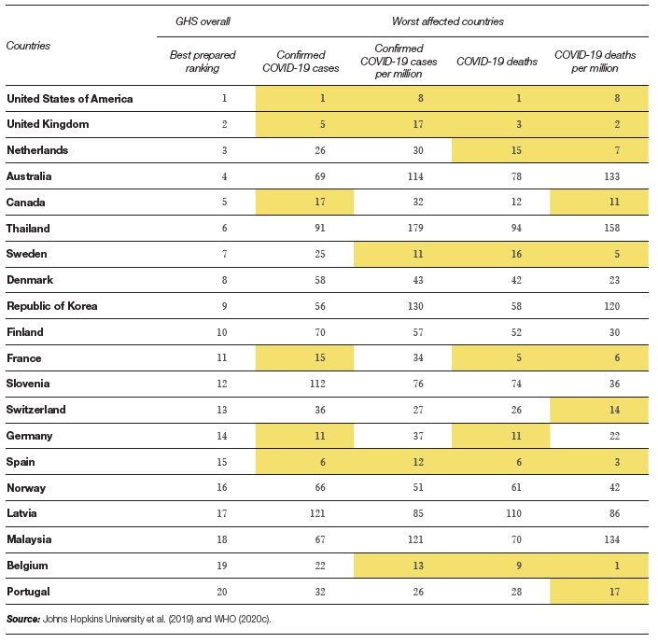
Global Health Security Index - Top 20 best prepared countries compared with 20 worst affected countries by COVID-19 (as of May 31st 2020)

Slide 5
Questions and lessons
Early days – index may perform better in the longer term
Health v Public Health vulnerabilities: The importance of public health systems / public infrastructure and services made clear by COVID-19
Justifies a more considered reflection on public services generally, including the strength and investmentin national statistical systems, but in particular investment in public health systems.
Risk environment to limited
Supplement index to take account of potential transmission vectors - connectivity and globalization indices would strengthen Health the robustness of the index.

Slide 6
Questions and lessons
Do country rankings have any real utility or simply distract readers from important underlying messages?
Although the report issued many stark warnings, the indices themselves may have conveyed a different message; at least for countries ranked near the top, with scores in excess of 70, the indices may have given a false sense of security.
Did the GHS help governments to understand the risks? Does it provide guidance on how to prepare for crises?
The authors portentously noted the importance of ‘political will’
This seems to have been the critical factor in how well countries have dealt with COVID-19 to date. Unfortunately, it is extremely difficult to measure political will. Furthermore, in light of developments, this dimension might warrant a higher weight in the overall index.

