Slide 1
Welcome to risk: As we know it or, do we?
Loretta Hieber Girardet
Chief, Risk Knowledge, Monitoring and Capacity-Development Branch
United Nations Office for Disaster Risk Reduction (UNDRR)

Slide 2
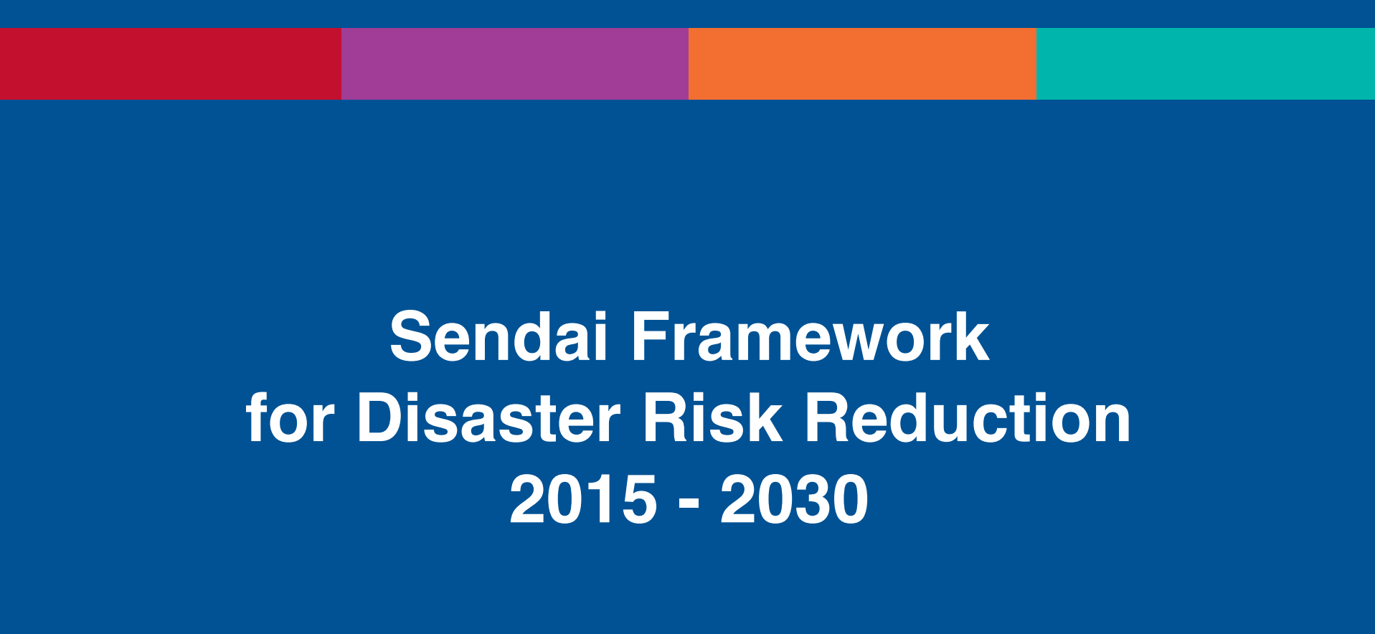
The Sendai Framework for Disaster Risk Reduction
Disaster Risk Reduction
  Para. 15. The present Framework will apply to the risk of small-scale and large-scale, frequent and infrequent, sudden and slow-onset disasters caused by natural or man-made hazards, as well as related environmental, technological and biological hazards and risks. It aims to guide the multihazard management of disaster risk in development at all levels as well as within and across all sectors.
Notes:
The Sendai Framework outlines a multi-hazard approach to risk
..and Para 15 is the point of departure.

Slide 3
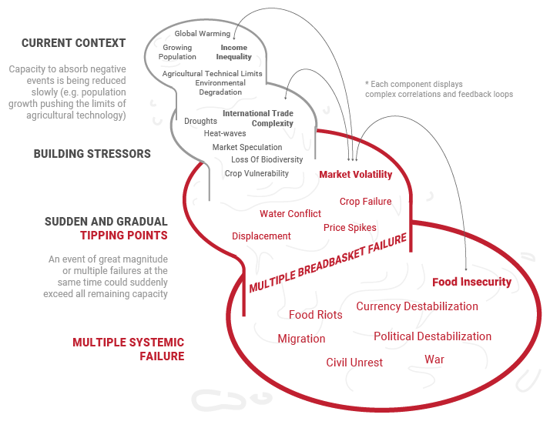
Growing risk in a shrinking world
Risk must not be compartmentalized.
Notes:
Risk is complex.
We need to avoid resorting to reductive measures that ignore the systemic nature of risk.
We must push back against approaches that treat risks in isolation of their contexts.
We must break away from the prevailing practice of compartmentalized research, hazard-by-hazard risk assessment and management if we are to improve understanding of complex systems and risk and identify solutions. This applies as much to our institutional configurations and mechanisms for risk governance as it does to community organization, research endeavours and macroeconomic policy.
Data and analytics tend to compartmentalize risk, to make it seem quantifiable; this is dangerous. Think of climate change due to global warming that is now contributing to environmental degradation and biodiversity loss with impacts on food production, international trade, financial market volatility and political instability. Or NATECH disasters where an extreme weather event can realize a “hidden” technological risk, damaging a power grid with cascading effects on business continuity, critical infrastructure and disruption of basic service. National bodies of governance and humanitarian actors with representation from all sectors must assume an all-of-State and non-state inclusive approach to risk reduction

Slide 4
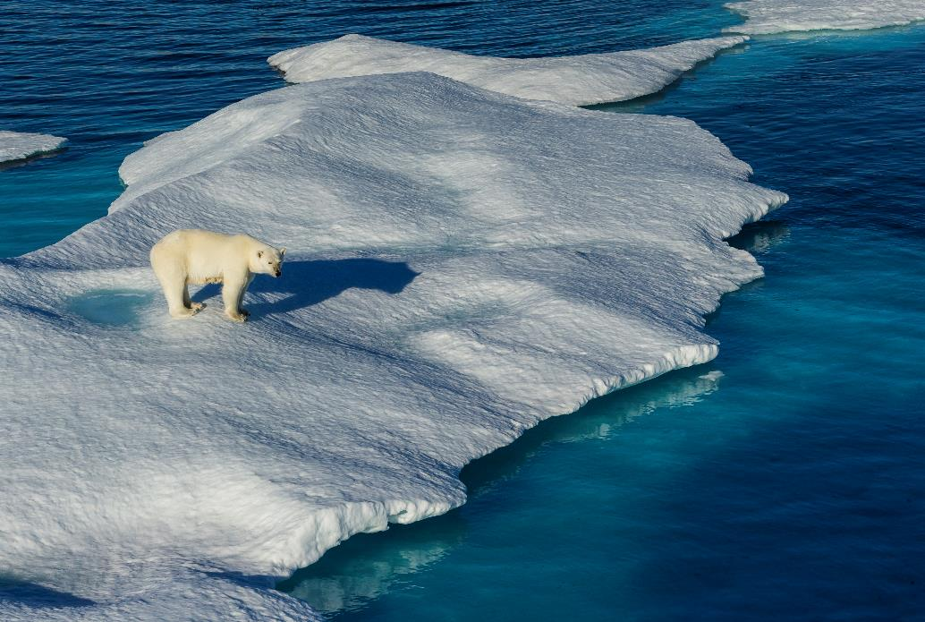
Climate change – the great risk amplifier
“If solutions within the system are so impossible to find, maybe we should change the system itself.”
Greta Thunberg
Sweden, youth advocate
for global action on change, 2019
Notes:
Decades-old projections about climate change have come true much sooner than we expected and at a calamitous scale.
The threshold of limiting global warming increase to 1.5°C above pre-industrial levels that the Paris Agreement sought to cap, will be surpassed by the early 2040s.
The development of risk reduction strategies and plans at the local, national and regional levels, and the assessments that underpin them, must integrate near-term climate change scenarios, and elaborate the enabling conditions for transformative adaptation presented by IPCC.

Slide 5
COVID-19 pandemic – the stark reminder
Epidemics are a stress test for a system....the issue is how much resilience is built into those systems
Scenario A
Scenario B
Dr. Michael J. Ryan,
WHO Informal Advisory Group.
Natural /
Man-made / Environmental / Technological
Natural /
Man-made / Environmental / Technological
'Covid has magnified every existing inequality'
Biological hazards
– Melinda Gates
Co-Chair, Bill and Melinda Gates Foundation
Notes:
The COVID-19 pandemic reminded the world that the days of one hazard, one impact are over and dual (or at times multiple) disasters have become a norm

Slide 6
UNDRR’s key areas of engagement
Strengthening Risk Information and Evidence
Enhanced science agenda
Comprehensive risk assessments
Improved disaster loss accounting
Monitoring progress in disaster risk reduction (SFM)
Promoting comprehensive disaster and climate risk management
Integrating climate change considerations into DRR strategies, policies and action
Technical support and policy advice on risk- informed adaptation
Partnerships and alliances
Scaling up local action to build resilience
Making Cities Resilient (MCR) 2030
Systemic risk analytics tailored for urban settings
Strengthened application of consistent resilience, climate change and DRR metrics

Slide 7
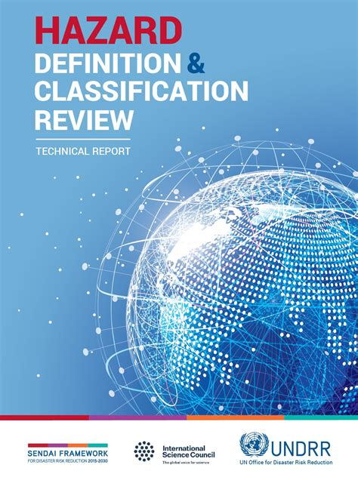
Expanding our understanding of hazards
302 hazards
8 clusters of hazards
5 nuclear related hazards
Notes:
Hazard information when combined with exposure, vulnerability and capacity is fundamental to all aspects of disaster risk management, from multi-hazard risk assessments for prevention and mitigation to warnings and alerts, to disaster response and recovery, long-term planning and public awareness.
This includes supporting the uptake of the hazard list and HIPs as a tool for countries to investigate the potential sources of risk in their particular context, which requires developing further guidance for end-users. has the potential to impact a community; has measurable spatial and temporal components; proactive and reactive measures are available.
“a process, phenomenon or human activity that may cause loss of life, injury or other health impacts, property damage, social and economic disruption or environmental degradation”.
The hazard list comprises 302 hazards grouped according to eight clusters: meteorological and hydrological hazards, extraterrestrial hazards, geohazards, environmental hazards, chemical hazards, biological hazards, technological hazards, and societal hazards.
There is an urgent need to investigate further the direct and indirect linkages and effects of natural, biological, technological and other human-induced hazards to identify better and understand cascading and complex hazards and risks in a systematic way.

Slide 8
Improving use of risk information:
GRAF (Global Risk Assessment Framework)
GRAF aims to strengthen the capacity of UN member states to generate, disseminate and apply risk information in development and humanitarian contexts reflective of the increasingly systemic and interconnected nature of risks. GRAF will facilitate access and use of systemic risk information to support more resilient development and humanitarian action, and public & private investment
INTENT
Help countries better access and use risk information
Help decision-makers at national and sub-national levels to address gaps in risk knowledge
Support actors to strengthen their understanding to effectively manage risk.
Advocacy, financing, and partnerships for systemic risk reduction.
Improved access to hazard, vulnerability & exposure risk information, including climate change
Innovative research and partnerships focused on systemic risk analysis
Capacity strengthening and tools for accelerated learning on risk analytics
Partnership engagement and targeted advocacy for better use of risk assessments in investment decisions.

Slide 9
DATA STANDARDIZATION AND INTER-OPERABILITY
Country Profile
Hazard and Exposure
Vulnerability
Climate change
Disaster profile
Country Overview
Hydrological Hazards
Social
Regional Climate
Past disasters
Global Risk Ranking
Geological/Geo-physical hazards
Economic
Past Climate
Annual losses
Environmental hazards
Environmental
Climate projections
Disaster trends
Migration & Displacement
Biological hazards
Performance indicators
Technological hazards
Notes:
Bringing these words into action for UNDRR means placing an emphasis on accelerating data standardization and inter-operability to support improved risk understanding. In 2020, UNDRR completed a major hazard definition and classification review that outlines more than 300 hazards, and information profiles on each of these are near completion that can help member states and other standard setting organisations link to global experience. A number of nuclear related issues, including on radioactive materials, nuclear facility infrastructure failure and related topics are covered in this hazard classification, and this would seem a clear area for potential further discussion.

Slide 10
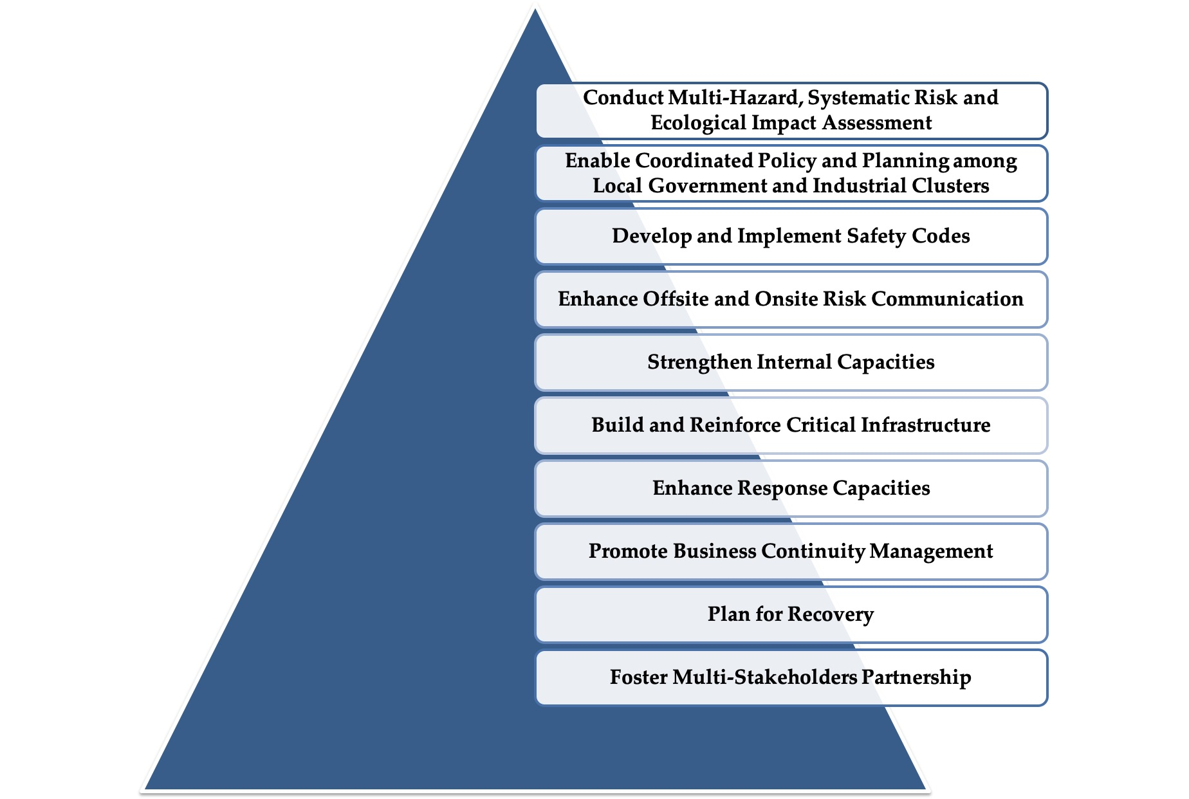
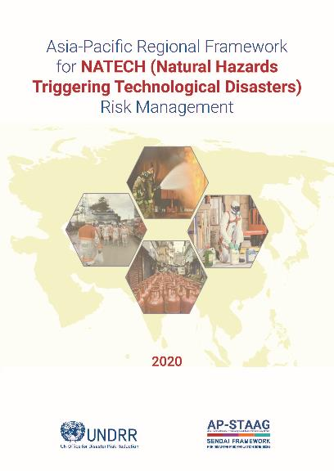
Expanding our management of risk: NATECH
10 Principles of NATECH risk management
https://bit.ly/3aBj9nu

Slide 11







Monitoring:
The Sendai Framework and 2030 Agenda:
Common monitoring systems for Disaster Risk Reduction
Target
Goal / Target
A
Number of deaths, missing persons and directly affected persons attributed to disasters per 100,000 population
Goal 1.
Target 1.5
B
Direct economic loss attributed to disasters in relation to global gross domestic product (GDP)
C
Goal 11.
Target 11.5
Direct economic loss in relation to global GDP, damage to critical infrastructure and number of disruptions of basic services, attributed to disasters
D
Number of countries that adopt and implement national disaster risk reduction strategies in line with the Sendai Framework for Disaster Risk Reduction 2015-2030
Goal 11.
Target 11.b
E
F
Proportion of local governments that adopt and implement local disaster risk reduction strategies in line with national disaster risk reduction strategies.
Goal 13.
Target 13.1
G
Notes:
How to read the slide:
5 Sendai Framework Targets (A to E) relate to 3 SDGs (Goals 1, 11 and 13) and 4 SDG Targets (1.5, 11.5, 11.b, 13.1) through 5 SDG indicators (the text in the centre of the slide).
Text in the centre is the wording of the SDG indicators. These indicators are linked more than once to each SDG /Target.
All in all the 5 unique SDG Indicators are linked to 11 repeated indicators of the 3 SDG / 4 SDG Targets to which the Sendai Framework contributes.

Slide 12
Monitoring to measure decrease in risk and conversely an increase in resilience
National disaster loss databases based on DesInventar disaster information management system help in a focused spatial and temporal risk assessment
A majority of Sendai Targets help in Deterministic risk analysis
based on measuring trends of annual losses faced by the reporting Member States
Challenges
Need for a common statistical framework for disaster related statistics
Scattered availability of data and coordination among authorities for data sharing
Low statistical capacities in line ministries
High turnover of monitoring Focal Points within government administration
Sendai Framework is non-binding – thus needing self-motivating incentives at times
Unpredictable data quality with under- and over-estimations
Limitations in sex, age, disability and income disaggregated data

Slide 13
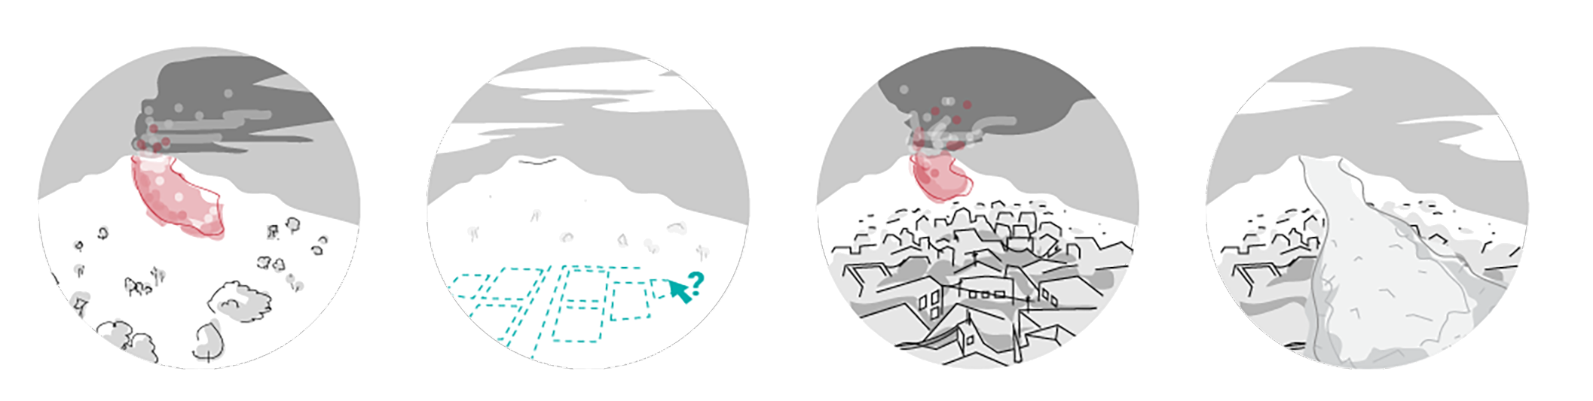



Understanding risk: Key messages
Risk is systemic, interconnected and cascading
Climate change projections have materialized before time, thus creating an urgency for transformative adaptation
The days of one hazard, one impact are over – dual and multiple disasters are the new normal
Understanding risk is more than just understanding hazards
Linking an understanding
of multiple hazards, plus exposure and vulnerability gives a clearer picture of risk
Interconnecting all our knowledge is complex, but the better linked the data, the better the interconnected nature of risk is explained

Slide 14
Thank you

