Slide 1

Graphic User Interface " Infrasound Event analyzer "
Chourouk Mejri
P1.1-147
Centre National de la Cartographie et de la Télédétection
NDC-TN

Slide 2
Graphic User Interface " Infrasound Event analyzer “
Chourouk Mejri , e-mail: ndc-tn@gnet.tn/ Centre National de la Cartographie et de la Télédétection
P1.1 -147
Infrasound is one of three waveform technologies of Comprehensive Test Ban Treaty (CTBT) verification regime. International Monitoring System (IMS) network records man made and natural sources of infrasound signals (bolides, spaceflight activity, sonic booms, volcanic eruptions, quarry blasts, earthquakes, etc.).
To identify those sources we need to download and process data then analyst have to interpret results. For the issue CTBTO provide us with needed software, but to use them experience and training are recommended.
Our idea is to let analyst enjoy interpreting infrasound data without being obliged to manipulate different software.
For this purpose, a Graphic User Interface called "Infrasound event analyzer" is under development by NDC-TN, in which NDC-in-a-Box software (nms_client,pmcc, Gpmcc) are grouped and called on a click.
ABSTRACT

Slide 3
Graphic User Interface " Infrasound Event analyzer “
Chourouk Mejri , e-mail: ndc-tn@gnet.tn/ Centre National de la Cartographie et de la Télédétection
P1.1 -147
Provisional Technical Secretariat (PTS) is providing NDC-in-a-box software and trainings to state parties to fulfil its role in the verification regime. Tunisian NDC has a good experience exploiting those benefits which allow us a deep use.
The Tunisian National Data Centre acts as the technical assistant/advisor of the country in the field of Nuclear explosion Monitoring, that's why that, rather than his role in stations operations and maintenance, a high importance was given to data analysis (SHI and R).
Infrasound data Processing and Analysis is one of major activities of the Tunisian NDC, for this purpose
A GUI "Infrasound event analyzer" wich allow the use of (nms_client,gpmcc )on a click, is under development by Tunisian NDC in order to reduce the analyst workload and to promote the use of infrasound data in both: test ban verification and civil and scientific application.
INTRODUCTION

Slide 4

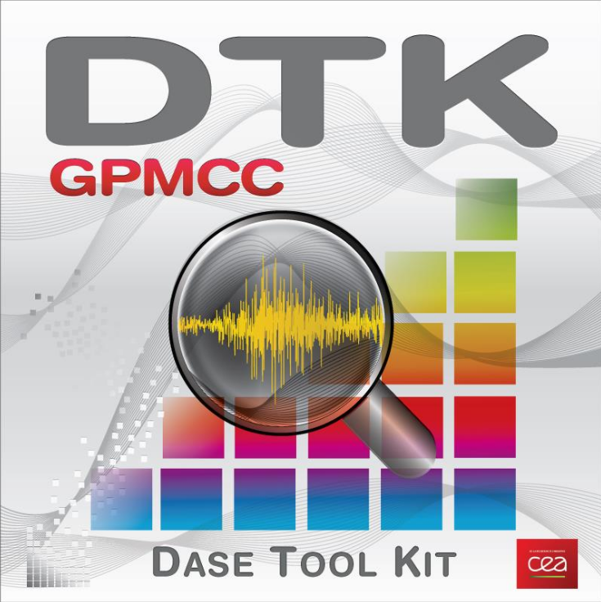

Graphic User Interface " Infrasound Event analyzer “
Chourouk Mejri , e-mail: ndc-tn@gnet.tn/ Centre National de la Cartographie et de la Télédétection
P1.1 -147
NEWS:
An infrasound Event Happened !!!!
Infrasound Event analyser
GUI: Infrasound Event Analyser
Event Details
Date:
Start Time:
End Time:
Infrasound Stations :
Step one :
collecte and insert informations about the event
Choose stations of interest
DD-MM-YYYY
The Purpose:
HH:MM:SS.00
1
HH:MM:SS.00
NDC-TN has planned to develop the graphical interface below which consists of processing and analyzing an infrasound event, as its name indicates "Infrasound Event Analyzer".
METHODS
- I48TN
- I31KZ
- I26DE
- I32KE
- I42PT
Caracteristics and details
Software to be used:
For Step one : Nms_Client(provided by PTS), subscription
For Step Two : PMCC, GPMCC (V6.3.0 provided by PTS)
For step Three: Loc_Infra (provided by CEA)
Programming language used :
Python
Operating system:
Linux
Data Processing
Possible Events
Select bulletin N1 :
Select bulletin N2 :
Step three :
Select bulletins of stations that possibly detect the event
Execute loc_infra
Step Two :
Download data
Execute PMCC
Open result files with GPMCC
Download Data
3
2
PMCC
20%
GPMCC
LOC-Infra
Reset
Cancel

Slide 5
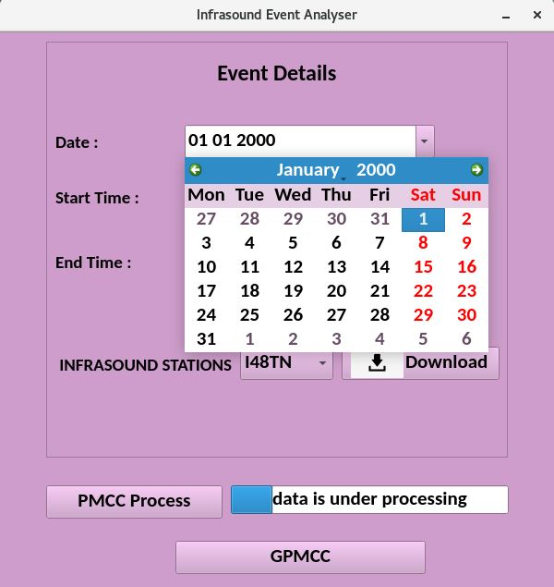
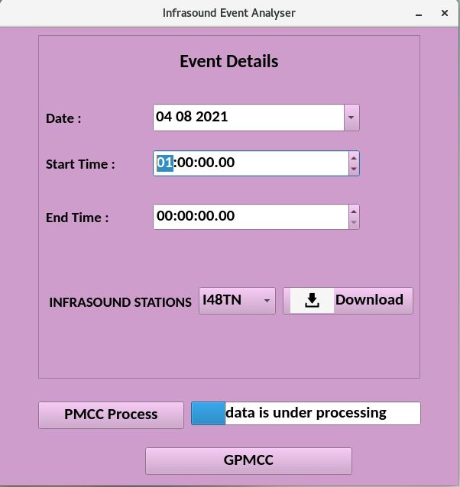
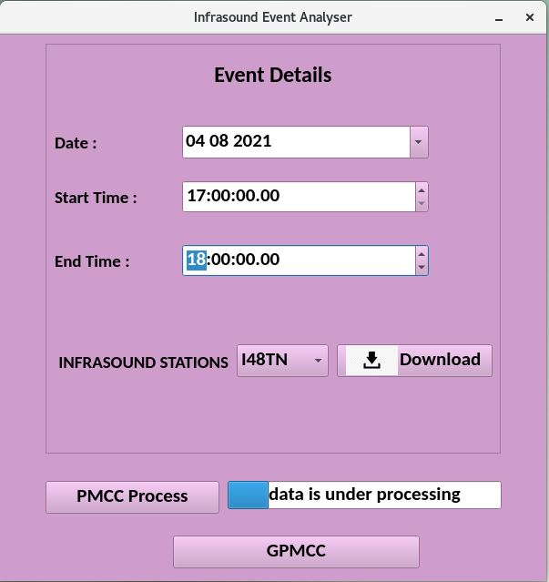
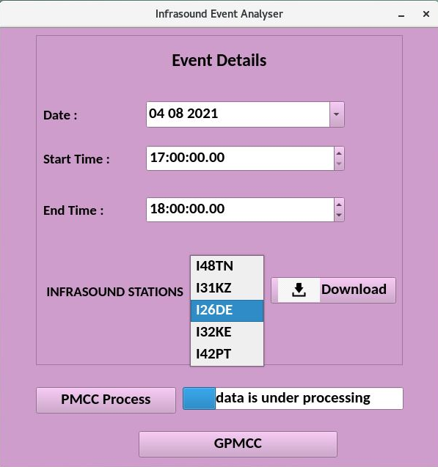
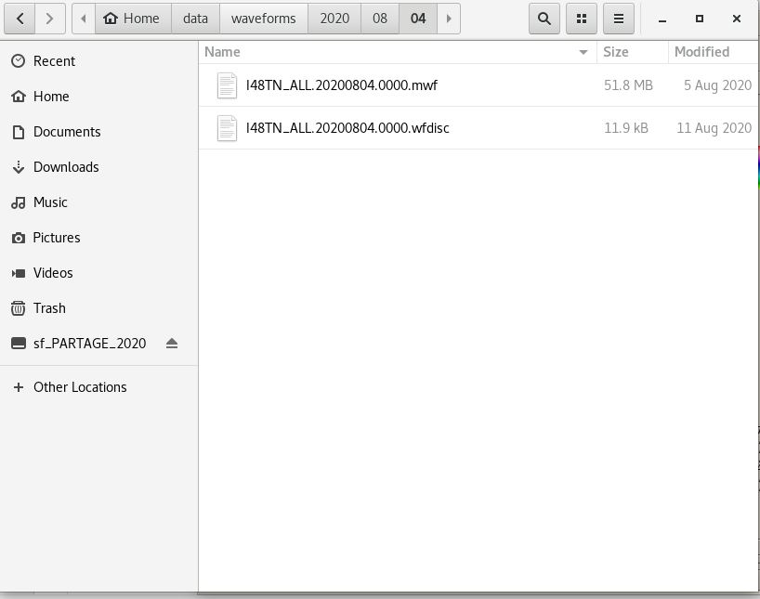
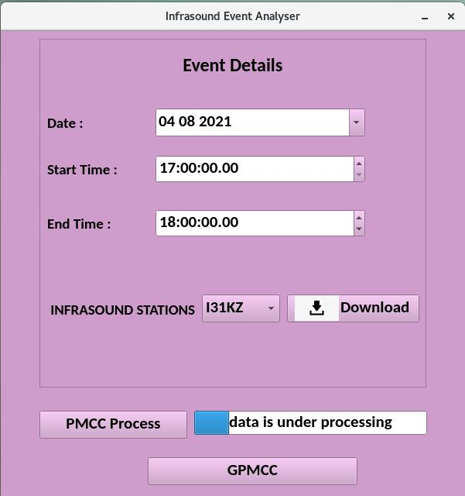
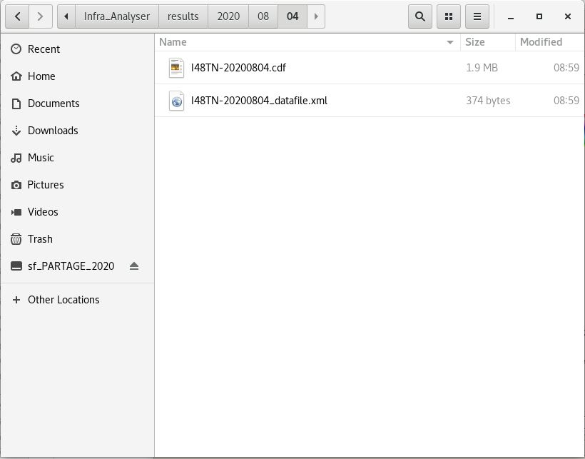
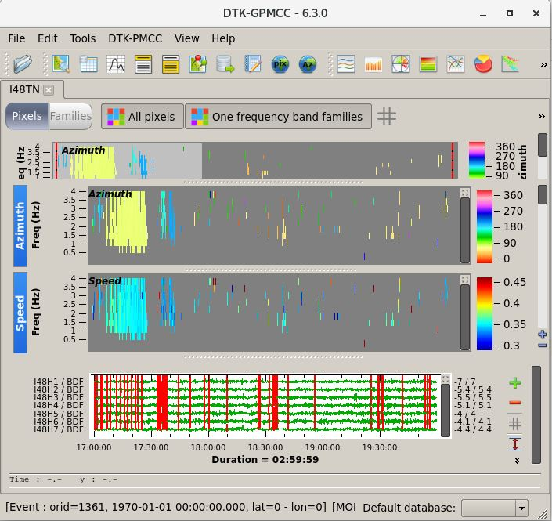
Graphic User Interface " Infrasound Event analyzer “
Chourouk Mejri , e-mail: ndc-tn@gnet.tn/ Centre National de la Cartographie et de la Télédétection
P1.1 -147
RESULTS
First result:
As a first result on the developement of the GUI infrasound event analyser, We present the (V1.0) wich:
contain only the part one and part two of the conception,
Tested only on the Station IS48TN
the GUI are tested for analyzing the beyrout explosion of the 4th of Aghust 2020 (screenshot beside)

Slide 6
Graphic User Interface " Infrasound Event analyzer “
Chourouk Mejri , e-mail: ndc-tn@gnet.tn/ Centre National de la Cartographie et de la Télédétection
P1.1 -147
Infrasound data Processing and Analysis is one of major activities of the Tunisian NDC, where did the idea for making the processing of Infrasound event more easier for NDC-TN staff,
The Objective is to reduce analyst workload and to promote the use of infrasound data in both: test ban verification and civil and scientific application,
Access to data or software needed will be just on click,
The final version of the GUI will be shared soon in the futur (ITW2021).
CONCLUSIONS

