Slide 1



Deep learning for converting noise into knowledge
Christophe Millet^{1,2}
P1.1-627
¹ CEA, DAM, DIF, F-91297 Arpajon, France
² Centre Borelli, ENS Paris-Saclay, F-91190 Gif-sur-Yvette, France

Slide 2
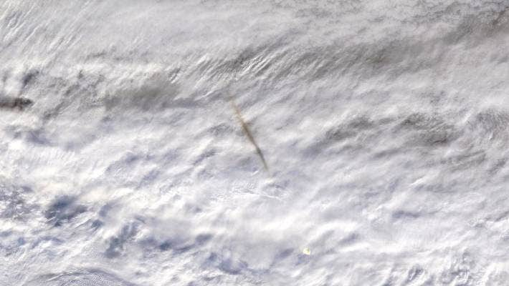
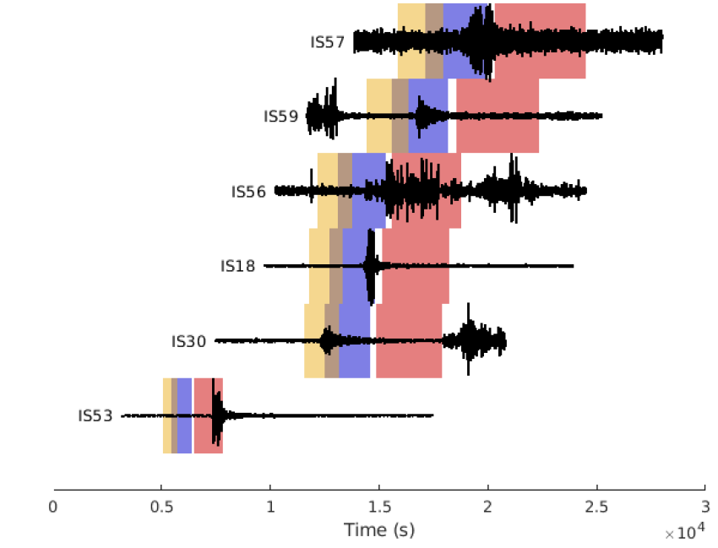
Deep learning for converting noise into knowledge
Christophe Millet^{1,2}
      ¹ CEA, DAM, DIF, F-91297 Arpajon, France
² Centre Borelli, ENS Paris-Saclay, F-91190 Gif-sur-Yvette, France
christophe.millet@cea.fr
P1.1-627
While awaiting signals from a nuclear test, the IMS routinely detects many events that are attributed to atmospheric processes and referred to as perturbators or noise. These events, known to cause false detections, are an important source of difficulty in the network processing operated at the IDC.
Because many thousands of events are recorded per day, recent efforts have been made in developing probabilistic inference for network processing and more recently, for estimating the energy. All these approaches, however, are based on priors that are poorly constrained, and/or extremely simplified propagation models, that are known to exhibit persistent shortcomings. In this work, we introduce a new hybrid framework to derive prior probability models from waveform modelling and take advantage of events accumulated in the analyst-reviewed bulletin.
This approach is based on using propagation models in combination with a data-driven machine learning tool to model the remaining residual that is hidden in data. This approach presents two significant innovations: (1) the capability of converting perturbators into information, thereby providing a physical basis for the priors and (2) the opportunity to incorporate on a daily-basis additional atmospheric data in the priors.
  Bering bolide (Dec. 2018).
  Terra satellite (NASA)
ABSTRACT
  Perturbator?
  Real-world signals, time windows for tropospheric stratospheric and thermospheric arrivals using IDC localization.

Slide 3
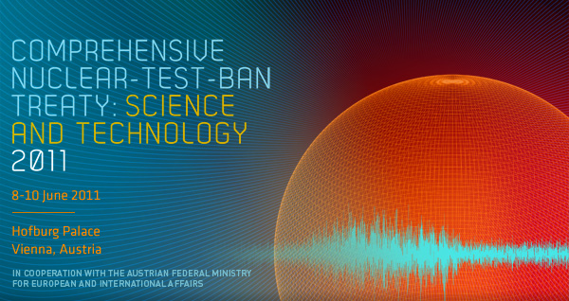
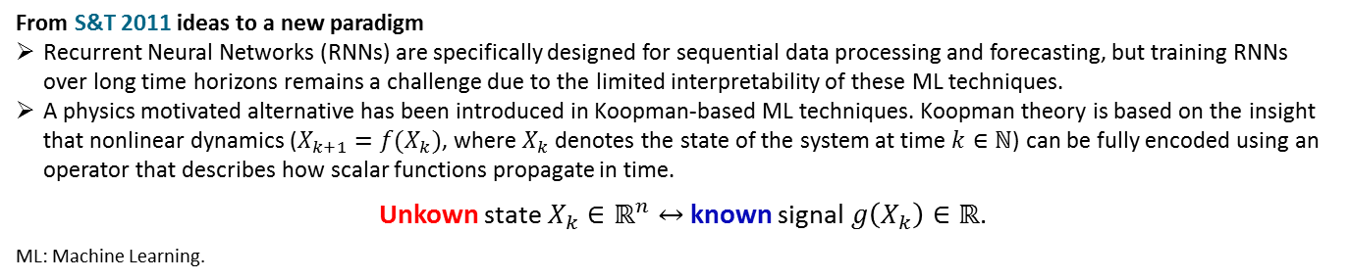
Deep learning for converting noise into knowledge
Christophe Millet^{1,2}
      ¹ CEA, DAM, DIF, F-91297 Arpajon, France
² Centre Borelli, ENS Paris-Saclay, F-91190 Gif-sur-Yvette, France
christophe.millet@cea.fr
P1.1-627
Context
The infrasound system routinely detects natural and anthropogenic events; many of them are considered as noise or “perturbators”.
Due to the atmospheric state variability, empirical or “stochastic” propagation models are necessarily of limited interest when studying a new event in a particular atmospheric state.
10 years ago (S&T 2011) two potential innovations arose out from the lecture of R. Garwin: (1) “automation via AI or ML to maintain or improve performance standards and to reduce cost” and (2) “converting noise into signal in order better to discriminate amongst signals.”
With recent advances in ML, time has come to make (1) & (2) concrete.
INTRODUCTION
https://www.ctbto.org/fileadmin/user_upload/SandT_2011/presentations/Keynote%20lecture%20R_Garwin.pdf
From S&T 2011 ideas to a new paradigm
Recurrent Neural Networks (RNNs) are specifically designed for sequential data processing and forecasting, but training RNNs over long time horizons remains a challenge due to the limited interpretability of these ML techniques.
A physics motivated alternative has been introduced in Koopman-based ML techniques. Koopman theory is based on the insight that nonlinear dynamics ($X_{k+1}=f(X_{k})$, where $X_{k}$ denotes the state of the system at time $k∈ℕ$) can be fully encoded using an operator that describes how scalar functions propagate in time.
Unkown state $X_{k}∈ℝ^{n}↔$ known signal $g\left(X_{k}\right)∈ℝ$.
ML: Machine Learning.

Slide 4
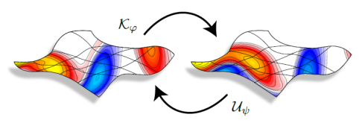
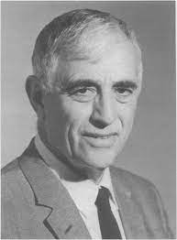
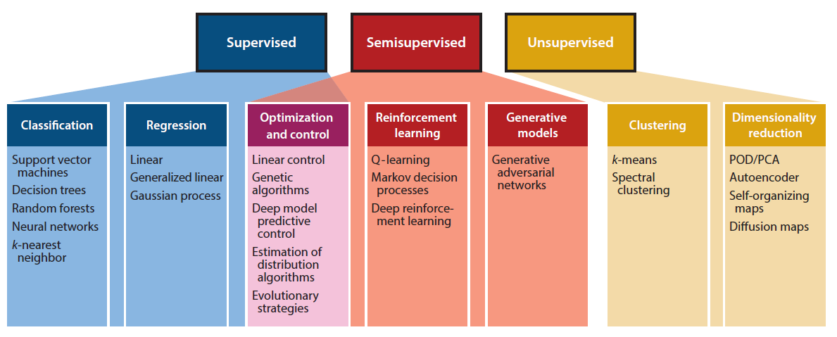
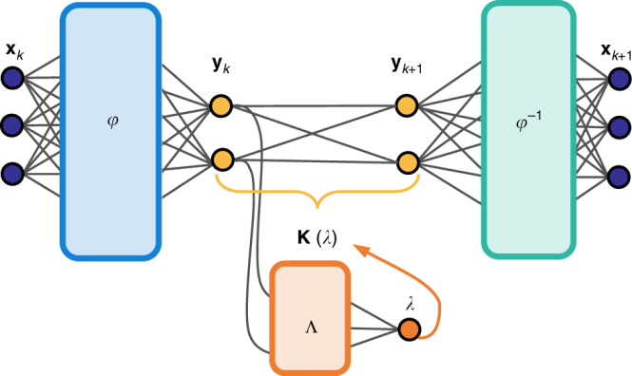

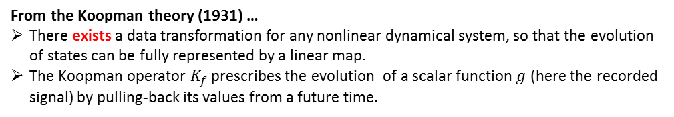

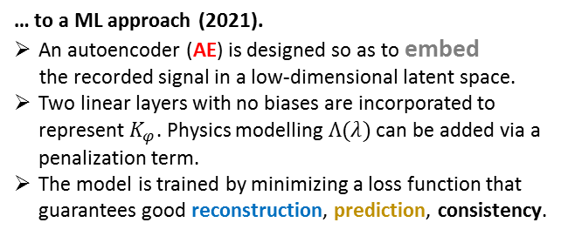



Deep learning for converting noise into knowledge
Christophe Millet^{1,2}
      ¹ CEA, DAM, DIF, F-91297 Arpajon, France
² Centre Borelli, ENS Paris-Saclay, F-91190 Gif-sur-Yvette, France
christophe.millet@cea.fr
P1.1-627
From the Koopman theory (1931) …
There exists a data transformation for any nonlinear dynamical system, so that the evolution of states can be fully represented by a linear map.
The Koopman operator $K_{f}$ prescribes the evolution of a scalar function $g$ (here the recorded signal) by pulling-back its values from a future time.
$$K_{f}g\left(X_{k}\right)=g∘f\left(X_{k}\right)=g(X_{k+1})$$
$∃φ, φ∘K_{f}∘φ^{−1}$ is linear
METHODS
$$\overset{encoding}{\overbrace{ }}$$
$$\overset{k↦ k+1}{\overbrace{ }}$$
$$\overset{decoding}{\overbrace{ }}$$
H11N
… to a ML approach (2021).
An autoencoder (AE) is designed so as to embed
the recorded signal in a low-dimensional latent space.
Two linear layers with no biases are incorporated to represent $K_{φ}$. Physics modelling $Λ(λ)$ can be added via a penalization term.
The model is trained by minimizing a loss function that guarantees good reconstruction, prediction, consistency.
Bernard Osgood Koopman
(1900–1981)

Slide 5


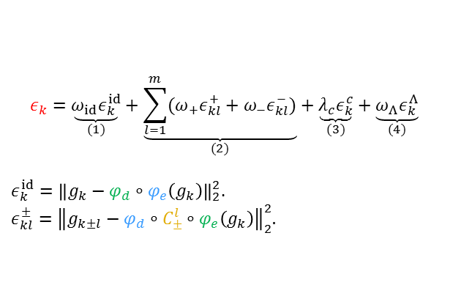
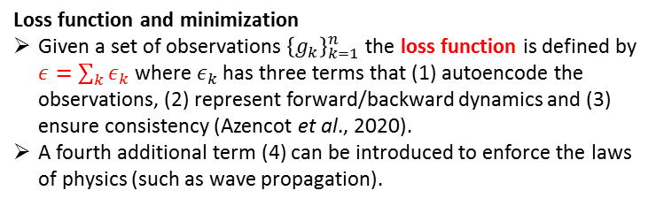
Deep learning for converting noise into knowledge
Christophe Millet^{1,2}
      ¹ CEA, DAM, DIF, F-91297 Arpajon, France
² Centre Borelli, ENS Paris-Saclay, F-91190 Gif-sur-Yvette, France
christophe.millet@cea.fr
P3.6-622
Loss function and minimization
Given a set of observations ${\left\{g_{k}\right\}}_{k=1}^{n}$ the loss function is defined by $ε=\sum_{k}{ε_{k}}$ where $ε_{k}$ has three terms that (1) autoencode the observations, (2) represent forward/backward dynamics and (3) ensure consistency (Azencot et al., 2020).
A fourth additional term (4) can be introduced to enforce the laws of physics (such as wave propagation).
$$ε_{k}=\underset{(1)}{\underbrace{ω_{id}ε_{k}^{id}}}+\underset{(2)}{\underbrace{\sum_{l=1}^{m}{({ω_{+}ε}_{kl}^{+}+ω_{−}ε_{kl}^{−}})}}+\underset{(3)}{\underbrace{λ_{c}ε_{k}^{c}}}+\underset{(4)}{\underbrace{ω_{Λ}ε_{k}^{Λ}}}$$
$ε_{k}^{id}={\left\|g_{k}−φ_{d}∘φ_{e}\left(g_{k}\right)\right\|}_{2}^{2}$.
$$ε_{kl}^{±}={\left\|g_{k±l}−φ_{d}∘C_{±}^{l}∘φ_{e}\left(g_{k}\right)\right\|}_{2}^{2}.$$
  ML in practice
  Machine learning library: PyTorch. Weights are computed using the deep-learning Adam algorithm.
  Parallelization using GLoST - Greedy Launcher of Small Tasks (https://github.com/cea-hpc/glost) and thousands of cores are involved to select the best KAEs (Koopman AEs).
  Supercomputer: COBALT (CEA’s TGCC computing centre) upgraded in 2019 to reach 2.4 Pflop.s⁻¹*.
  Optimization of the KAE architecture in (Te, Bo)-space
  The size of the first layer is adapted using Takens’ embedding,
  which introduces two hyperparameters for the KAE: the
  Taken Embedding Delay Dimension Te and the Bottleneck Bo.
METHODS
H11N
Bo=2
  *10080 cores from Intel Skylake processors (6148), set up in a Atos SEQUANA cell.
O. Azencot, N. B. Erichson, V. Lin, M. W. Mahoney (2020). Forecasting sequential data using consistent Koopman autoencoders, https://arxiv.org/abs/2003.02236
Te=4

Slide 6
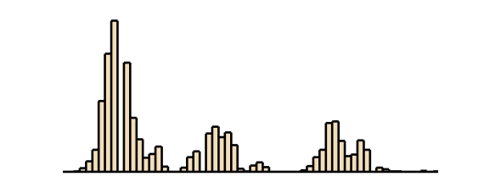
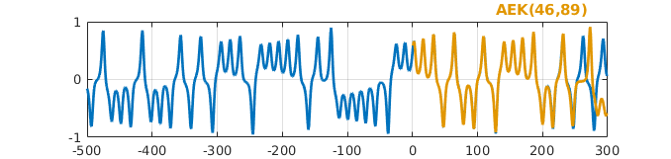
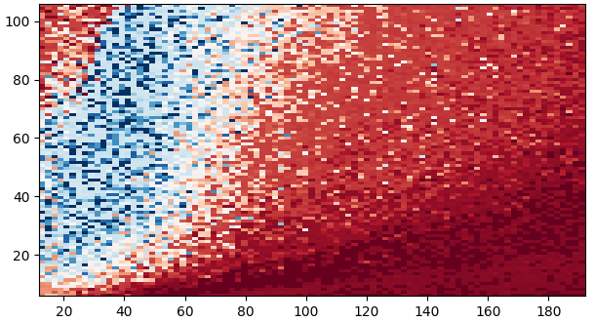
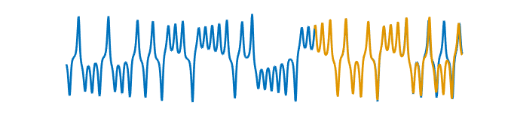

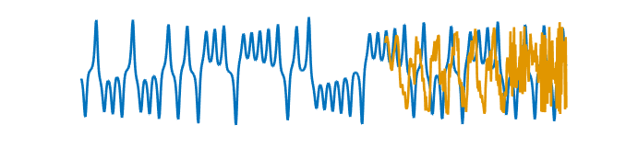
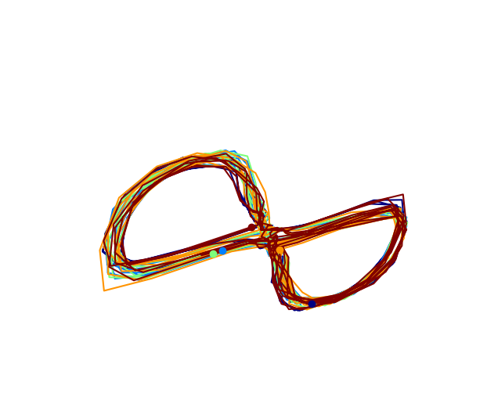






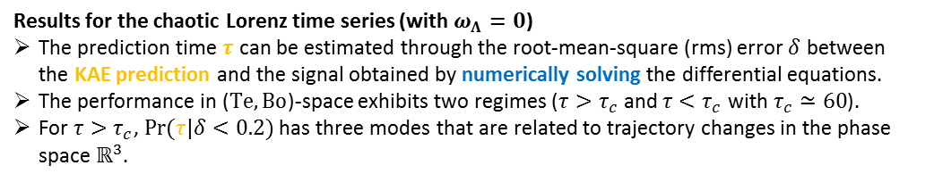
Deep learning for converting noise into knowledge
Christophe Millet^{1,2}
      ¹ CEA, DAM, DIF, F-91297 Arpajon, France
² Centre Borelli, ENS Paris-Saclay, F-91190 Gif-sur-Yvette, France
christophe.millet@cea.fr
P3.6-622
  Prediction time $τ$ for tolerance $δ<0.2$
$$Pr(τ|δ<20\%)$$
108
125
  KAE predictor
A
A
$$Bo$$
$τ|δ<0.2$
  Solving the equations
B
B
RESULTS
C
$$Te$$
$τ$
C
Results for the chaotic Lorenz time series (with $ω_{Λ}=0$)
The prediction time $τ$ can be estimated through the root-mean-square (rms) error $δ$ between the KAE prediction and the signal obtained by numerically solving the differential equations.
The performance in ($Te,Bo$)-space exhibits two regimes ($τ>τ_{c}$ and $τ<τ_{c}$ with $τ_{c}≃60$).
For $τ>τ_{c}$, $\operatorname{Pr}{(τ|δ<0.2)}$ has three modes that are related to trajectory changes in the phase space $ℝ^{3}$.
  Lorenz attractor captured by the KAE.

Slide 7
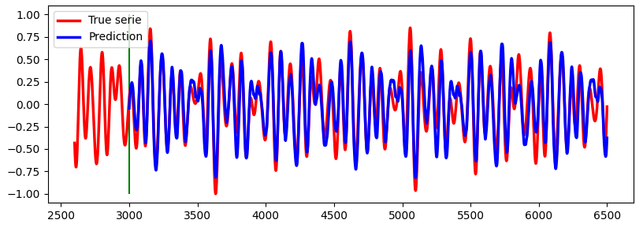
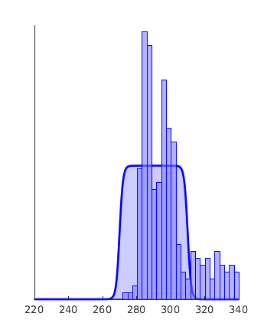
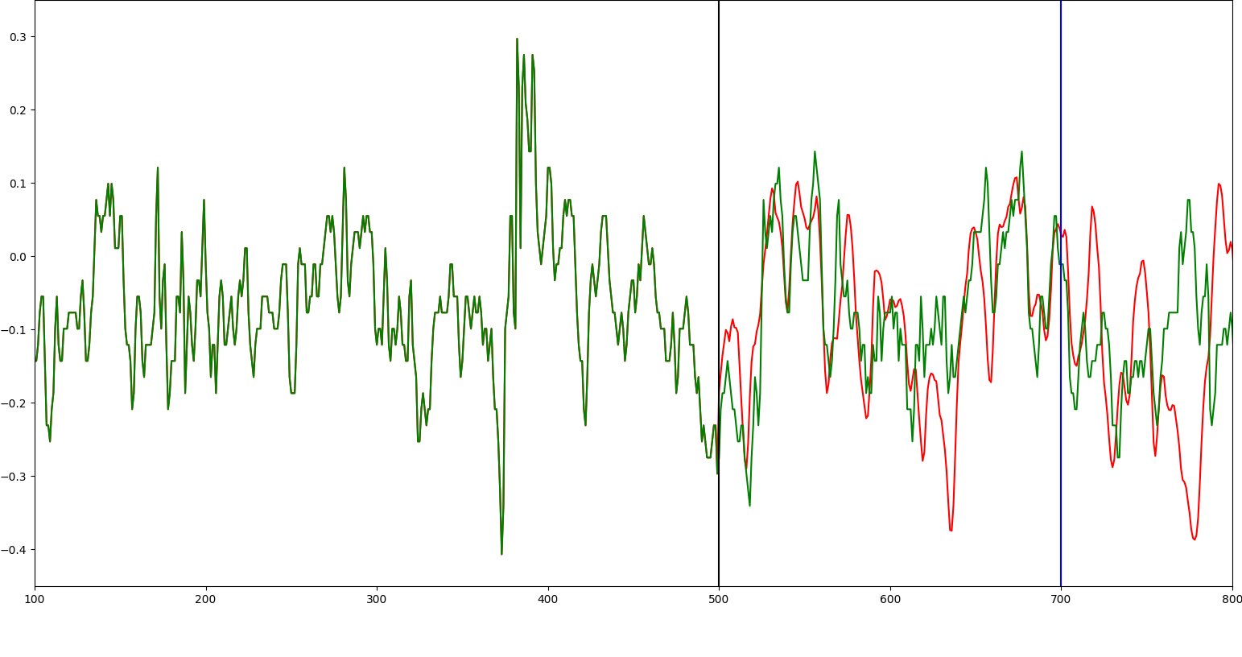

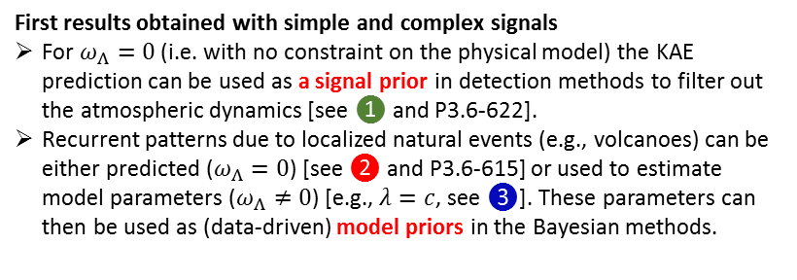
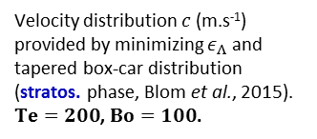


Deep learning for converting noise into knowledge
Christophe Millet^{1,2}
      ¹ CEA, DAM, DIF, F-91297 Arpajon, France
² Centre Borelli, ENS Paris-Saclay, F-91190 Gif-sur-Yvette, France
christophe.millet@cea.fr
P3.6-622
First results obtained with simple and complex signals
For $ω_{Λ}=0$ (i.e. with no constraint on the physical model) the KAE prediction can be used as a signal prior in detection methods to filter out the atmospheric dynamics [see ❶ and P3.6-622].
Recurrent patterns due to localized natural events (e.g., volcanoes) can be either predicted ($ω_{Λ}=0$) [see ❷ and P3.6-615] or used to estimate model parameters ($ω_{Λ}≠0$) [e.g., $λ=c$, see ❸]. These parameters can then be used as (data-driven) model priors in the Bayesian methods.
❷
KAE prediction and signal (pressure) generated by randomly distributed events [see also P3.6-615].
$Te=260$,
$$Bo=80.$$
RESULTS
$$τ|ε<ε_{c}$$
❶
ML-based predictions from a single time series
KAE Prediction
❸
WRF
12.5 days
priors
Velocity distribution $c$ (m.s⁻¹) provided by minimizing $ε_{Λ}$ and tapered box-car distribution (stratos. phase, Blom et al., 2015).
$Te=200$, $Bo=100$.
Prediction provided by KAE and simulation with WRF for the time derivative of pressure [see also P3.6-622]. $Te=603,$ $Bo=33$.
P. Blom, O. Marcillo, S. J. Arrowsmith (2015). Improved Bayesian infrasonic source localization for regional infrasound, Geophys. J. Int., 203:1682-1693.

Slide 8

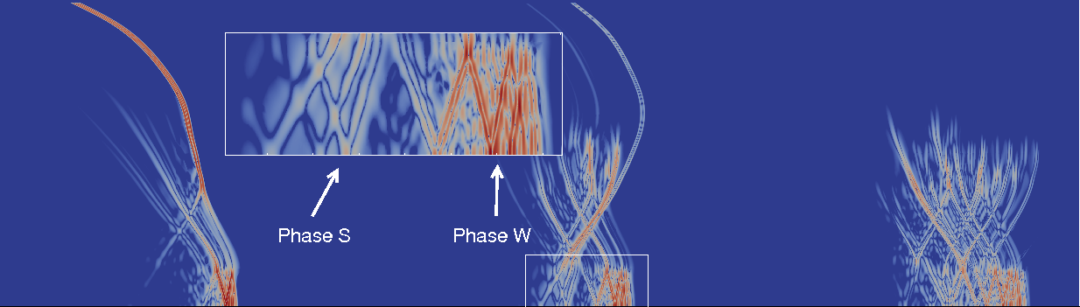



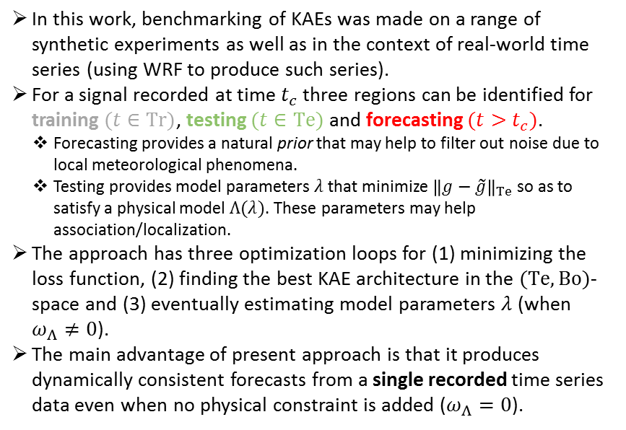






Deep learning for converting noise into knowledge
Christophe Millet^{1,2}
      ¹ CEA, DAM, DIF, F-91297 Arpajon, France
² Centre Borelli, ENS Paris-Saclay, F-91190 Gif-sur-Yvette, France
christophe.millet@cea.fr
P3.6-622
In this work, benchmarking of KAEs was made on a range of synthetic experiments as well as in the context of real-world time series (using WRF to produce such series).
For a signal recorded at time $t_{c}$ three regions can be identified for training $(t∈Tr)$, testing $(t∈Te)$ and forecasting $(t>t_{c})$.
    Forecasting provides a natural prior that may help to filter out noise due to local meteorological phenomena.
    Testing provides model parameters $λ$ that minimize ${\left\|g−\tilde{g}\right\|}_{Te}$ so as to satisfy a physical model $Λ(λ)$. These parameters may help association/localization.
The approach has three optimization loops for (1) minimizing the loss function, (2) finding the best KAE architecture in the $(Te,Bo)$-space and (3) eventually estimating model parameters $λ$ (when $ω_{Λ}≠0$).
The main advantage of present approach is that it produces dynamically consistent forecasts from a single recorded time series data even when no physical constraint is added ($ω_{Λ}=0$).
$$Tr$$
$$Te$$
$$g(t∈Tr)$$
$$t$$
Prior for association
KAE
$$Λ$$
CONCLUSIONS
$$\tilde{g}(Te)$$
$${\left\|g−\tilde{g}\right\|}_{Te}$$
$\tilde{g}(t>t_{c})$
Prior for detection
$Λ$: propagation model

