Slide 1
Development of Local Magnitude Scale and Determination of Station Magnitude Corrections
for Northern Thailand
Tanongsak Taothong
P1.2-201

Slide 2
Development of Local Magnitude Scale and Determination of Station Magnitude Corrections for Northern Thailand
Tanongsak Taothong, Thai Meteorological Department, nasavisa303@gmail.com
P1.2-201
In this research, a local earthquake magnitude formula (ML and MLv) was developed for measuring earthquake magnitude in northern Thailand and determined station magnitude corrections. By using data from 31 seismic stations of the Earthquake Observation Division, the Thai Meteorological Department and CTBTO Chiang Mai seismic station, analyzed 148 earthquake events from 2009 to 2019 to find the formula. The magnitude ML was defined as ML = log A+ 0.6682 log(R/100)+ 0.0026(R-100)+ 3 and the magnitude MLv was defined as MLv = log A + 0.6002 log (R/100) + 0.0030(R-100) + 3, for hypocentral distance 25 to 500 km and depth below 60 km.
The results comparing Richter’s local magnitude equation (1935) and the equation obtained from the study, found that the attenuation of earthquake magnitude in northern Thailand and southern California is quite similar. And the station magnitude corrections were between -1.1752 to 0.5393 magnitude.
ABSTRACT

Slide 3
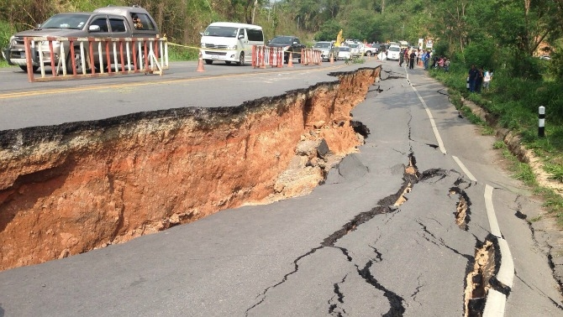
Development of Local Magnitude Scale and Determination of Station Magnitude Corrections for Northern Thailand
Tanongsak Taothong, Thai Meteorological Department, nasavisa303@gmail.com
P1.2-201
Northern Thailand is a large region with frequent occurrences of large earthquakes. And currently the Earthquake Observation Division uses the MLv, which has not been adjusted to the local scale for northern Thailand. Local scale formulas will improve the accuracy and reliability of earthquake reporting in the Northern Thailand.
INTRODUCTION
M6.3 Chiang Rai, 2014
from : https://www.tnews.co.th/

Slide 4
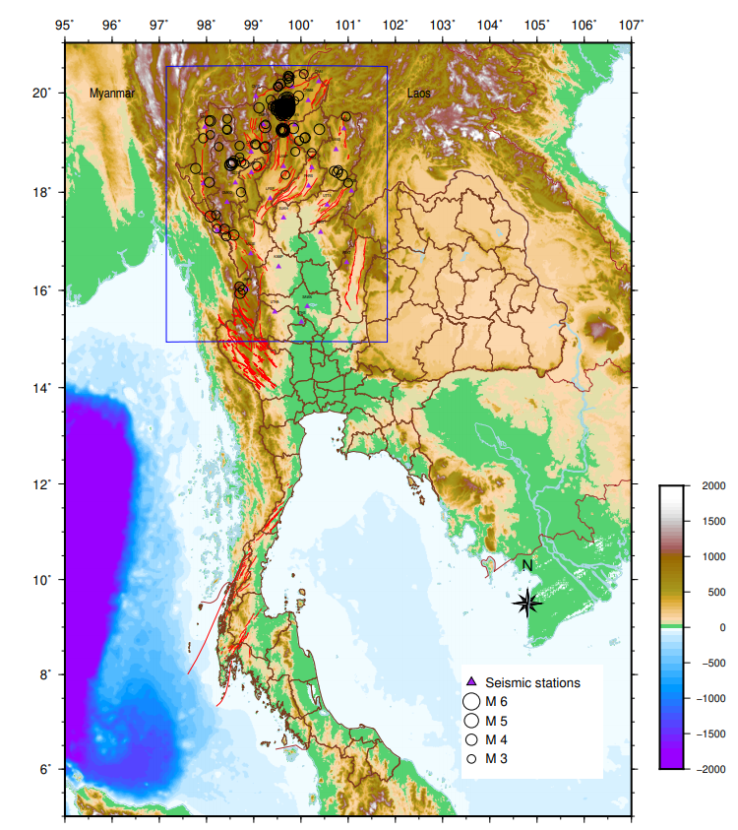
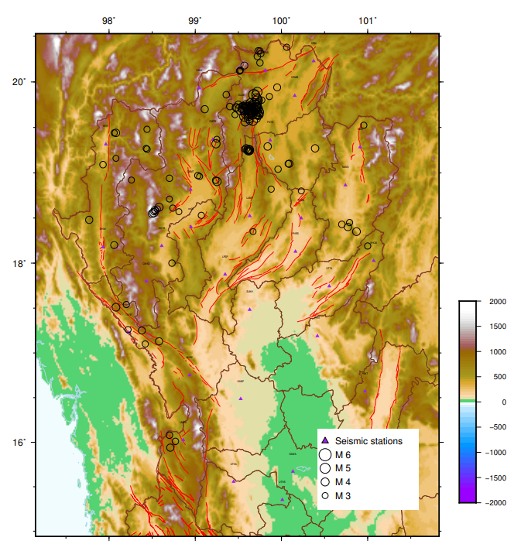
Development of Local Magnitude Scale and Determination of Station Magnitude Corrections for Northern Thailand
Tanongsak Taothong, Thai Meteorological Department, nasavisa303@gmail.com
P1.2-201
Study Area
latitude 14.941 – 20.529 °N longitude 97.147-101.828 °E
148 events 2009-2019, M 3.0 up, Depth < 60 km
TMD 30 stations + CTBTO (CM05) 1 stations

Slide 5


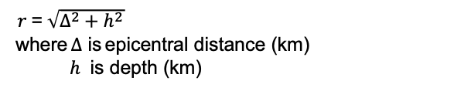

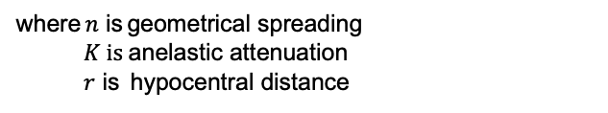


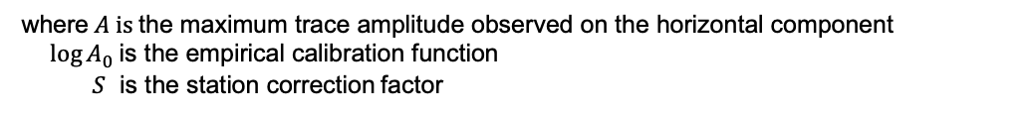

Development of Local Magnitude Scale and Determination of Station Magnitude Corrections for Northern Thailand
Tanongsak Taothong, Thai Meteorological Department, nasavisa303@gmail.com
P1.2-201
In Richter definition (1935, 1958)
$$M_{L}=\log{A}−\log{A_{0}}+S$$
$$\left(1\right)$$
$$−\log{A}=−log{A_{0}}−M_{L}+S$$
$$\left(2\right)$$
where $A \text{is} \text{the} \text{maximum} \text{trace} \text{amplitude} \text{observed} \text{on} \text{the} \text{horizontal} \text{component}$
$\log{A_{0}}$ is the empirical calibration function
$S$ is the station correction factor
METHODS
$$−\log{A_{0}}=n\log\left(\frac{r}{100}\right)+K\left(r−100\right)+3.0$$
$$\left(3\right)$$
where $n$ is geometrical spreading
$K is$ anelastic attenuation
$r$ is hypocentral distance
$r$ = $\sqrt{∆^{2}+h^{2}}$
where $∆$ is epicentral distance (km)
$h$ is depth (km)
5

Slide 6
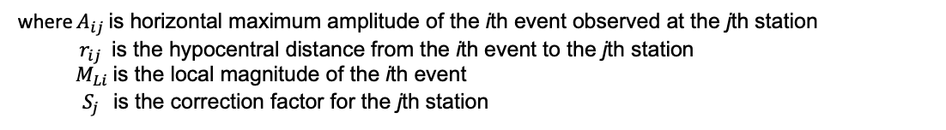


Development of Local Magnitude Scale and Determination of Station Magnitude Corrections for Northern Thailand
Tanongsak Taothong, Thai Meteorological Department, nasavisa303@gmail.com
P1.2-201
In Hutton and Boore definition (1987)
$$−\log{A_{ij}}=n\log\left(\frac{r_{ij}}{100}\right)+K\left(r_{ij}−100\right)+3.0−M_{Li}+S_{j}$$
$$\left(4\right)$$
where $A_{ij}$ is horizontal maximum amplitude of the ith event observed at the jth station
$r_{ij}$ is the hypocentral distance from the ith event to the jth station
$M_{Li}$ is the local magnitude of the ith event
$S_{j}$ is the correction factor for the jth station
METHODS
In Miao and Langston (2007) and RAQUEL VÁSQUEZ STANESCU (2017)
from Eq. (4)
$$−n\log\left(\frac{r_{ij}}{100}\right)−K\left(r_{ij}−100\right)+M_{Li}−S_{j}=\log{A_{ij}+3.0}$$
$$\left(5\right)$$

Slide 7
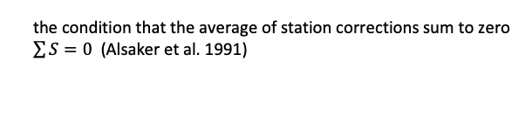



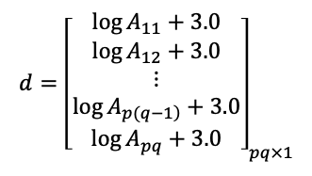
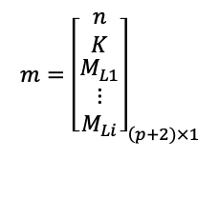
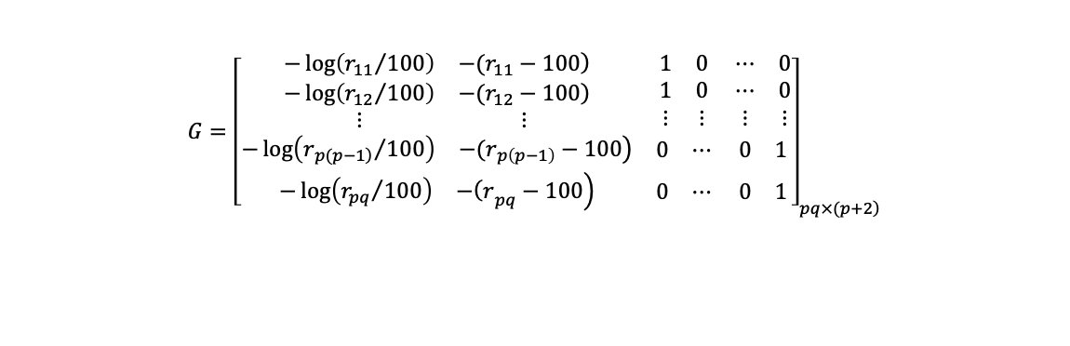
Development of Local Magnitude Scale and Determination of Station Magnitude Corrections for Northern Thailand
Tanongsak Taothong, Thai Meteorological Department, nasavisa303@gmail.com
P1.2-201
Eq. (5) can be expressed by matrix :
$$Gm=d$$
$$\left(6\right)$$
the condition that the average of station corrections sum to zero
$\sum{S=0}$ (Alsaker et al. 1991)
$$G={\left[\begin{matrix}\begin{matrix}−\log\left({r_{11}}/{100}\right) & \left.−(r_{11}−100\right) \\ −\log\left({r_{12}}/{100}\right) & \left.−(r_{12}−100\right) \\ ⋮ & ⋮\end{matrix} & \begin{matrix}1 & 0 \\ 1 & 0 \\ ⋮ & ⋮\end{matrix} & \begin{matrix}⋯ & 0 \\ ⋯ & 0 \\ ⋮ & ⋮\end{matrix} \\ \begin{matrix}−\log\left({r_{\left.p(p−1\right)}}/{100}\right) & \left.−(r_{p\left(p−1\right)}−100\right)\end{matrix} & \begin{matrix}0 & ⋯\end{matrix} & \begin{matrix}0 & 1\end{matrix} \\ \begin{matrix}−\log\left({r_{pq}}/{100}\right) & \left.−{\left(r\right.}_{pq}−100\right)\end{matrix} & \begin{matrix}0 & ⋯\end{matrix} & \begin{matrix}0 & 1\end{matrix}\end{matrix}\right]}_{\left.pq×(p+2\right)}$$
METHODS
$$m={\left[\begin{matrix}n \\ K \\ \begin{matrix}M_{L1} \\ ⋮ \\ M_{Li}\end{matrix}\end{matrix}\right]}_{\left(p+2)×1\right.}$$
$$d={\left[\begin{matrix}\log{A_{11}+3.0} \\ \log{A_{12}+3.0} \\ \begin{matrix}⋮ \\ \log{A_{\left.p(q−1\right)}+3.0} \\ \log{A_{pq}+3.0}\end{matrix}\end{matrix}\right]}_{pq×1}$$
where $p$ is number of earthquakes
$q$ is number of station components
7

Slide 8





Development of Local Magnitude Scale and Determination of Station Magnitude Corrections for Northern Thailand
Tanongsak Taothong, Thai Meteorological Department, nasavisa303@gmail.com
P1.2-201
$solve matrix m$ from
$$m=G^{−1}d$$
$$\left(7\right)$$
Get the a$nswer of n, K, M_{L1},…..,M_{Li}$
Find station correction factor
METHODS
from Eq. (4)
$$S_{j}=−n\log\left(\frac{r_{ij}}{100}\right)−K\left(r_{ij}−100\right)+M_{Li}−log{A_{ij}−3.0}$$
$$\left(8\right)$$

Slide 9
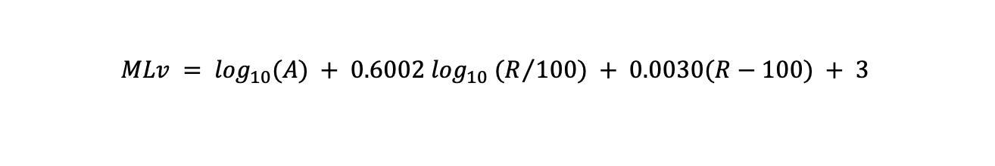
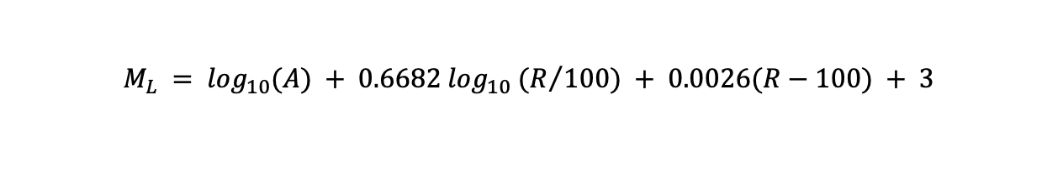
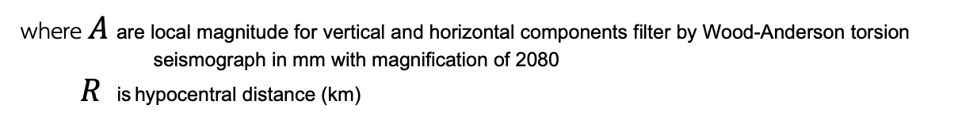
Development of Local Magnitude Scale and Determination of Station Magnitude Corrections for Northern Thailand
Tanongsak Taothong, Thai Meteorological Department, nasavisa303@gmail.com
P1.2-201
ML Northern Thailand
n = 0.6682 K = 0.0026
$$M_{L} = \log_{10}(A) + 0.6682 \log_{10} (R/{100}) + 0.0026(R−100) + 3$$
MLv Northern Thailand
RESULTS
n = 0.6002 K = 0.0030
$$MLv = \log_{10}(A) + 0.6002 \log_{10} (R/{100}) + 0.0030(R−100) + 3$$
where $A$ are local magnitude for vertical and horizontal components filter by Wood-Anderson torsion
seismograph in mm with magnification of 2080
$R$ is hypocentral distance (km)
for events 25 to 500 km of distances and 60 km depth.

Slide 10
Development of Local Magnitude Scale and Determination of Station Magnitude Corrections for Northern Thailand
Tanongsak Taothong, Thai Meteorological Department, nasavisa303@gmail.com
P1.2-201
RESULTS

Slide 11
Development of Local Magnitude Scale and Determination of Station Magnitude Corrections for Northern Thailand
Tanongsak Taothong, Thai Meteorological Department, nasavisa303@gmail.com
P1.2-201
station correction factor
NO. | Station code | Station correction (ML) | Station correction (MLv) | NO. | Station code | Station correction (ML) | Station correction (MLv)
1 | MHMT | -0.4424 | -0.4229 | 17 | CMAI | -0.4939 | -0.3087
2 | PHRA | -1.1752 | -0.9475 | 18 | PHRS | -0.0579 | -0.1432
3 | CRAI | -0.328 | -0.1968 | 19 | CRMJ | -0.1845 | 0.2044
4 | MHIT | -0.0296 | -0.0332 | 20 | OMKO | 0.5393 | 0.4357
5 | UTTA | 0.4235 | 0.464 | 21 | NANS | 0.3697 | 0.1701
6 | NAN | -0.179 | -0.0912 | 22 | KHOB | -0.0349 | -0.0804
7 | SUKH | 0.2813 | 0.2019 | 23 | TSYB | -0.5112 | -0.4268
8 | PBKT | -0.3777 | -0.27 | 24 | MUSE | -0.3285 | -0.1374
9 | UMPA | -0.1407 | -0.0749 | 25 | SAWA | 0.2223 | -0.0819
10 | PAYA | 0.0308 | 0.0446 | 26 | UTHS | 0.1092 | -0.0416
11 | CMMT | 0.0827 | -0.071 | 27 | SUAB | -0.5895 | -0.3417
12 | UTHA | 0.2932 | 0.0472 | 28 | CRMM | 0.3742 | 0.273
13 | PHIT | -0.2075 | -0.1602 | 29 | HOTB | -0.0478 | -0.042
14 | CMPR | -0.0099 | -0.1324 | 30 | KAMP | -0.3461 | -0.3959
15 | LAMP | 0.0278 | -0.0712 | 31 | CM05 |  | 0.0384
16 | LPSP | -0.1442 | -0.2061 | standard deviation (SD) |  | 0.360629507 | 0.277506
RESULTS

Slide 12
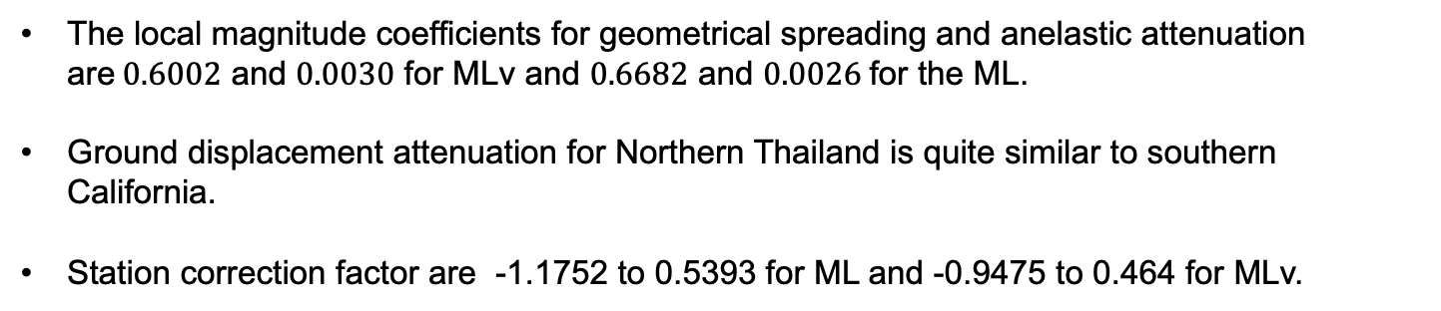
Development of Local Magnitude Scale and Determination of Station Magnitude Corrections for Northern Thailand
Tanongsak Taothong, Thai Meteorological Department, nasavisa303@gmail.com
P1.2-201
The local magnitude coefficients for geometrical spreading and anelastic attenuation are$0.6002$ and $0.0030$ for MLv and $0.6682$ and $0.0026$for the ML.
Ground displacement attenuation for Northern Thailand is quite similar to southern California.
Station correction factor are -1.1752 to 0.5393 for ML and -0.9475 to 0.464 for MLv.
CONCLUSIONS

