Slide 1

Occurrence And Extent of Earth Fissures:
Preliminary Findings From Chikwawa District, Southern Malawi.
Chindandali P., Manda B., Mtegha J., and Eliyasi C.
POSTER ID T1.2-503

Slide 2
Occurrence And Extent of Earth Fissures:
Preliminary Findings From Chikwawa District, Southern Malawi.
Chindandali P., Manda B., Mtegha J., and Eliyasi C.. Email: rafikiwanga@gmai.com Geological Survey Department, Malawi
T1.2-503
Although earth fissures have occurred in some parts of the country, they have not been well-documented or studied in detail. Recent field investigation into the formation and extent of earth fissures in Chikwawa District, reveal their formation due to erosion as well as tensional cracks within the affected area as a result of groundwater withdrawal from the alluvial sediments. Several sinkholes and linear fissures trending N-S and E-W, connected by horizontal conduits characterized by mud deposition and mud flow, cut through the village thereby weakening and cracking houses. Minor fissures connect orthogonally to major fissures without clear offsets. The water flow through the conduits influenced the formation of sinkholes and conduits by weakening their structural strength which caused top soil to collapse into existing voids, creating or widening the sinkholes and exposing the conduits. We used geological, airborne geophysical as well as seismic ambient noise to delineate structures and determine depth-to-bedrock. Additionally, data from local as well as international seismological monitoring networks indicate no occurrence of an earthquake in the vicinity to attribute such activity to tectonic movement or faulting.
Keywords: Fissures, Sinkholes, Alluvium, Tectonics, Faulting
ABSTRACT

Slide 3
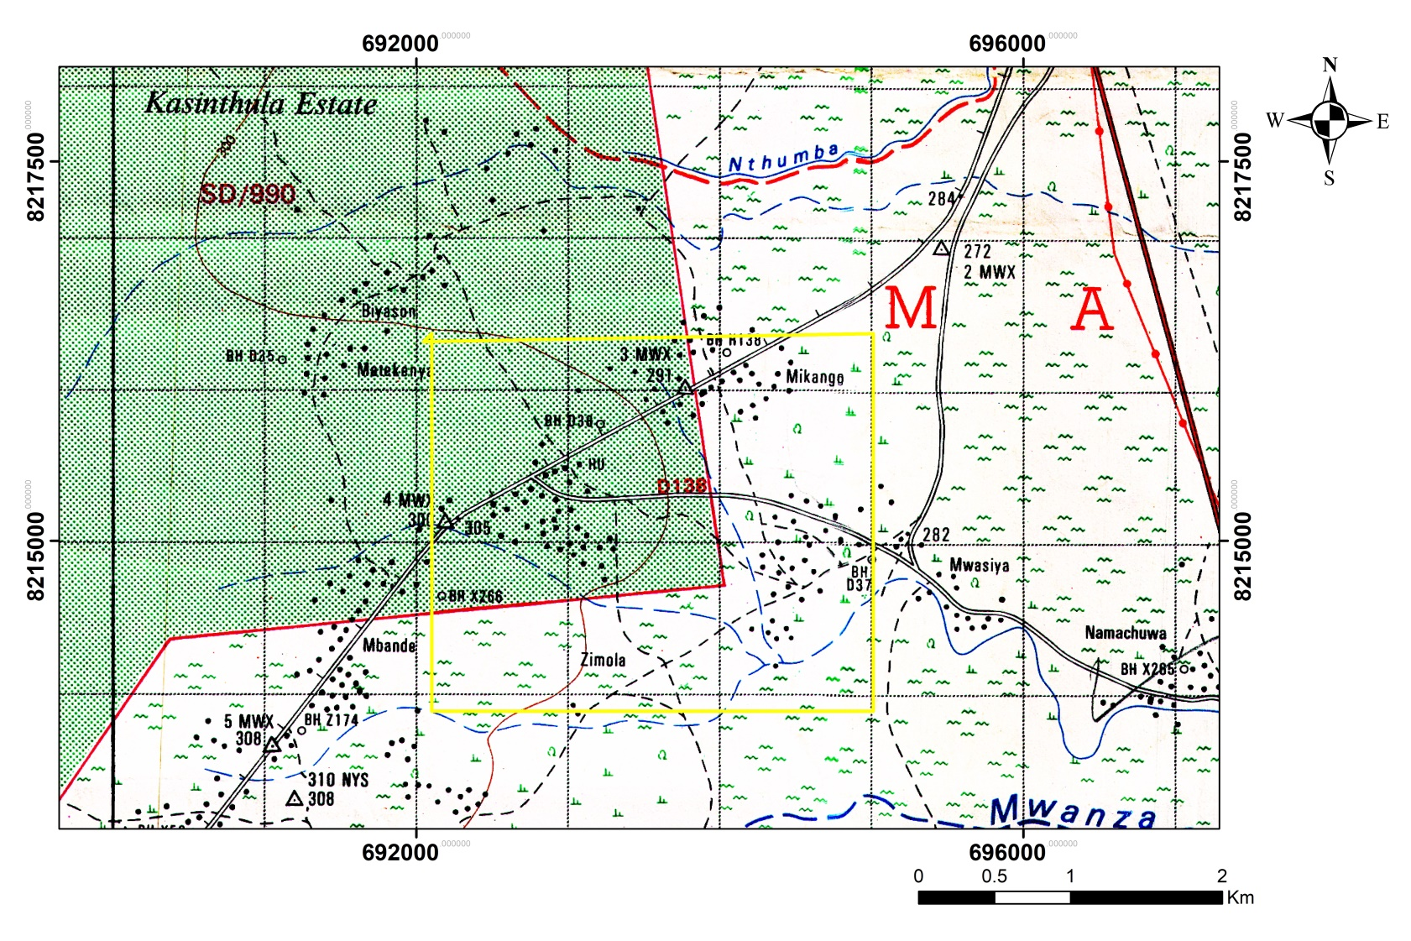
Occurrence And Extent of Earth Fissures:
Preliminary Findings From Chikwawa District, Southern Malawi.
Chindandali P., Manda B., Mtegha J., and Eliyasi C.. Email: rafikiwanga@gmai.com Geological Survey Department, Malawi
T1.2-503
Earth fissures are large cracks in the ground that are formed as a result of soil surface tension due to land subsidence mainly caused by groundwater withdrawal from the alluvium in the deeper part of the basin, causing the earth fissures to form as tension cracks (Dell’Allinga et.al., 2014).
Zimola Village had experienced some cracks occurred on 23rd November 2018 following heavy rains that fell on the previous day. The work was carried out from 14th to 19th December 2018. The affected area covered approximately 0.41 Km² (Figure 1).
INTRODUCTION
Figure 1: Location map of Zimola Village, T.A Maseya, (Yellow box indicates affected area).

Slide 4
Occurrence And Extent of Earth Fissures:
Preliminary Findings From Chikwawa District, Southern Malawi.
Chindandali P., Manda B., Mtegha J., and Eliyasi C.. Email: rafikiwanga@gmai.com Geological Survey Department, Malawi
T1.2-503
Ambient noise: Two 151-120A Observer broadband seismometers and RT130-B data loggers were used for ground measurements. All seismometers deployed were tri-axial velocity types with a flat response in the >0.01Hz frequency range.
Aeromagnetic data: Magnetic data enhancement algorithms were computed in ER-Mapper and Geosoft; analytical signal (AS), first and second vertical derivatives and continuation filters (Downward and upward continuation filters). Geological structures computed from all algorithms were overlaid and combined to select the best-fit
Geological mapping: Field mapping of the local geology
METHODS

Slide 5
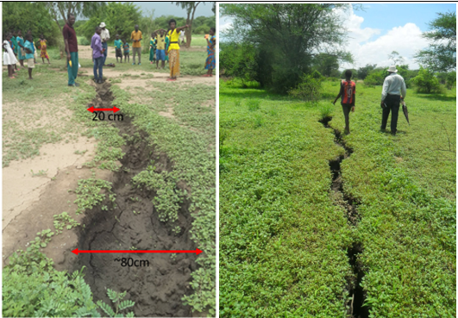
Occurrence And Extent of Earth Fissures:
Preliminary Findings From Chikwawa District, Southern Malawi.
Chindandali P., Manda B., Mtegha J., and Eliyasi C.. Email: rafikiwanga@gmai.com Geological Survey Department, Malawi
]
T1.2-503
The sub-surface conduits occur at shallow depths with weakened overburden collapsing into the void (Figure 2).
Heavy rainfall after several months of dry spell triggered the development of the cracks.
The development of ground fissures or cracks is a local phenomenon, related to aseismic causes.
RESULTS
A
B
Figure 2: A) Major fissure trending N-S characterized by mudflow. B) Minor fissure running almost orthogonal to the major fissure.

Slide 6
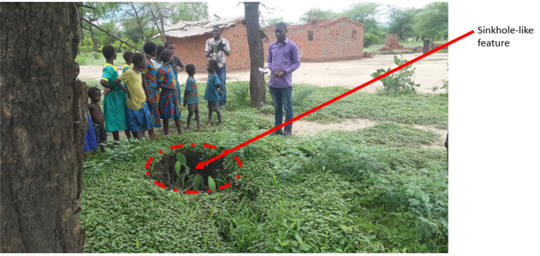
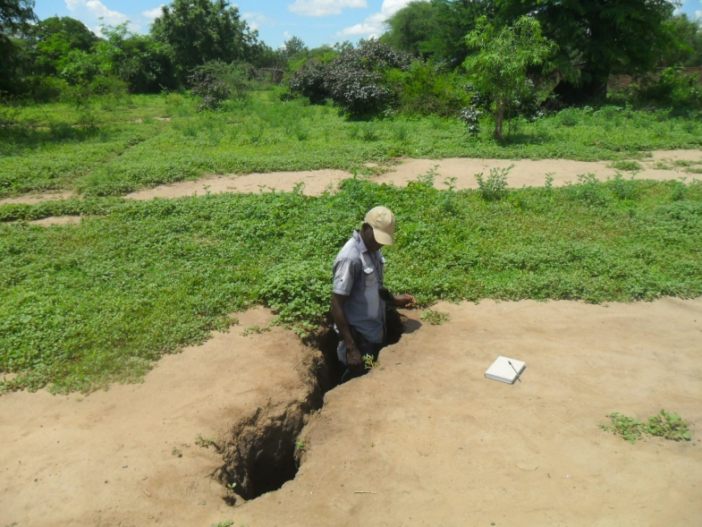
Occurrence And Extent of Earth Fissures:
Preliminary Findings From Chikwawa District, Southern Malawi.
Chindandali P., Manda B., Mtegha J., and Eliyasi C.. Email: rafikiwanga@gmai.com Geological Survey Department, Malawi
]
T1.2-503
Several linear sinkhole-like features and fissures were observed trending N-S and E-W were mapped, connected by horizontal conduits between the sinkholes (Figure 3A)
Few and short segments of fissures form orthogonal intersections with the major fissures (Figure 3B).
The waterflow through the conduits likely generated weak zones thereby reducing cohesion and structural strength which caused them to collapse (Dell’ Aringa et., al., 2014, Fergason et. al., 2015).
A
RESULTS
B

Slide 7
Occurrence And Extent of Earth Fissures:
Preliminary Findings From Chikwawa District, Southern Malawi.
Chindandali P., Manda B., Mtegha J., and Eliyasi C.. Email: rafikiwanga@gmai.com Geological Survey Department, Malawi
]
T1.2-503
  Ambient noise study at a much wider area to constrain the thickness of the overburden
  Microgravity to delineate the extent of fissures.
  Resistivity method to map the fissures
RECOMMENDATIONS

Slide 8
Table 2: Fitting parameters for Depth-to-bedrock estimation
Table 3: Depth-to-bedrock estimation for area under investigation
Occurrence And Extent of Earth Fissures:
Preliminary Findings From Chikwawa District, Southern Malawi.
Chindandali P., Manda B., Mtegha J., and Eliyasi C.. Email: rafikiwanga@gmai.com Geological Survey Department, Malawi
]
T1.2-503
Thick sedimentary layer overlying the bedrock (Table 1 and 2).
Fitting Parameters |  | Reference
a | b
96 | -1,388 | Ibs-Von Seht & Wohlenberg, 1999
108 | -1,551 | Parolai et al., 2002
Depth-to-bedrock estimation was achieved through the regression equations of Ibs-Von Seht and Wohlenberg, 1999 and Parolai et, al., 2002 as shown in equation below:
Site ID | Place | H/V Resonance Peak (Hz) | Interpreted Depth (m)
 |  | 10-60 s Window | Ibs-Von & Set (1999) | Parolai et al (2002)
STA1 | 1CKM | 2.8 | 21.87 | 22.99
STA2 | 2CKM | 2.5 | 26.07 | 26.91
STA3 | 3CKM | 2.7 | 23.14 | 24.18
RESULTS
Table 1: Fitting parameters for calculating depth-to-bedrock
Table 2: Calculated depth of sediments overlying the bedrock

Slide 9
Occurrence And Extent of Earth Fissures:
Preliminary Findings From Chikwawa District, Southern Malawi.
Chindandali P., Manda B., Mtegha J., and Eliyasi C.. Email: rafikiwanga@gmai.com Geological Survey Department, Malawi
]
T1.2-503
Thick sedimentary layer overlying the bedrock.
No record of any recent occurrence of earthquake(s) in the area thereby attributing the event to aseismic causes
No faulting evidence was found during the fieldwork to relate the activity to tectonic movement despite being located within Thyolo and Mwanza faults.
Activity in this area was due to soil surface tension caused by groundwater withdrawal from the alluvium in the deeper part of the basin.
Conduits as channels of erosion as the possible mechanism for their formation.
CONCLUSIONS

