Slide 1

Identifying Suspect Instrument Intervals Using Midnight Noise Time Histories
W. Scott Phillips, Richard J. Stead
P1.2-631
This research was funded by the National Nuclear Security Administration, Defense Nuclear Nonproliferation Research and Development (NNSA DNN R&D). The authors acknowledge important interdisciplinary collaboration with scientists and engineers from LANL, LLNL, MSTS, PNNL, and SNL.
LA-UR-21-24991

Slide 2
Identifying Suspect Instrument Intervals
Using Midnight Noise Time Histories
W. Scott Phillips, wsp@lanl.gov; Richard J. Stead, stead@lanl.gov, Los Alamos National Laboratory
P1.2-631
Statement of Contributions to SnT2021 Goals:
We demonstrate methods to improve nuclear monitoring and verification through studying noise time histories that can be used to identify issues with seismic instrumentation and calibration.

Slide 3
Identifying Suspect Instrument Intervals
Using Midnight Noise Time Histories
W. Scott Phillips, wsp@lanl.gov; Richard J. Stead, stead@lanl.gov, Los Alamos National Laboratory
P1.2-631
Instrument response issues are common in seismology, and they can hinder research. We use large data sets to develop models that will predict high-frequency seismic amplitudes, which requires extensive quality control. To identify response and station health issues, we have collected time histories of noise measurements near (but not restricted to) midnight to eliminate diurnal variations, and have manually determined time intervals that appear inconsistent with background behavior. We assign descriptive labels, but do not attempt to diagnose causes. We currently use results to discard data. To date, we have examined 39,260 channels from 11,105 stations, heavily weighted toward Incorporated Research Institutions for Seismology (IRIS) holdings, at bands between 1 and 8 Hz, finding 24,733 anomalous time intervals that represent 13% of the total inspected time range. The majority (90%) of these intervals are constant offset shifts, often bounded by known instrument changes, likely resulting from poor response documentation at one of many stages between the field and publication. We hope these results can be of use to our colleagues, and encourage community efforts to diagnose anomalous behavior, and fix poor responses. We also hope these results will support automation efforts, including application of supervised learning techniques.
ABSTRACT

Slide 4
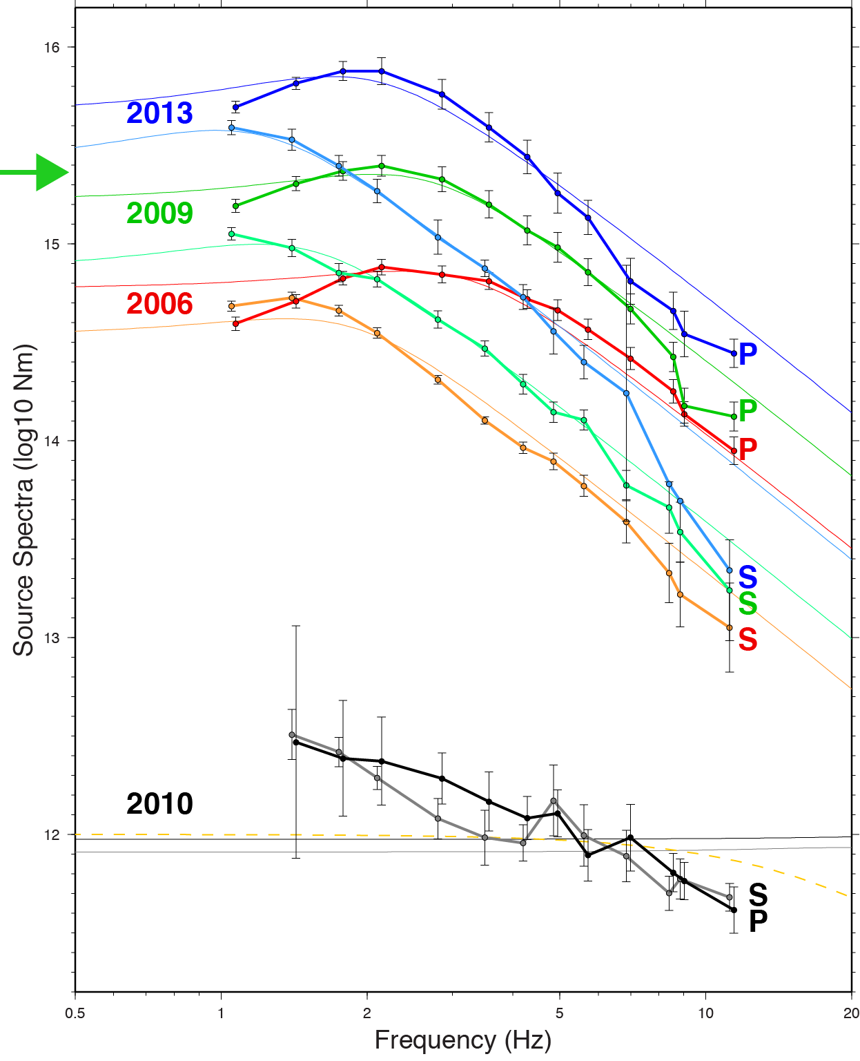
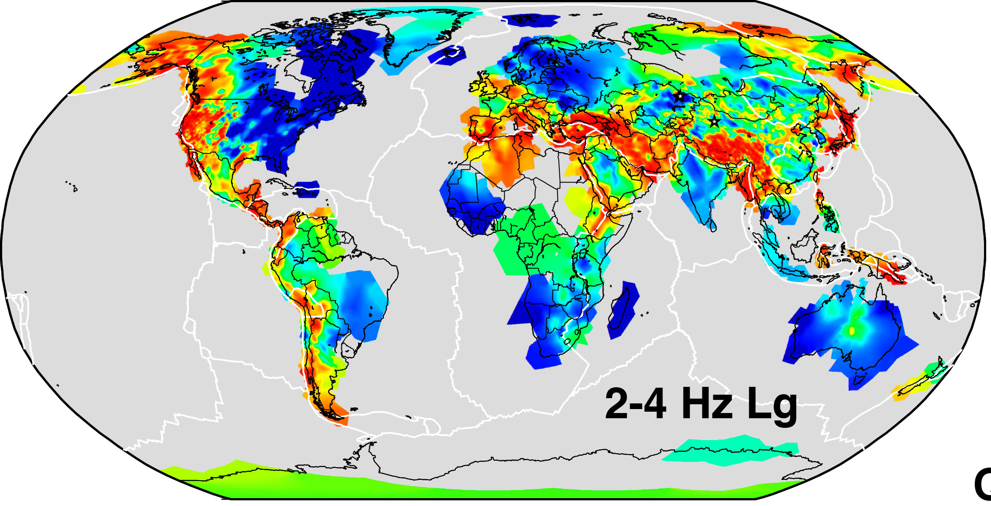
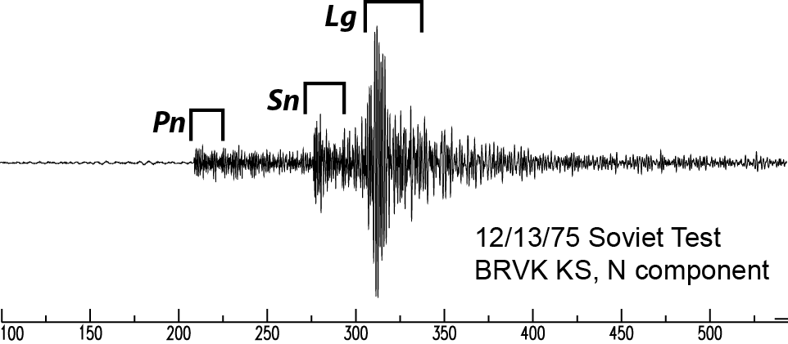
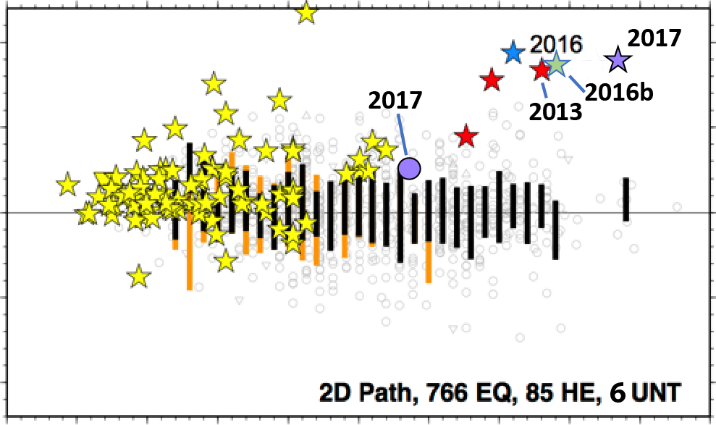
Identifying Suspect Instrument Intervals
Using Midnight Noise Time Histories
W. Scott Phillips, wsp@lanl.gov; Richard J. Stead, stead@lanl.gov, Los Alamos National Laboratory
P1.2-631
16
15
Lg coda
Pn
coda
Sn
coda
Seismic
Attenuation
high (red)
low (blue)
14
Source Spectra (log10 Nm)
Data
13
INTRODUCTION
Source
Corrections
DPRK Yield Estimation
MM91, Fisk Conjecture
12
1.0
Propagation models (attenuation and site response) can be used to obtain source spectra from amplitude measurements in a monitoring setting.
0.5
1
2
5
10
20
0.5
Frequency (Hz)
Log₁₀ Pg/Lg
0
To create models, we rely on accurate instrument response, which is too often not the case.
-0.5
DPRK Discrimination
-1.0
2-4 Hz
1
2
3
4
5
6
Mw

Slide 5
Identifying Suspect Instrument Intervals
Using Midnight Noise Time Histories
W. Scott Phillips, wsp@lanl.gov; Richard J. Stead, stead@lanl.gov, Los Alamos National Laboratory
P1.2-631
Basic Seismic Data Issues
Timing
  Important for velocity models, and event location
  Largely solved with global GPS
Instrument Response
  Important for amplitude/waveform models, discrimination, and yield estimation
  Poorly documented responses are common
  This is our biggest, fixable QC issue
Station Health
  Important for all monitoring activities
  Unavoidable, rarely fixable
INTRODUCTION
Our Midnight Noise QC efforts target response issues; however, health issues are also identified in the process.

Slide 6
Identifying Suspect Instrument Intervals
Using Midnight Noise Time Histories
W. Scott Phillips, wsp@lanl.gov; Richard J. Stead, stead@lanl.gov, Los Alamos National Laboratory
P1.2-631
11:30 PM 12:30 AM 1:30 AM 2:30 AM Local Time
Collect midnight noise, all channels of interest, full data streams:
  Avoid diurnal, cultural noise variations with midnight focus
  Use crude local time based on station longitude (15° TZ)
  Apply “known” instrument response to data segments, filter, RMS
  Avoid transient signal contamination by taking minimum
Manually inspect time histories:
  Employ interactive tool (Perl-Tk)
  Use MUSTANG as backup (poor time, band resolution; response different?)
  Mark inconsistent time intervals for later use, automation
METHODS

Slide 7
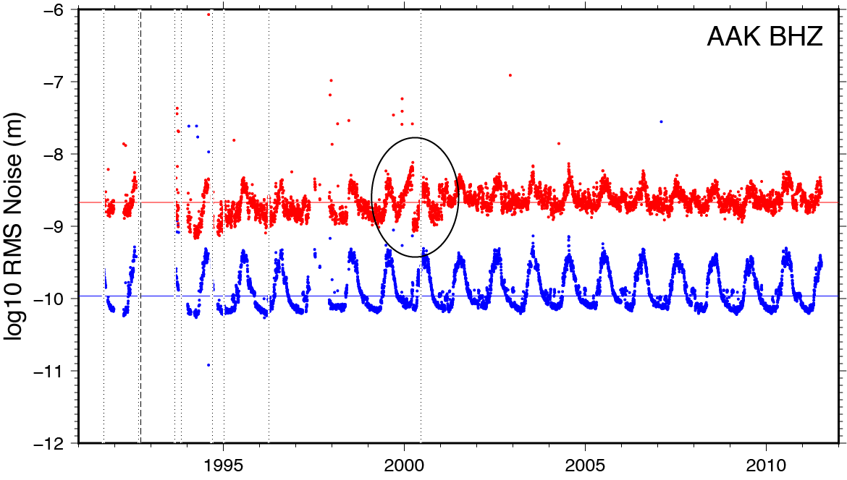
Identifying Suspect Instrument Intervals
Using Midnight Noise Time Histories
W. Scott Phillips, wsp@lanl.gov; Richard J. Stead, stead@lanl.gov, Los Alamos National Laboratory
P1.2-631
Midnight Noise Example
AAK BHZ, Kyrgyz Net
Red = 1-2 Hz (shifted up one unit for clarity)
Blue = 4-8 Hz
High-frequency monitoring bands targeted
Vertical lines = known instrument changes
Note seasonal variation, summertime peaks
Possible health issue circled
1-2 Hz
METHODS
4-8 Hz
Year

Slide 8
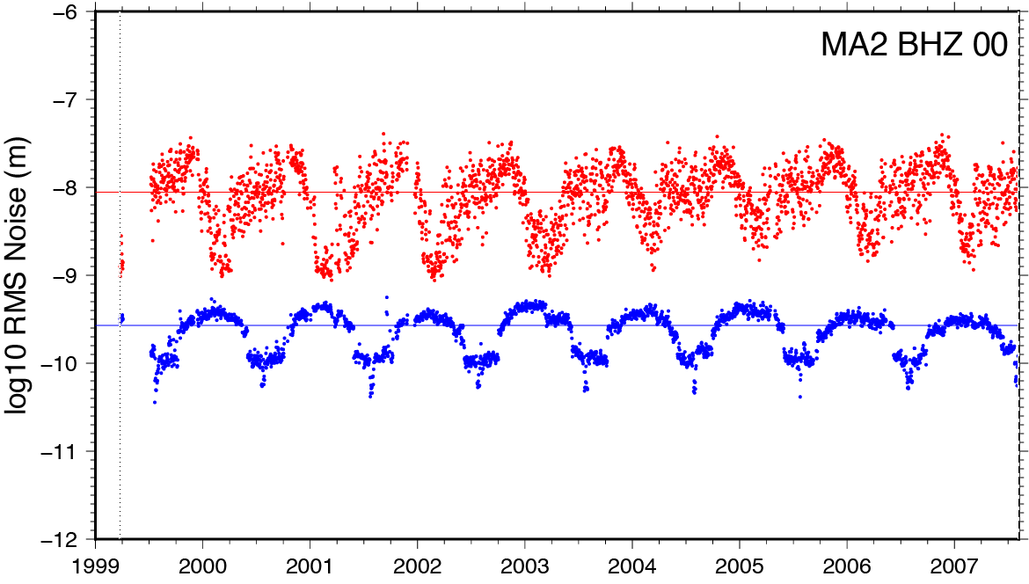
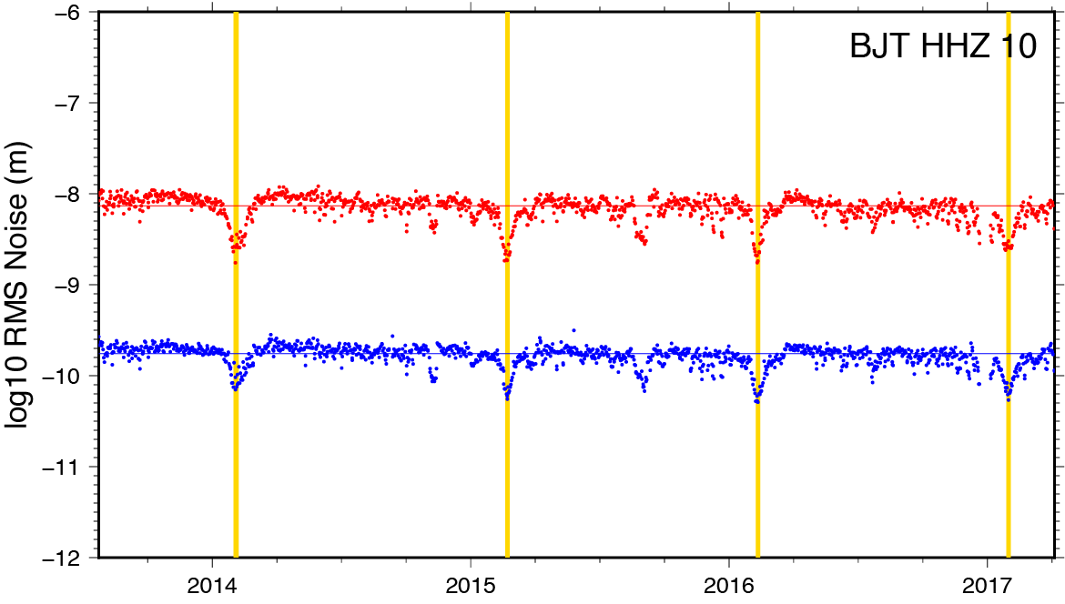
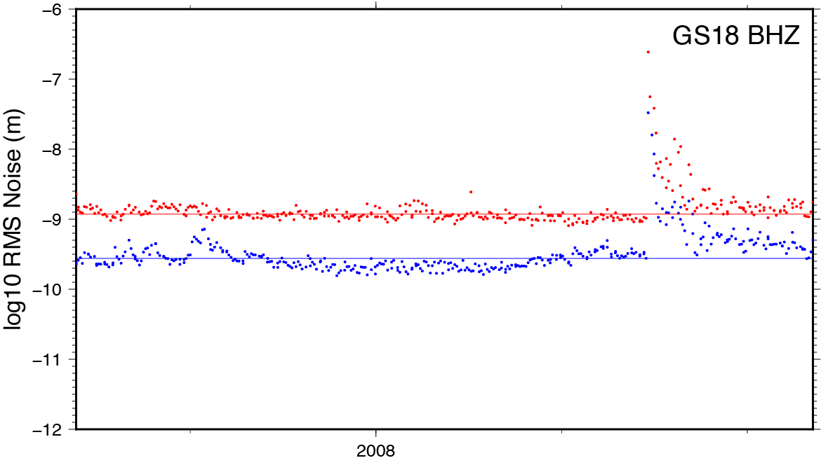
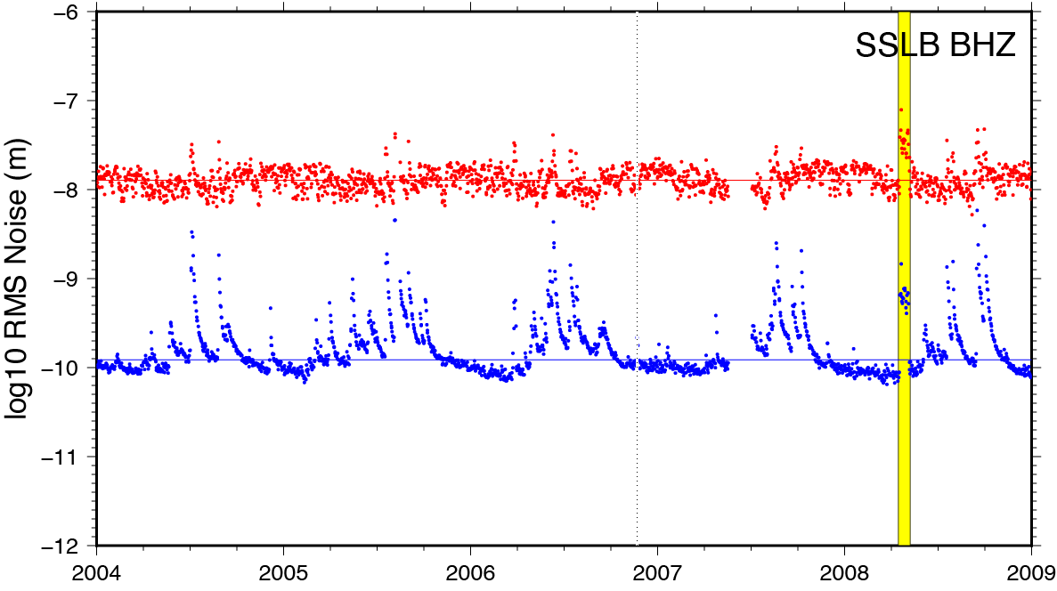
Identifying Suspect Instrument Intervals
Using Midnight Noise Time Histories
W. Scott Phillips, wsp@lanl.gov; Richard J. Stead, stead@lanl.gov, Los Alamos National Laboratory
P1.2-631
To manually choose suspect time intervals we must be aware of unusual, yet natural, noise patterns:
Magadan (Russia)
Bands out of phase
Midsummer low
Beijing (China)
New Year’s
Holiday duration marked
METHODS
Taiwan
Typhoon season
Yellow = heath issue?
ASCENT (China)
Wenchuan earthquake
Year
Year

Slide 9
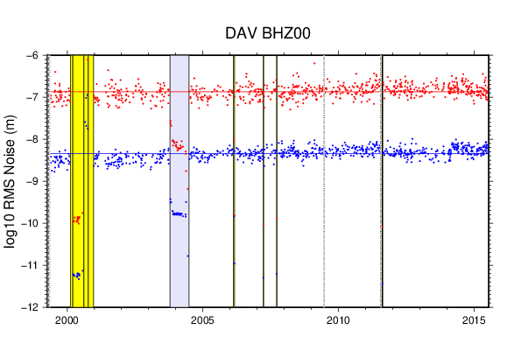
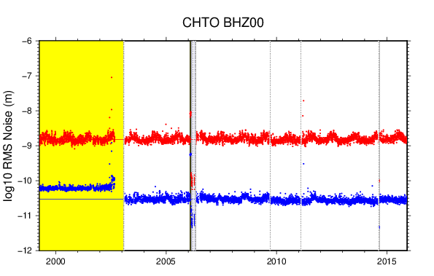
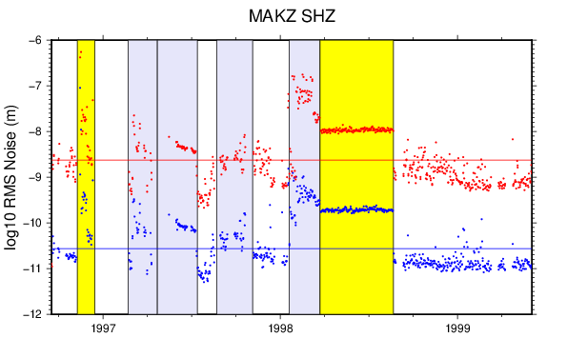
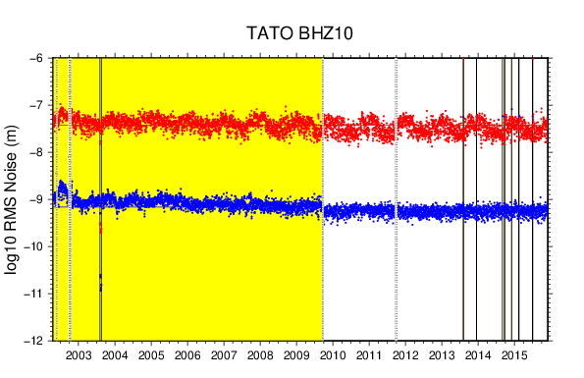
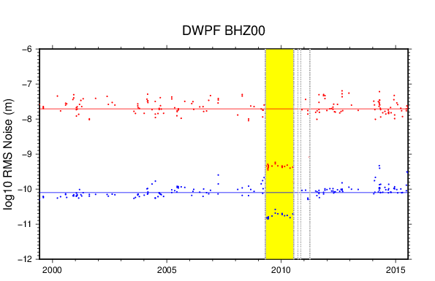
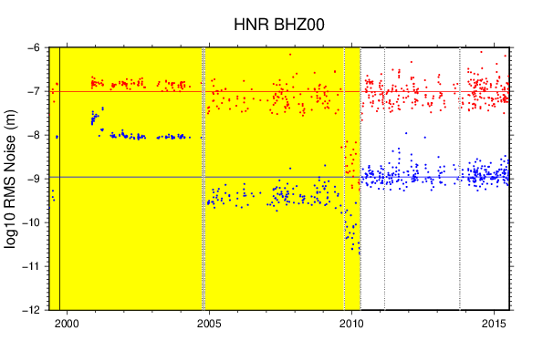
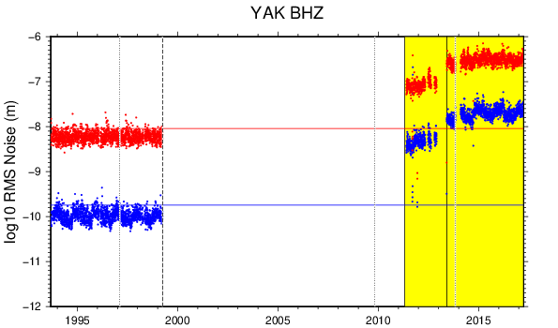
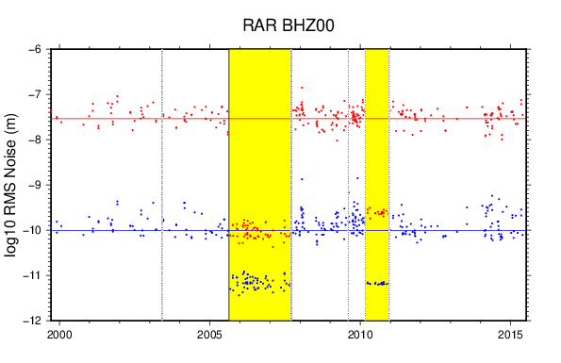
Identifying Suspect Instrument Intervals
Using Midnight Noise Time Histories
W. Scott Phillips, wsp@lanl.gov; Richard J. Stead, stead@lanl.gov, Los Alamos National Laboratory
P1.2-631
Manually Chosen Intervals for Selected IU = GSN Stations
RESULTS
Year
Year
Year
Year
Interval edges often coincide with known instrument changes (vertical lines)
Sparsely populated plots are for stations with event segment collections

Slide 10
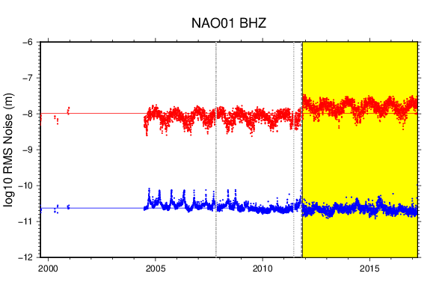
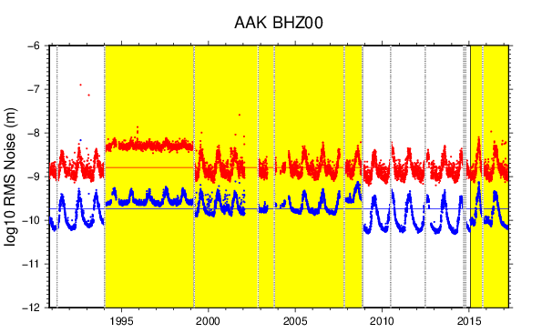
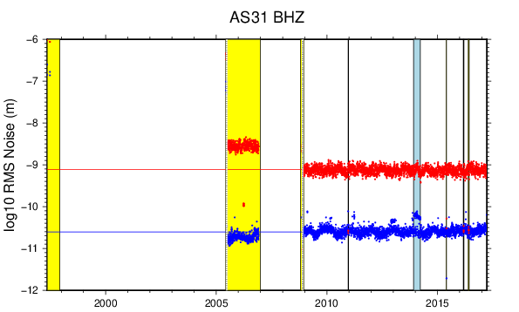
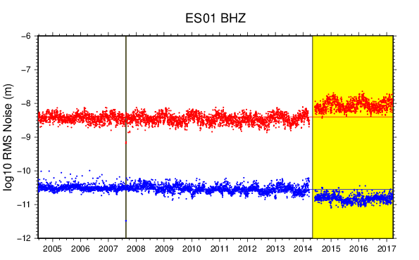
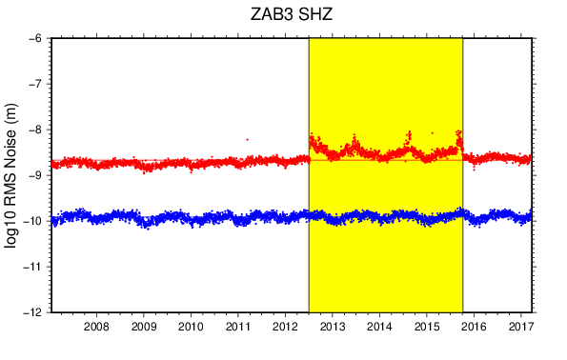
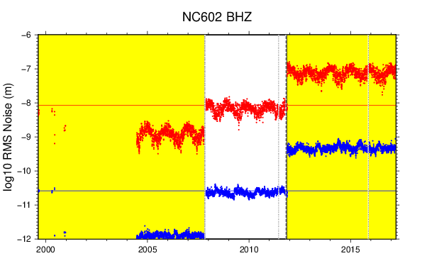
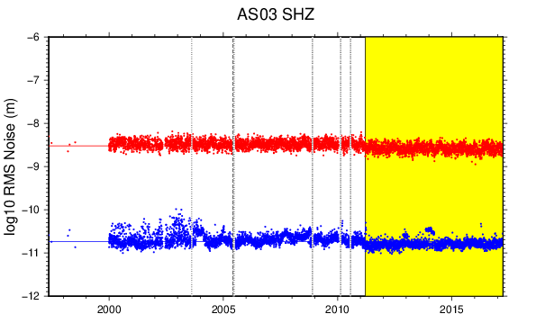
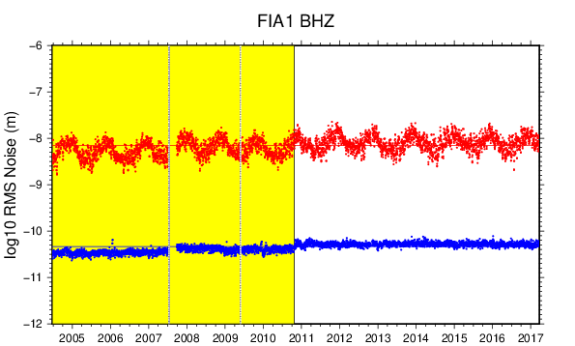
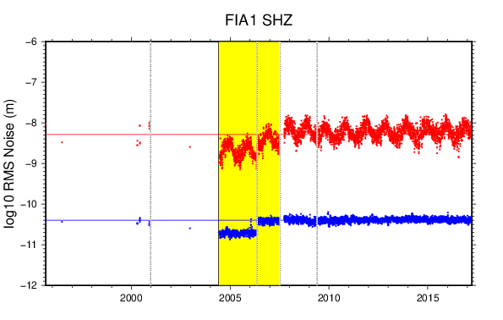
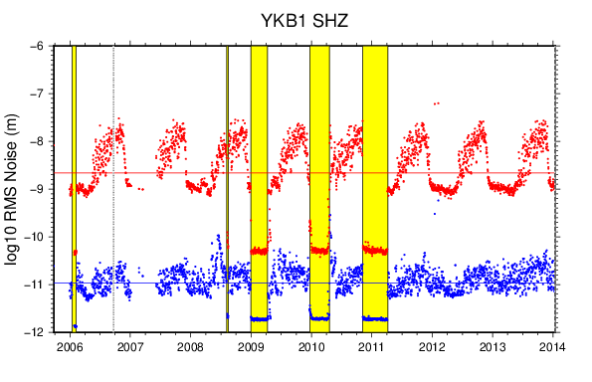
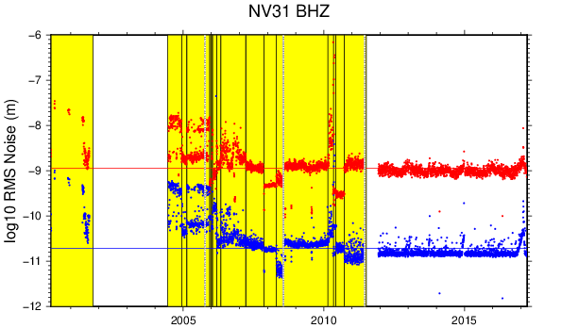
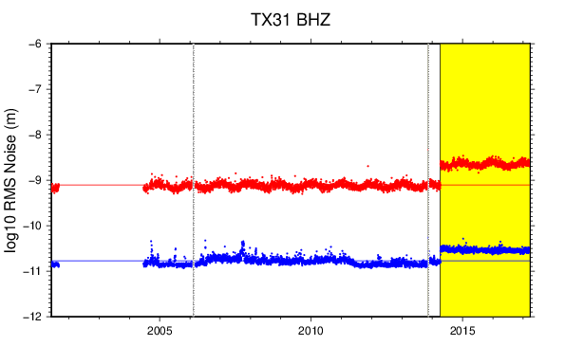
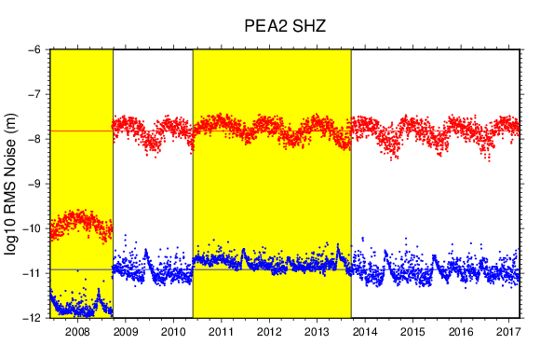
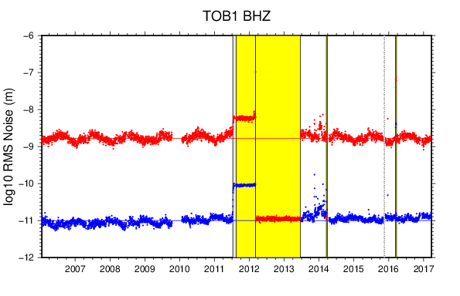
Identifying Suspect Instrument Intervals
Using Midnight Noise Time Histories
W. Scott Phillips, wsp@lanl.gov; Richard J. Stead, stead@lanl.gov, Los Alamos National Laboratory
P1.2-631
Manually Chosen Intervals for Selected IMS Primary Stations
RESULTS
Year
Year
Year
Year
Year

Slide 11
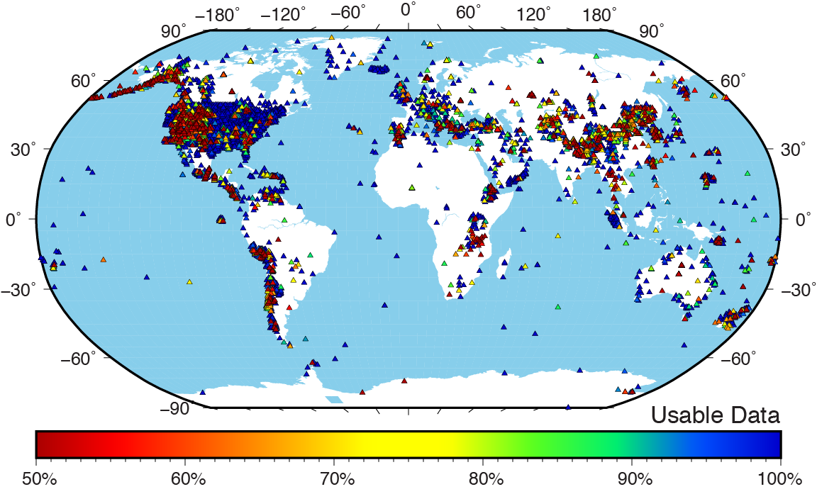
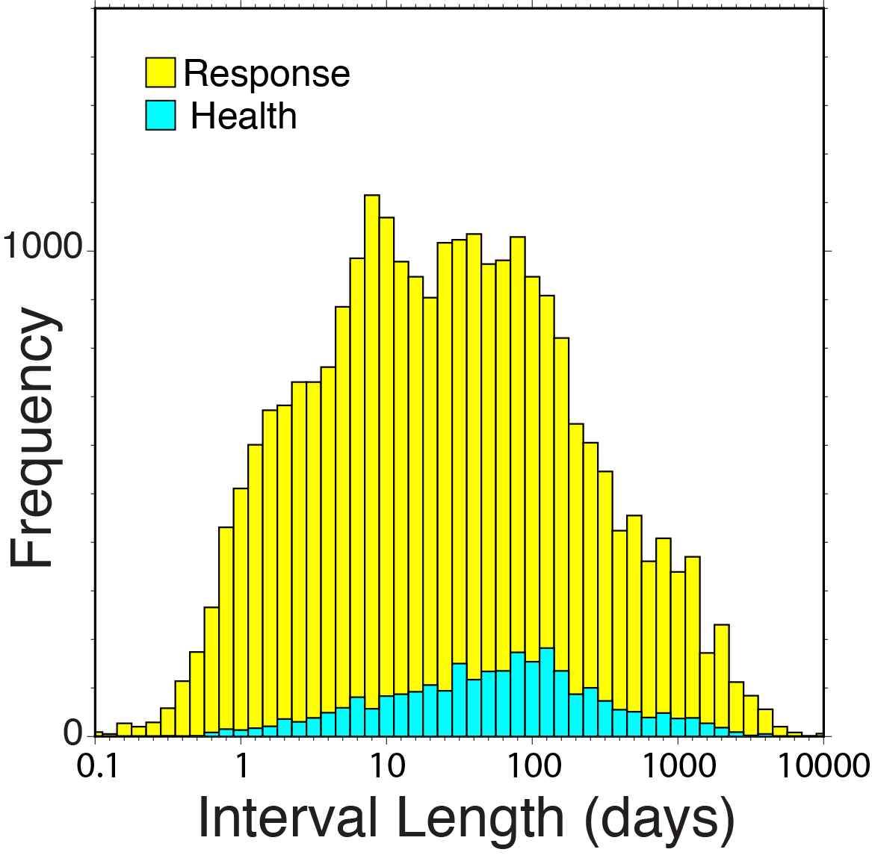
Identifying Suspect Instrument Intervals
Using Midnight Noise Time Histories
W. Scott Phillips, wsp@lanl.gov; Richard J. Stead, stead@lanl.gov, Los Alamos National Laboratory
P1.2-631
We identified over 24,000 suspect intervals in data from over 11,000 stations. Percent useable data are shown below.
“Response” = shifted time intervals
“Health” = drifting time intervals
Poor stations plotted on top
USArray is high quality!
Older data, take care
RESULTS
26,592
total
intervals

Slide 12
Identifying Suspect Instrument Intervals
Using Midnight Noise Time Histories
W. Scott Phillips, wsp@lanl.gov; Richard J. Stead, stead@lanl.gov, Los Alamos National Laboratory
P1.2-631
Midnight noise measurements avoid diurnal variation, cultural noise, transient signals; focus on HF bands
Interactive tool plots noise, sensor bounds, allows zoom, scroll, set/delete intervals
26,592 anomalous intervals marked; 11,388 stations; 13% of up time
Anomalous intervals include undocumented instrument changes and health issues
To be submitted to SRL, including full noise review results
Noise review results can be used for automation, including supervised learning applications
Diagnosis, fixes, must be community efforts
CONCLUSIONS

