Slide 1

The use of Seismological, Geodetic and Infrasound
techniques for novel integrated monitoring scheme
in Nigeria
Kadiri A. U.
P1.2-171
¹Centre for Geodesy and Geodynamics, PMB 11, Toro, Bauchi State, Nigeria

Slide 2
The use of Seismological, Geodetic and Infrasound techniques for novel
integrated monitoring scheme in Nigeria
Geodesy and Geodynamics, PMB 11, Toro, Bauchi State, Nigeria. Email: umakad@yahoo.com,
¹Mobile: +2348037122784
in Nigeria
[]
[click to edit Author(s) name(s) with division, email (and/or) Affiliation here using “Arial” font size approx. 9]
P1.2-171
Nigeria lies within the West African sub-region and the country is believed to be aseismic in nature. Despite this view by prominent geoscientists, the country has witnessed both historical and instrumental earthquakes from 1933 till date. The recent recorded chains of events with moment magnitudes ranging from 3.0 to 3.4 in Nigeria, were located in Kaduna state and Abuja. Reasons which include shallow faults reactivation by hydraulic fracturing, anthropogenic causes, etc., have been adduced to the recurrent earth tremors in Nigeria. As the events are of small to medium magnitudes, their vibrations felt in different parts of the country were not recorded by the scanty existing seismic stations. This paper therefore, presents a novel integrated approach towards understanding the Nigeria’s seismicity, and enhanced monitoring of seismic hazard through improved recording capability of earthquakes. It outlines a detailed scheme on densification of seismographs collocated with GPS, and deployment of the advanced Infrasound equipment to strategic areas where earth vibrations are frequently observed in Nigeria but not recorded by seismic equipment, etc. The realization of the monitoring scheme would not only assist Nigeria in seismic risk mitigation and holistic planning, but will promote her collaboration with CTBTO and other key partners
ABSTRACT

Slide 3
The use of Seismological, Geodetic and Infrasound techniques for novel
integrated monitoring scheme in Nigeria
Geodesy and Geodynamics, PMB 11, Toro, Bauchi State, Nigeria. Email: umakad@yahoo.com,
¹Mobile: +2348037122784
in Nigeria
[]
[click to edit Author(s) name(s) with division, email (and/or) Affiliation here using “Arial” font size approx. 9]
P1.2-171
Like other parts of West Africa, Nigeria is characterized with Stable Crustal Seismicity with no well defined seismotectonic characteristic
The country has been witnessing both historical and instrumental earthquakes from 1933.
Recent events with moment magnitudes ranging from 3.0 to 3.4, were located in Kaduna and Abuja.
The intraplate seismic activities have also been observed in Bayelsa, Rivers and Oyo; with Macroseismic intensity values of IV-V on the Modified Mercalli Scale.
The corresponding local magnitude to the intensities were estimated between 3.0 and 4.0 on the Richter scale.
The Kwoi (Kaduna State) and Igbogene (Bayelsa State) earth tremors caused wide spread panic as structures were seriously affected.
INTRODUCTION

Slide 4
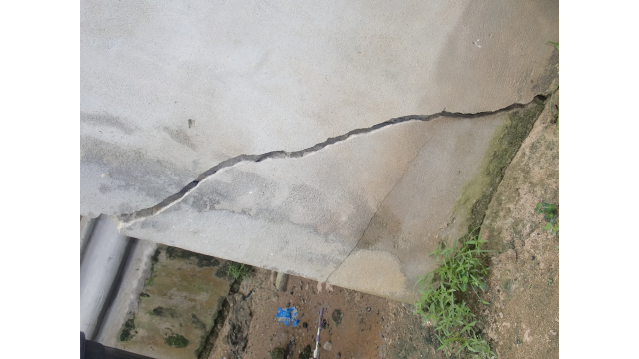
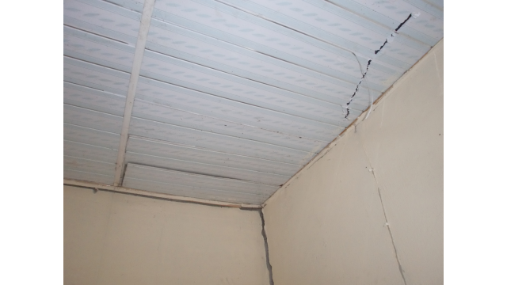
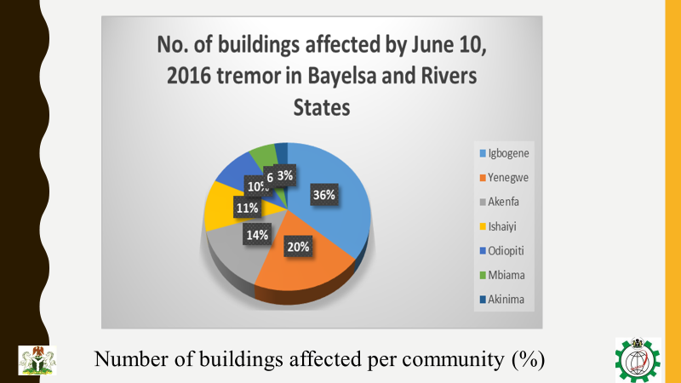
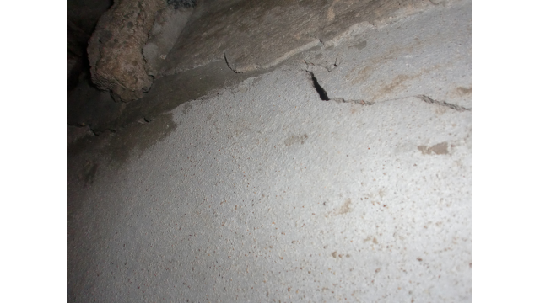
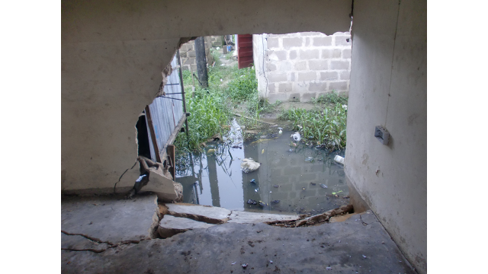
The use of Seismological, Geodetic and Infrasound techniques for novel
integrated monitoring scheme in Nigeria
Geodesy and Geodynamics, PMB 11, Toro, Bauchi State, Nigeria. Email: umakad@yahoo.com,
¹Mobile: +2348037122784
in Nigeria
[]
[click to edit Author(s) name(s) with division, email (and/or) Affiliation here using “Arial” font size approx. 9]
P1.2-171
Impacts of earthquakes in Nigeria
INTRODUCTION
Cracks on Some buildings in Bayelsa state affected by the earthquakes

Slide 5
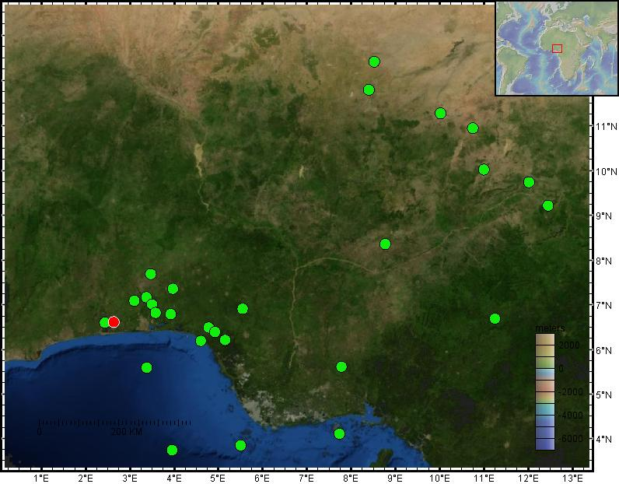
The use of Seismological, Geodetic and Infrasound techniques for novel
integrated monitoring scheme in Nigeria
Geodesy and Geodynamics, PMB 11, Toro, Bauchi State, Nigeria. Email: umakad@yahoo.com,
¹Mobile: +2348037122784
[]
P1.2-171
Historical and Instrumental Seismicity in Nigeria
2016
Nigeria
2018
2009
Seismograms of the first earthquake in Kaduna
Need for Continuous monitoring
To mitigate disaster risks
Planning & Development
Research
Local and International collaborations
2009, 2016 and 2018 events were recorded by seismic stations in Nigeria

Slide 6
The use of Seismological, Geodetic and Infrasound techniques for novel
integrated monitoring scheme in Nigeria
Geodesy and Geodynamics, PMB 11, Toro, Bauchi State, Nigeria. Email: umakad@yahoo.com,
¹Mobile: +2348037122784
in Nigeria
[]
[click to edit Author(s) name(s) with division, email (and/or) Affiliation here using “Arial” font size approx. 9]
P1.2-171
Causes of Intraplate earthquakes in Nigeria
Reactivation of the underlying faults, likely triggered by man-made activities.
Tectonic activities which resulted in the sudden release of tectonic stresses.
INTRODUCTION
In general, the geographical location of the cratons, the principal stress on the Nigeria’s Basement Complex rocks occur between the West African Craton and Congo Craton, acting WNW-ESE in the basement rocks (Murat, 1988). This may also be responsible for earthquakes in Nigeria
Linking Oceanic Fracture Zones with Fractures on land within Nigeria (Onuoha, 1988) may also serve as conduit for inland earth tremors in Nigeria.
Large volume of water caused reduction of friction along fault lines which can quicken slip along fault plains.

Slide 7
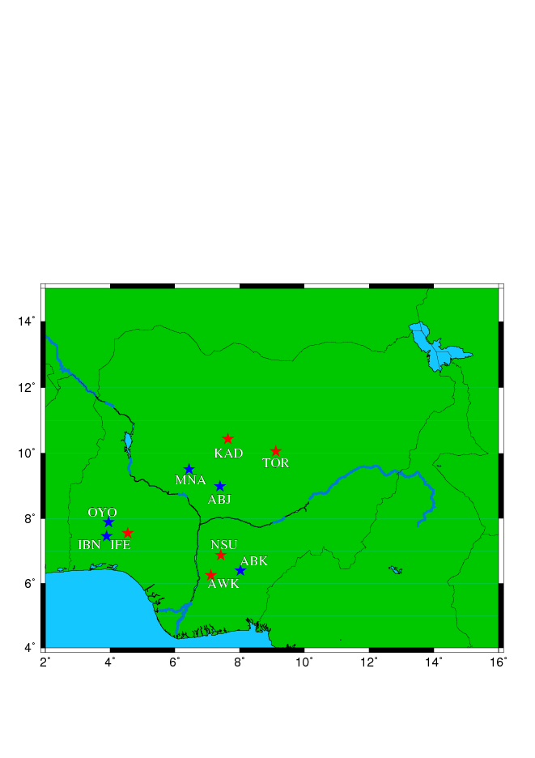
The use of Seismological, Geodetic and Infrasound techniques for novel
integrated monitoring scheme in Nigeria
Geodesy and Geodynamics, PMB 11, Toro, Bauchi State, Nigeria. Email: umakad@yahoo.com,
¹Mobile: +2348037122784
in Nigeria
[]
[click to edit Author(s) name(s) with division, email (and/or) Affiliation here using “Arial” font size approx. 9]
P1.2-171
Geological and Geophysical techniques were used to delineate existing faults in Nigeria
Seismographic equipment were installed in triangulations in three main zones (Northern, South-Western, South-Eastern Nigeria) for continuous monitoring (See fig. Right)
In regions where seismic activities are pronounced; densification of seismic equipment and co-located with GPS; deployment of Infrasound equipment
METHODS
Map of Nigeria and locations of existing (Red stars) and planned (Blue stars) stations.

Slide 8
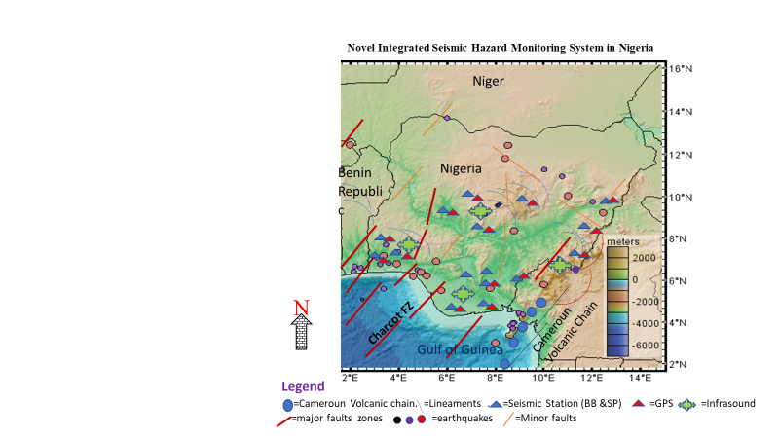
The use of Seismological, Geodetic and Infrasound techniques for novel
integrated monitoring scheme in Nigeria
Geodesy and Geodynamics, PMB 11, Toro, Bauchi State, Nigeria. Email: umakad@yahoo.com,
¹Mobile: +2348037122784
in Nigeria
[]
[click to edit Author(s) name(s) with division, email (and/or) Affiliation here using “Arial” font size approx. 9]
P1.2-171
Map of Nigeria showing complex features that make up the Integrated seismic monitoring system in Nigeria
RESULTS

Slide 9
The use of Seismological, Geodetic and Infrasound techniques for novel
integrated monitoring scheme in Nigeria
Geodesy and Geodynamics, PMB 11, Toro, Bauchi State, Nigeria. Email: umakad@yahoo.com,
¹Mobile: +2348037122784
in Nigeria
[]
[click to edit Author(s) name(s) with division, email (and/or) Affiliation here using “Arial” font size approx. 9]
P1.2-171
Although, the country does not belong to regions with high seismic hazard potentials, for effective and efficient disasters monitoring however, a novel and complex integrated seismic hazard system has been established in Nigeria
The system consists of permanent Broadband and Short Period Seismic equipment; collated with permanent GPS stations; Infrasound stations at areas with noticeable seismic activities (Microseismicity)
A part of the monitoring system promises a robust and joint seismic hazard monitoting between Nigeria and Cameroon along their borders
Benefits of the novel monitoring system include effective Microseismicity monitoring, detailed faults delineation and recording of small magnitude events in Nigeria
Detailed seismotectonic study is imperative in the entire Nigeria
CONCLUSIONS

