Slide 1


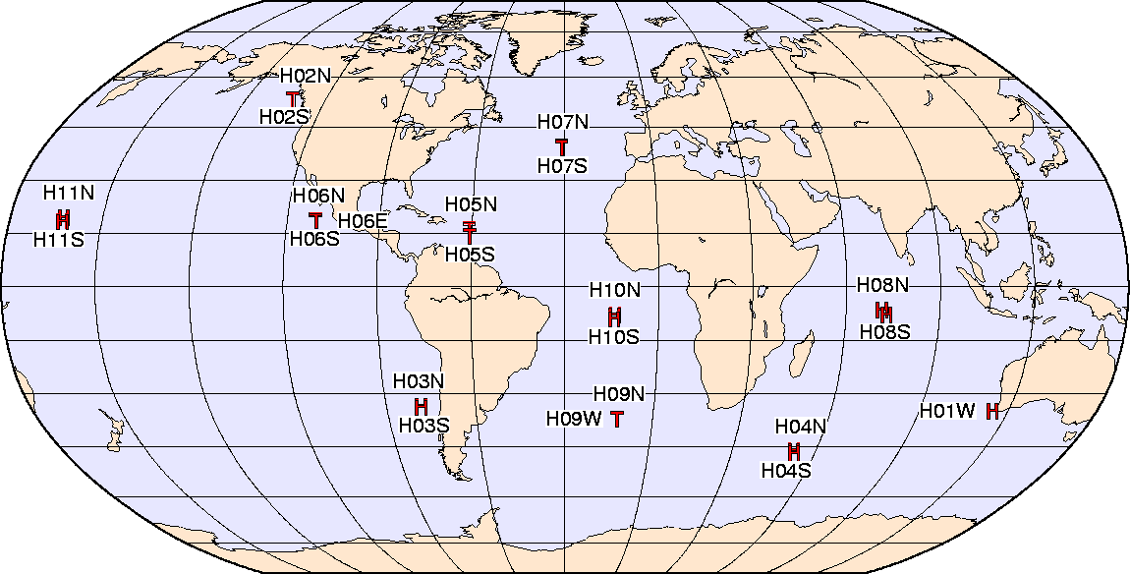
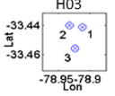
Using ambient noise at hydroacoustic stations for passive ocean sensing
Karim G. Sabra
School of Mechanical Engineering,
Georgia Institute of Technology, Atlanta, GA
Sponsored by the Office of Naval Research code 321

Slide 2
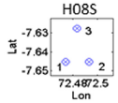
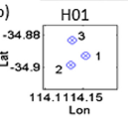
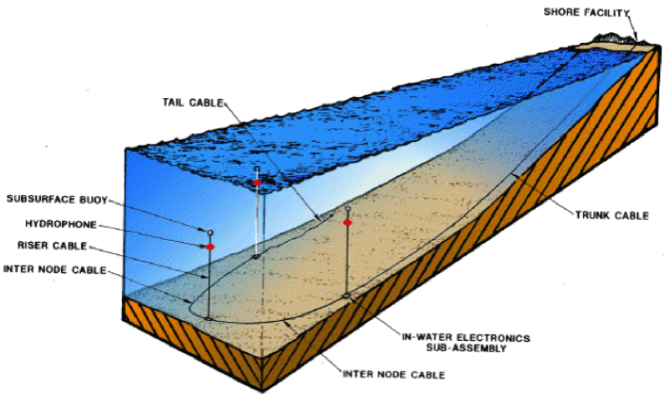
IMS Hydroacoustic Stations.
Each Hydrophone Station = 3 hydrophones (“Triad”), 2km side.
In the SOFAR channel
.
2km
Notes:
I studied only red circled stations H01=Cap Leeuwin/Australia and H08 = Diego Garcia

Slide 3
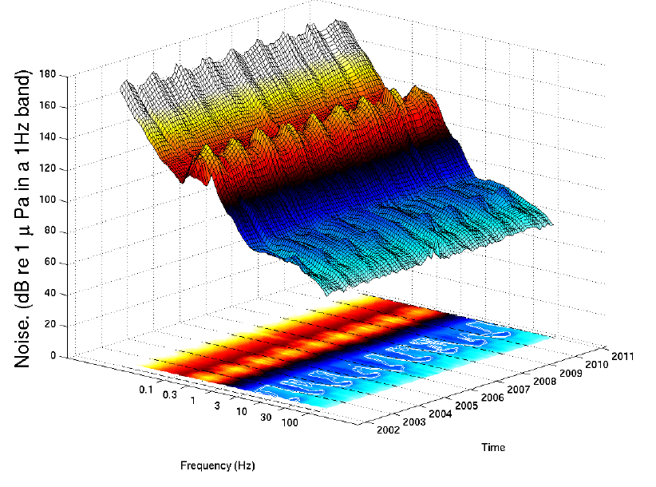
Seasonal variability of Ambient noise.
HO1W station
Cape Leeuwin
Australia
Microseisms
(Austral winter)
Ice noise
(Austral Summer)
Fin-whale
Reproduced from: Prior, M., Brown, D., & Haralabus, G. (2011).” Data features from long-term monitoring of ocean noise”.
Notes:
I studied only red circled stations H01=Cap Leeuwin/Australia and H08 = Diego Garcia

Slide 4
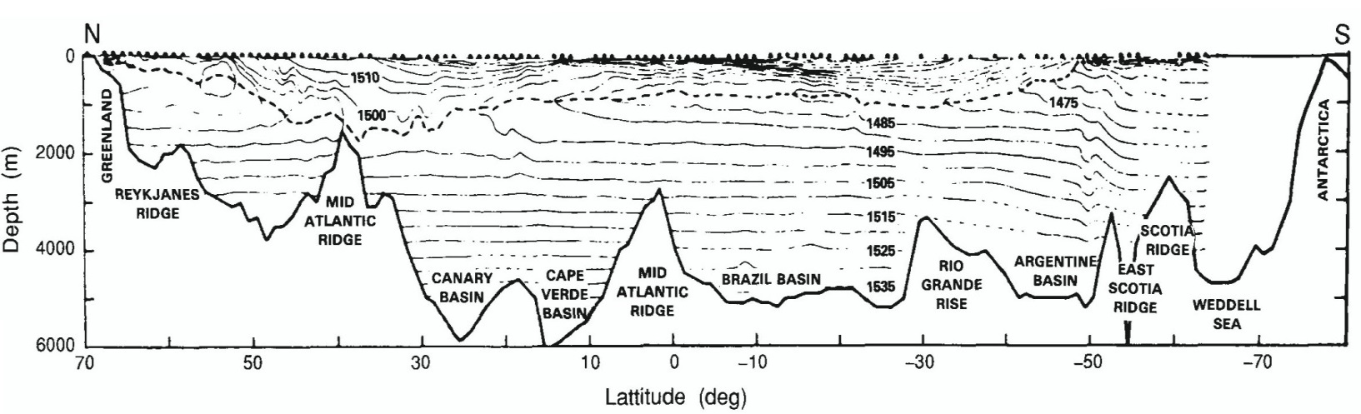
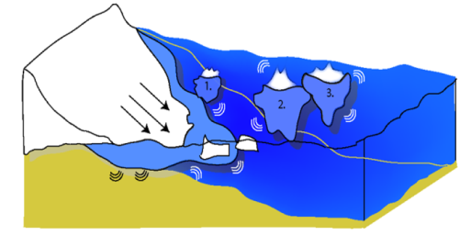
Ice noise & Long-range propagation
North-South Atlantic along 30.5°N
deep sound channel axis ( - - - )
Axis of the deep sound channel becomes shallower towards both poles and eventually reaches the surface.
Northrup and Colborn, JGR, 1974
Mid latitudes
Polar latitudes
Layers of constant sound speed
ICE NOISE
HYDROACOUSTIC
STATION
Ray trapped in the Deep Sound Channel (DSC)
Depth ~10,000 ft
Sea mountain or continental shelf
Typical northern sound speed profile
Typical mid-latitude sound speed profile
C (m/s)
Range ~1000 miles

Slide 5
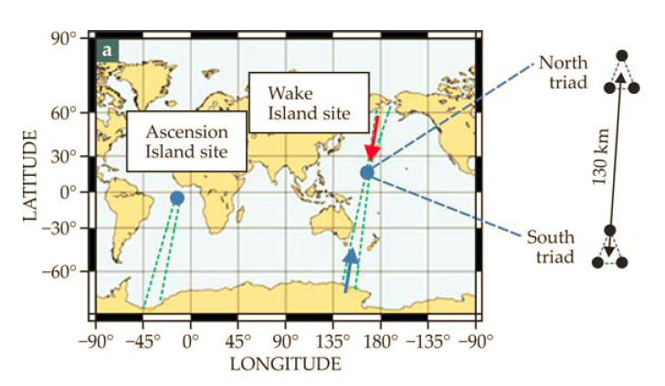
Passive Acoustics Thermometry of the Deep Ocean
H10- Ascension Island site
Tav=1 month, Bw=[1Hz-40Hz]
Woolfe, K. F., Lani, S., Sabra, K. G., & Kuperman, W. A. (2015). Monitoring deep‐ocean temperatures using acoustic ambient noise. Geophysical Research Letters, 42(8), 2878-2884.

Slide 6

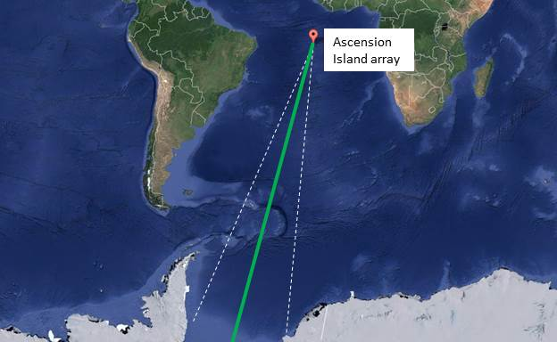
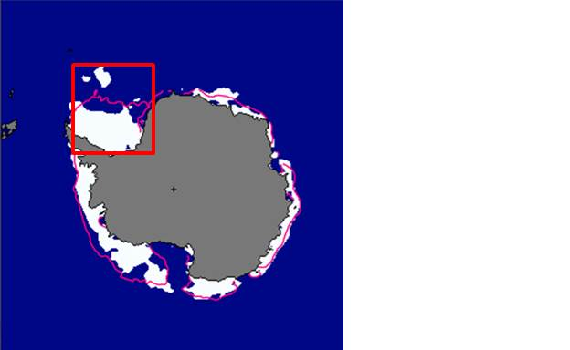
3. Passive Tomography: Sound Source
Relationship between SNR from beamformer output and arctic ice extent?
Seismic noise?
Array
Ice Coverage
SNR of beamformer output

Slide 7
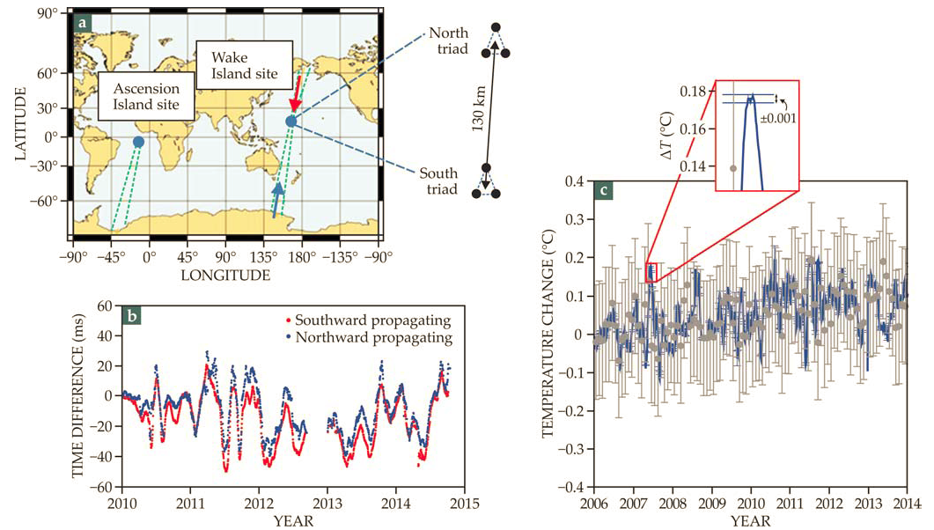
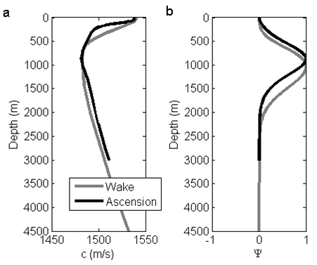
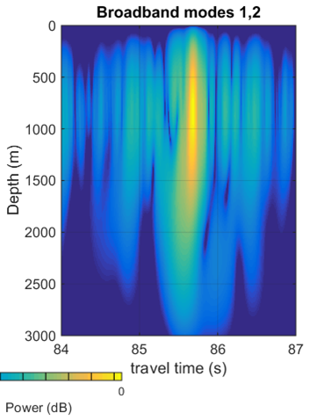

Passive Acoustics Thermometry of the Deep Ocean
Sound Speed
Mode @10Hz
R~130km, Tav=1 week, SNR>20dB
1Hz<f<40Hz

Slide 8
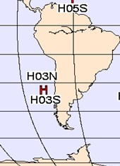
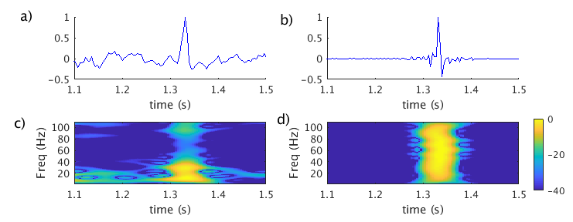

Passive acoustic sensing with same triad
Sound Speed
Mode @10Hz
Large up-and-down movement of seawater around the axis of the SOFAR channel (up to ~100m) due to internal tide.
Semi-diurnal & variations arrival-time variation Δc/ c₀ =(Δt /t₀)~10⁻³ ->Δc~2m/s
~2km
R~2km, Tav=3h, SNR>4dB
Arrival time rms error:
$σ_{t}={\left[ω_{0}\sqrt{SNR}\right]}^{−1}$
Notes:
The reason why I/m interested in such things is that if I can isolate such ocean physics acoustically, I might be able to enhance my acoustical signal processing
in such a complex medium. This is “through-the-sensor” processing, not independently finding out something about the ocean and then moving it over to acoustics….

Slide 9
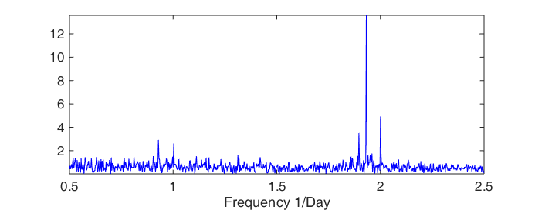
Passive acoustic sensing with same triad
M₂
N₂
S₂
O₁
K₁
R~2km, Tav=3h, SNR>4dB
Arrival time rms error:
$σ_{t}={\left[ω_{0}\sqrt{SNR}\right]}^{−1}$
Notes:
The reason why I/m interested in such things is that if I can isolate such ocean physics acoustically, I might be able to enhance my acoustical signal processing
in such a complex medium. This is “through-the-sensor” processing, not independently finding out something about the ocean and then moving it over to acoustics….

Slide 10
Adding environmental sensors near Hydroacoustic Stations ?
Each Hydrophone Station = 3 hydrophones (“Triad”), 2km side.
In the SOFAR channel
.
2km
Notes:
I studied only red circled stations H01=Cap Leeuwin/Australia and H08 = Diego Garcia

Slide 12
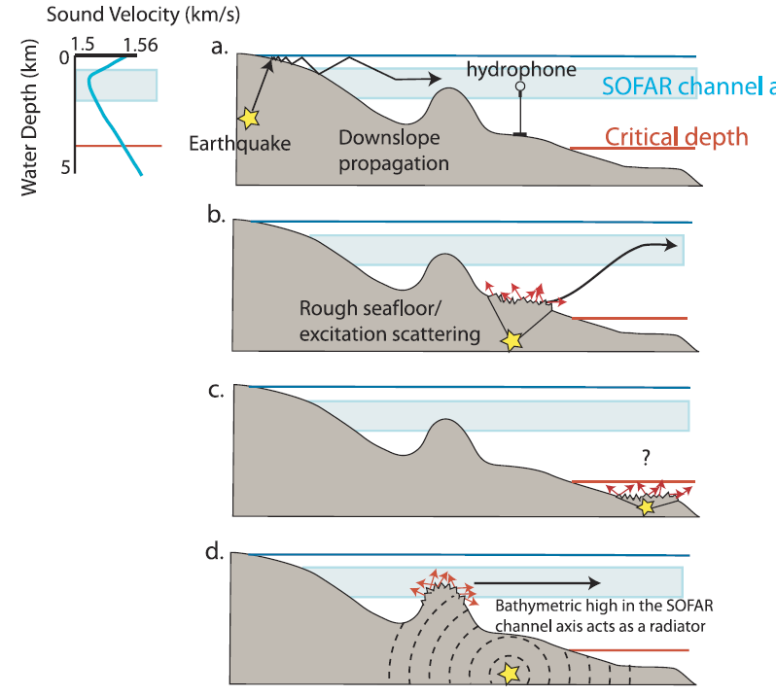
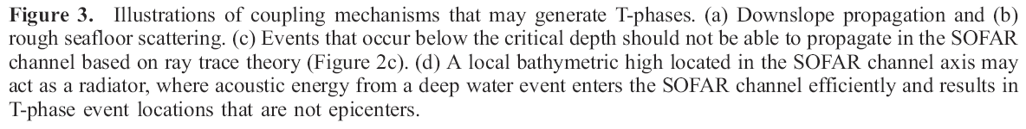
Other noise coupling mechanisms in the SOFAR channel
Williams et al. (2006
, Geochem. Geophys. Geosyst., 7

Slide 13
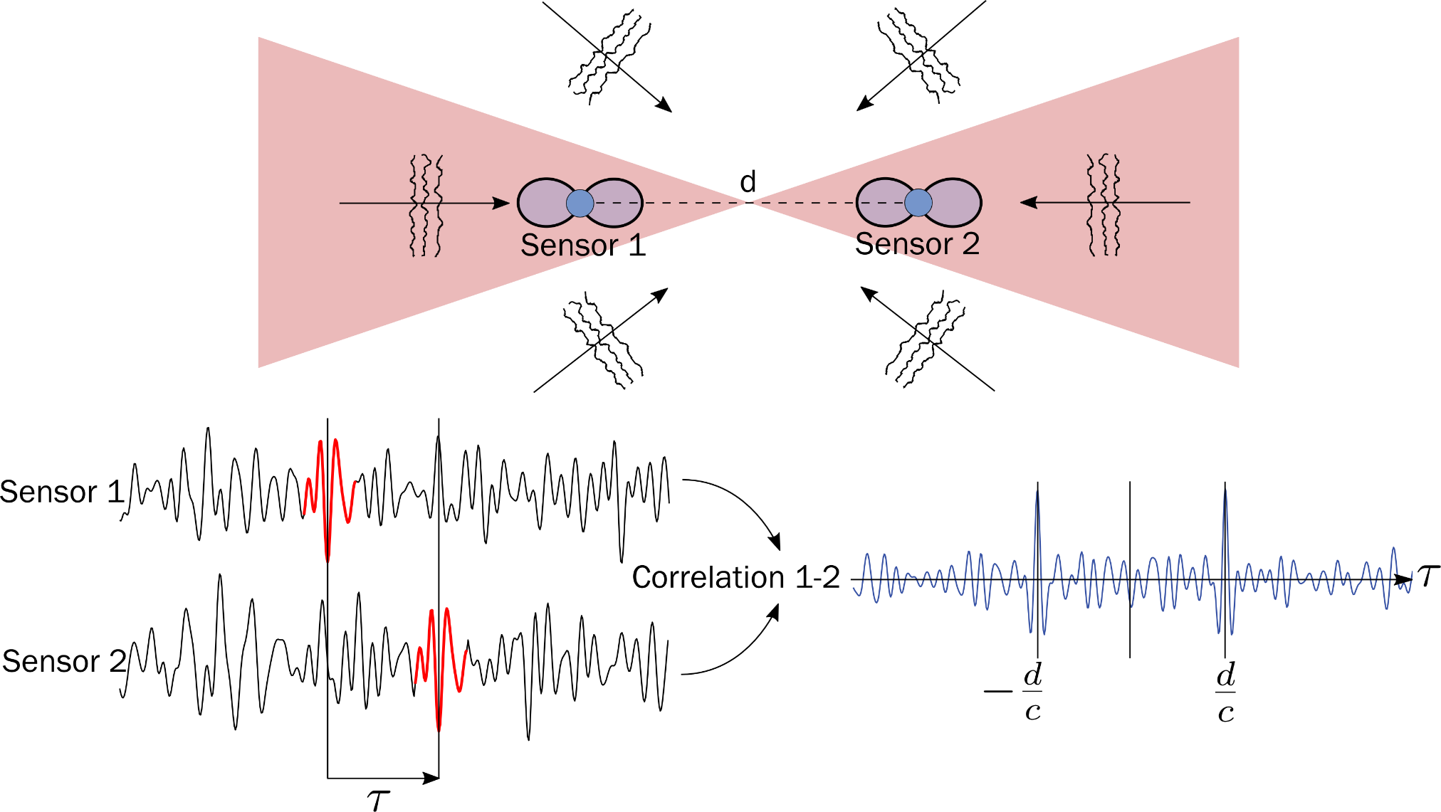

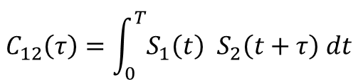
Ambient Noise Correlations for Passive sensing
τ <0
τ >0
$$C_{12}\left(τ\right)=\int_{0}^{T}{S_{1}\left(t\right) S_{2}\left(t+τ\right) dt}$$
2→ 1
1→ 2
t₀ =
$$SNR∝\sqrt{(B.T)/(fd)}$$
T
Passive sensing and imaging applications benefit from dense sensor network (i.e. with multiple receiver pairs)
Lobkis and Weaver, J. Acoust. Soc. Am. 2001
Sabra et al., IEEE Journal of Oceanic Engineering 2005
Δc/ c₀ =(Δt /t₀)
Applications in seismic, acoustics, structural monitoring, helioseismology, etc..

Slide 14
Coherent processing of Ambient noise
Across same triad: sensor separation ~2km
2) Across 2 triads (North & South) of the same hydroacoustic station:
sensor separation ~100km-. Only possible for H10 and H11 without island blockage
3) Across 2 hydroacoustic stations (basin scale): sensor separation ~1000m
Notes:
I studied only red circled stations H01=Cap Leeuwin/Australia and H08 = Diego Garcia

Slide 15
Exploiting ambient noise at hydroacoustic stations for passive ocean sensing
Across same triad: sensor separation ~2km
2) Across 2 triads North & South (same hydroacoustic station):
sensor separation ~100km-. Only possible for H10 and H11 without island blockage
3) Across 2 hydroacoustic stations (basin scale): sensor separation ~1000m
Notes:
I studied only red circled stations H01=Cap Leeuwin/Australia and H08 = Diego Garcia

Slide 16
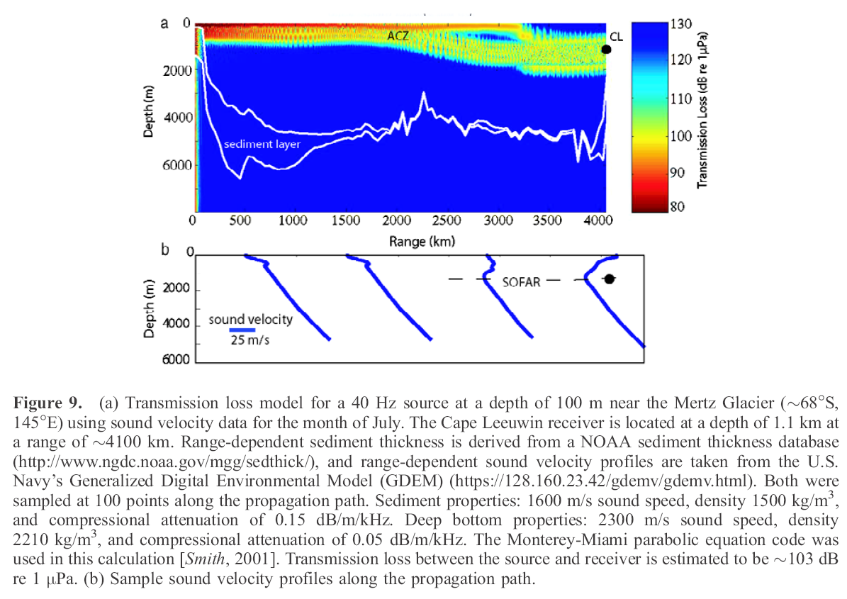
Coupling of Ice noise into the SOFAR channel

Slide 17
